Slide 1


Virtual Job Fair (VJF)
Introduction - Employers
January 2021
The Illinois workNet® Center System, an American Job Center, is an equal opportunity employer/program. Auxiliary aids and services are available upon request to individuals with disabilities. All voice telephone numbers may be reached by persons using TTY/TDD equipment by calling TTY (800) 526-0844 or 711. This workforce product was funded by a grant awarded by the U.S. Department of Labor’s Employment and Training Administration. For more information please refer to the footer at the bottom of any webpage at illinoisworknet.com.

Slide 2
Virtual job fairs: Overview
The VJF tool provides a platform in which employers can connect with job seekers to share open job opportunities within Illinois at no cost.
Employers may submit information about their opportunities by creating an Employer Booth page. These pages include the following:
  Website and address information
  Number of job openings and a link with more information
  Description about the organization
  Contact information for an employer representative
  Upcoming VJF events
  Recorded VJF events
  Additional documents and links that job seekers may find helpful for the application process, perks and benefits, social media links, and more

Slide 3
Virtual job fairs: Overview (Cont.)
Job seekers can explore these employer booths and attend VJF events to explore what opportunities are available to them and learn about their future employer by using a keyword search or filters for industry and location.
Past and upcoming VJF events can be seen on the VJF Event Calendar page. Each listing will include information about the event and a link to register. Upon registration, attendees will be emailed webinar information.
During a VJF, job seekers have the chance to learn about open job opportunities, the skills employers are looking for, tips for applying, perks, benefits packages, and even have a chance to ask their own questions during Q&A.

Slide 4
Virtual job fairs: Summary of event data*
• Total Businesses: 450
• Total Attendees: 3,098
• Total Jobs Represented by Sector: 22,136
*Numbers provided reflect events that have taken place through 1/11/2021

Slide 5
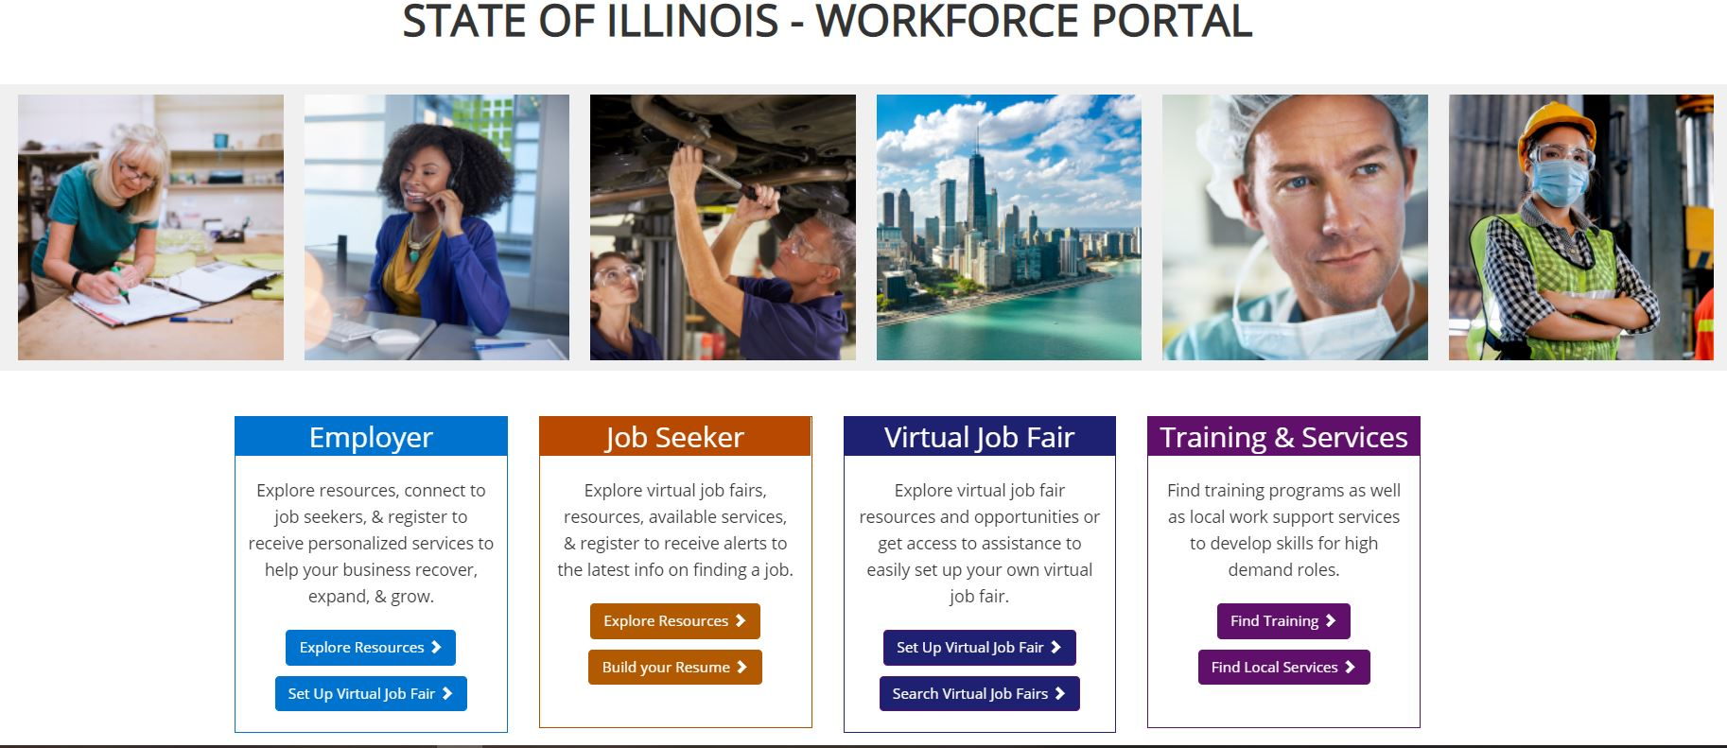
Virtual job fairs: Workforce portal
Located on homepage of www.illinoisworknet.com

Slide 6
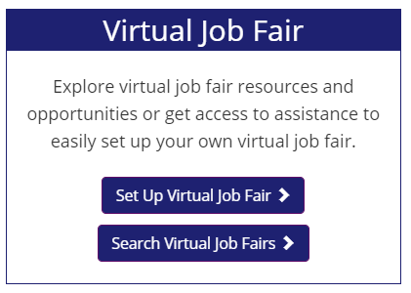
Virtual job fairs: setting up virtual job fairs

Slide 7
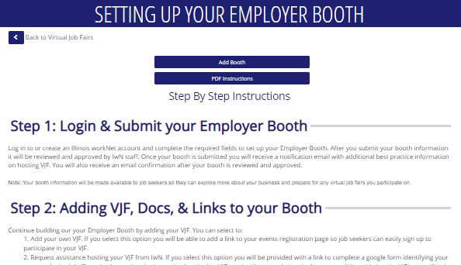
Virtual job fairs: setting up virtual job fairs
Includes instructions for:
Logging in and Submitting an Employer Booth
Adding Documents and Links to the Employer Booth
Preparing and Attending VJFs
Posting Archived VJFs and Following Up

Slide 8

Virtual job fairs: search virtual job fairs
Employers may set up VJFs while job seekers may search for upcoming VJF events.

Slide 9
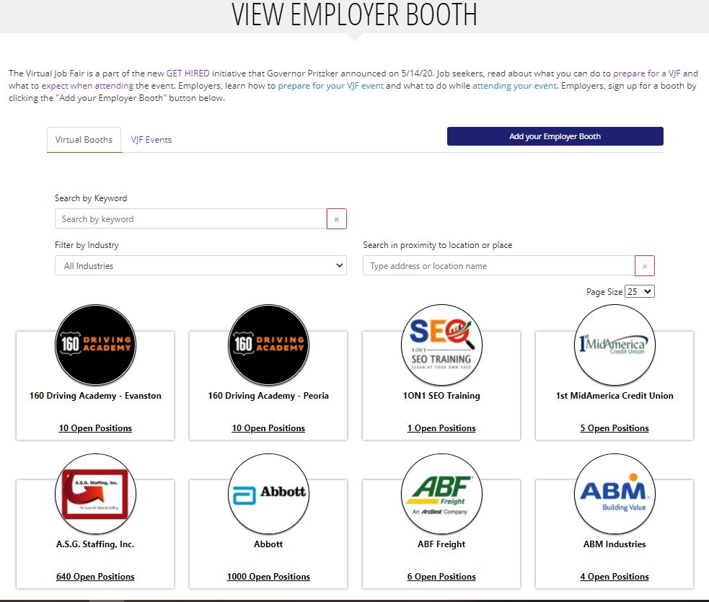
Virtual job fairs: Employer booths
View and search for employer booths by:
Name
Industry
Location
Upcoming VJF Events (currently being added)
Employer Booths can also be added from this page.

Slide 10
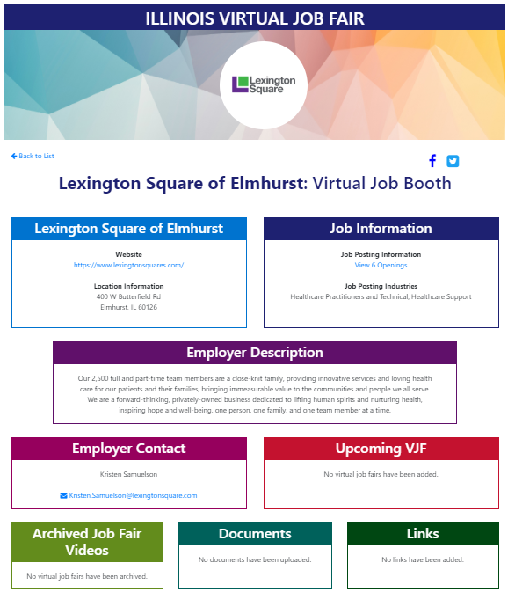
Virtual job fairs: Employer booths
Employer Booth Page:
Location and Website
Job Information / Industry
Description
Employer Contact
Upcoming VJF Events
Archived Job Fair Videos
Documents
Links
Social Media

Slide 11
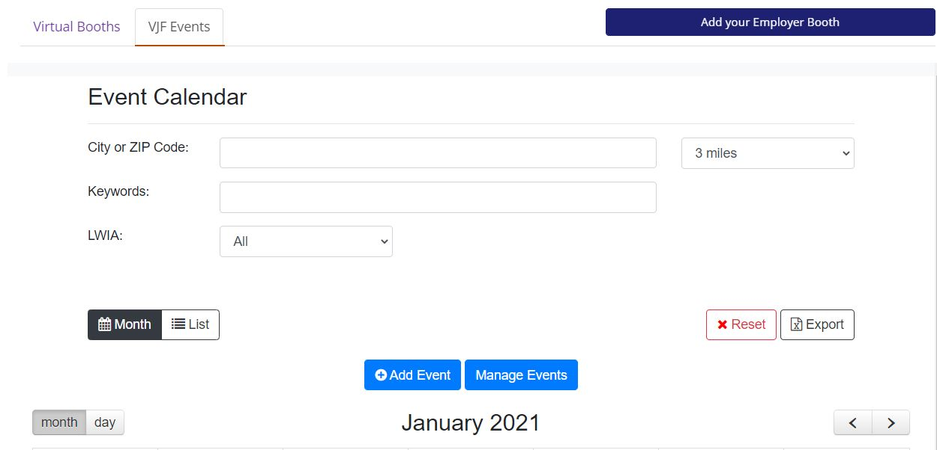
Virtual job fairs: Event calendar
Virtual Job Fair Event Calendar
  Search by City/Zip Code
  Keywords
  LWIA

Slide 12
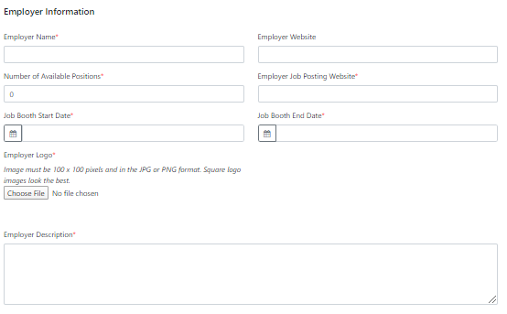
Virtual job fairs: Adding employer booths

Slide 13
Virtual job fairs: Approving employer booths
After adding an Employer Booth, workNet staff is notified via email that there is a new entry.
The entry will be reviewed for accuracy and approved within 3-5 business days.
The employer is then notified via email upon approval.
Employers may then add their own VJF to their Employer Booth or request assistance setting up a VJF.

Slide 14
Virtual job fairs: Requesting Assistance
If technical assistance for a live VJF event is requested, workNet staff will then coordinate with the Employer to help facilitate the following:
  Setting a date and time
  Determining an event format and outline
  Creation of a registration page
  Event promotion on the workNet VJF Event Calendar and social media channels (i.e., Facebook, Twitter, LinkedIn, etc.)
  Zoom training
  Recording the VJF, as well as editing and uploading the event to workNet’s YouTube channel
  Providing a link to the recorded VJF event on the Employer Booth
  Supplying registration and attendance reports

Slide 15
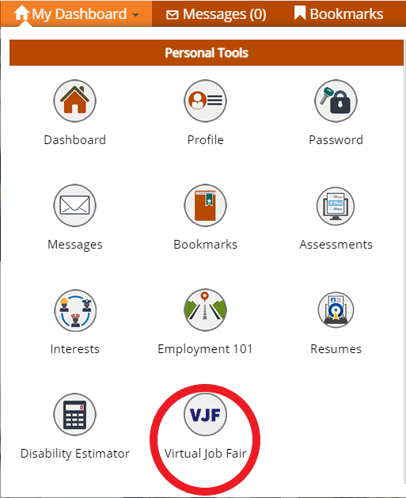
Virtual job fairs: Managing employer Booths
The VJF Dashboard is accessible through My Dashboard when logged into an Illinois workNet account.

Slide 16
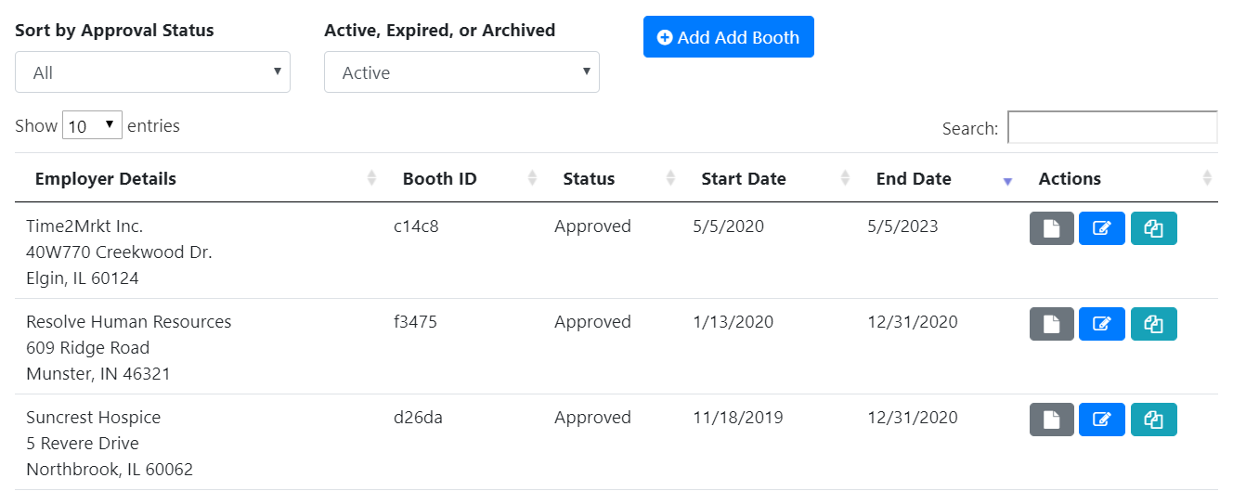
Virtual job fairs: Managing employer Booths
You can view and manage Employer Booths from the VJF Dashboard. Action icons allow you to:
View Booth
Edit Booth
Copy Booth

Slide 17

Virtual job fairs: Managing employer Booths
Editing an Employer Booth allows you to:
Update Employer Booth details
Preview Public Page
Add Virtual Job Fair (Request assistance hosting a VJF or add own VJF)
Add relevant documents and links

Slide 18









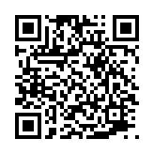
follow us!
Subscribe to our Newsfeed or check us out on Social Media
HOME: https://www.illinoisworknet.com/
EMAIL: info@illinoisworknet.com
MORE INFO: https://www.illinoisworknet.com/virtualjobfairs
Facebook
Twitter
Youtube
linkedin
Linkedin group
Pinterest

