Slide 1
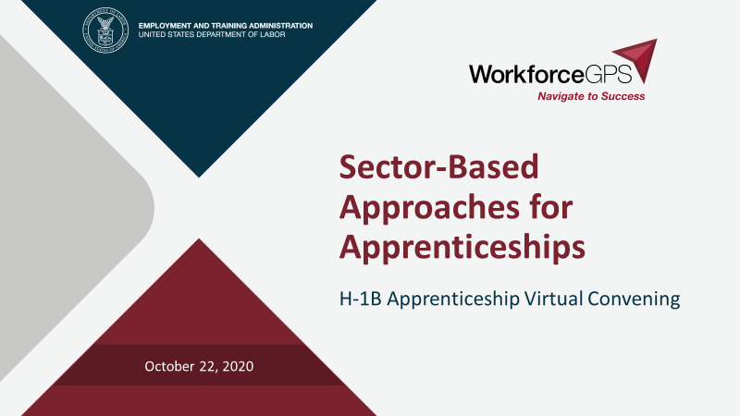

Slide 2
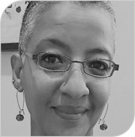
Today’s Moderator
Zodie Makonnen
  Scaling Apprenticeship Grant Lead
    DOL-ETA, Division of Strategic Investments

Slide 3
Today’s Objectives
Hear from grantees about their effective sector-based approaches
Explore how others can initiate and pursue such strategies

Slide 4
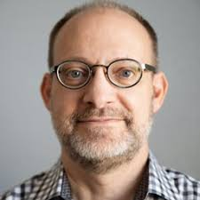
Today’s Speaker/Today’s Moderator
Jaime Fall
  Director, UpSkill America
    Aspen Institute

Slide 5
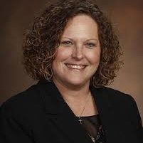
Today’s Speaker
Audrey Webb
  Project Director
    Alabama Community College System

Slide 6
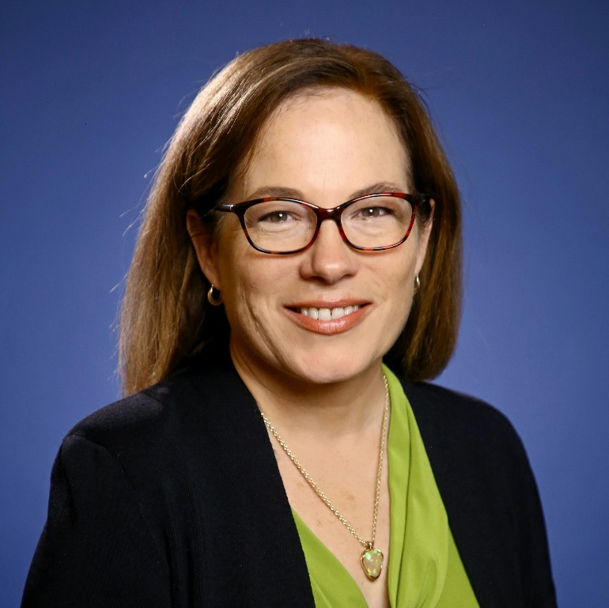
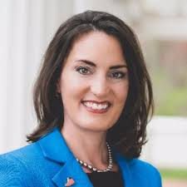
Today’s Speakers
Terri Burgess Sandu
  Director, Talent and Business Innovation
    Lorain County Community College
Jessica Borza
  Senior Advisor
    Ohio Manufacturer’s Association

Slide 7
1. How does your grant do sector-based strategy partnerships?

Slide 8
2. What does this partnership look like in practice?

Slide 9
3. Looking back, how did this form of partnership start in Ohio? What about Alabama?

Slide 10
4. What are practical steps on how to find/join a sector strategy to advance grant goals?

Slide 11
5. What are the lessons learned? What are key practices you adhere to?

Slide 12
Any Questions?

Slide 13
Thank You!
Need help? Email: Support@workforceGPS.org
_

