Slide 1
Serving QUEST Disaster DWG Clients
October 26th, 2022

Slide 2
Objective
The primary objective of this presentation is to discuss the details about the Quality Jobs, Equity, Strategy, and Training (QUEST) Disaster National Dislocated Worker Grants (DWG).
The secondary objective of this presentation is to discuss how these newest QUEST Disaster DWG grants are Emergency and Disaster grants.

Slide 3
National Disaster Worker Grants
For terminology in this PowerPoint, a Disaster National Dislocated Worker Grants (DWG) could include any current/active Emergency and Disaster Grant that might have been issued in the recent past and any DWG that could be awarded in the future.
These newest QUEST Disaster DWG grants are considered Emergency and Disaster grants.

Slide 4
QUEST Disaster National Dislocated Worker Grants
LWIA 1 – DWG #22-671001
LWIA 3 – DWG #22-671003
LWIA 7 – DWG #22-671007
LWIA 13 – DWG #22-671013
LWIA 19 – DWG #22-671019
LWIA 20 – DWG #22-671020
LWIA 21 – DWG #22-671021
LWIA 25 – DWG #22-671025
GRANT PERIOD - October 1, 2022, through September 30, 2024
Participating LWIAs: 1, 3, 7, 13, 19, 20, 21, 25 - Grant Number Series: 22-671xxx (e.g. 22-671001, etc.)

Slide 5
Emergency and Disaster Participants
These grants allow any traditional Dislocated Worker client to receive services under any Emergency and Disaster grant.
In addition, there is new alternative criteria that is being added for individuals who would not meet traditional Dislocated Worker criteria but would meet any of the alternative Emergency and Disaster criteria that has been established.

Slide 6
Emergency and Disaster Participants
Under an Emergency and Disaster grant (which includes QUEST Disaster DWG), an eligible individual could get services related to Disaster Relief Employment only (in that case the client would be excluded from Performance implications); OR,
An eligible individual could get Employment and Training Activities only (client would be in Performance); OR,
An eligible individual could get both Disaster Relief Employment and Employment and Training Activities (client would be in Performance).

Slide 7
Emergency and Disaster Participants
Eligible Emergency and Disaster participants must be one of the following:
1. An eligible dislocated worker;
A long-term unemployed individual, defined by the State as an individual who: 1.) has no work history; has not worked for an extended period of at least six weeks; or has an intermittent, erratic, or day-to-day employment work history (e.g., multiple terminations, employment gaps, temporary/seasonal/day labor employment, justice-touched history, etc.); 2.) has an employment barrier (as defined by the State or the local Board) and is unemployed; or 3.) is underemployed², including working or needing to work multiple jobs or earning less than $15/hour. (See next slide for continued criteria.)

Slide 8
Emergency and Disaster Participants
(Continued from previous slide)
An individual temporarily or permanently laid off as a consequence of the disaster or emergency (e.g., flood, tornado, fire, COVID-19, etc.), including individuals who were fired or voluntarily left their job (quit, resigned, or retired) due to the disaster or emergency.
A self-employed individual who became unemployed or significantly underemployed as a result of the emergency or disaster, including significantly underemployed individuals who experienced a substantial change in the need or demand for, or the ability to deliver their product or service; were unable to find or retain adequate staffing, suppliers, or vendors resulting in significant impact to operations; or experienced a substantial change in their costs or pricing because of the disaster/emergency.

Slide 9
Emergency and Disaster Criteria
The two previous slides provided the description of the eligibility criteria for an individual to be served under an Emergency and Disaster grant.
The next slides are going to break down the alternative questions that will be added to IWDS to capture eligibility criteria for an individual who does not meet any traditional Dislocated Worker criteria, but if the individual meets the criteria in any of the following questions they could be certified under Emergencies and Disasters DWG criteria.

Slide 10
Emergency and Disaster Criteria
Below are the seven (7) total alternative eligibility questions, any “Yes” response = eligible.
Client has no work history?
In the last twenty-four months has client held, or is currently holding, a temporary, seasonal, or day-to-day employment job?
In the last twenty-four months has client’s employment ended more than once?
Has client been unemployed for at least 6 of the past 13 weeks; or is unemployed and has a State or locally defined employment barrier?
Is client underemployed, works or needs to work multiple jobs, or is earning less than $15/hour?
For individuals who do not meet traditional Dislocated Worker criteria, was client laid off, fired, or voluntarily left their job due to the disaster/emergency?
Is client self-employed and is now significantly underemployed due to the disaster/emergency?

Slide 11
Emergency and Disaster Criteria
IMPORTANT – for any individual who meets traditional WIOA Dislocated Worker (DW) criteria, the client should be certified under the traditional WIOA DW eligibility criteria.
Those seven (7) questions that will be added to IWDS to support the alternative Emergency and Disaster criteria, should only be used when an individual would not meet any traditional Dislocated Worker eligibility criteria.
When certified under traditional Dislocated Worker eligibility, an individual is eligible to get served by any Dislocated Worker grant; including any formula grant as well as any National Dislocated Worker Grant (including but not limited to the QUEST Disaster DWG).

Slide 12
Emergency and Disaster Criteria
These alternative Emergency and Disaster criteria questions will appear in the middle of the Dislocated Worker Characteristics screen within IWDS; you will then see the following statement above these questions:
The following questions are only needed for an individual who does not meet any traditional Dislocated Worker eligibility, who is attempting to meet alternative Disaster National Dislocated Worker Grant (DWG) criteria:

Slide 13
Emergency and Disaster Criteria
First alternative question is: Client has no work history?
An individual that has never held a job before; a “Yes” response to this question and the client will be determined eligible under 1N – National Dislocated Worker Grant 1N – DWG Emergencies and Disasters Career Services.
The documentation to support the “Yes” would simply be the client's self-attestation that they have never worked before.

Slide 14
Emergency and Disaster Criteria
Second alternative question is: In the last twenty-four months has client held, or is currently holding, a temporary, seasonal, or day-to-day employment job?
Examples of this criteria could include but are not limited to people who work in the landscaping business; or with a temp agency; or someone who is a day worker.
a “Yes” response to this question and the client will be determined eligible under 1N – National Dislocated Worker Grant 1N – DWG Emergencies and Disasters Career Services.
The documentation to support the “Yes” could be the client’s work history or self-attestation of their employment circumstances.

Slide 15
Emergency and Disaster Criteria
Third alternative question is: In the last twenty-four months has client’s employment ended more than once?
For this criteria, it could have been by the client’s choice, or by the employer’s choice.
A “Yes” response to this question and the client will be determined eligible under 1N – National Dislocated Worker Grant 1N – DWG Emergencies and Disasters Career Services.
The documentation to support the “Yes” could be the client’s work history or self-attestation of their employment circumstances.

Slide 16
Emergency and Disaster Criteria
Fourth alternative question is: Has client been unemployed for at least 6 of the past 13 weeks; or is unemployed and has a State or locally defined employment barrier?
As stated, in the past 13 weeks, has the client been unemployed at least six (6) weeks? This could be due to the client’s choice, or by the employer’s choice.
OR, if client had not met the criteria for at least six or the past 13 weeks, but the client is unemployed and has an employment barrier(see next slide for detail about State defined barriers to employment.)
A “Yes” response to this question and the client will be determined eligible under 1N – National Dislocated Worker Grant 1N – DWG Emergencies and Disasters Career Services.
The documentation to support the “Yes” could be the client’s work history or self-attestation of their employment circumstances.

Slide 17
Barriers to Employment
From the criteria under question #4 on the previous slide, for an individual that is unemployed, but less than 6 of past 13 weeks; below is a list of the State defined barriers to employment:
Displaced homemakers; low-income individuals; Indian, Alaska Native, and Native Hawaiian individuals; individuals with disabilities; older individuals (age 55 or over); ex-offenders/justice-touched individuals; homeless individuals; youth who are in or have aged out of the foster care system; individuals who are English language learners, individuals who have low levels of literacy, and individuals facing substantial cultural barriers; eligible migrant and seasonal farmworkers; individuals within 2 years of exhausting TANF lifetime eligibility; single parents (including single pregnant women); and long-term unemployed individuals.

Slide 18
Facing a Substantial Cultural Barrier
“An individual who faces a substantial cultural barrier” is an individual that perceives him or herself as possessing attitudes, beliefs, customs or practices that influence a way of thinking, acting or working that may serve as a hindrance to employment.”

Slide 19
Emergency and Disaster Criteria
Fifth alternative question is: Is client underemployed, works or needs to work multiple jobs, or is earning less than $15/hour?
See next slide for the definition for Underemployed;
In addition, if someone is working multiple jobs, they would meet this criteria, and if someone is working at employment earning less than $15 an hour, they would meet this criteria.
A “Yes” response to this question and the client will be determined eligible under 1N – National Dislocated Worker Grant 1N – DWG Emergencies and Disasters Career Services.
The documentation to support the “Yes” could be the client’s work history or self-attestation of their employment circumstances.

Slide 20
Underemployed Definition
Underemployed: An individual who is working part-time but desires full-time employment; who is working in employment not commensurate with the individual's demonstrated level of educational and/or skill achievement; who is employed and meets the definition of a low-income individual as defined in WIOA Sec. 3(36); or who is employed but their current earnings are not sufficient compared to their previous job’s earnings from their previous employment.

Slide 21
Emergency and Disaster Criteria
Sixth alternative question is: For individuals who do not meet traditional Dislocated Worker criteria, was client laid off, fired, or voluntarily left their job due to the disaster/emergency?
This criteria is meant to assist any individuals who left employment due to circumstances around a disaster/emergency - see the next slide for examples of individuals who could meet this criteria.
A “Yes” response to this question and the client will be determined eligible under 1N – National Dislocated Worker Grant 1N – DWG Emergencies and Disasters Career Services.
The documentation to support the “Yes” could be the client’s work history or self-attestation of their employment circumstances.

Slide 22
Emergency and Disaster Criteria
For individuals who do not meet traditional Dislocated Worker criteria, was client laid off, fired, or voluntarily left their job due to the disaster/emergency?
Examples include but are not limited to, individuals who: contracted or were exposed to COVID and stayed home to quarantine/isolate or to care for a COVID-impacted individual or a child schooling at home; were in an at-risk health category; lacked access to adequate daycare; no longer felt safe in their job/career, in their work environment, or during their work commute due to COVID; experienced a change in work hours or shifts due to reduced schedule of business operations; complied with CDC/State/local COVID requirements (e.g., required vaccinations; quarantine/isolation; testing; masking; etc.).

Slide 23
Emergency and Disaster Criteria
Seventh alternative question is: Is client self-employed and is now significantly underemployed due to the disaster/emergency?
This criteria is meant to assist any individuals who own their business, but due to the current circumstances their business has declined where they are no longer considered full-time employed. Circumstances could include but are not limited to someone whose business has steadily declined since COVID occurred.
A “Yes” response to this question and the client will be determined eligible under 1N – National Dislocated Worker Grant 1N – DWG Emergencies and Disasters Career Services.
The documentation to support the “Yes” could be the client’s work history or self-attestation of their employment circumstances.

Slide 24
Emergency and Disaster Criteria
As a reminder, any client who has been certified under any traditional Dislocated Worker (DW) title, the client will be eligible for services under the QUEST Disaster DWG.
You only need to use the alternative criteria that will be added to IWDS for individuals who do not meet traditional DW criteria that you want to serve under your QUEST Disaster DWG.

Slide 25
Tracking QUEST Disaster Participants
Under monthly reporting/tracking, clients that will be served under your QUEST Disaster DWG will be reported by the number of clients who met traditional Dislocated Worker criteria, as compared to the number of clients who have will use the alternative Emergencies and Disaster criteria for their eligibility.
More details about the monthly reporting requirements/details will be provided by Jill Meseke.

Slide 26
IWDS as of 10-26-2022
We will now move forward with the details for the IWDS application for the clients who would not meet traditional Dislocated Worker criteria and are going to use the alternative Emergencies and Disasters eligibility.
Please keep in mind, that at the time of this meeting (Wednesday, 10-26-2022) the new eligibility questions associated with the alternative Emergencies and Disasters criteria has not yet been put in IWDS.
There will be a separate PowerPoint created once the new alternative eligibility criteria has been completed and deployed to production IWDS.

Slide 27
IWDS for Alternative Eligibility
Over the next several slides will demonstrate/discuss details for any an individual who would not meet traditional Dislocated Worker eligibility criteria, but you wish to serve the individual under your LWIA’s QUEST Disaster DWG using the alternative Emergencies and Disasters eligibility criteria that has been discussed in the PowerPoint up to this point.
This PowerPoint is being created out of the “Test” platform of IWDS; in “Test” IWDS the grants and provider/entity relationships are housed under LWIA 15 so that is where the “example” client will appear in this PowerPoint.

Slide 28
First Thing – Search Customer
From the “Staff Menu” Career Planner must always “Search Customers” to see if the individual you are wanting to put in IWDS had previously been put in IWDS.
If a thorough search of the customer records is not done in IWDS, it could cause significant delay when creating the application due to a previous record.

Slide 29
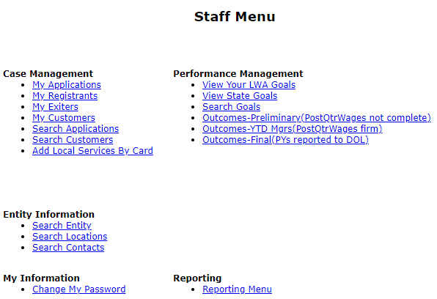
Searching Customer in IWDS
Sometimes when an individual comes into an office, staff may forget to search for an existing IWDS record and attempt to add an individual into IWDS without conducting a thorough search to see if the individual is already in IWDS.
When this occurs, this results in multiple customer-level records for the same individual.

Slide 30
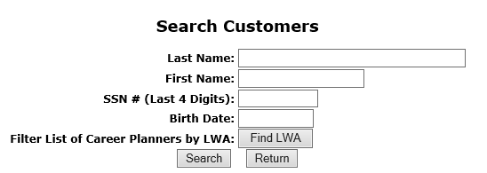
Searching for an Individual in IWDS
Due to the protection of personally identifiable information (PII), the ability to search by complete SSN has been removed.
The search feature within IWDS looks for exact matches, so searching partial spelling of the name is encouraged, versus spelling out the complete name for the initial search.

Slide 31
Searching for an Individual in IWDS
These four (4) simple searches will find 99% of existing IWDS client records:
Partial Last Name and Last 4 SSN.
Partial Last Name and Partial First Name (with or without Last 4 SSN).
Partial First Name and Last 4 SSN.
Last 4 SSN and Birth Date.
Note: These last two searches are essential if there could be a legal name change (especially if the client is female – more likely to have a legal name change with a marriage or divorce).

Slide 32
Example Recommended Customer Search in IWDS

Slide 33
Searching for an Individual in IWDS
Using any of the four recommended examples from the previous slide would have found the following “Customer” level record that was already in the “Test” platform of IWDS.
If we were moving forward with this client to build an application, the next step would be to click on “view” and the customer level record would come up.

Slide 34
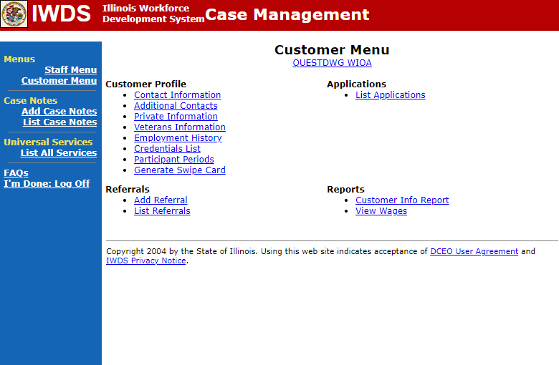
Create an Application
Once an individual is created as a “Customer” level record in IWDS, on right side under “Applications”, is “List Applications”, click on that to begin creating an application.

Slide 35
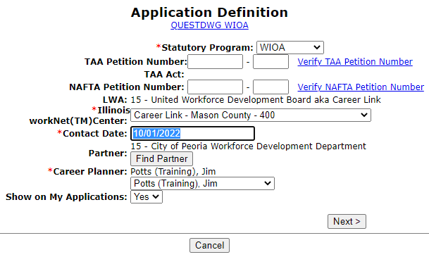
Contact Date of Application
If using the alternative eligibility, the changes in IWDS will be effective as of 10/1/2022;
IMPORTANT: The contact date for any application that will use the alternative criteria, must be dated 10/1/2022 or later to capture the updated alternative criteria.

Slide 36
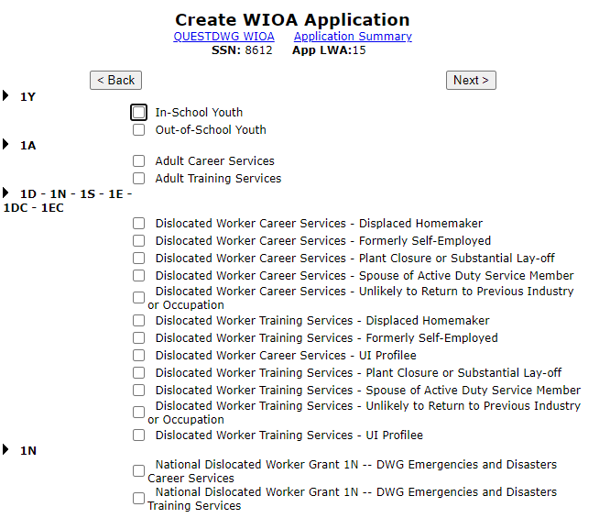
Guided Application
After the “Create” Application screen, the guided application will come up:

Slide 37
Guided Application
In IWDS, if the client does not meet any traditional Dislocated Worker criteria, and you are attempting to qualify the client under the alternative criteria the correct guided application for QUEST Disaster DWG grants would be:
National Dislocated Worker 1N - DWG Emergencies and Disasters Career Services
National Dislocated Worker 1N - DWG Emergencies and Disasters Training Services

Slide 38
Guided Application

Slide 39
Details about Guided Application
In the example on the previous slide, I chose to complete both the Career and Training Services guided application, if you know the client you are going to serve under your QUEST Disaster DWG is only planning to receive Career Services and/or Disaster Recovery Services level services, then you could choose to just complete the “Career Services” guided application as shown directly below.

Slide 40
Emergencies and Disaster Guided Application Screens
Contact Information;
Additional Contacts;
Private Information;
Veterans Information;
Concurrent Programs;
Tests;
Characteristics and Barriers;
Education Status;
Dislocated Worker Characteristics;
List Work History;
Public Assistance;
Family Characteristics;
WIOA Training Criteria.

Slide 41
Details about Guided Application
From the Emergencies and Disaster Guided Application screens only the Private Information screen (Authorized to Work in the U.S. & Selective Service) and the Dislocated Worker Characteristics screen (the seven alternative eligibility questions) have eligibility criteria under the Emergencies and Disaster certification.
All the information captured on the other screens in the guided application are tied to Federal Reporting requirements, and/or details about the client’s circumstances.

Slide 42
Assessment Test Requirements
For a client who is being certified under the Emergencies and Disasters Alternative criteria, if the client is going into Career Services only and/or Disaster Recovery Level services only, they would not be required to take assessment tests.
If under the Emergencies and Disasters Alternative criteria client is planning to go into WIOA funded training services, then prior to recording the training services, the internal logic within IWDS will require a Math and Reading test be recorded on or prior to the date the training service will begin.

Slide 43
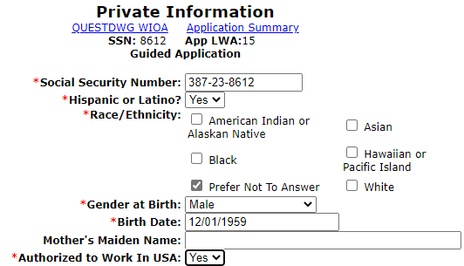
Private Information Screen
On any WIOA application in IWDS, there must be a “Yes” to the question of “Authorized to Work in the USA” question before the client will be determined eligible for any WIOA program.
At certification there must be documentation to support the “Yes” response.

Slide 44
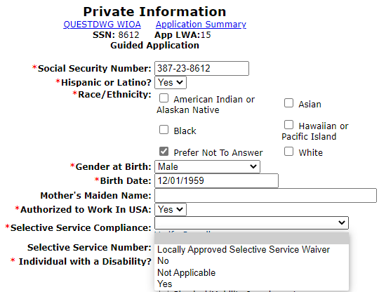
Private Information Screen
If “Gender at Birth” is male, and the birth date is on or after 1/1/1960, then the “Selective Service Compliance” questions must either be populated with “Yes” or “Locally Approved Selective Service Waiver”.
This example client was born prior to 1/1/1960, so the correct response was “Not Applicable”.

Slide 45
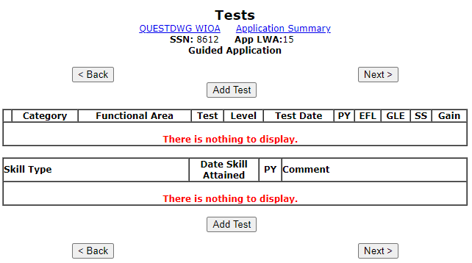
Assessment Tests
As previously mentioned, unless going into WIOA funded training services, the Emergencies and Disasters eligibility certification does not require the client to take Math and Reading Assessment tests.

Slide 46
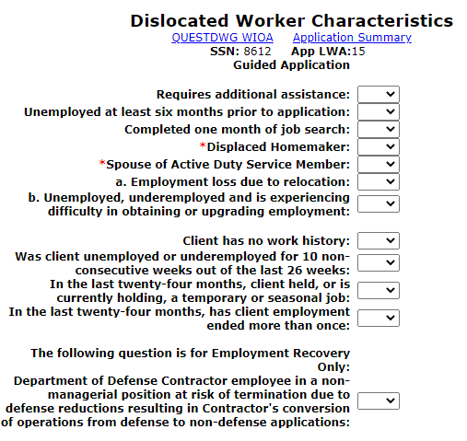
Dislocated worker Characteristics
This is the screen that will be getting modified for the new “Emergencies and Disasters” alternative eligibility criteria.
The current middle four questions will be getting modified/replaced with the new alternative criteria questions as previously discussed.
As a reminder, the next slide will list the new questions being added.

Slide 47
Emergencies and Disaster Criteria
Below are the seven (7) total alternative eligibility questions, any “Yes” response = eligible.
Client has no work history?
In the last twenty-four months has client held, or is currently holding, a temporary, seasonal, or day-to-day employment job?
In the last twenty-four months has client’s employment ended more than once?
Has client been unemployed for at least 6 of the past 13 weeks; or is unemployed and has a State or locally defined employment barrier?
Is client underemployed, works or needs to work multiple jobs, or is earning less than $15/hour?
For individuals who do not meet traditional Dislocated Worker criteria, was client laid off, fired, or voluntarily left their job due to the disaster/emergency?
Is client self-employed and is now significantly underemployed due to the disaster/emergency?
Documentation to support any “Yes” response to one or more of the questions above at certification will be the clients “Work History” or an “Applicant Statement” explaining how the client met the circumstances of the question.

Slide 48
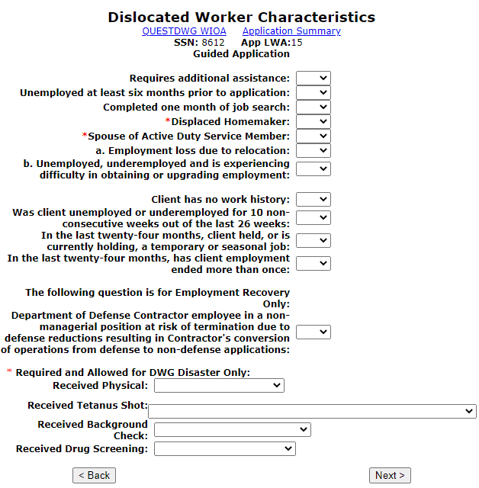
Bottom of Dislocated Worker Characteristics Screen
On the bottom of the Dislocated Worker Characteristics screen are four questions that will require responses for any client that is going to receive “Disaster Recovery Level” services.
“Disaster Recovery Level” services, which include Disaster Relief Employment, Disaster Relief Safety Training, and Disaster Relief Employment Supportive Services.

Slide 49
Required and Allowed for DWG Disaster Only Questions
These questions are not needed for certification under either Emergencies and Disasters alternative eligibility criteria or under traditional Dislocated Worker eligibility.
The “Required and Allowed for DWG Disaster Only” questions must be completed for any client that will be enrolled in “Disaster Recovery Level” services, which include Disaster Relief Employment, Disaster Relief Safety Training, and Disaster Relief Employment Supportive Services.

Slide 50
Required and Allowed for DWG Disaster Only Questions
“Received Physical” is tied to any planned Disaster Relief Employment.
This question only needs to have a response if the client is going into any “Disaster Recovery Level” services, such as Disaster Relief Employment.

Slide 51
Required and Allowed for DWG Disaster Only Questions
“Received Tetanus Shot” is tied to any planned Disaster Relief Employment.
This question only needs to have a response if the client is going into any “Disaster Recovery Level” services, such as Disaster Relief Employment.

Slide 52
Required and Allowed for DWG Disaster Only Questions
“Received Background Check” is tied to any planned Disaster Relief Employment.
This question only needs to have a response if the client is going into any “Disaster Recovery Level” services, such as Disaster Relief Employment.

Slide 53
Required and Allowed for DWG Disaster Only Questions
“Received Drug Screening” is tied to any planned Disaster Relief Employment.
This question only needs to have a response if the client is going into any “Disaster Recovery Level” services, such as Disaster Relief Employment.

Slide 54
Required and Allowed for DWG Disaster Only Questions
As mentioned previously, these questions are not needed for certification under either Emergencies and Disasters alternative eligibility criteria or under traditional Dislocated Worker eligibility.
After certification, those four question can be populated and will be required if you attempt to enroll the client in any “Disaster Recovery Level” services:

Slide 55
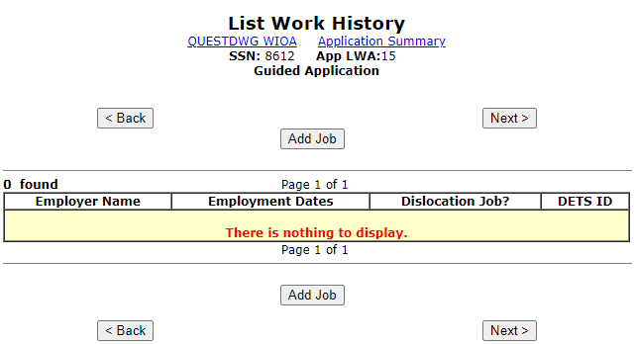
List Work History
Under the Emergencies and Disasters alternative eligibility criteria, there is no need to record a Dislocation job, as the eligibility is based on the responses to those seven (7) questions that will on the updated “Dislocated Worker Characteristics” screen discussed previously in this presentation.

Slide 56
Details about List History Screen
From the previous screen, if the client has a Dislocation job, then they should meet traditional Dislocated Worker eligibility and the alternative Emergencies and Disasters criteria should not be used.
If you are not sure if an individual would meet traditional Dislocated Worker eligibility criteria, please feel free to reach out to James (Jim) Potts at james.potts@illinois.gov

Slide 57
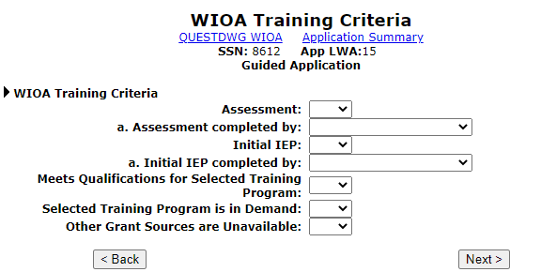
WIOA Training Criteria Screen
At the beginning of the guided application in this PowerPoint both Career and Training Services were checked; for the Training Services the only extra screen is the WIOA Training Criteria screen.
All the same IWDS logic for the answers to these questions are the same for traditional Adult and/or Dislocated Worker certification up to the “Training Services” level is needed.

Slide 58
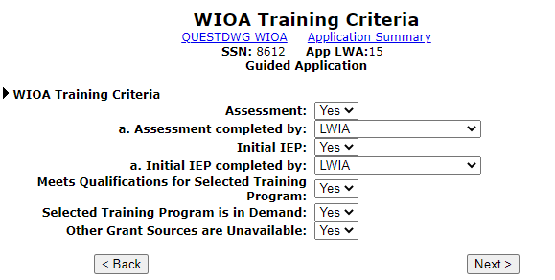
WIOA Training Criteria Screen
For this “example” client, the WIOA Training Criteria was completed as shown below:

Slide 59
Emergencies and Disaster Criteria
As mentioned previously, only the Private Information screen (Authorized to Work in the U.S. & Selective Service) and the Dislocated Worker Characteristics screen (the seven alternative eligibility questions) have eligibility criteria under the Emergencies and Disasters alternative criteria; the information captured on the other screens in the guided application are tied to Federal Reporting requirements, and/or basic details about the client’s circumstances.

Slide 60
Eligibility Determination Screen

Slide 61
Application Date Details
The Application date can be on or after any date from the original application contact date.
For this client, application date must be any date on or after 10/01/2022.

Slide 62
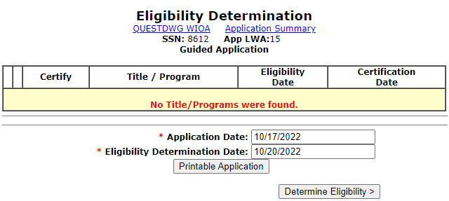
Application Date and Eligibility Date
Your application date and eligibility determination date are not required to be on the same date.
For most WIOA titles, internal IWDS logic requires eligibility determination date must be within 30 days of the application date.

Slide 63
Eligibility Determination
When we click on “Determine Eligibility” IWDS logic will take the responses we put in the application and display which titles the client might be eligible under WIOA.
Keep in mind, a client might be eligible under several WIOA titles, but your 1N QUEST Disaster DWG can only be utilized for individuals who either meet any traditional WIOA Dislocated Worker Eligibility or 1N Emergencies and Disasters Eligibility.

Slide 64
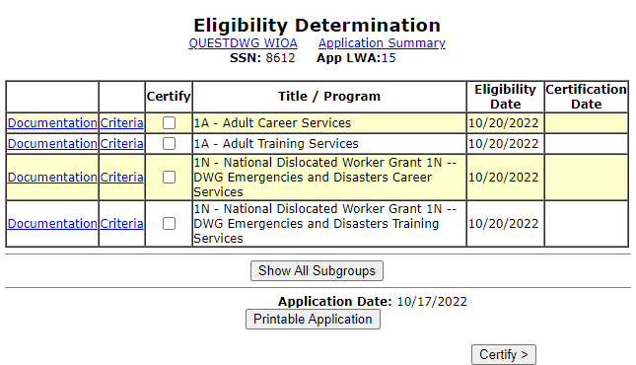
Eligibility Determination
Based on the information recorded in the completed guided application, this client is eligible under the Adult title and the alternative Emergencies and Disaster Career and Training Services.

Slide 65
Eligibility Certification (System is not ready yet)
For this client, we are not interested in certifying under the Adult title.
This client does not meet any traditional WIOA Dislocated Worker title eligibility, so we would want to certify under the 1N Emergency and Disaster criteria.
At this time the internal logic around the 1N Emergency and Disaster criteria for the updated alternative logic is not in IWDS, so this PowerPoint cannot demonstrate certification under 1N Emergency and Disaster.

Slide 66
Now You Have Seen
We had a discussion of the QUEST Disaster National Dislocated Worker (DWG).
We discussed how any client who meets traditional Dislocated Worker criteria, or any client who will meet the alternative Emergencies and Disasters Services will be able to get served under the QUEST Disaster DWG.
We discussed and demonstrated the alternative eligibility questions that will be added into IWDS for the 1N Emergency and Disaster alternative eligibility.
We discussed and demonstrated details about the 1N Emergency and Disaster application within IWDS.

Slide 67
Questions
If you have questions about anything in this PowerPoint, please reach out to James (Jim) Potts at james.potts@Illinois.gov or call him at (217) 416-7097 OR,
You can contact Jill Meseke who provides oversight of the Disaster Recovery Grants and she can be reached at mesekejill@gmail.com or call her at (217) 553-4243.

