Slide 1
JTED: Setting Up Programs in Illinois workNet
Illinois workNet® is sponsored by the Department of Commerce and Economic Opportunity. – August 2024

Slide 2
JTED Reporting System
Grantee Details & Training Programs
Presentation
Create an Illinois workNet Account & Request Access
Grantee Details
Training Provider
Demonstration
Grantee Details & Training Provider
JTED Partner Guide
Sign Up for an Individual Organization Technical Assistance Session

Slide 3
Request Access to the JTED reporting system
New Accounts:
Go to www.illinoisworknet.com.
Click “Sign Up” in the header.
Enter the required information and submit.
Check your email for a confirmation message.
Click the verification link in the email.
Once you have an Illinois workNet account:
Request to become a partner by sending an email to info@illinoisworknet.com. Include the following information:
Reason for the email: I would like to request an Illinois workNet partner account.
Your name as it appears in your Illinois workNet account.
Your organization name, address, and work phone number.
Request access to the JTED Reporting System.

Slide 4
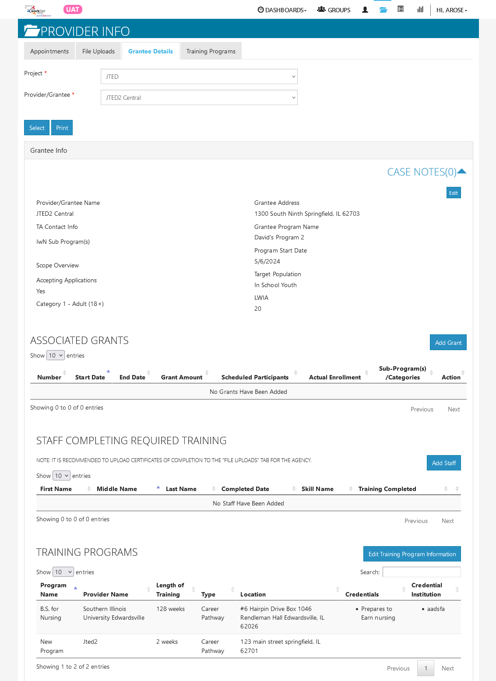
Grantee Details
Key Points
The Grantee Details is a place to maintain current grant information, training program information, worksites, and services used in the program.
Key sections used for this program include:
Grantee information
Associated Grants
Training Programs (The section is populated when you enter training programs in the training programs section.)
Worksites (This information is used if you are providing work-based learning opportunities at a worksite.)
Services (This section is prepopulated with JTED services. Review this section and remove the services that will not be used by your program.)

Slide 5
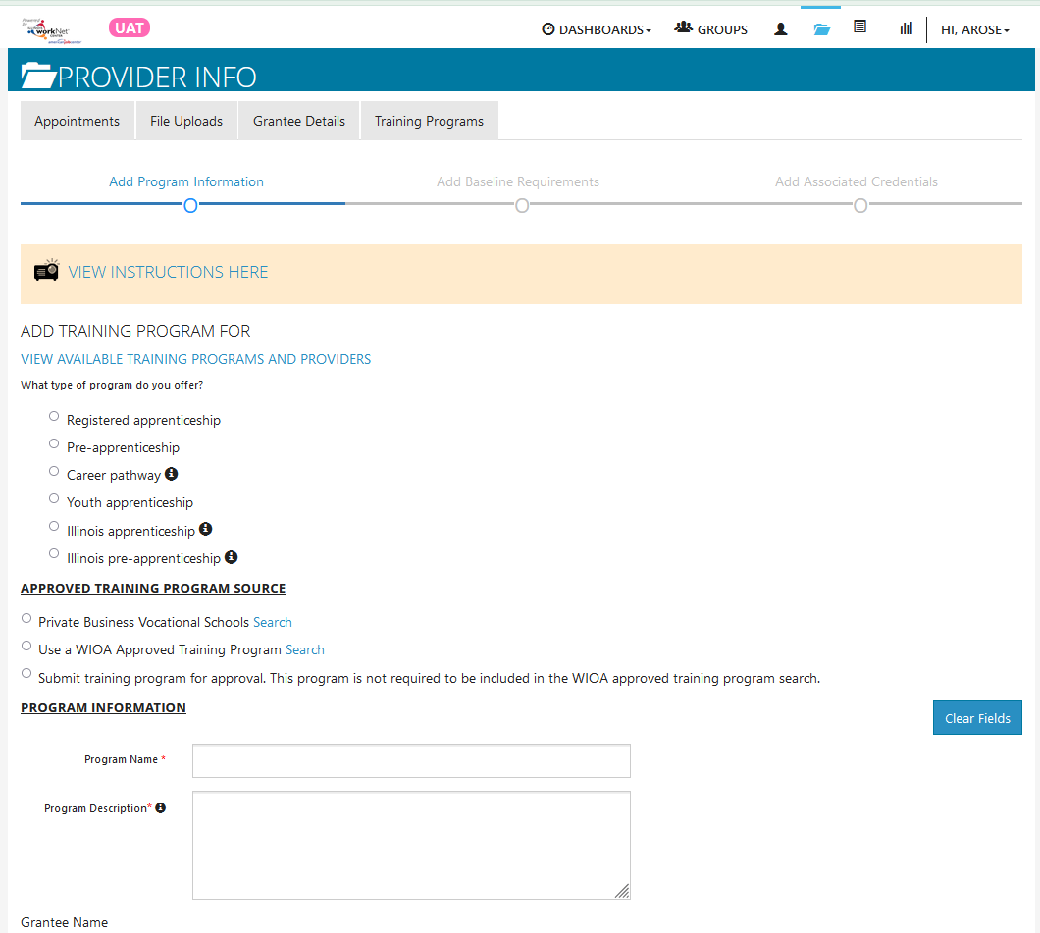
Training Programs
Key Points
The Grantee Details is a place to identify training programs and providers for the program.
Training program searches (i.e., Private Business Vocational Schools & WIOA Approved Training Programs) can be used to prepopulate program information fields. If the program is not in one of the searches, select the option to submit the training program for approval.
Program Contact is the person the who Illinois workNet should contact if the training program needs updates.
Baseline requirements are optional.
Add the industry credentials that can be earned by completing the program.
Commerce staff will review and approve the credentials and training program information.

Slide 6
Individual Technical Assistance for Organizations
Week of August 26th – September 9th
Register for one 30-minute time slot for your organization.
If multiple people would like to participate in the TA call, find a time that works with your schedules and reserve that time slot.
Include the names of participating individuals and your organization in the appointment sign-up notes.
TA with Natasha during the week of 8/26
TA with David during the week of 8/26
TA with Natasha during the week of 9/6
TA with David during the week of 9/2

