Slide 1

WIOA Performance 101:
An Overview of the Primary Indicators of Performance
August 18, 2026
Notes:
Should this have the Professional Development Logo or just workNet/AJC?

Slide 2

Today’s Objectives
Learn about Performance Accountability
Understand Key Definitions Related to Performance
Identify Five Indicators of Performance
Improve Knowledge of Performance Reporting and Documentation

Slide 3
WIOA Primary Indicators of Performance
Six Core Measures
Employment Rate
2nd QTR After Exit
Median Earnings
Credential Attainment
Measurable Skill Gains
Employment Rate
4th QTR After Exit
Effectiveness in Serving Employers

Slide 4
WIOA Primary Indicators of Performance
Six Core Measures
Employment Rate
2nd QTR After Exit
Median Earnings
Credential Attainment
Measurable Skill Gains
Employment Rate
4th QTR After Exit
Effectiveness in Serving Employers

Slide 5

WIOA Primary Indicators of Performance
Percentage of participants who are in unsubsidized employment during the second quarter after exit from the program.
  For Title I Youth: percentage of participants in education or training activities, or in unsubsidized employment during the second quarter after exit.
  All participants in all core programs are included in this indicator regardless of employment/education status at program entry.
  Placement in Education and Training counts for Youth.
Employment Rate
2nd Quarter After Exit

Slide 6
WIOA Primary Indicators of Performance
Calculation/Methodology:
Number of participants exited during reporting period and who are employed (or Youth in education or training) in 2nd quarter after exit DIVIDED by number of participants who exited during reporting period.
Participants who exit during the reporting period for any of the reasons listed in the Exclusions from Performance are not included in the measure.
Supplemental wage information is allowed to verify employment.
Six Core Measures
Employment Rate
2nd QTR After Exit
Median Earnings
Credential Attainment
Measurable Skill Gains
Employment Rate
4th QTR After Exit
Effectiveness in Serving Employers

Slide 7
WIOA Primary Indicators of Performance
Six Core Measures
Employment Rate
2nd QTR After Exit
Median Earnings
Credential Attainment
Measurable Skill Gains
Employment Rate
4th QTR After Exit
Effectiveness in Serving Employers

Slide 8
WIOA Primary Indicators of Performance
Percentage of participants who are in unsubsidized employment during the fourth quarter after exit from the program.
  For Title I Youth: percentage of participants in education or training activities, or in unsubsidized employment during the fourth quarter after exit.
  All participants in all core programs are included in this indicator regardless of employment/education status at program entry.
  Placement in Education and Training counts for Youth.
Employment Rate
4th Quarter After Exit

Slide 9
WIOA Primary Indicators of Performance
Calculation/Methodology:
Number of participants exited during reporting period and who are employed (or Youth in education or training) in 4th quarter after exit DIVIDED by number of participants who exited during reporting period.
Participants who exit during the reporting period for any of the reasons listed in the Exclusions from Performance are not included in the measure.
Supplemental wage information is allowed to verify employment.
Six Core Measures
Employment Rate
2nd QTR After Exit
Median Earnings
Credential Attainment
Measurable Skill Gains
Employment Rate
4th QTR After Exit
Effectiveness in Serving Employers

Slide 10
WIOA Primary Indicators of Performance
Six Core Measures
Employment Rate
2nd QTR After Exit
Median Earnings
Credential Attainment
Measurable Skill Gains
Employment Rate
4th QTR After Exit
Effectiveness in Serving Employers

Slide 11
WIOA Primary Indicators of Performance
The median earnings of participants who are in unsubsidized employment during the second quarter after exit from the program, as identified by direct UI wage record match, Federal or military employment records, or supplemental wage information.
Median Earnings
2nd Quarter After Exit

Slide 12
WIOA Primary Indicators of Performance
Calculation/Methodology:
Total quarterly earnings for all participants employed in the second quarter after exit are collected. The wage information values are listed in order from the lowest to highest value and the value in the middle of this list is the median earnings value.
Six Core Measures
Employment Rate
2nd QTR After Exit
Median Earnings
Credential Attainment
Measurable Skill Gains
Employment Rate
4th QTR After Exit
Effectiveness in Serving Employers
$12,500 $13,400 $16,300 $18,500 $18,600 $25,700 $32,500
Middle Number

Slide 13
WIOA Primary Indicators of Performance
Calculation/Methodology:
The following participants and associated earnings are excluded from the calculation:
Participants who exited and are not employed in the 2nd exit quarter will not count in this measure.
Participants who have exited a program and for whom information is not yet available.
Participants who have exited from a program and who have $0 income.
Participants who have exited a program and are in subsidized employment.
Participants who have exited for any of the Exclusion reasons.
Six Core Measures
Employment Rate
2nd QTR After Exit
Median Earnings
Credential Attainment
Measurable Skill Gains
Employment Rate
4th QTR After Exit
Effectiveness in Serving Employers

Slide 14
WIOA Primary Indicators of Performance
Six Core Measures
Employment Rate
2nd QTR After Exit
Median Earnings
Credential Attainment
Measurable Skill Gains
Employment Rate
4th QTR After Exit
Effectiveness in Serving Employers

Slide 15
WIOA Primary Indicators of Performance
Percentage of participants enrolled in education or training program who attain a recognized postsecondary credential or secondary school diploma during participation or within 1 year after program exit.
  Only includes those who received training or education (excluding OJT or Customized Training) in denominator.
  ALL In School Youth are included in the measure.
Credential Attainment

Slide 16
WIOA Primary Indicators of Performance
Calculation/Methodology:
The number of participants who exited during the reporting period who obtained a recognized postsecondary credential during the program or within one (1) year after exit OR those who were in a secondary education program and obtained a secondary school diploma or its recognized equivalent during the program or within one (1) year after exit and were also employed, or in an education or training program leading to a recognized postsecondary credential (See the “Special Rule”) within one (1) year after exit DIVIDED by the number of participants enrolled in an education or training program (excluding those in OJT and customized training) who exited during the reporting period.
Six Core Measures
Employment Rate
2nd QTR After Exit
Median Earnings
Credential Attainment
Measurable Skill Gains
Employment Rate
4th QTR After Exit
Effectiveness in Serving Employers

Slide 17
WIOA Primary Indicators of Performance
Types of Credentials
Secondary School Diploma or recognized equivalent (Note the Special Rule)
Post-Secondary Education Credentials
Associate’s Degree
Bachelor’s Degree
Graduate Degree for purposes of the VR program
Occupational Licensure
Occupational Certificate, including Registered Apprenticeship and Career and Technical Education educational certificates
Occupational Certification
Other recognized certificates of industry/occupational skills completion sufficient to qualify for entry-level or advancement in employment
Six Core Measures
Employment Rate
2nd QTR After Exit
Median Earnings
Credential Attainment
Measurable Skill Gains
Employment Rate
4th QTR After Exit
Effectiveness in Serving Employers

Slide 18
WIOA Primary Indicators of Performance
“Special Rule” related to Secondary School Diploma
  Participants who obtain a secondary school diploma or its recognized equivalent must also meet an additional condition before they are counted as a successful outcome (positive) and included in the numerator of the credential attainment indicator. These participants must be employed or enrolled in an education or training program leading to a recognized postsecondary credential within one year following exit.
“Special Rule” Credential Attainment

Slide 19
WIOA Primary Indicators of Performance
Recognized Credentials
A recognized postsecondary credential is defined as a credential consisting of an industry-recognized certificate or certification a certificate of completion of an apprenticeship, a license recognized by the State or Federal Government, or an associate or baccalaureate degree
A secondary school diploma (or alternate diploma) (commonly referred to as high school diploma) is one that is recognized by a state and that is included for accountability purposes under the Elementary and Secondary Education Act of 1965 (ESEA), as amended by the Every Student Succeeds Act (ESSA).
A secondary school equivalency certification signifies that a student has completed the requirements for a high school education.
Six Core Measures
Employment Rate
2nd QTR After Exit
Median Earnings
Credential Attainment
Measurable Skill Gains
Employment Rate
4th QTR After Exit
Effectiveness in Serving Employers

Slide 20
WIOA Primary Indicators of Performance
Certificates that Do NOT Count for the Credential Attainment Measure
Certificates that DO NOT document the measurable technical or industry/ occupational skills necessary to gain employment or advance within an occupation.
Examples include:
OSHA 10 or OSHA 30-hour safety courses
Work readiness, food handlers, and CPR/First Aid certifications
Completion of orientation or mobility training
Workforce Innovation Board (WIB) certificates
While these don’t count towards a Credential Attainment measure, they are allowable career services
Six Core Measures
Employment Rate
2nd QTR After Exit
Median Earnings
Credential Attainment
Measurable Skill Gains
Employment Rate
4th QTR After Exit
Effectiveness in Serving Employers

Slide 21
WIOA Primary Indicators of Performance
Six Core Measures
Employment Rate
2nd QTR After Exit
Median Earnings
Credential Attainment
Measurable Skill Gains
Employment Rate
4th QTR After Exit
Effectiveness in Serving Employers

Slide 22
WIOA Primary Indicators of Performance
Percentage of program participants who are in an education or training program that leads to a recognized postsecondary credential or employment AND who are achieving measurable skills gains, defined as documented academic, technical, occupational, or other forms of progress, towards such a credential or employment.
  Unlike the Credential Attainment measure, Adults and Dislocated workers who are in an OJT or Customized Training ARE included in the measure.
Measurable Skill Gains (MSG)

Slide 23
WIOA Primary Indicators of Performance
Median Earnings
2nd Quarter After Exit
Calculation/Methodology:
The number of program participants during the reporting period who are in an education or training program that leads to a recognized postsecondary credential or employment and are achieving measurable skill gains based on attainment of at least one type of gain DIVIDED by the number of program participants during the reporting period who are in an education or training program that leads to a recognized postsecondary credential or employment.
Six Core Measures
Employment Rate
2nd QTR After Exit
Median Earnings
Credential Attainment
Measurable Skill Gains
Employment Rate
4th QTR After Exit
Effectiveness in Serving Employers

Slide 24
WIOA Primary Indicators of Performance
Median Earnings
2nd Quarter After Exit
Five Types of MSGs
Educational Functioning Level (EFL)
Secondary or Post-Secondary Transcript/Report Card
Training Milestone(s)
Skills Progression: (Diploma/Certificate/Degree)
Secondary School Diploma or Equivalent (Skills Progression)
Six Core Measures
Employment Rate
2nd QTR After Exit
Median Earnings
Credential Attainment
Measurable Skill Gains
Employment Rate
4th QTR After Exit
Effectiveness in Serving Employers

Slide 25
WIOA Primary Indicators of Performance
Median Earnings
2nd Quarter After Exit
Types of MSGs
1.) Educational Functioning Level (EFL)
a.) Pre-Test compared with Post-Test
Documented attainment of a secondary school diploma or its recognized equivalent
b.) Adult Ed programs – Credits or Carnegie Units
c.) Increase education enrollment from secondary (below post-secondary) to POST – Secondary.
d.) State-recognized High School Equivalency – passing subtests
.2.) Secondary School Diploma or Equivalent
Six Core Measures
Employment Rate
2nd QTR After Exit
Median Earnings
Credential Attainment
Measurable Skill Gains
Employment Rate
4th QTR After Exit
Effectiveness in Serving Employers
Notes:
EFL measurements);
Participant increases EFL as Measures by an increase from pre-to post test.
Awarding of Credits or Carnegie Units for Secondary School Diploma or Equivalent:
Participants who exit a program in basic education and later enroll in post-secondary education or training.

Slide 26
WIOA Primary Indicators of Performance
Types of MSGs
3.) Secondary or Post-Secondary Transcript/Report Card:
Secondary Transcript/Report Card:
Applies to participants without a high school diploma or GED at program entry.
Post-Secondary Transcript/Report Card:
Full time Students must achieve a minimum of 12 credits within one semester.
Part-time students must achieve a minimum of 12 credits completed (in accordance with the institutions standards) in two consecutive semesters within the same 12-month period. If the first semester begins in one PY and the second semester ends in the next Program Year (PY), the MSG would be achieved in the PY that the second semester ends.
Six Core Measures
Employment Rate
2nd QTR After Exit
Median Earnings
Credential Attainment
Measurable Skill Gains
Employment Rate
4th QTR After Exit
Effectiveness in Serving Employers

Slide 27
WIOA Primary Indicators of Performance
Median Earnings
2nd Quarter After Exit
Types of MSGs
4.) Training Milestone(s):
Satisfactory or better progress report towards established milestones, such as completion of OJT or completion of one year of an apprenticeship program or similar milestones, from an employer or training provider who is providing training.” Progress reports must document substantive skill development.
5.) Skills Progression: (Diploma/Certificate/Degree):
Successful passage of an exam that is required for a particular occupation or progress in attaining technical or occupational skills as evidenced by trade-related benchmarks, such as knowledge-based exams.
Six Core Measures
Employment Rate
2nd QTR After Exit
Median Earnings
Credential Attainment
Measurable Skill Gains
Employment Rate
4th QTR After Exit
Effectiveness in Serving Employers
Notes:
Training Milestones: Training reports on milestones completed as individual masters the required job skill or steps to complete a program, for example an OJT or Registered Apprenticeship (RA).
Pay stubs showing increases in pay resulting from new skills or increased performance.
Should reflect on a participant’s ISS or IEP or other established goals.
Skills Progressions are documented by passage of a written assessment or exam leading to a credential or certificate.
This gain may include a High-School Diploma or GED, an Industry Recognized Credential or Certificate or an Associates or Bachelor’s Degree

Slide 28
WIOA Primary Indicators of Performance
Median Earnings
2nd Quarter After Exit
Need to Know:
To count as a positive in performance, participants need to achieve at least one skill gain each year they participate in WIOA and are enrolled in education or training.
ALL MSGs should be reported even though only one is counted in the performance calculation for each program year.
Since the MSG measure is NOT exit based, participants are included in the measure each program year they participate in WIOA and are enrolled in training or education.
Six Core Measures
Employment Rate
2nd QTR After Exit
Median Earnings
Credential Attainment
Measurable Skill Gains
Employment Rate
4th QTR After Exit
Effectiveness in Serving Employers

Slide 29
Exclusions from Performance
Exclusions from Performance Measures
Exclusions for All WIOA Titles (Reported at EXIT)
Incarceration or become resident of an institution
Medical treatment expected to last longer than 90 days
Participant is deceased
Member of the National Guard or other reserve military unit called to active duty for at least 90 days
Title I Youth ONLY
Participant is in Foster Care System and exits because of move from local area as part of program or system

Slide 30

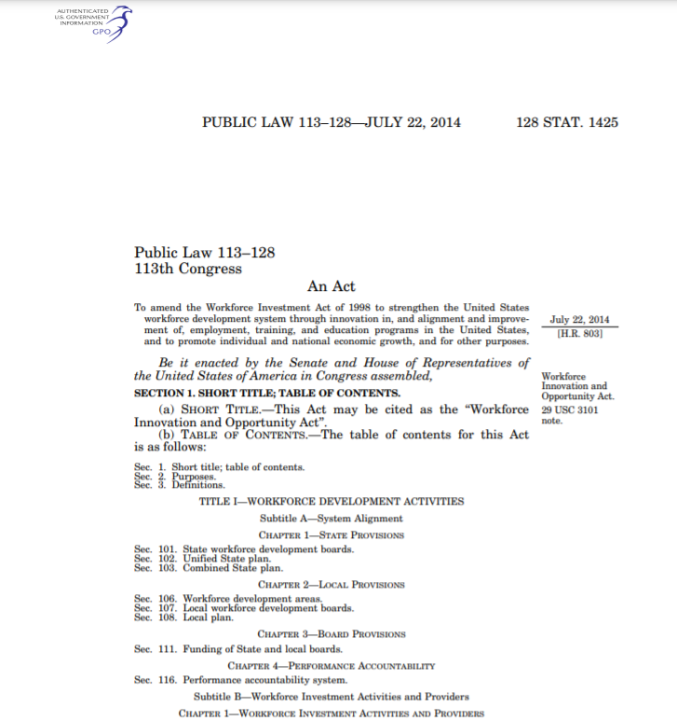
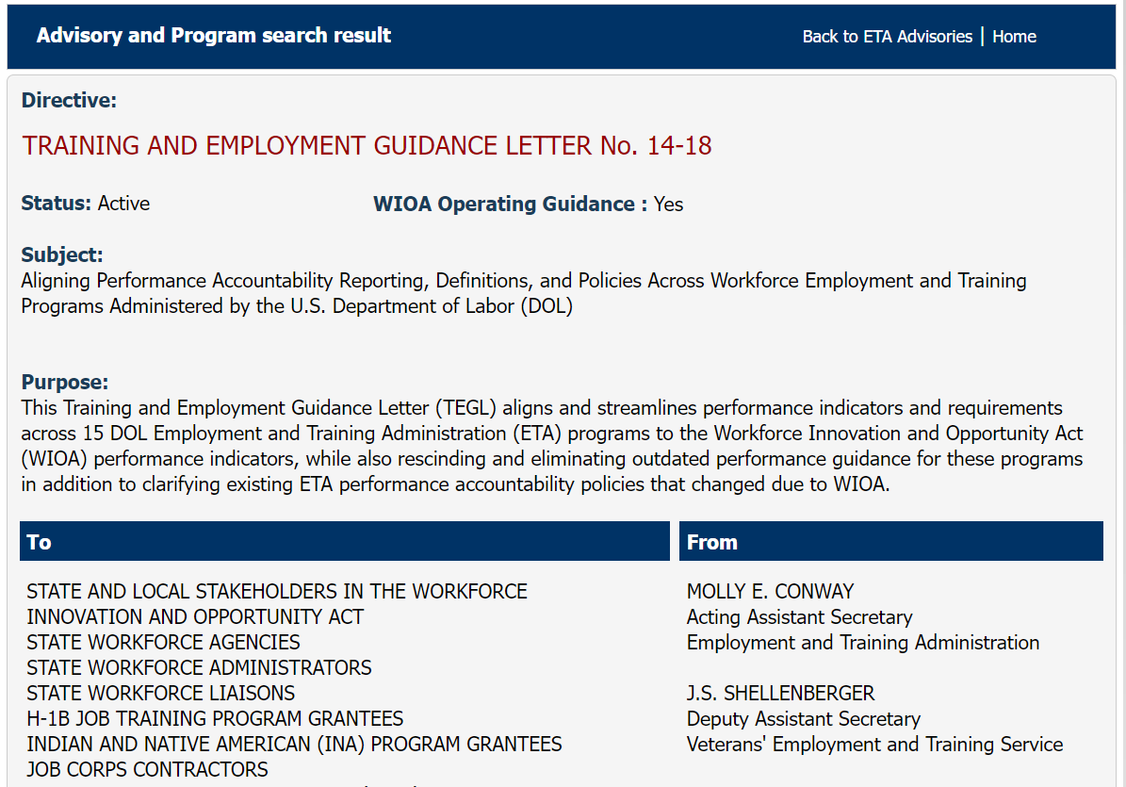

Statute, Regulations and Guidance
Statute:
  Workforce Innovation and Opportunity Act (WIOA) Section 116 establishes performance accountability requirements for the six core WIOA programs
Regulations: WIOA-DOL only & WIOA Joint Final Rules
  20 CFR 676, 677, and 678 (Adult, Dislocated Worker, Youth, and Wagner-Peyser); 603, 651, 652 (DOL Only)
Policy Guidance and Joint Issuances:
  Guidance is issued by each of the Federal agencies. “Joint issuances” is the identical content coming out under each Federal partner’s vehicle, for consistency
State Policies and Guidance
  Each Core Program issues additional State specific requirements and guidance through formal and informal communication with its grantees
Notes:
Ensure to describe the types of policy/guidance each State Program issues:
Title I: WIOA Policy, WIOA Notices

Slide 31

Performance Resources
Workforce Innovation and Opportunity Act: Public Law; Final Rules, Joint Rule and Labor Only
Workforce Innovation and Opportunity Act Section 116(c)
U.S. DOL Training and Employment Guidance Letter (TEGL) No. 10-16, Change 3, Performance Accountability Guidance for Workforce Innovation and Opportunity Act (WIOA) Title I, Title II, Title III, and Title IV Core Programs (August 23, 2017)
TEGL No. 14-18, Aligning Performance Accountability Reporting, Definitions, and Policies Across Workforce Employment and Training Programs Administered by the U.S. Department of Labor (DOL) (March 25, 2019)
“Credential TEN” for WIOA/ETA
https://www.dol.gov/agencies/eta/advisories/training-and-employment-notice-no-25-19

Slide 32

Additional Resources Available
WIOA Performance Indicators and Measures
WorkforceGPS.org
Performance Accountability - Guidance
Welcome to Performance Reporting
WIOA ePolicy
Chapter 3, Performance Accountability and Reporting (ePolicy)

Slide 33
Notes:
Telephone lines opened again for questions on the SAM and Tool. After questions, Mark picks it back up to speak to the Resources and References that are available for teams to utilize as they prepare for their negotiations. Mark then turns it back to Olivia to close out the webinar with a quick overview of IPATS.

Slide 34

Notes:
Mark to conclude and remind all that the webinar was recorded today and a link to the recording will be sent to all who registered and can share, as necessary. We’ll ensure to get the recording to any LWIAs that weren’t represented today.
Should we have PD or just workNet/AJC logo on these last two slides?

