Slide 1
SNAP Work Requirement in Illinois
June 18, 2026
Susan O’Callaghan, SNAP E&T Lead
Office of Workforce Development
Illinois Department of Human Services

Slide 2
Background on SNAP Work Requirement
SNAP recipients age 18-64 who are subject to the time limit lose eligibility for SNAP once they have received 3 full months of benefits in a three-year period without meeting the work requirement or an exemption.
Individuals who exhausted their three months can regain eligibility by either:
  Meeting an exemption, or
  Meeting the work requirement for 80 hours in 30 consecutive days.
  These individuals remain eligible in the three-year period as long as they continue to be exempt or meet the work requirement.
In Illinois:
  The time limit returned on February 1, 2026.
  Approximately 120,000 SNAP recipients lost SNAP eligibility on May 1, 2026; we are raising awareness about options for regaining eligibility.
  The current three-year period ends on December 31, 2026. The new three-year period begins and the time limit resets on January 1, 2027. This coincides with the Medicaid work requirement for ACA expansion adults which takes effect on January 1, 2027.

Slide 3
Exemptions

Slide 4

Exemptions from SNAP Work Requirements*
Younger than age 18, or age 65 or older
Pregnant
Parent or other member of the SNAP household with a child under 14 years of age
Indian, Urban Indian, California Indian, and other Indians who are eligible for Indian Health Services
Already working at least 30 hours a week OR earning $217.50 or more per week
Taking care of a child younger than age 6 (does not have to live in the home)
Providing care for another person who needs help caring for themselves (does not have to live in the home)
Not able to work 20 hours/week because of a physical or mental health reason
Going to school, college, or training program at least half time
Participating regularly in a drug or alcohol addiction treatment program
Meeting work requirements of another program (TANF or unemployment compensation)
Applied for or are receiving unemployment benefits
Residing in a waived (exempt) county (NOT APPLICABLE
IN ILLINOIS)
Otherwise exempt from the SNAP Work Provision
*This includes exemptions from the work provisions and work requirement.

Slide 5

ABAWD Work Requirement:
Exemption Request Process
Customers can request an exemption at any time by:
Contacting their local FCRC in person, via phone call etc.
Submitting form IL444-2341 SNAP Work Requirement- Request for Exemption (You can find the form on the ABE Manage My Case website)
  Note: Customers generally do not have to provide proof of the exemption. However, if the exemption is questionable, IDHS may ask for verification.
  Customers can upload documents and forms to show proof of meeting the Work Requirement or of being exempt through Manage My Case
A service provider may support an individual with completing this process.
For help with Manage My Case: ABE.questions@illinois.gov

Slide 6
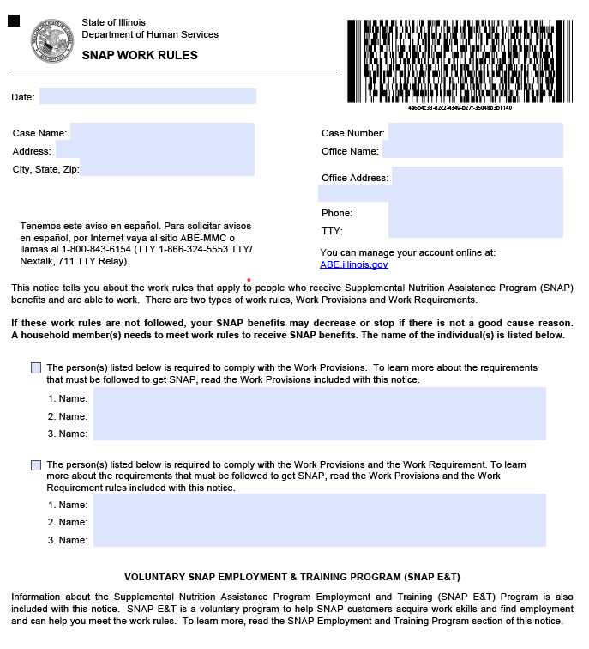
IL 444-5175 SNAP Work Rules Notice
Work registrants and/or ABAWDs should receive this notice at:
Initial certification
Renewal
When previously exempt household member or new household member becomes subject to the work rules.

Slide 7
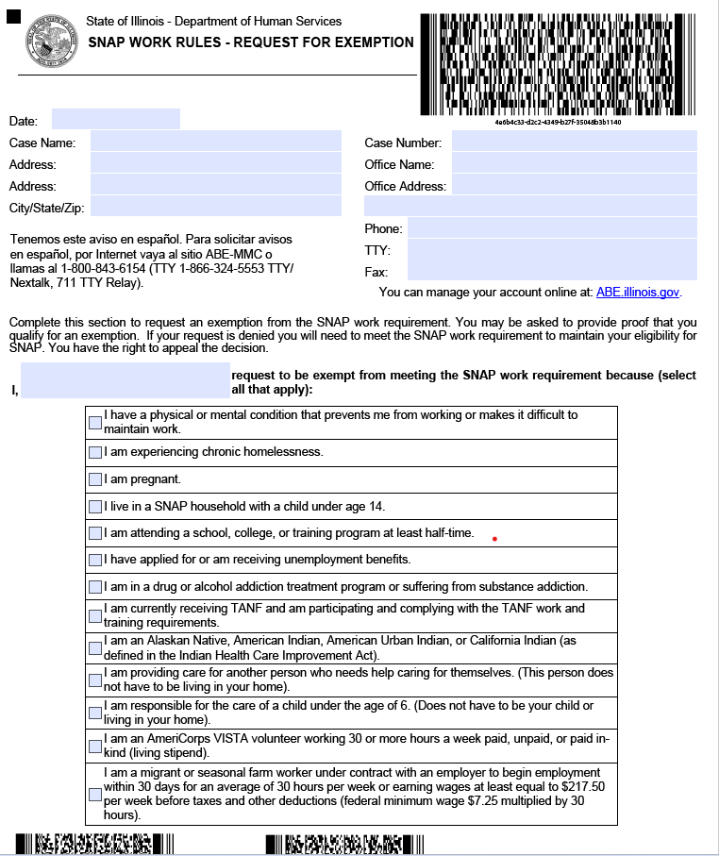
IL 444-2341 SNAP Work Rules -
Request for Exemption

Slide 8
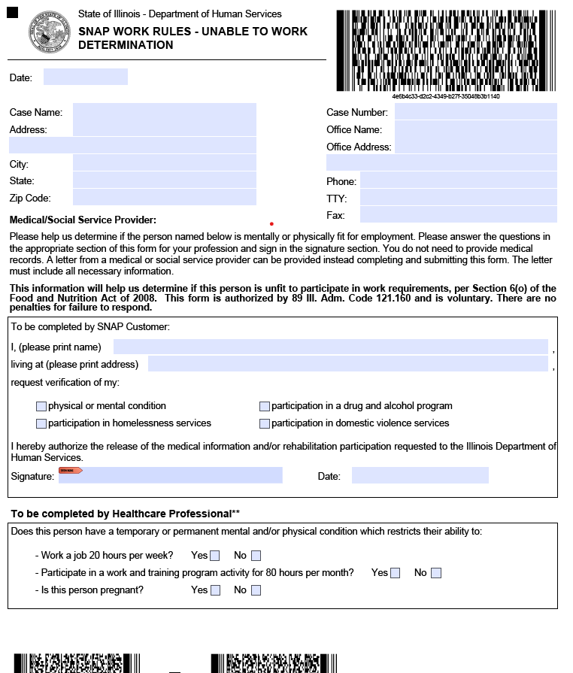
IL444-2340 SNAP Work Requirement Request – Unable to Work Determination Form

Slide 9
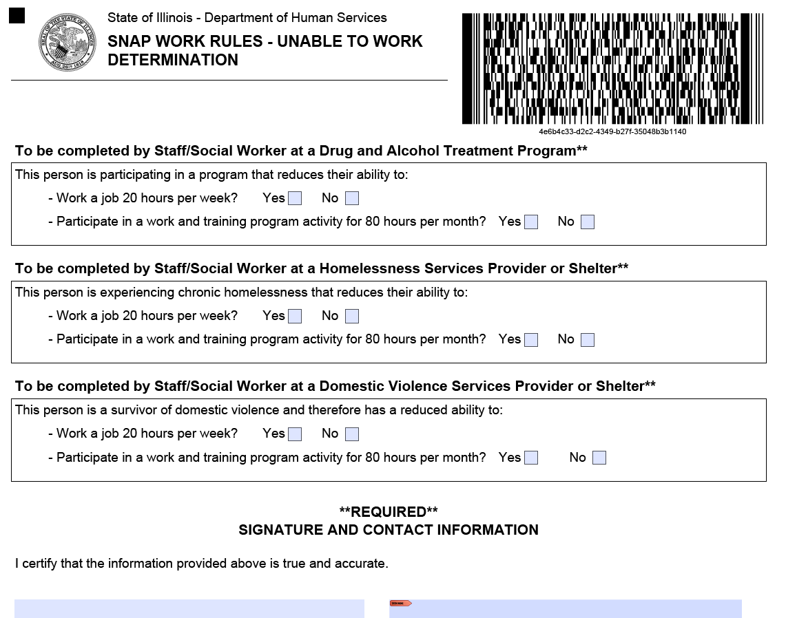
IL444-2340 SNAP Work Requirement Request – Unable to Work Determination Form

Slide 10
Meeting the Work Requirement

Slide 11
To meet the work requirement an individual must spend 20 hours per week (i.e., 80 hours per month):
Working
(paid or unpaid)
Participating in an approved work program that is operated or supervised by state or local government.
Doing self-initiated community service with a community-based organization
Any combination of the above

Slide 12
Qualifying Work Programs for the SNAP Work Requirement
WIOA Title 1 programs (Adult, Youth, and Dislocated Worker)
Trade Act programs
Employment and training programs for veterans operated by the Department of Labor or the Department of Veterans Affairs (e.g., Jobs for Veterans State Grant program (JVSG))
SNAP Employment and Training (SNAP E&T), administered by IDHS
New
  Job Training and Economic Development (JTED) program
  Climate and Equitable Jobs Act (CEJA) program
  Job Ready Illinois
  Senior Community Service Employment Program (SCSEP)
  Chicago DFSS Industry Specific Training Program (DFSS-ISTP)
  Chicago DFSS Transitional Jobs Program (DFSS-TJ)

Slide 13
JTEDVerification Options

Slide 14
JTED Participation and Verification
Example 1 - Half-Time Exemption
If an individual is enrolled half‑time or more in your program, as defined by your school or program, the individual may be exempt from the SNAP work requirement, and the 80‑hour requirement may not apply. Confirm with your leadership whether half-time status applies to your program, and if so, provide the individual with verification of their half‑time enrollment to submit to IDHS along with their Request for Exemption Form. Individuals can report an exemption online using Manage My Case, visit their local Family Community Resource Center (FCRC), or call the ABE Customer Service at 1-800-843-6154.

Slide 15
JTED Participation and Verification
Example 2 - Participation with 80 Monthly Planned Hours
JTED providers can prepare a letter, on letterhead, if possible, that verifies ongoing participation once the individual has completed their first 80 hours in the program. The letter should include:
Date
Individual’s name
Individual’s Date of Birth (this helps the IDHS Local office find the individual’s SNAP case)
Individual’s Contact Information (best way for IDHS local office to contact the individual, if needed, could be mailing address, telephone number, and/or email address)
Number of hours the individual is participating in the program monthly.
Provider signature
Provider contact information
Example certification statement: "I certify that [Individual’s Name] has enrolled in the Job Training and Economic Development (JTED) program and is participating for [Number of Hours] per month to meet the SNAP Work Requirement. JTED is an approved qualifying work program for the SNAP work requirement. Individual completed [Number of Hours] in [Most Recent Month].”
Individuals can upload the letter to Manage My Case or they can bring it or mail it to their local Family Community Resource Center (FCRC).

Slide 16
JTED Participation and Verification
Example 3- Co-Enrollment with Job Ready IL for 80 Hours
JTED providers can prepare a letter, on letterhead, if possible, that verifies ongoing participation once the individual has completed their first 80 hours in the program. The letter should include:
Date
Individual’s name
Individual’s Date of Birth (this helps the IDHS Local office find the individual’s SNAP case)
Individual’s Contact Information (best way for IDHS local office to contact the individual, if needed, could be mailing address, telephone number, and/or email address)
Number of hours the individual is participating in the DFSS-ISTP or TJ program and Job Ready IL programs monthly.
Provider signature
Provider contact information
Example certification statement: "I certify that [Individual’s Name] has enrolled in the Chicago Department of Family Support Services - Industry-Specific Training Program (DFSS-ISTP) and Job Ready Illinois and is participating for 80 hours per month to meet the SNAP Work Requirement. DFSS-ISTP and Job Ready Illinois are approved qualifying work programs for the SNAP work requirement. Individual completed DFSS-ISTP and Job Ready Illinois activities for 80 hours in [Most Recent Month].”
Individuals can upload the letter to Manage My Case or they can bring it or mail it to their local Family Community Resource Center (FCRC).

Slide 17
IDHS is actively coordinating multiple strategies to support SNAP recipients with meeting the work requirement and maintaining/regaining eligibility.
Expand and streamline options to connect to volunteer sites and track participation.
Community Service/Volunteering Expansion
Expand SNAP Outreach program with emphasis on addressing gaps in coverage and supporting ABAWDs.
Workforce Alignment and Collaboration
Designate government operated or supervised programs as qualifying work programs for individuals to meet the work requirement.
SNAP E&T Expansion – National Able
Expand strategically and intentionally to strengthen the program’s reach, impact, and effectiveness..
Build capacity to achieve statewide coverage.
IL SNAP Connect
Notes:
Jess

Slide 18


Slide 19

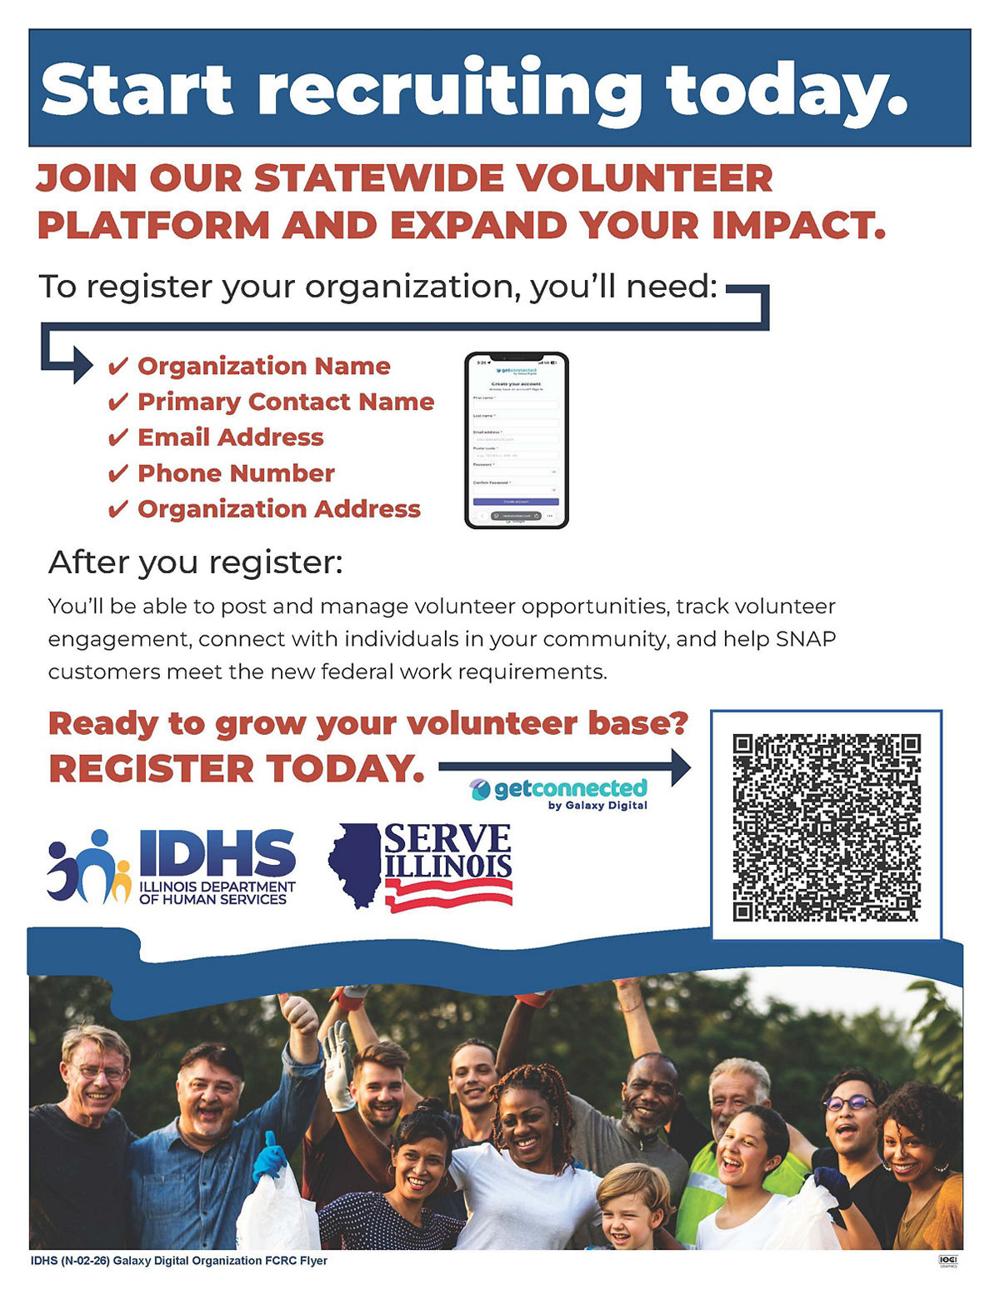
Expanding Volunteer Opportunities for SNAP Recipients

Slide 20

Additional Opportunity to Support ABAWDs: SNAP E&T Expansion
Through our intermediary National Able, IDHS is expanding SNAP E&T access statewide!
Adding subcontracted SNAP E&T providers:
  Non-federal funding sources (e.g., state, local, philanthropic) and/or CDBG that can be leveraged for Federal 50 percent reimbursement of allowable expenses.
  Allowable activities
  Case management
  Supportive services
  Capacity to meet programmatic, fiscal, and record-keeping requirements.
Exploring co-enrollment

Slide 21

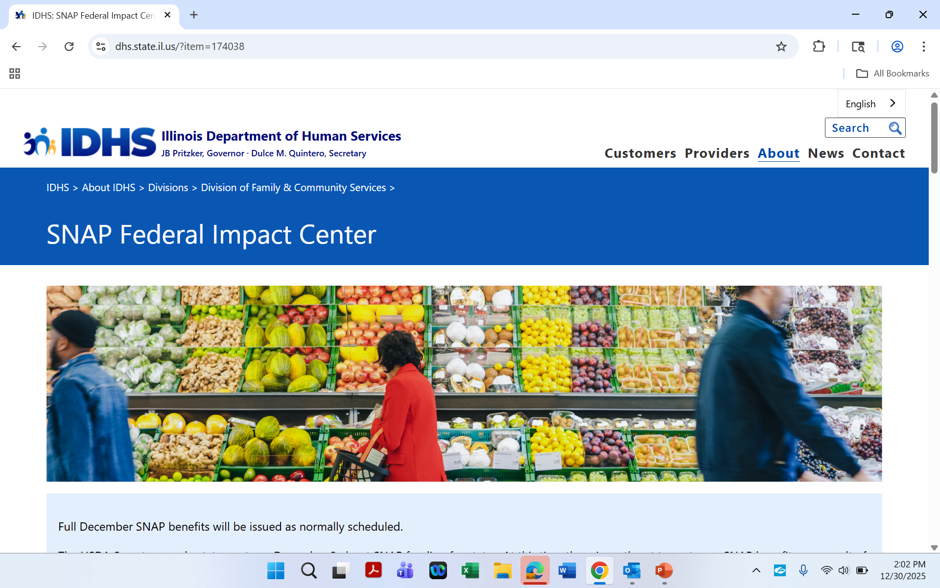
STAY
ENGAGED
SNAPfederalimpact.illinois.gov

