Slide 1

Introduction & Overview

Slide 2

Agenda
Work Requirements and the Origins of Job Ready IL
How the Program(s) Work
Call to Action and Next Steps

Slide 3
Work Requirements and SNAP
DHS landing page: SNAP Federal Impact Center
Feb 1, 2026 - Illinois lost its waiver and SNAP time limits kicked-in for ABAWDs
200,000+ people could lose benefits on May 1.
Work requirements are stricter, for example:
Workers age 54-65 are no longer exempt
Groups who used to be automatically exempt are not
ABAWDs need to meet work requirements by end of April, otherwise they fall off and it’s hard to get them back.

Slide 4
Illinois’ Three-Part Strategy
Maximize Exemptions
See Exemption Screener tools
Document/Encourage ABAWDs Meeting Requirement Through Work (Paid or Unpaid)
See guidance on documenting volunteer hours, work hours etc.
Increase “Qualifying Work Program Enrollment”
This is where Job Ready Illinois comes in

Slide 5
Qualifying Work Programs
The Governor (with IDHS/DCEO) set Illinois’ guidelines for Qualifying Work Programs for SNAP eligibility purposes
Pre-existing State and Local workforce programs are added to the list via an IDHS process and verification protocols are being set up
Job Ready Illinois is a companion solution
On the “Approved List”
Reach state-wide with “unlimited slots”

Slide 6
Origins of Job Ready Illinois
Idea originated with State of Illinois – an DCEO/IDHS partnership
Ownership (and funding) needed to be separated from both agencies
Foundations (CWFA, OWF) stepped in to further develop concept
The Innovation Nexus – ideal, pre-existing entity to host what needed to be a public/private partnership. The Nexus is hosted at Forefront

Slide 7
Main Landing Page
JobReadyIL.com
Simple landing page to make navigation easier
Basic information about Job Ready Illinois and work requirements
Includes links to IDHS and other help resources
Directs users to one of two content platforms based on geography

Slide 8
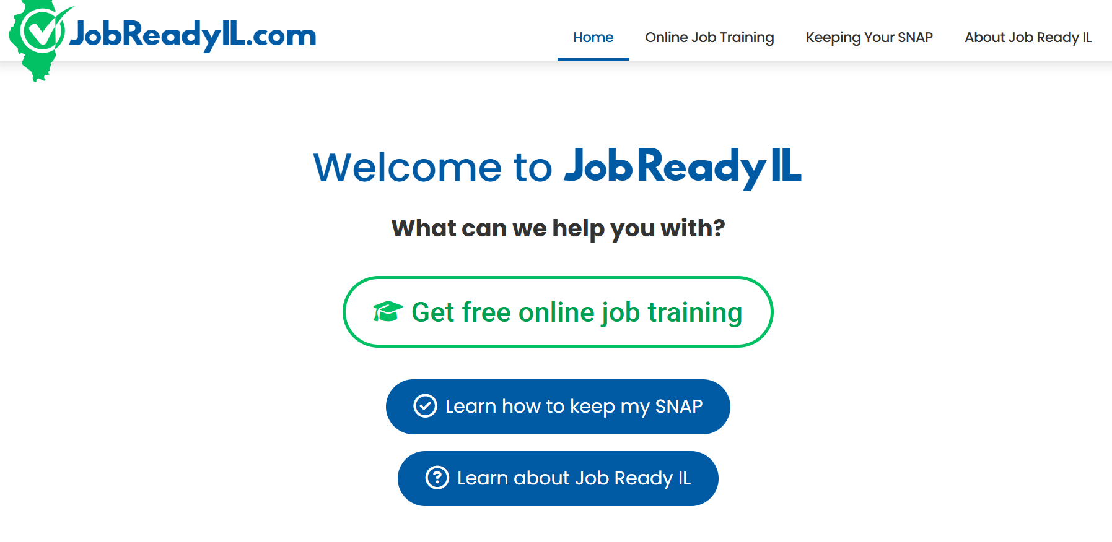
Main Landing Page

Slide 9
Primary Content Platform:
Customized LMS through Thinkific
Content presented in 20-hour units
Unit is 10+ hours of learning with independent job search for remaining time
Content provided by local workforce partners
Showcasing expertise and available resources in Illinois workforce system
Program certificate showing 20, 40, 60, or 80 hours of work
User must upload to My Case or deliver to FCRC
First two units are live with two more up by mid-April
Will continue to grow library over coming months

Slide 10
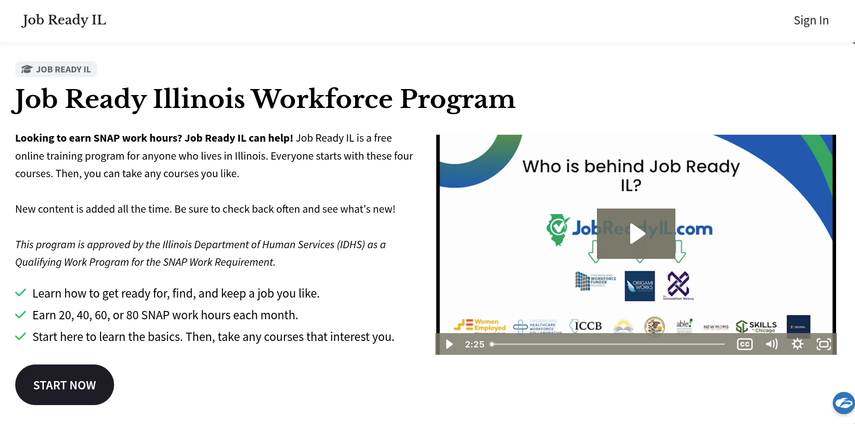
Primary Content Platform:
Customized LMS through Thinkific

Slide 11
Secondary Content Platform:
Metrix Learning
Risk management strategy, and opportunity for multiple options
Testing with up to 3000 users
Off-the-shelf content (7000 courses)
Multiple languages
Can print user activity report and submit to IDHS
Telephone, email, and online support available
Other features
Notes:
Some content available in Spanish and Chinese language
Subtitles available in many languages
Other features we are not highlighting at the moment - e.g., assessments and suggestions for courses

Slide 12
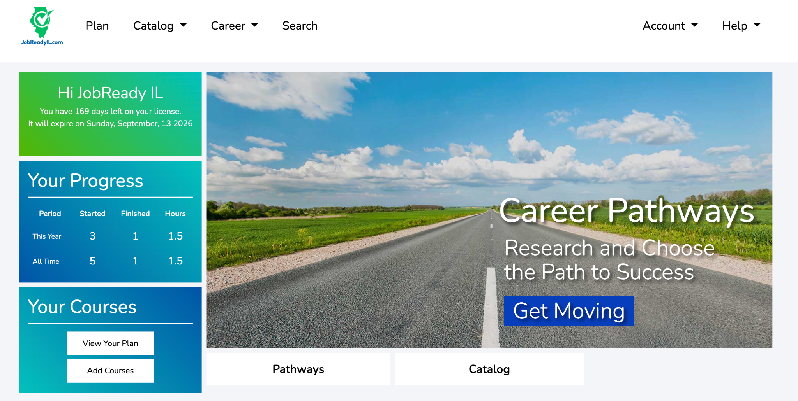
Secondary Content Platform:
Metrix Learning
Notes:
General job readiness (e.g., business etiquette, communication, effective emails)
Specific skill tracks (e.g., commercial driving, customer service)
Technology (e.g., Google apps, artificial intelligence)
Certifications (e.g., project management professional)
Manufacturing tracks available upon request

Slide 13
Metrix Learning: Types of Content
General job readiness
Specific skill tracks
Technology
Certifications
Manufacturing tracks available upon request
Notes:
General job readiness (e.g., business etiquette, communication, effective emails)
Specific skill tracks (e.g., commercial driving, customer service)
Technology (e.g., Google apps, artificial intelligence)
Certifications (e.g., project management professional)
Manufacturing tracks available upon request

Slide 14
Call to Action
Please join our communications partnership!
You will receive language and materials
Share feedback with partner@jobreadyil.com
Landing page
Thinkific Platform
Metrix platform (please request an account instead of self-registering)
Communications

Slide 15
Next Steps: 2026 and Beyond
Thinkific platform will continue to add content
Eventual review and evaluation of the two approaches
Sustainability Plan
Possible coordination with Resilient Chicago Fund
Working with State on Medicaid work requirements
Notes:
We are already communication with many stakeholders, AND -
Please share info with organizations likely to encounter SNAP recipients
We will send flyer and social media kit to those who registered for this webinar
Feel free to review the site; send feedback to partner@jobreadyil.com. This is a minimal viable product. We know there are issues, please do not be shy!
If you would like to review the Metrix learning platform, please email xxxx@origamiworks.org to request a temporary demo account (so we don’t use a license that could be allocated to a SNAP recipient).

Slide 16



Thank You!
Questions or Feedback?
Email: Partner@jobreadyil.com

