Slide 1

Reset to Success Foundation/Midwest Career source vocational school

Slide 2

About US
Established – 2012
Mission: uplifting our community by providing accessible, relevant career and technical education for youth and adults. We believe that true growth happens when education is supported by strong community connections. Through comprehensive wraparound services that include but are not limited to: childcare, transportation, housing support, and mental and emotional wellness—we strive to remove barriers and create pathways to lasting career success for every member of our community.
Located in Belleville
Service area (s): Southern Illinois Region
Approvals, IBHE, IDPH, DOL, VA

Slide 3

Staff
Registrar
Admission Support Specialist
Customer Support Specialist
Outreach Worker
Case Managers
Counselors
Psychologists
Information Technology Support
Faculty:
Registered Nurses, Lab Technicians,
English/Math Tutors

Slide 4

Enrollment
Open enrollment
Senior in high school on track to graduate
High School Diploma or HSE
Employer offer
Pass interview MCS and Employer
Pass pre-entrance test (TABE or CASA)

Slide 5
A few Partners
3 Hospital Systems (BJC, HSHS, American Health system)
7 Nursing Homes
1(one) High School District

Slide 6
Programs provided
Basic Nurse Assistant – 172 clock hours
Emergency Room Technician – 202 clock hours
Behavioral Health Technician – 202 clock hours
Phlebotomy – 160 clock hours
Clinical Medical Assistant – 424 clock hours
Introduction to Information Technology Course- 120 clock hours
Licensed Practical Nurse –1440 clock hours IBHE approved, pending IDFPR

Slide 7
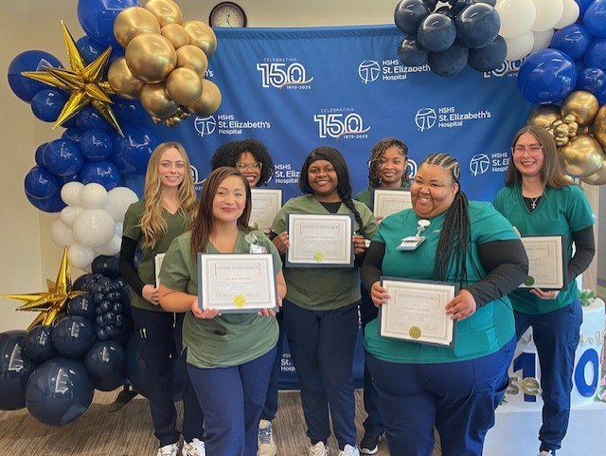
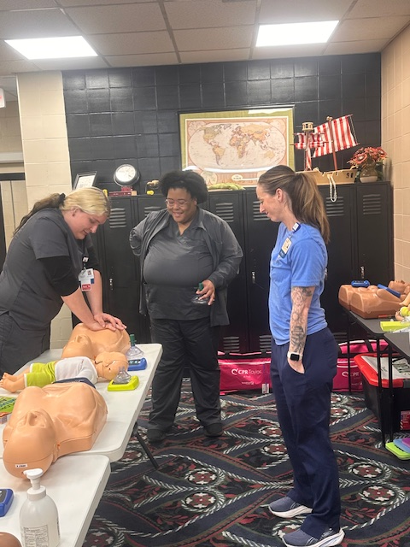
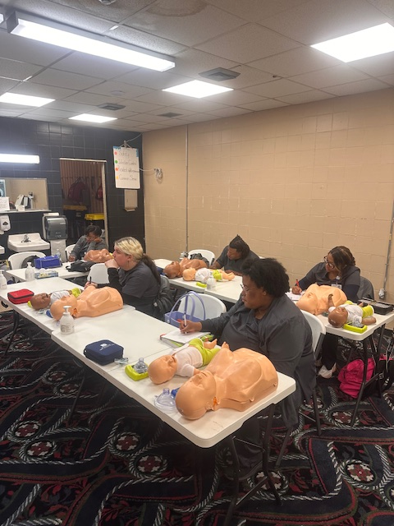
program strategy
It’s easy to get the job but it’s hard to keep it”
-student engagement/ success
- Team approach
-employer ENGAGEMENT

Slide 8
Student engagement
Individualized education plan
  One on one
  Daily Classroom Participation rubric
Employer rounding
Program Completion Award
  Highest GPA
  Perfect attendance
Dual Credentials
Career Guidance/Pathway

Slide 9
TEAM approach
One on one individual meetings while in training
3, 3 and 3
  Post training – 3rd day, 3rd week and 3rd month
Weekly Team meetings
Site visits (home or work place)
One year follow up

Slide 10
Employer Engagement
Custom training
Employers drive the cohort schedules
Job training programs added based on job vacancies
Case management model
Reimbursement for work- based learning hours
Bi-monthly Employer meetings

Slide 11
Teaching Methods/ styles/tools
--Hybrid
-Inperson
-Simulation (VR)
-Trauma informed CLASSROOM Instruction

Slide 12
Mental/Emotional/Trauma
Mental health continues to be a significant concern, with one in five U.S. adults experiencing mental illness annually.
Mental trauma has a high prevalence, with some data showing that over 60% of men and 50% of women have experienced a traumatic event in their lifetime,

Slide 13

trauma-informed classroom instruction
- Key components include recognizing trauma triggers,
-creating a learning environment,
-using various teaching styles and tools, offering choices to empower students, teaching self-regulation, and collaborating with families and mental health professionals
-focus on understanding how past trauma can affect behavior and learning in the classroom, rather than solely focusing on disciplinary actions.
-Key elements include giving students clear expectations, consistent routines, and strategies to help students manage stress and regulate emotions.

Slide 14
trauma-informed classroom instruction (continued)
Based on the feedback provided by the Psychologist or Counselor from one or ones, or case management meetings:
-Faculty members are provided the teaching strategies for the student,
-example, be observant, monitor non- verbals, posture- give break time, use a different teaching method.

Slide 15
Top barriers to training & employment
1) Homelessness
Child-care
Transportation
Literacy- Reading/Writing
2) Attendance: Tardies, Absences related to:
3) Low entrance scores related to:
Time management
5) Training Supplies-Uniforms
4) Mental/Emotional/Trauma- anxiety, depression

Slide 16
Supportive services
Transportation
Rental Assistance
Child-care
Training supplies
Career guidance
Coaching
Counseling
Financial Planning
Tutoring
Employer transportation stipend

Slide 17
Program Completion Rate 95%
Program Completion 90%
Employment Retention Rate 75%
State Exam pass rate 98%
Employed 100%
Performance
Outcome Metrics

Slide 18
FOCUS areas
Job retention
Employee Surveys:
Top reasons impacting job retention:
  transportation
  child-care (night shifts)
Plan – Team meeting with local Agencies
  Meeting with Employer Partners

Slide 19


Annual “Dancing for healthcare Gala” fundraiser

Slide 20

Thank you
Illinois department of commerce & Economic Opportunity!!!!!
“We are more than what you see!!!!”
Ronald Caradine, PhD, President
Sulbrena Day, RN, MSN, PhD, Administrator
Arnissa O’Bannon, RN, MBA, Executive Director
www.midwestcareersource.com
Office: 618-213-6539
https://www.ksdk.com/video/sponsor-story/sponsored-midwest-career-source-gears-up-for-gala-to-support-healthcare-education-programs/63-b741bd23-e1be-449c-a89d-0c91e6d9e94f

