Slide 1

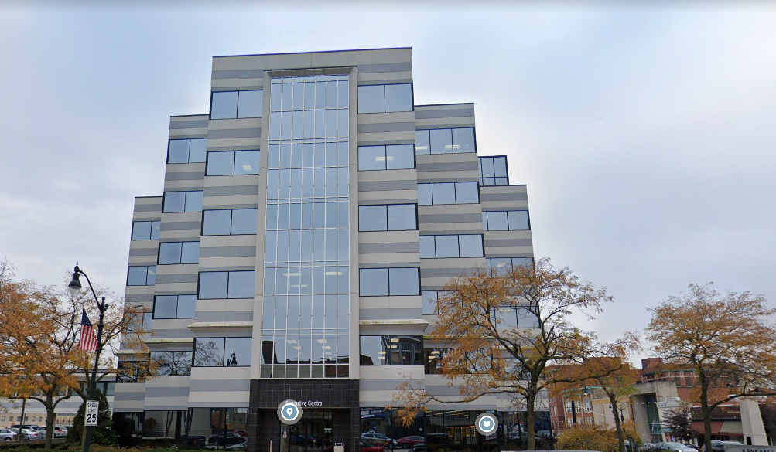
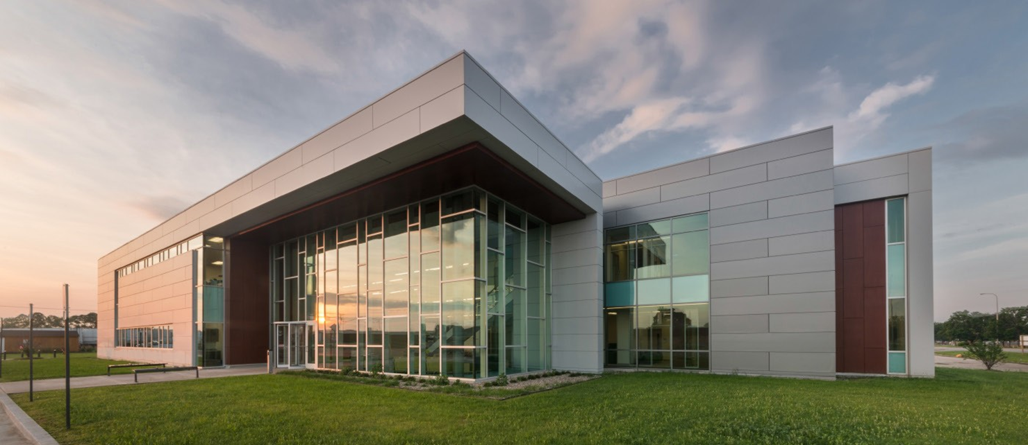


County of Kankakee: JTED Program

Slide 2

What is Workforce Board?
Kankakee County – Fiscal agent
Mission: Enhance workforce quality to meet regional needs
Provides administrative oversight to the federal Workforce Innovation & Opportunity Act (WIOA) funds.
Provides strategic planning/programs to workforce community
Creating talent pipeline programs: Trades Career Fair, Employer Wage Survey, High school presentations/events
Job fairs
Working with employers
Incumbent Worker Training
Partnerships
Funds tri county Workforce Services office

Slide 3

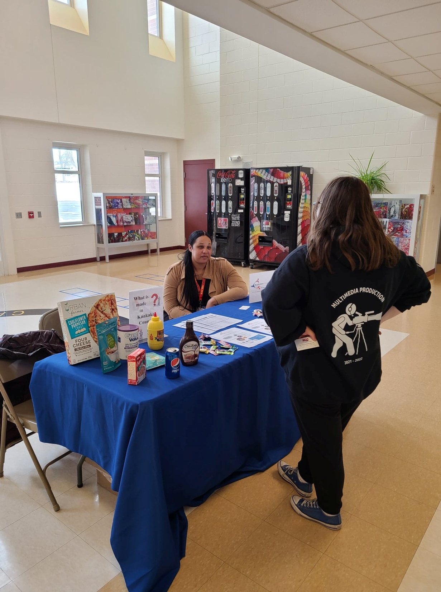
What is Kankakee Workforce Services?
American Job Center/Illinois workNet Center (One Stop)
Open to anyone: individuals & employers
Provided career services to 2,000 to individuals
Community resource for workforce services
Workshops/Job Readiness
Internships/Work Experience
Training
Community Partnerships
Outreach
WIOA Service Provider

Slide 4

How does Kankakee Workforce Services make a difference?
Act II
Amecia Morgan was laid off when local employer McKesson closed in 2024. She was unable to find another job that provided a livable wage due to a lack of education. While receiving unemployment benefits, Amecia attended an unemployment workshop, where she heard about the WIOA program and the opportunity for a scholarship to help further her education for a career she always wanted.
In high school, Amecia dreamed of becoming a nurse, but she’d never taken the necessary steps to pursue that career. The loss of her job and the WIOA scholarship opportunity influenced her decision to enroll in Kankakee Community College’s LPN program. She started taking classes during the summer term of 2024 and graduated in July 2025 with an advanced certificate in Practical Nursing. Amecia graduated with a 3.6 GPA.
WIOA paid for Amecia’s tuition and reimbursed her for gas, uniform scrubs, a stethoscope and other supplies required by the nursing program.
While recalling how WIOA helped her, Amecia stated, “WIOA saved my life”. She described the devastation she felt after losing her job and expressed great appreciation for the scholarship, and her career planner, Benjamin Miller. “I could always reach out to Ben with a question or request and he was on it, right away. He’s amazing!”
Amecia is continuing her studies in healthcare by pursuing the Registered Nursing (RN) degree. Her ultimate career goal is to work in forensics as a psychiatric nurse.

Slide 5
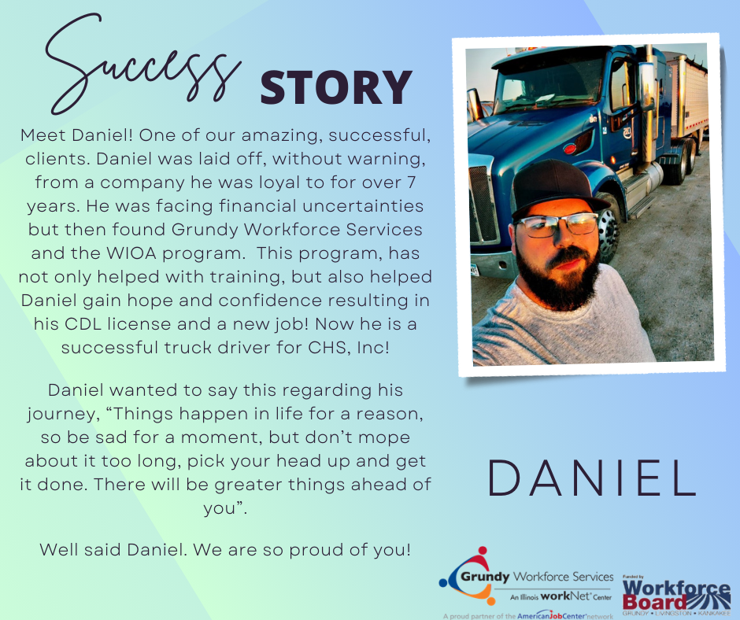

How does Kankakee Workforce Services make a difference?

Slide 6











Employer Services
Current employee training
Paid work experience
Recruiting Talent
Job postings
Job Fairs
Expand labor market: returning citizens, individuals with disabilities, Spanish speaking
Work Opportunity Tax Credit/Fidelity Bonding
Labor Market Information

Slide 7
JTED Program
Scope of Work
Target Population is youth ages 16 – 24 especially in rural populations, and returning citizens.
ESL for High School Students
Post Secondary Training in Manufacturing & IT Sectors
Supportive Services
Barrier Reduction Services
Paid work experience through WIOA

Slide 8
Recruitment
School Districts
Kankakee Workforce Service offices
(Illinois WorkNet Center)
Kankakee Community College
Social Media
Billboards
Probation/Kankakee Rentry Program
Word of mouth

Slide 9


ESL for High School Students
Kankakee High School presented need to community college
Current ESL funding can’t serve high school students. Skills gap
JTED perfect fit
KCC worked with school district to create program
ESL program is dual credit program so students earn both high school & community college credit. Win win!
Program started September 8th
4 enrolled with planned number of 8

Slide 10
Post Secondary Training in Manufacturing & IT Sectors
Manufacturing & IT sector growth sectors: Gotion
Stackable Credentials throughout programs:
IT credentials offered include CompTIA ITF+, CompTIA A+ Core 1 of 2, CompTIA A + Core 1 of 2, CompTIA Network+, uCertify, Oracle Certified Associate (OCA), Oracle Certified Associate (OSA), Certified Interactive Web Developer (CIW). In addition, youth could earn community college certificate and associate degree programs.
Manufacturing credentials include MSSC Certified Production Technician, OHSA 10, and American Welding Society (AWS) certification. In addition, the community college program design is to obtain community college certificates with as low as 15 credit hours to an Associate’s degree. Thus, program is designed for stackable credentials with exit and entrance points.
Currently 10 youth enrolled vs 25 planned
9 youth manufacturing
1 youth IT
Working closely with KCC
Supportive Services: books, training supplies,
laptops, travel, emergency grant

Slide 11
Let’s Talk about Positive & Challenges
Positive
WIOA Career Planner is also JTED Career Planner.
Familiar with assessments, creating career planners, eligibility, documentation, etc.
Knows how to pivot to ensure grant success
WIOA forms/processes in place so didn’t need to create anything
Supportive Service policy already established
Community partnerships established
ESL at high school is fulfilling an identified need within community
Training scholarships/creating the talent pipeline
Challenges
Received DCEO grant in December so missed enrollment for Spring 2025
YOUTH!
Completing paperwork/application/testing
Contacts within community partnerships changed, i.e. Kankakee High School principal
Community College/School district is training providers so invoices/bills aren’t received till later in semester.

Slide 12


Contact Info:
Ladonna Russell
Executive Director
Workforce Board
200 E. Court Street, #506
Kankakee, IL 60901
815-935-0074
lrussell@glkwb.com
Keisha Smith
Director of Workforce Services
Kankakee Workforce Services
450 N. Bradley Blvd
Bradley, IL 60915
815-802-8960
ksmith@kcc.edu
https://wioa.kcc.edu

