Slide 1
JTED Grantees PBVS Requirement

Slide 2
AGENDA
Introduction
Collaboration between DCEO and IBHE
Private Business Vocational School Overview
Application Requirements
Allowable Activities Pending Application Approval
Next Steps
Notes:
Housekeeping – recorded and sent out to everybody – potential partners have access.
Questions Nina – on PBVS
Regional Administrators – send the questions to Devon and Diana – programmatic questions only.

Slide 3
Collaboration
DCEO and IBHE are collaborating to prioritize applications for approvals
2 staff have been hired to support DCEO workforce programs
IBHE/DCEO will be available for questions and technical assistance during the application process
Notes:
Here is what we are doing.
Background and context – been around for a while
We have invited our partner IBHE here today to introduce you to their team and have them go over the process.

Slide 4
PBVS
Private Business and Vocational School
Any entity offering programs of study and/or courses in Illinois that prepares individuals for
a trade, occupation, vocation, profession, or
improves, enhances or adds to skills and abilities related to occupational/career opportunities
Notes:
Kicking to Nina
Mention here why PBVS – consumer protection
A program of study is a series/sequence of courses that must be taken to complete training
A Course of Instruction may directly prepare students for a certificate or other completion credential, or it can stand alone as an optional preparation or, in the case of students requiring catch-up work, a prerequisite for a program
A stand-alone course might lead to a credential to be used toward preparing individuals for a trade, occupation, vocation, or profession, or it might improve, enhance or add to skills and abilities related to occupational/career opportunities

Slide 5
Approval Requirement
The PBVS Act of 2012 (Section 30) and the Administrative Rules (Section 1095.20) detail the types of institutions and programs required to receive approval from the PBVS Division of the Illinois Board of Higher Education (IBHE)
No person or groups of persons subject to the Act and this Part may establish and operate or be permitted to become incorporated for the purpose of operating a private business and vocational school without obtaining from the Board a permit of approval, provided that a permit of approval is not required for a program that is devoted entirely to religion or theology or a program offered by an institution operating under the authority of the Private College Act [110 ILCS 1005], the Academic Degree Act [110 ILCS 1010], or the Board of Higher Education Act [110 ILCS 205] (Section 20 of the Act)
Notes:
Give examples of who is included: "Educational institution" or "institution" means an organization that promotes business and vocational education, even though the institution's principal effort may not be exclusively educational in nature. (Section 15 of the Act)
Even if the lead organization is exempt the other providers must be approved if they meet the definition.

Slide 6
Exemptions
Permitted under Section 30:
Religious or theological institutions
Employer-provided in-service education without tuition charges
Accredited educational institutions that meet specified criteria
Income tax courses under specified conditions
Sale of mediated instruction products without credentials
Out-of-state entities offering education under certain conditions
Approved schools adding courses related to existing programs
8. Organizations that receive funding for CEJA and Illinois Works
Labor Organizations with USDOL Registered Apprenticeship Programs
Notes:
The PBVS Act of 2012 (Section 30) and the Administrative Rules (Section 1095.20) detail the types of institutions and/or programs which are exempt. If you believe your institution qualifies for an exemption, the Exemption Application must be completed and submitted for review. An analyst reviews and analyzes the submitted information to determine if the request is approved or denied.
Note: Denial of an Exemption Application may result in the requirement to submit Permit of Approval and New Program of Study applications.

Slide 7
Submitting Changes
An entity must apply to IBHE relative to the PBVS Act of 2012 when
seeking to operate in Illinois
offer programs/courses of study in Illinois
add an extension site
change ownership of the institution
relocate the main campus
make changes to a program or the institution or
to be declared exempt from IBHE oversight

Slide 8
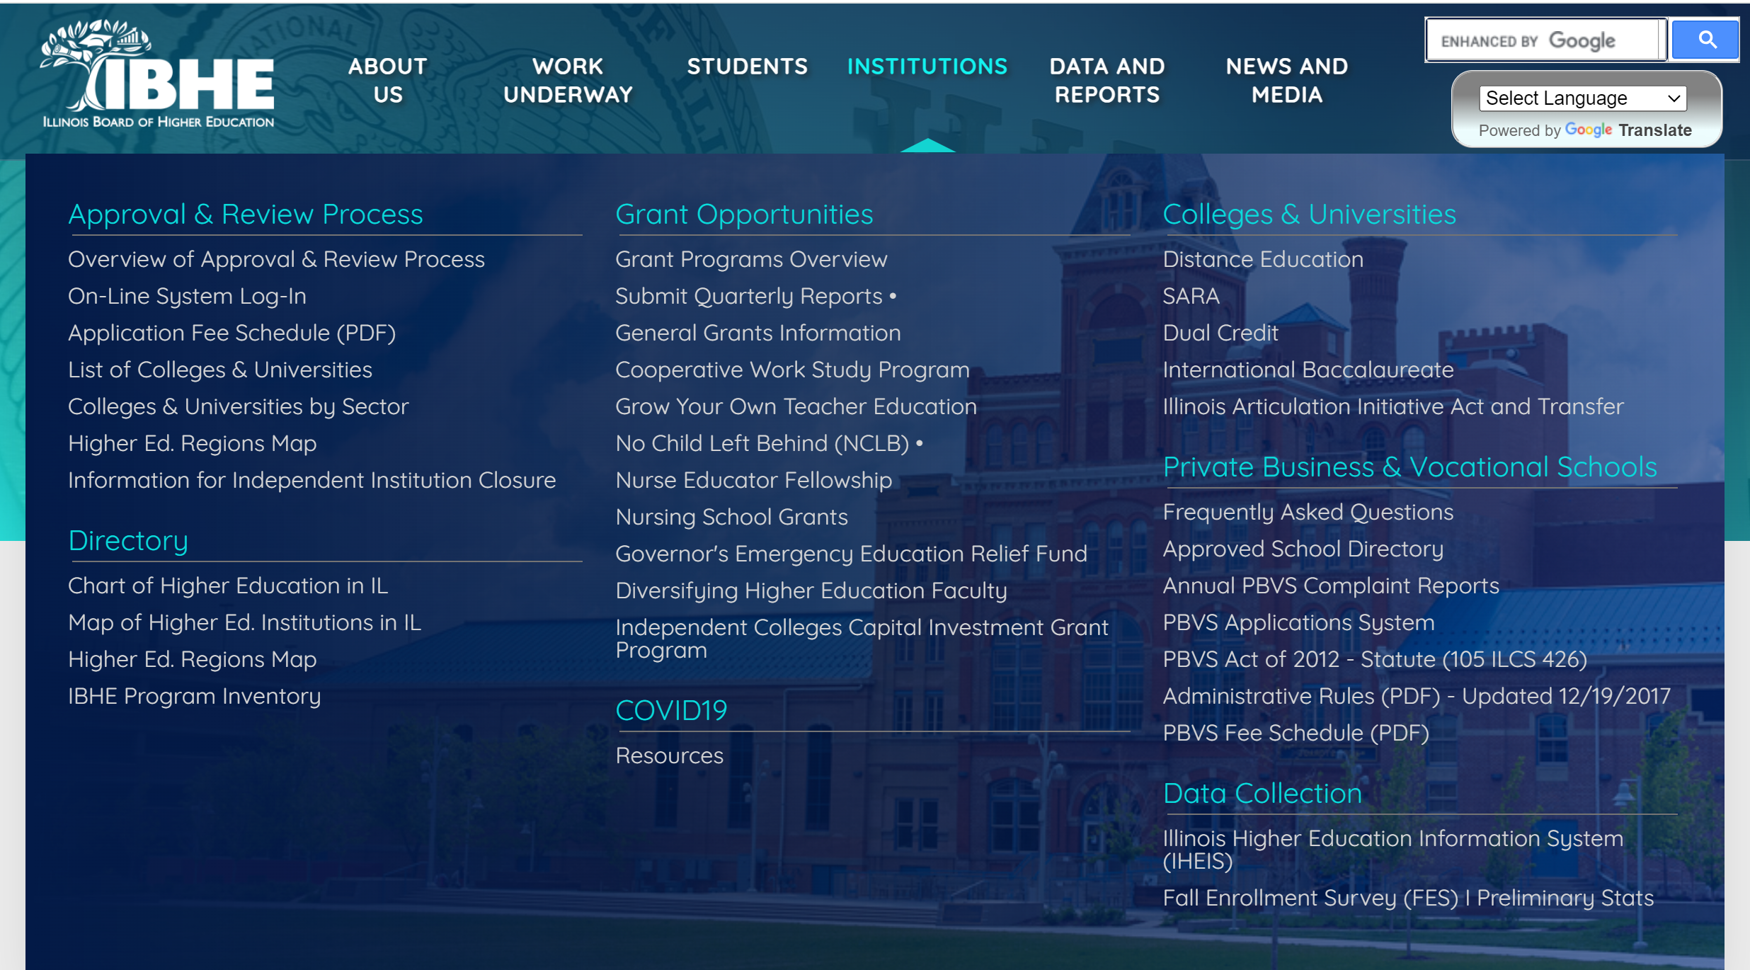
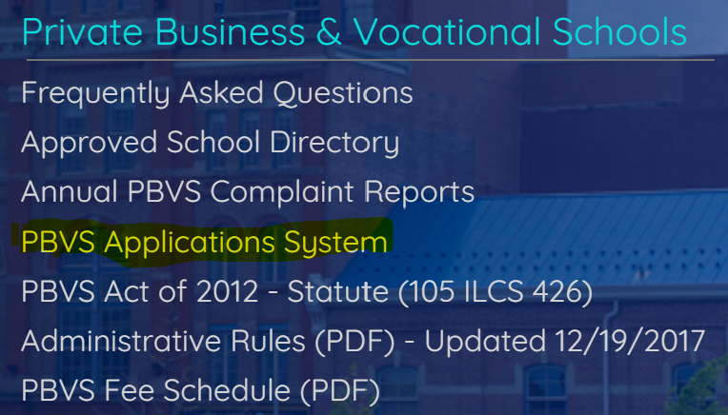
Where is the application?

Slide 9
Application Process
Two-part process
A Permit of Approval (application) for the school
An application for each New Program of Study for each program or course of instruction offered
There is a fee that must be submitted for each part

Slide 10
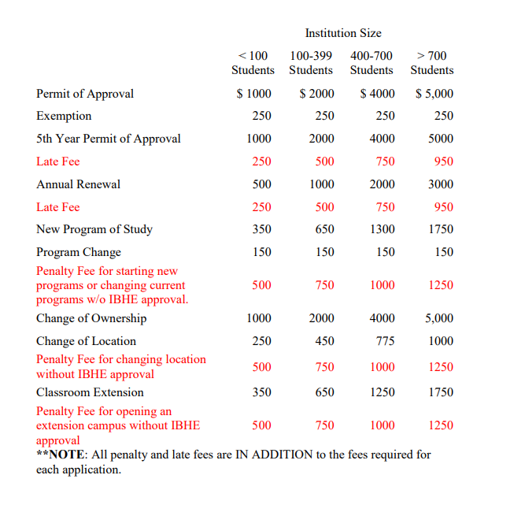
FEES

Slide 11
Application Components
In addition to institutional and financial details, examples of what will be required in the application include:
Program of Study/ Courses
Description
Admission Criteria
Program Length
Credentials Offered
Admission/Enrollment
Enrollment Agreement
Academic Catalog
Complaint Policy
Cancellation Policy
Academic Calendar
Facilities and Resources
Facilities and equipment
Staff Qualifications
Recruiting Practices
Surety Bond
Liability Insurance

Slide 12
Approval Review
While the application is under review, programs may begin planning and the initial implementation phase.
Z
Outreach and recruitment
Application & intake
Barrier reduction services
Orientation
Career Awareness & Bridge Program

Slide 13
Approval Review
Organizations and programs that already have approval to operate as a PBVS by the Illinois Board of Higher Education (IBHE) can enroll job seekers in the training program without delay.
Organizations and programs not approved by IBHE to operate as a PBVS will need to await PBVS application approval before enrolling job seekers in the training program.

