Slide 1


Grantee Reporting System (GRS)
Illinois Department of Commerce and Economic Opportunity

Slide 2
ECRF.gov
The Electronic Code of Federal Regulations that is a continuously updated online version of the CFR.
https://www.ecfr.gov/current/title-2/subtitle-A/chapter-II/part-200?toc=1

Slide 3
General Requirements-Reasonable Costs §200.404
A cost is reasonable if, in its nature and amount, it does not exceed that which would be incurred by a prudent person under the circumstances prevailing at the time the decision was made to incur cost. The question of reasonableness is particularly important when the non-Federal entity is predominantly federally-funded. In determining reasonableness of a given cost, consideration must be given to:
  Whether the cost is of a type generally recognized as ordinary and necessary for the operation of the non-Federal entity or the proper and efficient performance of the Federal award
  Market prices for comparable goods or services for the geographic area
  Whether the individuals concerned acted with prudence in the circumstances considering their responsibilities to the non-Federal entity, its employees, where applicable its students or membership, the public at large, and the Federal government
  Whether the non-Federal entity significantly deviates from its established practices and policies regarding the incurrence of costs, which may unjustifiably increase the Federal award’s cost

Slide 4
General Requirements Allowable Costs §200.403
Factors affecting allowability of costs:
  Be necessary and reasonable for the performance of the Federal award and be allocable under the Federal Cost Principles
  Conform to any limitations or exclusions set forth in these principles or in the Federal award as to types pr amount of cost items
  Be consistent with policies and procedures that apply uniformly to both federally-financed and other activities of the non-Federally entity
  Be determined in accordance with generally accepted accounting principles (GAAP)
  Not be included as a cost or used to meet cost sharing or matching requirements of an y other federally financed program in either the current or a prior period
  Be adequately documented.

Slide 5
General Requirements Allocable Costs § 200.405
A cost is allocable to a particular Federal award or other cost objective if the goods or services involved are chargeable or assignable to that Federal award or cost objective on accordance with relative benefits received. This standard is met if the cost:
  Is incurred specifically for the Federal award;
  Benefits both the Federal award and other work of the non-Federal entity and can be distributed in proportions that may be approximated using reasonable methods; and
  Is necessary to overall operation of the non0Federal entity and is assignable in part to the Federal award in accordance with the principles in this subpart.
All activities which benefit from the non-Federal entity’s indirect (F&A) cost, including unallowable activities and donated services by the non-Federal entity or third parties, will receive an appropriate allocation of indirect costs.

Slide 6
Budget Expenditures Categories (Operating Grant)
Occupancy – costs of renting/maintaining a building and utilities needed to carry out award
Research and Development – costs toward the innovation, introduction , and improvement of products and services
Telecommunications – costs incurred for telecommunications and video surveillances services or equipment such as phones, internet, and cloud services
Training and Education – costs incurred for training and education provided for employee development
Direct Administration – costs that can be identified specifically with a particular final cost objective
Miscellaneous - costs that do not fall under into any category listed; be specific!
Direct Training – costs incurred for training leading to jobs in demand occupations
Work Based Training – include on-the-training, customized training, work experience/internships, transition jobs, and incumbent worker training
Other Program – costs related to providing services to participants
Indirect Costs – costs associated with carrying out the project or award that cannot be specifically assigned

Slide 7
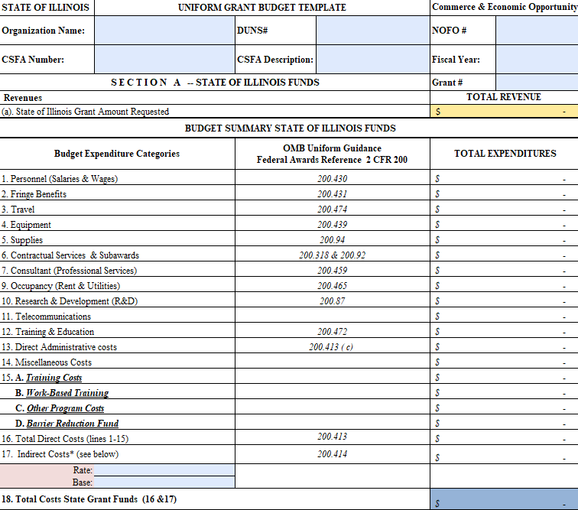
Uniform Budget Template (Section A)

Slide 8
General Information
Welcome to the Illinois Department of Commerce and Economic Opportunity Grantee Reporting System (GRS).
This is an electronic reporting system consisting of several screens accessible by grantees for the electronic entry of costs, obligations, miscellaneous receipts, disbursements, and cash requests.

Slide 9
Requesting System Access
Illinois Department of Commerce and Economic Opportunity

Slide 10
Grantee Reporting System (GRS) Access
Authorized grantee contacts that access GRS must complete a External Access Request Form
REQUIRED ITEMS: Application Date, Access Requested For, Phone Number, Work Address, City, State, Zip, Email, Applicant Signature, Date

Slide 12
DCEO Grant Information
DCEO Address Information
  Department of Commerce and Economic Opportunity
  1011 S 2nd Street
  Springfield, IL 62704
Grant Manager Contact Information
  See Grant Agreement

Slide 13
Grantee Reporting System (GRS) Access
NOTE: The person assigned to the ID should be the person who will be accessing the system to report expenditures and request cash
Once this form is complete and signed, please email to your grant manager

Slide 14
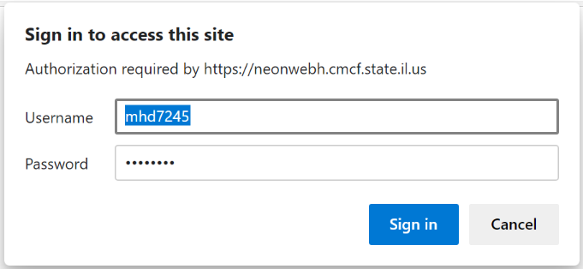
Accessing GRS
https://neonwebh.cmcf.state.il.us/dceo/costrpt
  You MUST use Google Chrome, Edge, or Firefox
Enter your username (RACF ID) and password and select Sign in

Slide 15
Grantee Reporting System (GRS) Access
Password Reset
  “Please reset the password for RACF ID___. I am an OET Grantee who needs access to the GRS.”
  CEO.RACFSecurity@Illinois.gov

Slide 16
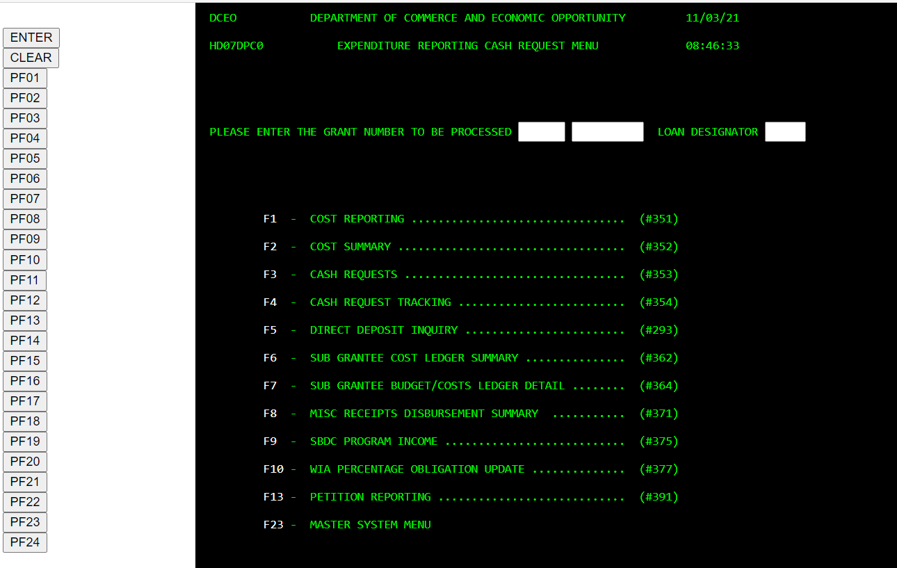
Accessing GRS

Slide 17
Accessing GRS
From this point on, you will be using only the navigation buttons on the left side of your screen. The <PF> buttons on your keyboard will not function properly in the website.
You will not utilize the following menu items from your grant
  F9 – SBDC Program Income #375
  F11 – Petition Reporting #391
  F23 – Master System Menu

Slide 18
Expenditure Reporting
Illinois Department of Commerce and Economic Opportunity

Slide 19
Expenditure Reporting Requirements
DCEO requires grantees to report grant expenditures monthly
Grantees must use the GRS to report costs
Note that grantees may report costs more than once a month
Grant costs that are reported in GRS must “tie back” to the grantee’s accounting system.
Grantees must maintain supporting documentation for all costs reported. This will be monitored.

Slide 20
Expenditure Reporting Deadlines
Expenditures for each month must be entered into GRS by the 20th of the following month.
For example, all active grants right now have the deadline of November 20th to complete their expenditure reporting for the month of October.
If the 20th of the month is on a Saturday or Sunday, the expenditures must be reported by the last business day prior to the 20th.

Slide 21
Reporting Costs #351 (PF01)
Enter your grant number at the top of the screen. The first box is for the first two digits of the grant number and the second box is for the other six digits of the grant number
Click the <PF01> button to go to Expenditure Reporting Screen

Slide 22
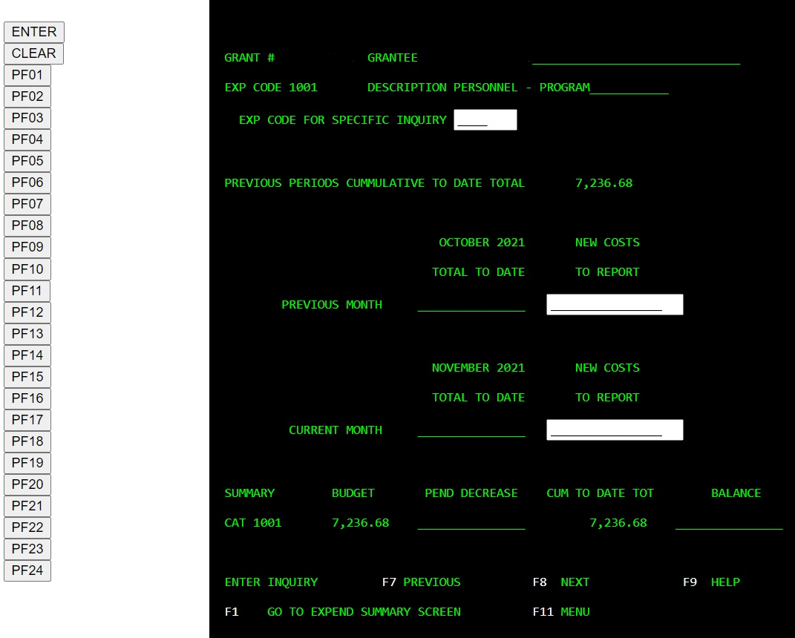
Reporting Costs #351
Ensure the correct expenditure code and description are selected on the screen
If it is not the correct code, you can either scroll using <PF08> until you see the correct code/description or enter the specific expenditure code in the box and press the <enter> button
Determine the month that you are reporting expenditures

Slide 23
Reporting Costs #351
3) Enter the expenditure on the appropriate line
To enter expenditures on another expenditure code, scroll to the desired expenditure code/description
If summary entry is complete, click the <PF01> button to transfer to the Expenditure Summary Screen
Notes:
You must enter the decimal place and cents when entering expenditures. If you do not, the system will place the decimal point in the entry
To reduce expenditures or adjust an incorrect entry, enter the amount followed by a minus sign

Slide 24
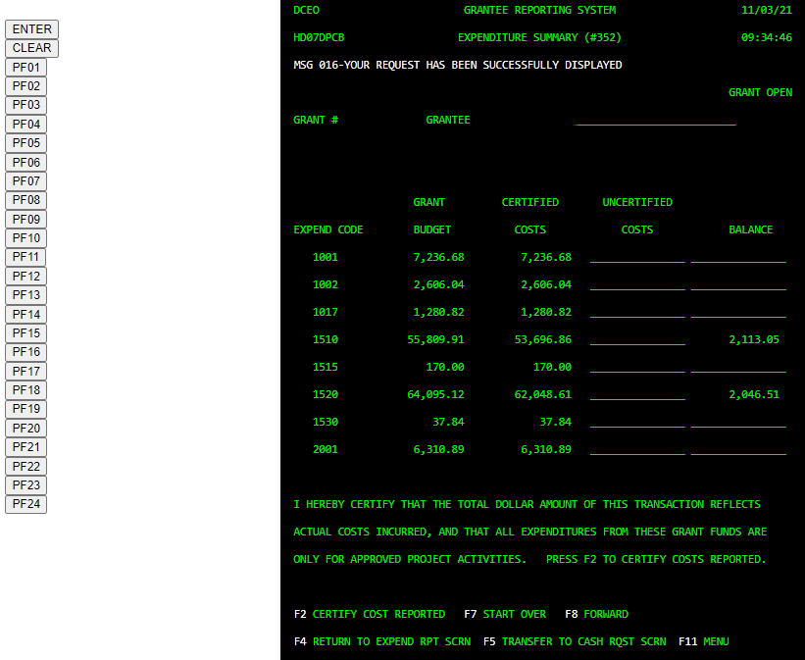
Expenditure Summary #352
Verify the expenditures in the “uncertified costs” column are correctly entered
If they are correct, click the <PF02> button to certify the expenditures. This moves the expenditures into the “Certified Costs” column
If costs are not entered correctly, click the <PF04> button to return to the expenditure reporting screen and correct the entries
Once entries have been confirmed and certified, you may enter a cash request to reimburse for the expenditures entered by clicking <PF05> button

Slide 25
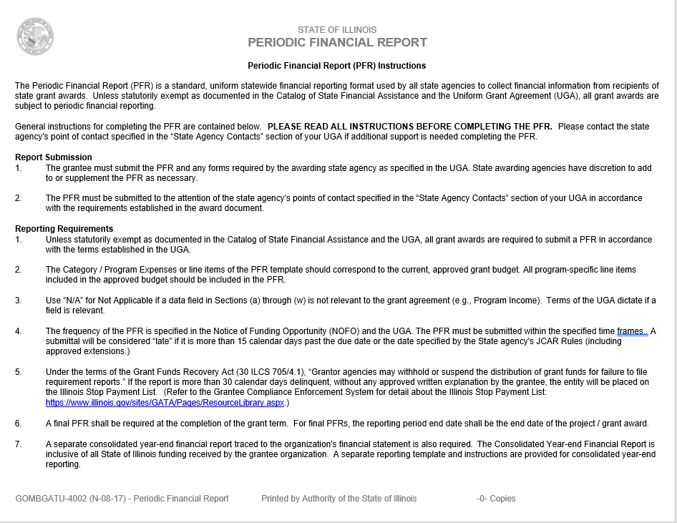
Periodic Financial Report (PFR)

Slide 26
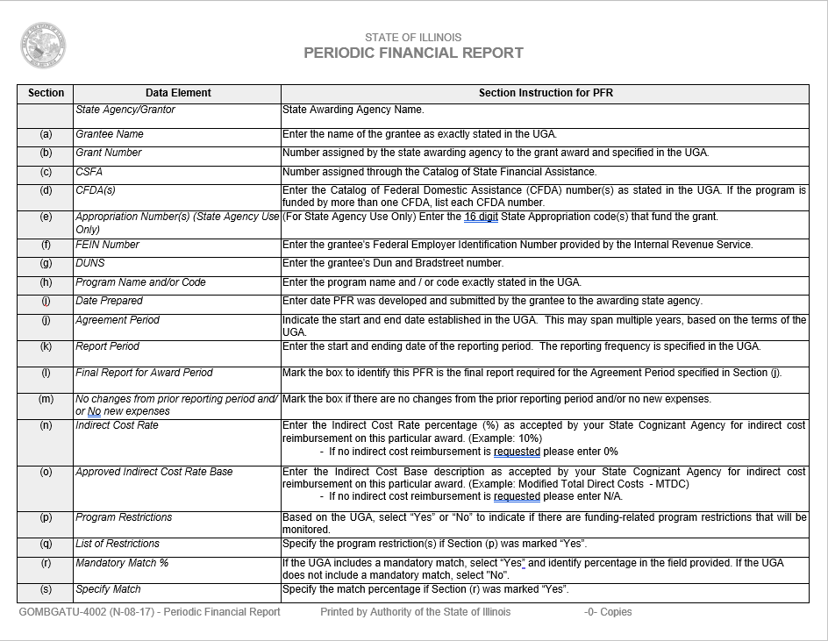
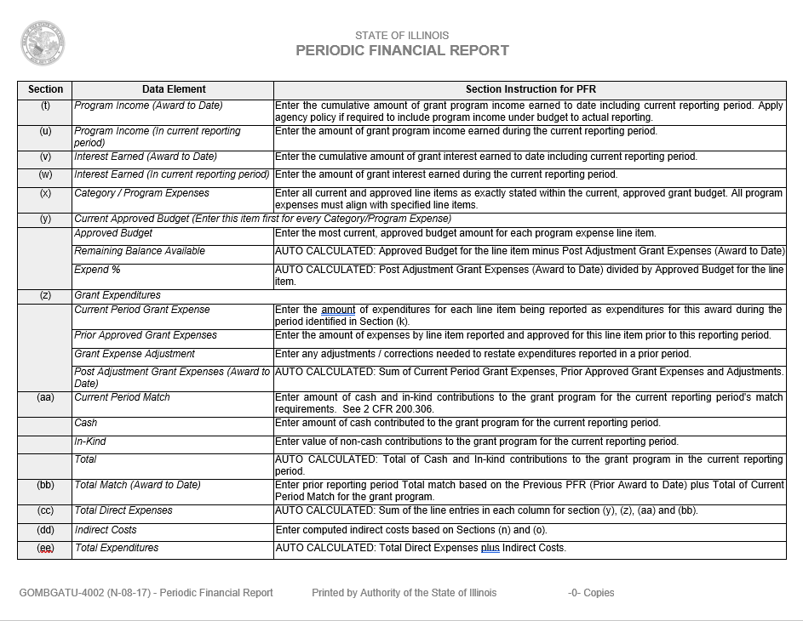
PFR-continued

Slide 27
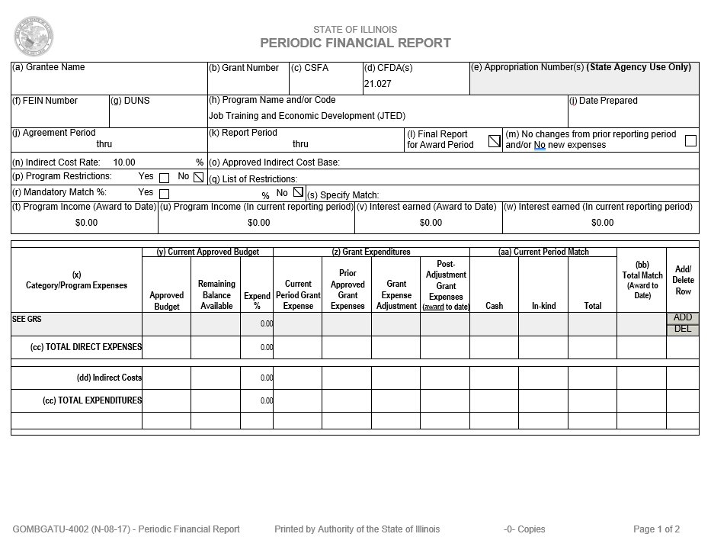
PFR-continued

Slide 28
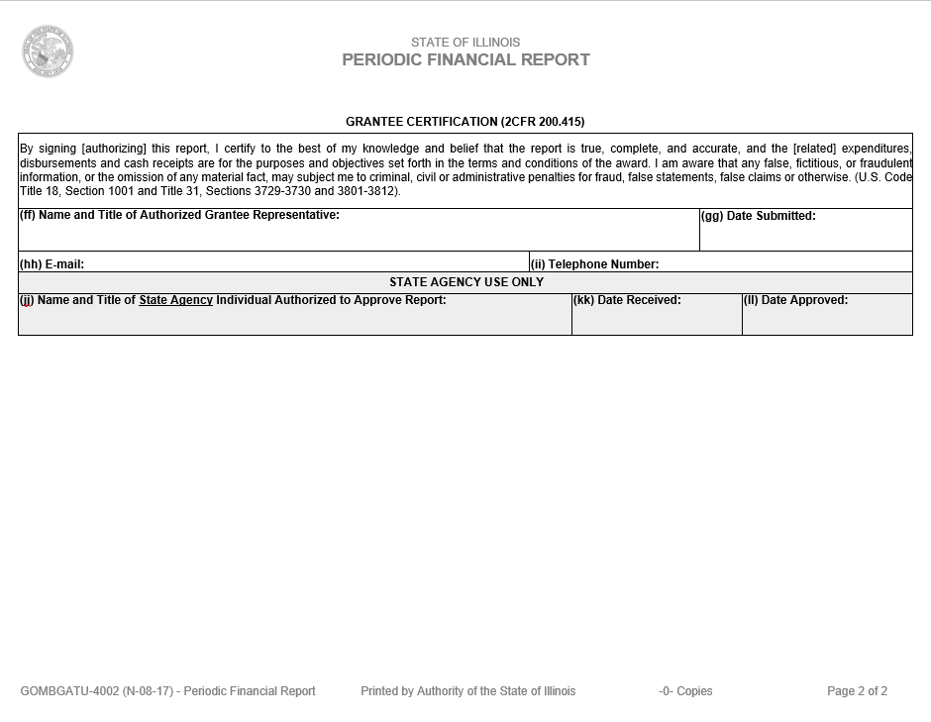
PFR - continued

Slide 29
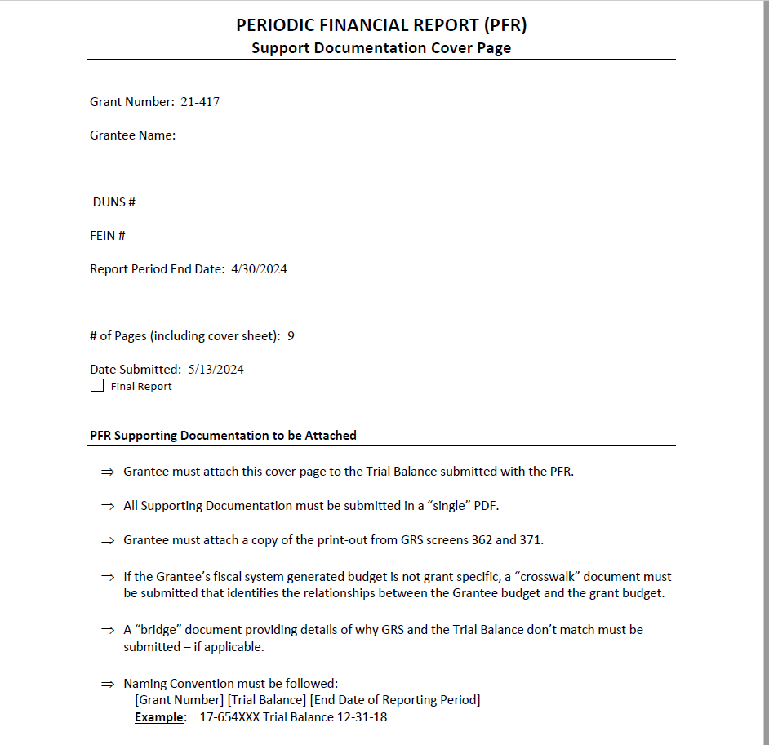
PFR – Support Documentation

Slide 30
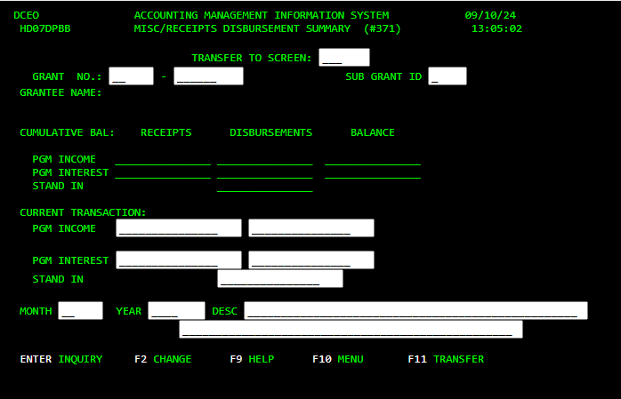
PFR – Support Documentation Continued

Slide 31
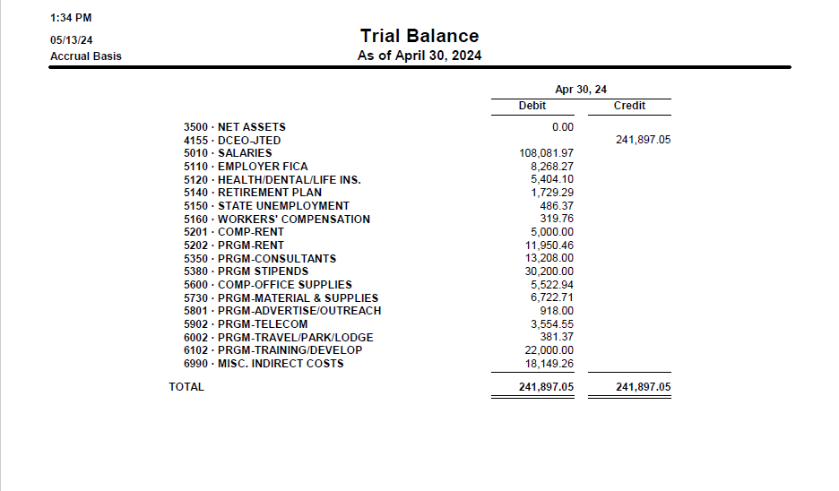
PFR – Support Documentation Continued

Slide 32
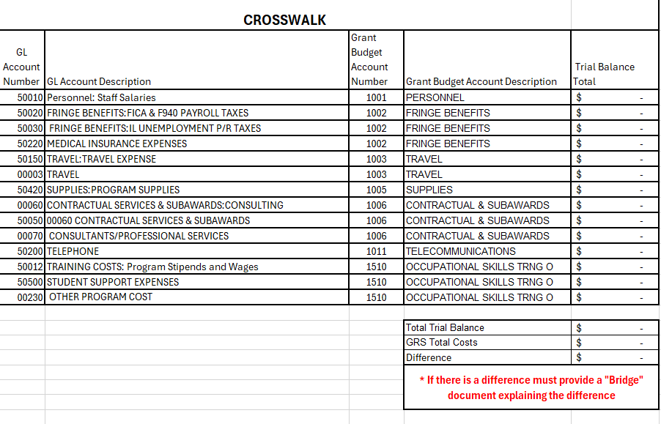
PFR – Support Documentation Continued

Slide 33
Grantee Fiscal Responsibility
October 17, 2024
Illinois Department of Commerce and Economic Opportunity

