Slide 1
HOME ILLINOIS JTED
Technical Assistance Call
Reset • Support • Illinois workNet Refresher
August 13, 2026
11:00 a.m.–12:00 p.m.
Office Hours: 12:00–12:30
DCEO Office of Employment & Training + OPEH + Illinois workNet
Notes:
Welcome everyone to the August 13 Home Illinois JTED Technical Assistance call.
Frame the call as a reset, not a restart. There is already strong work happening across the partnerships, and today begins a more consistent monthly cadence for support, questions, and shared learning.

Slide 2
Today’s Flow
Home Illinois JTED TA • August 13, 2026
A simple one-hour reset, followed by optional office hours.
11:00–11:08
Welcome + reset
Thank partners, reconnect DCEO/OPEH, set the tone.
11:08–11:15
Monthly TA relaunch
Explain cadence, office hours, and practical focus.
11:15–11:20
Illinois workNet setup
Introduce the pre-recorded walkthrough by David Garvey.
11:20–11:45
Recorded walkthrough
Enrollment, participant records, referrals, and system basics.
11:45–11:55
Partner questions
Capture system issues and follow-up needs.
11:55–12:00
Next steps
September preview, survey, toolkit, success stories.
12:00–12:30 p.m. Optional Office Hours
Stronger housing + workforce coordination around one participant
Notes:
Use this slide to ground the group in the hour. Be clear that the meeting is not meant to be overloaded.
The live portion is for framing, discussion, and questions. The Illinois workNet walkthrough is pre-recorded so all partners receive the same information and can reference it later.

Slide 3
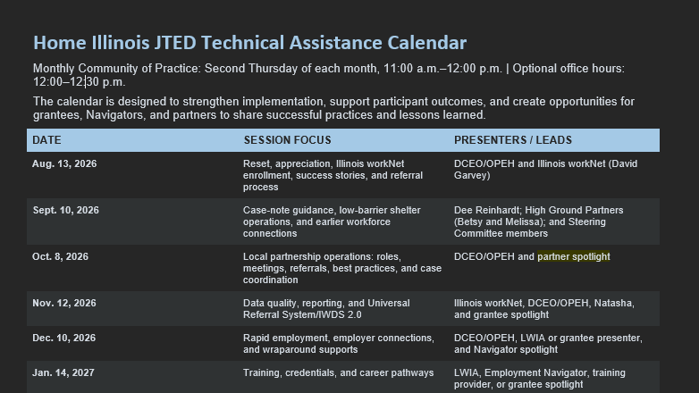

Slide 4
A Reset — Not a Restart
Home Illinois JTED TA • August 13, 2026
We are building from the work partners have already done.
There is already strong work happening.
Why reset now?
Year 3 gives us time to strengthen the model before closeout: referrals, data quality, employer engagement, participant stories, and sustainability.
• Participants are being connected to housing, employment, supportive services, training, and other resources.
• Local teams have built relationships, tested referral processes, and learned what works in different communities.
• The next step is consistent support, clearer communication, and a place to raise issues early.
The message to partners: We appreciate the work already done — and we want to support the next phase together.
Stronger housing + workforce coordination around one participant
Notes:
Thank partners for the work they have already put into the pilot. Acknowledge the work across systems, funding structures, case-management models, and reporting expectations.
Say clearly: today is a reset, not a restart. We are not dismissing the work that happened before. We are building on it with a stronger monthly cadence and more responsive technical assistance.

Slide 5
Partners at the Table
Home Illinois JTED TA • August 13, 2026
DCEO, OPEH, Illinois workNet, and regional partnerships each bring a different piece of the model.
DCEO
OPEH
Illinois workNet
• Workforce strategy
• LWIAs + AJCs
• Grant oversight
• Employment, training, credentials
• Illinois workNet reporting
Contacts:
Jarol- jarol.rendonjimenez@illinois.gov
Jennifer- jennifer.L.Sergent@illinois.gov
• Housing strategy
• CoC coordination
• Shelter + RRH perspective
• TA + learning community
• Housing stability lens
Contacts:
Shunta- Shunta.Mcgee@illinois.gov
Jeremy- Jeremy.Nichols@illinois.gov
Char- Char.Flickinger@illinois.gov
• David Garvey
• Recorded system refresher
• Enrollment + participant records
• Referral process
• Follow-up support
Contacts:
David- david.garvey@siu.edu
One participant. One coordinated partnership.
Housing stability creates the foundation for work. Employment creates a path to long-term stability.
Stronger housing + workforce coordination around one participant
Notes:
Use this slide to make the state partnership visible. DCEO brings the workforce side: LWIAs, AJCs, training, work experience, employer engagement, reporting, and grant implementation.
OPEH brings the housing side: CoCs, shelter and Rapid Rehousing perspective, housing stability, and learning community support.
Illinois workNet, represented through David Garvey for this session, supports the system functions partners need to enter participants, document activity, and track referrals.

Slide 6
Relaunching the Monthly TA Series
Home Illinois JTED TA • August 13, 2026
A practical space for support, partner learning, and problem-solving.
Cadence
What the calls should include
Second Thursday of each month
11:00 a.m.–12:00 p.m.
Office hours: 12:00–12:30 p.m.
• Focused technical assistance
• Partner questions and real challenges
• Grantee and Navigator success stories
• Examples of practices that are working
• Time to troubleshoot issues together
Field-driven
These sessions should reflect what LWIAs, CoCs, Employment Navigators, housing providers, and subgrantees are actually experiencing locally — not repeat broad program overviews.
Best-practice spotlights: 10–15 minutes when a partner has something others can learn from.
Stronger housing + workforce coordination around one participant
Notes:
Explain that this is not just another monthly meeting. It is meant to be a consistent support structure.
Emphasize that partners should bring real questions, real implementation challenges, success stories, and examples that could help other regions.
If a grantee or Navigator has a useful practice, we want them to present briefly in a future session.

Slide 7
What We Need From Partners
Home Illinois JTED TA • August 13, 2026
Document what is working, what is difficult, and what others can learn.
Please continue capturing:
• Participant successes
• Referral challenges
• Engagement + retention issues
• Training and employment outcomes
• Supportive services provided
• Employer successes or challenges
• Illinois workNet issues
• Lessons another region could use
Success stories matter.
They help us understand the participant’s starting point, the barriers addressed, the services provided, and what changed because housing and workforce partners worked together.
IL workNet add stories:
Success and Guide
Capture the story while the details are fresh — even if it is not ready for formal submission yet.
Stronger housing + workforce coordination around one participant
Notes:
Ask partners to continue documenting both successes and challenges. Stress that a challenge does not automatically mean someone has failed. It may show a process, system, or support gap that needs attention.
Emphasize success stories: success can be employment, a credential, training, reengagement, a barrier removed, or coordination that helped someone stay connected.
Remind partners that these stories will help build the Home Illinois toolkit and final lessons learned.

Slide 8
Illinois workNet Refresher
Home Illinois JTED TA • August 13, 2026
Pre-recorded walkthrough by David Garvey, Illinois workNet.
Why this is first
Recorded walkthrough focus:
Partners have asked for continued system support. We also want services happening locally to be reflected in Illinois workNet so the pilot’s full story is visible.
• Adding and enrolling participants
• Finding key participant information
• Current referral process
• Common functions Home Illinois staff should understand
Helpful links:
JTED Home Illinois Quick Start Guide
JTED Home IL - Intake & Referral Overview - 8/13/26
David Garvey
david.garvey@siu.edu
The recording is not the end of support. Partners can reach out to David for system questions, trainings, office hours, and troubleshooting.
Stronger housing + workforce coordination around one participant
Notes:
Introduce David Garvey and explain that he prepared a recorded walkthrough for this session. We are using a recording so partners have a consistent overview that can be referenced later.
State that David remains the primary Illinois workNet contact for Home Illinois system support. Partners can contact him at david.garvey@siu.edu for system questions, office hours, trainings, or other Illinois workNet-related issues.
Ask partners to copy DCEO and OPEH when appropriate, especially if the issue may affect more than one partnership.

Slide 9
Questions to Hold During the Recording
Home Illinois JTED TA • August 13, 2026
Think about your local workflow while watching the walkthrough.
Access
Do the right people on your team have Illinois workNet access?
Enrollment
Are all Home Illinois participants being entered consistently?
Referrals
Are referrals being documented and reaching the right partner?
Responsibility
Who enters services, notes, referrals, and outcomes locally?
Data
Do records match the services happening on the ground?
Follow-up
Are there system issues that keep coming up?
If we cannot answer a specific system question today, we will capture it and follow up with David and the Illinois workNet team.
Stronger housing + workforce coordination around one participant
Notes:
Before playing or after playing the recording, encourage partners to think about these questions.
Make it clear that we are not asking partners to solve everything during this call. We want to surface what needs follow-up and make sure the right support gets connected to the issue.

Slide 10
Next Steps After Today
Home Illinois JTED TA • August 13, 2026
Keep the momentum moving after the call.
Use the follow-up support
Document success stories
Reach out to David Garvey for Illinois workNet questions, trainings, office hours, or troubleshooting.
Capture participant, employer, and partnership stories while details are fresh.
Watch for Shunta’s survey
Join us September 10
Partner feedback will shape future TA sessions and the Home Illinois toolkit.
Case-note guidance with Dee Reinhardt, followed by low-barrier shelter operations and earlier workforce engagement.
Thank you for the work you are doing across housing, workforce, and community partnerships.
Stronger housing + workforce coordination around one participant
Notes:
Close by thanking partners for the work they are doing. Emphasize that DCEO and OPEH want the monthly sessions to be useful, practical, and honest.
Preview the September 10 session: Dee Reinhardt will lead case-note guidance, then the group will move into low-barrier shelter operations and earlier workforce engagement.
Invite partners to remain for optional office hours from 12:00 to 12:30.

Slide 11
Optional Office Hours
Home Illinois JTED TA • August 13, 2026
Stay as long as needed after the formal session.
Use this time for questions that may be too detailed or site-specific for the larger group.
• Illinois workNet access or enrollment
• Referral-system questions
• Reporting or data-entry concerns
• Participant records that may be missing information
• Local coordination challenges
• Technical assistance needs or future training requests
No need to stay the full 30 minutes.
Stay only if you have a question, issue, or support need to discuss. If it requires deeper Illinois workNet support, we can connect you directly with David for follow-up.
David Garvey • david.garvey@siu.edu
Office Hours • 12:00–12:30 p.m.
Notes:
Use this slide at the end of the formal session. Tell partners that the structured meeting is complete, but DCEO/OPEH will remain for office hours.
Let partners know they can raise system questions, implementation challenges, or site-specific issues. They do not need to stay for the full 30 minutes.

