Slide 1
Asset Assessment
Trainings, Webinars, and Existing Written Resources to Support Home Illinois Workforce Pilot Project Sites
October 2024

Slide 2
Process
The Intersect conducted interviews with all of the Home Illinois Workforce Pilot project sites to understand needs and interests.
The Intersect discussed current assets (in the form of webinars and trainings) with Aimee Julian.
Aimee suggested looking at the offerings from IL WIOA Professional Development
House Liaison Center
The Intersect cross referenced current Home Illinois Workforce Pilot site interests and needs with available assets in these two public websites

Slide 3
Summary of Interviews with Home Illinois Workforce Pilot Sites
Best Practices, Models, and Strategies
OJT models working with people experiencing homelessness
Transitional jobs programs working with people experiencing homelessness
Skilled trades, pre-apprenticeship, and apprenticeship models working with people experiencing homelessness
Career services
Retention services
Human centered design practices in workforce and homeless services
Engaging with employers on behalf of people experiencing homelessness or people who have a criminal record
Supported employment models adapted to people experiencing homelessness
Workforce system assessment tools and specifically tools that are strengths-based
Best practices in working with shelters and shelter staff and engaging in workforce programs
Best practices aligning coordinated entry systems to support employment goals assessment and matching
Job readiness training and working with individuals experiencing homelessness
Social enterprises specifically serving individuals who are in shelter and those participating in rapid rehousing
Case management services at the intersection of the workforce development system and homeless services system
Navigator services

Slide 4
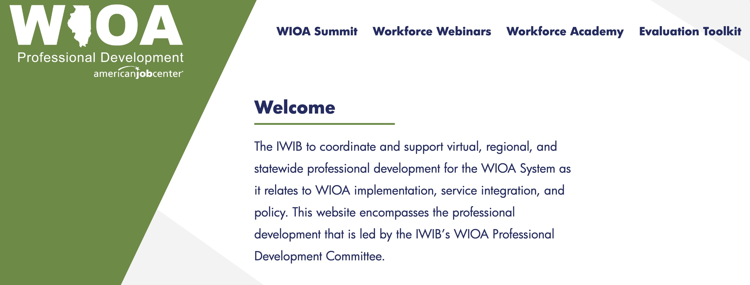

Slide 5
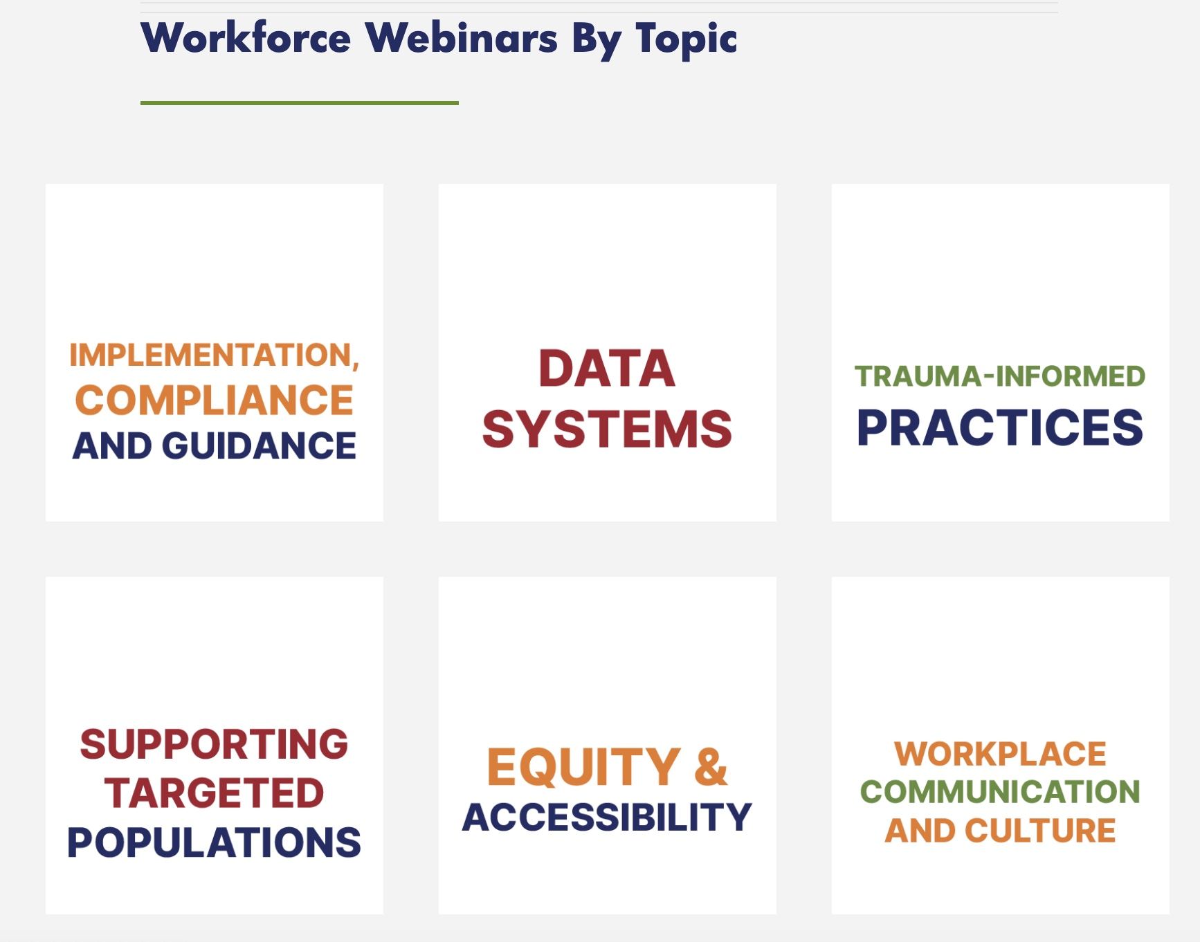
Cross Reference
Current Webinars from IL WIOA Professional Development
https://ilworkforceacademy.com/workforce-webinars/

Slide 6
Aligned Trauma-Informed Practice Webinars
Trauma Sensitive Practices/ Trauma-Informed Employability Skills- November 8, 2023
Self-Fulfilling Prophecy: Identifying, Challenging, and Changing- February 15, 2023
Culture and Trauma ICOY- March 16, 2022
Vicarious Trauma ICOY Trauma Series- March 9, 2022
Impact of Trauma – _March 2, 2022
Mental Illness Signs and Symptoms: Safe and Effective Responses – November 10, 2021
Moving Beyond Stigma Mental Health & Employment- August 12, 2020

Slide 7
Somewhat Aligned Apprenticeship, Pre-Apprenticeship, and Work-Based Learning Webinars
How to Build a Pre-Apprenticeship for Illinois: Pathways to Success- December 7, 2022
Registered Apprenticeship Programs: What’s all the fuss? – September 14, 2022
Career Planning Policy Session – February 16, 2022
Demand Occupation Training List (DOTL) Updates- February 16, 2022
Trade Training Part 2 – _December 14, 2021
Trade Trainings: ATTA/RTAA – December 9, 2021
Trade Training Part 1- December 2021
Navigating through Apprenticeships- What’s in your toolbox? – June 23, 2021
WIOA Innovations Career Pathways Navigator- June 17, 2020
Guidance and Resources for Providing High-Quality Work- Based Learning – _March 4, 2020
Understanding, Defining, and Building Career Pathway Systems- October 19, 2016

Slide 8
Somewhat Aligned Targeted Population Webinars
Considerations for Working with LGBTQIA+- March 22, 2023
An Introduction to Social Identity, Bias, & Power Dynamics in Helping Relationships- March 8, 2023
The Intersection of Justice and Education- Building Skills inside and outside the walls – March 6, 2023
Untapped Talent – Re-Entry Workshop Series Orientation – February 8, 2023
Understanding Substance Use Disorder- January 26, 2022
Mental Illness Signs and Symptoms: Safe and Effective Responses – _November 10, 2021
A Hire Calling: Reentry Employment- August 18, 2021
Migrant Seasonal Farm Workers, Foreign Labor, & the Agricultural Recruitment System- July 21, 2021
Bridges Out of Poverty: Part 3
Bridges Out of Poverty- Part 2 – _June 23, 2021
– Bridges Out of Poverty- Part 1
Bridging the Gap Between Substance Use Recovery Staff & Workforce Staff Administrators- February 24, 2021
Illinois Career Pathways Dictionary- October 18, 2023
Ticket to Work- March 31, 3031

Slide 9

To provide assistance to students experiencing homelessness or with experience in foster care, the State of Illinois Public Act 102-0083 requires each institution of higher education to designate at least one staff member to serve as a liaison.
The HOUSE Liasion Center is designed to support liaisons through professional development, technical assistance, and resources.

Slide 10
Somewhat Aligned Written Resources

Slide 11
Summary of Interviews with Home Illinois Workforce Pilot Sites
Best Practices, Models, and Strategies | Gaps in Current Assets in Blue
OJT models working with people experiencing homelessness
Transitional jobs programs working with people experiencing homelessness
Skilled trades, pre-apprenticeship, and apprenticeship models working with people experiencing homelessness
Career services
Retention services
Human centered design practices in workforce and homeless services
Engaging with employers on behalf of people experiencing homelessness or people who have a criminal record
Supported employment models adapted to people experiencing homelessness
Workforce system assessment tools and specifically tools that are strengths-based
Best practices in working with shelters and shelter staff and engaging in workforce programs
Best practices aligning coordinated entry systems to support employment goals assessment and matching
Job readiness training and working with individuals experiencing homelessness
Social enterprises specifically serving individuals who are in shelter and those participating in rapid rehousing
Case management services at the intersection of the workforce development system and homeless services system
Navigator services

Slide 12
Discussion and Next Steps

