Slide 1


IWDS Transition 2.0
Illinois Workforce Development System (IWDS)
Project Introduction
Illinois workNet® is sponsored by the Department of Commerce and Economic Opportunity. – November 2023

Slide 2
IWDS Transition Agenda
Background
Project Scope
Project Timeline & Phases
Discovery
Communication
Roles & Responsibilities
Next Steps
Questions

Slide 3
IWDS Transition Background
Technical End of Life
Why Now?
IWDS Plan For Replacement
Illinois Worknet expansion
IWDS is an enterprise software system that provides the case management, data warehousing, reporting, and monitoring functions required by federal and state law.
Without IWDS or an adequate replacement system, the associated workforce programs would be unable to serve customers and DCEO would be out of compliance with grant requirements.
Illinois workNet uses widely accepted technology standards for platforms, accessibility, responsive design, plug-ins, databases, and programming languages.
This system is currently used for non-formula workforce grants and other state-funded workforce programs such as Illinois Works.

Slide 4

IWDS Transition
Project Scope
Project Scope
The new system will deliver the core functionality needed to meet the Federal and State reporting requirements and support a case management system.
Transition the WIOA Title I and Trade data to Illinois workNet to fully replace IWDS.
Meet the State requirements of a reporting and case management system for the workforce programs that DCEO oversees.
Utilize a modern technology platform resulting in an intuitive user interface with a robust application and database architecture.
Focus more on the ideal customer workflow and build the best product in the time allowed.

Slide 5



IWDS Transition Project Phases
Initiation & Discovery
Development sprints
User Acceptance Testing
Training
Data Migration & Go Live
Define the scope of the project and timeline. Build and approve the project plan and schedule. Research and define the technical requirements and the business requirements. Receive approval on the user stories that will go into the development sprints.
Build the system’s infrastructure then develop the system using approved user stories. Short development cycles allow teams to develop, deploy, and iterate on the product with frequent feedback from stakeholders.
In User Acceptance Testing, business stakeholders determine whether an application or feature fulfills its purpose. Because development is happening in cycles, testing happens more frequently to ensure that work is being completed towards the product's vision.
Hands-on sessions will be conducted to train the staff on the new system prior to go-live. End users will be provided instructional resources in a variety of formats including documents, videos, and quick start guides.
IWDS and historical data is moved to the new application and validated.
Once migrated, users will only need to use the new application.

Slide 6

IWDS Transition Sprinting
Discovery doesn’t stop with the initial discovery phase.
Each sprint is two-weeks in duration, starting on a Friday and ending on a Thursday.
Stories planned for current sprint were discovered & defined in previous sprints.
Business Rules, Data Definition, User Interface Design and validation steps are all part of a fully defined user story.
The better the definition, the lower the level of story refinement during a sprint.
Mon | Tue | Wed | Thu | Fri
 |  |  |  | -Start Sprint -Develop -Define
-Develop -Define | -Develop -Define | -Develop -Define -Test | -Develop -Define -Test | -Develop -Define -Test
-Develop -Define -Test | -Develop -Define -Test | -Finish Testing -Define | -Demo -Planning -Retrospective | -Start Sprint -Develop -Define

Slide 7
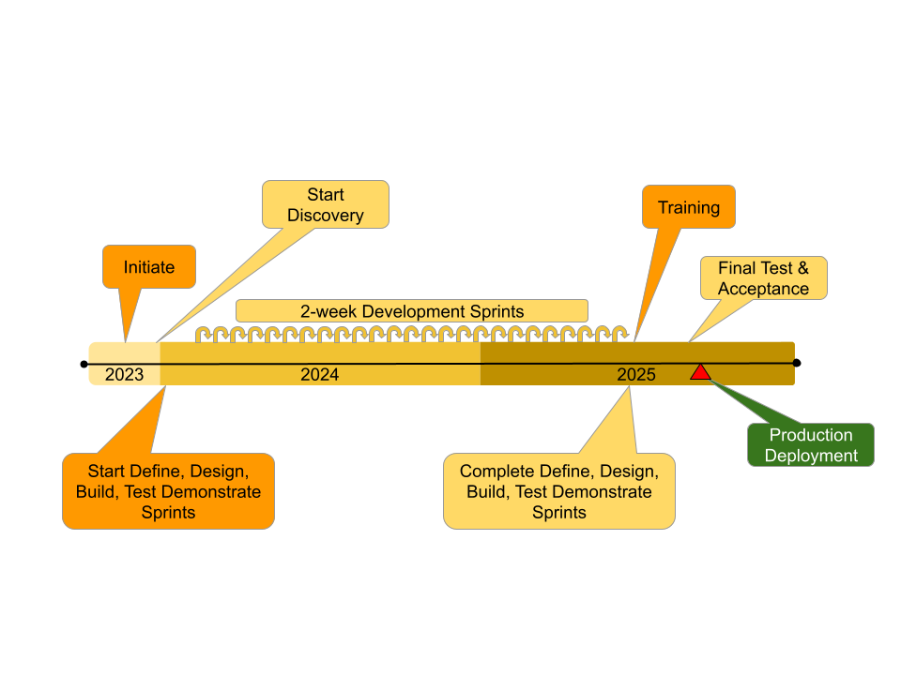
IWDS Transition Project Timeline

Slide 8
IWDS Transition INITIAL project Schedule
Phase | Duration Days | Start | Finish
IWDS Transition
Initiate Project | 24 | Mon 10/16/2023 | Fri 11/16/2023
Initial Discovery | 70 | Mon 10/30/2023 | Fri 2/1/2024
Sprint 0 (Infrastructure development, Stories for Sprint 1) | 45 | Fri 12/1/2023 | Thu 2/1/2024
Define, Design, Develop, Test | 366 | Fri 2/2/2024 | Thu 7/24/2025
Sprints 1-4 (1st Qtr. 2024) | 40 | Fri 2/2/2024 | Thu 3/28/2024
Sprints 5-10 (2nd Qtr. 2024) | 60 | Fri 3/29/2024 | Thu 6/20/2024
Sprints 11-17 (3rd Qtr. 2024) | 80 | Fri 6/21/2024 | Thu 9/26/2024
Sprints 18-24 (4th Qtr. 2024) | 80 | Fri 9/27/2024 | Thu 1/2/2025
Sprints 25-30 (1st Qtr. 2025) | 70 | Fri 1/3/2025 | Thu 4/3/2025
Sprints 31-36 (2nd Qtr. 2025) | 60 | Fri 4/4/2025 | Thu 6/26/2025
Sprints 37-38 (3rd Qtr. 2025) | 20 | Fri 6/27/2025 | Thu 7/24/2025
Training | 60 | Fri 5/30/2025 | Thu 8/21/2025
Data Conversion Validation | 10 | Fri 7/25/2025 | Thu 8/7/2025
Final MVP Integration & Acceptance Testing (UAT) | 20 | Mon 7/28/2025 | Fri 8/22/2025
Cycle 1 - Testing, Tracking, Fixing | 5 | Mon 7/28/2025 | Fri 8/1/2025
Cycle 2 - Testing, Tracking, Fixing | 5 | Mon 8/4/2025 | Thu 8/8/2025
Cycle 3 - Testing, Tracking, Fixing | 5 | Mon 8/11/2025 | Fri 08/15/2025
Cycle 4 - Testing, Tracking, Fixing | 5 | Mon 8/18/2025 | Fri 08/22/2025
Production Deployment | 3 | Fri 08/22/2025 | Sun 08/24/2025

Slide 9
IWDS TRANSITION Discovery Work
Listing of Initial Milestones that will be further defined during discovery.
Note – These are not listed in a priority order
01
Initiate the project planning process with DoIT
12
Accommodate Reporting & Dashboarding Needs
02
DoIT to Stand Up Web Application and SQL Server & SIU Grant Access
13
Expand Performance (IPATS) Tools
03
Create grant monitoring functionality
14
Expand Entity & Relationship Management
04
Expand Customer Tracking Functionality
15
Create Grant Management Functionality
05
Expand Intake to Incorporate WIOA Title I Functionality
16
Incorporate Demand Occupation Functionality
06
Expand Intake to Incorporate 1E and 1N Functionality
17
Expand User Management Functionality
07
Expand Intake to Incorporate Trade Program Functionality
18
Migrate IWDS Data to The new system
08
Expand Services Functionality
19
MVP Testing & Acceptance
09
Expand Case Management Functionality
20
IWDS Cutoff Date and Transition to DoIT-Hosted IWIS Application
10
Expand Customer Exit & Follow-up Functionality
21
MVP Testing at DoIT Data Center
11
Expand Federal Reporting Functionality
22
DoIT Hosting Application and Go-Live
Notes:
The discovery work will focus on milestones 04-17

Slide 10

IWDS Transition Local Discovery Schedule
Week 1 : 12/5-12/7
 | Tuesday |  | Thursday
9:00 am – 9:15 am | Review |  | Review
9:15 am – 10:30 am | Customer Flow & Local Policy and Procedures |  | Customer Flow & Local Policy and Procedures
10:30 am – 10:45 am | Break |  | Break
10:45 am – 11:45 am | Customer Flow & Local Policy and Procedures |  | Customer Flow & Local Policy and Procedures
11:45 am – 12:00 pm | Q&A and Review |  | Q&A and Review
November
Week 2-3 : 12/12 -12/19, TBD 12/21
 | Tuesday |  | Thursday
9:00 am – 9:15 am | Review |  | Review
9:15 am – 10:30 am | Define Feature Sets |  | Define Feature Sets
10:30 am – 10:45 am | Break |  | Break
10:45 am – 11:45 am | Define Feature Sets |  | Define Feature Sets
11:45 am – 12:00 pm | Q&A and Review |  | Q&A and Review

Slide 11
IWDS Transition LWIA Participation
Primary & Secondary Team Member Expectation
It is important to receive feedback and keep the LWIAs informed throughout each phase of this project.
Primary Team Member Expectation
  Serve as a point of contact and representative of the LWIA for this project.
  Help completes assignments (research, content review, or sending needed information) that come out of discovery sessions.
  Participate in discovery working session (as applicable)
Secondary Team Member Expectation
  Be prepared to attends meetings when the primary is unable to.
  Be prepared to assists the primary with completing assignments.

Slide 12
IWDS Transition Discovery WORKING SESSIONS
Primary & Secondary Team Member Expectation
The initial discovery sessions will include an intensive series of “working sessions” focused on how career planners currently use IWDS
  With the help of the IWP, we want to identify around 10 members from the Project’s LWIA SME team, one per EDR.
  These members will be expected to attend the discovery session as described.
  All primary and secondary members will be kept informed of ongoing project status and may be asked to assist at various times.

Slide 13
IWDS Transition Roles & Responsibilities
Product Ownership - State Level
State Level Subject Matter Experts – Drive project decisions, day-to-day SME support. Definition of “what” we are building. (Features)
Trainers
LWIA SME System Team
Point of contact staff throughout the state and local areas, lead trainers to support implementation & transition of the product.
System requirement definition from the local perspective. Direct User Subject Matter Experts (SMEs), Integral to the success of product definition. Definition of “how” we process.
Oversight Steering Sponsors
Communication Team
SIU Development Team
Develop approved flow of communications for project. Draft all content, schedule, work closely with Project Oversight to deliver consistent message.
Lead discovery, document requirements into user stories, produce process flow diagrams and wireframe product, coach team in Scrum, build the system, ensure quality.
Notes:
Participate in the Discovery process – help define the business and technical requirements and provide process detail on the way the system works
Participate in User Acceptance Training – will include demonstrations of the system as it is built and provide an opportunity for testing and feedback. As we get to UAT we will expand the local involvment.

Slide 14
IWDS Transition Level of Effort (LOE)
 |  | Est Start | 10/16/23 | 10/30/23 | 2/2/24 | 5/30/25 | 7/28/25
 |  | Est Finish | 11/3/23 | 2/1/24 | 7/24/25 | 8/21/25 | 8/22/25
Role | Staff Member | Activities | Initiate | Discovery | Build & Test | Training | Final UAT
Senior Leadership Sponsorship Team | Julio Rodriguez, Lisa Jones, John Barr, Patti Schnoor, Annamarie Dorr, Michelle Cerutti CEJA Division Mgr, OET Tech Assistance Mgr | Kick-off Planning, Initial Kick-off Meeting, Full Kick-off Meeting | 14-20hrs
 |  | Monthly Status | .5hr / mo | .5hr / mo | .5hr / mo | .5hr / mo | .5hr / mo
 |  | Communication Planning, Communication content review, approval, execution | 2-4hrs/mo | 2-4hrs/mo | 2-4hrs/mo | 2-4hrs/mo | 2-4hrs/mo
 |  | Requirement Validation |  | 1-2hrs/wk | 1-2hrs/wk
 |  | Preparation and Review | 2-4hrs/wk | 1-2hrs/wk | 1-2hrs/wk | 1-2hrs/wk | 1-2hrs/wk
 |  | Discovery, Requirements gathering, Design |  | 1-16hrs/wk | 1-6hrs/wk
System Owner Team | Kelly Lapetino, Tamika Chism, Lora Dohm, Mark Burgess, Jeff Brown, Mike Baker, Mark Saladino, David Swanson | Project Team Meetings | 2h/wk | 2h/wk | 2h/wk | 2h/wk | 2h/wk
 |  | Internal & External Kickoff Meetings | 4hr
 |  | Discovery, Requirements gathering, Design |  | 12-16hrs/wk | 4-6hrs/wk
 |  | Demonstrations |  |  | 1hr/bi-wk
 |  | User Acceptance Testing |  |  | 4-6hrs/wk |  | 12-16hrs/wk
 |  | Training |  |  |  | 6hrs/wk
 |  | Preparation and Review |  | 2-4hrs/wk | 2-4hrs/wk | 2-4hrs/wk | 2-4hrs/wk
Communication Team | Annamarie Dorr, Kelly Lapetino, Bryan Ellis | Communication Planning | 4-8hrs | 1-2hrs/mo | 1-2hrs/mo | 1-2hrs/mo | 1-2hrs/mo
 |  | Build communication content | 24-30hrs | 4-6hrs/mo | 4-6hrs/mo | 4-6hrs/mo | 4-6hrs/mo
 |  | Communication Approvals | 2hrs | 2-4hrs/mo | 2-4hrs/mo | 2-4hrs/mo | 2-4hrs/mo
State Level - Subject Matter Experts (SME) | Paula Barry, Bryan Ellis, Kris Theilen, Jim Potts, Susan Boggs, Shelia Sloan, Lorraine Wareham | Discovery, Requirements gathering, Design | 2hrs | 4-6hrs/wk
 |  | Demonstrations |  |  | 1hr/bi-wk
 |  | Training |  |  |  | 4-6hrs/wk
 |  | User Acceptance Testing |  |  | 4-6hrs/wk
Local Workforce Innovation Area SME Team | System Administrators, Super Users, Champ. Users, TBD | Discovery, Requirements gathering, Design | 2hrs | 4-6hrs/wk
 |  | Demonstrations |  |  | 1hr/wk
 |  | Training (Title 1 Admins) |  |  |  | 4-6hrs/wk
 |  | User Acceptance Testing |  |  | 4-6hrs/wk |  | 4-6hrs/wk
Field Reps/Trainers Team | Regional Team, Aime'e Julian, Sarah Goldhammer, Fiscal/Monitoring, System Administrators, TBD | Discovery, Requirements gathering, Design | 2hrs | 4-6hrs/wk
 |  | Demonstrations |  |  | 1hr/wk
 |  | Training (Title 1 Admins) |  |  |  | 4-6hrs/wk
 |  | User Acceptance Testing |  |  | 4-6hrs/wk

Slide 15
IWDS Transition Roles LOE
Level of Effort & Next Steps
Level of Effort (LOE):
  Initial Discovery Phase (LOE: 4 – 6 hr/wk)
    November 2023 – January 2023: State-Level User Initial Discovery
    November 30, 2023: Kickoff Meeting with LWIA SME System Team Members
    December 2023 – January 2023: Local Level User Initial Discovery
  Continued Discovery & Development (LOE: 4 – 6 hr/wk)
    February 2024 – July 2025: Translate Program Requirements to Specifications
    February 2024 – Mid 2025: Start Continuous Design-Build-Test Development Sprints
  Mid 2025: Training (LOE: 4 – 6 hr/wk)
  Mid 2025: Final User Acceptance Testing & Integration (LOE: 4 – 6 hr/wk)
  Late 2025 – Early 2026: Production Deployment/Go Live

Slide 16

IWDS Transition Communication Controls
Communications Team builds content, selects channel, creates schedule
Senior Leadership reviews and approves content, channel, schedule
Message gets delivered through appropriate channels
(website, email, meetings, etc.)
Please refer questions to your
LWIA Director or System Administrator.

Slide 17
IWDS Transition Next Steps
Reach out to Caroline Portlock cportlock@willcountyillinois.com if you are interested in participating in the intensive series of “working sessions” by end of day 12/1/23.
Those 10 reps will get a calendar event for weekly discovery sessions by EOD 12/4/23
  What to bring
    Local Processes
    IWDS Usage Notes
Next Steps &
Actions

Slide 18
IWDS Transition Questions
When does it start?
  Now! It’s already started!
When will we start using the system?
  Late 2025 or Early 2026.
How will I know what to do?
  Scheduled meetings on your calendars.
  Project communications website.
  Recurring demonstrations and status (Every 2 weeks on a set day starting in 2025).
What do I communicate to others?
  Communications are created by the communications team and reviewed by Senior Leadership.
  Most of the formal communications will be distributed from the Senior Leadership or product owners.
  Please refer questions to your LWIA Director or System Administrator.
Other Questions. . .
Questions &
Answers

