Slide 1



Illinois Works Pre-Apprenticeship Program
Updates and Feedback Session
www.illinois.gov/dceo
Notes:
Thank you all for attending. Before we begin I want to touch on a few logistical items. First, as you noticed this presentation was planned for 1 hour and 15 minutes, the first hour will be the training and the final 15 minutes is set aside for questions. Second, I will send you all this PowerPoint so please don’t feel you have to copy all of the information down as I offer a good amount here that is intended to be a reference point for you during your scoring. Third, at the end of each section there is an opportunity to ask questions, so please feel free to unmute yourself or type in the chat which I will check at the end of each section. OK, let’s get started.

Slide 2

Agenda
Updates to the Illinois Works System
  Transcript/Progress Report
  Post-Assessment Scores and Attendance Report
  Bulk Attendance Tool
Feedback Session
Notes:
Today I will begin with a short overview of the Office of Illinois Works including the goals of the Illinois Works program and what makes this project so innovative and unique. Then I will walk through the evaluation process so you all can gather a better understanding of how our process has played out, some requirements we are asking of you and important dates. Then we will get into the four evaluation criteria we will ask you to utilize in your scoring. We have a templated scoring rubric that I will then show you how to use. The final two sections are focused on logistical items such as how to navigate Microsoft Teams which we will be using for this process and communications between you and I during this process.

Slide 3
Transcript Report: Upcoming
Produce transcript report for individual participants that would show:
Modules/services
If customer passed/did not pass module/service
Successful / unsuccessful completion of program
Notes:
The Office of Illinois Works is housed within the Department of Commerce and Economic Development and was developed as part of the $45 billion capital plan known as Rebuild Illinois in 2019. In addition to several other major investments, Rebuild Illinois created the Illinois Works Program Act. This act is rooted in Governor Pritzker’s commitment to expand equity in Illinois’ construction workforce.

Slide 4
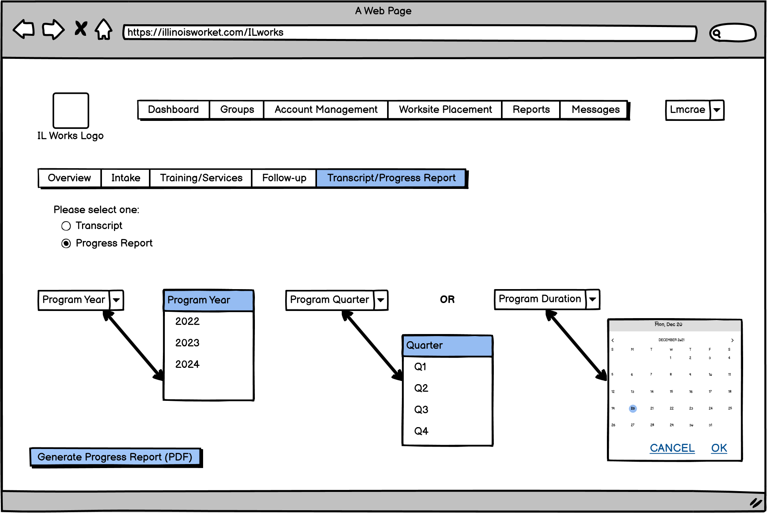
Transcript/Progress Report: Upcoming
Notes:
The Office of Illinois Works is housed within the Department of Commerce and Economic Development and was developed as part of the $45 billion capital plan known as Rebuild Illinois in 2019. In addition to several other major investments, Rebuild Illinois created the Illinois Works Program Act. This act is rooted in Governor Pritzker’s commitment to expand equity in Illinois’ construction workforce.

Slide 5
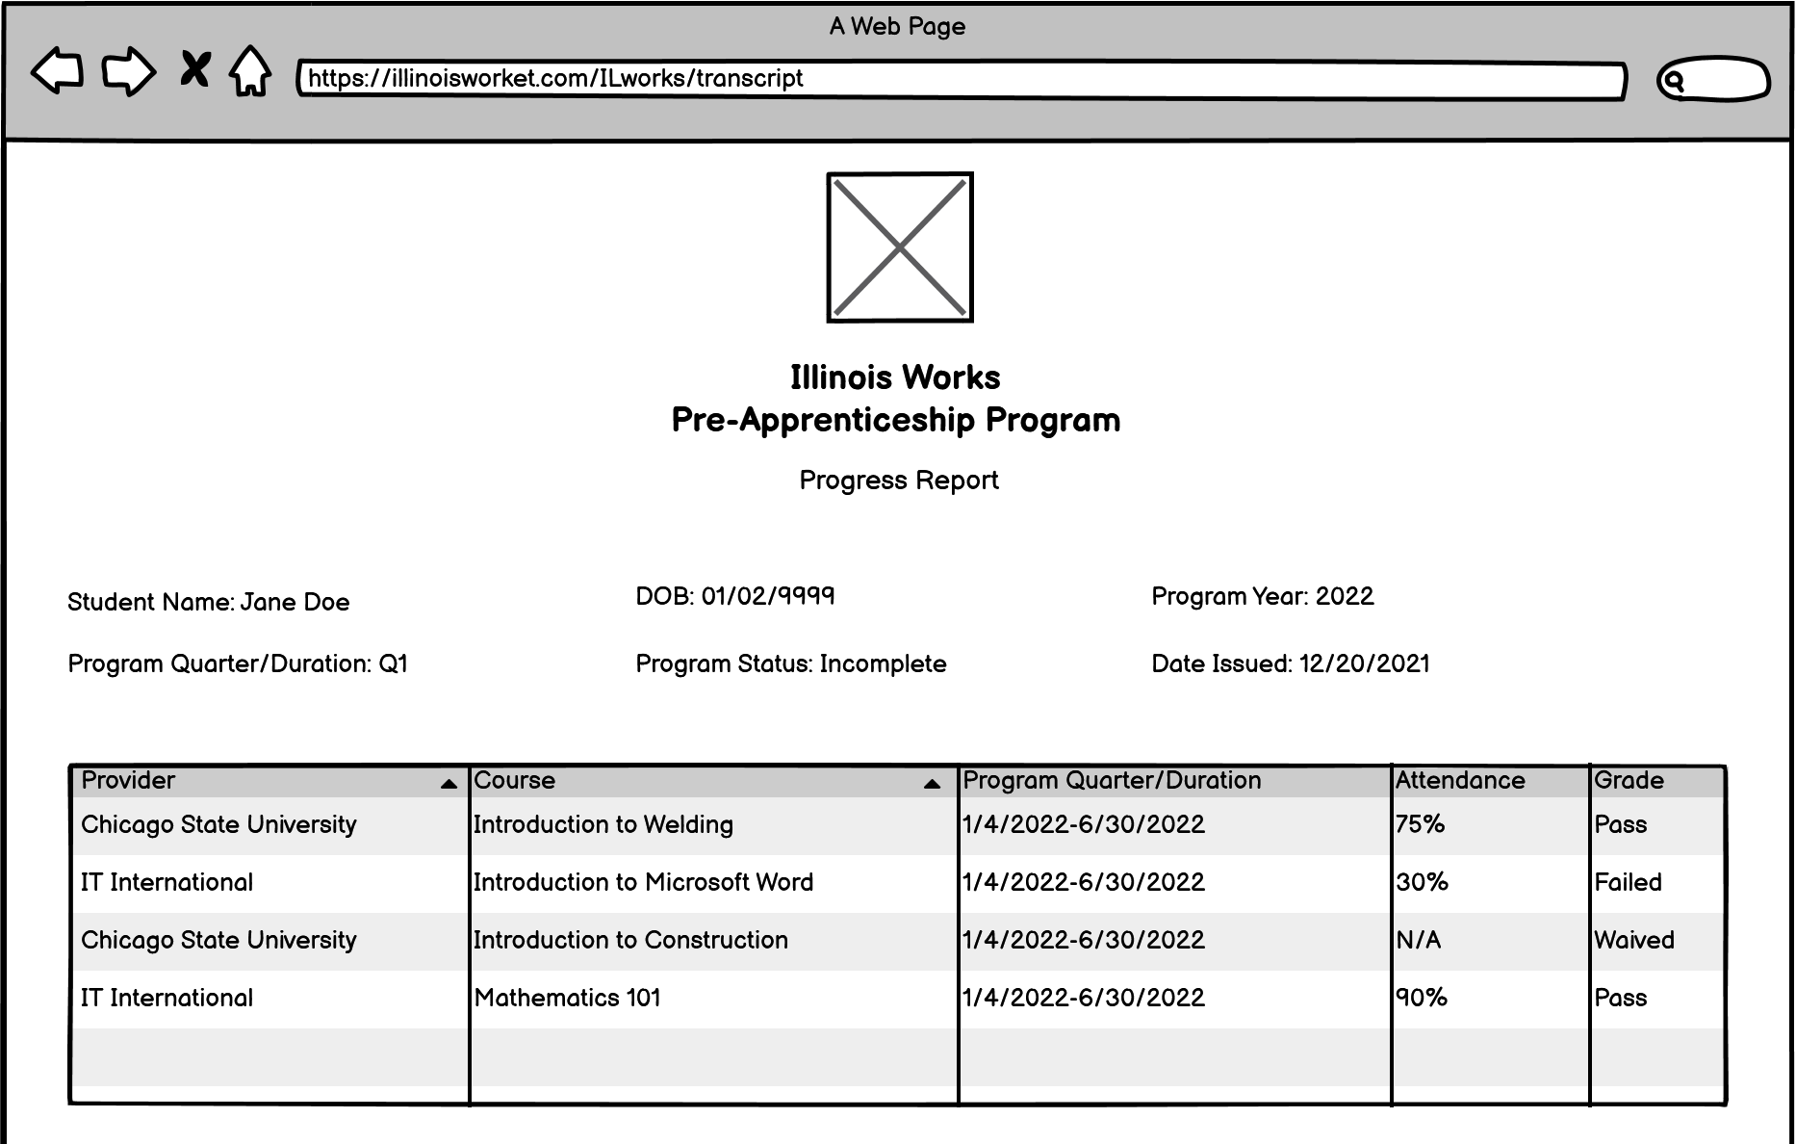
Additional fields for:
Comments
Support Services Needed
Action Plan
Notes:
The Office of Illinois Works is housed within the Department of Commerce and Economic Development and was developed as part of the $45 billion capital plan known as Rebuild Illinois in 2019. In addition to several other major investments, Rebuild Illinois created the Illinois Works Program Act. This act is rooted in Governor Pritzker’s commitment to expand equity in Illinois’ construction workforce.

Slide 6
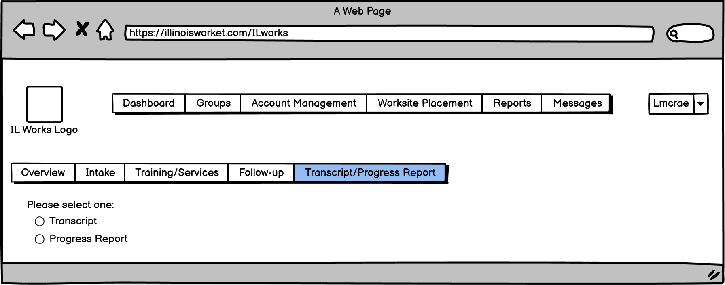
Transcript/Progress Report: Upcoming
Notes:
The Office of Illinois Works is housed within the Department of Commerce and Economic Development and was developed as part of the $45 billion capital plan known as Rebuild Illinois in 2019. In addition to several other major investments, Rebuild Illinois created the Illinois Works Program Act. This act is rooted in Governor Pritzker’s commitment to expand equity in Illinois’ construction workforce.

Slide 7
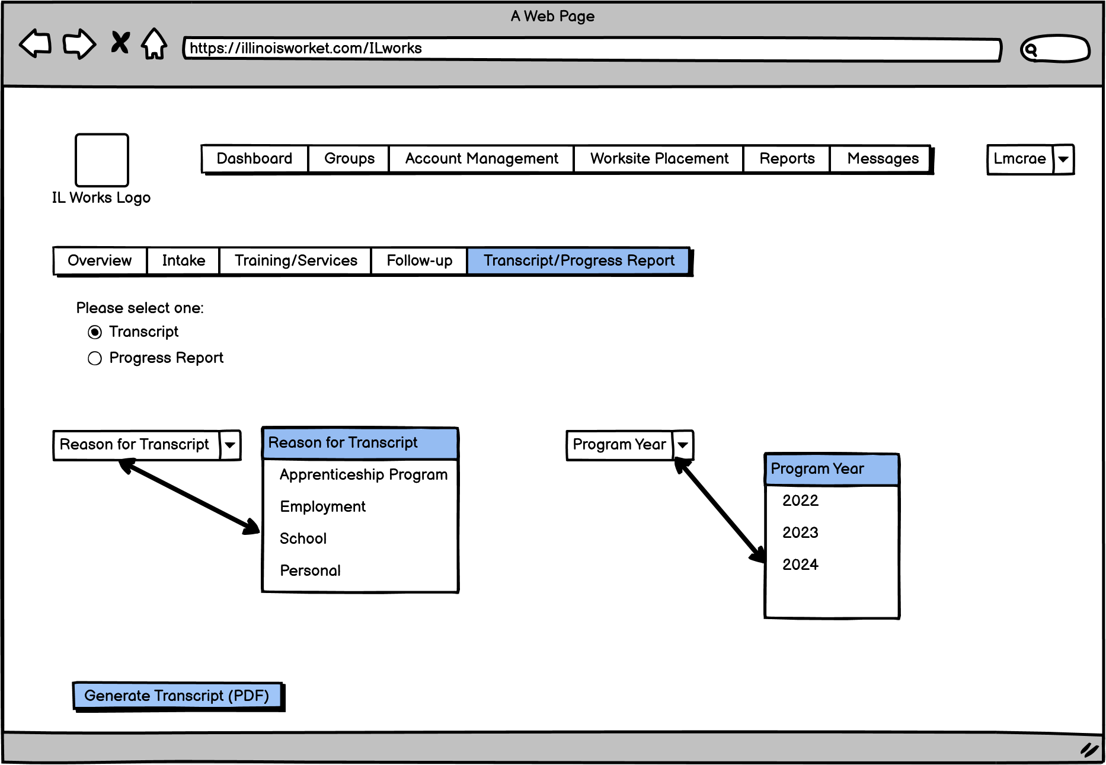
Notes:
The Office of Illinois Works is housed within the Department of Commerce and Economic Development and was developed as part of the $45 billion capital plan known as Rebuild Illinois in 2019. In addition to several other major investments, Rebuild Illinois created the Illinois Works Program Act. This act is rooted in Governor Pritzker’s commitment to expand equity in Illinois’ construction workforce.

Slide 8
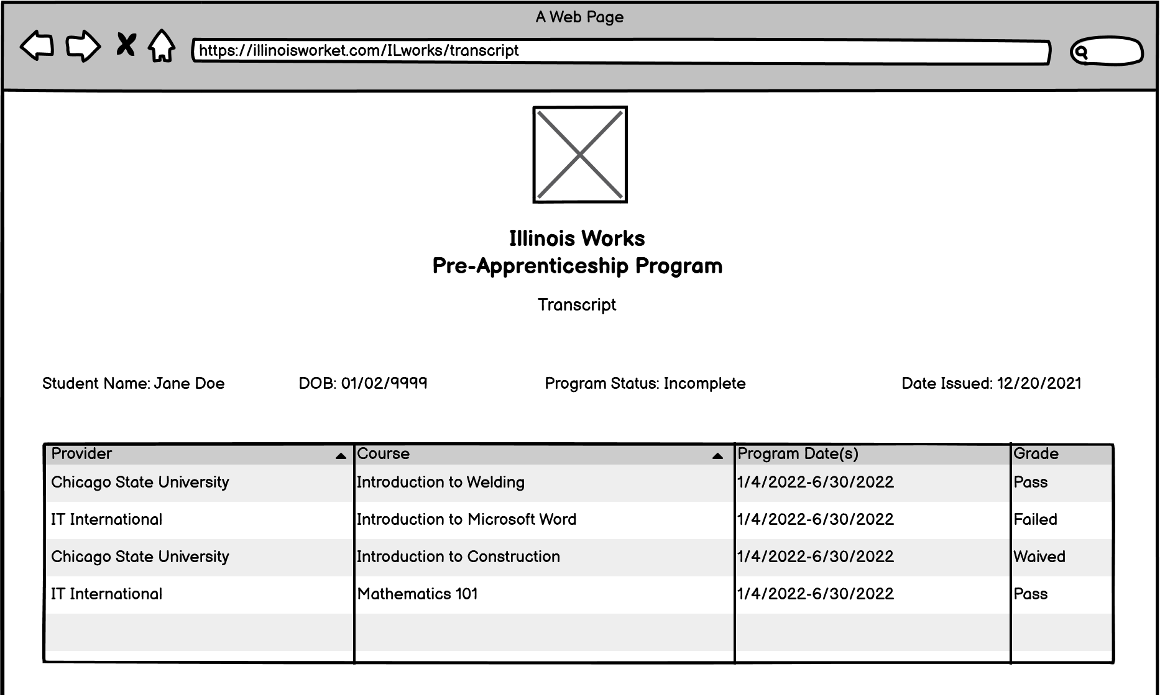
Transcript/Progress Report: Upcoming
Notes:
The Office of Illinois Works is housed within the Department of Commerce and Economic Development and was developed as part of the $45 billion capital plan known as Rebuild Illinois in 2019. In addition to several other major investments, Rebuild Illinois created the Illinois Works Program Act. This act is rooted in Governor Pritzker’s commitment to expand equity in Illinois’ construction workforce.

Slide 9
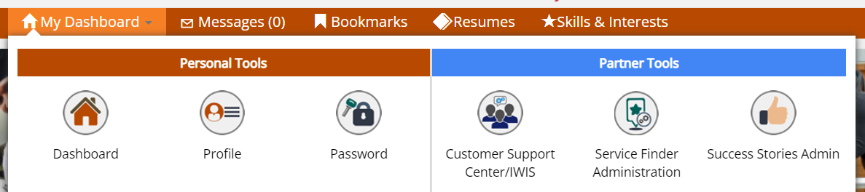
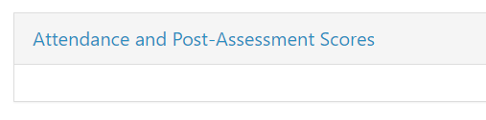
Post-Assessment Scores and Attendance Report: Complete
Ability to access report showing participant’s post-assessment scores and their attendance:
Access Customer Support Center/IWIS
Click Reports icon
Select Attendance and Post-Assessment Scores
Notes:
The Office of Illinois Works is housed within the Department of Commerce and Economic Development and was developed as part of the $45 billion capital plan known as Rebuild Illinois in 2019. In addition to several other major investments, Rebuild Illinois created the Illinois Works Program Act. This act is rooted in Governor Pritzker’s commitment to expand equity in Illinois’ construction workforce.

Slide 10
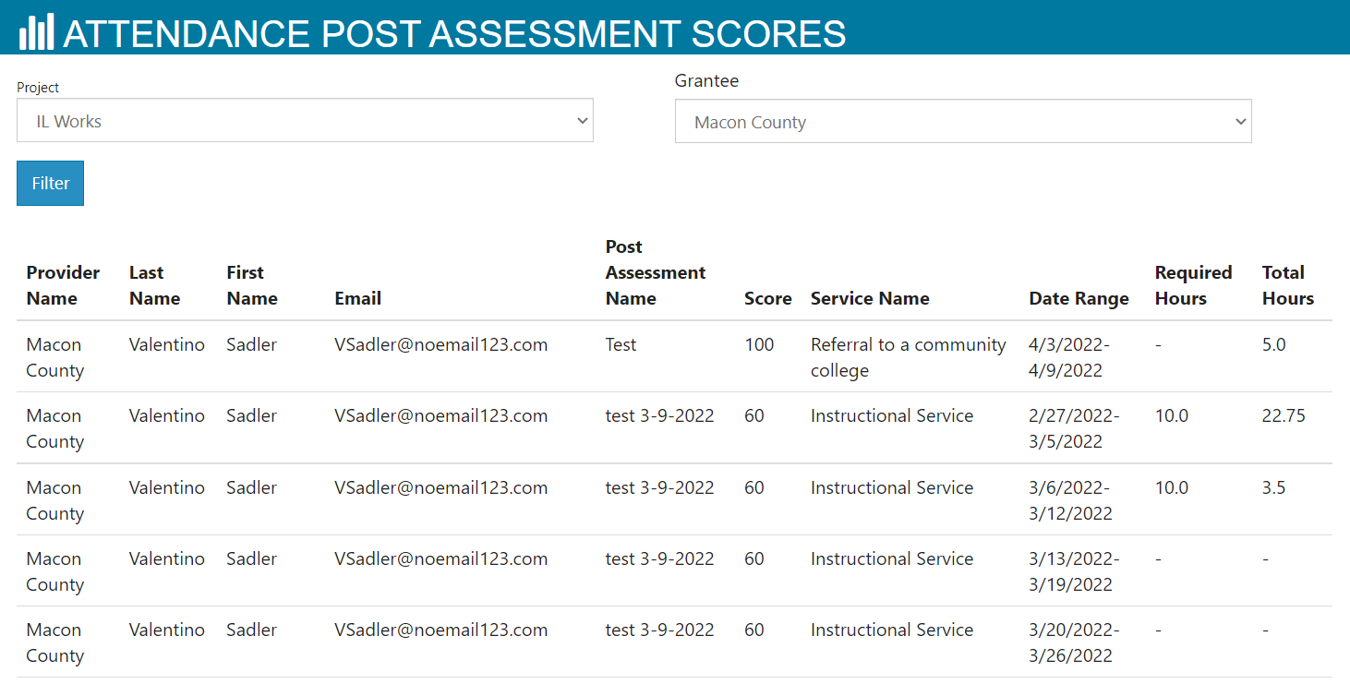
Notes:
The Office of Illinois Works is housed within the Department of Commerce and Economic Development and was developed as part of the $45 billion capital plan known as Rebuild Illinois in 2019. In addition to several other major investments, Rebuild Illinois created the Illinois Works Program Act. This act is rooted in Governor Pritzker’s commitment to expand equity in Illinois’ construction workforce.

Slide 11
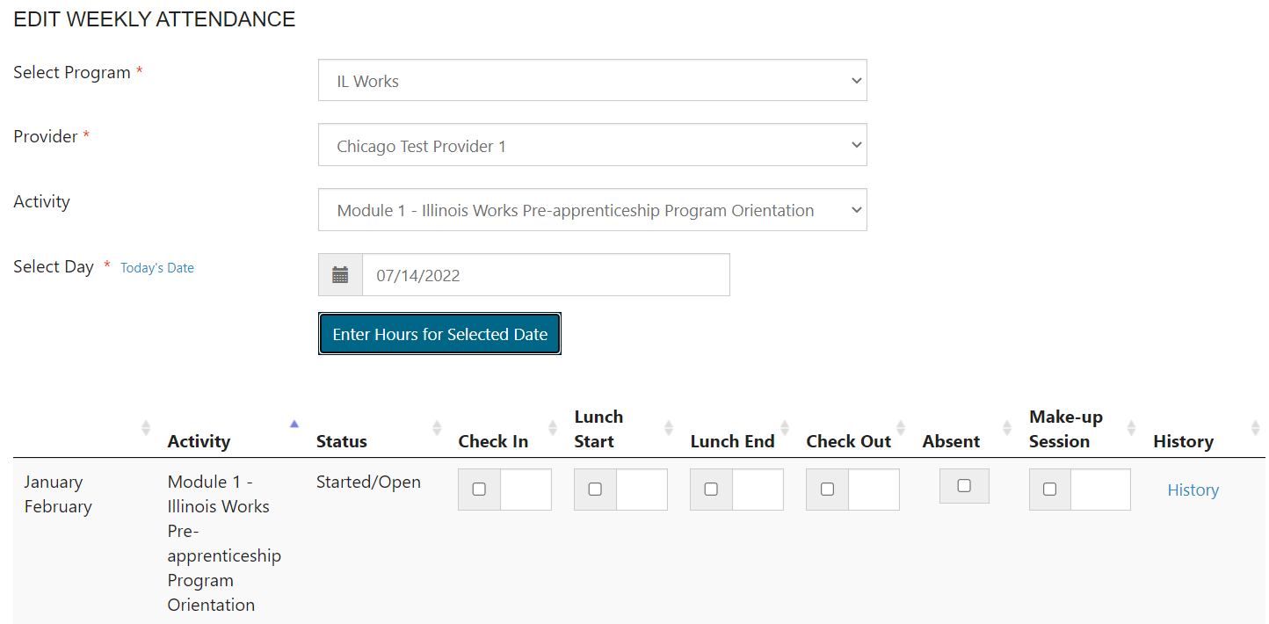
Bulk Attendance Tool: Complete
Ability to choose program, provider, and service from dropdown now available for bulk attendance tool:
Notes:
The Office of Illinois Works is housed within the Department of Commerce and Economic Development and was developed as part of the $45 billion capital plan known as Rebuild Illinois in 2019. In addition to several other major investments, Rebuild Illinois created the Illinois Works Program Act. This act is rooted in Governor Pritzker’s commitment to expand equity in Illinois’ construction workforce.

Slide 12

CEO.ILWorks@Illinois.Gov

