Slide 1


CEJA/FEJA Reporting System
Session 3 Part B
February 4, 2026
Illinois workNet® is sponsored by the Department of Commerce and Economic Opportunity.

Slide 2
AGENDA
Part A Covered:
Chapter 6: Barrier Reduction
Chapter 7:Training Programs
Chapter 8: Program Completion, Transition Services, and Follow -up
Part B Agenda:
Set Up: Brief Demo of Training/Credentials, Services, and Cohorts
Intake: Review Service Needs Assessment
Service Delivery: Demonstrate Documenting Services and Credentials, Adding/Viewing Flags via Progress Page or Dashboard
Completion and Follow-up: Training Completion, Program Completion, and Document Transition Outcomes

Slide 3
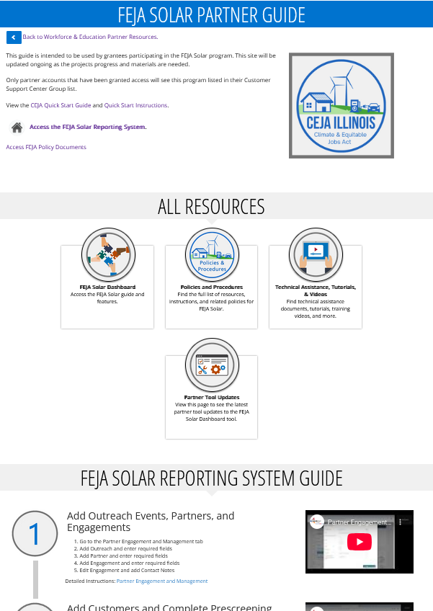
REPORTING SYSTEM PARTNER GUIDE
https://www.illinoisworknet.com/partners/Pages/FEJASolar.aspx

Slide 4
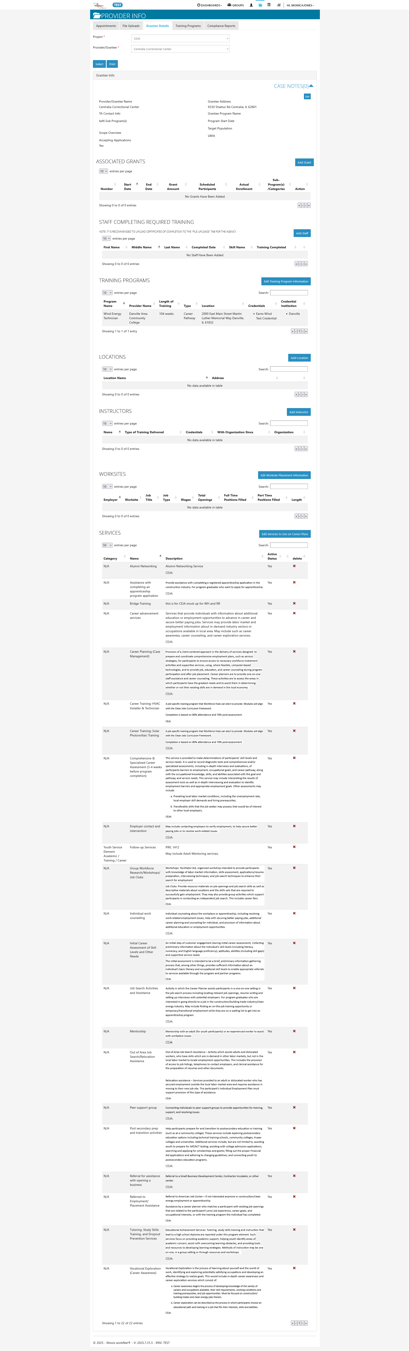
GET SET UP IN THE SYSTEM GRANTEE DETAILS
Grantee Details the Customer Support Center (PDF)

Slide 5
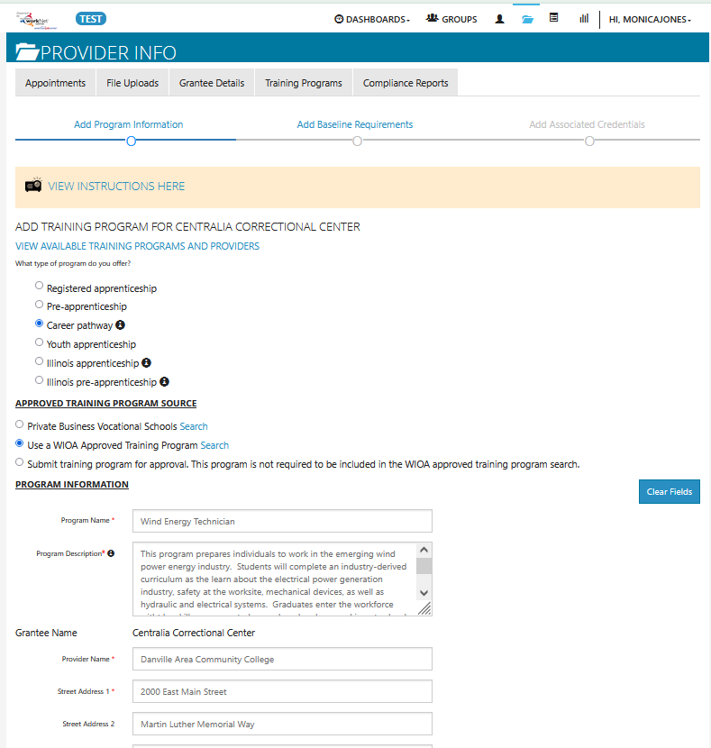
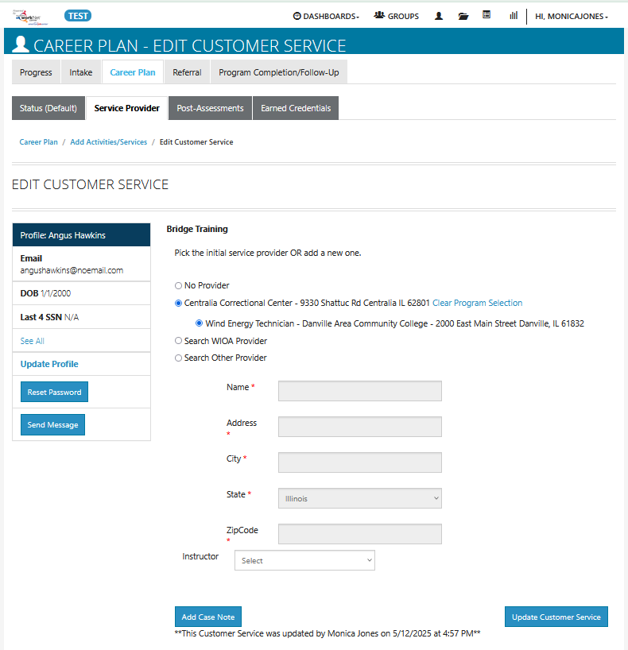
GET SET UP IN THE SYSTEM TRAINING PROGRAMS
Add Training Programs (PDF)​​

Slide 6
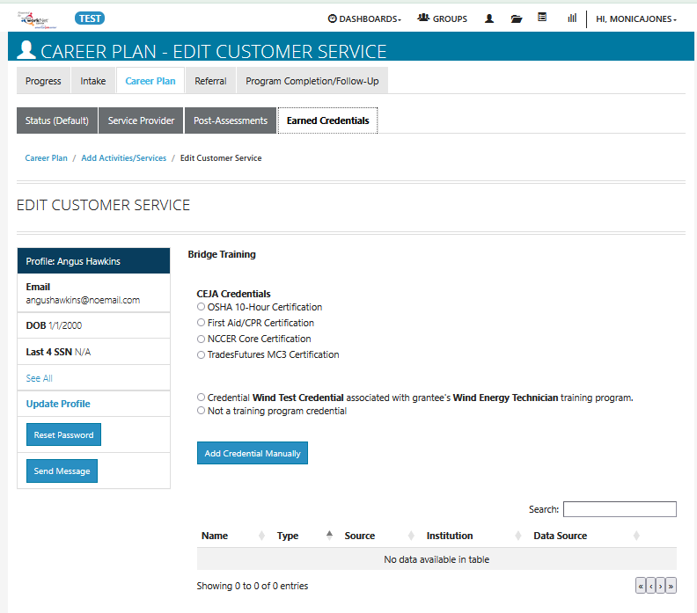
GET SET UP IN THE SYSTEM TRAINING PROGRAMS

Slide 7
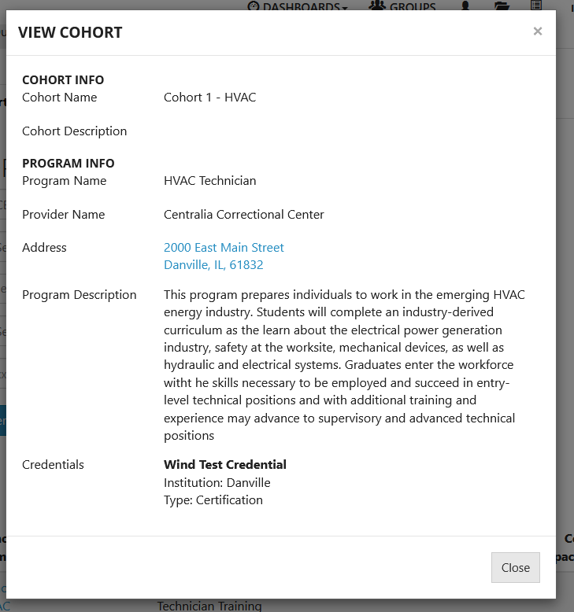
GET SET UP IN THE SYSTEM TRAINING PROGRAMS

Slide 8
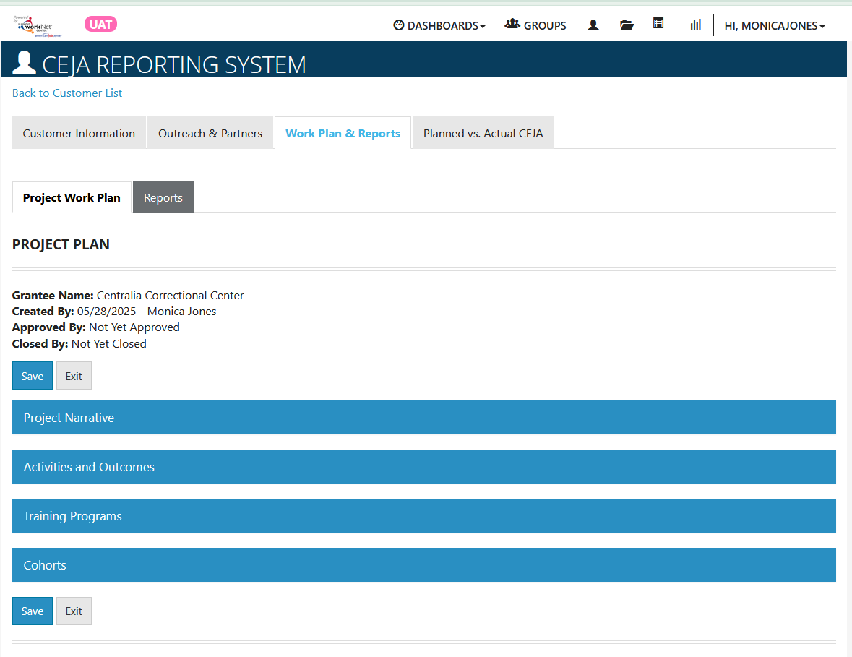
GET SET UP IN THE SYSTEM WORK PLAN

Slide 9
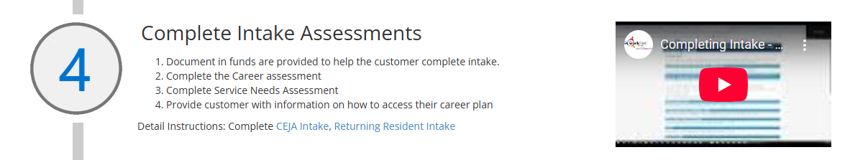
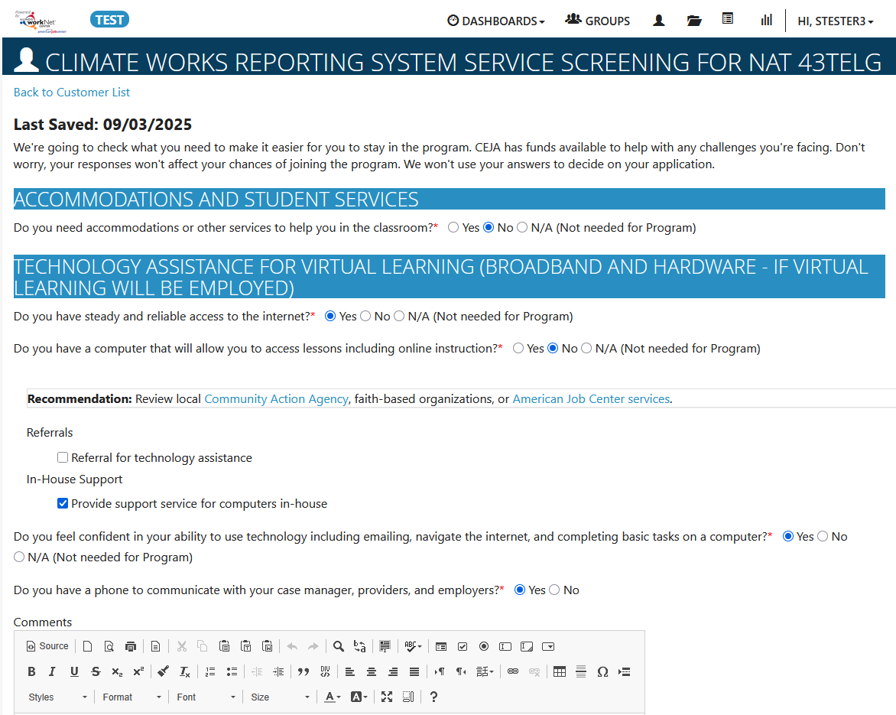
REPORTING SYSTEM INTAKE

Slide 10
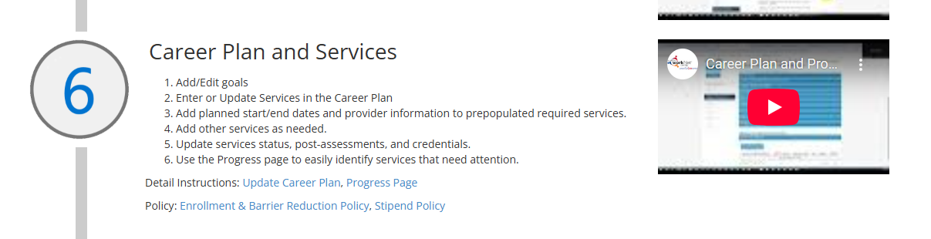
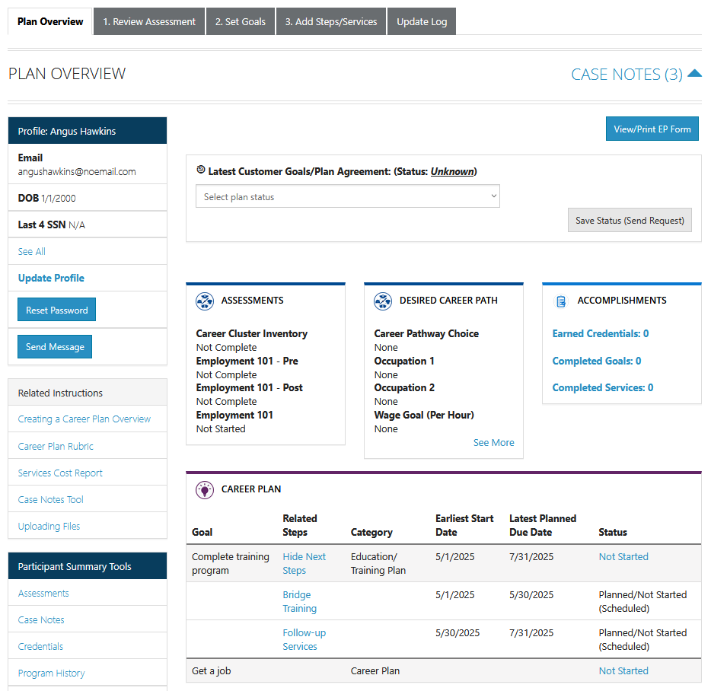
REPORTING SYSTEM ENTER SERVICE INFORMATION

Slide 11
REPORTING SYSTEM ENTER SERVICE INFORMATION
Training Service Data
Other Services Data
Status (required) - All services include the related goal, status, start date, weekly hours, and notes. A completion date is required if the status is complete.
Service Provider (required) - Identify who is providing the service. The grantee is the default provider. If the grantee is not providing the service, enter the provider information
Post-assessment (required upon completion) – The post-assessment section is preset with 70% as the passing score. The grantee will need to enter a post-assessment score of 70% or higher before the service can be marked as successfully completed.
Credentials – There are several credentials listed on this tab. Select the credentials earned with the service. The fields will be prepopulated so that only the credential source and date earned need to be entered. If additional credentials are earned, they can be manually entered
Status (required) - All services include the related goal, status, start date, weekly hours, and notes. A completion date is required if the status is complete ​
Service Provider (required) - Identify who is providing the service. The grantee is the default provider. If the grantee is not providing the service, enter the provider information​
Dollar Value of Service (optional)

Slide 12
REPORTING SYSTEM ENTER SERVICE INFORMATION

Slide 13
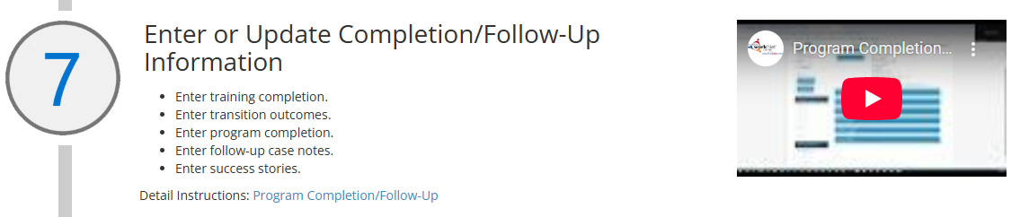
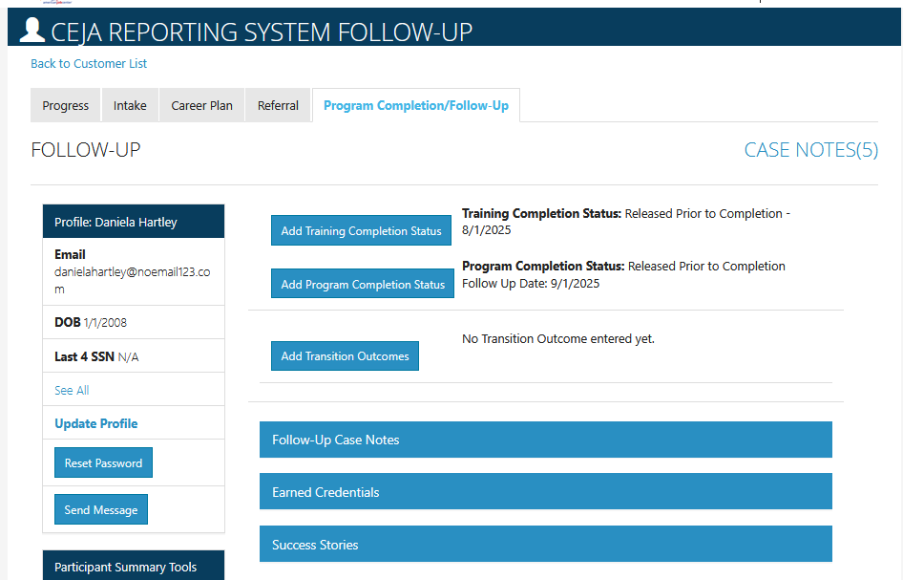
REPORTING SYSTEM COMPLETION/FOLLOW-UP
Updates to this section of the Quick Start Guide are forthcoming.

Slide 14

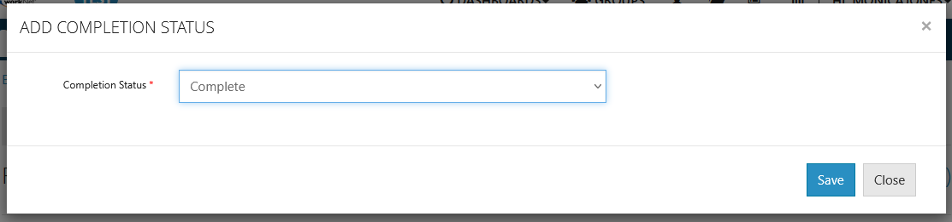
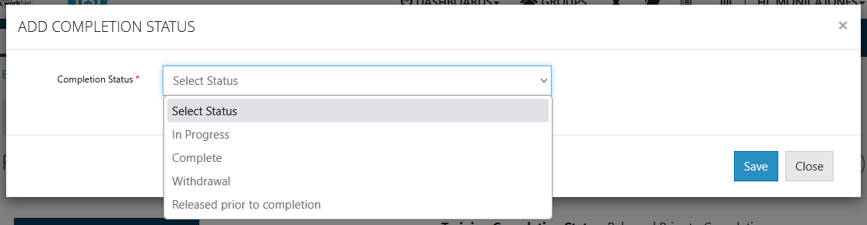
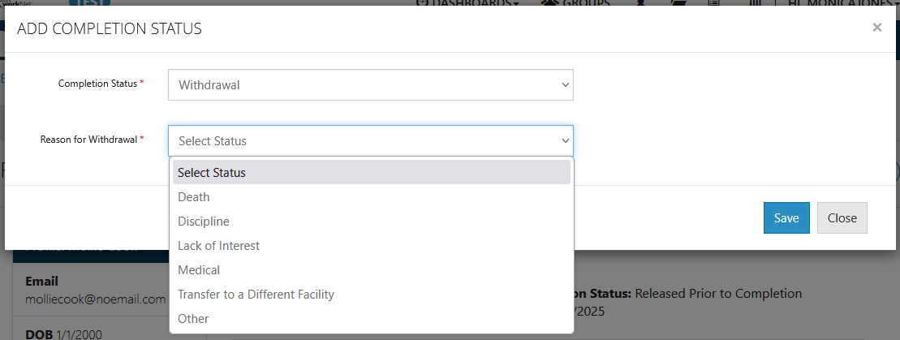
COMPLETION INFORMATION TRAINING COMPLETION

Slide 15

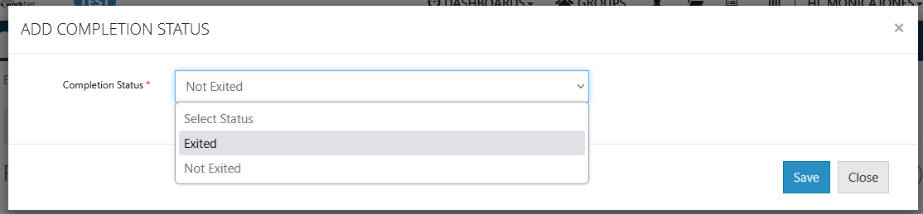
COMPLETION INFORMATION PROGRAM COMPLETION

Slide 16

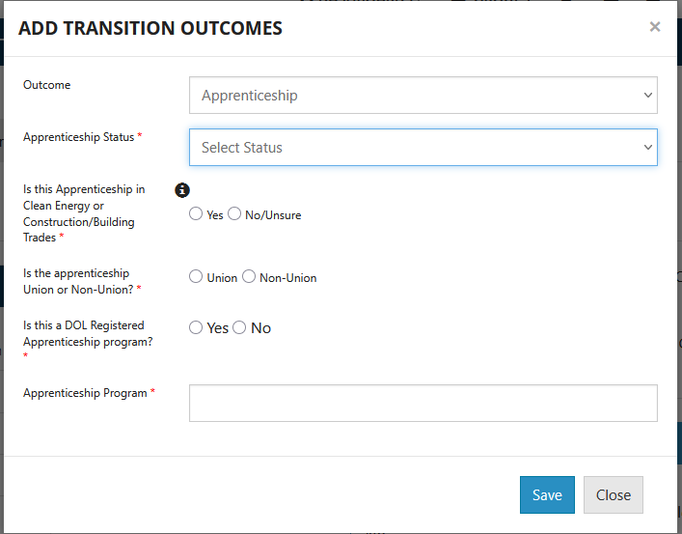
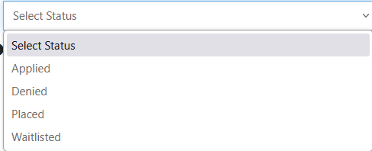
TRANSITION OUTCOMES APPRENTICESHIP

Slide 17
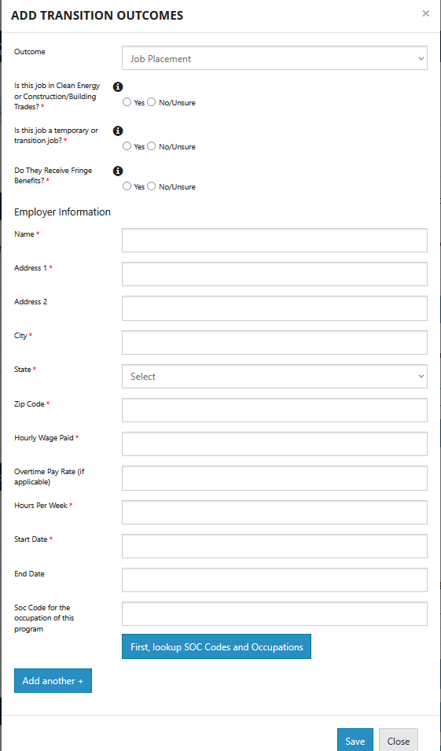
TRANSITION OUTCOMES JOB PLACEMENT

Slide 18
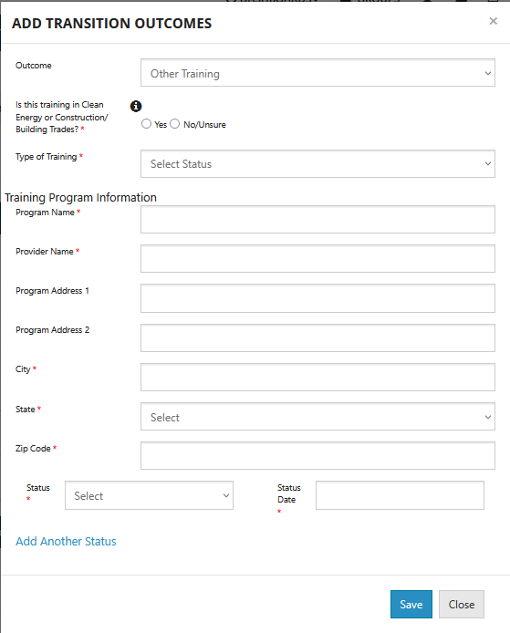
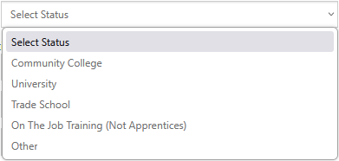
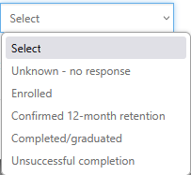
TRANSITION OUTCOMES OTHER TRAINING

Slide 19
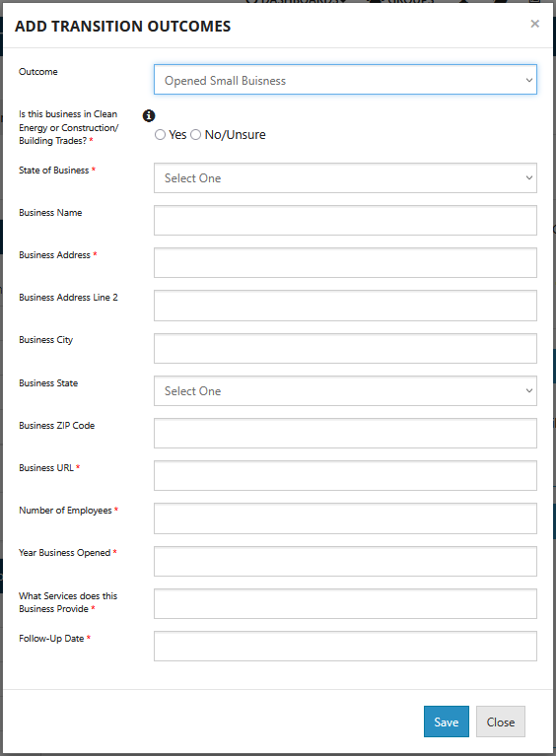
TRANSITION OUTCOMES OPEN SMALL BUSINESS

Slide 20
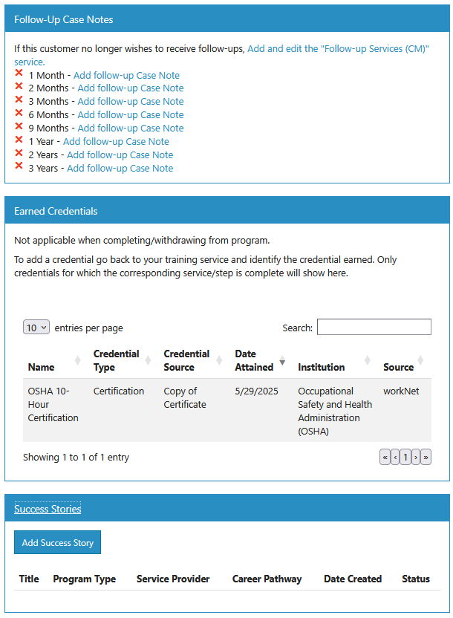
PROGRAM COMPLETION/FOLLOW-UP
FOLLOW-UP/CREDENTIALS/SUCCESS STORIES

Slide 21

THANKS FOR viewing!
The Illinois workNet Center System, an American Job Center, is an equal opportunity employer/program. Auxiliary aids and services are available upon request to individuals with disabilities. All voice telephone numbers may be reached by persons using TTY/TDD equipment by calling TTY (800) 526-0844 or 711. This workforce product was funded by a grant awarded by the U.S. Department of Labor’s Employment and Training Administration. For more information please refer to the footer at the bottom of www.illinoisworknet.com.

