Slide 1

Marketing Campaign Tactics
September 2022 – August 2026
by

Slide 2
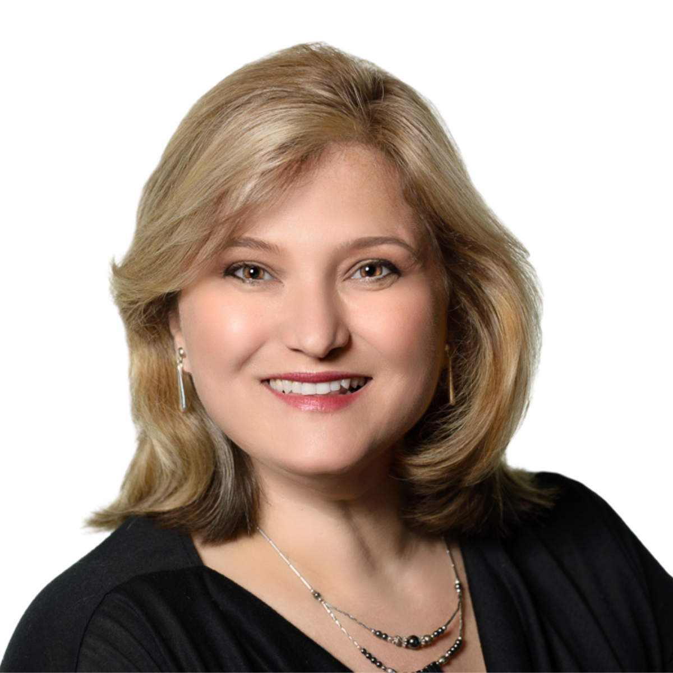



Our Leadership Team
Susan MacNicol – Founder/President
25+ Years of National and Global, Integrated Marketing Experience
Certified Recruitment Marketer
Strategic Marketing Expert
MBA – Pepperdine University
Tami Wloch – Digital Marketing Director
Advisory Panelist, Meta Corporate
Advisory Panelist, LinkedIn Corporate
SEO & Google Analytics Certified
International Speaker
Shilpa Chaubal – Marketing Manage r
5+ Years – Marketing & Project Manager
Traditional Marketing Tactics Expert
MBA – DePaul University

Slide 3
Marketing Tactics Agenda
Program Brochure
Conference Materials
Reporting Templates
Video Assets -
  Program Overview
  Day in the Life of the Apprentices
  Employer & Apprentice Testimonials
  45-Second Overview Video
  Workforce Employer Success Stories
  Workforce Employer Testimonials
Connected TV Advertising
Paid Social Media Ad Campaigns -
  LinkedIn, Meta and Reddit

Slide 4
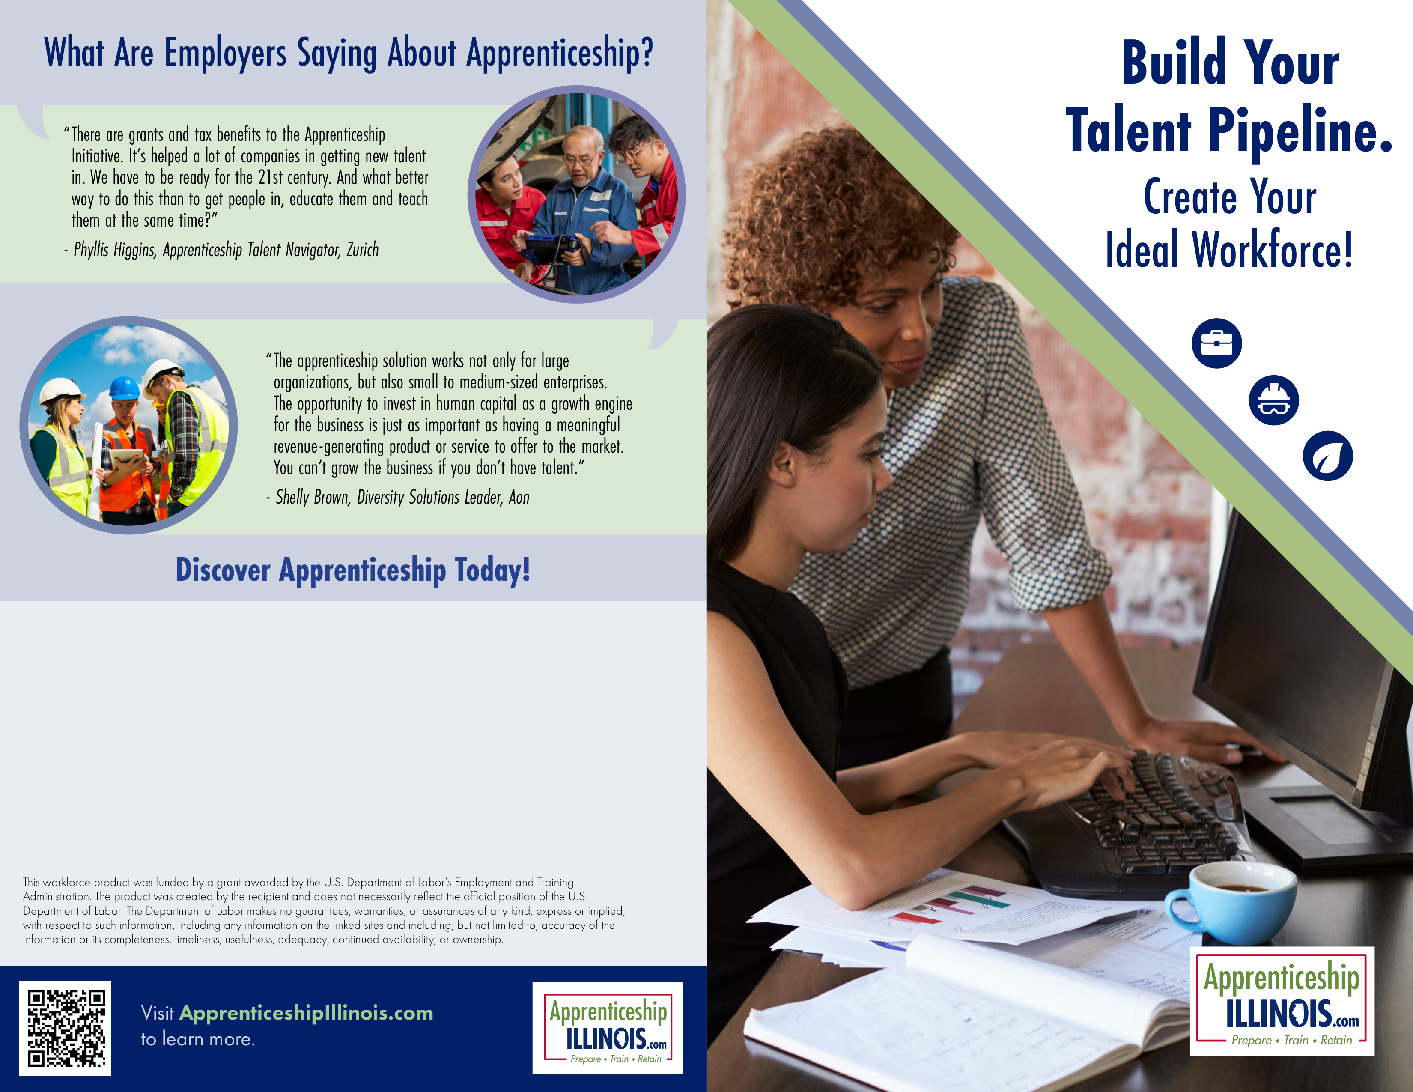
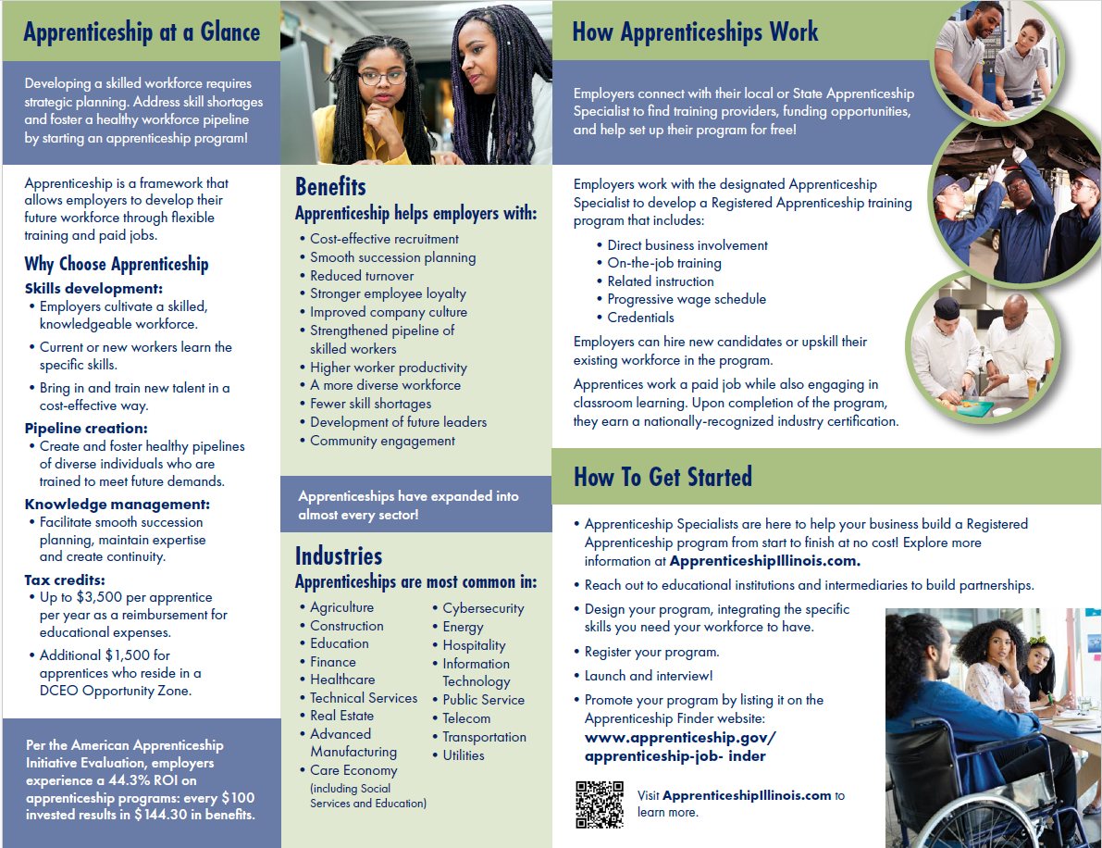
Editable Program Brochure
4-page branded editable brochure
Overview, benefits, and getting started
Customizable contact info block
Brochure Available at:
https://www.illinoisworknet.com/ApprenticeshipIL/Pages/Outreach.aspx

Slide 5
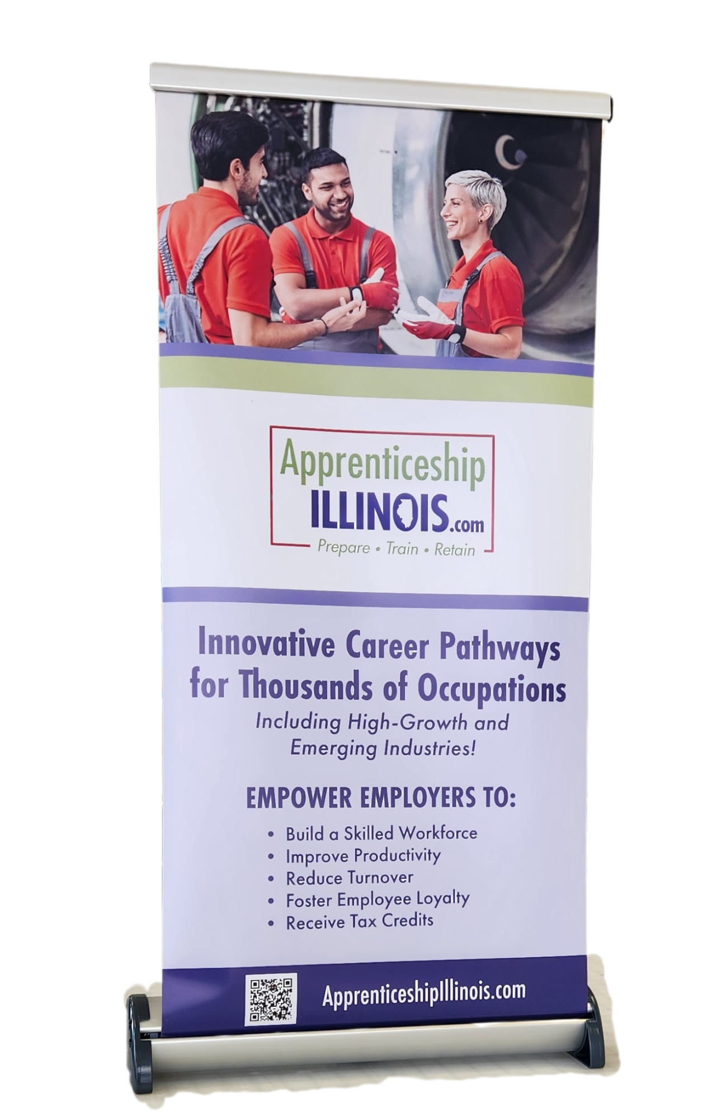
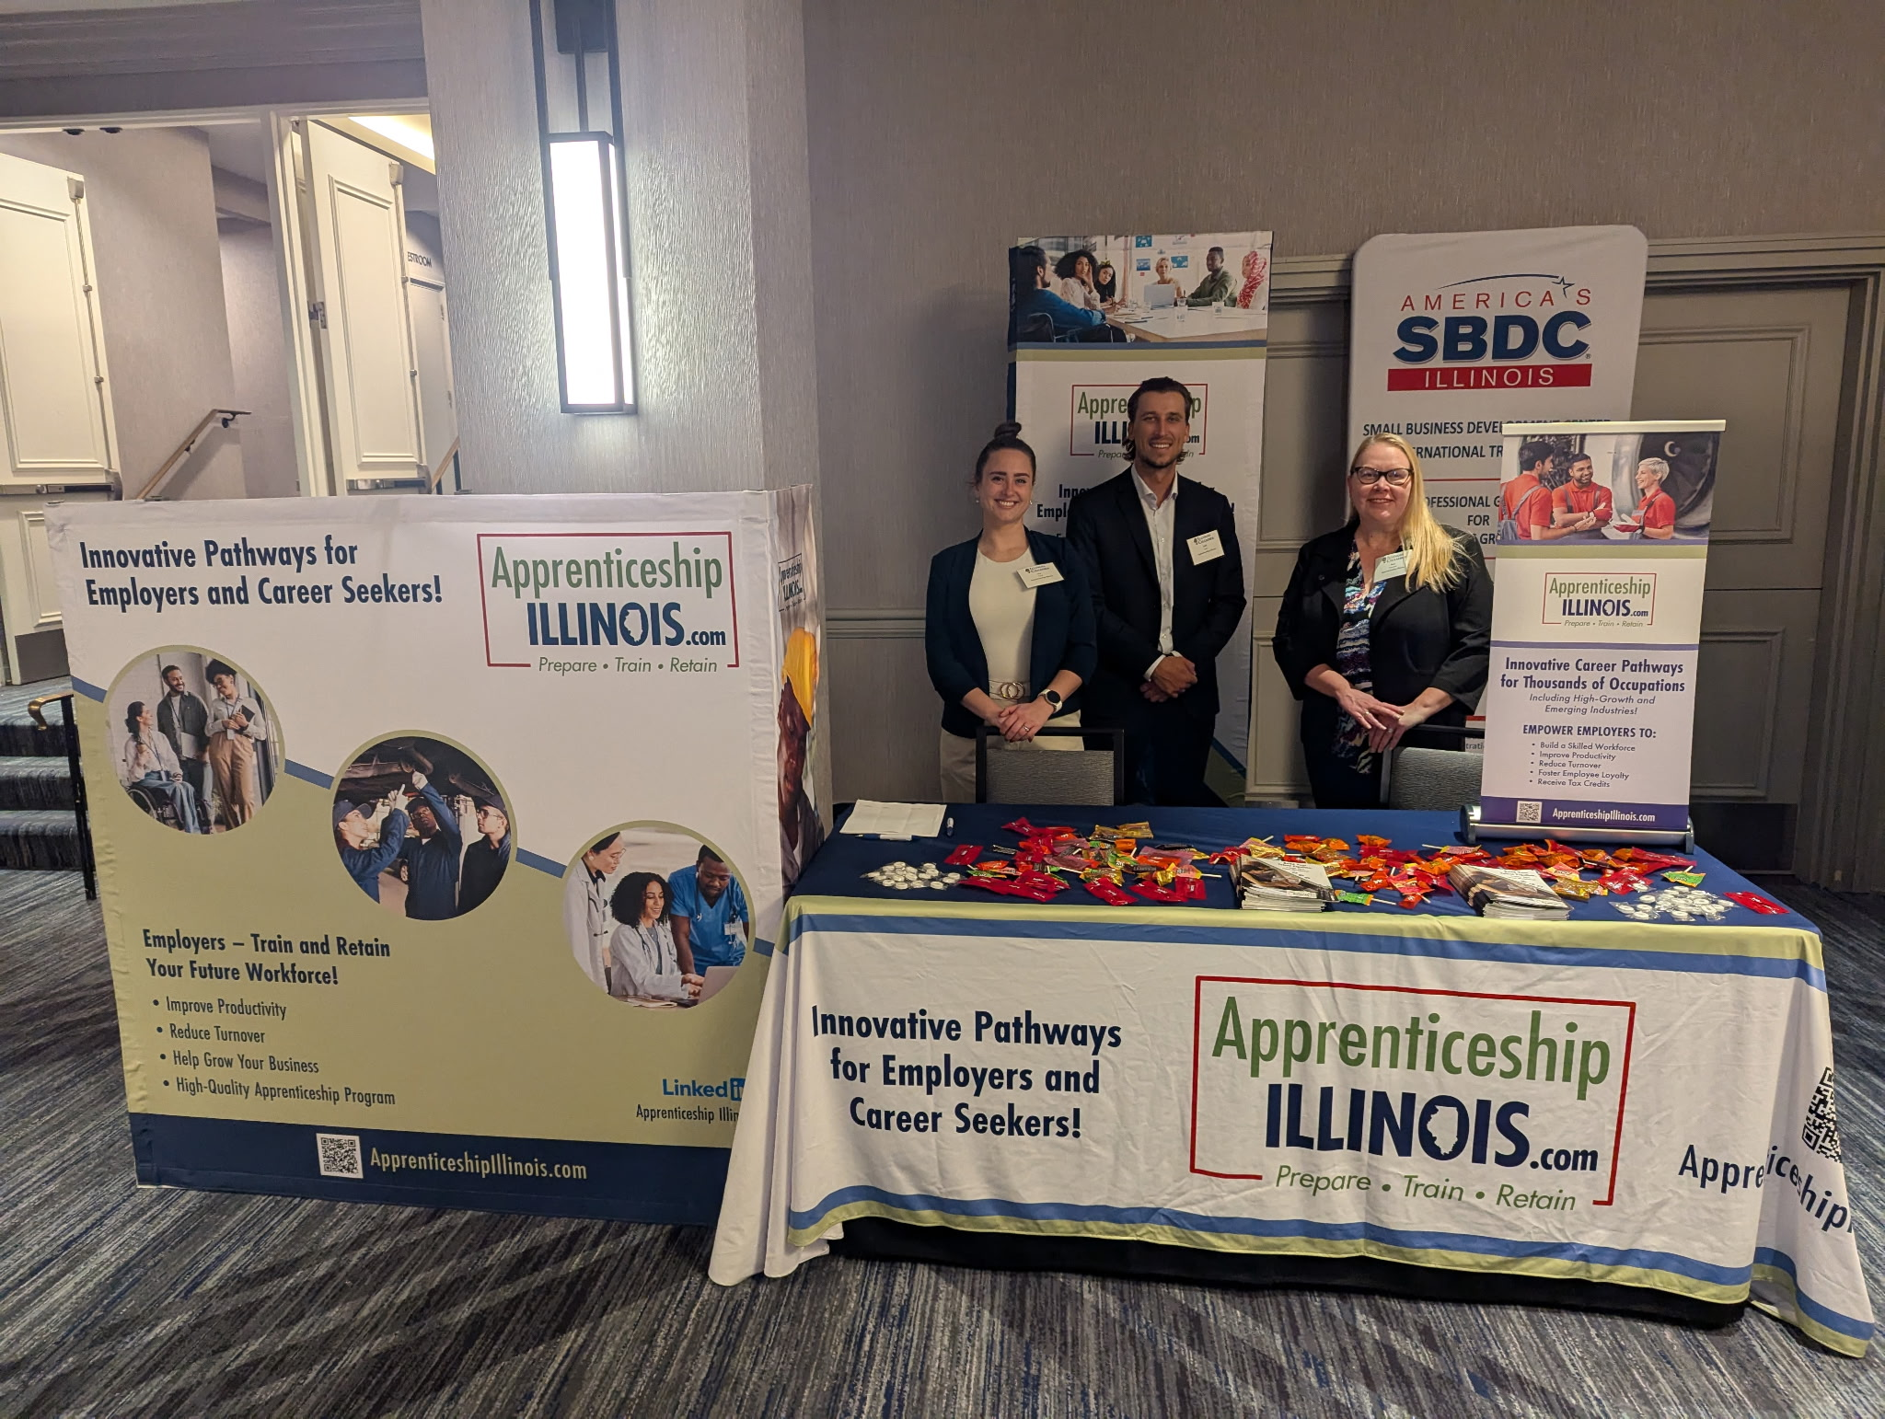
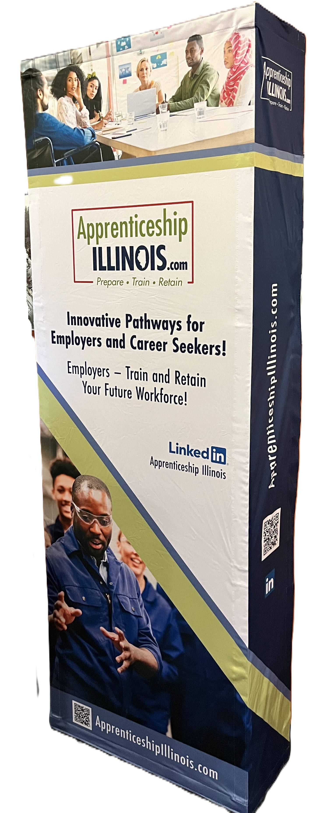
Conference Materials
Branded trade show display materials
  Tall floor banner
  Table Top banner
  Scroll Up signage
  Tablecloth
Shipped to DCEO’s Northern, Central and Southern regional offices
Trade Show Pieces Available at: https://www.illinoisworknet.com/ApprenticeshipIL/Pages/Outreach.aspx

Slide 6
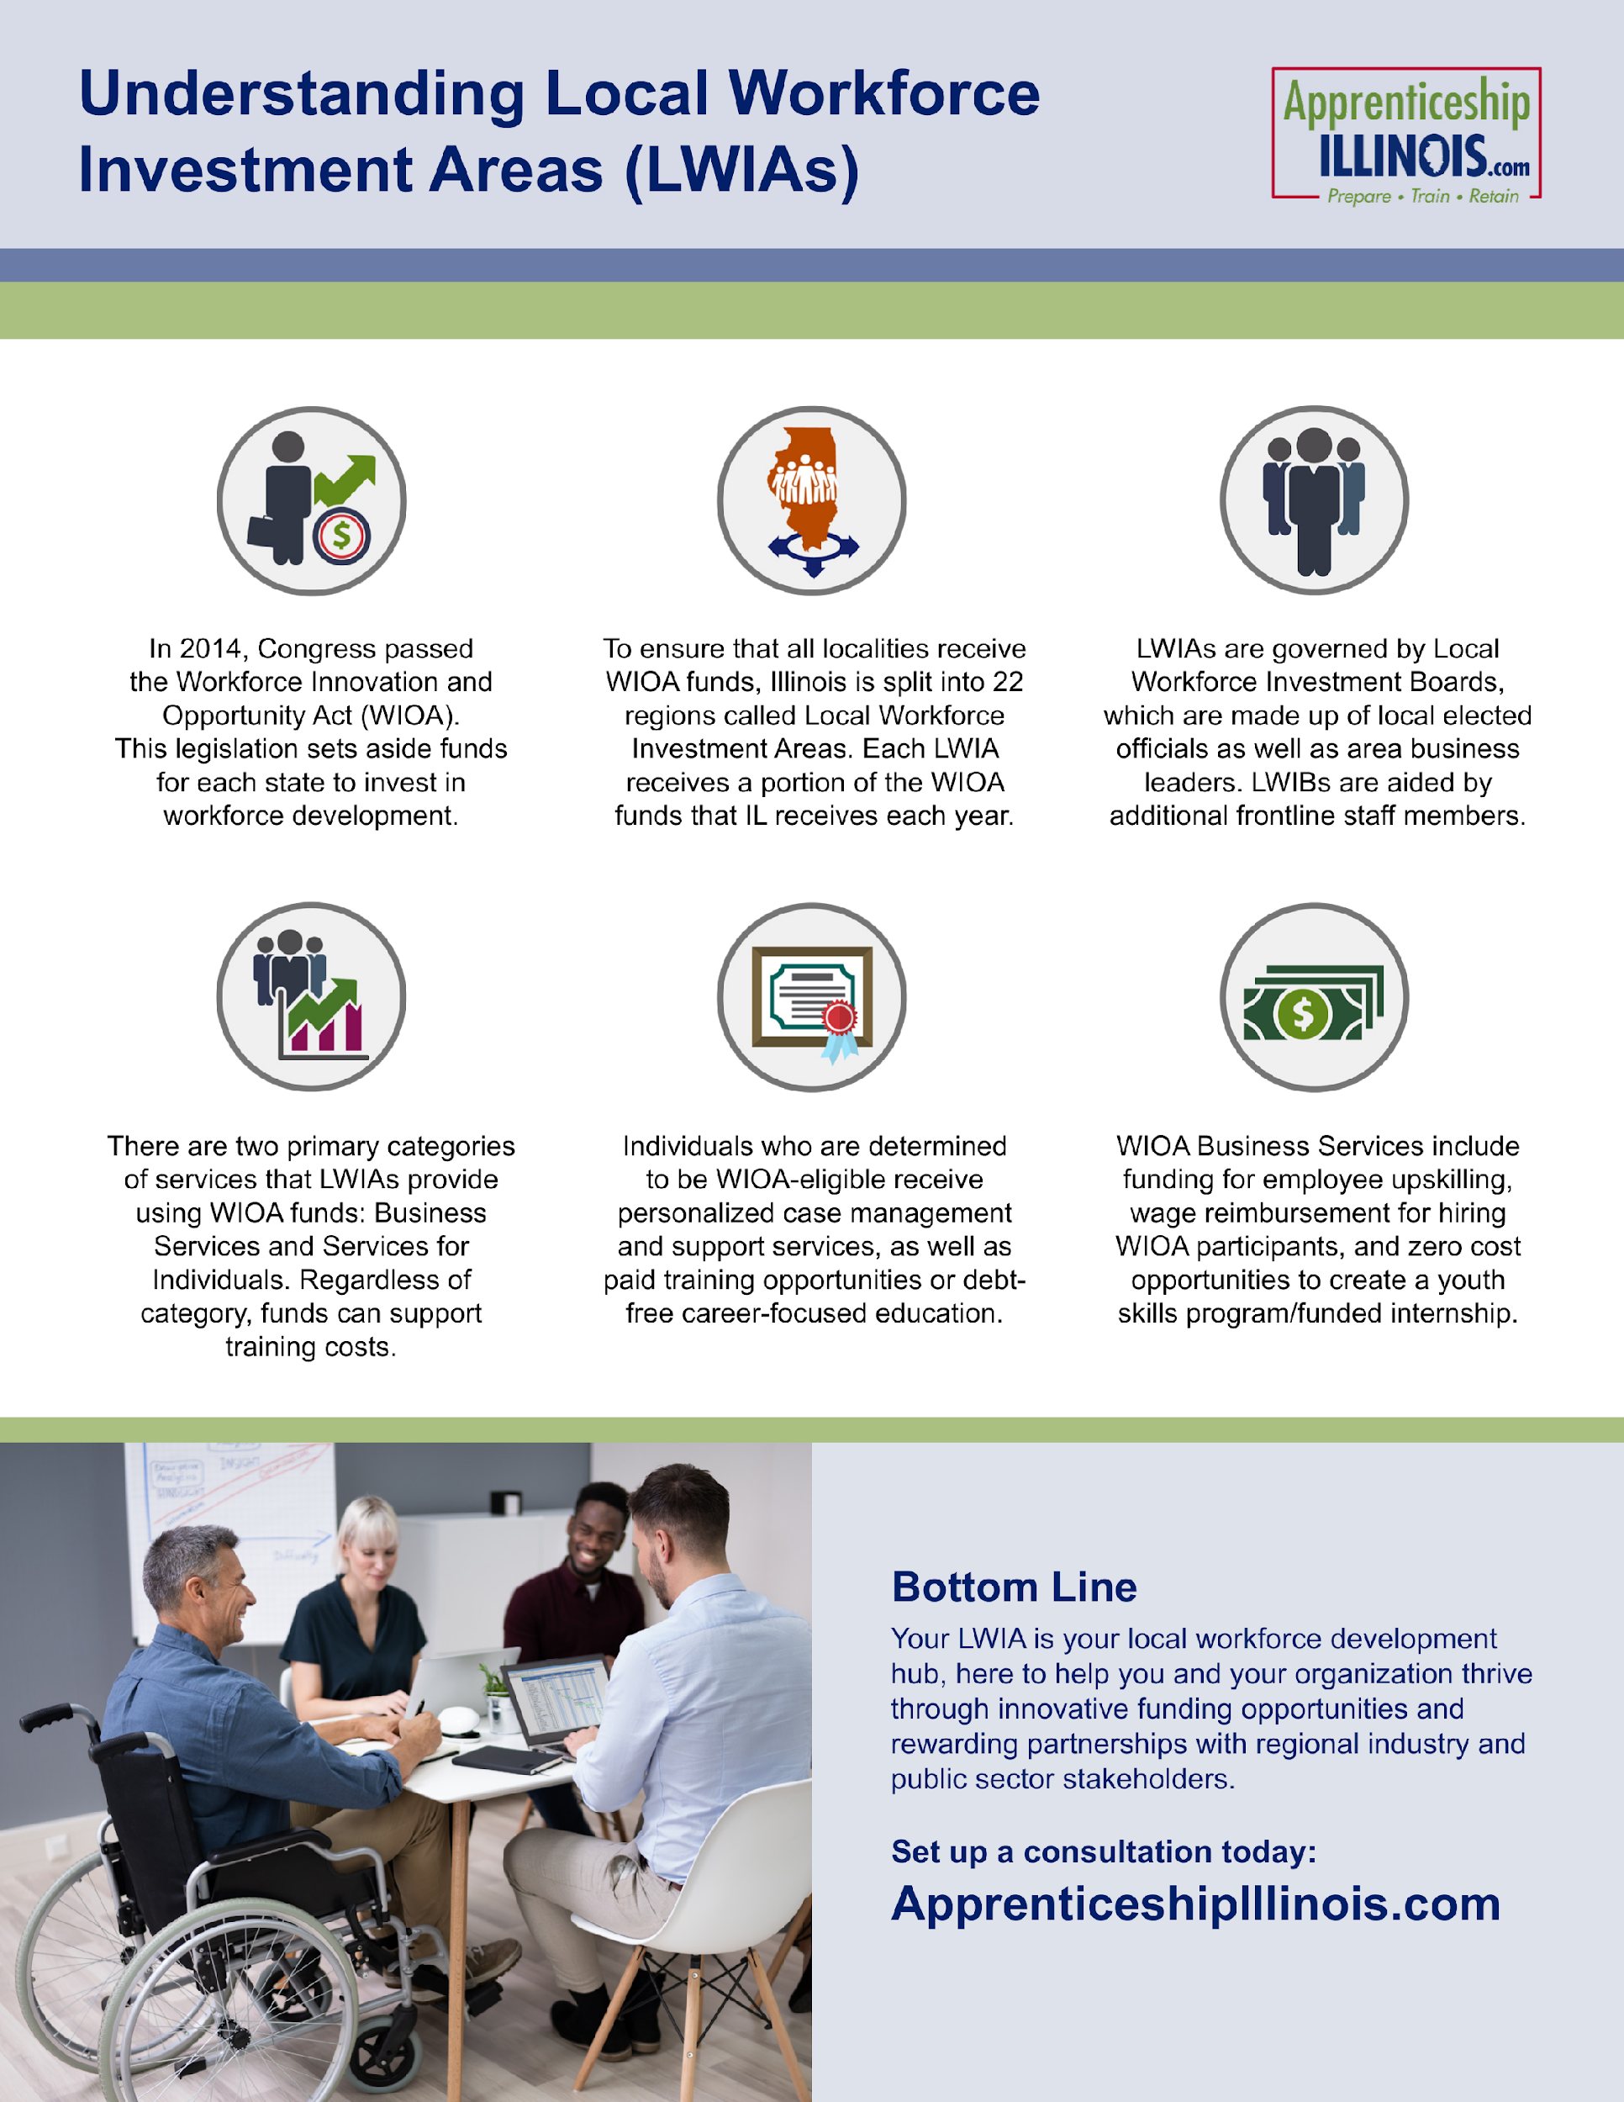
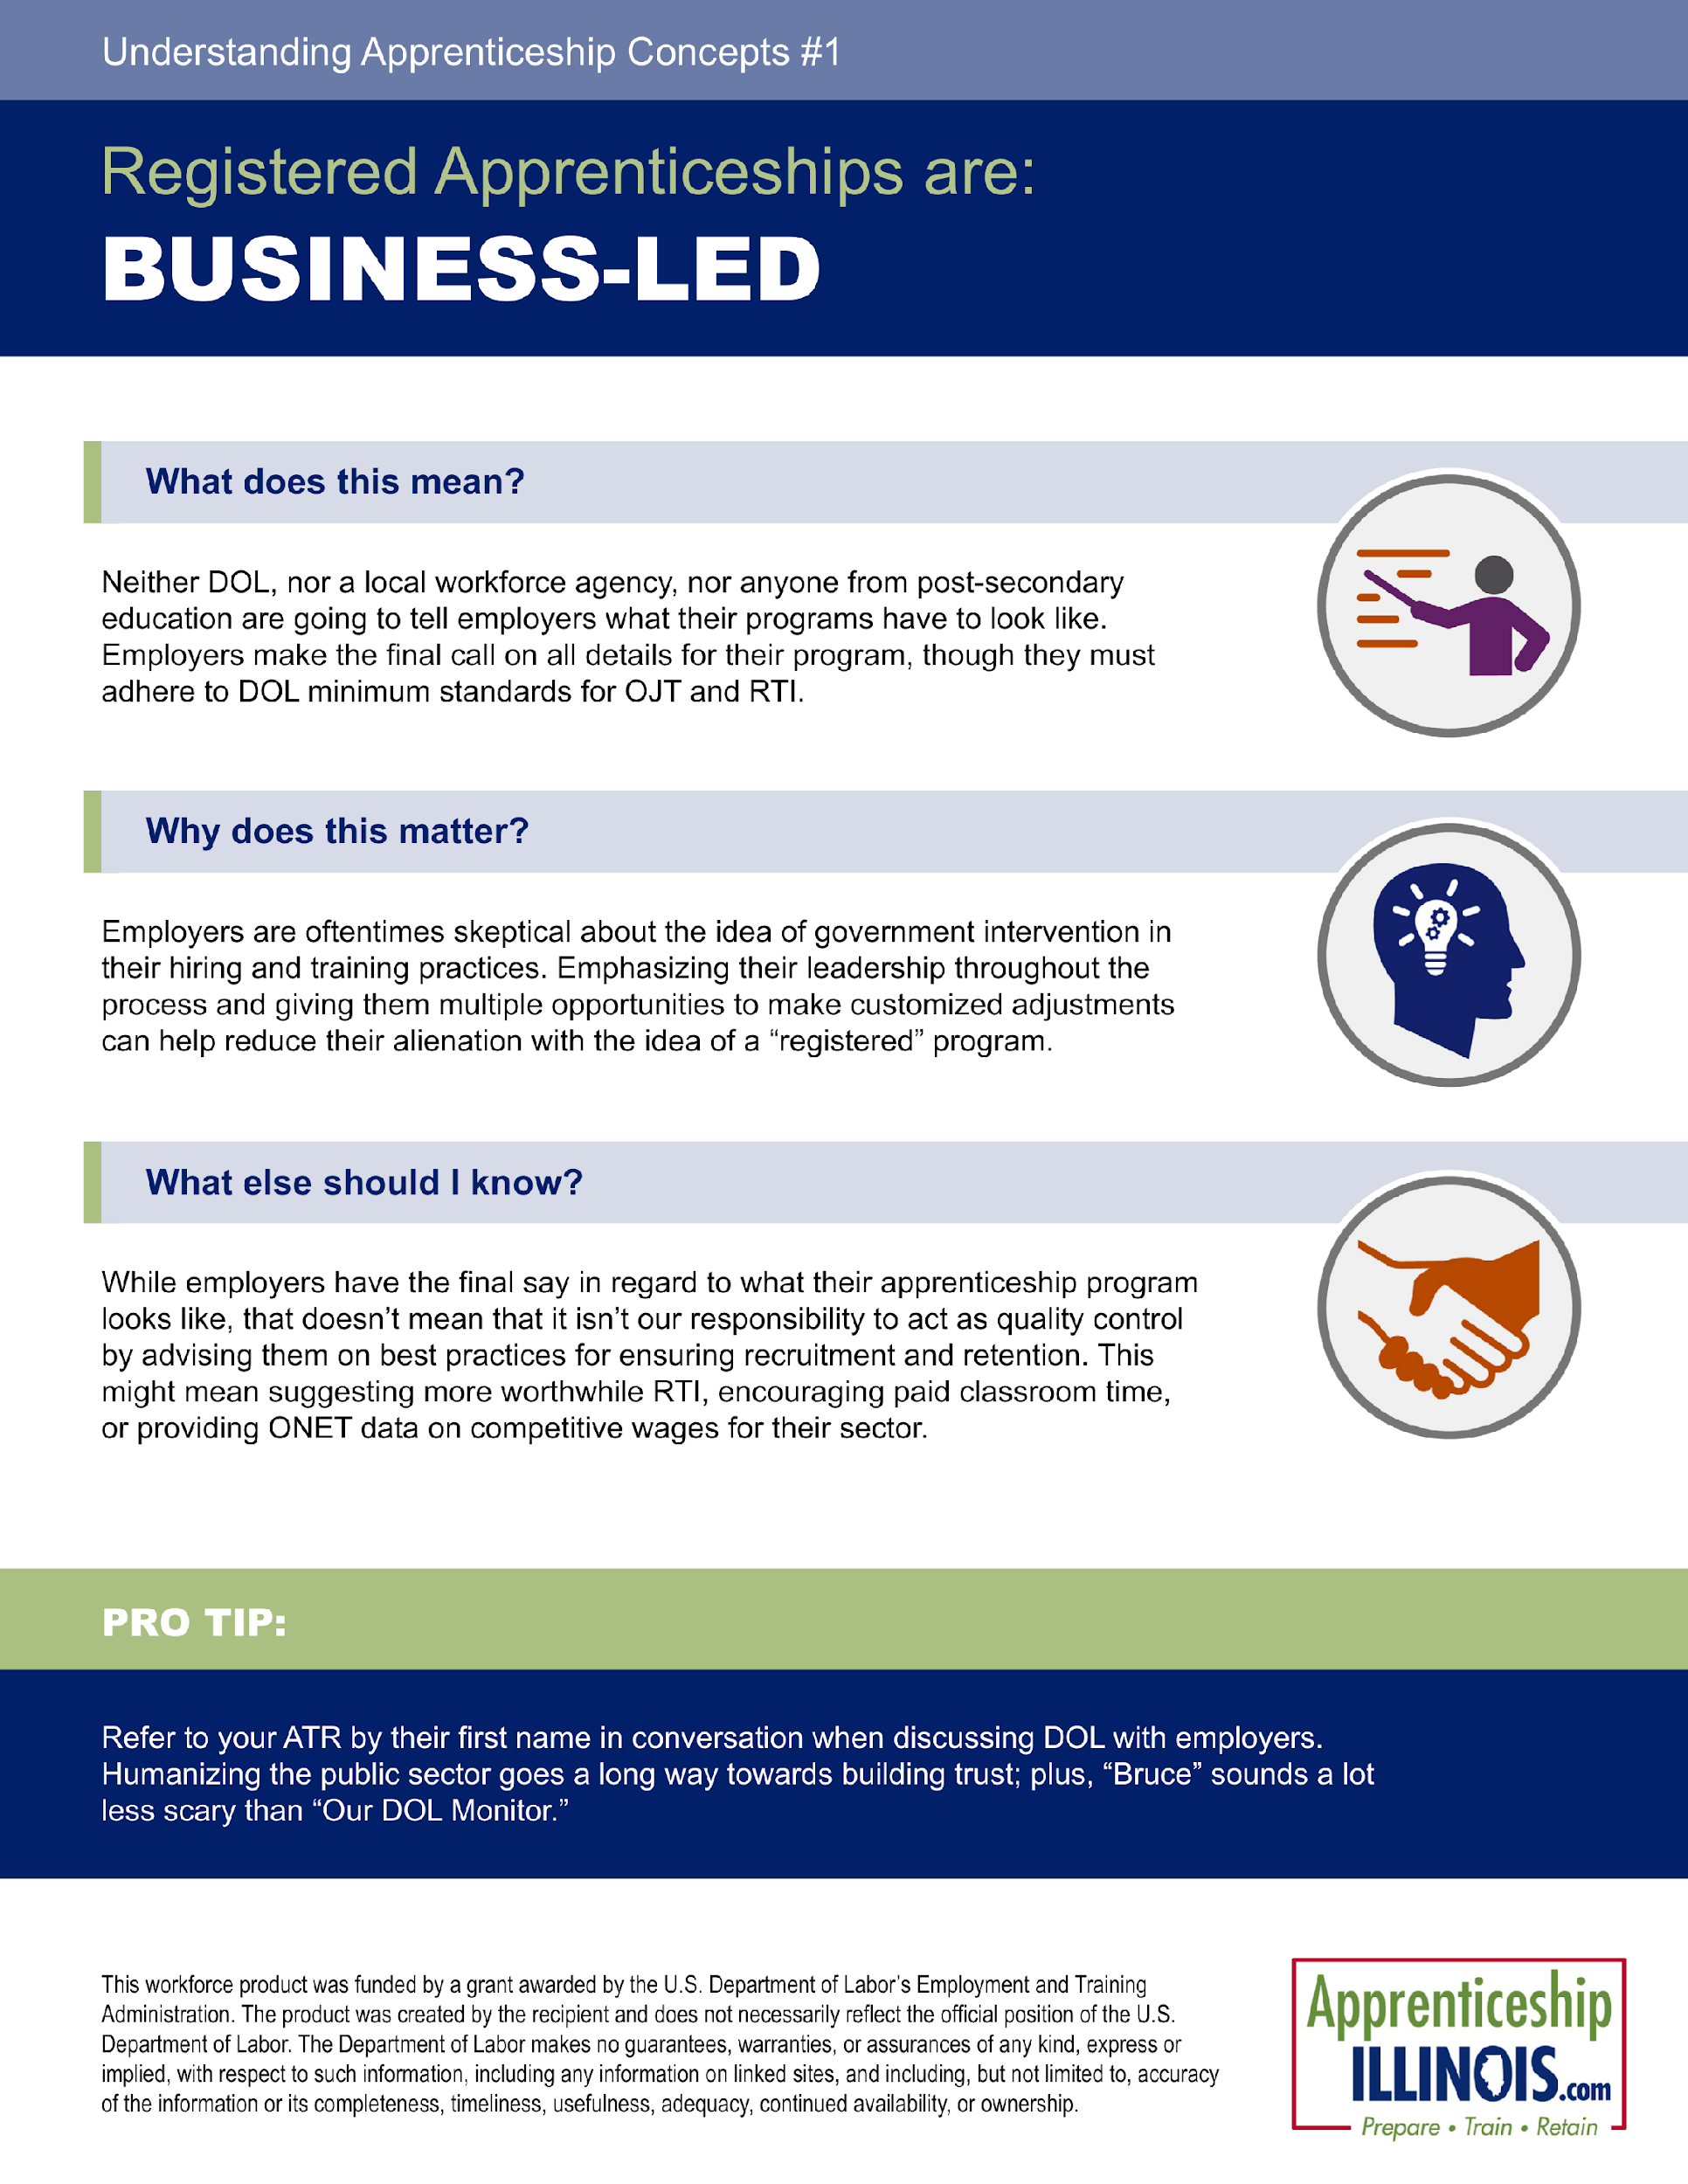
Reporting Templates
Branded reporting templates in PDF & Word format for grantees & specialists –
Program Classification Guide
Specialist Process Guide
Understanding LWIAs
Employer Playbook
DOL Components
Cover Page template
Reporting Templates Available at:
https://www.illinoisworknet.com/ApprenticeshipIL/Pages/Outreach.aspx

Slide 7
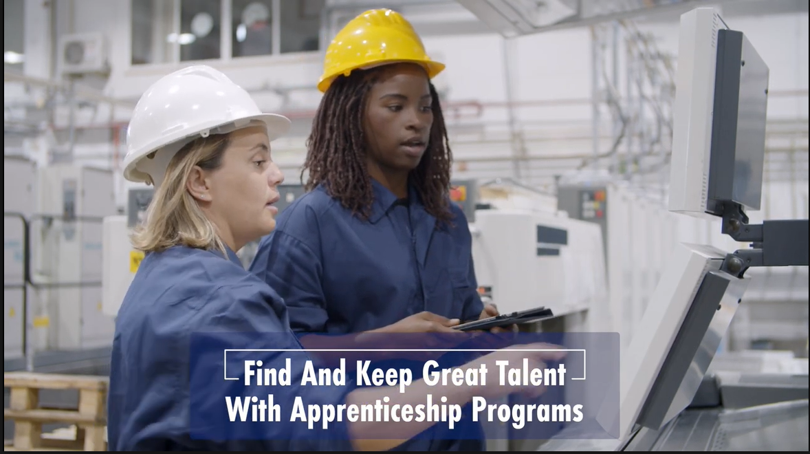
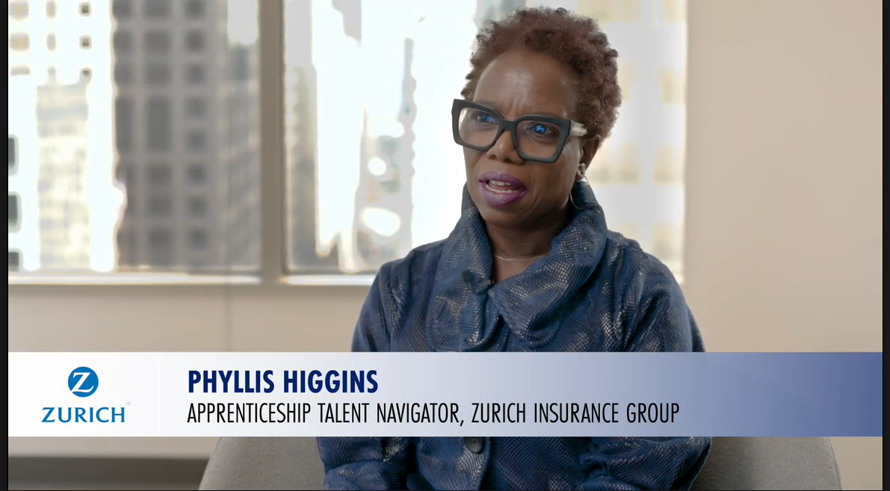
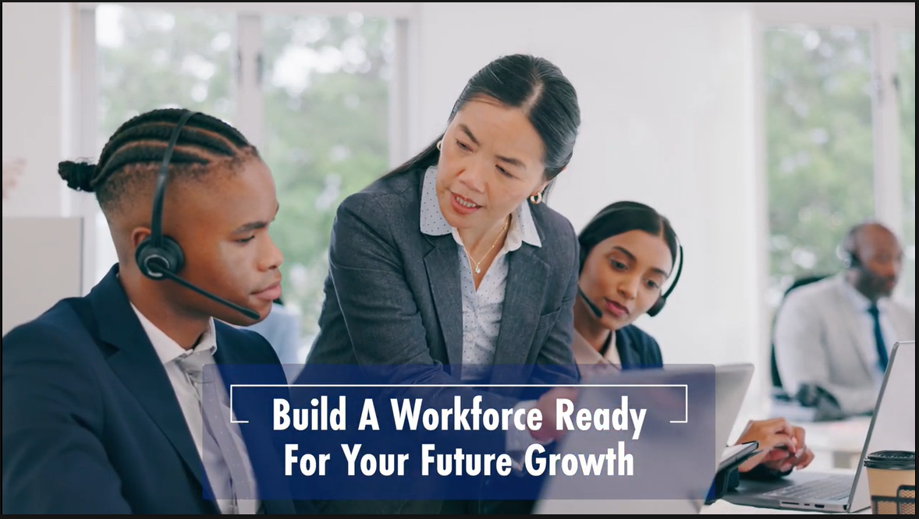
Overview Video
Branded video featuring stock footage and interviews from
  May 2023 Chicago Apprenticeship event
  3 Sisters Logistics
  Quad Graphics
Highlighted key program benefits for both employers & employees.
Positioned the program as a strategic growth engine for businesses.
Click to view –
Apprenticeship IL Overview Video

Slide 8
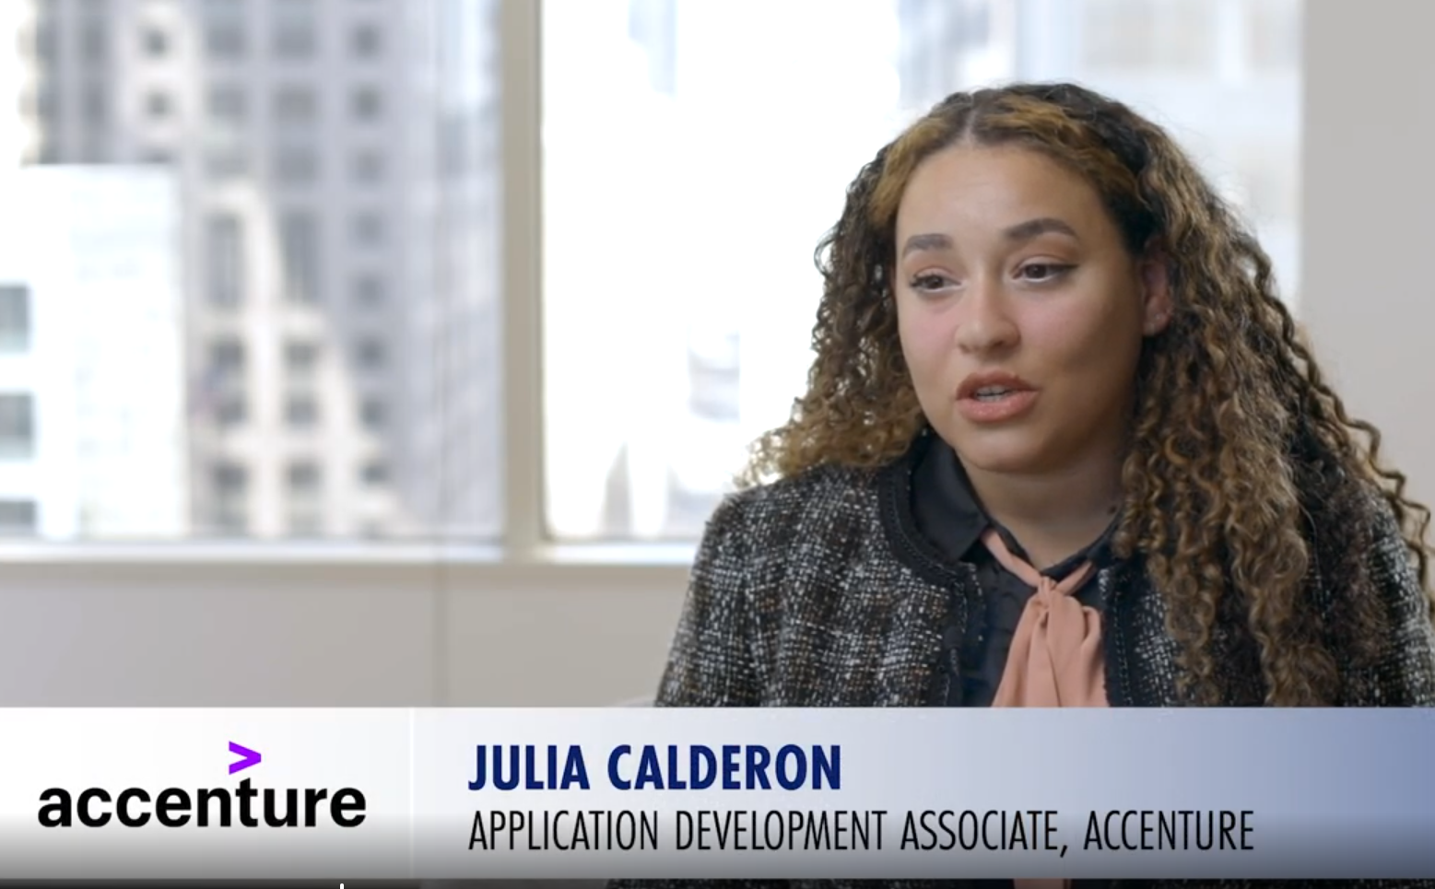
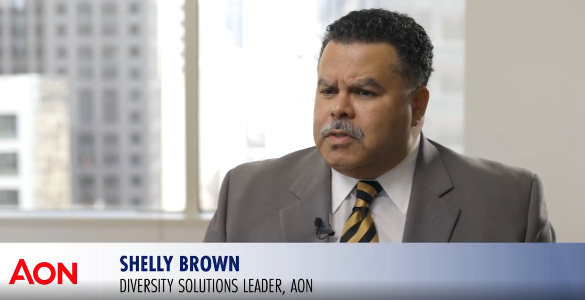
Employer & Apprentice Testimonials
Interviewed employers and apprentices at May 2023 Chicago Apprenticeship event
Captured authentic success stories and impact and benefits of the program
Produced (10) short social-ready clips in Vertical and Horizontal format
Used in digital ad campaigns
Testimonials available on the Illinois workNet YouTube Channel
Click to View - Apprentice Success Story
Click to View –
Employer Success Story

Slide 9
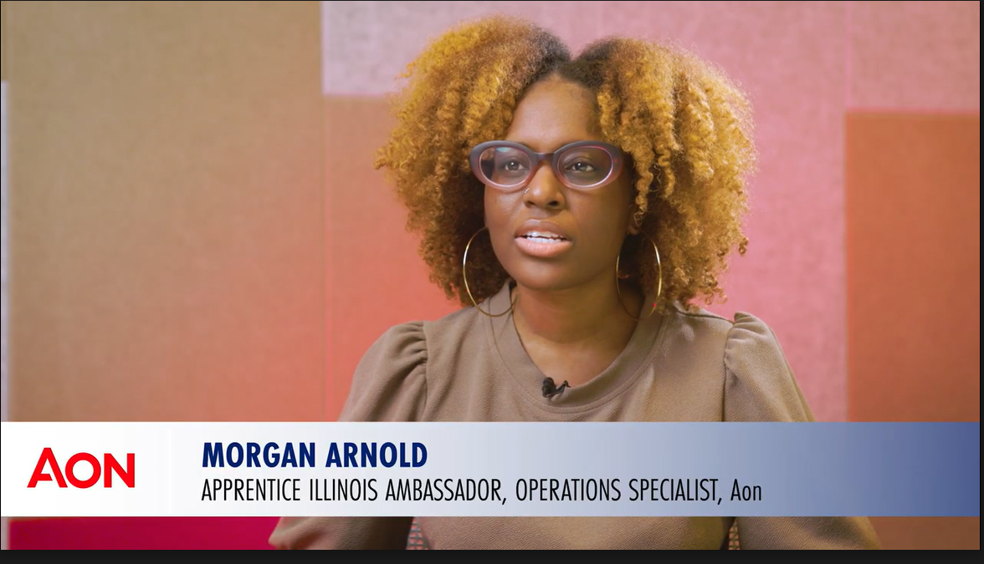
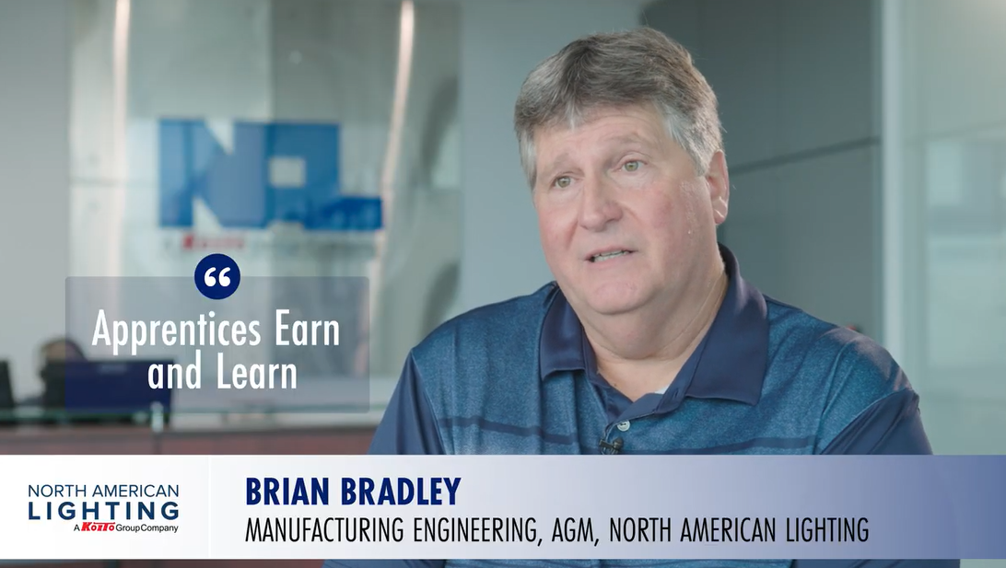
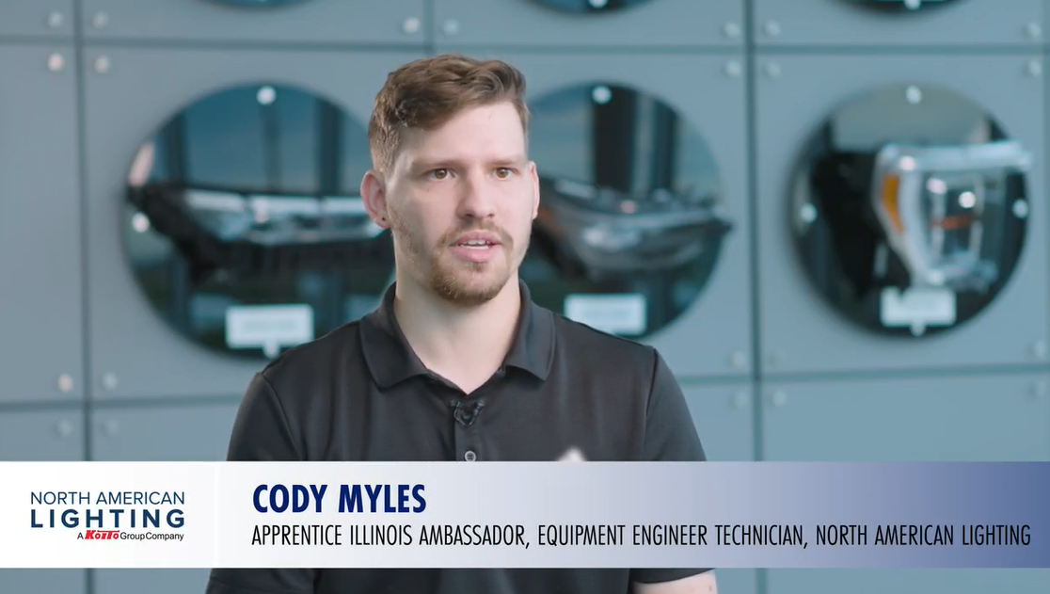
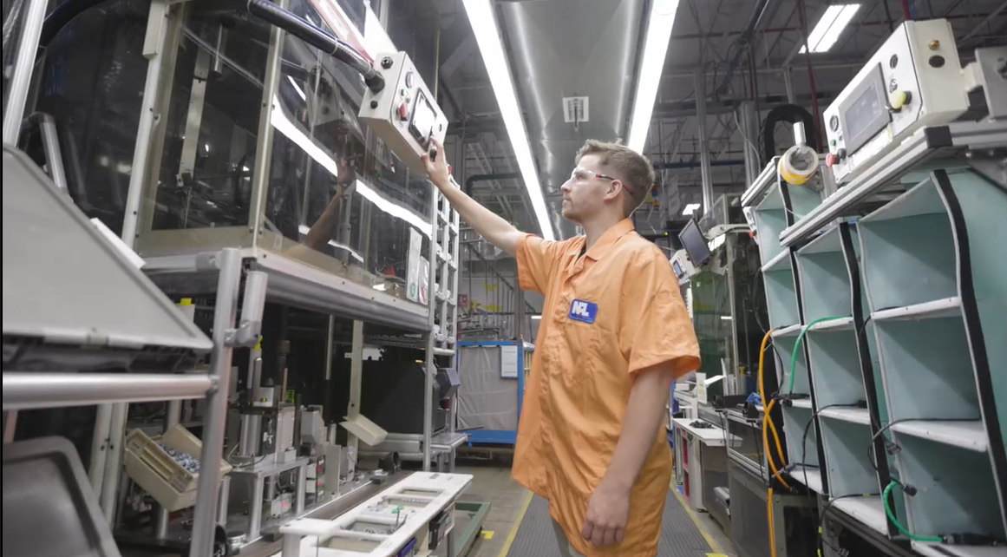
Day in the Life of the Apprentices Video
Filmed and interviewed employers and apprenticeship ambassadors at
  June 2024 Chicago Apprenticeship event
  National American Lighting (NAL)
  Aon
Showcased the program’s impact on apprentices and benefits to businesses
  Click to view –
  A Day in the Life of Apprentices Video

Slide 10
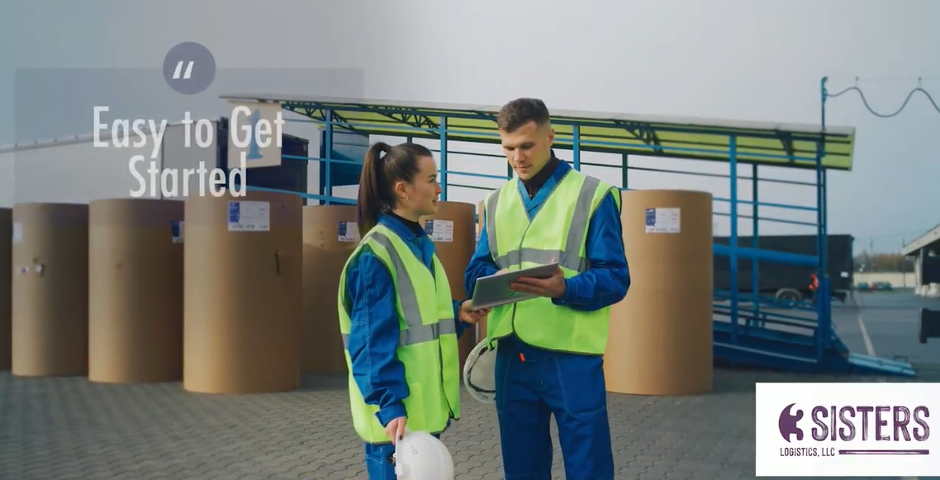
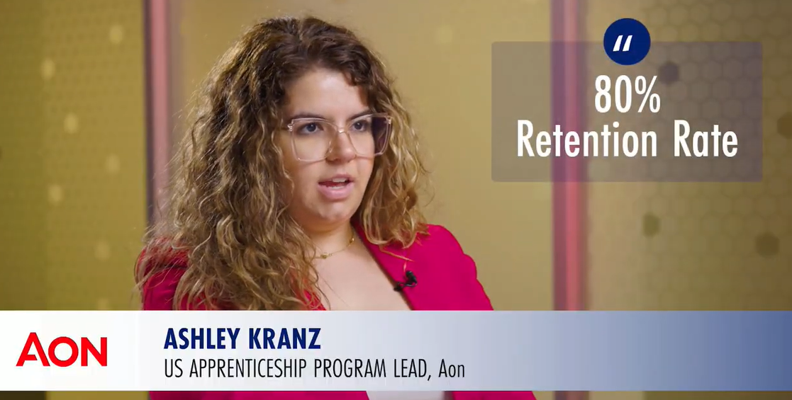
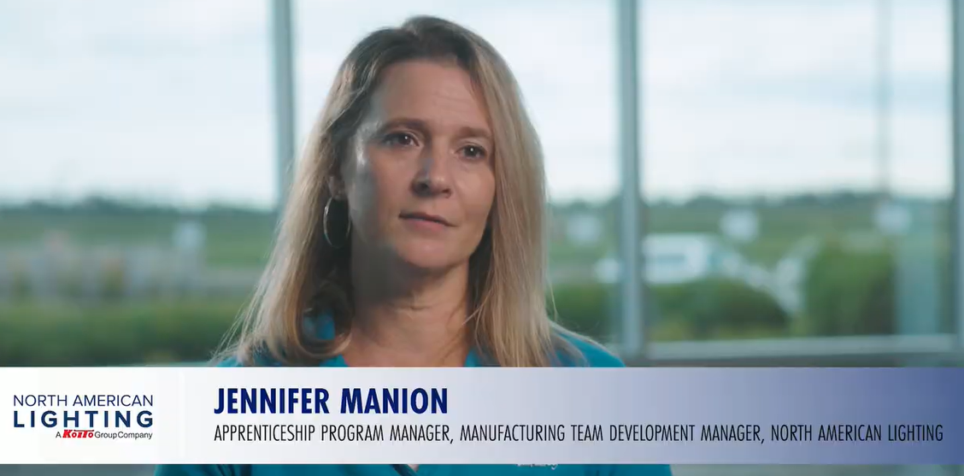
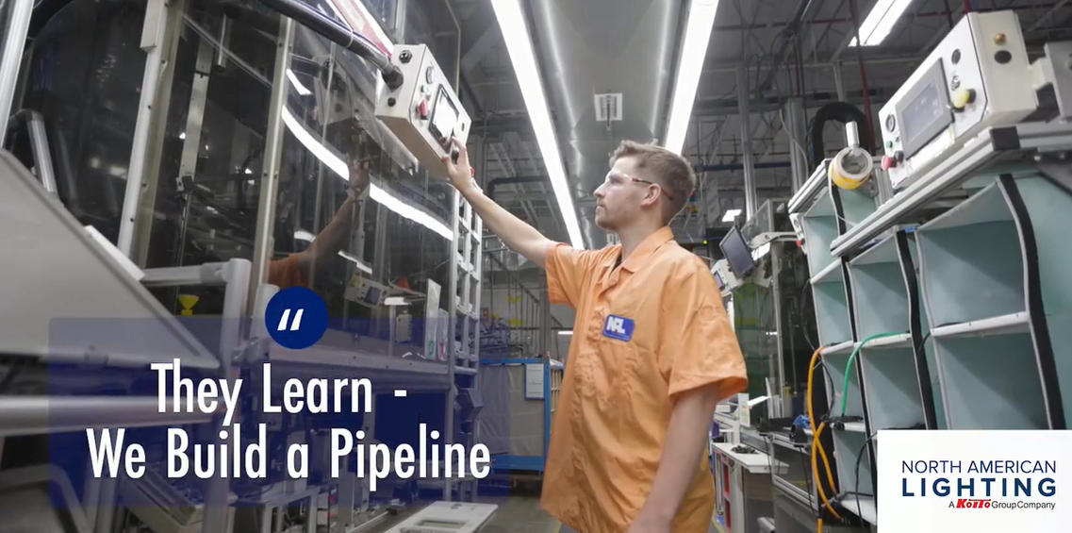
45-Second Overview
Video Reel
Produced a short employer benefits reel
Footage from three IL employers
  3 Sister Logistics
  National American Lighting (NAL)
  Aon
Used across digital ad campaigns
Click on the link below to view
Apprenticeship IL 45-Second Overview Video

Slide 11
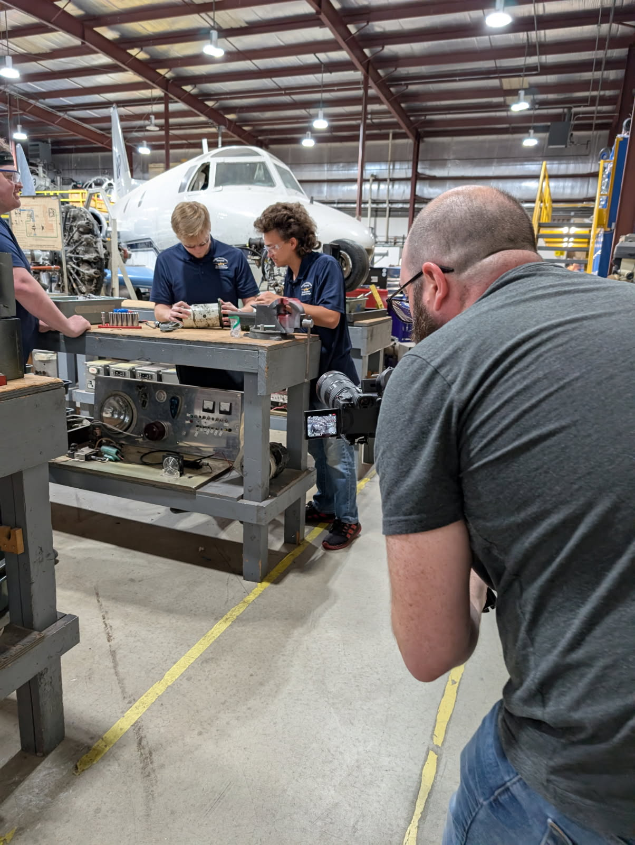
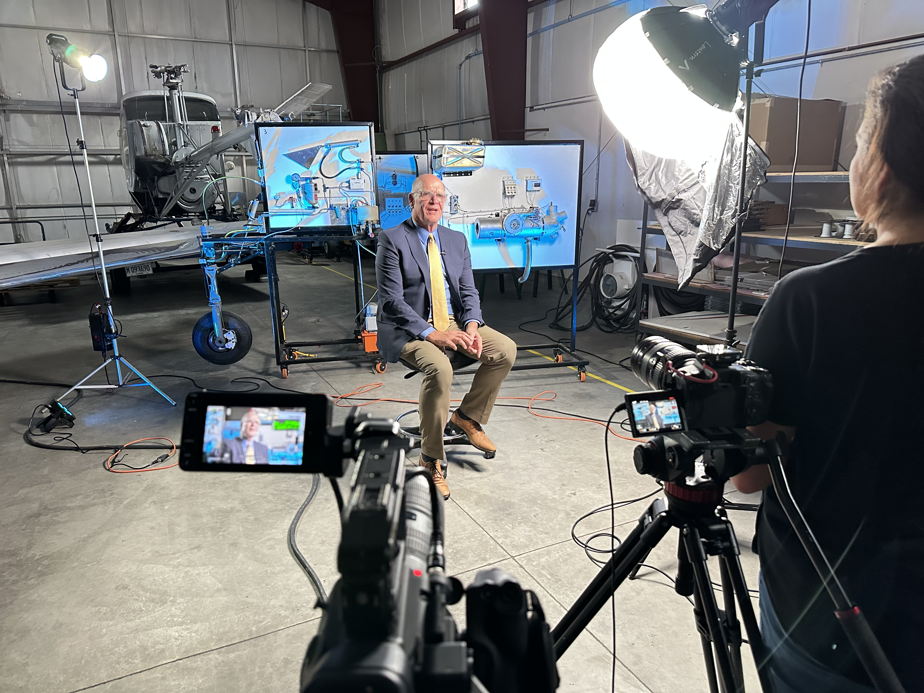
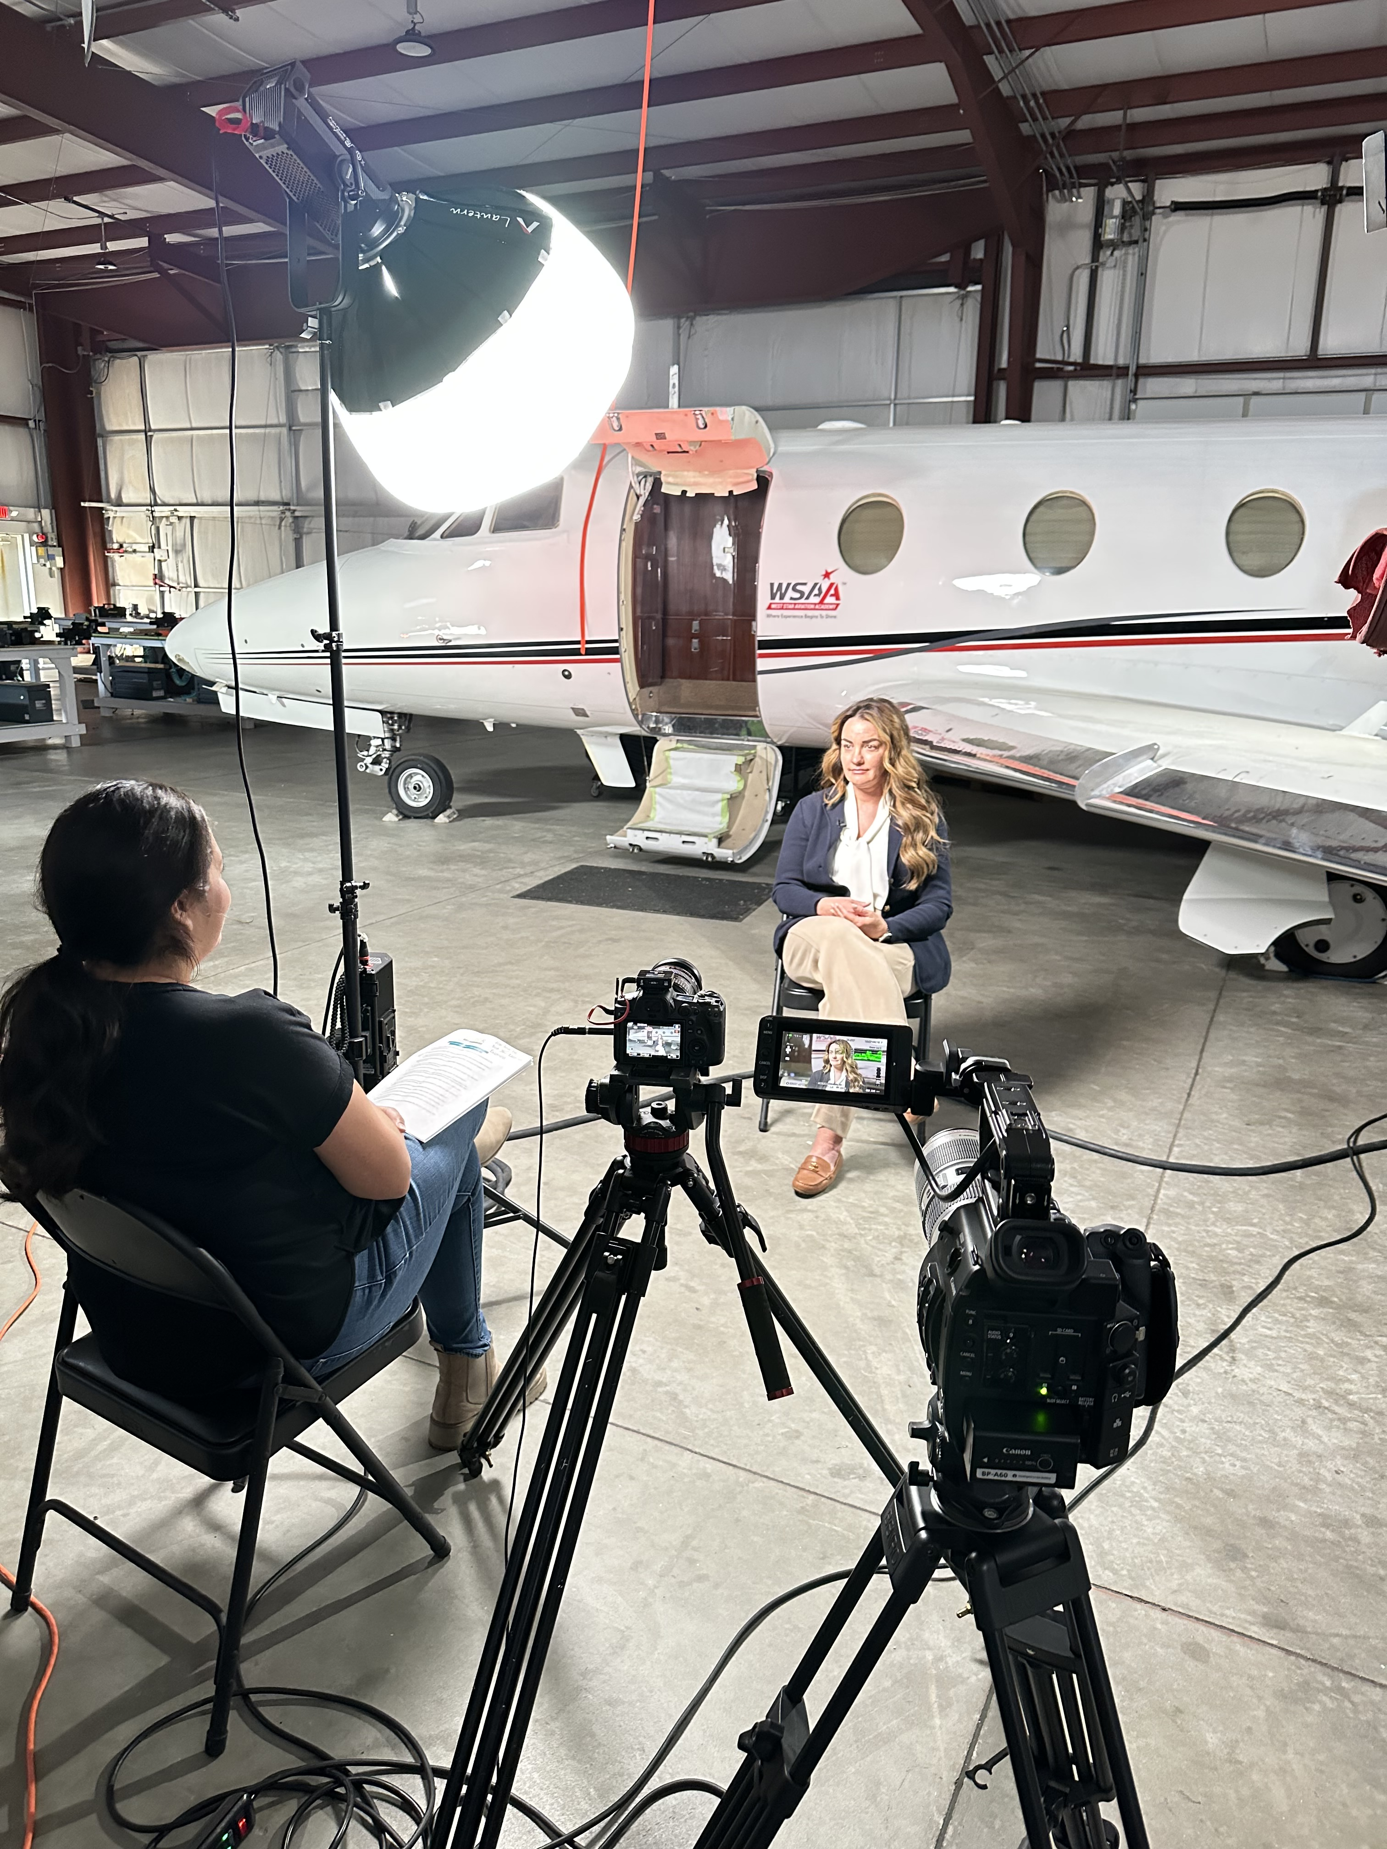
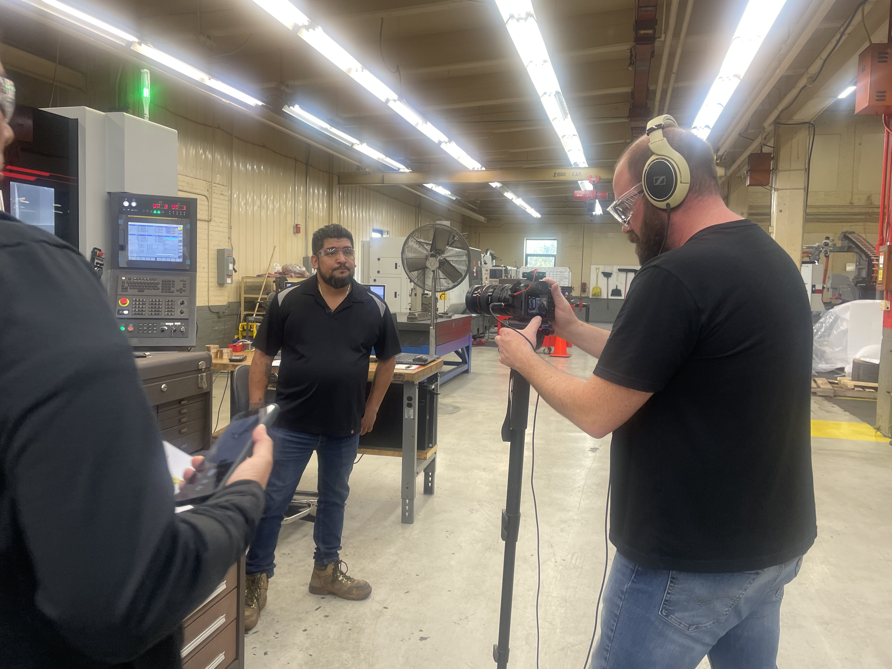
Workforce Employer
Success Story Video Shoot
Filmed and interviewed workforce partners and employers in 2025. Featured-
Madison County - Katie Johnson (West Star Aviation), Tony Fuhrmann (Madison County Workforce), and Mike Conley (SWIC)
Rockford - Todd Wells (Bourn & Koch), Casey Schwebke (RRVTMA) and Dr. Ginna Caronna, Collin Ruthe (Rockford TWC)

Slide 12
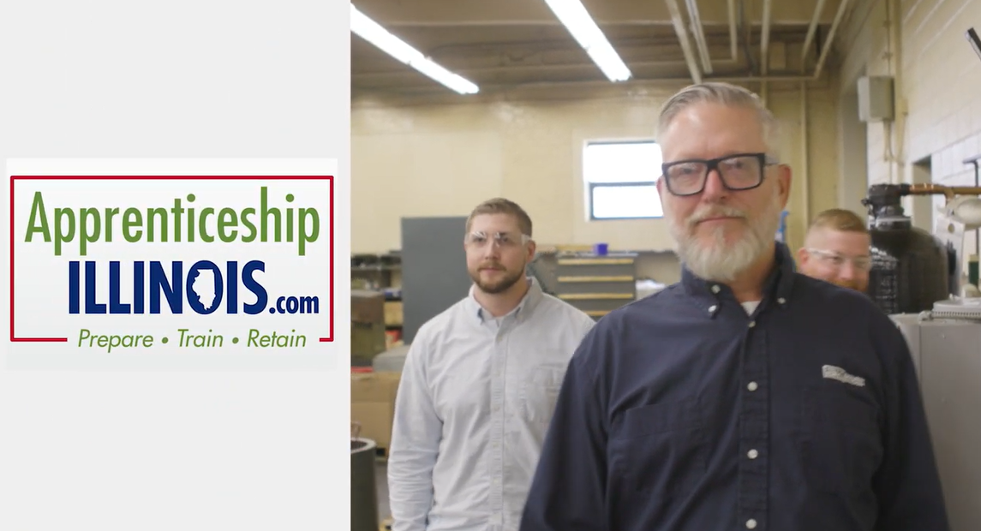
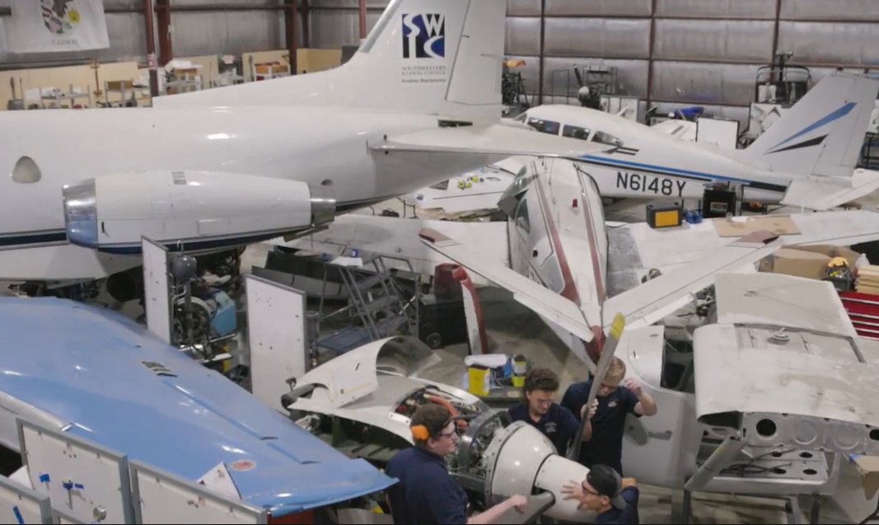
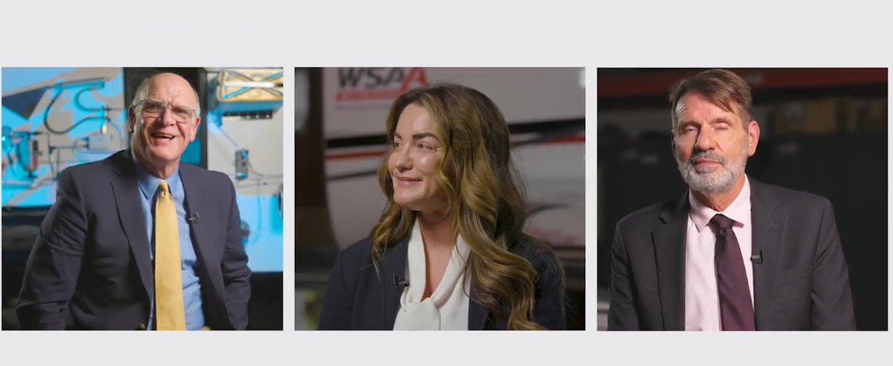
Workforce Employer
Success Story Videos
Produced 3 video formats:
5-minute
2-minute
(10) short social media ready videos
Showcased Workforce - Employer Apprenticeship Success Stories featuring:
Bourn & Koch at Rockford
West Star Aviation at Madison County.
5-MIN Workforce Employer Video
2 Min Workforce Employer Video

Slide 13
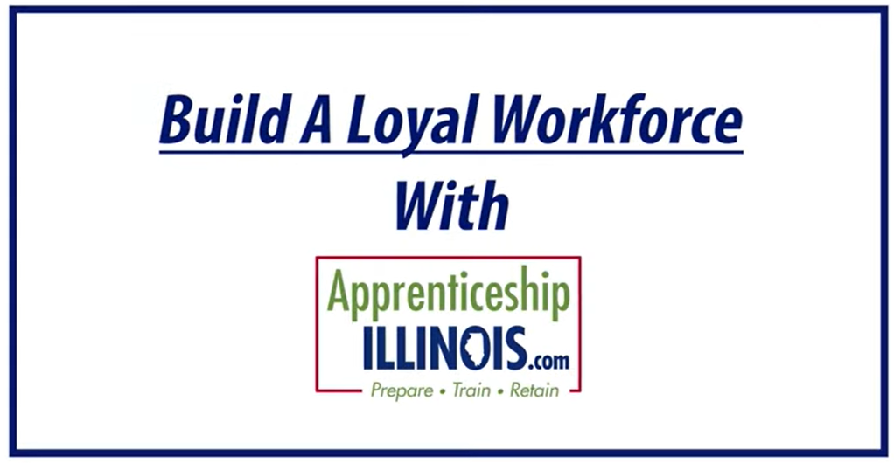
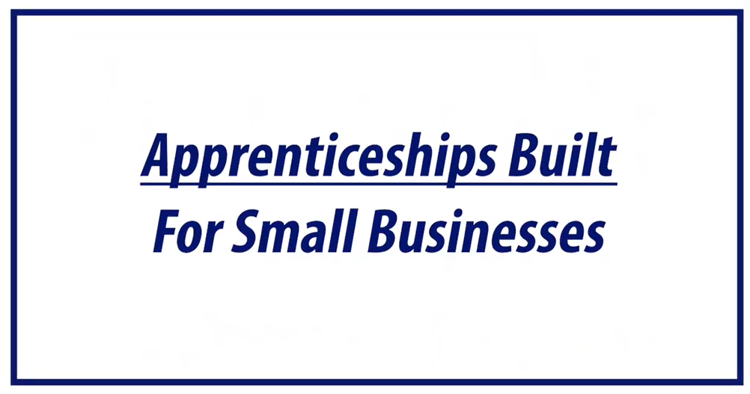
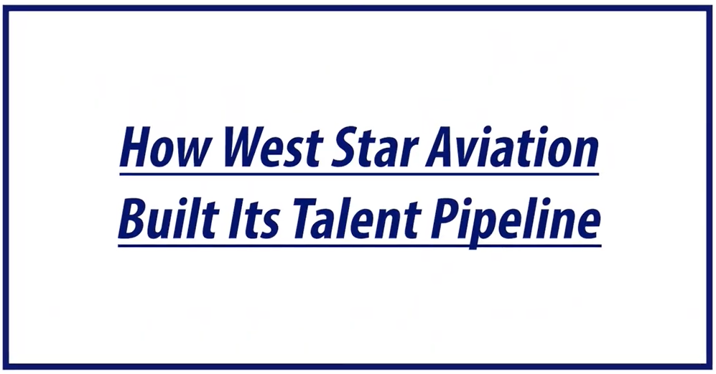

Workforce Employer
Success Story Testimonials
Produced 10 short-form videos (45–59 sec.) showcasing key features and program benefits such as Flexibility, Retention, Loyalty, Free Support & More
Created horizontal and vertical versions optimized for social media
Click on the images below to view some of the snippets:
Click to View –
Tailored Apprenticeship Solutions

Slide 14
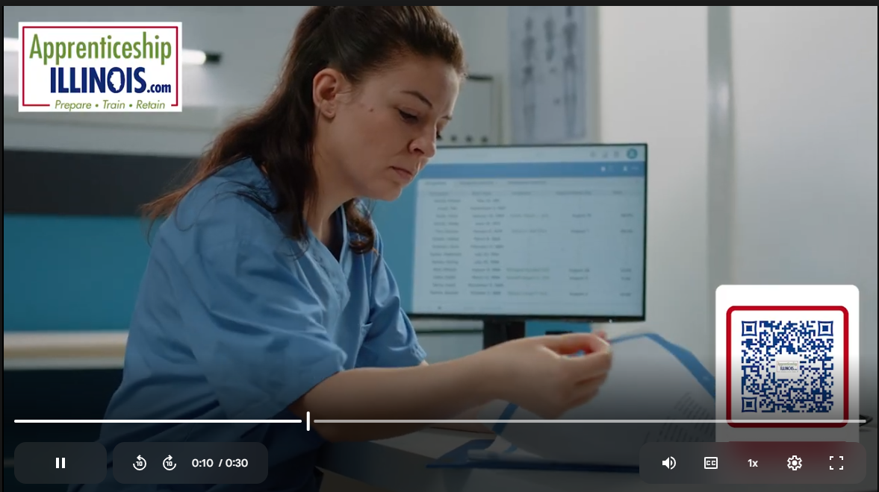
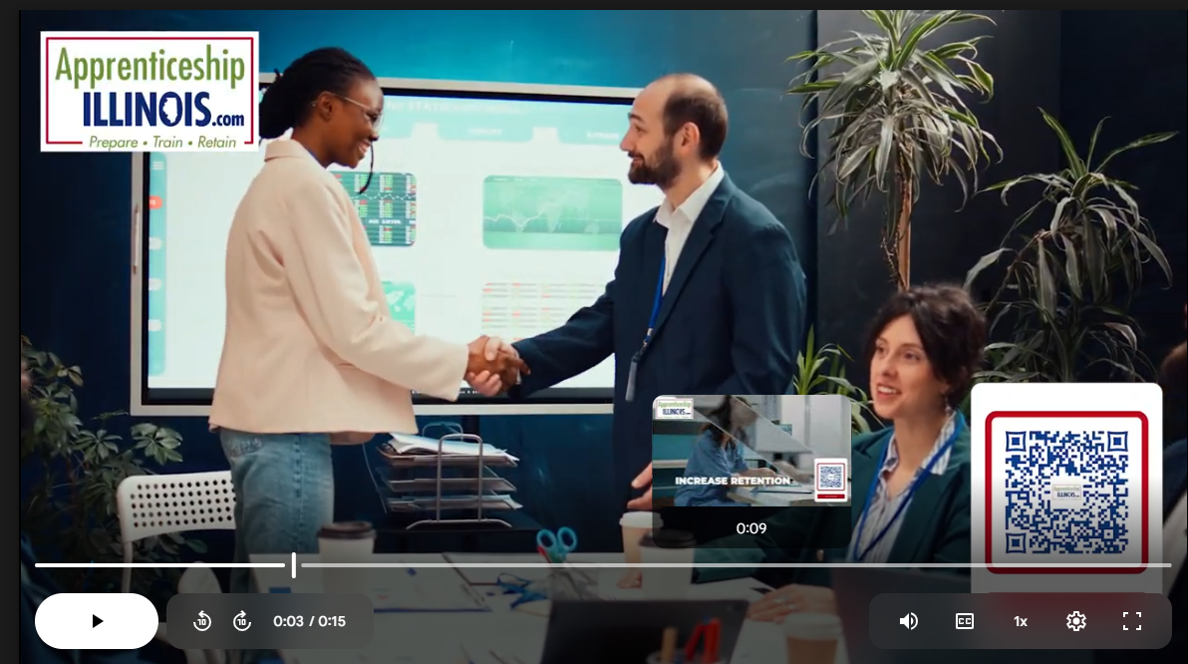
Connected TV Ad Spots
Created 30- and 15-second video spots
Produced high-energy, fast-paced, broadcast-quality videos
Focused on key employer benefits
Delivered via LinkedIn CTV
Targeted senior HR and Ops decision-makers across Illinois industries
AP IL 30 Sec CTV Spot
AP IL 15 Sec CTV Spot

Slide 15
Paid Social Ad Campaigns
3/21/24 to 7/7/26
* LinkedIn * Reddit * Meta

Slide 16
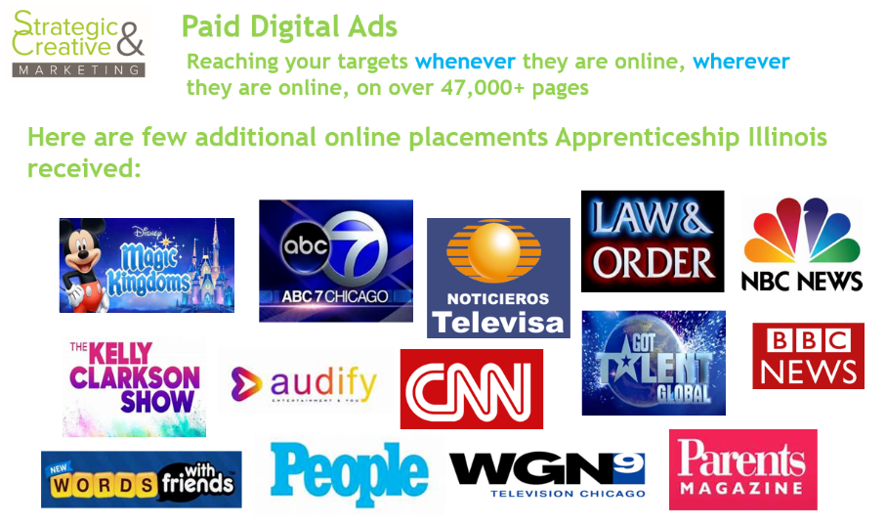
Social Media Ads
Platforms Reached
LinkedIn + Audience Network
Reddit
Meta = Facebook, Instagram, Messenger, Threads, WhatsApp, Audience Network
Audience Network

Slide 17
Social Media Ads
Definitions
Impressions = Views of the ad
CPC = Cost per click
ER = Engagement Rate
  Take the total number of engagements (likes, shares, video views, etc.) and divide by number of Impressions
  ER is important because if it high, that means the right audience saw the right content and the right graphic

Slide 18
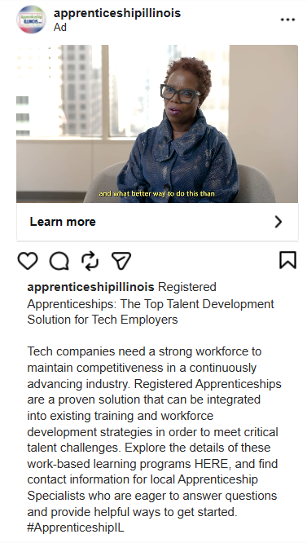
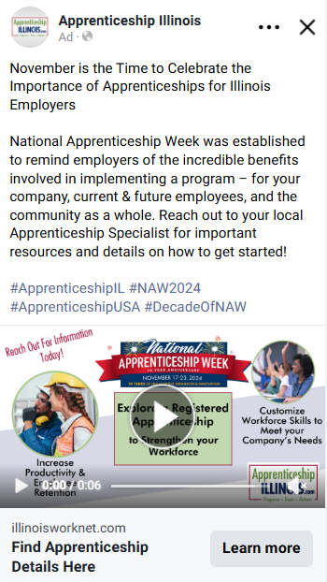

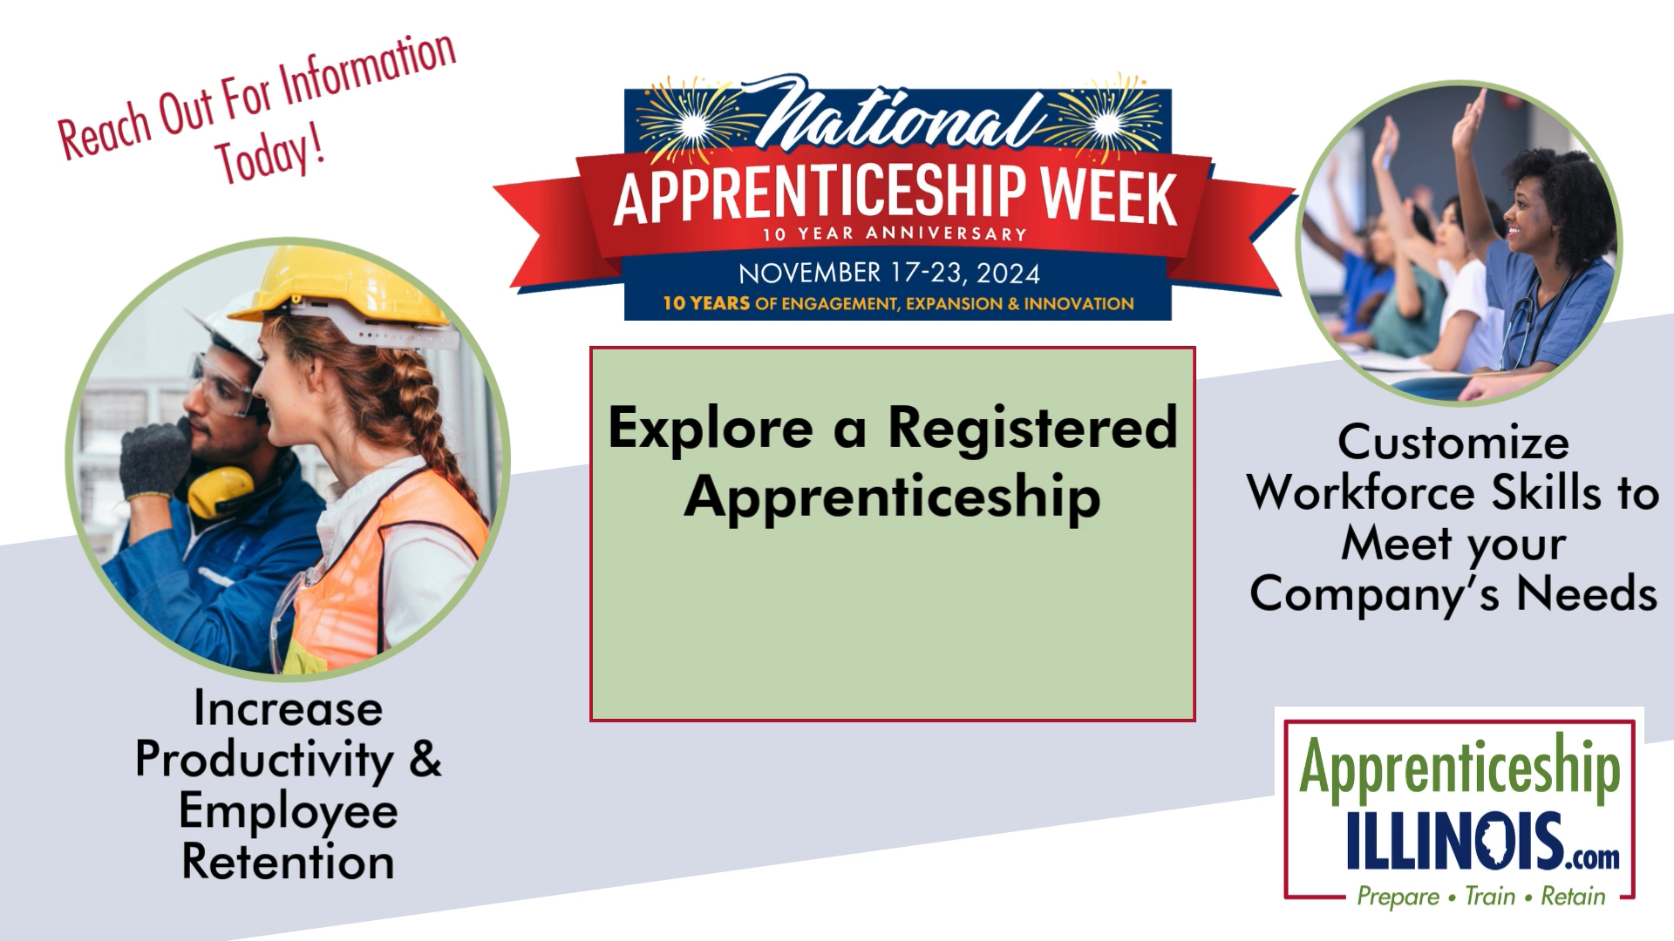
Social Media Ads
Ad Examples - Meta Ads
Instagram Feed
Facebook Feed
Campaign 6 Facebook Views = 179,000 Clicks = 6,600 Engagement Rate = 25% (avg=.50%) CPC=$0.15 (avg=$4.50)

Slide 19
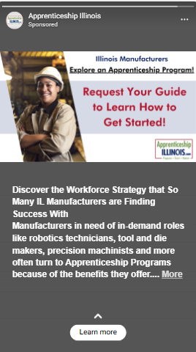
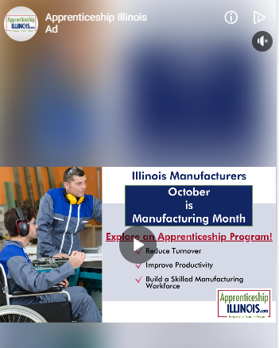


Social Media Ads
Ad Examples - Meta Ads
Messenger Stories
Audience Network

Slide 20
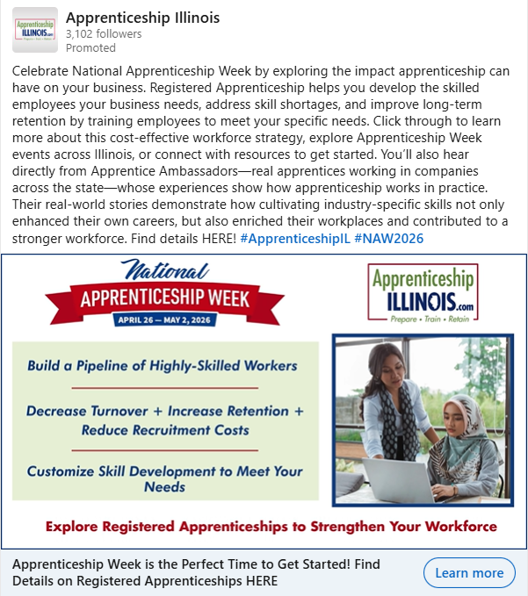
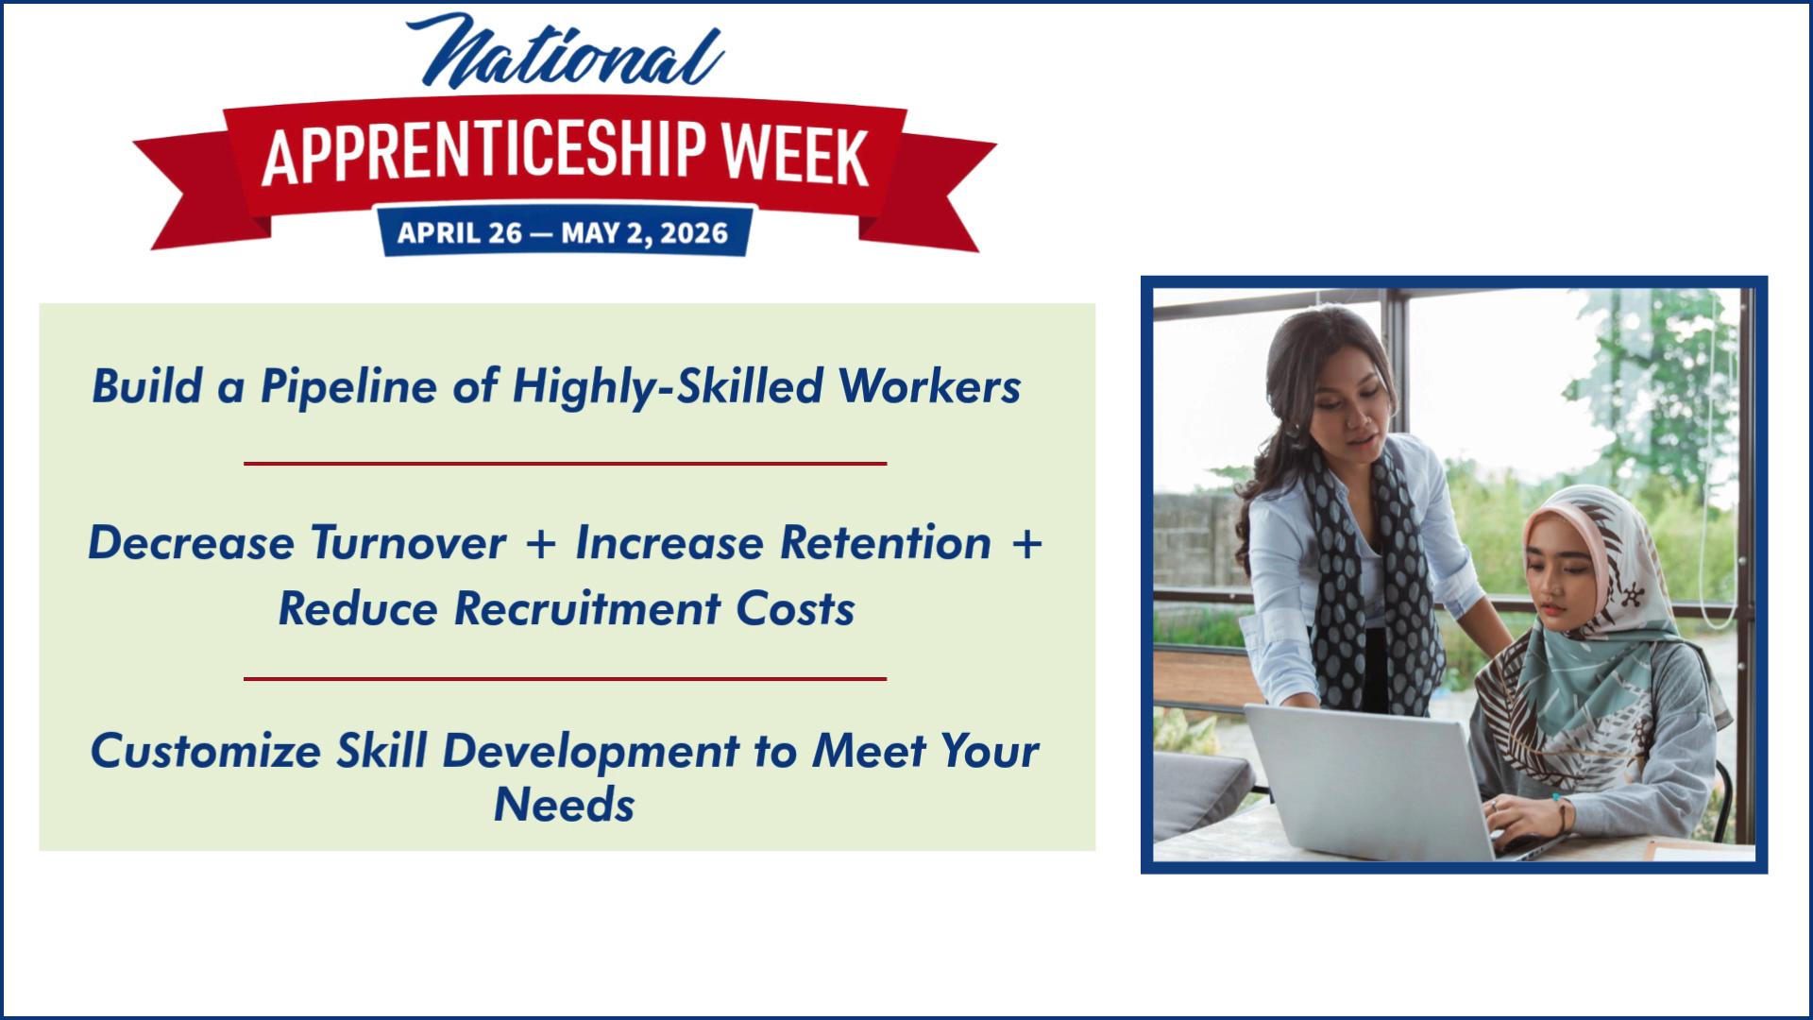
Social Media Ads
Ad Examples - LinkedIn Ads
Campaign 16 LinkedIn Views = 36,000 Clicks = 1,300 Engagement Rate = 3.6% (avg=1%) CPC=$1.16 (avg=$20)

Slide 21
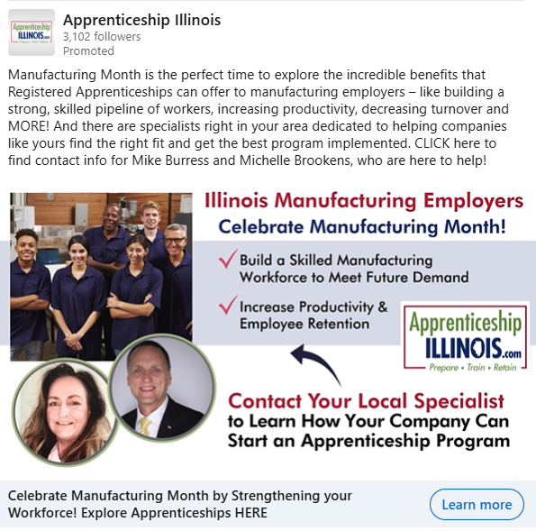

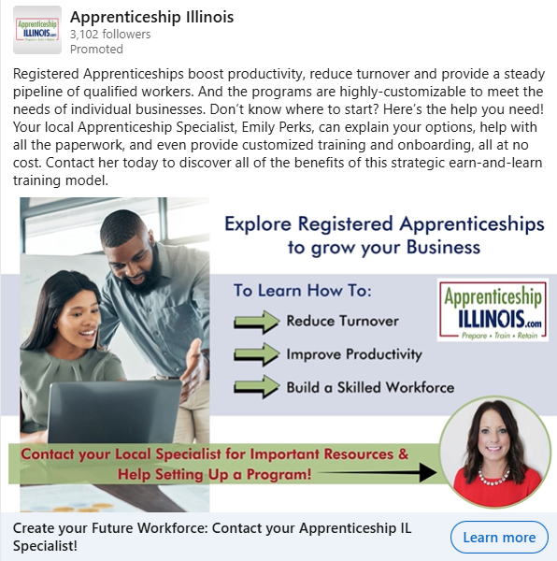
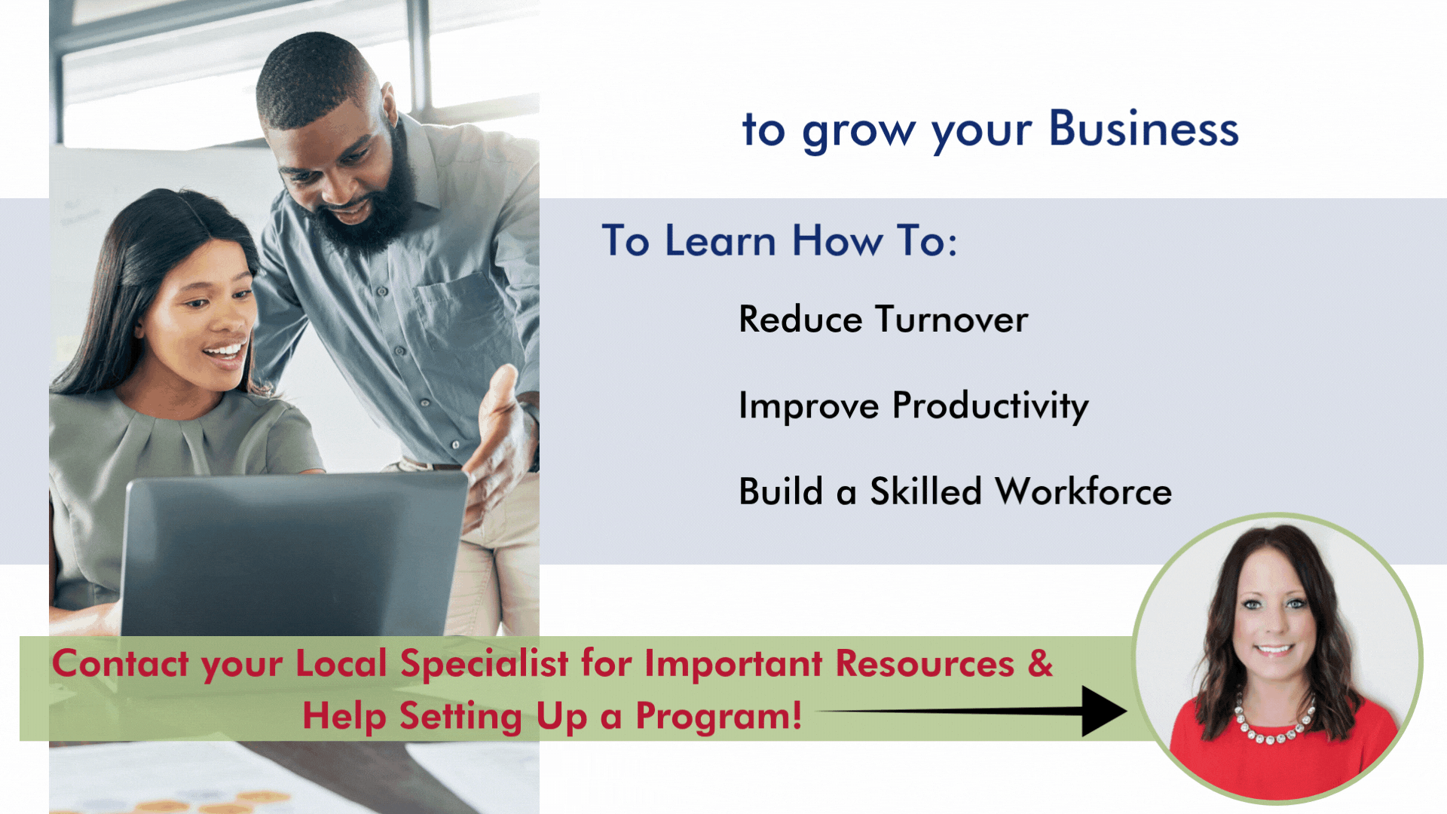
Social Media Ads
Ad Examples
LinkedIn Ads

Slide 22
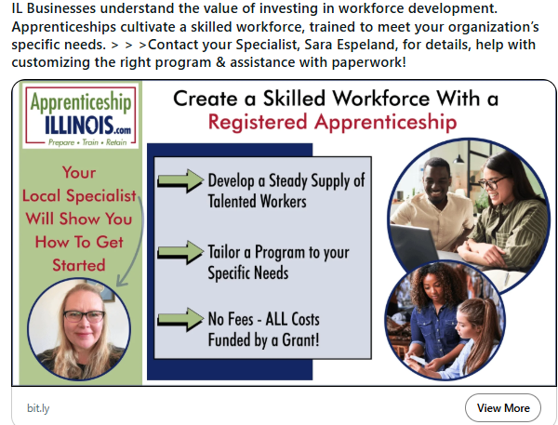
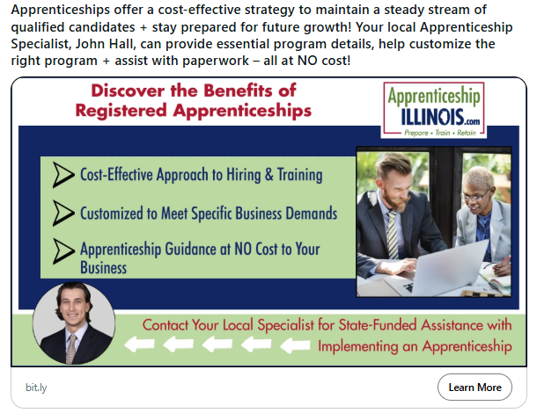
Social Media Ads
Ad Examples
Reddit Ads
Campaign 12 Reddit Views = 141,500 Clicks = 660 Engagement Rate = .47% (avg=.2%) CPC=$1.51 (avg=$3)

Slide 23
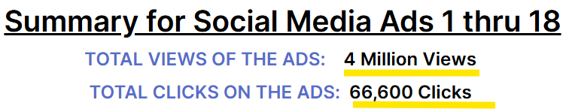
Social Media Ads

Slide 24
Social Media Ads
Platforms
LinkedIn Views Clicks
  LinkedIn Sponsored 181,000 2,800
  Audience Network 1 million 11,750
  LinkedIn CTV 250,000 41
  LinkedIn totals: 1.43 million 14,600

Slide 25
Social Media Ads
Platforms
LinkedIn Views Clicks
  LinkedIn Sponsored 181,000 2,800
  Audience Network 1 million 11,750
  LinkedIn CTV 250,000 41
  LinkedIn totals: 1.43 million 14,600
Meta
  Facebook 2.1 million 46,000
  Instagram 134,000 3,300
  Audience Network 47,000 1,300
  Messenger 22 1
  Meta totals: 2.3 million 50,600

Slide 26
Social Media Ads
Platforms
LinkedIn Views Clicks
  LinkedIn Sponsored 181,000 2,800
  Audience Network 1 million 11,750
  LinkedIn CTV 250,000 41
  LinkedIn totals: 1.43 million 14,600
Meta
  Facebook 2.1 million 46,000
  Instagram 134,000 3,300
  Audience Network 47,000 1,300
  Messenger 22 1
  Meta totals: 2.3 million 50,600
Reddit
  Reddit totals: 310,000 1,400

Slide 27
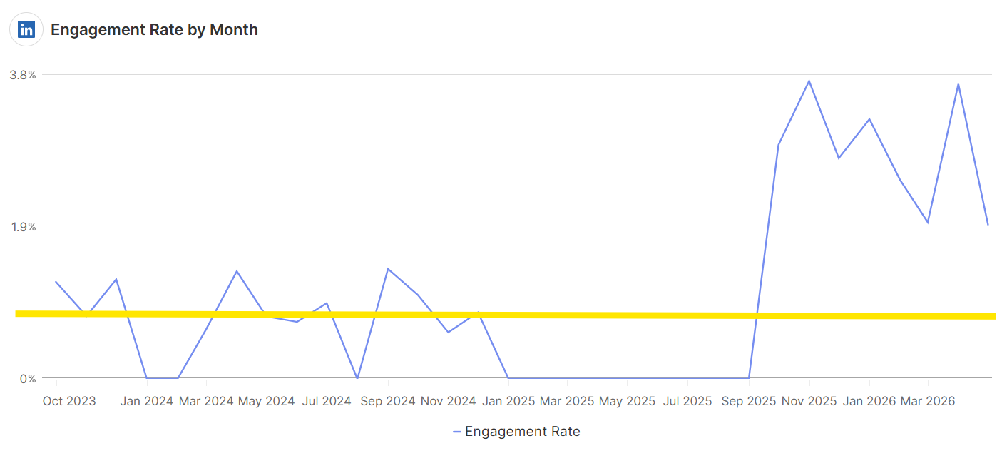
Social Media Ads
Platform Performance
LinkedIn Sponsored Ads
Engagement Rate rose dramatically as the ads ran
Viewers usually need to see a LinkedIn ad repeatedly before they click on it

Slide 28
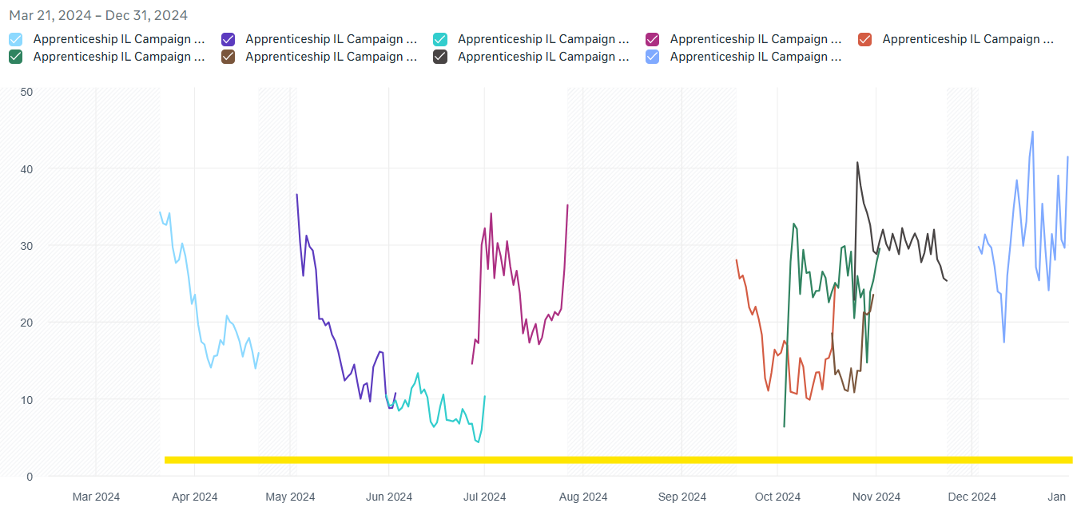
Social Media Ads
Platform Performance
Meta/Facebook Ads
Engagement Rate ran as high as 45% when the average Meta ER is just 1%

Slide 29
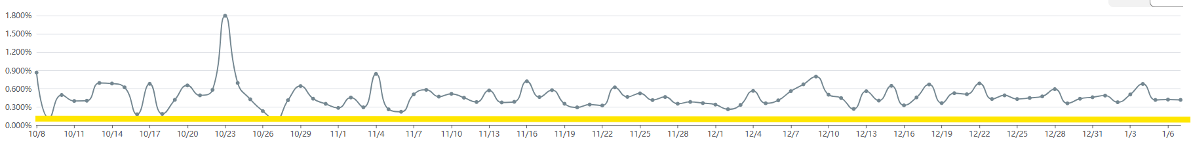
Social Media Ads
Platform Performance
Reddit Ads
Each Campaign was targeting to a different audience by Specialist Location.
Engagement Rate averaged .43% when the average Reddit ER is .20%

Slide 30

Social Media Ads
Platform Performance
LinkedIn Ads - Top Job Titles

Slide 31

Social Media Ads
Platform Performance
LinkedIn Ads - Business Sizes

Slide 32

Social Media Ads
Platform Performance
LinkedIn Ads - Top Industries

Slide 33

Social Media Ads
Platform Performance
LinkedIn Ads - Top Companies

Slide 34

Social Media Ads
Platform Performance
LinkedIn Ads - DMA Regions

Slide 35

Social Media Ads
Platform Performance
Reddit Ads - DMA Regions

Slide 36
Boost Apprenticeship Illinois’ Program Awareness
How to Share a LinkedIn Post

Slide 37

Boost Apprenticeship Illinois’ Program Awareness
How to Share a LinkedIn Post

Slide 38
Thank You!

