Slide 1


Illinois Youth Career Pathway Grant Opportunity
Technical Assistance Session
Illinois Department of Commerce and Economic Opportunity

Slide 2
Access and Participation Guidelines
Meeting Access
Meeting Participation
Select the “Call Me” option on Zoom to use your phone for audio while using the video option, if you choose.
This webinar will be recorded and posted to IWN.
Everyone will be muted for this webinar.
A FAQs Page has been created to track questions raised during the webinar.
Materials shared during the meeting will be available on workNet.

Slide 3
Agenda
Introduction
  Education Systems Center
State Frameworks on College and Career Pathways
Pathway Endorsement: Requirements and Key Features
Implementing CCPE Within DCEO’s Youth Career Pathways NOFO
  Potential Opportunities for WIOA In-School Youth
  Examples from the Field
Resources

Slide 4
The EdSystems Mission
Shape and strengthen education and workforce systems to advance racial equity and prepare more young people for productive careers and lives in a global economy.
Statewide
Community Networks
College &
Career Pathways
Bridges to
Postsecondary
Data Impact &
Leadership
Innovation
Notes:
JON

Slide 5

Postsecondary and Workforce Readiness Act
Public Act 99-0674 (HB 5729)
Signed by Governor July 29, 2016
Four Components:
Postsecondary and Career Expectations (PaCE)
Scaling of 12th Grade Transitional Courses
College & Career Pathway Endorsements on High School Diplomas
Pilot of Competency-based High School Graduation Requirements
pwract.org

Slide 6



State Pathways Model
Individualized Planning
Endorsement
Secondary Pathway
Postsecondary Pathway
Career Focused Instruction
Internships
/CDE
Low-Skilled
Jobs
Semi-
Skilled
Jobs
Middle-
Skilled Jobs
Advanced-Skilled Jobs
Work-Based Learning
Stackable
Credentials
Stackable
Credentials
AA/AAS
BA/BS
Core Academics

Slide 7
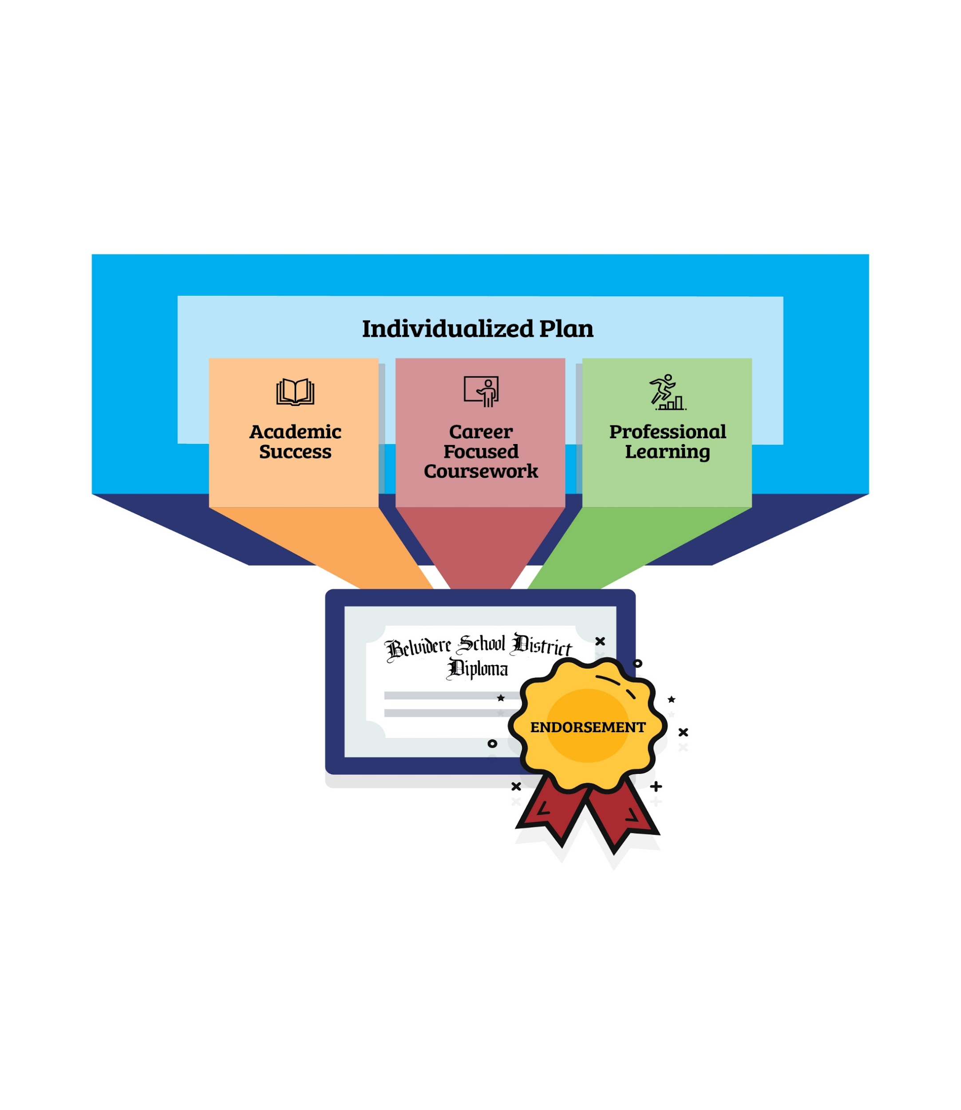

Pathway Endorsement: HS Diploma
WIOA Eligible In-School Youth?

Slide 8

Endorsement Areas

Slide 9
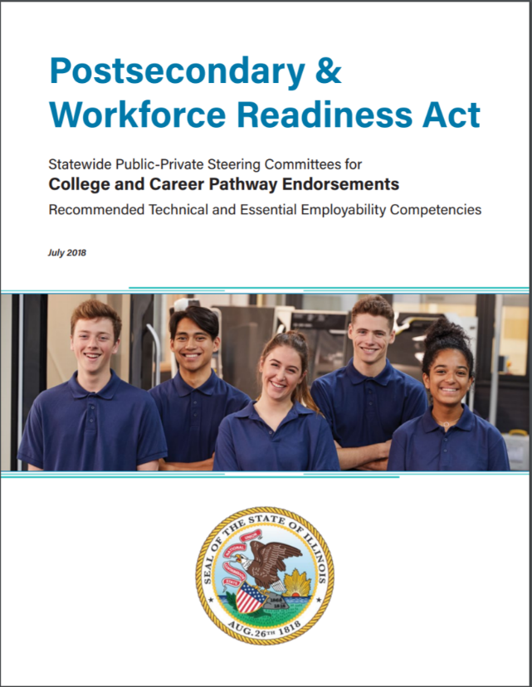
Recommended Technical and Essential Employability Competencies
https://edsystemsniu.org/resources/

Slide 10
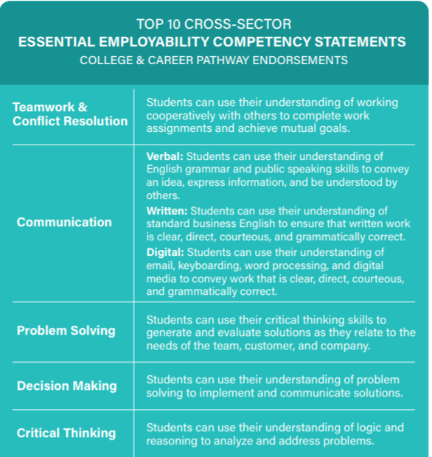
Recommended Technical and Essential Employability Competencies
https://edsystemsniu.org/resources/

Slide 11
Pathway Endorsements Statewide
73 school districts representing 107 high schools statewide (16% of Illinois high schools)
650 total HS in ISBE report data file
Urban, suburban, rural
Check out our Podcast with several Pathway highlights! (Apple podcasts, spotify)

Slide 12
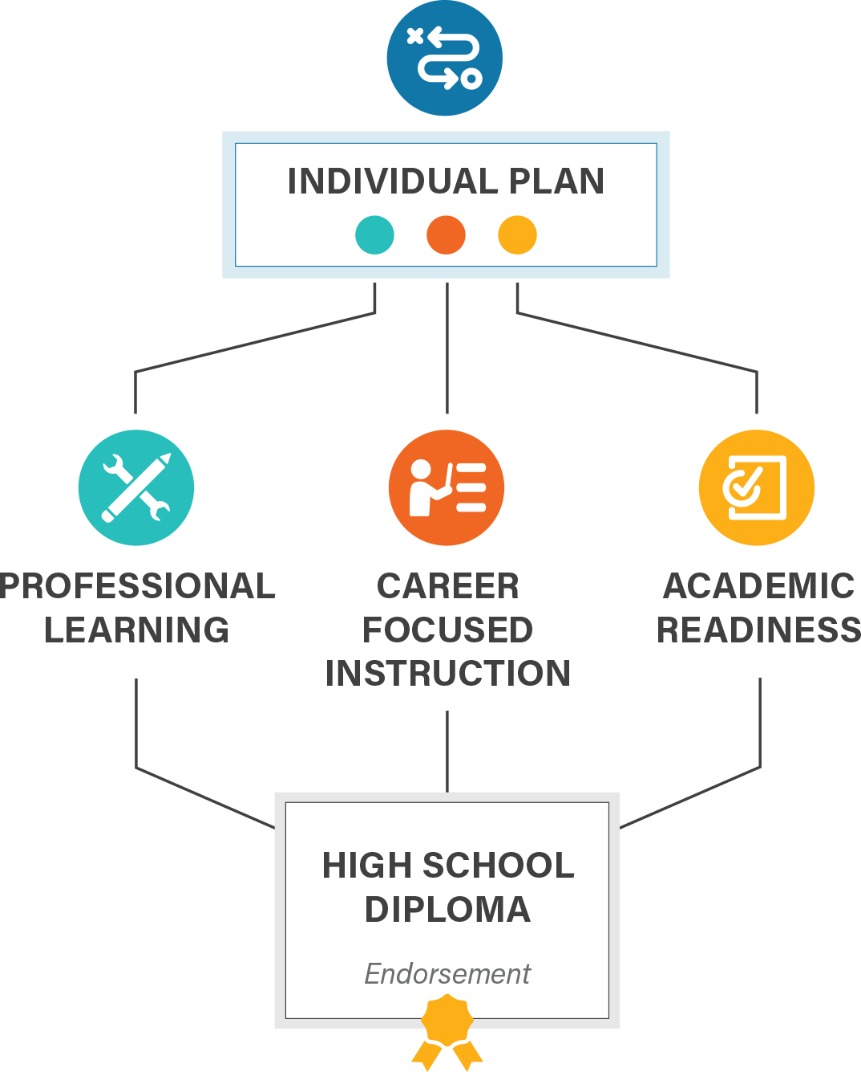
College and Career Pathway Endorsement Framework
INDIVIDUAL PLAN
Each student completing an endorsement must have an individualized plan, which includes college planning linked to early understanding of career goals, financial aid, resume, and personal statement.
PROFESSIONAL LEARNING
Awareness, exploration, and preparation activities that provide opportunities for students to interact with adults in their workplace
9th
10th
11th
12th
At least 2 career exploration activities or 1 intensive experience
60 cumulative hours of paid or credit supervised career development experience with a professional skills assessment
At least 2 team-based challenges with adult mentoring
Through these experiences, a student gains essential employability and technical competencies in their identified sector.
CAREER-FOCUSED INSTRUCTIONAL SEQUENCE
Two years of secondary coursework, or equivalent competencies, that articulate to a postsecondary credential with labor market value. Must include at least 6 hours of early college credit.
9th
10th
11th
12th
Orientation / Introduction
Skill Development
Capstone / Advanced Courses
ACADEMIC READINESS
Ready for non-remedial coursework in reading and math by high school graduation through criteria defined by district and local community college

Slide 13
Benefits of CCPE
Accelerated Toward a Career Area
Foundational Skills for All Careers
Academically Ready for Postsecondary

Slide 14
Benefits of CCPE
Course Sequences
- CTE Course sequence and Programs of Study
- Potential Focus on Industry Credential Attainment
- Not necessarily restricted to CTE Courses,
- Add “Career Focused” Early College Courses
Work-Based Learning
- Job Shadows, Site visits
- Internship Placements / SAE
3 Distinct Work-Based Learning activities with specific numeric goals for each
College Readiness
- Transition to postsecondary institutions an afterthought
- Must create plan for students to enter postsecondary institutions with non-remedial coursework

Slide 15
Implementing CCPE Within DCEO’s Youth Career Pathways NOFO
2017 YCP
Grantee: Peoria Public Schools (Peoria Metropolitan Area)
Business: Ruyle Mechanical, Morton Industries, and City of Peoria (Work Based Learning)
Award Amount: $213,721
Project Summary: Peoria Public Schools will partner with Goodwill, ABC and Illinois Central College to provide forklift, NCCER and OSHA 30 training to WIOA eligible high school senior. Peoria Public Schools will link 25 youth students with occupations in the construction sector. Participants will have work-based learning opportunities with varies companies throughout the Peoria region. The training credentials include CPR and First Aid, OSHA 30, Forklift Operator Certificate, High School Diploma and NCCER by various program partners.

Slide 16
WIOA In-School Youth (2018 YCP)

Slide 17
Field Example: 6 Hours Early College Credit
Resource: Model Programs of Study Guides (https://edsystemsniu.org/model-programs-of-study-guides/)
How to Get Students “Career-Focused” Early College Credit
Target Career-Focused Dual Credit/Enrollment with Easy student eligibility
Common Community College Courses
Intro to Construction (3 credit hours)
Medical Terminology (3 Credits)
Target Industry Credentials through Community College Offerings
Common Community College Courses
Certified Nursing Assistant (6+ Credit Hours)
Manufacturing Processes I/II (3 to 6 Credits)
Integrate Dual Credit Courses Into Existing CTE Structures
Common Community College Courses
Foundations of Production & Manufacturing Processes I/II (3 to 6 Credits)
Intro to Emergency Medical Technician (6+ Credit Hours)
Target Courses w/Applicability to Multiple Industry Areas
Common Community College Courses
Computer Applications for Business (3 Credit Hours)
Blueprint Reading (3 credit Hours)

Slide 18
Field Example: Embedded WBL in courses
Orientation Level Courses (9th & 10th Grade)
HS level intro courses (such as CTE) with “Career Exploration
Skill Development (10th -11th Grade)
HS Level Courses in with Embedded “Team-Based Challenges”
Capstone (12th grade)
Early College Courses with Embedded Career Development Experience / Internship
Early College Credit Courses start
Coop-Courses
CTSO
Welding Competition,.
CNA Clinical Experiences
Site visits / Field trips
Job Shadows

Slide 19
Resources
Education Systems Center: https://edsystemsniu.org/
Postsecondary and Workforce Readiness Act: WWW.PWRACT.ORG
Juan Jose Gonzalez: jgonzalez28@niu.edu

Slide 20

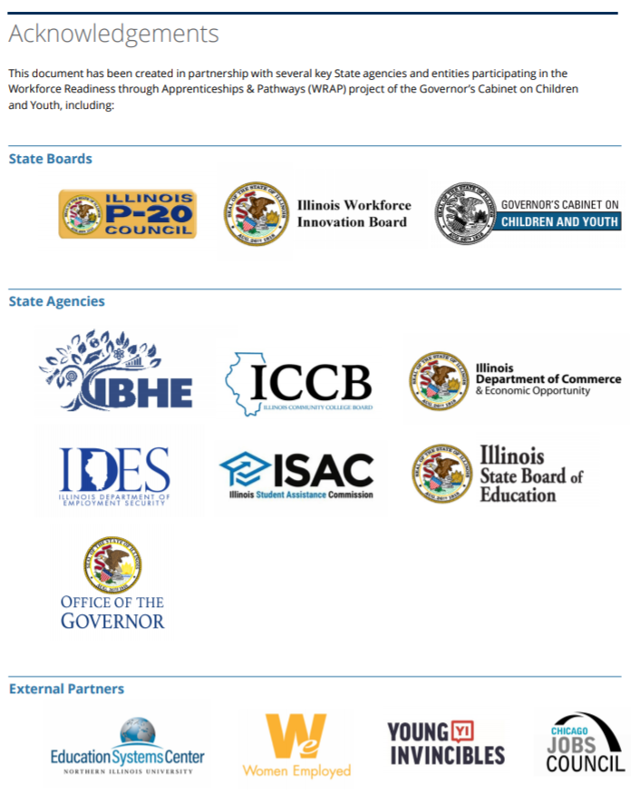
Career Pathways Dictionary

Slide 21
Thank You
Education Systems Center: https://edsystemsniu.org/
Postsecondary and Workforce Readiness Act: WWW.PWRACT.ORG
Juan Jose Gonzalez: jgonzalez28@niu.edu

