Slide 1
Workers’ Rights in the Age of COVID-19
October 5, 2021

Slide 2
About me..
I am an economic researcher focused on issues affecting U.S. workers, especially low-wage workers, families and communities. I am particularly interested in policy issues pertaining to low-wage labor markets including minimum wages, paid sick leave, fair scheduling legislation and efforts to combat wage theft.
In addition to my research, I direct and teach in the Worker Rights Project, a U of I initiative that provides bilingual (Spanish-English) workers’ rights training for low-wage workers. In collaboration with the Chicago Jobs Council, I also conduct train-the-trainer courses for frontline providers of workforce development programs in the Chicagoland area.
Alison Dickson
Senior Instructor, Labor Education Program,
School of Labor and Employment Relations
University of Illinois at Urbana-Champaign
aquesada@illinois.edu

Slide 3
Agenda
The changing nature of work
Connecting workers’ rights to job training programs
Workers’ rights 101
Wage theft
Minimum wages differences
Misclassification
Workers’ comp
Discrimination
Documenting strategies
Takeaways and final questions

Slide 4
Housekeeping
Please ask questions in chat box as well as email me questions after the session
Please turn on your camera if you would like
PLEASE keep in mind that we are all navigating challenging and varying working situations with children, other dependents and animals sometimes interrupting our work despite our best intentions.

Slide 5
As you are listening today, write down a…
Quotation (something I’ve said) that stands out
Question(s) you have
Talking point that you might want to bring up with a colleague later
Notes:
End of session we will share these pieces in a short discussion

Slide 6
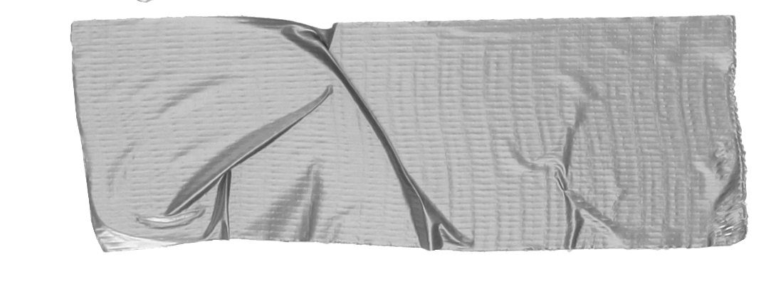
Why teach workers’ rights?
Epidemic of wage theft $7.3 million/week stolen from low-wage workers in Cook County (2009)
Lack of education Workers do not learn this information anywhere else - not in high school, not on the job - only when they have a problem
Confusing patchwork of laws Different minimum wages, paid sick leave and anti-discrimination laws based on where you work
Notes:
-Wage theft disproportionately impacts most marginalized workers - women, workers of color, immigrants, returning citizens
-Confusing patchwork of laws - minimum wages, anti-discrimination, workers’ comp

Slide 7
… the compounding intersections between degraded work and negative social and economic and health/life outcomes
Inadequate paid time off
Growth of non-standard, temporary and gig work
Worker injuries and illness
Xenophobia
Growing income inequality
Declining union density
INSTABILITY
Ableism
Employer labor violations
Racism
Growing divide between wages and productivity
Lack of policies to support working parents and caregivers
Unstable, unpredictable and inadequate work hours
Gender discrimination
Healthcare and benefits tied to employment
Wage theft
INSECURITY
Lack of awareness/education of workers’ rights
Underfunded regulatory regimes/lack of enforcement
Gender-based workplace VIOLENCE
Homophobia
Misclassification
Mass incarceration and legal discrimination against formerly incarcerated
Expansion of anti-worker legislation

Slide 8
Why connect with
workforce development?
Job readiness Part of being “job ready” is knowing your rights as a worker
Financial literacy Protecting against wage theft and other workplace violations helps workers earn more $ and better support their families
Perfect partnership Low-wage workers + mission-driven CBOs + career focused education
Notes:
-Train the trainer model has led to program expansion

Slide 9
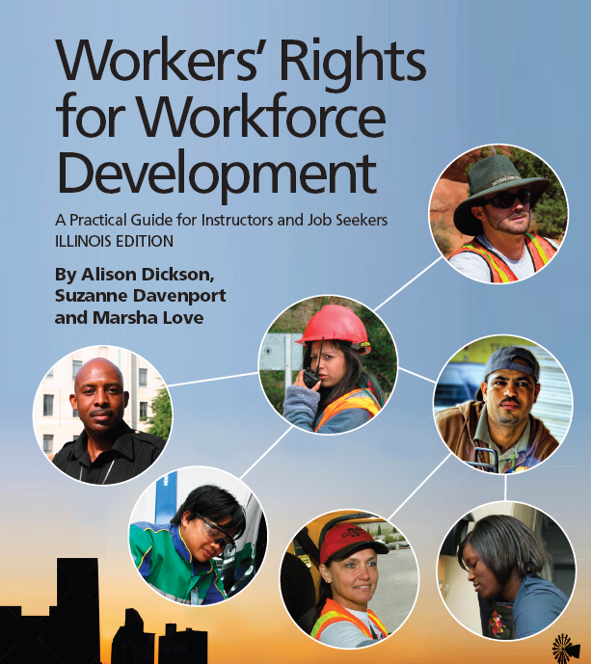
For a lot more information: Illinois workers’ rights curriculum for FREE download!
3rd edition available for download!!
https://cjc.net/frontline-focus/tools-frontline-staff/
Notes:
-open-sourced, free to download, updated annually due to changes in the law and administrations

Slide 10
Methods
Intro to workers’ rights on the job
Wage & hours laws and protections
Getting hired, disciplined & getting fired
Leaves of absence
Discrimination on the job
Worker health & safety
Organizing workers
Curriculum Structure:
8 units with pick and choose modules:
Notes:
-10-30 min modules based on a variety of teaching/learning methods and techniques

Slide 11
Connecting WR to existing job training programs...
Skills | Workers’ Rights Curriculum
Interviewing | Recognizing illegal discrimination in hiring
Communication | Talking with a supervisor or coworker about a problem on the job
Reading | Understanding and comparing employee manuals and union contracts
Financial Literacy | Reading paychecks, calculating OT and shift differentials and identifying illegal deductions
Writing | Journal is kept, recording who/what/where information about incidents/problems
Notes:
-focus on documenting/record-keeping
-share worker’s story from quiz question 1.

Slide 12
Activity: Practicing math skills and reading a check stub.
What’s wrong here?

Slide 13
Workers’ Rights 101 Let’s explore strategies for protecting yourself on the job… Assume the workers in every case study work in Illinois, are at least 16 years old, and are non-union (at-will)

Slide 14
Breakout room 1 directions
Choose a notekeeper/reporter
Refer to the Google Doc with quiz questions
In your breakout group:
Discuss and answer each of the workers’ rights quiz questions and note where consensus and divisions occur
What are potential documenting strategies the workers in each scenario can employ in order to protect themselves?

Slide 15
Ryan, of Fast and Easy Painters, hires a few painters for a paint job in Bolingbrook. He says he will pay them $15 an hour and that they must start work on Monday morning at 8:00 am.
On Tuesday, one of the painters, Piotr, slips and falls off of the scaffolding and breaks his ankle. Ryan claims Piotr is responsible for his medical bills because he hired him as an independent subcontractor.
What do you think?

Slide 16
NO
Issue areas
Independent contractors v. employees
Misclassification
Workers’ comp
Wage theft
Rights of undocumented workers

Slide 17
Is Piotr an independent contractor or employee? How do you know? Why does this matter?
What should workers’ comp provide him?
What if:
Ryan has vanished and Piotr can’t find him?
Piotr is undocumented?
Ryan hired Piotr from the Home Depot parking lot?
How should Piotr be documenting his working conditions to protect himself?
Who else can help Piotr?
How do Piotr’s workers’ rights change if he takes a job in Indianapolis?

Slide 18
Independent contractor v. employees
An independent contractor is a worker who makes arrangement with a customer or client, brings her own equipment, sets her own work schedule, and carries her own insurance.
For example: a plumber, a computer tech, an accountant, a nanny, a hair stylist, or house cleaner. These workers often work on their own as their own bosses.
Piotr is an employee, not an independent contractor, and is entitled to Workers Compensation (Illinois Department of Labor).

Slide 19
Misclassification
An employer claims their worker is an independent contractor, when legally she should be an employee.
Ex: A cleaning agency classifies its workers as independent contractors, even though the company sets the work schedules and provides the cleaning equipment.
If the workers are called independent contractors, the company does not have to follow many important workers’ rights laws.
They do not pay overtime or benefits such unemployment compensation and workers’ compensation.
They also do not make deductions for taxes or Social Security.
The worker loses money and the protections of labor laws.

Slide 20
Workers’ compensation
An insurance system that all employers must carry to cover employees who are injured on the job.
Workers’ compensation (or workers’ comp) covers all work-related injuries, regardless of fault.
Piotr is an employee and is entitled to workers’ comp. In Illinois, workers comp is a “no-fault” system and pays for 100% of medical bills (Illinois Workers’ Compensation Commission).

Slide 21
Wage theft
Wage theft, or non-payment of wages, is illegal.
If your employer refuses to pay you the wages you are owed, s/he is violating federal and state wage laws.
You have the legal right to be paid for your work regardless of your documentation status.

Slide 22
Piotr’s documenting strategies…
Record of work hours (CALENDAR)
Address of worksite/home owners’ contact info (JOURNAL/PHONE)
Collecting coworkers contact info (JOURNAL/PHONE)
Photos of contractor license plate number (PHONE)
Hospital records; workers’ comp forms (JOURNAL)

Slide 23
Jeremy waits tables at an Olive Italiano restaurant in Peoria. His shifts starts at 11:00 am, but his manager insists he arrive by 10:45 am so that his station is ready for the lunch service.
Is Olive Italiano required to pay Jeremy for this extra 15 minutes?

Slide 24
YES
Issue areas
Wage theft (off-the-clock work)

Slide 25
Common forms of wage theft…
Fail to pay overtime
Violate minimum wage laws
Misclassify employees
Take illegal deductions from paychecks
Require workers to work for no pay, or “off the clock”
Steal workers’ tips
Not pay workers for training
Not pay out or allow accrued vacation/sick time
Pay with checks that bounce
Suddenly close a business without paying a final check

Slide 26
At-risk for wage theft…
Young workers
Immigrant workers, especially those who are undocumented
Returning citizens/ex-offenders
POC in general
Women; working mothers
Certain industries maintain a culture of wage theft (car washes, temp work, non-union construction, domestic work).

Slide 27
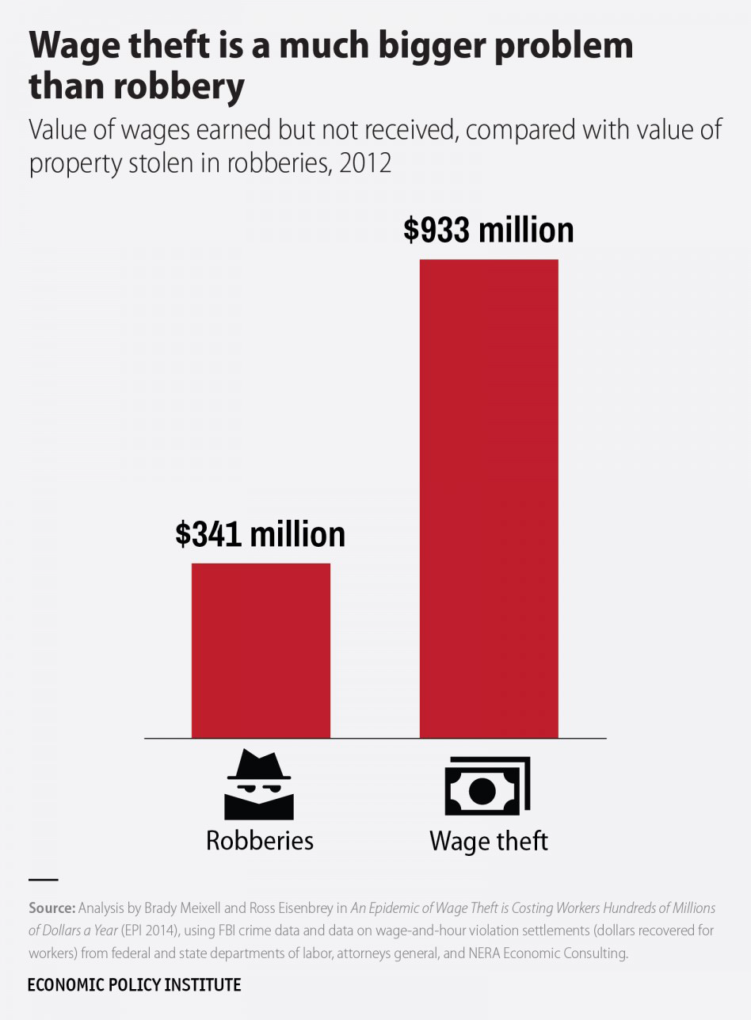

Slide 28
Jeremy’s documenting strategies…
Record of work hours (CALENDAR)
Check stubs (FOLDER)
Journal of tips received (JOURNAL)
Collecting coworkers contact info (JOURNAL/PHONE)

Slide 29
A global pandemic plus polar vortex mean that most of Olive Italiano’s business has switched to take-out orders. Jeremy no longer has tables to wait and is helping package customer orders .
Before the pandemic, Jeremy was paid a tipped sub-minimum wage in addition to his tips. Can his employer continue doing this now?

Slide 30
Depends
Issue areas
Minimum wage differences
Wage theft

Slide 31
Minimum wages
Minimum wage is the lowest amount per hour an employer can pay a worker. The federal minimum wage is $7.25 and sets the floor for US workers.
Minimum wage levels vary by state, county, city, and even by occupation. Local and state governments have passed their own minimum wage laws.
There are also sub-minimum wages for workers under 18, tipped workers, and some workers with disabilities.

Slide 32
2021 Minimum wages
CITY OF CHICAGO
$14.00/hour ($15 after 7/1/21)
$21.00/overtime hours
$8.40/tipped wage
$10.00/YOUTH*
COOK COUNTY
$13.00/hour**
$19.50/overtime hours
$6.60/tipped wage
*Beginning, January 1, 2020, if a worker under 18 works more than 650 hours for the employer during any calendar year, they must be paid the regular (over 18 wage).
**Many Cook County municipalities have opted-out of the minimum wage increase. They are still subject to the Illinois minimum wage increases.
ILLINOIS (outside Cook)
$11.00/hour (after 1/1/21)
$6.60/tipped wage
$8.50/YOUTH
INDIANA
$7.25/hour
$2.13/tipped wage
WISCONSIN
$7.25/hour
$2.13/tipped wage
IOWA
$7.25/hour
$4.35/tipped wage

Slide 33
Jeremy’s documenting strategies…
Record of work hours
Check stubs
Journal of tips received
Collecting coworkers contact info

Slide 34
Brianna is 7-months pregnant and works as a cashier at Dollar Commander in Kankakee. Her OB/GYN says she cannot be on her feet for an 8-hour shift. Can she be fired for not being able to stand and operate her cash register?

Slide 35
NO
Potential issue areas
Discrimination

Slide 36
Accommodations
An accommodation is a change in a working situation to improve a worker’s ability to do job.
Examples: making aisles on work floor wide enough for a worker in a wheelchair, changing work schedule for a worker over 40 years old (age related), or enabling a pregnant worker to have more seated work time to avoid back stress.
Under the Illinois Pregnancy Accommodation Law (Public Law 098-1050), employers must allow pregnant women who want to work during pregnancy reasonable job accommodations, such as to take more frequent bathroom breaks or to get help with heavy work or limit lifting.

Slide 37
Illegal discrimination
Brianna must be accommodated and given a chair/have her register lowered. Alternatively, she could rotate her work with another position where she does not need to be on her feet for 8 hours (Equal Employment Opportunity Commission; Illinois Department of Human Rights).
https://www.youtube.com/watch?v=zBIjVXHl1aA

Slide 38
Briana’s documenting strategies…
Record of work hours
Personnel file/past incidents
Journaling incidents with discriminatory behavior/comments (DATE, TIMES, EVENT with factual info, WITNESSES)
Collecting coworkers contact info to prove different treatment

Slide 39
Melanie has a felony conviction from 15 years ago for stealing some clothes from a store.
She has been out of work for awhile and feels that she never receives call backs from her job applications because of her criminal record. Is this legal?

Slide 40
NO
Potential issue areas
Ban the Box

Slide 41
Final thoughts…
What workers’ rights issues do you think most affect your clients/jobseekers?
Are there areas in your day-to-day programming where you think you could include workers’ rights information? Be specific.
Do you have any concerns or reservations about talking about these issues in the context of workforce development work?

Slide 42
Thank you!
Alison Dickson
Labor Education Program
School of Labor and Employment Relations
aquesada@Illinois.edu

