Slide 1
Illinois Youth Career Pathway Grant Opportunity Technical Assistance Session
Illinois Department of Commerce and Economic Opportunity

Slide 2
Moderator & Technology Support
Kiersten Baer
Online Marketing Coordinator
Illinois Center for Specialized Professional Support
ksheary@ilstu.edu

Slide 3
Access and Participation Guidelines
Meeting Access
Meeting Participation
Select the “Call Me” option on Zoom to use your phone for audio while using the video option, if you choose.
This webinar will be recorded and posted to IWN.
Everyone will be muted for this webinar.
A FAQs Page has been created to track questions raised during the webinar.
Materials shared during the meeting will be available on workNet.

Slide 4
Workers’ Rights and
Young Workers in the
Age of COVID-19
February 11, 2021
DCEO Professional Development Committee
Alison Dickson
Senior Instructor
Labor Education Program
aquesada@illinois.edu

Slide 5
Agenda
Google drive resource folder
Connecting workers’ rights to job training programs
Workers’ rights 101 preview: Wage theft, minimum wages differences, discrimination…
Documenting strategies
Next steps:

Slide 6
As you are listening today, write down a…
Quotation (something I’ve said) that stands out
Question(s) you have
Talking point that you might want to bring up with a colleague later
Notes:
End of session we will share these pieces in a short discussion

Slide 7
RESOURCE FOLDER
You will be sent a link with to a Google Drive folder containing fact sheets and resource guides related to workers’ rights and young workers

Slide 8
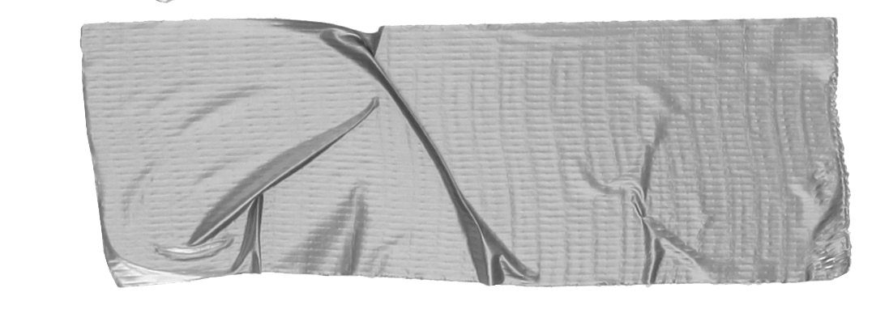
Why teach workers’ rights?
Epidemic of wage theft $7.3 million/week stolen from low-wage workers in Cook County (2009)
Lack of education Workers do not learn this information anywhere else - not in high school, not on the job - only when they have a problem
Confusing patchwork of laws Different minimum wages, paid sick leave and anti-discrimination laws based on where you work
Notes:
-Wage theft disproportionately impacts most marginalized workers - women, workers of color, immigrants, returning citizens
-Confusing patchwork of laws - minimum wages, anti-discrimination, workers’ comp

Slide 9
Why connect with
workforce development?
Job readiness Part of being “job ready” is knowing your rights as a worker
Financial literacy Protecting against wage theft and other workplace violations helps workers earn more $ and better support their families
Perfect partnership Low-wage workers + mission-driven CBOs + career focused education
Notes:
-Train the trainer model has led to program expansion

Slide 10
For a lot more information: Illinois workers’ rights curriculum for FREE download!
3rd edition available for download!!
https://cjc.net/frontline-focus/tools-frontline-staff/
Notes:
-open-sourced, free to download, updated annually due to changes in the law and administrations

Slide 11
Methods
Intro to workers’ rights on the job
Wage & hours laws and protections
Getting hired, disciplined & getting fired
Leaves of absence
Discrimination on the job
Worker health & safety
Organizing workers
Curriculum Structure:
8 units with pick and choose modules:
Notes:
-10-30 min modules based on a variety of teaching/learning methods and techniques

Slide 12
Connecting WR to existing job training programs...
Skills | Workers’ Rights Curriculum
Interviewing | Recognizing illegal discrimination in hiring
Communication | Talking with a supervisor or coworker about a problem on the job
Reading | Understanding and comparing employee manuals and union contracts
Math | Reading paychecks, calculating OT and shift differentials and identifying illegal deductions
Writing | Journal is kept, recording who/what/where information about incidents/problems
Notes:
-focus on documenting/record-keeping
-share worker’s story from quiz question 1.

Slide 13
Activity: Practicing math skills and reading a check stub.
What’s wrong here?

Slide 14
Workers’ Rights 101 Let’s explore strategies for protecting yourself on the job… Assume the workers in every scenario work in Illinois, are at least 16 years old, and are non-union (at-will)

Slide 15
Jeremy waits tables at an Olive Italiano restaurant in Peoria. His shifts starts at 11:00 am, but his manager insists he arrive by 10:45 am so that his station is ready for the lunch service.
Is Olive Garden required to pay Jeremy for this extra 15 minutes?

Slide 16
YES
Issue areas
Wage theft (off-the-clock work)
Wage theft, or non-payment of wages, is illegal.
If your employer refuses to pay you the wages you are owed, s/he is violating federal and state wage laws.

Slide 17
Common forms of wage theft…
Fail to pay overtime
Violate minimum wage laws
Misclassify employees
Take illegal deductions from paychecks
Require workers to work for no pay, or “off the clock”
Steal workers’ tips
Not pay workers for training
Not pay out or allow accrued vacation/sick time
Pay with checks that bounce
Suddenly close a business without paying a final check

Slide 18
At-risk for wage theft…
Young workers
Immigrant workers, especially those who are undocumented
Returning citizens/ex-offenders
POC in general
Women; working mothers
Certain industries maintain a culture of wage theft (car washes, temp work, non-union construction, domestic work).

Slide 19
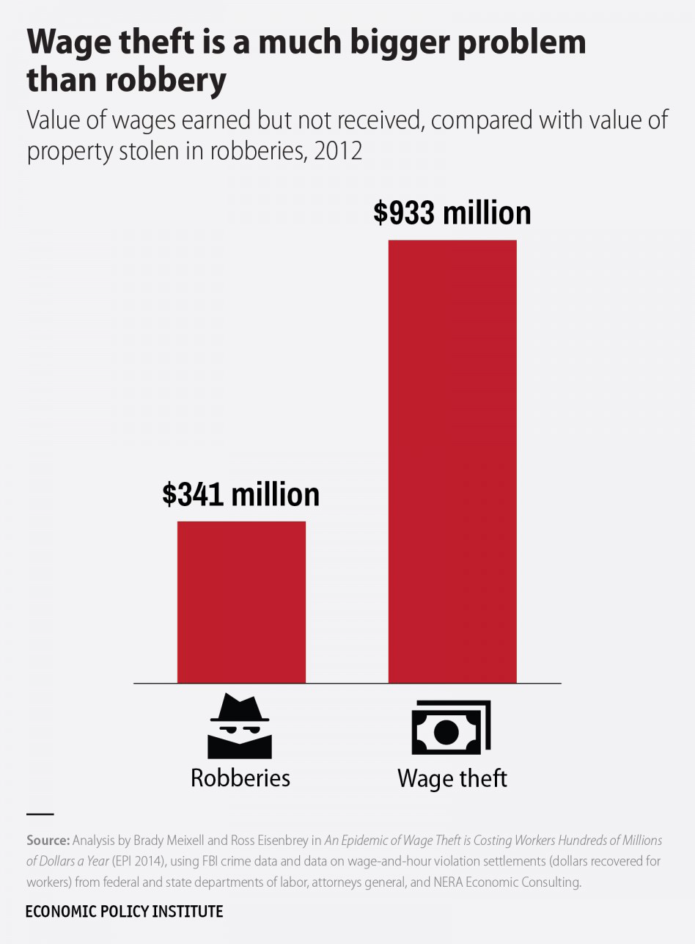

Slide 20
Jeremy’s documenting strategies…
Record of work hours (CALENDAR)
Check stubs (FOLDER)
Journal of tips received (JOURNAL)
Collecting coworkers contact info (JOURNAL/PHONE)

Slide 21
A global pandemic plus polar vortex mean that most of Olive Italiano’s business has switched to take-out orders. Jeremy no longer has tables to wait and is helping package customer orders .
Before the pandemic, Jeremy was paid a tipped sub-minimum wage in addition to his tips. Can his employer continue doing this now?

Slide 22
Depends
Issue areas
Minimum wage differences
Wage theft

Slide 23
Minimum wages
Minimum wage is the lowest amount per hour an employer can pay a worker. The federal minimum wage is $7.25 and sets the floor for US workers.
Minimum wage levels vary by state, county, city, and even by occupation. Local and state governments have passed their own minimum wage laws.
There are also sub-minimum wages for workers under 18, tipped workers, and some workers with disabilities.

Slide 24
2021 Minimum wages
CITY OF CHICAGO
$14.00/hour ($15 after 7/1/21)
$21.00/overtime hours
$8.40/tipped wage
$10.00/YOUTH*
COOK COUNTY
$13.00/hour**
$19.50/overtime hours
$6.60/tipped wage
*Beginning, January 1, 2020, if a worker under 18 works more than 650 hours for the employer during any calendar year, they must be paid the regular (over 18 wage).
**Many Cook County municipalities have opted-out of the minimum wage increase. They are still subject to the Illinois minimum wage increases.
ILLINOIS (outside Cook)
$11.00/hour (after 1/1/21)
$6.60/tipped wage
$8.50/YOUTH
INDIANA
$7.25/hour
$2.13/tipped wage
WISCONSIN
$7.25/hour
$2.13/tipped wage
IOWA
$7.25/hour
$4.35/tipped wage

Slide 25
Jeremy’s documenting strategies…
Record of work hours
Check stubs
Journal of tips received
Collecting coworkers contact info

Slide 26
Brianna is 7-months pregnant and works as a cashier at Dollar Commander in Kankakee. Her OB/GYN says she cannot be on her feet for an 8-hour shift. Can she be fired for not being able to stand and operate her cash register?

Slide 27
NO
Potential issue areas
Discrimination

Slide 28
Accommodations
An accommodation is a change in a working situation to improve a worker’s ability to do job.
Examples: making aisles on work floor wide enough for a worker in a wheelchair, changing work schedule for a worker over 40 years old (age related), or enabling a pregnant worker to have more seated work time to avoid back stress.
Under the Illinois Pregnancy Accommodation Law (Public Law 098-1050), employers must allow pregnant women who want to work during pregnancy reasonable job accommodations, such as to take more frequent bathroom breaks or to get help with heavy work or limit lifting.

Slide 29
Illegal discrimination
Brianna must be accommodated and given a chair/have her register lowered. Alternatively, she could rotate her work with another position where she does not need to be on her feet for 8 hours (Equal Employment Opportunity Commission; Illinois Department of Human Rights).
https://www.youtube.com/watch?v=zBIjVXHl1aA

Slide 30
Briana’s documenting strategies…
Record of work hours
Personnel file/past incidents
Journaling incidents with discriminatory behavior/comments (DATE, TIMES, EVENT with factual info, WITNESSES)
Collecting coworkers contact info to prove different treatment

Slide 31
Thank you!
Alison Dickson
Labor Education Program
School of Labor and Employment Relations
aquesada@Illinois.edu

