Slide 1


Waivers
November 4, 2021

Slide 2
Waivers
The fundamental component of Trade is training.
Participant may be eligible for a Waiver from the Training:
  Unable to enroll in training by the 26/26 or 8/16(2021R) Trade Readjustment Assistance (TRA) eligibility deadline.
  Meet one of the Waiver criteria.
The 26/26 or 8/16 (2021R) deadline is defined as:
  The later of the last day of the 26th week (8th week for 2021R) after the week in which the certification was issued or the last day of the 26th week (16th week for 2021R) after the participant’s most recent qualifying separation.

Slide 3
Waivers (cont.)
While on a waiver, a participant must actively seek employment.
Must accept any offers of suitable employment.
Initially issued for 60 days.
Cannot exceed 6 months or period of Basic Trade Readjustment Allowance (TRA).
30 day reviews required to maintain eligibility for TRA.

Slide 4
Waivers (cont.)
Only one waiver per certification.
Cannot be issued after a participant enrolls in training
Training plan must be developed.
TRA eligibility deadline still applies, or eligible for extenuating circumstances.

Slide 5
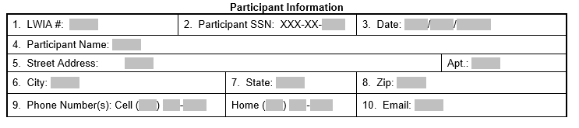
Waiver Form – Participant Information
Participant Information
  Complete all information for the participant.
  Section from Trade Form 003 Illinois Waiver From Training/Trade Form #003:

Slide 6
Waiver Form – Training Plan
A waiver can only be issued if the participant has a fully developed training plan in place and enrollment will take place at the next available enrollment period.
  Accepted into training program at training institution.
  Completed Form #014 Individual Employment Plan (IEP)
  Completed Form #006 Verification of Trade Training Enrollment.
  Completed Form #005 Eligibility for Trade Travel-Subsistence Assistance with Google Map printout.
  Completed Form #006d or Form #006e Training Program Tracking Form.
  6 criteria for training case note entered.
  Uploaded to IWDS.

Slide 7
Waiver Form – Training Plan
If the Training Plan question on the Waiver form is answered “No”, then the Waiver cannot be approved.
Section from Trade Form 003 Illinois Waiver From Training/Trade Form #003:

Slide 8
Waiver Form – Certification Information
Certification Information
  Obtain the information to complete this section from the certification and the Illinois Benefit Information System (IBIS).
  Dates must be verified with IBIS TRA Claim Details and UI Basic Claim Inquiry Printouts.
  Dates in this section, on the IBIS documents, and the TAA Additional Info Screen in Illinois Workforce Development System (IWDS) must match.

Slide 9
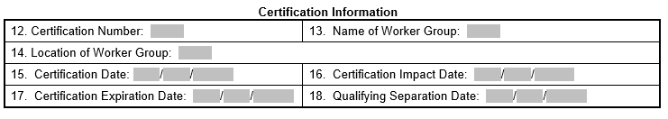
Waiver Form – Certification Information (cont.)
Section from Trade Form 003 Illinois Waiver From Training/Trade Form #003:

Slide 10
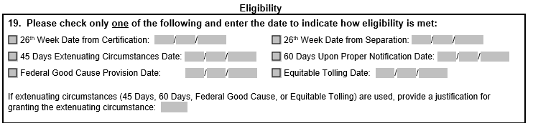
Waiver Form – Eligibility Petitions up to 97,999
Eligibility Section for petitions numbered up to 97,999 (check the one that describes how eligibility is met for the waiver.
The 26th week dates can be determined with the Trade Date Grid.
Extenuating Circumstances must be documented and justified.
Section from Trade Form 003 Illinois Waiver From Training/Trade Form #003:

Slide 11
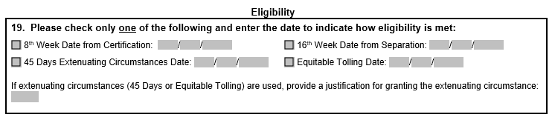
Waiver Form – Eligibility 2021R
2021R Waiver Eligibility Section for petitions numbered 98,000 and above.
  8/16 dates can be determined with the Trade Date Grid.
  Only two extenuating circumstances are available.
Section from Trade Form 003 2021R lllinois Waiver From Training Commerce/2021R Trade Form #003:

Slide 12
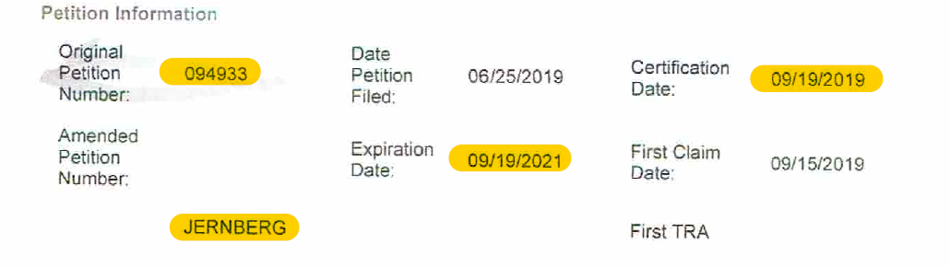
TRA Claim Details Printout

Slide 13
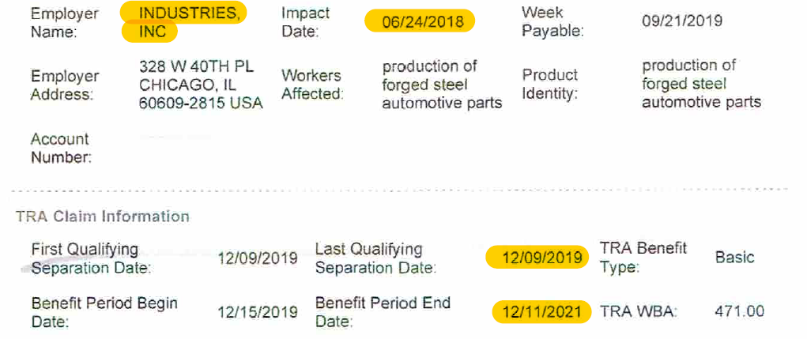
TRA Claim Details Printout

Slide 14
Waiver Form – Calculating 26/26 or 8/16 Deadline Dates
Determining the 26/26 or 8/16 deadline dates.
  Petition Certification Date: 09/19/2019
  Participant’s Qualifying Separation Date: 12/09/2019
    Petition 94933
      26th week from Certification Date: 03/19/2020
      26th week from Qualifying Separation Date: 06/08/2020
    Petition 98023
      8th week from Certification Date: 11/14/2019
      16th week from Qualifying Separation Date: 03/30/2020

Slide 15
Waiver - Extenuating Circumstances
Granting Extenuating Circumstances
Petitions 69,999 and Below | Petitions 70,000 thru 79,000 | Petitions 80,000 thru 80,999 | Petitions 81,000 and Above | Petitions 98,000 and above
2002 Law Benefits | 2009 Law Benefits | 2011 Law Benefits | 2015 Law Benefits | 2021R Law Benefits
45 Days Equitable Tolling | 45 Days 60 Days Upon Proper Notification State Good Cause Equitable Tolling | 45 Days Equitable Tolling | 45 Days 60 Days Upon Proper Notification Federal Good Cause Equitable Tolling | 45 Days Equitable Tolling

Slide 16
Waiver - Extenuating Circumstances (cont.)
45-Day Extenuating Circumstances (20 CFR 618.725(a)(3)): (Applies to all Trade Laws) A participant may be issued a waiver or enrolled in training within 45 additional days after the 26/26 or 8/16 (for 2021R) deadline if there are extenuating circumstances that justify the extension. Circumstances that would justify the extension must be for good cause, which means the participant acted diligently yet was unable to enroll because of exigent circumstances.

Slide 17
Waiver - Extenuating Circumstances (cont.)
State Good Cause: (Applies Only to 2009 Trade Law) A state Unemployment Insurance (UI) Good Cause provision (law, policy or practice) may be used to waive time limitations governing TRA and enrollment in training. The participant must meet one of the criteria below:
1) The worker was unaware of his/her rights under the act;
2) There was a failure by the State or the employer to discharge its
responsibilities or obligations under the act or the rules;
3) Any act by the employer in coercing, warning or instructing the
worker not to pursue his/her benefits or rights; or
4) Other circumstances beyond the worker’s control.

Slide 18
Waiver - Extenuating Circumstances (cont.)
60 Day Proper Notification Exception (20 CFR 618.725(a)(4)): (Applies Only to 2009 and 2015 Trade Law) Upon the state’s failure to provide the participant with timely information regarding the applicable training enrollment deadline, the participant must be issued a waiver by the Monday of the first week occurring 60 consecutive calendar days following the date the participant was properly notified.

Slide 19
Waiver - Extenuating Circumstances (cont.)
Federal Good Cause Provisions (20 CFR 618.730): (Applies to 2011 and 2015 Trade Law) States must waive the time limitations with respect to an application for TRA, enrollment in training, or receipt of a training waiver if the participant shows good cause. The following factors should be considered when determining whether good cause exists:
1) Whether the State failed to provide timely notice of the need to act before the deadline passed;
2) Whether factors outside the control of the worker prevented the worker from taking timely action to meet the deadline;
3) Whether the worker attempted to seek an extension of time by promptly notifying the State;
4) Whether the worker was physically unable to take timely action to meet the deadline;
5) Whether the employer warned, instructed, threatened, or coerced the worker in any way that prevented the worker’s timely
filing of an application for TRA or enrolling in training;
6) Whether the State failed to perform its affirmative duty to provide advice reasonably necessary for the protection of the
worker’s entitlement to TRA; and
7) Other compelling reasons or circumstances that would prevent a reasonable person from meeting a deadline.

Slide 20
Waiver - Extenuating Circumstances (cont.)
Equitable Tolling (20 CFR 618.888): (Applies to all Trade Laws) A Trade Program deadline must be equitably tolled when:
1) an extraordinary circumstance prevented an individual’s timely action; and
2) the individual otherwise acted with diligence
3) When an individual fails to take timely action because the State failed to give notice required
under this part, that failure is prima facie evidence of an extraordinary circumstance.
4) If the individual did not receive the required notice, but otherwise received actual notice with
sufficient time to take timely action, the last of receipt of the required notice is not evidence of an
extraordinary circumstance.
5) A Trade Program deadline equitably tolled under this section is tolled for the time period during which
the extraordinary circumstance exists. Once that circumstance is resolved, the time period that was tolled
begins to run again.
6) Equitable tolling may extend an otherwise expired Trade Program deadline by no more than 36 months.

Slide 21
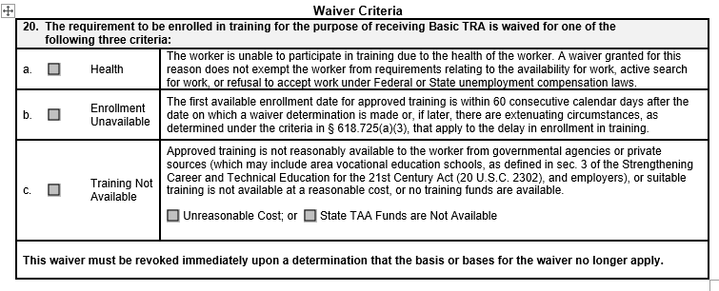
Waiver Form - Criteria
Waiver Criteria
Section from Trade Form 003 Illinois Waiver From Training/Trade Form #003:

Slide 22
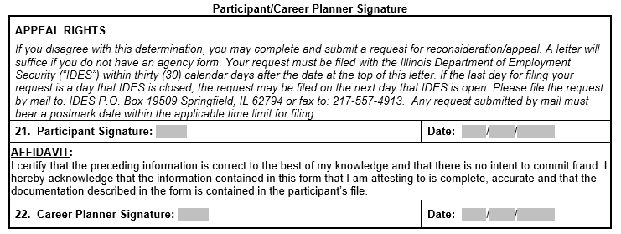
Waiver Form – Signatures & Appeal Rights
Signatures and Appeal Rights
  The participant and career planner must sign and date this form.
  Section from Trade Form 003 Illinois Waiver From Training/Trade Form #003:

Slide 23
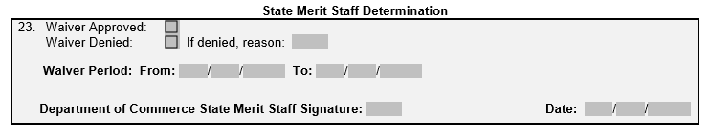
Waiver Form – State Merit Staff Determination
State Merit Staff Determination.
  Waivers are initially issued for a period of 60 days.
  Waiver period will be determined and entered by state merit staff.
    From: Date of approval.
    To: 60 Days after date of approval.
Section from Trade Form 003 Illinois Waiver From Training/Trade Form #003:

Slide 24
Waiver Form – Extension Information
Waiver Extensions
  There are limited instances where it may be necessary to continue the waiver beyond the initial waiver period.
  Must occur prior to the end of the waiver expiration date.
  Complete Waiver Extension section on Form #003, upload form to IWDS, and update IWDS.
  Complete Form #014a IEP Modification Form and upload to IWDS.
  Submit to State Merit Staff for approval.

Slide 25
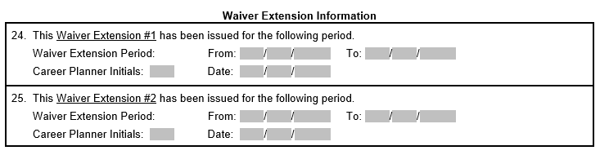
Waiver Form – Extension Information (cont.)
Waiver Extension Information
Section from Trade Form 003 Illinois Waiver From Training/Trade Form #003:

Slide 26
Waiver Form – Criteria Changes
Waiver Criteria Changes
  May be discovered during 30 day review.
  Change reason must be documented.
  Complete waiver criteria change section on Form #003 Illinois Waiver from Training Requirement and upload to IWDS.
  Complete Form #014a IEP Modification Form and upload to IWDS.
  Submit to State Merit Staff for approval.

Slide 27
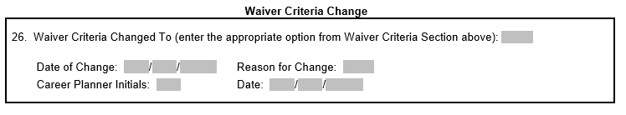
Waiver Form – Criteria Changes (cont.)
Waiver Criteria Changes
Section from Trade Form 003 Illinois Waiver From Training/Trade Form #003:

Slide 28
Waiver Form - Revocations
Waiver Revocation
  A waiver can end by participant request, Enrollment in Training, Expiration, or is revoked for cause.
  Complete Waiver Revocation Section on Form #003 and upload to IWDS.
  Complete the IEP Modification Form #014a and upload to IWDS.
  Complete the Trade Training Revocation Letter (Form #003d) - Enrollment in Training, Failed to make contact for 30 day reviews, Failure to enroll in training program.
    Form #003d must be sent to the participant for signature and returned to the career planner and placed in the participant file.

Slide 29
Waiver Form – Revocations (cont.)
  Complete additional appropriate letter, if applicable.
    Trade Waiver Termination Letter (Form #003a) – participant request.
    Trade Waiver Non-Compliance Letter (Form #003b) – participant non-compliance.
    Trade Potential Suspension Letter (Form #003c) – Trade Eligibility Requirements not met.
  Case note the date the letters are sent to the participant.
  Submit to State Merit Staff for approval.

Slide 30
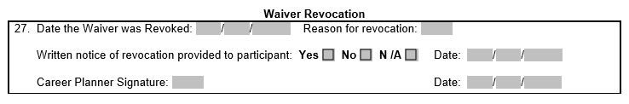
Waiver Form – Revocations (cont.)
Waiver Revocation Section.
Section from Trade Form 003 Illinois Waiver From Training/Trade Form #003:

Slide 31
Merit Staff Approval
Documents to upload to request merit staff approval for new Waiver:
  Completed Form #014 IEP.
  Completed applicable Form #003 Waiver.
  Completed Form #006 Verification of Trade Training Enrollment.
  Completed Form #005 Eligibility Determination for Trade Travel-Subsistence Assistance and Google Map printout.
  Completed Form #006d or Form #006e Program Tracking Form.

Slide 32
Waiver – 30 Day Reviews
30 Day reviews required.
Recorded in IWDS on the Waiver Status and in case notes.
Purpose is to ascertain if conditions for the waiver still exist.
A participant who fails to maintain contact with the career planner every 30 days will be sent a Trade Waiver Non-Compliance Letter Commerce/Trade Form #003b (Non-Compliance Letter) with instructions to contact the career planner immediately.
Upon failure of the participant to contact the career planner as instructed in the Non-Compliance Letter, the career planner will send a second Non-Compliance Letter marking the 2nd failure box.
Then after the 2nd failure to maintain the 30 day contact, a Trade Potential Suspension Letter Commerce/Trade Form #003c (Potential Suspension Letter) must be sent to the participant. This will initiate the entry of a Potential Suspension Request in IWDS.
See Chapter 9: Potential Suspension Request Chapter.

Slide 33
Waiver – 30 Day Reviews
During the 30 day review, determine the following:
If Health is the Waiver reason, the career planner must ensure:
The reason for granting the health waiver still exists.
That nothing has changed that would impact the development or implementation of a training plan and a potential start date for training. If something has changed, describe.
If the Health reason no longer exists, contact state merit staff.

Slide 34
Waiver – 30 Day Reviews
If Enrollment Unavailable is the Waiver reason, the career planner must ensure:
The training will begin within the 60 day period.
The participant meets the Extended Benefit (EB) work test. To determine, the participant must:
  Be registered for work with the Illinois Job Link and Illinois workNet;
  Actively engage in seeking work;
  Upon request, furnish the tangible evidence of work search efforts each week; and
  Accept any offer of suitable work, including those referred by the State.
If the Enrollment Unavailable reason no longer exists, contact state merit staff.

Slide 35
Waiver – 30 Day Reviews
If Training Not Available is the Waiver reason, the career planner must ensure:
The participant meets the Extended Benefit (EB) work test. To determine, the participant must:
  Register for work with the Illinois Job Link and Illinois workNet;
  Actively engage in seeking work;
  Upon request, furnish tangible evidence of work search efforts each week; and
  Accept any offer of suitable work, including those referred by the State.
What activities have been completed to find a suitable training program for the participant? If the participant is not making any substantial progress or does not have a valid reason for finding or enrolling in training, contact state merit staff.

Slide 36
Waiver – 30 Day Reviews
There are two reports in IWDS that will aid the career planner in managing the 30 day reviews.
  30 day Waiver Review Report – locates the most recent 30 day review record and calculates the number of days since the completion of the review.
  TAA Waiver Review Report - counts down the days until the next review is due based on the waiver's issue date.

Slide 37
Correspondence
Emails.
  Send all emails regarding Trade participants to state merit staff: Susan Boggs (susan.boggs@illinois.gov), Sheila Sloan (sheila.sloan@illinois.gov), and Lori Graham (lori.graham@illinois.gov).
  Send all emails regarding Trade grants to Crystal Bigelow (crystal.bigelow@illinois.gov).
  Always include a clear subject line that includes the LWIA, the purpose of email and participant name.
    LWIA XX - IEP & New Occupational Training Approval Request for (participant name).
  Do not combine information in emails for multiple participants. Each email should be for one participant only.

Slide 38
Websites
Illinois workNet Trade Forms
  https://www.illinoisworknet.com/tradeforms
US Department of Labor Employment & Training Trade Site
  https://www.dol.gov/agencies/eta/tradeact
Illinois Workforce Development System (IWDS)
  https://iwds.dceo.Illinois.gov/iwds/staffhome.html
US General Services Administration (GSA)
  http://www.gsa.gov
Workforce GPS (Trade 101 Resources)
  https://taa.workforcegps.org/

Slide 39
DCEO Trade Contacts
Susan Boggs
TAA Coordinator
susan.boggs@illinois.gov
Sheila Sloan
Quality Assurance
sheila.sloan@illinois.gov
217-685-2513
Crystal Bigelow
Trade Grants
crystal.Bigelow@illinois.gov
Lori Graham
Manpower Planner
lori.graham@illinois.gov
309-830-8458

Slide 40
IDES Trade Unit Contacts
John Ferry
Special Programs Manager
john.ferry@illinois.gov
Erik Hack
ATAA/RTAA Coordinator
erik.hack@illinois.gov
Amy Saumur
TRA & UI Claims
amy.saumur@illinois.gov
Angela Mosley
Petition Lists, TRA & UI Claims
angela.mosley@illinois.gov
TRADE UNIT PHONE NUMBER:
217-524-7826

Slide 41
Trade Training
Upcoming Training (Thursday Zoom Meetings):
Invitations sent out from Kiersten Baer at ISU.
  November 18 – Training (including completion of Form #006 Verification of Trade Training Enrollment, Form #005 Eligibility Determination of Travel-Subsistence Assistance, and Form #006d/e Program Tracking Form).
  December 2 – Attendance, Benchmarks, Breaks in Training (including completion of the Form #006a Bi-Weekly Verification of Training Attendance), and IEP Modifications.
  December 9 – Alternative/Reemployment Trade Adjustment Assistance (A/RTAA), Job Search Allowances, Relocation Allowances.

Slide 42
Trade Training (cont.)
  December 16 – Credential & Measurable Skill Gains, Exiting Participants.
  January 6 – TAPR/GRS (this is geared more towards the fiscal staff responsible for entries in GRS and uploading of the quarterly TAPR costs in IWDS).
  January 13 – Appeals, Fraud, Overpayments & Monitoring.
  Additional training if needed.
  Training recordings, presentations, and materials posted at:
    https://www.illinoisworknet.com/WIOA/Resources/Pages/Archived-Training.aspx

Slide 43

Questions

