Slide 1
The Employer Engagement Playbook
Insights and Strategies for Workforce Professionals
Origami Works and Cook County Partners
February 11, 2026

Slide 2
Welcome and Introductions
Employer Engagement is foundational to strong workforce outcomes.
Dani Houchin, Executive Director, Origami Works Foundation
Biswa ‘Biz’ Phuyal, Manager of Business and Workforce Development, IL Department of Human Services
This session is designed for:
Business Service Representatives (BSRs)
Business Service Teams
One-Stop Operators
WIOA Administrators
Non-profit workforce partners

Slide 3
Why Employer Engagement Matters Right Now
A slackening labor market raises the stakes for effective employer engagement
Employers are adjusting to:
Slower hiring in some sectors
More selective recruitment
Greater scrutiny of workforce partnerships
Pace not aligning with demand
Workforce teams need to be clear, relevant, and well-coordinated

Slide 4

What does Business Engagement look like right now
Many BSRs operate in a complex and crowded employer-facing landscape.
Cook County includes:
One LWIA
Multiple WIOA delegate agencies
Numerous non-delegate nonprofit partners
Common realities:
Multiple agencies serving the same employers
Limited visibility into who is doing what
Tools and practices living in silos
Constant pressure to update messaging and data
Size and scope are big, collaboration is small

Slide 5
The Risk and the Opportunity
When the first approach is not a fit, opportunities can quietly drop off.
The Risk
Missed employer follow-up
Relationships that never deepen
Employers disengaging after an initial contact
The Opportunity
Learnings from other organizations
More consistent and responsive employers' experiences
Frequent and deeper relationships across the ecosystem

Slide 6
Why we created the Employer Engagement Playbook
The playbook was designed to make employer engagement practice visible and discussable
Our goals were to:
Document what is currently happening
Support learning across organizations
Avoid heavy-handed standardization
Central “entry point” resource

Slide 7
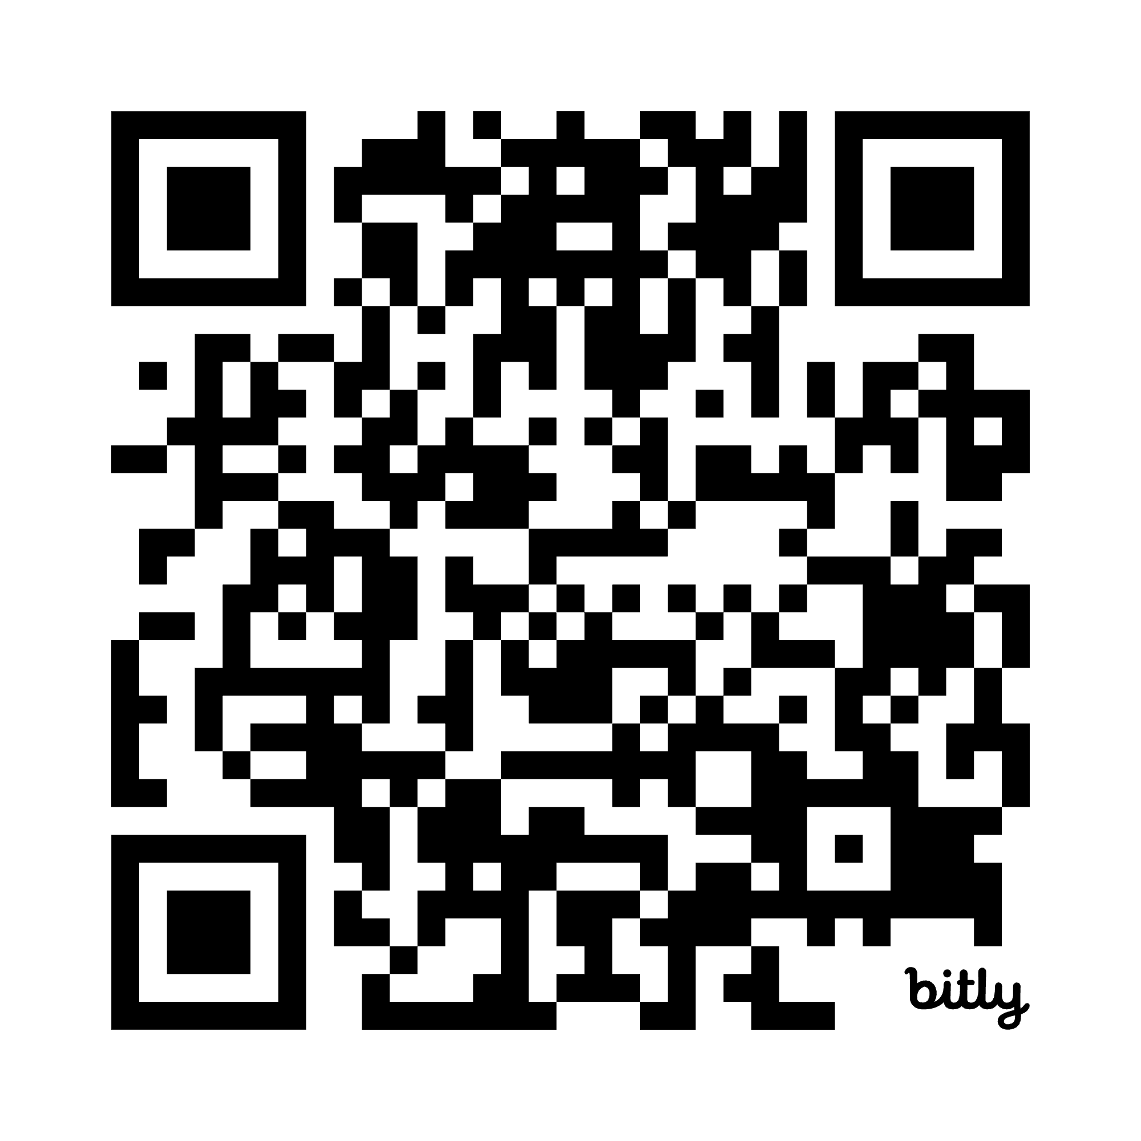
The Playbook
Link and QR Code:
If you would like to view the Playbook on your own device, use the QR code or visit the link provided:
https://theinnovationnexus.org/playbook

Slide 8
Who contributed to the playbook
The playbook reflects real practices from people doing the work today.
We spoke with employer-facing staff from:
WIOA delegate agencies
Non-delegate nonprofit partners
Roles included:
Business Service Representatives
Employer Engagement Managers
Program leaders supporting employer-facing teams

Slide 9
What the playbook Is and Is Not
The playbook is (practice):
The playbook is NOT (policy):
A free online resource
A snapshot of current approaches
Grounded in real tools and workflows
A compliance document
A required model
A finished product

Slide 10
How we built the playbook
We used a qualitative, practice-driven approach.
Our process included:
Interviews across organizations
Identifying recurring patterns
Grouping practices into topic areas
Designing a structure that can evolve
Non-delegate nonprofit partners

Slide 11
A Learning Loop, Not a Final Answer
This work is intended to evolve through use and feedback.
We see the playbook as:
A starting point for conversation
An onboarding and learning tool
A shared reference for teams
A way to test and refine approaches over time

Slide 12
What You Will Find Inside the Playbook
The Playbook focuses on practical employer-facing work.
High level topic areas include:
Introductory Conversations and Assessment
Establishing Employer Relationships
Metrics and Financial Factors
Organization Level Considerations
Challenges

Slide 13
Example 1: Learning About Employer Needs
Strong first conversations emphasize listening over pitching.
Points of alignment:
Intake forms
Advance research
Checklists
Detailed needs assessments

Slide 14
Example 2: Following Up
Strong first conversations emphasize listening over pitching.
Points of alignment:
Timely responses
Regular, recurring contact

Slide 15
Example 3: Handling Employer Objections
Effective teams anticipate and respond to common employer concerns:
What we saw:
Stressing outcomes such as retention rates and success stories
Providing hands-on support for accessing subsidies, tax credits, and other funding opportunities
Emphasizing return on investment over time
Highlighting the competencies, qualifications, and training of candidates

Slide 16
What We Learned So Far Across Organizations
Several patterns consistently showed up in conversations:
These included:
• Similar discovery approaches
• Shared challenges around employer follow-up
• Informal tools filling formal gaps
• Strong commitment to employer relationships

Slide 17
Where Practices Differ and Why That Matters
Differences often reflect context rather than quality.
Variation showed up by:
• Industry focus
• Employer size
• Target populations and participant needs
• Funding structure and staff capacity
These differences offer learning opportunities rather than conflicts.

Slide 18
What Business Services Reps Told Us They Need Most
Access to shared, practical information reduces friction.
Business Services Representatives emphasized the need for:
• Peer examples
• Clear starting points
• Easily accessible tools
• Less duplication of effort

Slide 19
What Comes Next for the Playbook
The next phase focuses on refinement and responsiveness.
Sharing use cases
Expanding the repository over time
Responding directly to user feedback

Slide 20
Monthly Essential Intelligence
We have launched a monthly employer engagement email communication.
Essential Intelligence for “Employer Engagement” includes:
Success Stories
Employer events
Use cases for the playbook

Slide 21
Ways to stay connected
This work is stronger when regions learn together.
You can:
Subscribe to the monthly Essential Intelligence email
Explore and use the Playbook
Reach out if your region is interested in adapting the model

Slide 22
Discussion Q and A
Your questions help shape what comes next.
We invite reflection on:
• What resonates from your region
• Where alignment feels hardest
• What would make this more useful

Slide 23


Closing
Thank you for your time and your work with employers and career seekers.
This playbook is an early step toward shared learning. We look forward to refining it together.

Slide 24
Contact and Resource
Dani Houchin - dani@origamiworks.org
Executive Director, Origami Works Foundation
Biswa ‘Biz’ Phuyal – biswa.phuyal2@illinois.gov
Manager Business and Workforce Development – Illinois Department of Human Services
This playbook is an early step toward shared learning. We look forward to refining it together.

Slide 25
Thank You

Slide 26
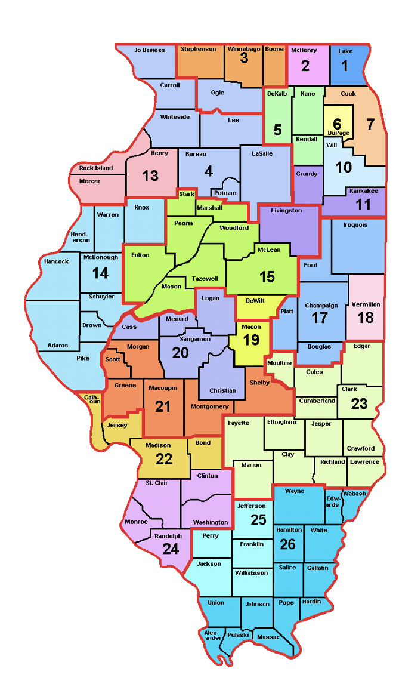
Where is Your Local Area?

Slide 27







































Title I
Job Corps
Adult Ed
Second Chance
Wagner Peyser
Which partner do you best represent?
Youth Build
Voc Rehab
Chief Elected Official
SCSEP
One stop partners
CTE
Board Member
Migrant
Farmworker s
TANF
Business
HUD
TAA
CSBG
UI
Veterans

