Slide 1
Workforce Innovation and Opportunity Act
Youth Eligibility
As of January 11th, 2020

Slide 2
Federal Youth Guidance
Workforce Innovation and Opportunity Act of 2014
Training and Employment Guidance Letter 21-16 – Third WIOA Title I Youth Formula Guidance – dated March 2nd, 2017

Slide 3
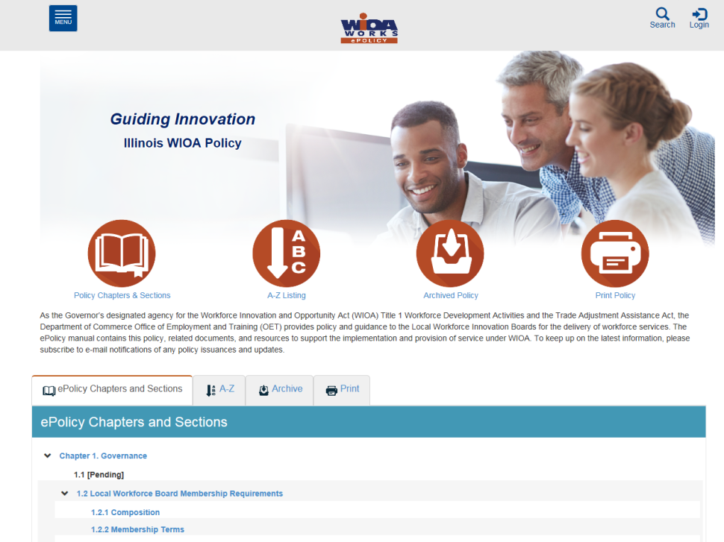
Understanding the ePolicy Manual
The Illinois Department of Commerce and Economic Opportunity, Office of Employment and Training (OET) utilizes a WIOA ePolicy portal where all current and new guidance issued by the Illinois Workforce Innovation Board (IWIB) and OET will be maintained.
Homepage: www.illinoisworknet.com/DCEOPolicies

Slide 4
State Youth Guidance
WIOA E-Policy Chapter 5 - General Eligibility
WIOA E-Policy Chapter 5.1.1 – 1.1.4 – Selective Service
WIOA E-Policy Chapter 5.4 – General Youth Eligibility
WIOA E-Policy Chapter 5.4.1 – Out-of-School Youth
WIOA E-Policy Chapter 5.4.2 – In-School Youth
WIOA E-Policy Chapter 5.5 - Low-Income Individuals
OET Notice NO. 19-NOT-03 - Basic Skills Deficient, Change 3

Slide 5
WIOA Youth Eligibility
Prior to viewing this presentation on Youth Eligibility, it is important that you view and understand the details that were covered in the presentation on:
    WIOA General Eligibility – 1-7-2021
    WIOA Low Income – 1-7-2021
    WIOA Basic Skills Deficient – 1-11-2021

Slide 6
General WIOA Eligibility
General Eligibility Requirements - all registered individuals must meet two general eligibility requirements:
  Be a citizen or noncitizen authorized to work in the US; and
  Meet Military Selective Service registration requirements (males only)

Slide 7
WIOA Youth Program
Workforce Innovation and Opportunity Act of 2014:
  In-School Youth is a separate category from Out-of-School Youth and the eligibility between these two are significantly different.

Slide 8
School Status at Application
The school status should be recorded based on what the client is doing at the time of their WIOA application, not what the client will be entering as part of their WIOA services.

Slide 9
Guidance from TEGL 21-16
    For purposes of WIOA, providers of Adult Education under Title II of WIOA, YouthBuild programs, the Job Corps program, high school equivalency programs, and dropout re-engagement programs are not considered to be schools for the purposes of determining school status, with one exception:
      Youth attending high school equivalency (HSE) programs, including those considered to be dropout re-engagement programs, funded by the public K–12 school system that are classified by the school system as still enrolled in school are considered ISY.

Slide 10
Determining School Status
In Illinois Workforce Development System (IWDS), on the “Education Status” screen within the application, is where the question to determine if an individual is an In-School Youth (ISY) or an Out-of-school Youth (OSY).
The “Attending School” question has the internal logic criteria and determines if a client will be considered an “In School Youth” (ISY) or an “Out-of-School Youth” (OSY) within IWDS.

Slide 11
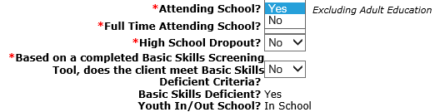
Determining ISY Status
If the question of “Attending School is populated with a “Yes”, the internal logic will determine the client as an ISY.

Slide 12
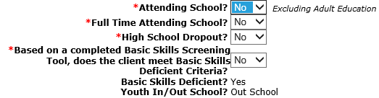
Determining OSY Status
If the question of “Attending School” is populated with a “No”, the internal IWDS logic will determine the client as an OSY.

Slide 13
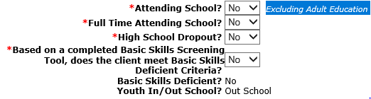
Excluding Adult Education
To reiterate, for the “Attending School” question in IWDS, if the individual applying for the WIOA Youth program is currently part of an Adult Education under Title II of WIOA, OR YouthBuild programs, OR the Job Corps program, the question of attending school should be recorded as a “No”.

Slide 14
WIOA In-School Youth
WIOA E-Policy Chapter 5.4.2 – In-School Youth:
    In-School Youth – Youth not younger than 14 or older than age 21
      Attending school (as defined by state law)

Slide 15
In-School Youth
WIOA E-Policy Chapter 5.4.2 – In-School Youth:
  95% of the In-School Youth must meet low-income criteria (see WIOA E-Policy Chapter 5.5 - Low-Income Individuals)
As mentioned earlier, it is essential that you have viewed and understand the previous power point on WIOA Low Income, so you understand the eight different ways an In-School Youth client could meet WIOA Low Income criteria.
Lastly, all In-School Youth clients must have one or more of the following barriers shown on the next slide.

Slide 16
WIOA In-School Youth Barriers
Basic Skills Deficient
An English Language Learner
An offender
Homeless
Runaway
Foster Child or aged out of foster care
Pregnant or Parenting
An individual with a disability
An individual requiring additional assistance to enter or complete an educational program or to secure or hold employment.

Slide 17
Basic Skills Deficient
Basic Skills Deficient – respect to an individual— (A) who is a youth, that the individual has English reading, writing, or computing skills at or below the 8th grade level on a generally accepted standardized test; or (B) who is a youth or adult, that the individual is unable to compute or solve problems, or read, write, or speak English, at a level necessary to function on the job, in the individual’s family, or in society.

Slide 18
Basic Skills Deficient
As was covered in the separate presentation on Basic Skills Deficient (BSD), there are three different ways an individual could meet BSD criteria:
  Scoring at or below 8th Grade Level Equivalency (GLE) on their pre-assessment math or reading tests.
  Being determined BSD due to the Basic Skills Screening Tool.
  If a Youth Client is assessed as an English Language Learner (ELL) they are also considered BSD.

Slide 19
Basic Skills Deficient (BSD)
A key internal logic item in IWDS to understand about BSD from assessment tests:
  The assessment test date must be, on or before the application date before the internal logic within IWDS is going to pick up the client as BSD due to the assessment test:
    Example, if a client has an application date of 1/4/2021, but was given the assessment test(s) on a date after 1/4/2021, even if the client scores at or below 8th Grade Level on the assessment test(s), the internal IWDS logic would not determine the individual BSD based on the assessment test.

Slide 20
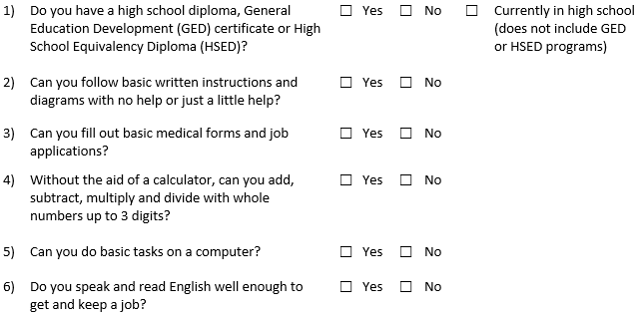
Basic Skills Screening Tool
If an individual replies “No” to any of the following questions on the screening tool, they can be determined BSD:

Slide 21
Basic Skills Screening Tool
Within IWDS, on the “Education Status” screen within the application, is where the question has been added when a client is being determined BSD due to the new screening tool.
If any question on the screening tool is answered “No” by the client, then the question related to the BSD screening tool on the “Education Status” screen should be answered “Yes”; (see example on next slide).

Slide 22
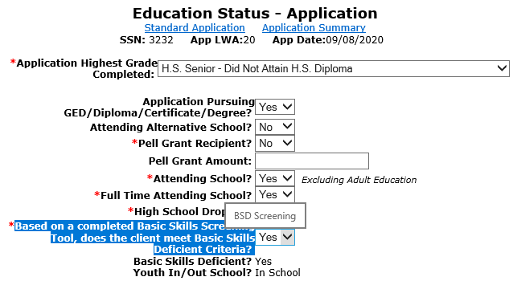
Basic Skills Screening Tool
Demonstrating recording BSD due to the screening tool.

Slide 23
English Language Learner
English Language Learner – the term “English language learner” when used with respect to an eligible individual, means an eligible individual who has limited ability in reading, writing, speaking, or comprehending the English language, and (A) whose native language is a language other than English; or (B) who lives in a family or community environment where a language other than English is the dominant language.

Slide 24
Youth Barriers
Within IWDS, on the “Characteristics and Barriers” screen within the application, is where the question has been added when a client is being determined an English Language Learner (ELL).
If the question is populated with a “Yes”, the client must pass on a Language of Preference; (see example on next slide).

Slide 25
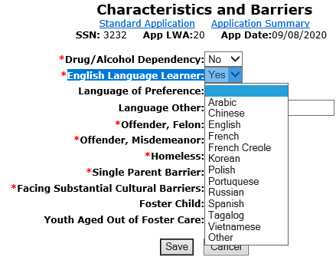
English Language Learner
Demonstrating barrier of ELL being recorded.

Slide 26
Youth “Offender” Barrier
Offender - An adult or youth (A) who is or has been subject to any stage of the criminal justice process, for whom services under this Act may be beneficial; or (B) who requires assistance in overcoming artificial barriers to employment resulting from a record of arrest or conviction.

Slide 27
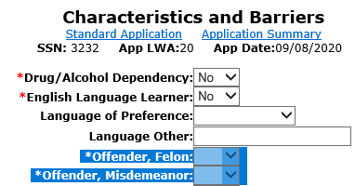
Youth “Offender” Barrier
Within IWDS, on the “Characteristics and Barriers” screen within the application, if either of the two questions highlighted in blue below are answered with “Yes”, it would meet the criteria for ISY barrier of “Offender”.

Slide 28
Youth “Homeless” Barrier
Individual who lacks a fixed, regular or adequate nighttime residence; as defined in the Violence Against Women Act of 1994, or
Adult or youth with a primary nighttime residence that is a public or privately operated shelter for temporary accommodation as defined in the
McKinney-Vento Homeless Assistance Act

Slide 29
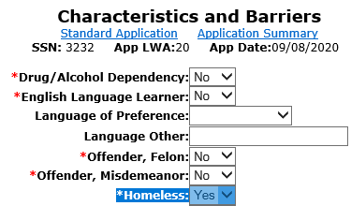
Youth Barrier of Homeless
Within IWDS, on the “Characteristics and Barriers” screen within the application, if the question of “Homeless” is answered with “Yes”, it would meet the criteria for the Youth barrier of “Homeless”.

Slide 30
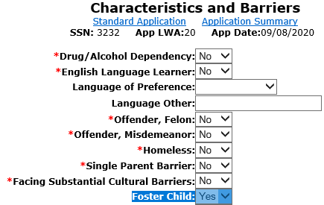
Foster Child
Within IWDS, on the “Characteristics and Barriers” screen within the application, if the question of “Foster Child” is answered with “Yes”, it would meet the criteria for the Youth barrier of “Foster Child”.

Slide 31
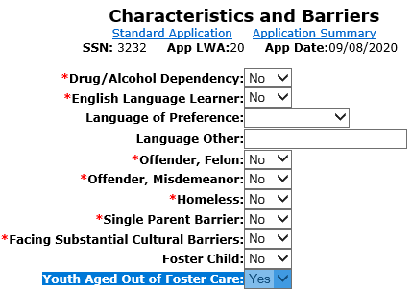
Aged out of Foster Care
Within IWDS, on the “Characteristics and Barriers” screen within the application, if the question of “Youth Aged Out of Foster Care” is answered with “Yes”, it would meet the criteria for the Youth barrier of “Youth Aged Out of Foster Care”.

Slide 32
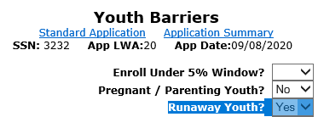
Runaway
Within IWDS, on the “Youth Barriers” screen within the application, if the question of “Runaway Youth” is answered with “Yes”, it would meet the criteria for the Youth barrier of “Runaway”.

Slide 33
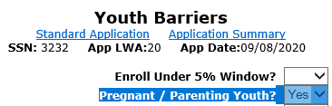
Pregnant or Parenting Barrier
Within IWDS, on the “Youth Barriers” screen within the application, if the question of “Pregnant/Parenting Youth” is answered with “Yes”, it would meet the criteria for the Youth barrier of “Pregnant or Parenting Youth”.

Slide 34
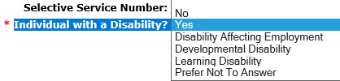
An Individual with a Disability
Within IWDS, on the “Private Information” screen within the application, if the question of “individual with a disability“ has any response other than “No” or “Prefer Not to Answer”, the Youth Barrier of “Individual with a Disability” will be identified.

Slide 35
Youth Barrier Must Understand
Under Youth eligibility, there is a barrier for, “An individual requiring additional assistance to enter or complete an educational program or to secure or hold employment.”
It is important to understand the criteria to support this barrier is determined by each Local Workforce Innovation Area (LWIA) in their own Local Policy.
  If this barrier is indicated in an application, staff must explain in the case note (or with appropriate documentation), how the client meets the criteria that is laid out within the LWIA Policy on this barrier.

Slide 36
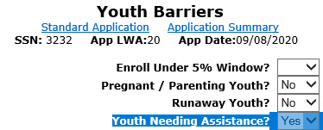
Youth Requiring Assistance
Within IWDS, on the “Youth Barriers” screen within the application, if the question of “Youth Needing Assistance” is answered with “Yes”, it would meet the criteria for the Youth barrier of “Youth Requires Additional Assistance”.

Slide 37
Concludes In-School Youth (ISY)
This concludes the portion of the presentation on ISY, key points to remember are for an ISY the Youth is required to meet WIOA Low Income criteria and have one or more of the identified Youth barriers.

Slide 38
Out-of-School Youth Eligibility
WIOA E-Policy Chapter 5.4.1 – Out-of-School Youth
  Out-of-School Youth – Youth not younger than 16 or older than age 24.

Slide 39
Out-of-School Youth
WIOA E-Policy Chapter 5.4.1 – Out-of-School Youth
  Not attending any school as defined under state law.
  Individuals attending Adult Education provided under Title II of WIOA, YouthBuild or Job Corps are also classified as out-of-school youth for eligibility determination;

Slide 40
Guidance from TEGL 21-16
  If a youth graduates high school and registers for postsecondary education but does not ultimately follow through with attending postsecondary education, then such a youth would be considered an OSY if the eligibility determination is made after the point that the youth decided not to attend postsecondary education.
  If the youth is only enrolled in non-credit-bearing postsecondary classes, they would not be considered attending postsecondary school and, therefore, an OSY.

Slide 41
The following out-of-school youth barriers do not require the individual to meet low-income criteria:
School Dropout
Within the age of compulsory attendance but has not attended school for at least the most recent complete school year quarter
Subject to the juvenile or adult justice system
Homeless
Runaway
Foster care or aged out of foster care
Pregnant or parenting
An individual with a disability

Slide 42
High School Drop Out
This barrier can only be used for an individual who drops out of High School and has not gone back to school. If they dropped out but went back or obtained their General Equivalency Degree (GED), they are not considered a “Drop Out” under WIOA Eligibility.
Within IWDS, on the “Education Status” screen within the application, if the question of “High School Dropout” is answered with “Yes”, it would meet the criteria for the OSY barrier of “High School Dropout” (see next slide).

Slide 43
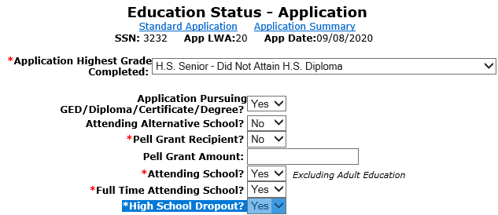
Documenting High School Drop Out
On Education Status screen of application is where OSY barrier of “High School Dropout” is recorded.

Slide 44
Not Attended High School in a Quarter
In some instances, a High Schools might not consider an individual to be a High School Drop Out until the end of a school year.
Under the WIOA legislation, the Out-of-School Youth barrier of “Within the age of compulsory attendance but has not attended school for at least the most recent complete school year quarter” was added for this reason.

Slide 45
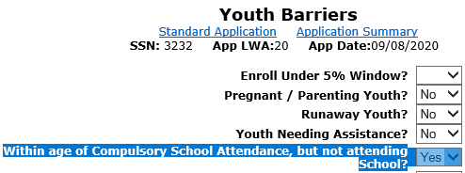
Not Attended High School in a Quarter
Within IWDS, on the “Youth Barriers” screen within the application, if the question of “Within age of Compulsory School Attendance, but not attending School?” is populated with a “Yes”, the OSY barrier of “Within the age of compulsory attendance but has not attended school for at least the most recent complete school year quarter” will be met.

Slide 46
Subject to Justice System
Under the WIOA legislation, under In-School Youth (ISY) there is a barrier for an ”Offender”, for the Out-of-School Youth (OSY) this barrier is called, “Subject to the juvenile or adult justice system.”
In the March 2017, TEGL 21-16 – WIOA Youth guidance it was clarified that the OSY barrier of “Subject to the juvenile or adult justice system” has the same definition as the ISY barrier of “Offender”.

Slide 47
Subject to Justice System
An adult or youth is “Subject to the Juvenile or Adult Justice System” if, (A) who is or has been subject to any stage of the criminal justice process, for whom services under this Act may be beneficial; or (B) who requires assistance in overcoming artificial barriers to employment resulting from a record of arrest or conviction.

Slide 48
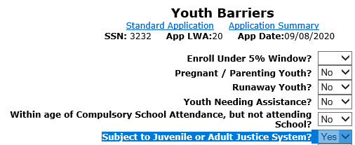
Subject to Justice System
Within IWDS, on the “Youth Barriers” screen within the application, if the question of “Subject to Juvenile or Adult Justice System” is populated with a “Yes”, the OSY barrier of “Subject to Juvenile or Adult Justice System” will be met.

Slide 49
Out-of-School Youth Barriers
For the other Out-of-School Youth barriers that do not require a client to meet WIOA low-income criteria are shown in the adjacent column, we have already covered the place in the application where those questions are addressed to record those barriers.
Homeless
Runaway
Foster care or aged out of foster care
Pregnant or parenting
An individual with a disability

Slide 50
Out-of-School Youth Barriers
If an Out-of-School Youth (OSY) did not meet any of the previously addressed barriers, there are two more possible barriers that could support OSY eligibility, but both require the client to meet WIOA Low Income criteria with the barrier.

Slide 51
The following out-of-school youth barriers require the individual to meet WIOA low-income criteria:
A recipient of a secondary school diploma or its recognized equivalent who is low-income individual and is
  Basic Skills Deficient, or
  An English language learner
A low-income individual requiring additional assistance to enter or complete an educational program or to secure or hold employment (must be supported based on local policy criteria.)

Slide 52
H.S. Diploma or GED & BSD or ELL
For this barrier, the client will need to have been an OSY that has already graduated H.S. or completed their GED but is BSD or an ELL as was discussed and demonstrated on slides 17-25 in this power point.

Slide 53
Youth Requiring Assistance
For the barrier of “requiring additional assistance to enter or complete an educational program or to secure or hold employment.” were addressed on slides 35 & 36 of this power point.

Slide 54
5% Youth
A last point to cover for Youth, WIOA Legislation allows for a LWIA to serve up to 5% of their Youth, that are required to meet WIOA Low Income criteria as part of the eligibility (either ISY or OSY), who do not in fact meet WIOA Low Income criteria.
The Youth is still required to have at least one or more barriers.
Each LWIA is responsible to track their own 5% Youth, so check with the individual who is responsible for providing oversight of your Youth program if you feel you have a good client for the 5% Youth criteria

Slide 55
Youth Wrap-up
In conclusion – for all WIOA Youth they must meet WIOA General Eligibility tied to Authorized to Work in the U.S. criteria, and if a guy who turns age 18, he must be compliance with Selective Service.
95% of In-School Youth must meet WIOA Low Income criteria and have at least one or more of the identified Youth Barriers.
For Out-of-School Youth, most of the clients are not required to meet WIOA Low Income criteria unless their only barriers are tied to being a High School Graduate who is Basic Skills Deficient or an English Language Learner, or if the Youth Needing Assistance barrier is the only barrier.

Slide 56
WIOA Youth Eligibility
This concludes the block on Youth Eligibility.
If you have any questions, please contact James (Jim) Potts at james.potts@Illinois.gov or call him at (217) 416-7097.

