Slide 1
Workforce Innovation and Opportunity Act Eligibility
WIOA Low Income
As of September 9th, 2020

Slide 2
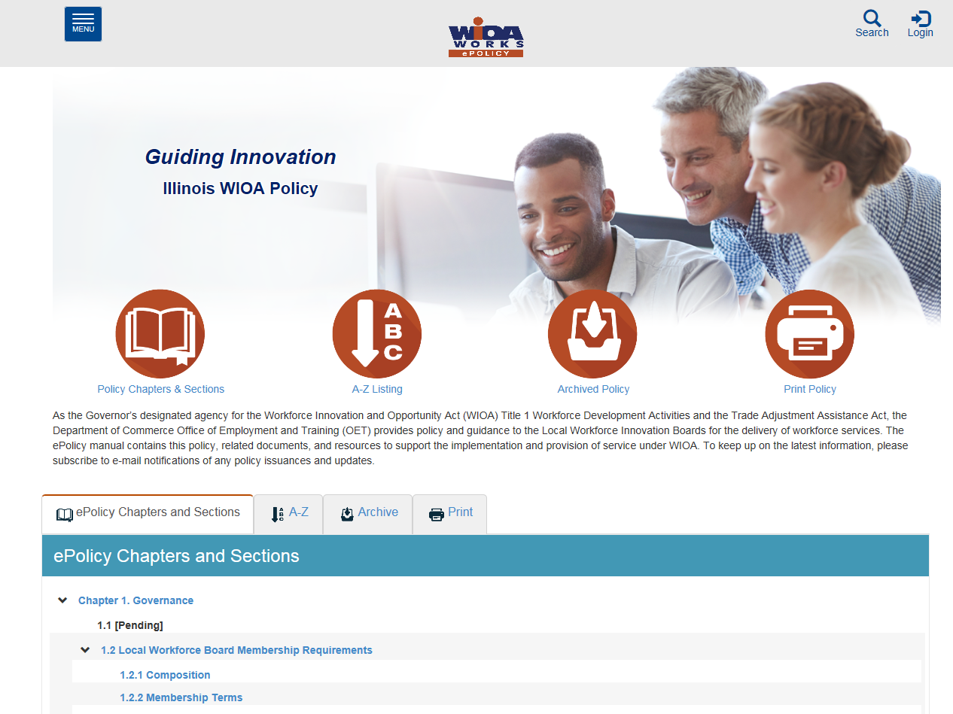
WIOA Title 1 Authorization
Federal:
Workforce Innovation and Opportunity Act of 2014
State of Illinois:
Department of Commerce Office of Employment and Training (OET) WIOA
E-Policy Chapter 5.5 - Low-Income Individuals

Slide 3
WIOA Low Income
Additional guidance provided in Training and Employment Guidance Letter (TEGL) 19-16 – Guidance on Services Provided through Adult and Dislocated Worker under WIOA – dated March 1st, 2017.
Additional guidance provided by TEGL 21-16 – Third WIOA Title I Youth Formula Program Guidance – dated March 2nd, 2017.

Slide 4
WIOA Low Income Rules
Adult Program - Priority of service for low income individuals.
In-School Youth – 95% of clients must meet WIOA low income criteria.
Out-of-School Youth – Youth with certain barriers can be required to meet low income criteria.

Slide 5
Low Income Individual Policy
WIOA E-Policy Chapter 5.5 - Low-Income Individuals.
Attachment A – Documentation
Attachment B – Inclusions/Exclusions
WIOA Notice NO. 19-NOT-03.

Slide 6
The eight ways an applicant can become qualified as Low Income
Cash Welfare
Food Stamps
Homeless
Free or Reduced Priced Lunch
Foster Child
Youth Customer Living in a High Poverty Level
Family Income Calculation
Family of One Due to Disability

Slide 7
Low Income Only Requires One
To meet WIOA Low income criteria, a client would only need to meet one of the eight different low income criteria.
However, if a client claims to meet low income criteria multiple ways, then the expectations at eligibility determination would be to have verification documentation for each criteria claimed.

Slide 8
WIOA Low Income Criteria that does not require an income calculation
Cash Welfare
Food Stamps
Homeless
Free or Reduced Priced Lunch
Foster Child
Youth Customer Living in a High Poverty Level

Slide 9
WIOA Low Income Criteria
The criteria for Cash Welfare and Food Stamps is:
Personally receives, or is a member of a family that receives or received in the past six (6) months either Cash Welfare or Food Stamps.

Slide 10
Low Income: Cash Welfare
Temporary Assistance for Needy Families (TANF) program under Part A of Title IV of the Social Security Act, or
Supplemental Security Income (SSI) program established under Title XVI of the Social Security Act, or
State or local income-based public assistance.
No Income Calculation Needed

Slide 11
The WIOA definition of “Family”
The term “family” means two or more persons related by blood, marriage, or decree of court, who are living in a single residence, and are included in one or more of the following categories:
Married couple and dependent children.
Parent or guardian and dependent children.
Married couple.

Slide 12
Question about Family ?
Referring to the WIOA family definition; Charlie and Betty live together and they are not married, they have a son, Tommy.
Q - Betty comes in, how many people are in her WIOA defined family and who are they?

Slide 13
Question about Family ?
Referring to the WIOA family definition; Charlie and Betty live together and they are not married, they have a son, Tommy.
Q - Betty comes in, how many people are in her WIOA defined family and who are they?
A – Family size of two, Betty and Tommy. Based on the WIOA Definition of family, to be considered a family of three in this situation, Charlie and Betty would need to be married.

Slide 14
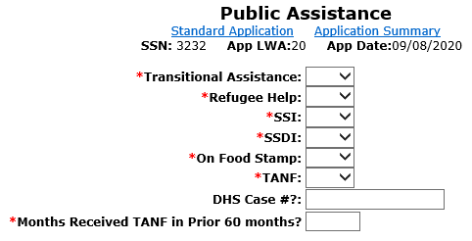
The Public Assistance Screen is where the various Cash Welfare and Food Stamps eligibility criteria are captured.

Slide 15
Low Income: Cash Welfare
Temporary Assistance for Needy Families (TANF) program under Part A of Title IV of the Social Security Act, or
Supplemental Security Income (SSI) program established under Title XVI of the Social Security Act, or
State or local income-based public assistance.
No Income Calculation Needed…

Slide 16
Public Assistance
If “Yes” is entered on the IWDS Public Assistance screen for following:
Transitional Assistance
Refugee Help
SSI
TANF
The client will be determined low income based on “Cash Welfare”.

Slide 17
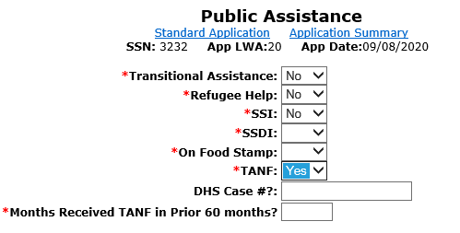

Slide 18
Question about Cash Welfare
Q – Betty is currently receiving TANF benefits, she lives with Charlie, but they are not married and Charlie is not on the household determination of the TANF printout. If Charlie came in for Services, could he be determined low income because he lives with Betty and she receives TANF benefits?

Slide 19
Answer to ? about Cash Welfare
Q – Betty is currently receiving TANF benefits, she lives with Charlie, but they are not married and Charlie is not on the household determination of the TANF printout. If Charlie came in for Services, could he be determined low income because he lives with Betty and she receives TANF benefits?
A – No, Charlie could not be determined as low income under WIOA due to Betty receiving TANF, as they do not meet the criteria under the family definition since they are not married.

Slide 20
The WIOA definition of “Family”
The term “family” means two or more persons related by blood, marriage, or decree of court, who are living in a single residence, and are included in one or more of the following categories:
Married couple and dependent children.
Parent or guardian and dependent children.
Married couple.

Slide 21
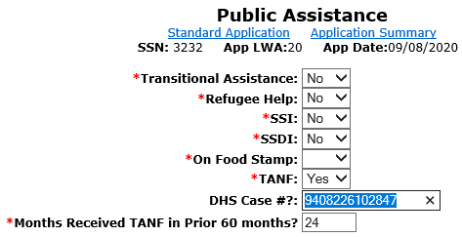
If the TANF is populated with “Yes”, the DHS Case # must be provided and the number of months the individual has been on TANF must be included.

Slide 22
Low Income: Food Stamps
Personally receives, or is a member of a family that receives or received in the past six (6) months the Supplemental Nutrition Assistance Program (SNAP) assistance.
Food and Nutrition Act of 2008

Slide 23
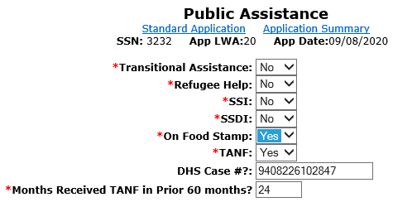
If Food Stamp and TANF are populated with “Yes” at certification, the documentation must be on hand to support both criteria. The documentation must remain in the hard copy file for monitoring and data validation.

Slide 24
Question about Food Stamps
Q – Betty is currently receiving Food Stamps, her son Tommy lives with her. If Tommy came in for WIOA Services could he be determined low income based on food stamps, even if he does not appear on his mothers food stamp account?

Slide 25
Answer to ? about Food Stamps
Q – Betty is currently receiving Food Stamps, her son Tommy lives with her. If Tommy came in for WIOA Services could he be determined low income based on food stamps, even if he does not appear on his mothers food stamp account?
A –WIOA Low Income criteria can be determined based on, “Personally receives, or is a member of a family that receives or received in the past six (6) months the Supplemental Nutrition Assistance Program (SNAP) assistance.”
Since Tommy lives with his mom who is receiving food stamps, he could be determined low income based on his mother Betty receiving food stamps.

Slide 26
Low Income: Homeless
Individual who lacks a fixed, regular or adequate nighttime residence; and
Violence Against Women Act of 1994
Adult or youth with a primary nighttime residence that is a public or privately operated shelter for temporary accommodation.
McKinney-Vento Homeless Assistance Act

Slide 27
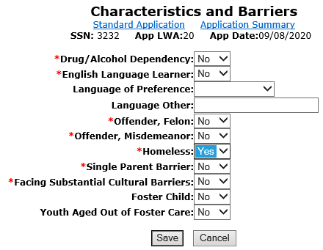
If “Yes” is entered in “Homeless” the client
will be determined as low income.

Slide 28
Low Income : Free or Reduced Priced Lunch
Receives or is eligible to receive a free or reduced price lunch under the
Richard B. Russell National School Lunch Act
-> Criteria for In-School Youth Only
Must have documentation from school.

Slide 29
Low Income : Free or Reduced Priced Lunch
TEGL 21-16 and our Low Income Policy clarified that “In schools where the whole school automatically receives free or reduced price lunch, WIOA programs must base low-income status on an individual student’s eligibility to receive free or reduced price lunch or on meeting one of the other low-income categories under WIOA”
Meaning if only whole school criteria is used for free or reduced lunch, you cannot use this method to determine low income criteria and must use one of the other low income categories to determine an individuals low income status

Slide 30
Youth Barriers Screen
Youth Barriers” screen is where the “Free or Reduced Price Lunch” question is housed – if an in-school youth client has a response of “Yes” the client will be determined as low income.

Slide 31
? about Free or Reduced Lunch Documentation
Q – Sally is currently a Junior in H.S., and in the school district she attends, all students are eligible for free lunch. She has applied for WIOA services, what documentation would be needed to support her WIOA Low Income Criteria due to free or reduced lunch?

Slide 32
Answer to ? about Free or Reduced Lunch Documentation
Q – Sally is currently a Junior in H.S., and in the school district she attends, all students are eligible for free lunch. She has applied for WIOA services, what documentation would be needed to support her WIOA Low Income Criteria due to free or reduced lunch?
A – The documentation would need to specifically address that Sally herself, by name, is eligible for free or reduced lunch. If the school will not provide information about an individual, then the client must find another way to support WIOA Low Income criteria.

Slide 33
Low Income: Foster Child
A minor on behalf of whom State or local government payments are made to a foster parent or other guardian.

Slide 34
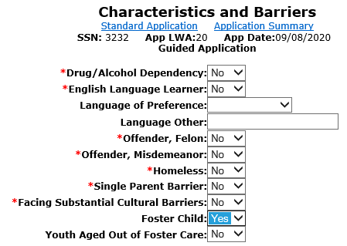
“Characteristics and Barriers” screen is where the “Foster Child” question is housed – if any client has a response of “Yes” to “Foster Child” - the client will be determined as low income.

Slide 35
Question about Foster Child Documentation
Q – Conrad is currently a Senior in H.S., he lives with his foster parents. What is the documentation that could be used support his WIOA Low Income Criteria due to Foster Child status?

Slide 36
Question about Foster Child Documentation
Q – Conrad is currently a Senior in H.S., he lives with his foster parents. What is the documentation that could be used support his WIOA Low Income Criteria due to Foster Child status?
A – The documentation choices to support Foster Child status to support WIOA Low Income criteria are listed in Attachment “A” to Commerce WIOA Low Income Policy WIOA E-Policy Chapter 5.5:
To support foster child status the following are acceptable choices: Court Contact; Court Documentation; Medical Card showing Foster Child Status; Verification of Payment made on behalf of the child; Written Statement from State/Local Agency

Slide 37
Youth Living in a High Poverty Level
According to Section 129(a)(2) of WIOA, for ISY and OSY, a youth qualifies as low income if the youth lives in a high poverty area.
Many rural counties in the U.S. have a poverty rate of 25 percent or above.
New Guidance was issued in April 2020 on the steps to determine this criteria.
The next few slides provides additional guidance on these new steps.

Slide 38
New Guidance in April 2020
DIRECTIONS FOR USING AMERICAN COMMUNITY SURVEY DATA TO IDENTIFY HIGH-POVERTY AREA IN URBAN OR RURAL AREAS
Note that these are new directions given that the Census Bureau has changed its web site since last year for obtaining American Community Survey Data.
Section 1: Determining if an Overall City or County has a Poverty Rate of 25 percent. 1. First, check to see if your overall city or county has a poverty rate of 25 percent or above. Go to Census.gov or click on https://www.census.gov. In the middle of the page, go to Quick Facts: Access Local Data and click on the arrow. On the top of the page that comes up type in the name of your city or county and then click on your city or county from the list provided of places with the same name. Scroll down near the bottom of the table to Income and Poverty and it will give you the poverty rate of your city or county. If the poverty rate is 25 percent or above, that is all that you need to do to show that your city or county is a high-poverty area.

Slide 39
New Guidance in April 2020
Section 2: Determining if an Individual Lives in a High-Poverty Area Based on Their Street Address.
There are two steps to this—first determining the Census tract in which the street address is located, and second determining the poverty rate of the Census tract.
For the first step, click on https://geocoding.geo.census.gov/geocoder/geographies/address?form. There will be two choices: Find Locations Using… and Find Geographies Using…Click on the second option to Find Geographies.
Type in the street address, city, and state. You don’t need to type in the zip code. The click on Find.
A list of information comes up giving geographic identifiers first by state, then by Census block, then by County, then by Census Tract. Scroll down near to bottom of the page to Census Tract. In the middle of the information for Census tracts there will be listed Name. This will give the Census tract number of the street address.
For the second step, Go to the American Community Survey home page by clicking on https://www.census.gov/programs-surveys/acs.

Slide 40
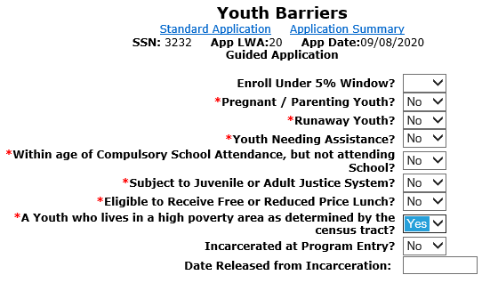
“Youth who live in a high poverty area” question is if youth client has a response of “Yes” - the client will be determined as low income

Slide 41
Question about High Poverty Area
Q - If a Youth client is determined low income based on living in a High Poverty Area, and then at a later date you would like to co-enroll the client into Adult services, could you certify under Adult Low Income utilizing the High Poverty Area criteria?

Slide 42
Answer about High Poverty Area ?
Q - If a Youth client is determined low income based on living in a High Poverty Area, and then at a later date you would like to co-enroll the client into Adult services, could you certify under Adult Low Income utilizing the High Poverty Area criteria?
A – No, only Youth clients are able to utilize the criteria of living in a High Poverty Area for determining WIOA low income.

Slide 43
Family Income Calculation
A Family Income Calculation is only needed to determine low income if the client does not meet any of the six automatic low income qualification criteria previously covered.
A family with total family income that does not exceed the higher of:
The poverty line; or
Seventy percent (70%) of the lower living standard income level

Slide 44
Family Income Calculation Requirements
Must capture the income on each individual within the WIOA defined family.
Pay stubs or other acceptable documentation for each of the family member’s income.
Documentation supporting family size.

Slide 45
Must have the family identified WIOA Family definition
The term “family” means two or more persons related by blood, marriage, or decree of court, who are living in a single residence, and are included in one or more of the following categories:
(A) A married couple and dependent children.
(B) A parent or guardian and dependent children.
(C) A married couple.

Slide 46
If Not Living with WIOA Family Members
Guidance was provided on page 7., of TEGL 21-16, that “if an individual is not living in a single residence with other family members, that individual is not a member of a family for purposes of WIOA income calculations.”
Meaning, if an individual is not living with their WIOA defined family, then their income determination should be based on their own income only.

Slide 47
Income Calculation Question
Q – A 19 year-old individual Tom, is applying for the WIOA program. He lives with his older sister, Tori and their cousin, Sue who is 23. Both Tori and Sue are also thinking about applying for WIOA. How many people would be considered to be in the WIOA defined family? Whose income would be included to determine the low income status?

Slide 48
Answer to the Income Calculation ?
Q – A 19 year-old individual Tom, is applying for the WIOA program. He lives with his older sister, Tori and their cousin, Sue who is 23. Both Tori and Sue are also thinking about applying for WIOA. How many people would be considered to be in the WIOA defined family? Whose income would be included to determine the low income status?
A – None of these individuals meet the criteria under the WIOA family definition, in each case it would be a family size of one. Each individuals low income status would be based on their own income.

Slide 49
Family Income Calculation Requirements
It is essential to view DCEO WIOA Policy 5-5 – Low Income Individuals – specifically Attachment “B” – Inclusions and Exclusions for Determining Family Income.
Any family member that counts towards the WIOA defined family must have the included income for the previous six months prior to the application date for the family income calculation.

Slide 50
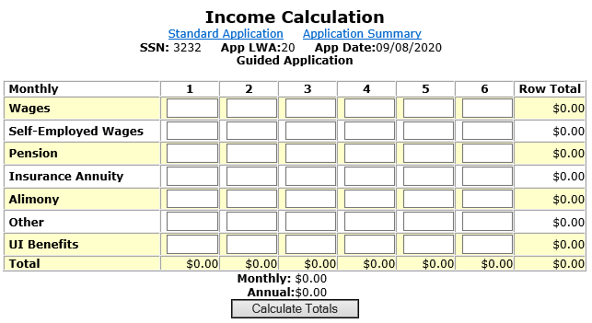

Slide 51
Family Income Calculation
After the entire family’s income has been loaded into the “Income Calculation” the Career Planner must “Calculate Totals”.

Slide 52
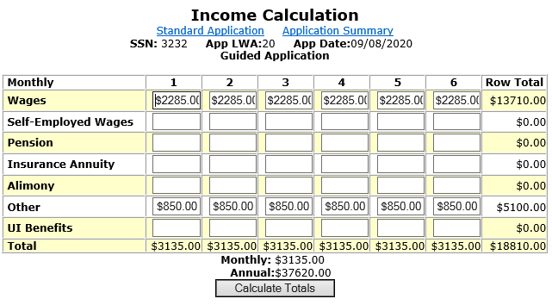

Slide 53
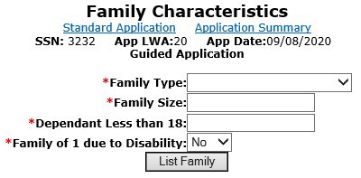
Family Characteristics Screen
You must record all family members that are counted if you are conducting a family income calculation.

Slide 54
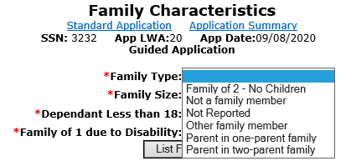
Family Type
Choose what is the best description of the Family.

Slide 55
The definition of Family is important to understand:
The term “family” means two or more persons related by blood, marriage, or decree of court, who are living in a single residence, and are included in one or more of the following categories:
(A) A married couple and dependent children.
(B) A parent or guardian and dependent children.
(C) A married couple.

Slide 56
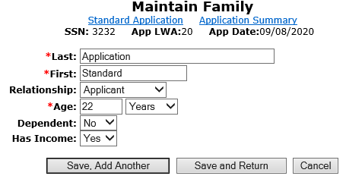
Maintain Family Screen
You must Document all family members that are counted towards the income calculation.

Slide 57
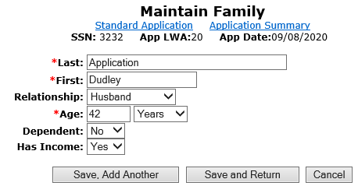

Slide 58
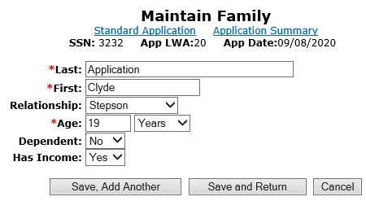
Could a 19 year old step-child still be considered part of the WIOA defined “Family”?

Slide 59
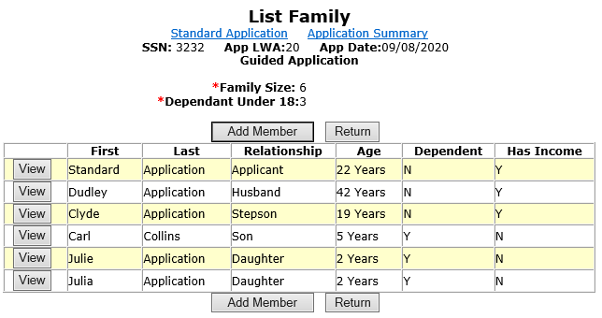
Yes, but the income of the Adult aged child must also be included as part of the “Family Income” calculation.

Slide 60
For the income calculation, the “Career Planner” would be responsible for having the income verification documentation for each individual in the family that had income.

Slide 61
If Over Family Income
If a client does not meet any of the automatic low income qualification factors, and is over the family income low income level, there is a final way low income could be determined.

Slide 62
Family of One due to a Disability
Is an individual with a disability whose own income does not exceed the higher of:
The poverty line; or
Seventy percent (70%) of the lower living standard income level, but who is a member of a family whose income does not meet this requirement.

Slide 63
Family of one due to a disability
IWDS must be documented in three places within the IWDS application to properly document family of one due to a disability.

Slide 64
Family of one due to a disability
On the “Private Information” screen the disability must be identified.
The “Income Calculation” screen is where the clients income must be documented.
The “Family Characteristics” screen is where the criteria of “Family of One” is specified.

Slide 65
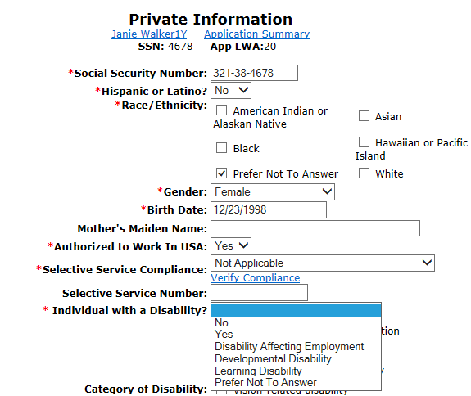

Slide 66
Family of one due to a disability
The clients income for the six months prior to application date must be documented on the “Income Calculation” screen.

Slide 67
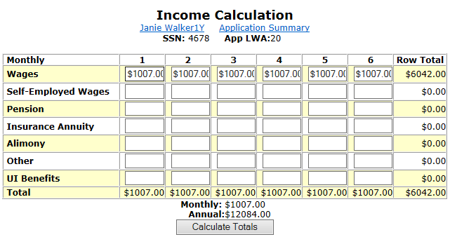

Slide 68
Must capture the income for the client
If the client does not have income, the client must write an attestation stating they have not had income in the previous 6-month period.
If client has income, it must be at or under the income for a family of one ($12,760) as described in WIOA Notice 19-NOT-03, Revised Income Guidelines for Determining Low Income Status for WIOA.

Slide 69
On the “Family Characteristics” screen the client is characterized as “Family of One Due to a Disability”.

Slide 70
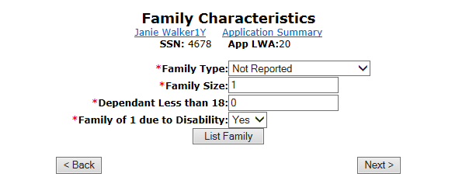

Slide 71
Question about Documentation
Q – 17 year-old Holly is applying for the In-School Youth Program, she lives with her parents and their family income is above the low income criteria guidelines. However, one of Holly’s barriers is a disability due to a hearing impairment. Her own income is less than the family of one income criteria so she will meet the low income criteria of family of one due to a disability. Would a self attestation be acceptable documentation to support her disability?

Slide 72
Answer about Documentation
Q – 17 year-old Holly is applying for the In-School Youth Program, she lives with her parents and their family income is above the low income criteria guidelines. However, one of Holly’s barriers is a disability due to a hearing impairment. Her own income is less than the family of one income criteria so she will meet the low income criteria of family of one due to a disability. Would a self attestation be acceptable documentation to support her disability?
A – No, a self attestation for the disability is not an acceptable documentation choice under these circumstances due to the client is utilizing family of one due to a disability to support her low income criteria.

Slide 73
Additional Clarification on Documentation for a Disability
In instances where a Youth client has multiple barriers that support eligibility; and the low income determination of the individual is not based on family of one due to a disability; the formal documentation for the disability is not required and a self-attestation for the disability could then be used.
The thought it to be less intrusive in regards to the individuals documentation of the disability, since the client would have other barriers to support their eligibility beyond just the disability.

Slide 74
Family of One due to a Disability
For documentation, must have:
Documentation addressing income.
Documentation addressing disability.

Slide 75
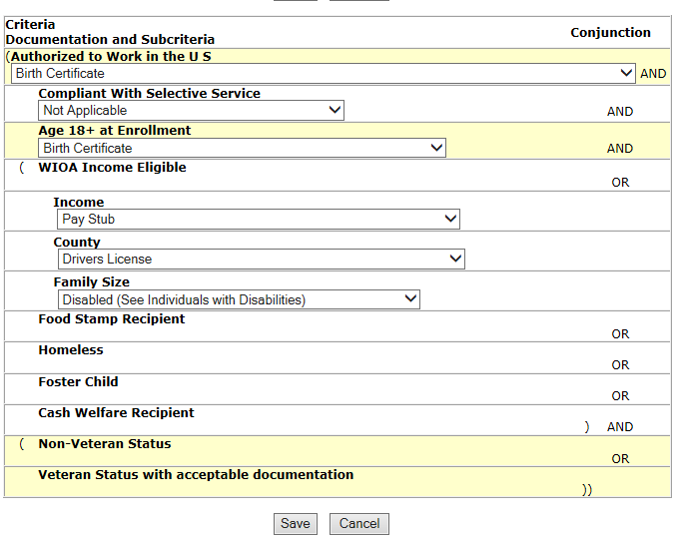

Slide 76
Low Income Individual
Of the eight ways an individual can be determined to be low income for WIOA there are six different ways that do not require capturing income information on the customer and/or the customers family.

Slide 77
WIOA Low Income Criteria that does not require income calculation
Cash Welfare
Food Stamps
Homeless
Free or Reduced Priced Lunch
Foster Child
Youth Customer Living in a High Poverty Level

Slide 78
Doesn’t Meet Automatic Qualification Criteria
If a client does not meet one of the previous six automatic qualification factors that is when an income calculation should be utilized to determine low income status.

Slide 79
WIOA Low Income Eligibility
All determinations of low-income status for customers must be supported by proper documentation of the qualifying condition as outlined in the “WIOA Title IB General and Fund Source Eligibility Requirements and Documentation Sources”.

Slide 80
WIOA Low Income Eligibility
Questions ?’s

