Slide 1
Workforce Innovation and Opportunity Act Eligibility
  WIOA Low Income Eligibility
As of January 6th, 2021

Slide 2
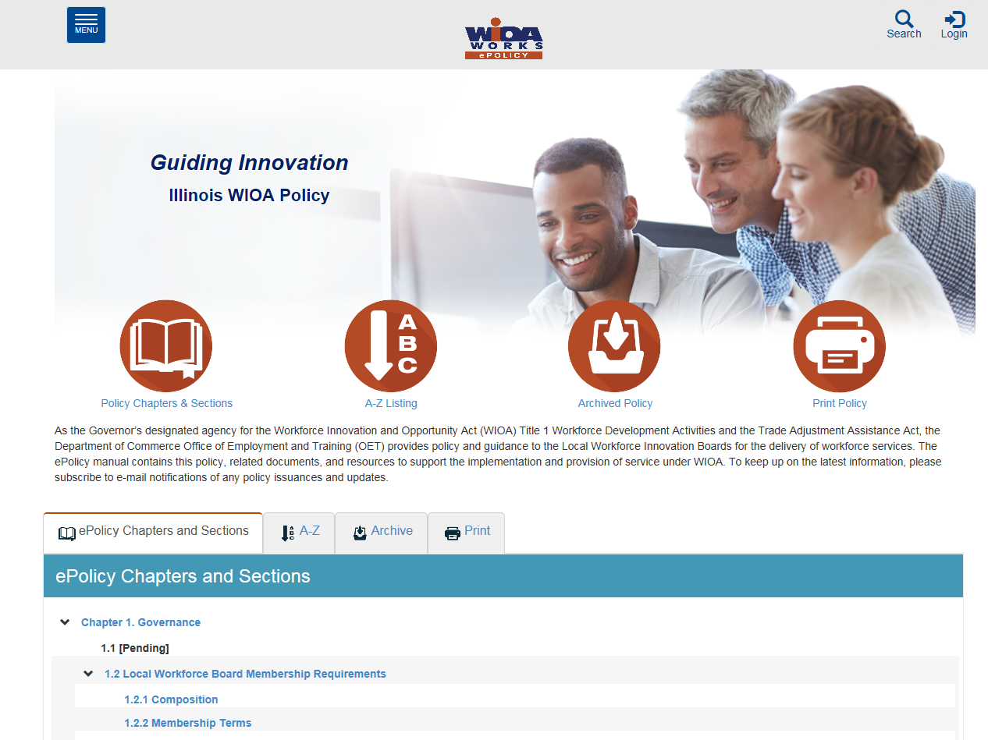
WIOA Title 1 Authorization
Federal:
Workforce Innovation and Opportunity Act of 2014
State of Illinois:
Department of Commerce Office of Employment and Training (OET) WIOA
ePolicy Chapter 5 - Section 5 - Low-Income Individuals

Slide 3

Understanding the ePolicy Manual
The Illinois Department of Commerce and Economic Opportunity, Office of Employment and Training (OET) utilizes a WIOA ePolicy portal where all current and new guidance issued by the Illinois Workforce Innovation Board (IWIB) and OET will be maintained.
Homepage: www.illinoisworknet.com/DCEOPolicies

Slide 4
Federal WIOA Low-Income Guidance
Additional guidance provided in Training and Employment Guidance Letter (TEGL) 19-16 – Guidance on Services Provided through Adult and Dislocated Worker under WIOA – dated March 1st, 2017.
Additional guidance provided by TEGL 21-16 – Third WIOA Title I Youth Formula Program Guidance – dated March 2nd, 2017.

Slide 5
WIOA Low Income Rules
Adult Program - Priority of service for low-income individuals.
In-School Youth – 95% of clients must meet WIOA low-income criteria.
Out-of-School Youth – Youth with certain barriers can be required to meet low-income criteria.

Slide 6
State WIOA Low Income Guidance
WIOA ePolicy Chapter 5 Section 5 - Low-Income Individuals.
  Attachment A – Documentation
  Attachment B – Inclusions/Exclusions
WIOA Notice NO. 19-NOT-03 – Revised Income Guidelines for Determining Low Income Status for WIOA Eligibility – dated May 4th, 2020.

Slide 7
The eight ways an applicant can become qualified as Low Income
Cash Welfare
Food Stamps
Homeless
Free or Reduced Priced Lunch
Foster Child
Youth Customer Living in a High Poverty Level
Family Income Calculation
Family of One Due to Disability

Slide 8
Low Income Verification
To meet WIOA low-income criteria, a client would only need to meet one of the eight different low-income criteria.
However, if a client claims to meet low-income criteria multiple ways, then the expectations at eligibility determination/certification would be to have verification documentation for each criteria claimed.

Slide 9
WIOA Low Income Criteria that does not require an income calculation
Cash Welfare
Food Stamps
Homeless
Free or Reduced Priced Lunch
Foster Child
Youth Customer Living in a High Poverty Level

Slide 10
WIOA Low Income Criteria
The criteria for Cash Welfare and Food Stamps is:
Personally receives, or is a member of a family that receives or received in the past six (6) months either Cash Welfare or Food Stamps.

Slide 11
Low Income: Cash Welfare
Temporary Assistance for Needy Families (TANF) program under Part A of Title IV of the Social Security Act, or
Supplemental Security Income (SSI) program established under Title XVI of the Social Security Act, or
State or local income-based public assistance.
No Income Calculation Needed

Slide 12
The WIOA definition of “Family”
  The term “family” means two or more persons related by blood, marriage, or decree of court, who are living in a single residence, and are included in one or more of the following categories:
    (A) A married couple and dependent children.
    (B) A parent or guardian and dependent children.
    (C) A married couple.

Slide 13
Question about Family?
Referring to the WIOA family definition; Charlie and Betty live together, and they are not married, they have a son, Tommy.
  Q - Betty comes in, how many people are in her WIOA defined family and who are they?

Slide 14
Question about Family?
Referring to the WIOA family definition; Charlie and Betty live together, and they are not married, they have a son, Tommy.
  Q - Betty comes in, how many people are in her WIOA defined family and who are they?
  A – Family size of two, Betty and Tommy. Based on the WIOA Definition of family, to be considered a family of three in this situation, Charlie and Betty would need to be married.

Slide 15
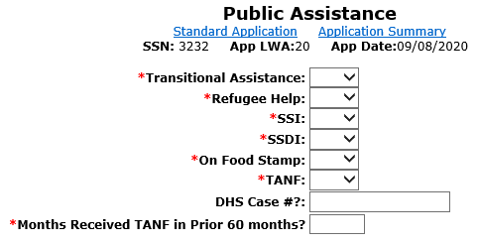
The Public Assistance Screen is where the various Cash Welfare and Food Stamps eligibility criteria are captured.

Slide 16
Low Income: Cash Welfare
Temporary Assistance for Needy Families (TANF) program under Part A of Title IV of the Social Security Act, or
Supplemental Security Income (SSI) program established under Title XVI of the Social Security Act, or
State or local income-based public assistance.
No Income Calculation Needed…

Slide 17
Public Assistance
If “Yes” is entered on the IWDS Public Assistance screen for following:
  Transitional Assistance
  Refugee Help
  SSI
  TANF
  The client will be determined low income based on “Cash Welfare”.

Slide 18
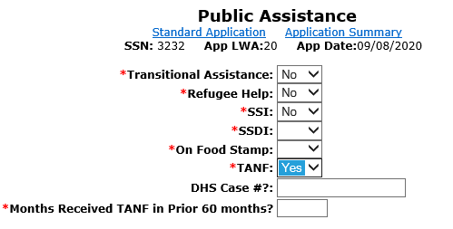

Slide 19
Question about Cash Welfare
Q – Betty is currently receiving TANF benefits, she lives with Charlie, but they are not married, and Charlie is not on the household determination of the TANF printout. If Charlie came in for Services, could he be determined low income because he lives with Betty and she receives TANF benefits?

Slide 20
Answer to ? about Cash Welfare
Q – Betty is currently receiving TANF benefits, she lives with Charlie, but they are not married, and Charlie is not on the household determination of the TANF printout. If Charlie came in for Services, could he be determined low income because he lives with Betty and she receives TANF benefits?
A – No, Charlie could not be determined as low income under WIOA due to Betty receiving TANF, as they do not meet the criteria under the family definition since they are not married.

Slide 21
The WIOA definition of “Family”
  The term “family” means two or more persons related by blood, marriage, or decree of court, who are living in a single residence, and are included in one or more of the following categories:
    (A) A married couple and dependent children.
    (B) A parent or guardian and dependent children.
    (C) A married couple.

Slide 22
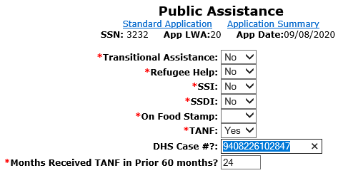
If the TANF is populated with “Yes”, the DHS Case # must be provided and the number of months the individual has been on TANF must be included.

Slide 23


Low Income: Food Stamps
Personally receives, or is a member of a family that receives or received in the past six (6) months the Supplemental Nutrition Assistance Program (SNAP) assistance.
Food and Nutrition Act of 2008

Slide 24
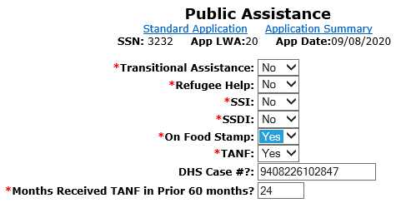
If Food Stamp and TANF are populated with “Yes” at certification, the documentation must be on hand to support both criteria. The documentation must remain in the hard copy file for monitoring and data validation.

Slide 25
Question about Food Stamps
Q – Betty is currently receiving Food Stamps; her son Tommy lives with her. If Tommy came in for WIOA Services could he be determined low-income based on food stamps, even if he does not appear on his mother's food stamp account?

Slide 26
Answer to ? about Food Stamps
Q – Betty is currently receiving Food Stamps; her son Tommy lives with her. If Tommy came in for WIOA Services could he be determined low income based on food stamps, even if he does not appear on his mother’s food stamp account?
A – WIOA Low Income criteria can be determined based on, “Personally receives, or is a member of a family that receives or received in the past six (6) months the Supplemental Nutrition Assistance Program (SNAP) assistance.”
  Since Tommy lives with his mom who is receiving food stamps, he could be determined low income based on his mother Betty receiving food stamps.

Slide 27
Low Income: Homeless
Individual who lacks a fixed, regular or adequate nighttime residence; and
Violence Against Women Act of 1994
Adult or youth with a primary nighttime residence that is a public or privately operated shelter for temporary accommodation.
McKinney-Vento Homeless Assistance Act

Slide 28
? About Homeless Definitions
Q - Could a male client be determined homeless utilizing the definition under the Violence Against Women Act of 1994?

Slide 29
Answer to ? About Homeless Definitions
Q - Could a male client be determined homeless utilizing the definition under the Violence Against Women Act of 1994?
A - Yes, for all clients (male or female) either the Violence Against Women Act of 1994 or McKinney-Vento Homeless Assistance Act definitions could be used determine a client’s homeless status.

Slide 30
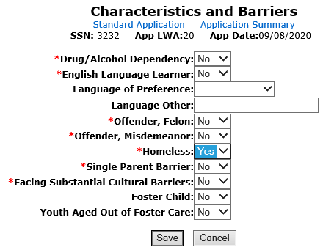
If “Yes” is entered in “Homeless” the client
will be determined as low income.

Slide 31
Low Income :
Free or Reduced Priced Lunch
Receives or is eligible to receive a free or reduced-price lunch under the
Richard B. Russell National School Lunch Act
-> Criteria for In-School Youth Only
Must have documentation from school.

Slide 32
Low Income :
Free or Reduced Priced Lunch
TEGL 21-16 and our Low-Income Policy clarified that “In schools where the whole school automatically receives free or reduced- price lunch, WIOA programs must base low-income status on an individual student’s eligibility to receive free or reduced-price lunch or on meeting one of the other low-income categories under WIOA”.
  Meaning if only whole school criteria is used for free or reduced lunch, you cannot use this method to determine low-income criteria and must use one of the other low-income categories to determine an individual’s low-income status.

Slide 33
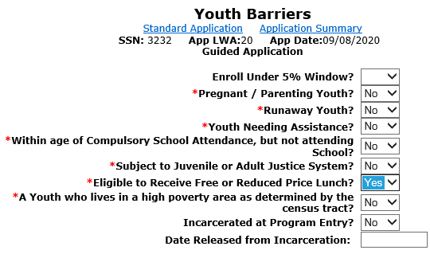
Youth Barriers Screen
Youth Barriers” screen is where the “Free or Reduced-Price Lunch” question is housed – if an in-school youth client has a response of “Yes” the client will be determined as low income.

Slide 34
? about Free or Reduced Lunch Documentation
Q – Sally is currently a Junior in H.S., and in the school district she attends, all students are eligible for free lunch. She has applied for WIOA services, what documentation would be needed to support her WIOA Low Income Criteria due to free or reduced lunch?

Slide 35
Answer to ? about Free or Reduced Lunch Documentation
Q – Sally is currently a Junior in H.S., and in the school district she attends, all students are eligible for free lunch. She has applied for WIOA services, what documentation would be needed to support her WIOA Low Income Criteria due to free or reduced lunch?
A – The documentation would need to specifically address that Sally herself, by name, is eligible for free or reduced lunch. If the school will not provide information about an individual, then the client must find another way to support WIOA Low Income criteria.

Slide 36
Low Income: Foster Child
A minor on behalf of whom State or local government payments are made to a foster parent or other guardian.

Slide 37
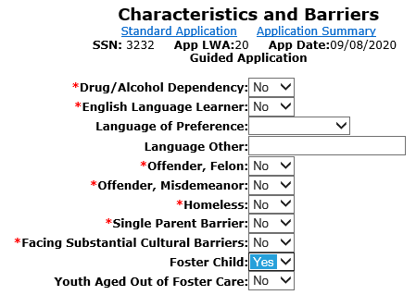
“Characteristics and Barriers” screen is where the “Foster Child” question is housed – if any client has a response of “Yes” to “Foster Child” - the client will be determined as low income.

Slide 38
Question about Foster Child Documentation
Q – Conrad is currently a Senior in H.S., he lives with his foster parents. What is the documentation that could be used support his WIOA Low Income Criteria due to Foster Child status?

Slide 39
Question about Foster Child Documentation
Q – Conrad is currently a Senior in H.S., he lives with his foster parents. What is the documentation that could be used support his WIOA Low Income Criteria due to Foster Child status?
A – The documentation choices to support Foster Child status to support WIOA Low Income criteria are listed in Attachment “A” to Commerce WIOA Low Income Policy WIOA ePolicy Chapter 5.5:
  To support foster child status the following are acceptable choices: Court Contact; Court Documentation; Medical Card showing Foster Child Status; Verification of Payment made on behalf of the child; Written Statement from State/Local Agency

Slide 40
Youth Living in a
High Poverty Level
According to Section 129(a)(2) of WIOA, for ISY and OSY, a youth qualifies as low income if the youth lives in a high poverty area.
Many rural counties in the U.S. have a poverty rate of 25 percent or above.
New Guidance was issued in April 2020 on the steps to determine this criteria.
The next few slides provides additional guidance on these new steps.

Slide 41
New Guidance in April 2020
DIRECTIONS FOR USING AMERICAN COMMUNITY SURVEY DATA TO IDENTIFY HIGH-POVERTY AREA IN URBAN OR RURAL AREAS
Note that these are new directions given that the Census Bureau has changed its web site since last year for obtaining American Community Survey Data.
Section 1: Determining if an Overall City or County has a Poverty Rate of 25 percent. 1. First, check to see if your overall city or county has a poverty rate of 25 percent or above. Go to Census.gov or click on https://www.census.gov. In the middle of the page, go to Quick Facts: Access Local Data and click on the arrow. On the top of the page that comes up type in the name of your city or county and then click on your city or county from the list provided of places with the same name. Scroll down near the bottom of the table to Income and Poverty and it will give you the poverty rate of your city or county. If the poverty rate is 25 percent or above, that is all that you need to do to show that your city or county is a high-poverty area.

Slide 42
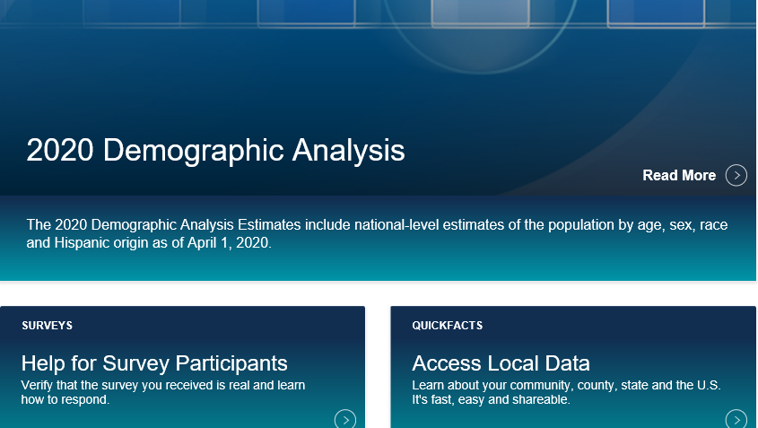
From Census Site
Go Into “Access Local Data”

Slide 43
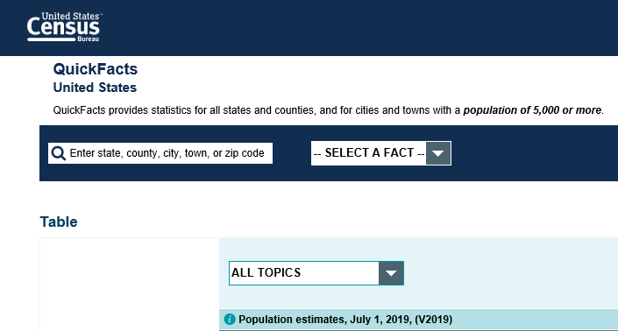
Could Search by Either City or County or Zip Code

Slide 44
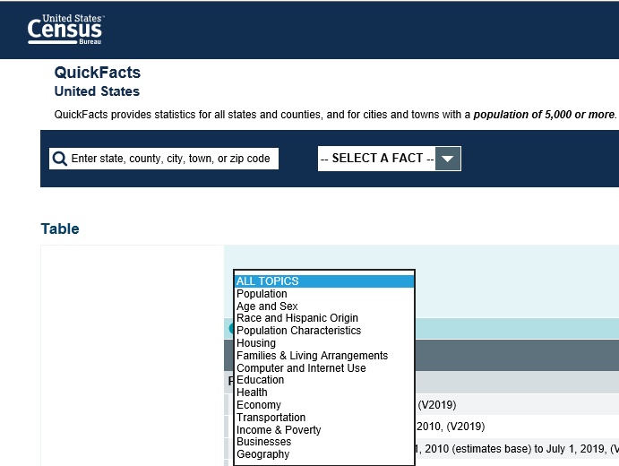
Tailor Search to Income & Poverty Area

Slide 45
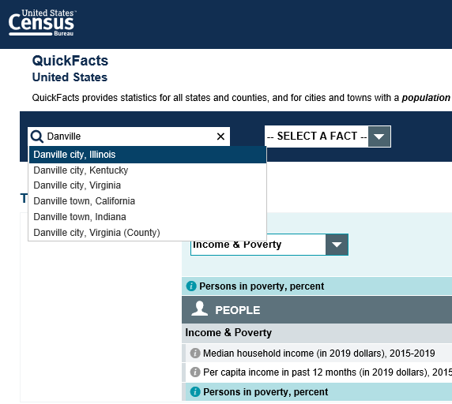
Demonstrate Searching By a City

Slide 46
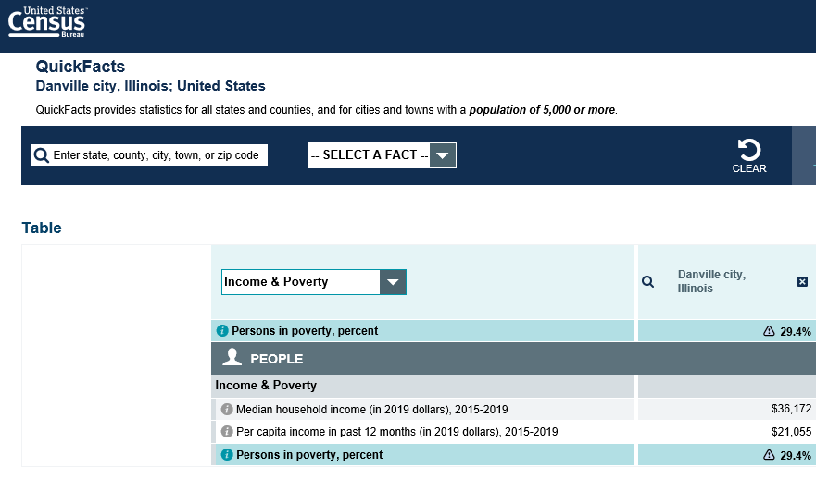
Results of Search for Danville, IL

Slide 47
In the Examples in Previous Slides
As was shown on the previous slide, the poverty percentage in Danville, IL was listed 29.4%
This means any Youth client with an address in Danville, IL could be determined low income based on “Youth Living in a High Poverty Area”.
On the next slide, it demonstrates where the “Youth Living in a High Poverty Area” is recorded on the “Youth Barriers” screen within the WIOA Youth application in IWDS.

Slide 48
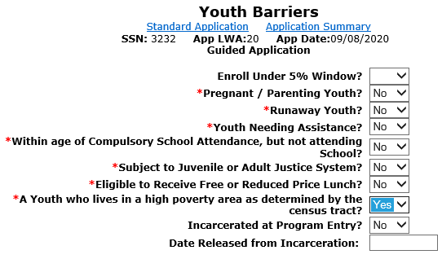
“Youth who live in a high poverty area” question is if youth client has a response of “Yes” - the client will be determined as low income

Slide 49
Specific Guidance by Address
Section 2: Determining if an Individual Lives in a High-Poverty Area Based on Their Street Address.
There are two steps to this—first determining the Census tract in which the street address is located, and second determining the poverty rate of the Census tract.
For the first step, click on https://geocoding.geo.census.gov/geocoder/geographies/address?form. There will be two choices: Find Locations Using… and Find Geographies Using…Click on the second option to Find Geographies.
Type in the street address, city, and state. You don’t need to type in the zip code. The click on Find.
A list of information comes up giving geographic identifiers first by state, then by Census block, then by County, then by Census Tract. Scroll down near to bottom of the page to Census Tract. In the middle of the information for Census tracts there will be listed Name. This will give the Census tract number of the street address.
For the second step, Go to the American Community Survey home page by clicking on https://www.census.gov/programs-surveys/acs.

Slide 50
Question about High Poverty Area
Q - If a Youth client is determined low income based on living in a High Poverty Area, and then later you would like to co-enroll the client into Adult services, could you certify under Adult Low Income utilizing the High Poverty Area criteria?

Slide 51
Answer about High Poverty Area ?
Q - If a Youth client is determined low income based on living in a High Poverty Area, and then later you would like to co-enroll the client into Adult services, could you certify under Adult Low Income utilizing the High Poverty Area criteria?
A – No, only Youth clients can utilize the criteria of living in a High Poverty Area for determining WIOA low income.

Slide 52
Family Income Calculation
A Family Income Calculation is only needed to determine low income if the client does not meet any of the six automatic low-income qualification criteria previously covered.

Slide 53
Family Income Calculation
A Family Income Calculation is only needed to determine low income if the client does not meet any of the six automatic low-income qualification criteria previously covered.
Total family income that does not exceed the higher of:
  The poverty line; or
  Seventy percent (70%) of the lower living standard income level

Slide 54
Family Income Calculation Requirements
Must capture the income on everyone within the WIOA defined family.
Pay stubs or other acceptable documentation for each of the family member’s income.
Documentation supporting family size.

Slide 55
Must have the family identified WIOA Family definition
  The term “family” means two or more persons related by blood, marriage, or decree of court, who are living in a single residence, and are included in one or more of the following categories:
    (A) A married couple and dependent children.
    (B) A parent or guardian and dependent children.
    (C) A married couple.

Slide 56
If Not Living with WIOA Family Members
Guidance was provided on page 7., of TEGL 21-16, that “if an individual is not living in a single residence with other family members, that individual is not a member of a family for purposes of WIOA income calculations.”
Meaning, if an individual is not living with their WIOA defined family, then their income determination should be based on their own income only.

Slide 57
Income Calculation Question
Q – A 19-year-old individual Tom, is applying for the WIOA program. He lives with his older sister, Tori and their cousin, Sue who is 23. Both Tori and Sue are also thinking about applying for WIOA. How many people would be in the WIOA defined family? Whose income would be included to determine the low-income status?

Slide 58
Answer to the Income Calculation?
Q – A 19-year-old individual Tom, is applying for the WIOA program. He lives with his older sister, Tori and their cousin, Sue who is 23. Both Tori and Sue are also thinking about applying for WIOA. How many people would be in the WIOA defined family? Whose income would be included to determine the low-income status?
A – None of these individuals meet the criteria under the WIOA family definition, in each case it would be a family size of one. Everyone's low-income status would be based on their own income.

Slide 59
Family Income Calculation Requirements
It is essential to view DCEO WIOA Policy 5-5 – Low Income Individuals – specifically Attachment “B” – Inclusions and Exclusions for Determining Family Income.
Any family member that counts towards the WIOA defined family must have the included income for the previous six months prior to the application date for the family income calculation.

Slide 60
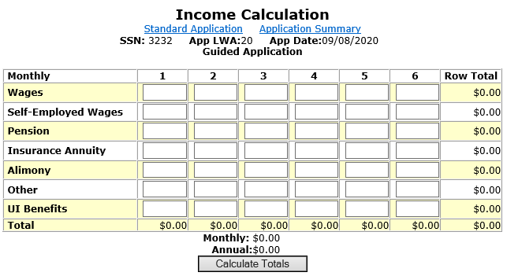

Slide 61
Family Income Calculation
After the entire family’s income has been loaded into the “Income Calculation” the Career Planner must “Calculate Totals”.

Slide 62
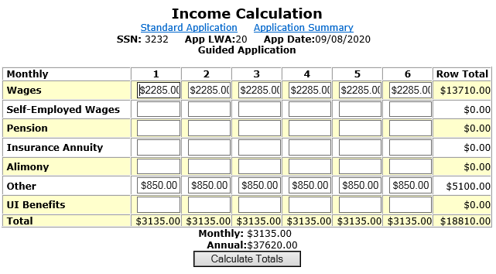

Slide 63
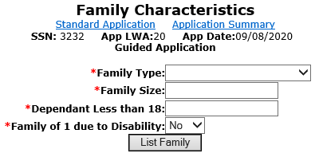
Family Characteristics Screen
You must record all family members that are counted if you are conducting a family income calculation.

Slide 64
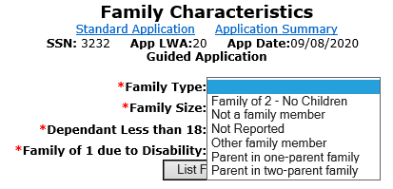
Family Type
Choose what is the best description of the Family.

Slide 65
The definition of Family is important to understand:
  The term “family” means two or more persons related by blood, marriage, or decree of court, who are living in a single residence, and are included in one or more of the following categories:
    (A) A married couple and dependent children.
    (B) A parent or guardian and dependent children.
    (C) A married couple.

Slide 66
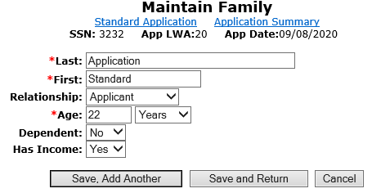
Maintain Family Screen
You must Document all family members that are counted towards the income calculation.

Slide 67
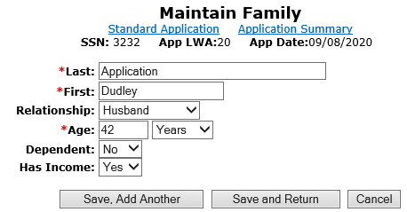

Slide 68
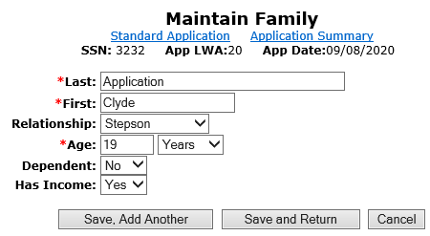
Could a 19-year-old step-child still be considered part of the WIOA defined “Family”?

Slide 69
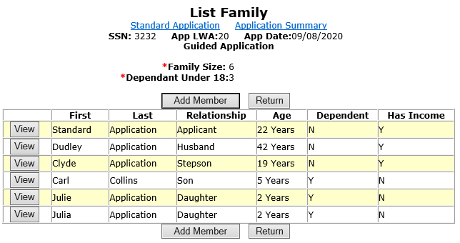
Yes, but the income of the Adult aged child must also be included as part of the “Family Income” calculation.

Slide 70
For the income calculation, the “Career Planner” would be responsible for having the income verification documentation for everyone in the WIOA defined family that had income.

Slide 71
If Over Family Income
If a client does not meet any of the automatic low-income qualification factors, and is over the family low-income level, there is a final way low income could be determined.

Slide 72
Family of One due to a Disability
Is an individual with a disability whose own income does not exceed the higher of:
  The poverty line; or Seventy percent (70%) of the lower living standard income level, but who is a member of a family whose income does not meet this requirement.

Slide 73
Family of One due to a Disability
IWDS must be documented in three places within the IWDS application to properly document family of one due to a disability.

Slide 74
Family of One due to a Disability
  On the “Private Information” screen the disability must be identified.
  The “Income Calculation” screen is where the client’s income must be documented.
  The “Family Characteristics” screen is where the criteria of “Family of One” is specified.

Slide 75
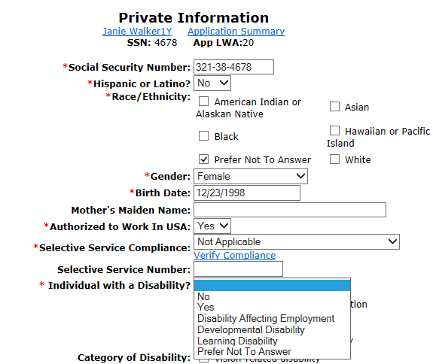

Slide 76
Family of One due to a Disability
The client’s income for the six months prior to application date must be documented on the “Income Calculation” screen.

Slide 77
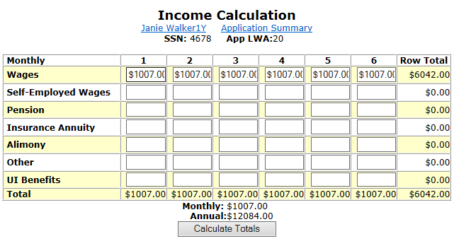

Slide 78
Must capture the income for the client
  If the client does not have income, the client must write an attestation stating they have not had income in the previous 6-month period.
  If client has income, it must be at or under the income for a family of one ($12,760) as described in WIOA Notice 19-NOT-03, Revised Income Guidelines for Determining Low Income Status for WIOA.

Slide 79
On the “Family Characteristics” screen the client is characterized as “Family of One Due to a Disability”.

Slide 80
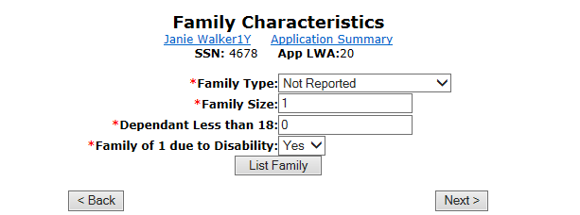

Slide 81
Question about Documentation
Q – 17-year-old Holly is applying for the In-School Youth Program, she lives with her parents and their family income is above the low-income criteria guidelines. However, one of Holly’s barriers is a disability due to a hearing impairment. Her own income is less than the family of one income criteria so she will meet the low-income criteria of family of one due to a disability. Would a self attestation be acceptable documentation to support her disability?

Slide 82
Answer about Documentation
Q – 17-year-old Holly is applying for the In-School Youth Program, she lives with her parents and their family income is above the low-income criteria guidelines. However, one of Holly’s barriers is a disability due to a hearing impairment. Her own income is less than the family of one income criteria so she will meet the low-income criteria of family of one due to a disability. Would a self attestation be acceptable documentation to support her disability?
A – No, a self attestation for the disability is not an acceptable documentation choice under these circumstances due to the client is utilizing family of one due to a disability to support her low-income criteria.

Slide 83
Additional Clarification on Documentation for a Disability
In instances where a Youth client has multiple barriers that support eligibility; and the low-income determination of the individual is not based on family of one due to a disability; the formal documentation for the disability is not required and a self-attestation for the disability could then be used.
The thought is to be less intrusive regarding the individual’s documentation of the disability, since the client would have other barriers to support their eligibility beyond just the disability.

Slide 84
Family of One due to a Disability
For documentation, must have:
  Documentation addressing income.
  Documentation addressing disability.

Slide 85
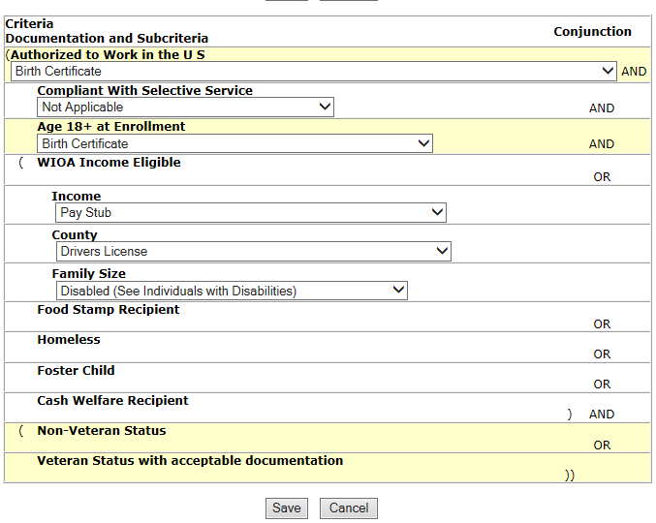

Slide 86
Low Income Individual
Of the eight ways an individual can be determined to be low income for WIOA there are six different ways that do not require capturing income information on the customer and/or the customers family.

Slide 87
WIOA Low Income Criteria that does not require income calculation
Cash Welfare
Food Stamps
Homeless
Free or Reduced Priced Lunch
Foster Child
Youth Customer Living in a High Poverty Level

Slide 88
Doesn’t Meet Automatic Qualification Criteria
If a client does not meet one of the previous six automatic qualification factors that is when an income calculation should be utilized to determine low-income status.

Slide 89
WIOA Low Income Eligibility
All determinations of low-income status for customers must be supported by proper documentation of the qualifying condition as outlined in the “WIOA Title IB General and Fund Source Eligibility Requirements and Documentation Sources”.

Slide 90

WIOA Low Income Eligibility
Questions ?’s

Slide 91
WIOA Low Income Eligibility
This concludes the presentation on WIOA Low Income Eligibility.
If you have any questions, feel free to contact me at james.potts@Illinois.gov or you can call me at (217) 416-7097.

