Slide 1


WIOA Mandated Follow-up Services
September 16th, 2020

Slide 2
Federal and State Guidance
Federal Guidance
  Training and Employment Guidance Letter (TEGL) 19-16 – Guidance on Services Provided through Adult and Dislocated Worker under WIOA – dated March 1st, 2017.
  TEGL 21-16 – Third WIOA Title I Youth Formula Program Guidance – dated March 2nd, 2017.
State Guidance
  DCEO Office of Employment & Training (OET) Chapter 4 Section 2.4 - Follow-Up Services – effective 6/18/2020
  DCEO OET Chapter 4 Section 2.4.1 – Adult and Dislocated Workers Programs Follow-Up Services – effective 6/12/2020
  DCEO OET Chapter 4 Section 2.4.2 – Youth Program Follow-Up Services – effective 6/12/2020

Slide 3
Follow-up Services
Federal guidance requires states and local areas to set policy on Follow-Up Services:
OET Policy Chapter 4: Section 2.4 - Follow-Up Services – provides overall feedback for Adult, Dislocated Worker and Youth follow-up related to two-way communication; including telephone conversations, in person or via e-mail (or other social media) could be considered two-way communication as part of follow-up.
This policy guidance reiterates that sending a letter or leaving a voicemail for a client is not an acceptable two-way communication to be recorded as follow-up.
This policy guidance states that follow-up services may begin after the last date of service, if the participant does not receive any other future services.

Slide 4
Follow-up Services
Other guidance in OET Policy Chapter 4: Section 2.4 - Follow-Up Services:
  It is the responsibility of the Career Planner to determine, in conjunction with the Participant, which follow-up services after exit would best suit the individual’s circumstances.
  Some things to consider, at a minimum for Federal Reporting and Performance Impacts items related to post exit Employment, Wages, Education Status are considered on a quarterly basis, especially note worthy is 2nd Quarter post exit and 4th Quarter post exit are the most important time frames for Performance outcomes.

Slide 5
Follow-up Services
Other guidance in OET Policy Chapter 4: Section 2.4 - Follow-Up Services:
  Guidance is given that follow-up should be as often as necessary throughout the required twelve (12) months.
    At a minimum, it should occur at least every thirty (30) days for the first three (3) months and then must occur once a quarter for the remainder of the twelve (12) month period.
    This aligns with quarterly post-exit reporting requirements.
  The follow-up service activity must be recorded in Illinois Workforce Development System (IWDS) throughout the required twelve (12) months.
    Service of Follow-up is opened, but the actual follow-up actions are recorded within the Case Note section or on the exit control panel of the client’s record.

Slide 6
Adult & Dislocated Worker Follow-up Services
OET Policy Chapter 4: Section 2.4.1 provides specific feedback on Adult and Dislocated Worker Programs Follow-Up Service.
Federal guidance under TEGL 19-16 requires that follow-up services must be provided for up to twelve (12) months after the first date of employment for Adults and Dislocated Workers who obtain “Unsubsidized Employment”.
  However, if an Adult or Dislocated Worker client is still receiving traditional WIOA services, it is not possible to open Follow-up services.
  So in those instances when the client enters “unsubsidized employment” while still enrolled in traditional WIOA services, the follow-up is included and recorded by the Career Planner staff in routine, two-way communication with the client.

Slide 7
Adult & Dislocated Worker Follow-up Services
OET Policy Chapter 4: Section 2.4.1 provides specific feedback on Adult and Dislocated Worker Programs Follow-Up Service.
Federal guidance under TEGL 19-16 requires that follow-up services must be provided for up to twelve (12) months after the first date of employment for Adults and Dislocated Workers who obtain “Unsubsidized Employment”.
  When all WIOA services have been completed, then the activity of Follow-up should be opened.
  All two-way communication completed as part of follow-up, should be recorded under the “Case Note” feature within IWDS and/or on the exit control panel of the client’s record.

Slide 8
Adult & Dislocated Worker Follow-up Services
OET Policy Chapter 4: Section 2.4.1 provides specific feedback on Adult and Dislocated Worker Programs Follow-Up Service.
  For those Adult and Dislocated Worker clients who obtain unsubsidized employment, the follow-up services are designed to help individuals retain employment, earn wage gains, or advance within their occupation.
  Supportive Services cannot be provided for Adult and Dislocated Worker clients while in Follow-up (this is allowed for Youth clients who are in Follow-up).

Slide 9
Adult & Dislocated Worker Follow-up Services
OET Policy Chapter 4: Section 2.4.1 provides specific feedback on Adult and Dislocated Worker Programs Follow-Up Service.
  Follow-up services must be provided as appropriately related to counseling regarding the workplace to improve/assist with retention of employment.
  Below is a list of activities offered, but is not limited to the following:
    Counseling individuals about the workplace;
    Contacting individuals or employers to verify employment;
    Contacting individuals or employers to help secure better paying jobs;
    Assisting individuals and employers in resolving work-related problems;
    Connecting individuals to peer support groups;
    Providing individuals with information about additional educational or employment opportunities; and
    Providing individuals with referrals to other community resources.

Slide 10
Adult & Dislocated Worker Follow-up Services
OET Policy Chapter 4: Section 2.4.1 provides specific feedback on Adult and Dislocated Worker Programs Follow-Up Service.
  If after ninety (90) days following exit, if a participant is not responsive, cannot be located, or refuses to provide information, the Career Planner may close follow-up services.
  When that is done, case notes and the IEP must document the reason for discontinuation of the follow-up services.

Slide 11
Adult & Dislocated Worker Follow-up Services
OET Policy Chapter 4: Section 2.4.1 provides specific feedback on Adult and Dislocated Worker Programs Follow-Up Service.
  In instances where an Adult or Dislocated Worker Participant does not obtain unsubsidized employment upon completion of traditional WIOA Services, follow-up services should be made available.
    Understanding the client is still being tracked for Federal Reporting and Performance outcomes for 12 months post exit, it makes perfect sense to stay engaged with the client in an attempt to assist with gaining self-sustaining employment.
    If individuals who do not obtain unsubsidized employment and decline follow-up services, policy Chapter 4 Section 2.4.1 states it must be documented in the Case Notes and/or the Individual Employment Plan (IEP).

Slide 12
Youth Follow-up Services
Follow-Up Requirements for individuals who have been served under the WIOA program:
Follow-Up for all Youth – Chapter: 4 Section 2.4.2
  Follow-up services are critical services provided following a participant’s completion of WIOA services to help ensure their success in employment and/or postsecondary education and training.
  The goal of follow-up services for youth is to enable participants to continue life-long learning and achieve a level of self-sufficiency to ensure job retention, wage gains, and postsecondary education and training progress.

Slide 13
Youth Follow-up Services
Follow-Up for all Youth – Chapter: 4 Section 2.4.2
  Follow-up services must be made available to all WIOA Youth for a minimum of twelve (12) months from the exit.
  Youth follow-up may include, but are not limited to the following program elements:
    Supportive Services – if funding is available and the need for supportive services are supported in the Individual Service Strategy (ISS) for the client;
    Adult Mentoring;
    Financial Literacy education;
    Services that provide labor market and employment information;
    Activities that help youth prepare for and transition to postsecondary education and training;
    Other services necessary to ensure the success of the youth in employment and/or postsecondary education.

Slide 14
Youth Follow-up Services
Follow-Up for all Youth – Chapter: 4 Section 2.4.2
  Final Regulation and rules under WIOA allow for youth to decline follow-up services altogether, however, when that occurs it should be the exception and not the rule.
  We spend a lot of time helping a Youth client getting aimed towards the right direction in life through WIOA Youth services/activities.
  If all attempts and efforts to contact the youth has been attempted and has been documented in the case notes, then “Unable to Locate” could be used and follow-up would not be provided.
  Opting Out of the twelve (12) month follow-up period may occur at any point in time. The request to opt-out or discontinue follow-up services must be clearly documented in the case notes. Career Planners should not promote youth to opt out of follow-up.

Slide 15
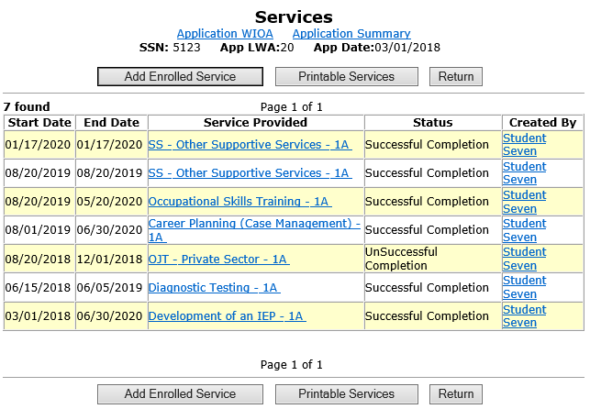
When to Open Follow-up
For any client, when all services have been completed/closed, and no further services are planned, that is when the service of follow-up should be opened in IWDS.

Slide 16
Documenting the Service of Follow-up
For this example client whose final WIOA service was recorded/closed on 6/30/2020. I will demonstrate opening the actual “Follow-Up Service” on that same date within the IWDS client record.
The actual start date of follow-up could be recorded on the date the last service ended, or you could open the follow-up service on the day after the last service had ended.

Slide 17
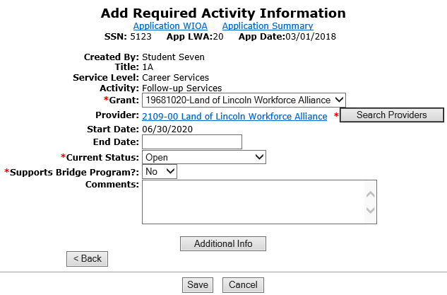
Documenting the Service of Follow-up
For this example, I began follow-up on the date the last service ended on 6/30/2020.

Slide 18
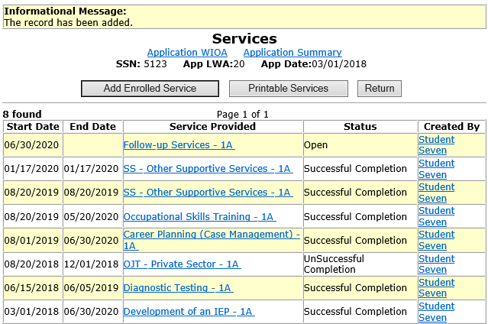
Documenting the Service of Follow-up
The service of follow-up remains open until follow-up has been completed.

Slide 19
Documenting the service of Follow-up
The actions taken as part of follow-up should be recorded in the case notes and when appropriate, within IWDS screens such as the exit control panel.
The actual “Follow-up” service just remains open, until the client has completed follow-up.

Slide 20
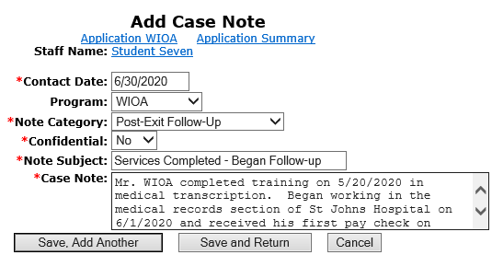
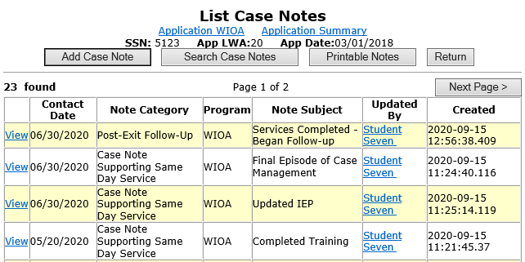
Recording Actions during Follow-up
Case notes should explain what has occurred during follow-up.

Slide 21
Follow-up Actions
The guidance on the frequency of conducting follow-up is addressed in OET Policy Chapter 4: Section 2.4 - Follow-Up Services:
  Guidance is given that follow-up should be as often as necessary throughout the required twelve (12) months.
    At a minimum it should occur at least every thirty (30) days for the first three (3) months and then must occur once a quarter for the remainder of the twelve (12) month period.
    This aligns with quarterly post-exit reporting requirements.
Other additional guidance on the frequency of conducting follow-up will be directed by your LWIA’s local policy on follow-up.

Slide 22
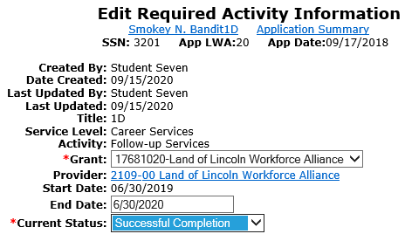
Documenting the service of Follow-up
Do remember, once twelve months of follow-up has been completed, you will want to go back into the actual service of follow-up, and close the follow-up service that was opened when follow-up began.

Slide 23
Documenting the service of Follow-up
This power point discussed the WIOA legislatively mandated follow-up, and demonstrated the steps required to record the service of follow-up within IWDS.
If you have questions related to recording the service of follow-up in IWDS, feel free to contact me at James.potts@Illinois.gov or you can call me at (217) 416-7097.

