Slide 1
Workforce Innovation and Opportunity Act
Follow-Up Services
As of January 11th, 2021

Slide 2
Objective of Training
The primary objective of this presentation is to discuss the Federal and State requirements tied to WIOA legislatively mandated Follow-Up requirements for clients who were served under WIOA.
The secondary objective of this presentation is to demonstrate recording Follow-Up services within Illinois Workforce Development System (IWDS).

Slide 3
Associated Federal Guidance
Workforce Innovation and Opportunity Act (WIOA) of 2014.
Training and Employment Guidance Letter (TEGL) 19-16 – Guidance on Services Provided through Adult and Dislocated Worker under WIOA – dated March 1st, 2017.
TEGL 21-16 – Third WIOA Title I Youth Formula Program Guidance – dated March 2nd, 2017.

Slide 4
Understanding the ePolicy Manual
The Illinois Department of Commerce and Economic Opportunity, Office of Employment and Training (OET) utilizes a WIOA ePolicy portal where all current and new guidance issued by the Illinois Workforce Innovation Board (IWIB) and OET will be maintained.
Homepage: www.illinoisworknet.com/DCEOPolicies

Slide 5
Associated State Guidance
DCEO Office of Employment & Training (OET) Chapter 4 Section 2.4 - Follow-Up Services – effective 6/18/2020.
DCEO OET Chapter 4 Section 2.4.1 – Adult and Dislocated Workers Programs Follow-Up Services – effective 6/12/2020.
DCEO OET Chapter 4 Section 2.4.2 – Youth Program Follow-Up Services – effective 6/12/2020.

Slide 6
Follow-Up Guidance
Federal guidance requires states and local areas to set policy on Follow-Up Services:
OET Policy Chapter 4: Section 2.4 - Follow-Up Services – provides overall feedback for Adult, Dislocated Worker and Youth follow-up related to two-way communication; including telephone conversations, in person or via e-mail (or other social media) could be considered two-way communication as part of follow-up.
This policy guidance states that sending a letter or leaving a voicemail for a client is not an acceptable two-way communication to be recorded as follow-up.

Slide 7
Follow-Up Guidance
Other guidance in OET Policy Chapter 4: Section 2.4 - Follow-Up Services:
It is the responsibility of the Career Planner to determine, in conjunction with the Participant, which follow-up services after exit would best suit the individual’s circumstances.
Some things to consider, at a minimum for Federal Reporting and Performance Impact items related to post exit Employment, Wages, Education Status are considered on a quarterly basis, especially note worthy is 2nd Quarter post exit and 4th Quarter post exit are the most important time frames for recording/reporting Performance outcomes.

Slide 8
Follow-Up Guidance
Other guidance in OET Policy Chapter 4: Section 2.4 - Follow-Up Services:
Guidance is given that follow-up should be as often as necessary throughout the required twelve (12) months.
At a minimum, it should occur at least every thirty (30) days for the first three (3) months and then must occur once a quarter for the remainder of the twelve (12) month period.
This aligns with quarterly post-exit reporting requirements.

Slide 9
Follow-Up Guidance
Other guidance in OET Policy Chapter 4: Section 2.4 - Follow-Up Services:
The follow-up service activity must be recorded in Illinois Workforce Development System (IWDS) throughout the required twelve (12) months.
Service of Follow-Up is opened, but the actual follow-up actions are recorded within the Case Note section or on the exit control panel of the client’s record.

Slide 10
Adult & Dislocated Worker Guidance
Federal guidance under TEGL 19-16 requires that follow-up services must be provided for Adult and Dislocated Worker clients up to twelve (12) months after the first date of employment for Adults and Dislocated Workers who obtain “Unsubsidized Employment”.
However, if an Adult or Dislocated Worker client is still receiving traditional WIOA services, it is not possible to open Follow-Up services.
In instances when the client enters “unsubsidized employment” while still enrolled in traditional WIOA services, the follow-up is included and recorded by the Career Planner staff in routine, two-way communication with the client.

Slide 11
Adult & Dislocated Worker Guidance
OET Policy Chapter 4: Section 2.4.1 provides specific feedback on Adult and Dislocated Worker Programs Follow-Up Service.
When all WIOA services have been completed, then the activity of Follow-up should be opened.
All two-way communication completed as part of follow-up, should be recorded under the “Case Note” feature within IWDS and/or on the exit control panel of the client’s record.

Slide 12
Adult & Dislocated Worker Guidance
OET Policy Chapter 4: Section 2.4.1 provides specific feedback on Adult and Dislocated Worker Programs Follow-Up Service.
For those Adult and Dislocated Worker clients who obtain unsubsidized employment, the follow-up services are designed to help individuals retain employment, earn wage gains, or advance within their occupation.
Supportive Services cannot be provided for Adult and Dislocated Worker clients who are enrolled in Follow-up
Note: Supportive Services are allowed for Youth clients who are enrolled Follow-up if justified/supported in the client’s Individual Service Strategy (ISS).

Slide 13
Adult & Dislocated Worker Guidance
Follow-Up services must be provided as appropriately related to counseling regarding the workplace to improve/assist with retention of employment.
Below is a list of activities offered, but is not limited to the following:
Counseling individuals about the workplace;
Contacting individuals or employers to verify employment;
Contacting individuals or employers to help secure better paying jobs;
Assisting individuals and employers in resolving work-related problems;
Connecting individuals to peer support groups;
Providing individuals with information about additional educational or employment opportunities; and
Providing individuals with referrals to other community resources.

Slide 14
Adult & Dislocated Worker Guidance
According to OET Policy Chapter 4: Section 2.4.1
If after ninety (90) days following exit, if a participant is not responsive, cannot be located, or refuses to provide information, the Career Planner may close follow-up services.
When that is done, case notes and the Individual Employment Plan (IEP) must document the reason for discontinuation of the follow-up services.

Slide 15
Adult & Dislocated Worker Guidance
In instances where an Adult or Dislocated Worker Participant does not obtain unsubsidized employment upon completion of traditional WIOA Services, follow-up services should be made available.
Understanding the client is still being tracked for Federal Reporting and Performance outcomes for 12 months post exit, it makes perfect sense to stay engaged with the client to assist with gaining self-sustaining employment.
If individuals who do not obtain unsubsidized employment and decline follow-up services, policy Chapter 4 Section 2.4.1 states it must be documented in the Case Notes and/or the IEP.

Slide 16
Youth Follow-Up Guidance
Follow-Up for all Youth – OET Policy Chapter 4: Section 2.4.2
Follow-up services are critical services provided following a participant’s completion of WIOA services to help ensure their success in employment and/or postsecondary education and training.
The goal of follow-up services for youth is to enable participants to continue life-long learning and achieve a level of self-sufficiency to ensure job retention, wage gains, and postsecondary education and training progress.

Slide 17
Youth Follow-Up Guidance
Follow-Up for all Youth – Chapter: 4 Section 2.4.2
Follow-up services for all Youth must be made available to all WIOA Youth for a minimum of twelve (12) months from the exit.

Slide 18
Youth Follow-Up Guidance
Youth follow-up may include, but are not limited to the following program elements:
Supportive Services – if funding is available and the need for supportive services are supported in the Individual Service Strategy (ISS) for the client;
Adult Mentoring;
Financial Literacy education;
Services that provide labor market and employment information;
Activities that help youth prepare for and transition to postsecondary education and training;
Other services necessary to ensure the success of the youth in employment and/or postsecondary education.

Slide 19
Youth Follow-Up Guidance
Final Regulation and rules under WIOA allow for youth to decline follow-up services altogether, however, when that occurs it should be the exception and not the rule.
We spend a lot of time helping a Youth client getting aimed towards the right direction in life through WIOA Youth services/activities.
If all attempts and efforts to contact the youth has been attempted and has been documented in the case notes, then “Unable to Locate” could be used and follow-up would not be provided.
Opting Out of the twelve (12) month follow-up period may occur at any point in time. The request to opt-out or discontinue follow-up services must be clearly documented in the case notes.
Career Planners should not promote youth to opt out of follow-up.

Slide 20
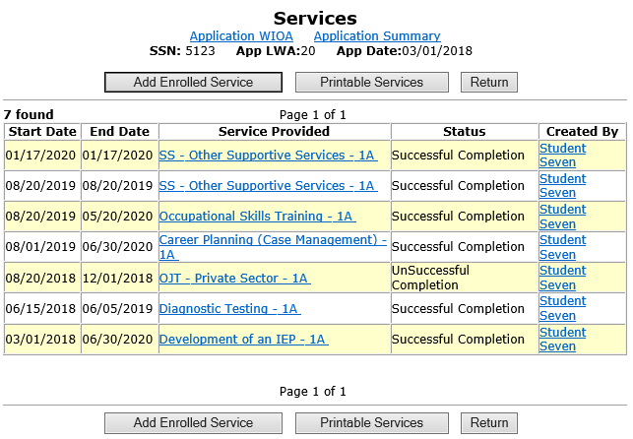
When to Open Follow-Up
For any client, when all services have been completed/closed, and no further services are planned, that is when the service of follow-up should be opened in IWDS.

Slide 21
Documenting the Service of Follow-Up
For the example client on the previous slide, the final WIOA service(s) were recorded/closed on 6/30/2020.
On the next slide, it will demonstrate opening the actual “Follow-Up Service” in the IWDS record.
The Follow-up Service will begin on 6/30/2020, the same date the final WIOA service(s) were completed.
The actual start date of follow-up could be recorded on the same date the last enrolling service ended, or you could open the follow-up service on the day after the last enrolling service had ended; either one is acceptable.

Slide 22
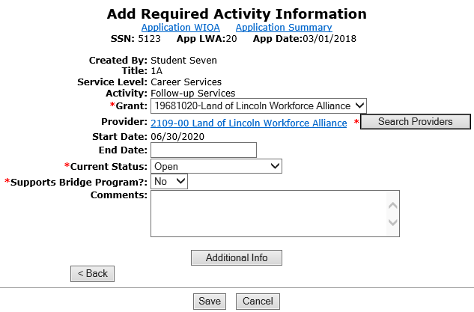
Documenting the Service of Follow-Up
For this example, follow-up began on the same date the last enrolling service ended on 6/30/2020.

Slide 23
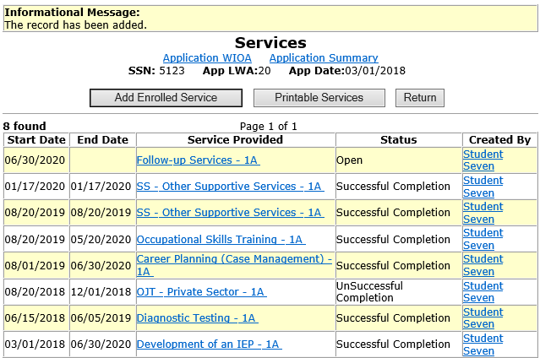
Documenting the Service of Follow-Up
The actual service of follow-up remains open until follow-up has been completed.

Slide 24
Documenting the Service of Follow-Up
The actions taken as part of follow-up should be recorded in the case notes and when appropriate, within IWDS screens such as the exit control panel.
The actual “Follow-up” service remains open on the services screen, until the client has completed follow-up.

Slide 25
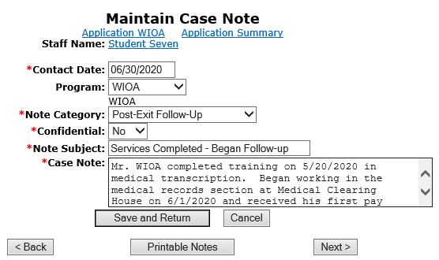
Recording Actions During Follow-Up
Case notes should explain what has occurred during follow-up.

Slide 26
Post Exit Follow-Up on Exit Panel
Besides recording the follow-up actions in the client's case notes, each quarter the post exit control panel should be examined and when appropriate recorded with the most current information on the client.
This is especially important for Youth clients where post exit education status could have an impact on Performance Outcomes.
Additionally, if the client’s post exit employment is not reported through traditional Illinois Department of Employment Security (IDES), but will be recorded via “Supplemental Wages”, it is essential that the information get recorded on the exit control panel.

Slide 27
Exit Control Panel

Slide 28
UI Wages VS Supplemental Wages
It is important to understand, for most clients they will have their post employment wages populated into IWDS through the interface that Commerce has with Illinois Department of Employment Security (IDES)
For those clients who do not work at employment where the wages are reported to IDES, it is very important for the Career Planner to record the Supplemental Wages.

Slide 29
Updating Exit Control Panel
In this example, we are going to update Q1 Post Exit for Supplemental Employment. Update all appropriate post exit outcomes. This client was an Adult client, who was exited with Supplemental Employment and still has the same employment in Q1 Post Exit.

Slide 30
Updating Exit Control Panel
Client still has supplemental employment with the same employer as time of exit.
The supplemental wage amount will be correlated based on the actual wages on the client's employment record in the IWDS.

Slide 31
Exit Control Panel
Notice the Supplemental wages are displayed on the Exit Control Panel.
This is calculated based on the wage information on the clients “Employment History” in the IWDS record.
In the hard copy file, there would need to be documentation supporting the current wage information recorded on the record.

Slide 32
2nd and 4th Quarter Post Exit
As was mentioned earlier, the 2nd and 4th Quarter post exit are the most critical times for reporting performance outcomes.
On the previous slide it was demonstrated recording post exit supplemental employment in the 1st Quarter Post exit. Then next couple of slides will demonstrate recording supplemental employment in the 2nd Quarter post exit.

Slide 33
Exit Control Panel

Slide 34
Updating Exit Control Panel
In this example, we are going to update Q2 Post Exit for Supplemental Employment. Update all appropriate post exit outcomes. This client was an Adult client, who was exited with Supplemental Employment and still has the same employment in Q2 Post Exit.

Slide 35
Updating Exit Control Panel
Client still has supplemental employment with the same employer as time of exit.
The supplemental wage amount will be correlated based on the actual wages on the client's employment record in the IWDS.

Slide 36
Exit Control Panel
Notice the Supplemental wages are displayed on the Exit Control Panel.
This is calculated based on the wage information on the clients “Employment History” in the IWDS record.
In the hard copy file, there would need to be documentation supporting the current wage information recorded on the record.

Slide 37
Updating Exit Control Panel
Additionally, for any Youth Client who is participating in post secondary education during post exit, it is important to update the exit control screen with that information.
There should be case notes recorded corresponding the actions taken on the exit control panel.
The next few slides demonstrate this being done.

Slide 38
Post Exit Screen - Education Status
For exited Youth clients, if employed or participating in post secondary education they are both positive outcomes.
On the screen shown to the right demonstrates recording the education status.
There would need to be documentation in the hard copy file to support post exit education status.

Slide 39
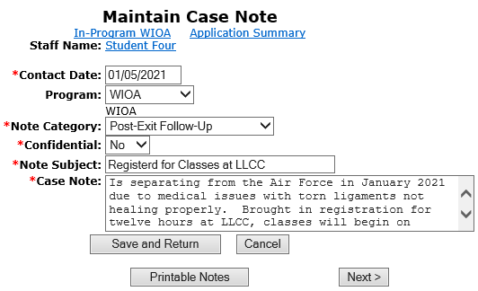
Case Notes Supporting Actions
As shown in the screen print below, here is a case note explaining what had been done on the exit control panel.

Slide 40
Follow-Up Actions
The guidance on the frequency of conducting follow-up is addressed in OET Policy Chapter 4: Section 2.4 - Follow-Up Services:
Guidance is given that follow-up should be as often as necessary throughout the required twelve (12) months.
At a minimum follow-up should occur at least every thirty (30) days for the first three (3) months and then must occur once a quarter for the remainder of the twelve (12) month period.
This aligns with quarterly post-exit reporting requirements.

Slide 41
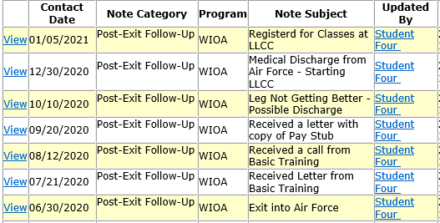
Example of Case Notes
This example client exited on 6/30/2020, case notes recording Follow-up through January 2021. Follow-up should continue through June 2021:

Slide 42
Closing Follow-up Service
Do remember, once twelve months of follow-up has been completed, you will want to go back into the actual service of follow-up and close the follow-up service that was opened when follow-up began.

Slide 43
Follow-Up Guidance
This power point discussed the WIOA legislatively mandated Follow-Up, and demonstrated the steps required to record the service of follow-up within IWDS.
If you have questions related to Follow-Up or recording the follow-up services in IWDS, feel free to contact James (Jim) Potts at james.potts@Illinois.gov or call him at (217) 416-7097.

