Slide 1
Workforce Innovation and Opportunity Act
Basic Skills Deficient
As of January 11th, 2020

Slide 2
Objective of Training
The primary objective of this presentation is to discuss the various ways an individual could meet the criteria of Basic Skills Deficient (BSD) and to demonstrate the various ways the BSD criteria could be recorded as part of a client’s WIOA application within Illinois Workforce Development System (IWDS).

Slide 3
WIOA Definition
Basic Skills Deficient – with respect to an individual— (A) who is a youth, that the individual has English reading, writing, or computing skills at or below the 8th grade level on a generally accepted standardized test; or (B) who is a youth or adult, that the individual is unable to compute or solve problems, or read, write, or speak English, at a level necessary to function on the job, in the individual’s family, or in society.

Slide 4
Basic Skills Deficient
Under WIOA, Basic Skills Deficient (BSD) has eligibility/priority criteria under both the Adult and Youth titles.
  Under the Adult title, if an eligible client is determined BSD, the client is considered a priority.
    Being BSD is an equal to the priority an Adult client receives for meeting WIOA Low Income criteria.
  Under the Youth titles (In-School Youth and Out-of-School Youth), being BSD is a barrier that is part of the Youth eligibility criteria.

Slide 5
Associated Federal Guidance
Workforce Innovation and Opportunity Act (WIOA) of 2014
Training and Employment Guidance Letter (TEGL) 19-16 – Guidance on Services Provided through Adult and Dislocated Worker under WIOA – dated March 1st, 2017.
TEGL 21-16 – Third WIOA Title I Youth Formula Guidance – dated March 2nd, 2017.
TEGL 07-20 – Implementation of Priority of Service in WIOA Adults – dated November 24th, 2020.

Slide 6
Associated State Guidance
Office of Employment and Training (OET) WIOA e-Policy Chapter 5 - General Eligibility.
OET WIOA e-Policy Chapter 5.6 – Service Priorities.
OET Notice NO. 19-NOT-03 - Basic Skills Deficient, Change 3 – dated 12-9-2020.

Slide 7
Different Ways of Being BSD
If an individual scores at or below 8th Grade Level on either their Math or Reading Assessment test they would be determined BSD.
In WIOA Notice NO 19-NOT-01, Change 3 it includes an alternative way an individual can be determined BSD by using a Basic Skills Screening Tool.
Lastly, if an individual is assessed as an English Language Learner (ELL), they could also be determined to meet BSD criteria.

Slide 8
BSD based on Assessment Testing
A key internal logic issue that is important to understand about BSD within IWDS:
  The assessment test date must be, on or before the application date before the internal logic within IWDS is going to pick up the client as BSD due to the assessment test:
    Example, if a client has an application date of 12/1/2020, but had taken the assessment tests on a date after the application date, even if the client scores at or below 8th Grade Level on the assessment test(s), the internal IWDS logic will not determine the client BSD.

Slide 9
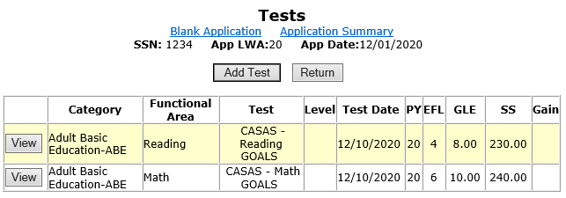
Example Client
Based on internal IWDS logic, would the results from the assessment tests recorded below determine this client as Basic Skills Deficient?

Slide 10
Dates
Look close at the application date and the test date:

Slide 11
Not with this Application Date
The reading assessment test recorded on the previous slide was at or below 8th Grade Level, however, the test is dated 12/10/2020 and the client’s application is dated 12/01/2020.
For this example, the internal logic within IWDS would not determine this client BSD due to the assessment test, because the assessment tests were taken after the client’s actual WIOA application date.

Slide 12
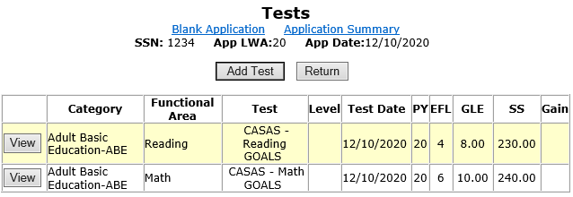
New Example
Based on internal IWDS logic, would the results from the assessment tests recorded below determine this client as Basic Skills Deficient?

Slide 13
Yes – BSD due to Test Results
Based on the test results displayed on the previous slide, the client would be determined BSD due to the test results.
The client has an 8th Grade Level on the reading assessment test, and the test was dated on or prior to the client’s WIOA application date.

Slide 14
Determining BSD due to Tests
Key points to understand about determining BSD due to assessment tests within IWDS.
  A client will be determined BSD with a score at or below 8th Grade Level on either the math or reading assessment tests, as long as the tests are dated on or before the client’s application date.
    Note – for an Adult client, valid assessment tests must be dated within one year of the application date.
    Note – for a Youth client, the assessment tests must be dated within six months of the application date.

Slide 15
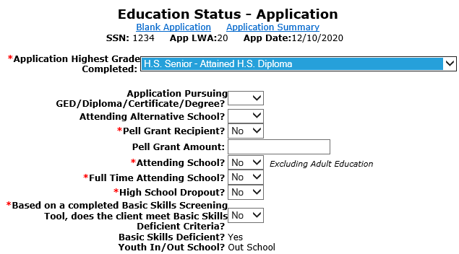
Education Status Screen
Within IWDS, if the assessment tests are dated on or prior to the application and the eligibility determination date, and the client scores at or below 8 GLE, the Basic Skills Deficient status will be auto populated to, “Yes”:

Slide 16
Documentation of BSD Due to Assessment Testing
If the client was determined BSD due to assessment tests (scoring at or below 8th Grade Level), then a hard copy of the assessment tests scoring sheet indicating the Category of Test (Adult Basic Education, English as a Second Language or Other), type of test (Math or Reading), the date of test, grading (including the scale score and Grade Level Equivalency) must be in the hard copy file that support BSD criteria.

Slide 17
Basic Skills Screening Tool
We will now transition to the next way a client could be determined BSD.
Based on guidance in OET Notice NO. 19-NOT-03 - Basic Skills Deficient, Change 3 – dated 12-9-2020.
  Attachment “A” within this policy is a Basic Skills Screening Tool (see example on next slide.)
  If a client has a response of “No” to any of the questions on the screening tool, they will be determined BSD.

Slide 18
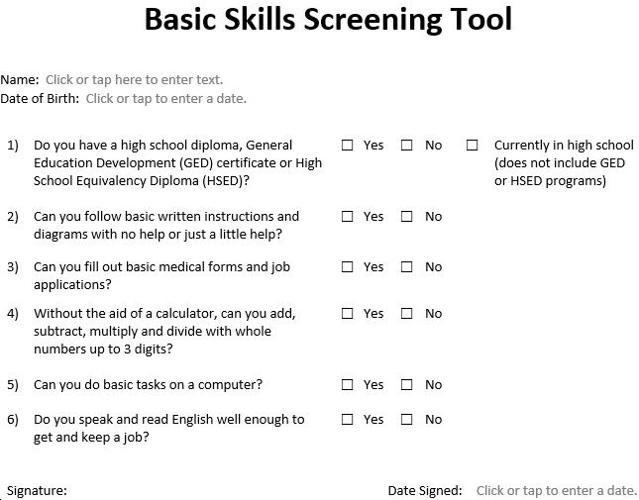

Slide 19
Basic Skills Screening Tool
On the “Education Status” screen within the IWDS application, is where the question, “Based on a completed Basic Skills Screening Tool, does the client meet Basic Skills Deficient Criteria?” has been added.
If any question on the screening tool was answered “No” by the client, then the question related to the BSD screening tool on the “Education Status” screen should be answered “Yes”; (see example on next slide).

Slide 20
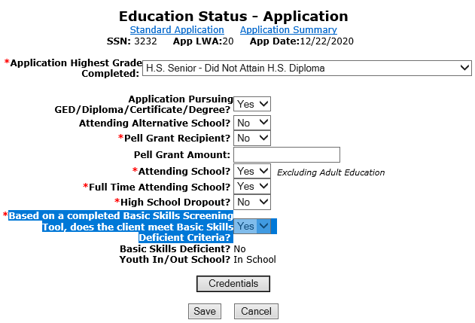
Basic Skills Screening Tool
Demonstrating recording BSD due to the screening tool.

Slide 21
Basic Skills Screening Tool
If a client is being indicated as meeting BSD criteria due to the Basic Skills Screening tool, the only acceptable documentation to support this criteria is the completed screening tool (with one or more response(s) of “No” indicated on the tool).
The screening tool must have been signed and dated by the client and the bottom portion of the screening tool must be completed by Career Planer staff (see example of bottom of tool on next slide.)

Slide 22
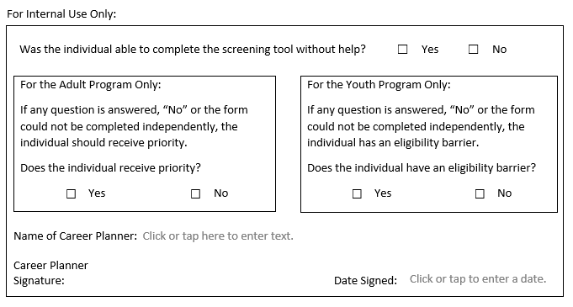
Bottom Portion of the BSD Screening Tool

Slide 23
Documentation of BSD from Screening Tool
To reiterate, if a client is being determined BSD due to the Basic Skills Screening Tool, the only acceptable documentation to support this criteria is the completed, signed and dated (by both the client and the Career Planner) Basic Skills Screening Tool.

Slide 24
BSD Criteria
We have now covered how an individual could be determined BSD due to assessment testing.
We have also covered how an individual could be determined BSD utilizing the Basic Skills Screening tool.
One last way an individual could be determined BSD is, if an individual is assessed as an English Language Learner (ELL).

Slide 25
English Language Learner
The term “English Language Learner” when used with respect to an eligible individual, means an eligible individual who has limited ability in reading, writing, speaking, or comprehending the English language, and (A) whose native language is a language other than English; or (B) who lives in a family or community environment where a language other than English is the dominant language.

Slide 26
Where ELL is Recorded in IWDS
Within IWDS, on the “Characteristics and Barriers” screen within the WIOA application, is where the question related to an English Language Learner (ELL) has been added.
If the “English Language Learner” question is populated with a “Yes”, the internal logic within IWDS will determine the client to meet BSD criteria (see example on next slide).

Slide 27
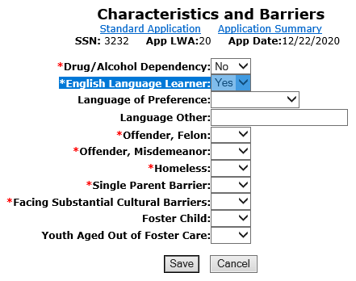
English Language Learner
Demonstrating the barrier of ELL being recorded:

Slide 28
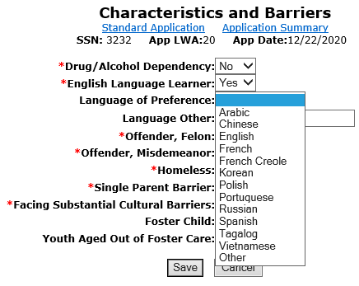
English Language Learner
If “Yes” to the ELL question, the client must indicate a language of preference as part of WIOA Federal reporting criteria:

Slide 29
Documentation for ELL
If a client has been recorded as an English Language Learner based on the response to the question on the Characteristics and Barriers screen, the only acceptable documentation choices would be the career planner assessment on how the client met the criteria or the client’s self attestation on meeting the ELL definition.

Slide 30
Three Possible Ways of BSD
To recap, an individual can meet the WIOA criteria of Basic Skills Deficient (BSD) three different ways:
  Based on scoring at or below 8th Grade Level on either a math or reading assessment tests.
  An individual could be determined BSD due to the Basic Skills Screening tool.
  An individual could be determined BSD due to being assessed as an English Language Learner.

Slide 31
Overview
Under WIOA, Basic Skills Deficient (BSD) has eligibility/priority criteria under both the Adult and Youth titles.
  If a qualified WIOA Adult client meets any of the three BSD criteria discussed in the previous slide, they would be considered a priority client under WIOA.
  Under the Youth titles (In-School Youth and Out-of-School Youth), meeting any of the three BSD criteria is a barrier that is part of the Youth eligibility criteria.

Slide 32
Basic Skills Deficient
This concludes the block on Basic Skills Deficient criteria.
If you have any questions, please contact James (Jim) Potts at james.potts@Illinois.gov or call him at (217) 416-7097.

