Slide 1
Workforce Innovation and Opportunity Act
Adult Eligibility
As of January 11th, 2021

Slide 2
WIOA Title 1 Authorization
Workforce Innovation and Opportunity Act of 2014

Slide 3
Understanding the ePolicy Manual
The Illinois Department of Commerce and Economic Opportunity, Office of Employment and Training (OET) utilizes a WIOA ePolicy portal where all current and new guidance issued by the Illinois Workforce Innovation Board (IWIB) and OET will be maintained.
Homepage: www.illinoisworknet.com/DCEOPolicies

Slide 4
WIOA Title 1 Authority
Workforce Innovation and Opportunity Act of 2014
Training and Employment Guidance Letter (TEGL) 19-16 – Guidance on Services Provided through Adult and Dislocated Worker under WIOA – dated March 1st, 2017
TEGL 7-20 – Implementation of Priority of Service in WIOA Adults – dated November 24th, 2020
WIOA ePolicy Chapter 5 - General Eligibility
WIOA ePolicy Chapter 5.1.1 – 1.1.4 – Selective Service
WIOA ePolicy Chapter 5.2 – Adult Eligibility
WIOA ePolicy Chapter 5.5 - Low-Income Individuals
WIOA ePolicy Chapter 5.6 – Service Priorities
Commerce Notice NO. 19-NOT-01, Change 3 – Basic Skills Deficiency dated December 9th, 2020

Slide 5
General Eligibility and Low Income
Prior to reviewing this presentation on Adult Eligibility, it is important that you view and understand the details that were covered in the presentation on:
WIOA General Eligibility – 1-7-2021
WIOA Low Income – 1-7-2021
WIOA Basic Skills Deficient – 1-11-2021

Slide 6
WIOA Adult Eligibility
WIOA ePolicy Chapter 5.2 – Adult Eligibility
WIOA Legislation requires that an Adult be 18 years of age or older
Be a citizen or noncitizen authorized to work in the US; and
Meet Military Selective Service registration requirements (males only)

Slide 7
Changes from WIA to WIOA Adult
There is no longer a sequence of services; a participant may receive services in any order that is deemed appropriate.
Core and Intensive WIA services were combined into “Career Services” under WIOA.
Coordination with outside agencies (WIOA partners) is permitted to provide comprehensive services to participants.

Slide 8
WIOA Adult Priority
WIOA Adult clients who meet WIOA Low Income criteria are a priority under WIOA Legislation.
WIOA Adult clients who are determined “Basic Skills Deficient” (BSD) or are considered English Language Learners (ELL) are a priority under WIOA Legislation.
It is important to understand, Low Income, BSD & ELL are equal priorities under the Adult title.

Slide 9
Veterans Priority of Service
As was addressed in the WIOA General Eligibility presentation, based on guidance in the Jobs for Veterans Act, a Veteran or Qualified Spouse of a Veteran must receive priority of service over other qualified individuals who are not a Veteran or Qualified Spouse of a Veteran.

Slide 10
Adult Priority Per WIOA ePolicy 5.6 Service Priorities
Veterans and eligible spouses who meet WIOA low-income criteria or are BSD or ELL.
Individuals who are not veterans, who meet WIOA low-income criteria, or are BSD or ELL.
Veterans or eligible spouses who do not meet WIOA low-income criteria and are not BSD or ELL.
Non-veterans who do not meet WIOA low-income criteria or BSD/ELL criteria.

Slide 11
DOL TEGL 7-20
Department of Labor issued TEGL 7-20, Implementation of Priority of Service in WIOA Adults in November 2020:
This new guidance is issuing a threshold for each state (which in turn will be monitored down to each LWIA,) to serve at least 75% of their Adult population in one or more of the priority groups of Low Income, Basic Skills Deficient (including English Language Learners), as well as Veterans or Qualified Spouse of a Veteran.
In December 2020, our programmers ran various ad hoc reports by LWIA, and by and large every LWIA has exceeded 75% of their Adult Registrants in PY19 and (from 7-1-20 – to date) in PY20.

Slide 12
DOL TEGL 7-20 – Tracked by Exiters
Department of Labor issued TEGL 7-20, Implementation of Priority of Service in WIOA Adults in November 2020:
Closer examination of TEGL 7-20, it was noted that DOL will be tracking this Adult Priority based on Adult Exiters in PY20 (7-1-20 – 6-30-21) to capture a baseline on how each state (and each LWIA) has been doing regarding serving Adult clients who have met the WIOA Adult Priorities outlined in the WIOA legislation.
Basically, for those working with the Adult title, keep doing what you have been regarding following the Adult priorities and everything will work well.

Slide 13
Reports for Tracking Adult Priorities
A new report under the Reporting Menu (Participant Reports), called Non-Priority 1A Adult Report:
This report will allow each LWIA the ability to run a report, for a given period that identifies the clients who are currently being served under the Adult Funding stream that had not met any of the WIOA Adult priorities.
See the next slide for a screen print of the actual report criteria screen.

Slide 14
Non-Priority 1A Adult Report

Slide 15
Example Results from a Non-Priority 1A Adult Report
From the “Training Platform” of IWDS, below is an example of results from the report:

Slide 16
Another New Report on the Way
There is another new report currently in development that will be added to the reporting menu soon. It will be run by LWIA, program year and either by Registrant or Exiter, showing how the LWIA has done or is doing serving Adult clients who meet one or more of the Adult Priorities.
This report will also provide a detailed numeric breakdown on how the Adult clients have met the different Adult Priorities during the selected reporting period.

Slide 17
WIOA Adult Low Income
As was addressed in the WIOA Low Income presentation, below are the six different ways an Adult client could meet WIOA Low Income criteria:
Cash Welfare
Food Stamps
Homeless
Foster Child
Family Income Calculation
Family of One Due to a Disability (Requires the client to have a disability, and their own income be below the low-income threshold for a family size of one.)

Slide 18
WIOA Adult Low Income
If a qualified Adult client meets any one or more of the six WIOA Low Income criteria shown on the previous slide, they should be certified under Adult Low Income and receive priority under the WIOA Adult title.

Slide 19
Basic Skills Deficient
Basic Skills Deficient – respect to an individual—
who is a youth, that the individual has English reading, writing, or computing skills at or below the 8th grade level on a generally accepted standardized test; or
who is a youth or adult, that the individual is unable to compute or solve problems, or read, write, or speak English, at a level necessary to function on the job, in the individual’s family, or in society.

Slide 20
Basic Skills Deficient
As was covered in the standalone presentation on Basic Skills Deficient (BSD), there are three different ways an Adult client could meet the WIOA Adult Priority tied to BSD:
Scoring at or below 8th Grade Level Equivalency (GLE) on their pre-assessment math or reading tests.
Being determined BSD due to the Basic Skills Screening Tool.
If an Adult Client is assessed as an English Language Learner (ELL).

Slide 21
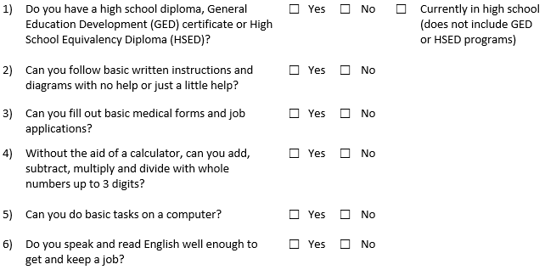
Basic Skills Screening Tool
If an individual replies “No” to any of the following questions on the screening tool, they can be determined BSD:

Slide 22
Basic Skills Screening Tool
Within IWDS, on the “Education Status” screen within the application, is where the question has been added when a client is being determined BSD due to the new screening tool.
If any question on the screening tool is answered “No” by the client, then the question related to the BSD screening tool on the “Education Status” screen should be answered “Yes”; (see example on next slide).

Slide 23
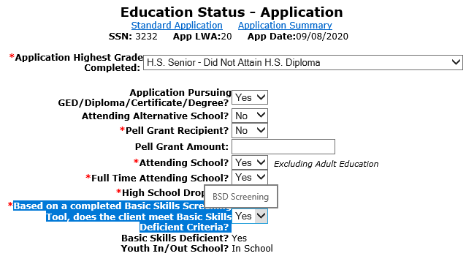
Basic Skills Screening Tool
Demonstrating recording BSD due to the screening tool.

Slide 24
English Language Learner
English Language Learner – when used with respect to an eligible individual, means an eligible individual who has limited ability in reading, writing, speaking, or comprehending the English language, and (A) whose native language is a language other than English; or (B) who lives in a family or community environment where a language other than English is the dominant language.

Slide 25
English Language Learner
Within IWDS, on the “Characteristics and Barriers” screen within the application, is where the question has been added when a client is being determined an English Language Learner (ELL).
If the question is populated with a “Yes”, the client must pass on a Language of Preference; (see example on next slide).

Slide 26
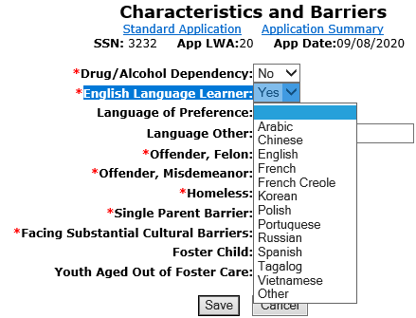
English Language Learner (ELL)
Demonstrating barrier of ELL being recorded.

Slide 27
Basic Skills Deficient (BSD)
A key internal logic item in IWDS to understand about BSD from assessment tests:
The assessment test date must be, on or before the application date before the internal logic within IWDS is going to pick up the client as BSD due to the assessment test:
Example, if a client has an application date of 1/4/2021, but was given the assessment test(s) on a date after 1/4/2021, even if the client scores at or below 8th Grade Level on the assessment test(s), the internal IWDS logic would not determine the individual BSD based on the assessment test.

Slide 28
Adult Training Services
Prior to certification under “Training Services” an Adult client must have:
Documented Assessment
Individual Employment Plan (IEP)

Slide 29
Individual Employment Plan (IEP)
IEP - A plan developed by the participant and the career planner to identify the participant's employment goal, the appropriate achievement objectives, and the appropriate combination of services for the participant to achieve the employment goal, including providing information on eligible providers of training services and career pathways to attain career objectives.

Slide 30
Adult Training Services
The “Assessment” and “IEP” could be completed by either the LWIA staff (Career Planner); WIOA Core partner staff (Adult Ed., Wagner Peyser, Vocational Rehab, TANF staff); Training Provider or staff from some other agency.
Most often the assessment and IEP will be completed by the WIOA Adult Career Planner at the LWIA.

Slide 31
Co-Enrolled Adult
WIOA Adult clients who meet the priority of services – Low Income and/or Basic Skills Deficient can be co-enrolled with an age- appropriate Youth title or a Dislocated Worker title to break up funding of services:
If this is done, the client cannot exit from one title until services from all titles are completed.
If this is done, the client would fall into performance outcomes for each title that the client is registered.

Slide 32
WIOA Adult Eligibility
To recap, for overall WIOA Adult Eligibility a client must be 18 years of age or older, be legally authorized to work in the U.S. and if born a male, who was born on or after 1/1/1960, must be compliant with Selective Service requirements.

Slide 33
Adult Eligibility and Priorities
However, it is important that the priorities laid out in the OET WIOA Priorities Policy is followed, meaning:
Veterans Priority of Service must be followed.
Any qualified Adult who meets WIOA Low Income criteria (please see separate power point on WIOA Low Income) or is Basic Skills Deficient or is considered an English Language Learner (please see separate power point on BSD) must be served priority to eligible Adults who do not meet the priorities laid out.

Slide 34
WIOA Adult Eligibility
This concludes the presentation on WIOA Adult Eligibility.
If you have any questions, feel free to contact me at james.potts@Illinois.gov or you can call me at (217) 416-7097.

