Slide 1
Work-based Learning Technical Assistance Session
JTED NOFO
October 4, 2021
Heather Penczak, Policy & Program Manager

Slide 2
Work-based Learning and the JTED NOFO
Jobseeker Focus
Any combination of work-based learning under Program Services may be offered to participants. However, the work-based learning opportunity must align with education and training within a career pathway. Essential employability skills, digital and financial literacy, and career readiness services must be incorporated into the program model.
Employer Engagement
Conduct industry-specific events to create an intentional focus on an industry and a specific worker group; and
Invite employers to present at local workshops to interview interested participants and/or on-the-job training (OJT) candidates.

Slide 3
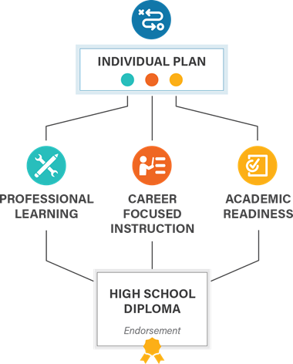
Student-centered, competency-based approach

Slide 4
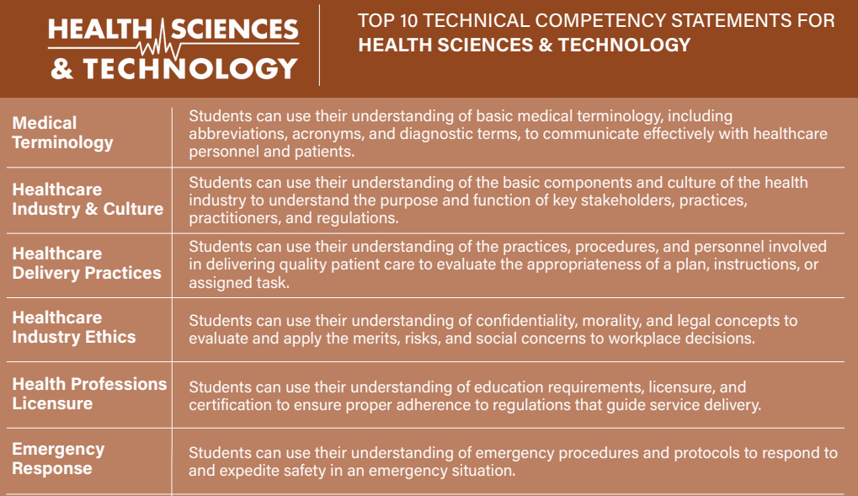
Essential & Technical Employability Competencies
Link to Competency Document

Slide 5
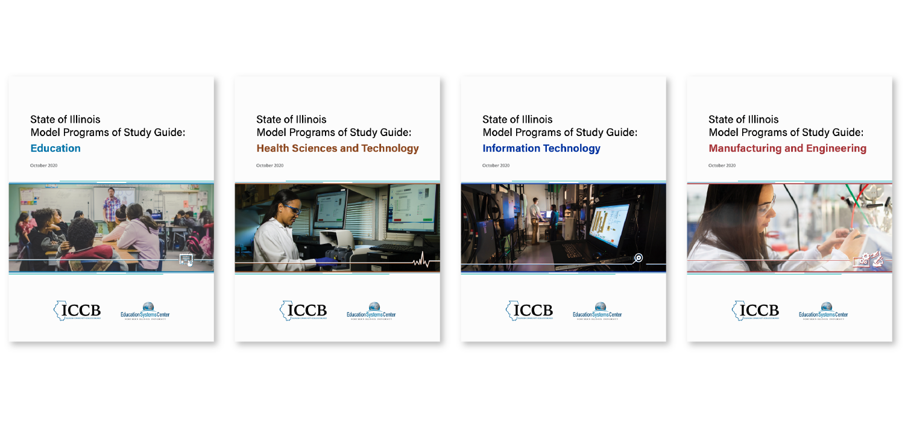
Model Programs of Study Guides
Health Sciences
Information Technology
Education
Manufacturing and Engineering
Agriculture, Food and Natural Resources
Arts and Communications
Finance and Business Services
Architecture, Construction and Energy
edsystemsniu.org/guides

Slide 6
Illinois’ Work-Based Learning Continuum
Career Awareness
Career Exploration
Team-Based Challenge
Career Development Experience
Pre-apprenticeship / Youth Apprenticeship
Apprenticeship
Increasing Intensity of Employer Engagement
Definitions: Illinois Career Pathways Dictionary

Slide 7
Career Development Resources
Link to Toolkit
Link to Dictionary

Slide 8
Exploring Illinois’ WBL Continuum

Slide 9
Link to I-WIN Resource Hub
Subscribe to the I-WIN Newsletter!
Highlight and explore innovative models for work-based learning, initial focus on virtual
Engage in conversations on creating sustainable, high-quality models that provide broader and more equitable access, with a focus on building social capital for Black and Latinx students
Build connections among communities to share best practices, learnings and resources
Identify needs for state policy changes or support systems

Slide 10
Career Exploration

Slide 11
Career Exploration
From Illinois Career Pathways Dictionary:
An activity such as a job shadow, attendance at a career exposition, or employer site visit providing an individual with the ability to engage directly with employers, for the purpose of gaining knowledge of one or more industry sectors or occupations
Notes:
Career Exploration is when students move into a more engaged, rather than passive experience exploring career pathways. During Career Awareness, students might have taken surveys, watched videos and had conversations with their teachers to start reflecting and thinking about what they are interested in. Career Exploration is their opportunity to engage directly with industry experts.

Slide 12
Engagement with Industry Experts
Opportunities for participants to engage in small groups or one-on-one discussions with industry professionals
Engage youth who have experience in the industry area
College and/or high school students (alumni from school/at local postsecondary institutions)
Have industry experts (employers, staff, college faculty, students in postsecondary programs) facilitate a workshop and leave time for questions at the end
Notes:
Virtual - this might be in small breakout rooms, so need to make sure have enough guest speakers available to facilitate each room
College students can provide valuable insight to students since they may have recently been in their place and can speak directly to the current pathway towards a career
Virtual - have another industry expert monitor the chat to address questions throughout

Slide 13
Meaningful Participant Engagement
Before
Youth research organizations/individuals
Develop questions to ask (specific and general)
During
Coordinating staff help facilitate presentations/ interactions and encourage questions
Determine how youth can continue to connect (LinkedIn, school email, etc.)
After
Reflect on experience - insights gained, questions they still have
Postsecondary education/training discussions for career interest area(s)

Slide 14
Career Exploration - Resources
JFF Career and College Exploration Experiences: Planning for Success
Chicago Public Schools WBL Toolkit - Checklists and implementation tools for
Career Day
Guest Speaker
Site Visit
Job Shadowing
Informational Interview
Overview recording, Probing Questions Design Template and Career Exploration Template for capturing “final” model
I-WIN Resource Hub
Career Connect Washington presentation
Networking Night and Virtual Career Panels
Notes:
Recording, probing questions, and template can be used to guide workshops within your own community

Slide 15
Team-based Challenges

Slide 16
Team-based Challenge
From the Illinois Career Pathways Dictionary:
A group problem-based learning project relating to an individual’s career area of interest that involves a problem relating to employers within that area, including mentoring from adults with expertise in that area, and requires the individual to present the outcomes of the project.

Slide 17
Team-based Challenge Best Practices
‘Mentoring from adults with expertise” – consider employer partners as well as postsecondary partners, community-based organizations, families of youth, in-house staff
Embedded within coursework
Consider especially Intro level courses
Dual credit opportunities
Connect with existing opportunities, models and resources of CTSOs and other extracurricular orgs, professional associations

Slide 18
Student Experience
Learning is driven by challenging, open-ended problems with no one “right” answer
Students work as self-directed, active investigators and problem-solvers in small collaborative groups
A key problem is identified and a solution is agreed upon and implemented
Teachers adopt the role as facilitators of learning, guiding the learning process and promoting an environment of inquiry
Identify a Problem
Present & Reflect
Research
Implement?
Develop a Plan
Evaluate & Re-examine

Slide 19
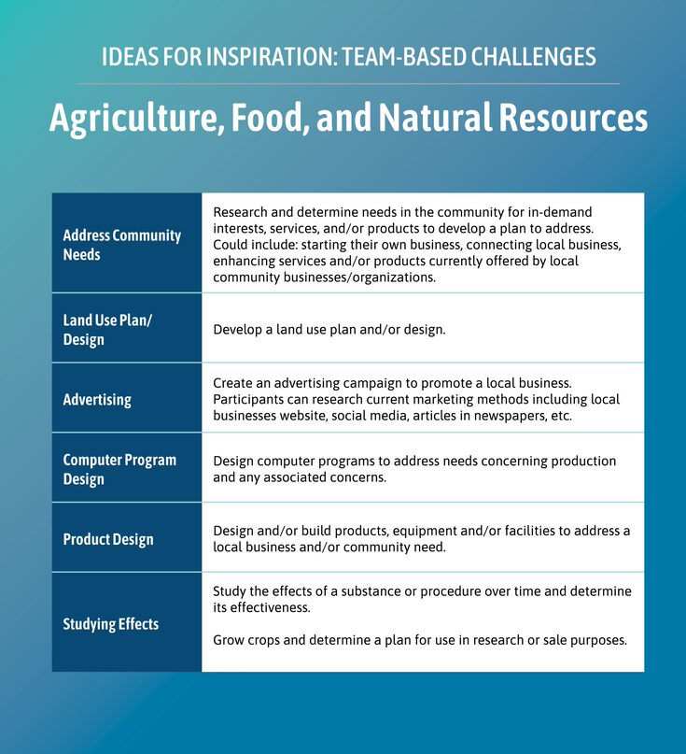
Statewide Team-based Challenge Resource Bank
Organized by College and Career Pathway Endorsement Area
Includes ideas for inspiration and detailed models, along with a template for designing your own
Resource bank and materials available on I-WIN resource hub
Team-based Challenge Template

Slide 20
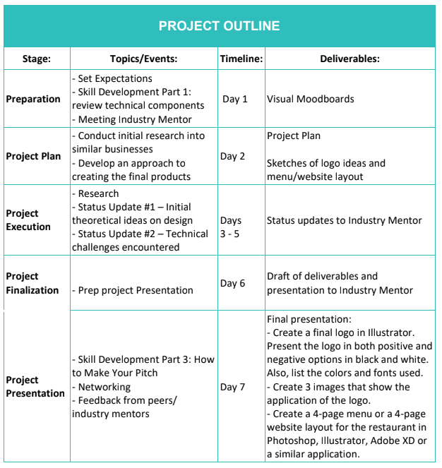
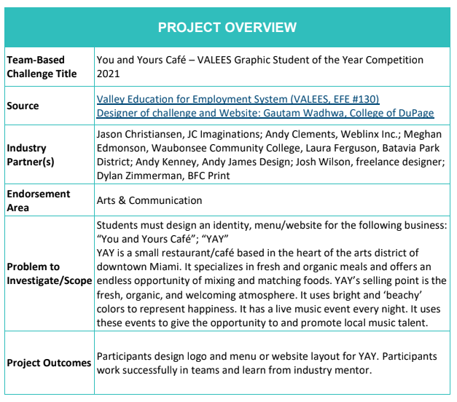

Slide 21
Additional Team-based Challenge Resources
Illinois 60 by 25 conference presentation and recording from Illinois Health Occupations Students of America (HOSA) and the Illinois Science and Technology Institute (ISTI)
Chicago Public Schools WBL Toolkit for Team-based Challenges: Checklists, tip and fact sheets, and implementation tools
Illinois Science and Technology Coalition: Guidebook of Professional Learning Experiences within Information Technology (p. 6-19)
Project Lead the Way: Resources, Materials, and Case Studies – Computer Science, Engineering, and Biomedical Sciences
Educators Rising: Competition Guidelines and Scoring Rubrics
SkillsUSA: Contest Descriptions for Championships Competitions

Slide 22
Career Development Experiences
Work Experiences or Internships

Slide 23
Work-Based Learning Continuum
Career Awareness
Career Exploration
Team-Based Challenge
Career Development Experience
Pre-apprenticeship / Youth Apprenticeship
Apprenticeship
Increasing Intensity of Employer Engagement
Definitions: Illinois Career Pathways Dictionary

Slide 24
Career Development Experience (CDE)
A supervised work experience relating to an individual’s career area of interest that:
Occurs in a workplace or under other authentic working conditions;
Is co-developed by an education provider and at least one employer in the relevant field;
Provides compensation or educational credit to the participant;
Reinforces foundational professional skills including, at a minimum, those outlined in the Essential Employability Skills framework;
Includes a Professional Skills Assessment that assesses skill development and is utilized as a participant feedback tool; and
Takes place for a minimum of 60 total hours.

Slide 25
CDEs are commonly known as..
Internship
School-based Enterprise
Supervised Agricultural Experience
Cooperative Education
Remote Work for a Client or Employer
Student-led Enterprise
Youth Apprenticeship

Slide 26
CDE Models
“Typical” internship with tasks and deliverables assigned by the Host on a daily/weekly basis
Micro-internships with project-based tasks
Ready-to-go projects
What are the things Hosts wish they had time to research/complete?
Departmental rotations
Expand Participant’s awareness of opportunities within an industry area
“In-house” opportunities
Current part-time job aligned with competencies

Slide 27
Stages of Implementation
Getting Started | Outreach | Onboarding | During | Wrapping Up
Clearly define roles and responsibilities of team to be able to communicate to Hosts & Participants Provide any relevant PD for staff Determine industry area(s) and general CDE model | Determine how CDE opportunities will be communicated so that all eligible Participants are provided the same information Recruit and assess potential Hosts to determine readiness for a CDE | Meet 1-1 with Participants to address transportation and support needs Are there any specific HR requirements from the Host for Participants to complete? | First days, mid-point check-ins to monitor progress and address needs to proactively navigate challenges Site visits for longer term CDEs and new Hosts Begin discussions on the Professional Skills Assessment | Provide an opportunity for both Participants and Hosts to evaluate one another and reflect on their experience Gather testimonials Support Participants to update resumes, portfolios, etc.

Slide 28
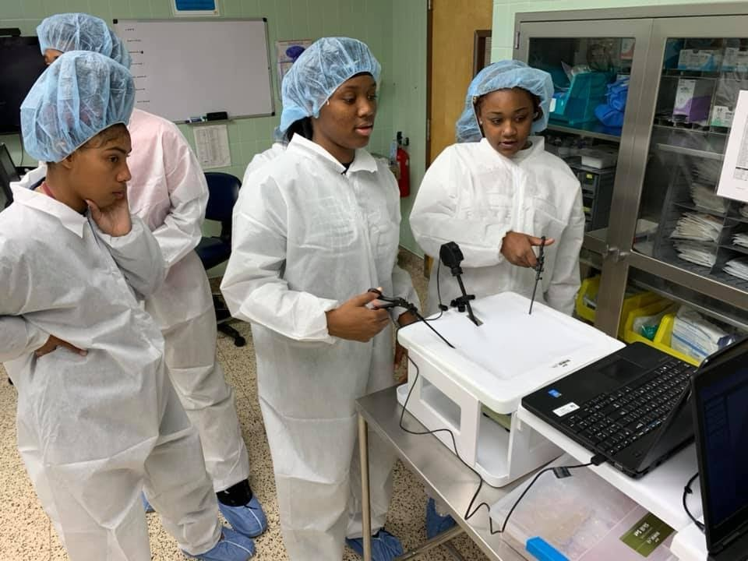
Participant Experience in a CDE
Exposure to a new environment and expectations to support growth of Essential Employability & Technical competencies
Authentic, quality engagement with industry professionals to build social capital and connection to college and career pathways
Valued as a resource of talent with background knowledge and lived experience that are recognized as a benefit to the CDE Host
High School Interns at BJC Healthcare
Notes:
Resource of talent – by the time participants complete a CDE they have likely taken career-focused coursework and completed previous WBL experiences
50/50 – 50% tasks, 50% PD and skill development opportunities

Slide 29
Career Development Experience Toolkit
Establish expectations for implementing high-quality, rigorous work-based learning experiences that prepare young people to be college and career ready through the development of Essential, Entrepreneurial and Technical Employability Competencies
Provide guidance, tools, and frameworks to offer a Career Development Experience, which is a required component of the College and Career Pathway Endorsement framework and in the State’s Every Student Succeeds Act (ESSA) as a College and Career Readiness Indicator
Highlight best practice examples of how organizations are accomplishing this on-the-ground and spark thinking for other communities on how these examples might be modified to fit into their own unique context

Slide 30
CDE Toolkit Resources Include:
Toolkit Document: A PDF document is available for download and guides readers through each stage of implementation with links to related resources and materials
Toolkit Website: The website includes links to all resources and materials referenced in the document and will be updated monthly with additional resources and best practices
Customizable Templates: Within the document and website are links to templates that can be customized to reflect the unique context and needs of each community and organization
Link to CDE Toolkit Website

Slide 31
Career Development Experience - Additional Resources
CDE Toolkit Companion Piece: provides additional resources to address the needs of stakeholders outside of a traditional high school setting including workforce development organizations, community-based organizations, and alternative high schools.
Overview recording and Career Development Experience Template for capturing “final” model
I-WIN Resource Hub
CDEs in Health Sciences
Practera virtual internship

Slide 32
Thank you!
Questions?

