Slide 1


Illinois Youth Career Pathway Grant Opportunity
Technical Assistance Session
Illinois Department of Commerce and Economic Opportunity

Slide 2


Moderator & Technology Support
Kiersten Baer
Online Marketing Coordinator
Illinois Center for Specialized Professional Support
ksheary@ilstu.edu

Slide 3
Access and Participation Guidelines
Meeting Access
Meeting Participation
Select the “Call Me” option on Zoom to use your phone for audio while using the video option, if you choose.
This webinar will be recorded and posted to IWN.
Everyone will be muted for this webinar.
A FAQs Page has been created to track questions raised during the webinar.
Materials shared during the meeting will be available on workNet.

Slide 4
Agenda
Introductions
Overview of Career Development Experiences (CDE)
Examples of CDEs
Overview of CDE Toolkit
Overview of CDE Toolkit Companion Piece
Resources

Slide 5


Speakers
Heather Penczak
Policy & Programs Manager,
Education Systems Center
Caroline D’Andrea
Policy & Programs Fellow,
Education Systems Center

Slide 6
What is a Career Development Experience (CDE)?
A supervised work experience relating to an individual’s career area of interest that:
  Occurs in a workplace or under other authentic working conditions;
  Is co-developed by an education provider and at least one employer in the relevant field;
  Provides compensation or educational credit to the participant;
  Reinforces foundational professional skills including, at a minimum, those outlined in the Essential Employability Skills framework;
  Includes a Professional Skills Assessment that assesses skill development and is utilized as a participant feedback tool; and
  Takes place for a minimum of 60 total hours.
  Source: Illinois Career Pathways Dictionary

Slide 7
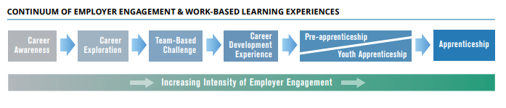
But Really Though… What Is It?
Part of Illinois’ broader work-based learning continuum and refers to terms such as:
Internship
School-based Enterprise
Supervised Agricultural Experience
Cooperative Education
Remote Work for a Client or Employer
Student-led Enterprise
Youth Apprenticeship

Slide 8
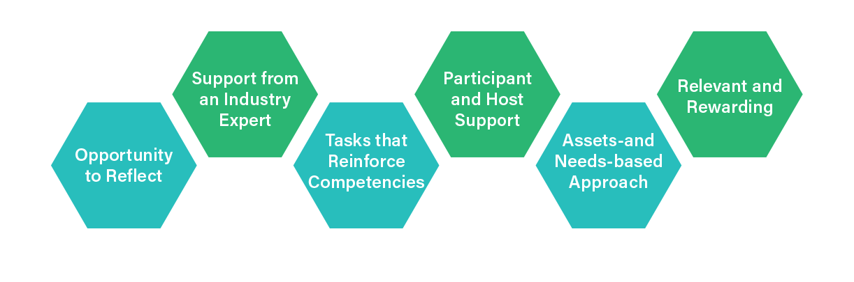
Work 1-1, Provide feedback, both Coach and Supervisor
Point person to address needs and receive feedback
Applicable to pathway and recognized for
How and what have they learned?
Meaningful, authentic, transferable
Resources of talent – builds potential
Notes:
We can remove this one to cut down on length

Slide 9
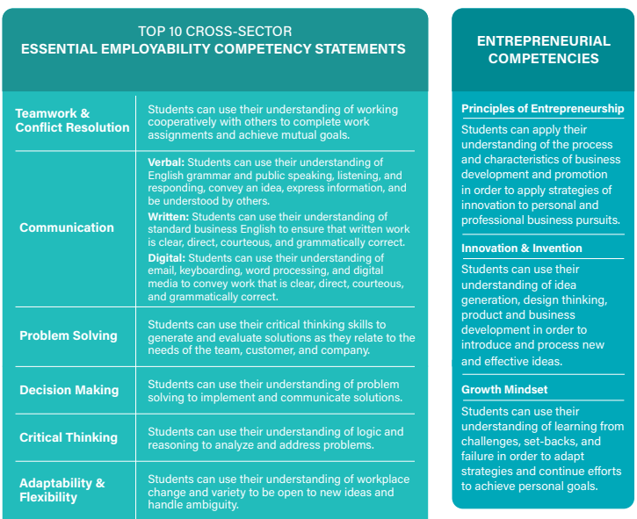
Essential Employability Competencies

Slide 10
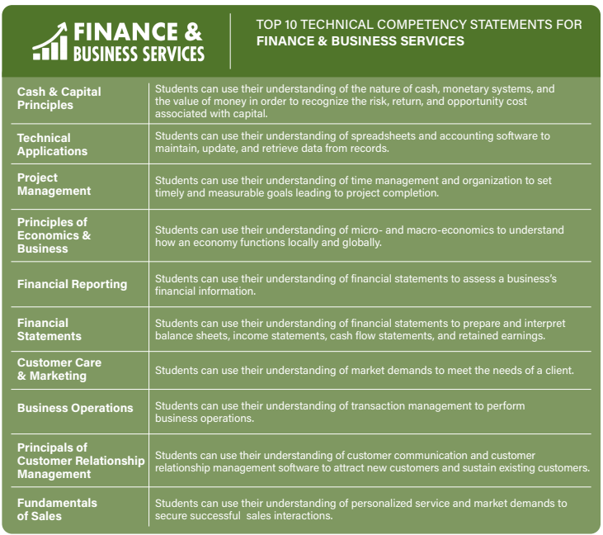
Technical Competencies

Slide 11
WIOA Youth Program & CDE Elements
Paid and Unpaid Work Experience
Occupational Skills Training
Education Offered Concurrently with Workforce Preparation
Leadership Development Opportunities
Entrepreneurial Skills Training
Notes:
CDEs can target…

Slide 12
CAREER DEVELOPMENT EXPERIENCE TOOLKIT
Created in collaboration with the Illinois State Board of Education and the Illinois Department of Commerce and Economic Opportunity

Slide 13
PURPOSES OF THE TOOLKIT
Establish expectations for implementing high-quality, rigorous work-based learning experiences that prepare young people to be college and career ready through the development of Essential, Entrepreneurial and Technical Employability Competencies
Provide guidance, tools, and frameworks to offer a Career Development Experience, which adhere the framework of the Postsecondary and Workforce Readiness Act for College and Career Pathway Endorsement framework
Highlight best practice examples of how organizations are accomplishing this on-the-ground and spark thinking for other communities on how these examples might be modified to fit into their own unique context

Slide 14
COMPONENTS OF THE TOOLKIT
Getting Started
Organizational Structure
Host Outreach
Onboarding
During
Wrapping Up
Notes:
GETTING STARTED
Creating a Quality Career Development Experience
Models for Implementation
Needs of the Local Labor Market
ORGANIZATIONAL STRUCTURE
Staffing Considerations
Staff Professional Development
Space Usage and Scheduling
Transportation
Data Collection Legal Considerations
HOST OUTREACH
Host Engagement
Forming Host Partnerships
Host Information and Assessment
ONBOARDING
FOR PARTICIPANTS
Demonstrating Readiness Preparing for the CDE
First Day Needs and Considerations
Professional Resources
FOR HOSTS
Clarifying Expectations Orientation
First Day Needs and Considerations
Youth Development Resources
DURING
Providing Ongoing Support
Participant Assessment
Site Visits
Navigating Challenges
WRAPPING UP
CDE Close-Out for Participants
CDE Close-Out for Hosts
CDE Close-Out for Managing Organization
Measuring and Communicating Impact

Slide 15
RESOURCES INCLUDED
Toolkit Document: A PDF document is available for download and guides readers through each stage of implementation with links to related resources and materials
Toolkit Website: The website includes links to all resources and materials referenced in the document and will be updated monthly with additional resources and best practices
Customizable Templates: Within the document and website are links to templates that can be customized to reflect the unique context and needs of each community and organization

Slide 16
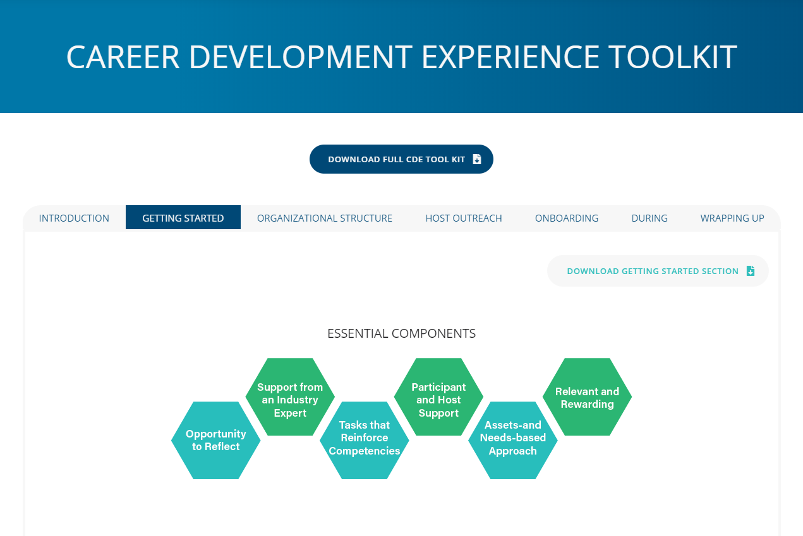

Slide 17
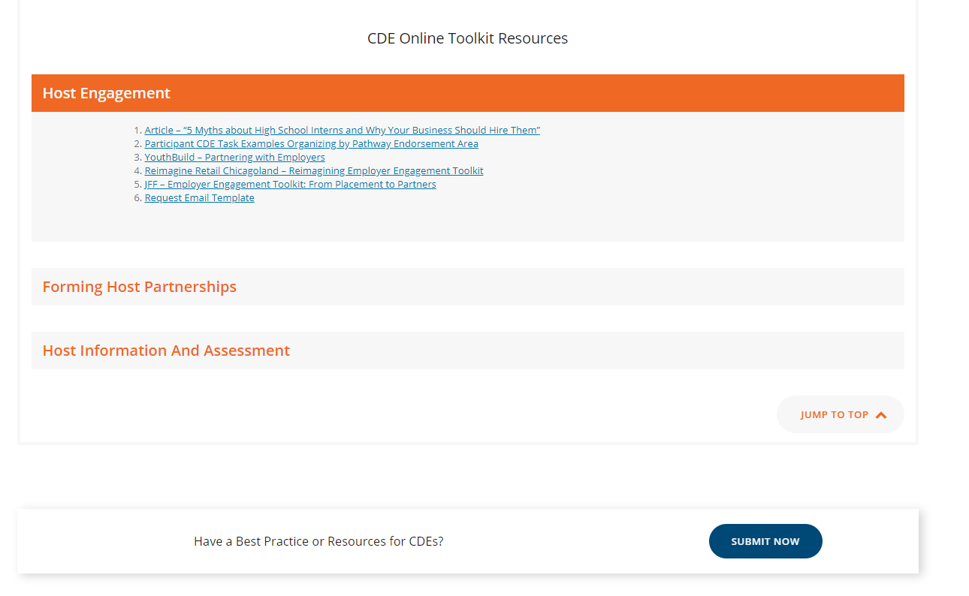
Dropdown menu of resources organized by topic within section

Slide 18
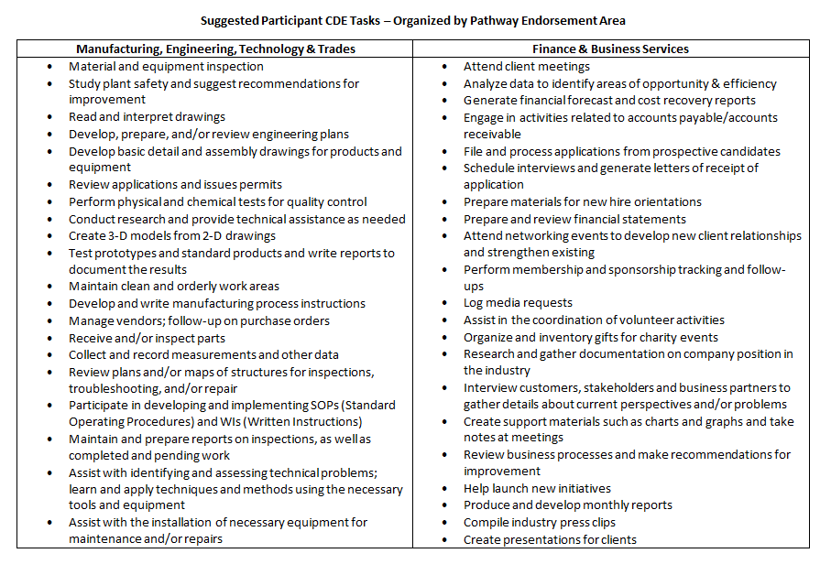

Slide 19
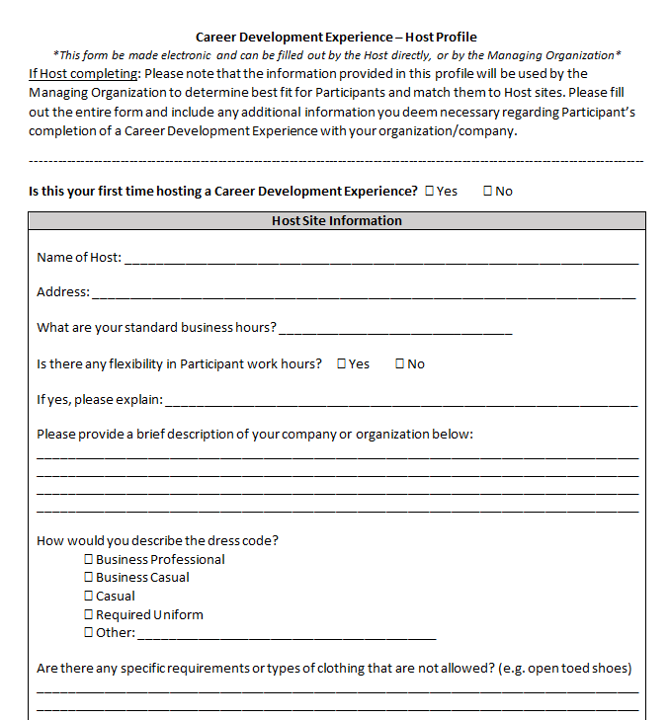
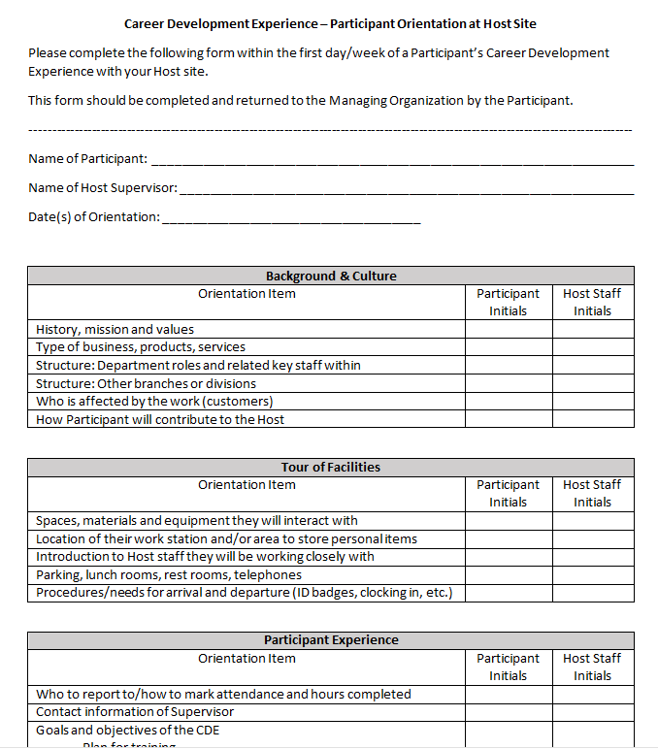

Slide 20
CAREER DEVELOPMENT EXPERIENCE TOOLKIT COMPANION PIECE
Created in collaboration with the Illinois Department of Commerce and Economic Opportunity

Slide 21
Why a Companion Piece?
While the original toolkit is meant to serve any organization that seeks to provide rigorous work-based learning opportunities to Participants, we must commit to creating career development experience resources with a focus on underserved populations, particularly Opportunity Youth.
In the United States and in Illinois, disparities in education and employment outcomes can’t be discussed without considering racism and poverty. We need to start by highlighting systemic disparities and model solutions in order to build context, empathy, and, ultimately, equity.

Slide 22
Purposes of the Companion Piece
Original Purposes of the Toolkit, PLUS:
Tailor these expectations, tools, and practices for Opportunity Youth
Address the needs of stakeholders outside of a traditional high school setting, including: workforce development organizations, community-based organizations and alternative high schools. This companion piece targets these organizations and employers in order to serve youth more inclusively.
Notes:
Original Purposes:
Establish expectations for implementing high-quality, rigorous work-based learning experiences that prepare young people to be college and career ready through the development of Essential, Entrepreneurial and Technical Employability Competencies
Provide guidance, tools, and frameworks to offer a Career Development Experience, which adhere the framework of the Postsecondary and Workforce Readiness Act for College and Career Pathway Endorsement framework
Highlight best practice examples of how organizations are accomplishing this on-the-ground and spark thinking for other communities on how these examples might be modified to fit into their own unique context

Slide 23
WIOA Youth Program & CDE Elements
Supportive Services
Adult Mentoring
Follow-up Services
Financial Literacy Education
Services that Provide Labor Market Information
Notes:
These are elements highlighted through the Companion Piece.

Slide 24
Components of the Companion Piece
Companion Piece Introduction
Models
Building Equity
Notes:
COMPANION PIECE INTRODUCTION
Why a Companion Piece?
How can we entice employers to hire and support historically-underserved populations?
What role does your organization play in supporting students as they work with employers?
MODELS
Community Models
Host-led Model
Federal Model
BUILDING EQUITY
Addressing Equity
Common Barriers and Solutions for Engaging Opportunity Youth
Equitable Considerations COVID-19 / Alternative Plans
Supports and Services for Participants During and After the CDE
Conclusion

Slide 25
Resources Included
Toolkit Document:
A PDF document is available for download and guides readers through each stage of implementation with links to related resources and materials
Customizable Templates:
Within the document and website are links to templates that can be customized to reflect the unique context and needs of each community and organization
Notes:
TBD

Slide 26
Types of Models
Type of Model | Community Model | Host-led Model | Federal Model
Definition | A partnership between a Host and a Managing Organization. Usually, the Managing Organization identifies and trains Participants and the Host provides work-related tasks and oversight through supervision and mentoring by a designated Host Supervisor. | Hosts have their own internal practices for acquiring new talent and building their skills. In a Host-led model, the Host recruits Participants, provides ongoing training, and works to retain Participants for the host company. | National, funded efforts are underway to support Opportunity Youth’s reconnection to education or employment. We can learn from these models for local implementation of CDEs.
Example | Business and Career Services, Inc. | Caterpillar | Opportunity Youth Forum

Slide 27
Equitable Practices
Payment/stipend
  Opportunity Youth are more likely experience poverty and homelessness than their peers. Without payment or stipend, Participants are forced to pick between a meaningful CDE experience and a job that covers essential costs.
  Even more, transportation is often a barrier to equitable access, especially in smaller cities and rural communities without public transportation. Can your organization include a transportation stipend?
Flexible scheduling
  Participants may have many competing priorities, depending on their circumstances. Assigning work that can be completed around their schedule increases capacity for participation.
  Some Participants have other childcare responsibilities. Can your Organization provide support around childcare, such an information about Head Start in the area?

Slide 28
Equitable Practices Continued…
Virtual Opportunities
  The various barriers Participants face can be lowered through virtual CDE opportunities. Offering opportunities to connect or work virtually whenever possible keeps equity at the forefront of the CDE.
  With advancing technology, such as video conferencing and online shared documents, organizations can consider fully or partly virtual engagements.
  Transportation needs of Participants will no longer be a barrier to their participation if conducted virtually. The financial burden and time commitment of commuting for Participants is eliminated.
  Organizations must confirm that Participants have a device and internet at home, or other needed equipment. If they do not, can your organization offer them a device or stipend to meet these needs?

Slide 29
Supports and Services for Participants
During and After the CDE:
When working with OY, there must be an explicit connection to further resources, education, or employment throughout the program so that OY leave with clear next steps in their development towards career and/or education. This work can be furthered by supporting Participants even after the CDE.
Focus on developing relationships, between Participants and Host Supervisors, Mentors, and other employees, to build Social Capital.
Create networks for Participants to keep them engaged during and after the CDE with one another and with the organization.

Slide 30
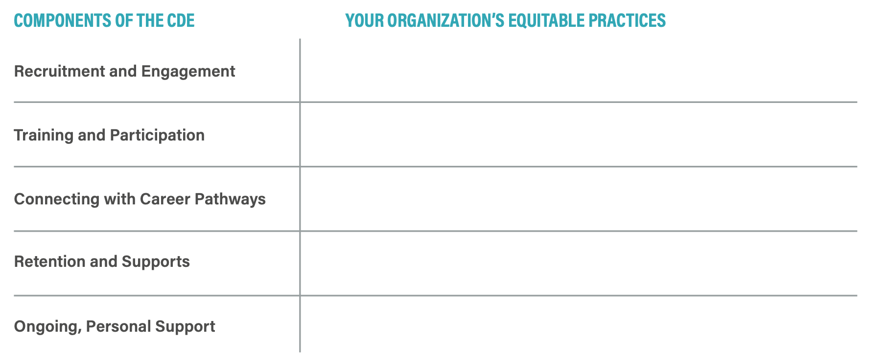
Notes:
Dependent on timing

Slide 31
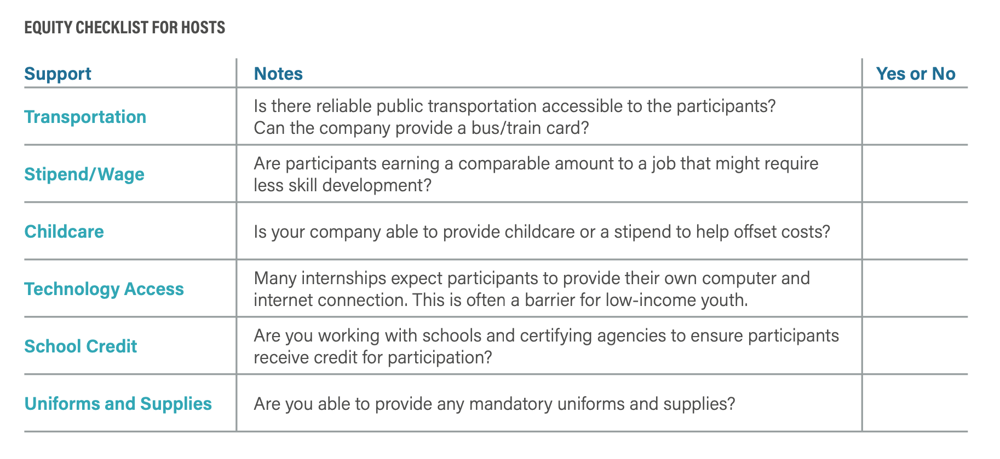
Notes:
Dependent on timing

Slide 32
Illinois WBL Innovation Network (I-WIN)
Highlight and explore innovative models for work-based learning with a focus this first year on virtual work-based learning
Engage in conversations on creating sustainable, high-quality models that ultimately provide broader and more equitable access to work-based learning with a focus on building social capital for Black and Latinx students
Build connections among communities to share best practices, learnings and resources
Identify needs for state policy changes or support systems

Slide 33
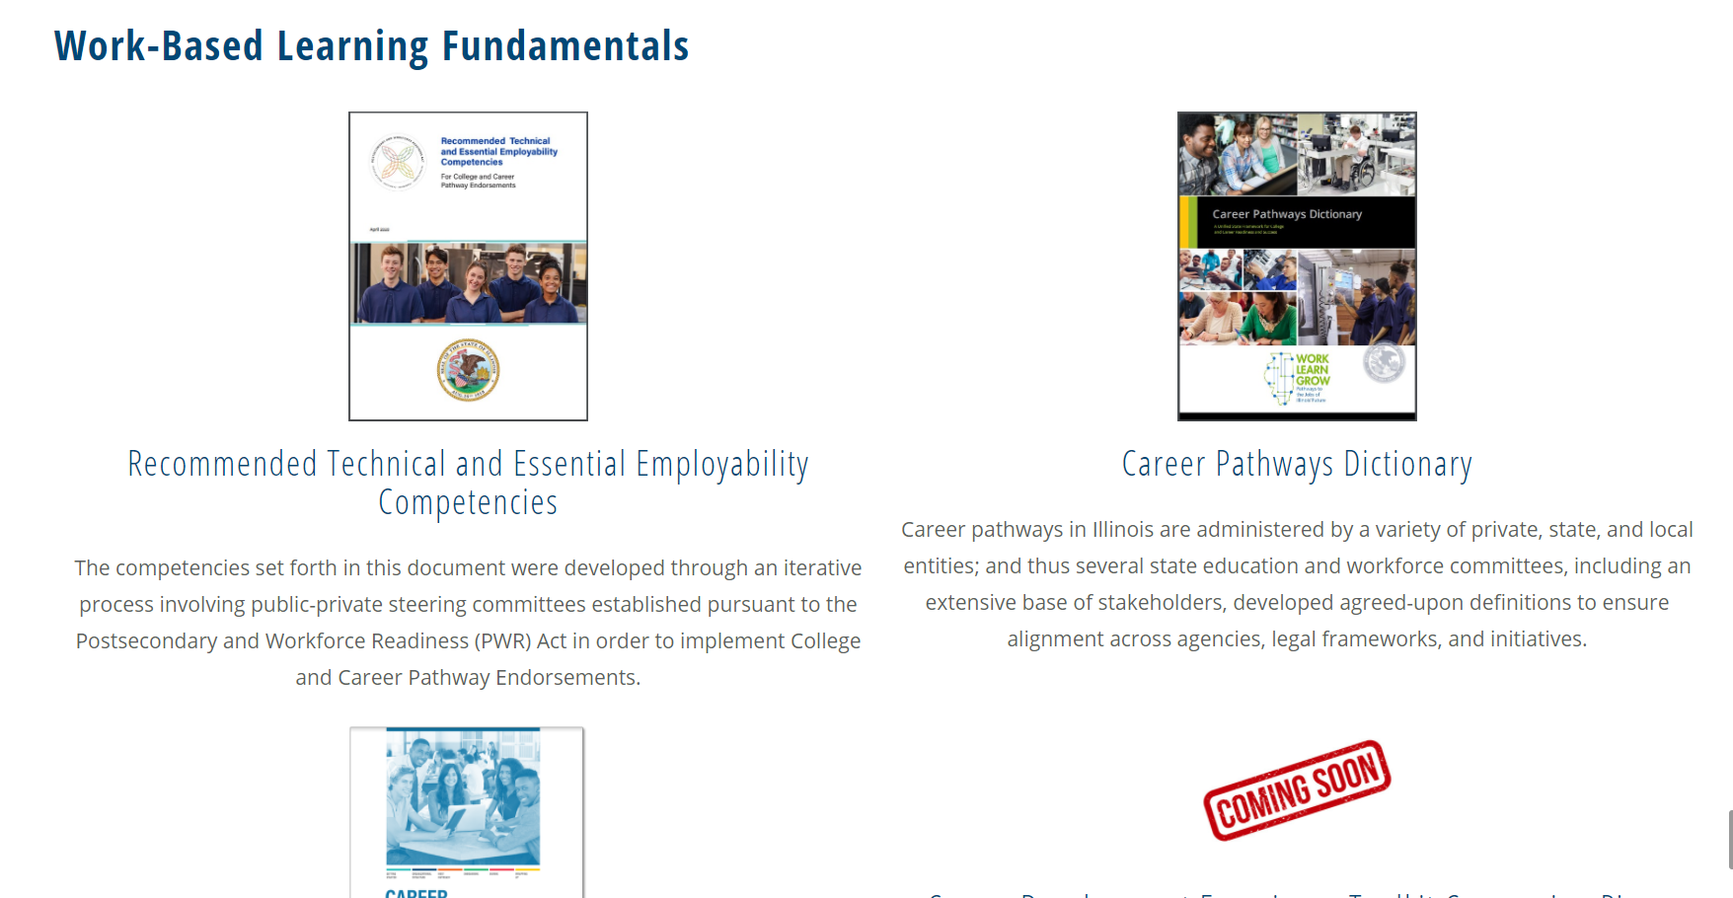
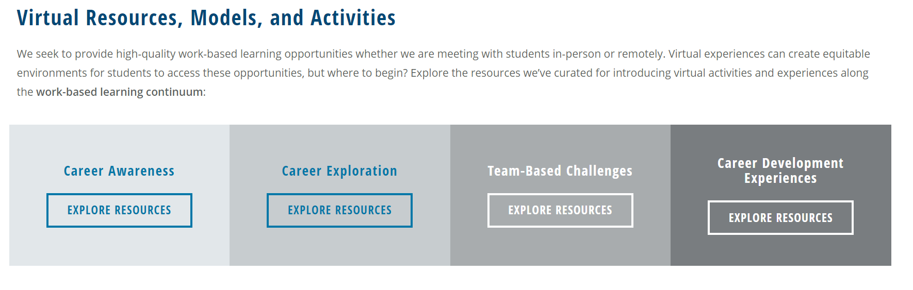
Resources & Connecting with I-WIN
I-WIN Resources Site includes:
  Recording and materials from previous I-WIN sessions
  Virtual resources, models, and activities along the WBL Continuum
  Space for communities to submit resources
Notes:
I-WIN will meet monthly – to be added to the membership list please email Heather Penczak (hpenczak@niu.edu) or
use this link.
I-WIN membership is meant to represent a diverse set of stakeholders – please encourage employer partners, CBOs, intermediaries, etc. to join.

Slide 34
Resources
Career Development Experience Toolkit
Recommended Technical and Essential Employability Competencies
State of Illinois Career Pathways Dictionary
Postsecondary and Workforce Readiness Site

Slide 35
Using The Toolkit and Companion Piece
Are you interested in utilizing the resources from the toolkit?
Please contact Heather Penczak (hpenczak@niu.edu) and Caroline D’Andrea (cdandrea@niu.edu ) to:
  Learn more about the Toolkit
  Receive direct support to adapt and implement Toolkit components and resources
  Join I-WIN

Slide 36
We Want to Hear from You!
What do you need?
What resources would support your work?
What communities have we not thought about?

