Slide 1



Submitting your Customer Success Story
Submit and Search Customer & Employer Success Stories from various Workforce Development programs in Illinois.
June 2019
The Illinois workNet® Center System, an American Job Center, is an equal opportunity employer/program. Auxiliary aids and services are available upon request to individuals with disabilities. All voice telephone numbers may be reached by persons using TTY/TDD equipment by calling TTY (800) 526-0844 or 711. This workforce product was funded by a grant awarded by the U.S. Department of Labor’s Employment and Training Administration. For more information please refer to the footer at the bottom of any webpage at illinoisworknet.com.

Slide 2
Agenda
Success Stories
Updates
Importance
Success Story Resources
Submitting your customer Success Story
Q & A

Slide 3
Success Story Updates
THROUGH ILLINOIS WORKNET
WWW.ILLINOISWORKNET.COM/SUCCESS

Slide 4


ILLINOIS WORKNET SUCCESS STORY: UPDATES
01
02
03
Including Trade Adjustment Assistance
Auto-populating Customer Information
Creating specific URLs for each success story
Some programs will not auto-populate because customer info is not stored in a system. These programs include: Apprenticeship Plus, Incumbent Worker, Laid Off Worker, and the National Emergency Grant (NEG).

Slide 5
Success Story Importance
THROUGH ILLINOIS WORKNET
WWW.ILLINOISWORKNET.COM/SUCCESS

Slide 6
ILLINOIS WORKNET SUCCESS STORY: IMPORTANCE
Customers
Customers can see what their peers are doing.
Can connect to others facing similar situations.
Shows customers how others have succeeded in the program.
Provides Credibility.
Program
Gives credibility to program and organizations running them.
Gives others hope that the program can work for them too.
Highlights aspects of the programs that work best.

Slide 7
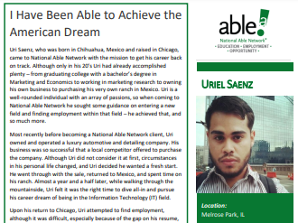
ILLINOIS WORKNET SUCCESS STORY: IMPORTANCE
Annual Reports
Illinois workNet success stories are used in the Workforce Development Annual Reports. Each year the stories are reviewed by commerce and various stories are added to the report.

Slide 8
Success Story Resources
THROUGH ILLINOIS WORKNET
WWW.ILLINOISWORKNET.COM/SUCCESS

Slide 9

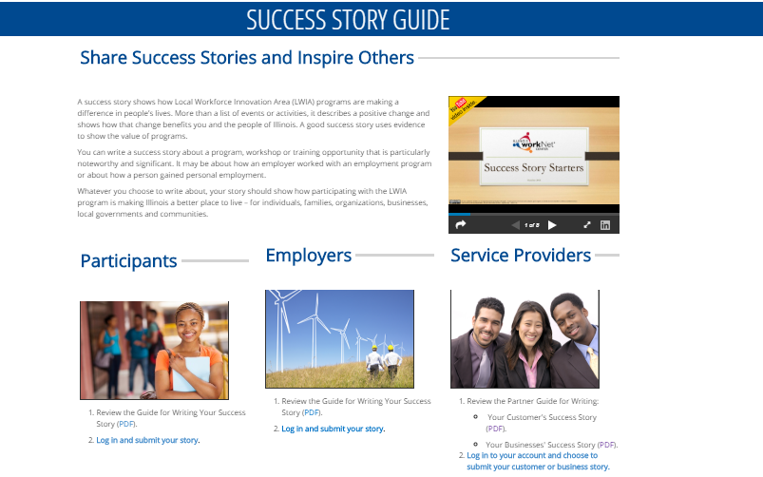
ILLINOIS WORKNET SUCCESS STORY GUIDE
www.illinoisworknet.com/success

Slide 10
TIPS FOR WRITING A SUCCESS STORY
A success story shows how a program made a difference in your customer’s life. A success story is more than a list of events or activities. The story demonstrates a positive change and describes how that change benefits them and the people of Illinois. A good success story uses evidence to show value of the program.
Answer the following questions to develop the body of your story:
Where was the participant when they started the program and what was their background or challenge?
What was the outcome of those services, programs, or activities? (i.e., Did they earn any credentials? What did they learn or experience in the program? What positive changes occurred?)
What services, programs, or activities was the individual involved in as they prepared for employment?
What are the details of the employment the participant received?
What WIOA and other partners were included in the employment plan?

Slide 11
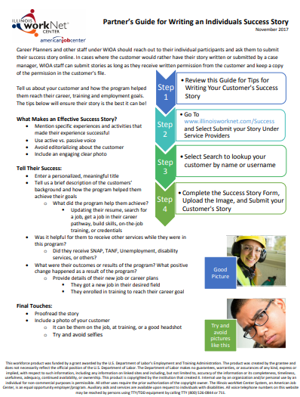
Partner Guide for Writing an Individual’s Success Story
Use this guide to learn about:
  What Makes an Effective Success Story
  Telling your Customer’s Success
  Final Touches
  What Makes a Good Picture
  Step by Step Instructions for Adding your Customer’s Success Story.

Slide 12
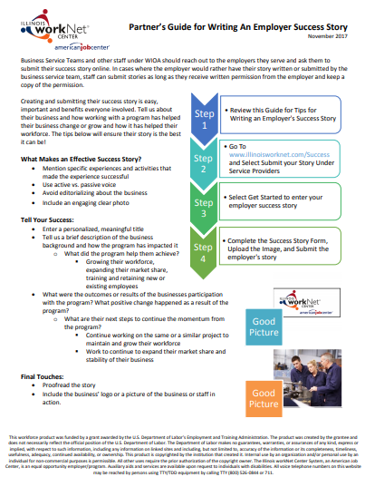
Partner Guide for Writing an Employer’s Success Story
Use this guide to learn about:
  What Makes an Effective Success Story
  Telling your Employer’s Success
  Final Touches
  What Makes a Good Picture
  Step by Step Instructions for Adding your Employer’s Success Story.

Slide 13
SUBMITTING YOUR CUSTOMERS SUCCESS STORY
THROUGH ILLINOIS WORKNET
WWW.ILLINOISWORKNET.COM/SUCCESS

Slide 14

ILLINOIS WORKNET SUCCESS STORY: ACCESS
Step 1
Go to www.illinoisworknet.com
Log into your Illinois workNet account

Slide 15
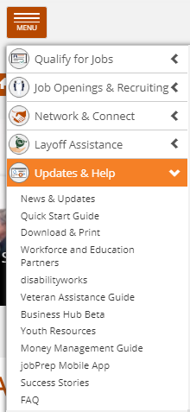
ILLINOIS WORKNET SUCCESS STORY: ACCESS
Step 2
Open the Menu
Select Updates & Help
Then select Success Stories

Slide 16
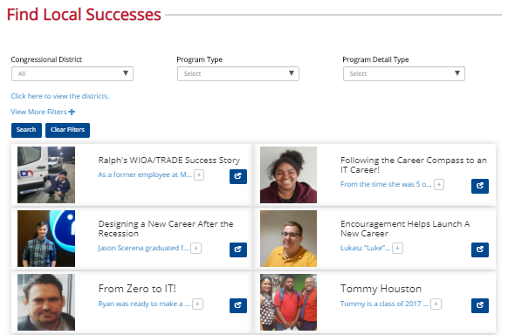
ILLINOIS WORKNET SUCCESS STORY: PUBLIC PAGE
Searching Success Stories
Find and read success stories that have been submitted for various workforce development programs in the state of Illinois.
Congressional District
01
Use the congressional district filter to find success stories for a specific congressional district.
Program Type
02
Use the Program Type filter to find success stories for specific workforce development programs. (i.e., WIOA Adult)
Program Detail Type
03
Use the Program Detail Type filter to find success stories for specific program details. (i.e., Training)
View More Filters
04
Click View More Filters to get access to additional filter options to use when searching success stories.

Slide 17
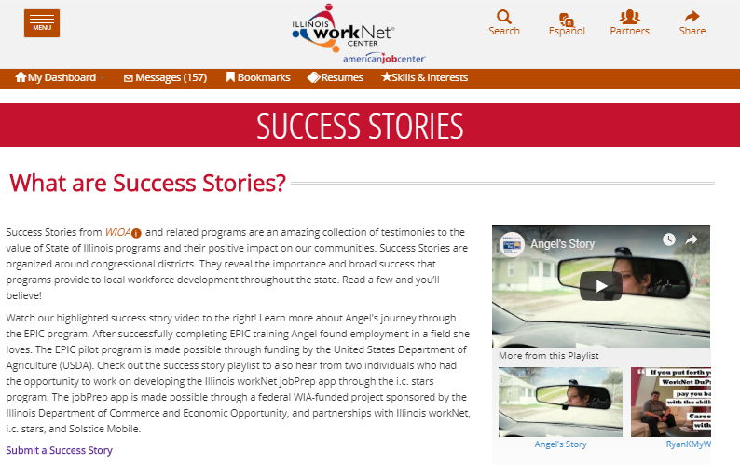
ILLINOIS WORKNET SUCCESS STORY: ACCESS
Step 3
From the Success Stories page, select Submit a Success Story.

Slide 18
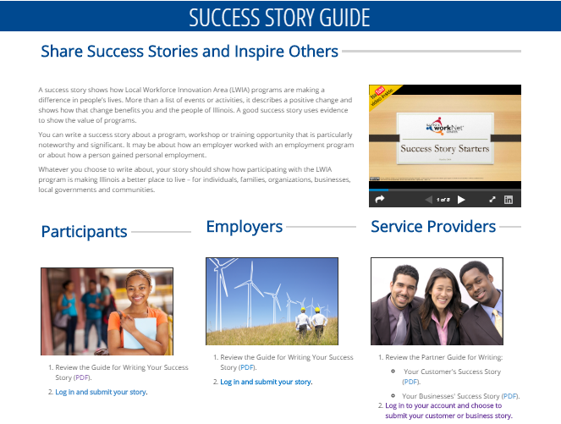
ILLINOIS WORKNET SUCCESS STORY: ACCESS
Step 4
From the Success Stories Guide page you will select the link located under the service provider section. Log in to your account and choose to submit your business or business story.

Slide 19
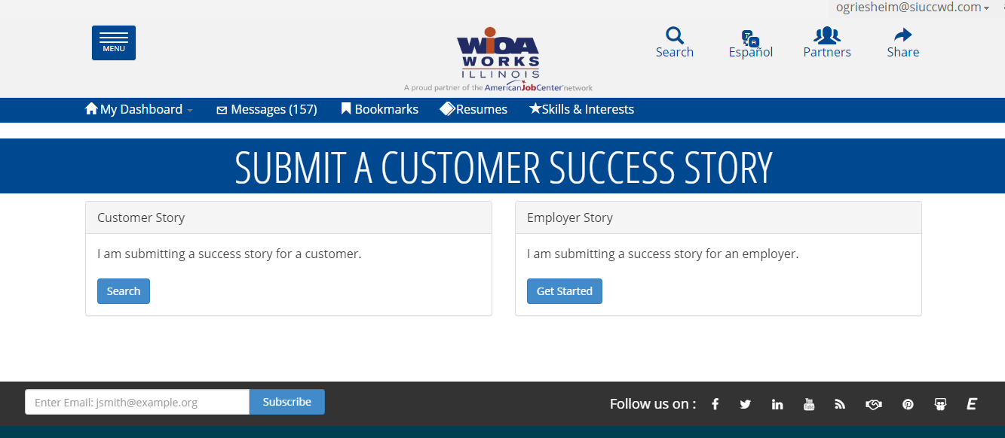
ILLINOIS WORKNET SUCCESS STORY: FINDING YOUR CUSTOMER
Step 5
If adding a customer story click Search under Customer.
If adding an employer story click Get Started under Employer.

Slide 20
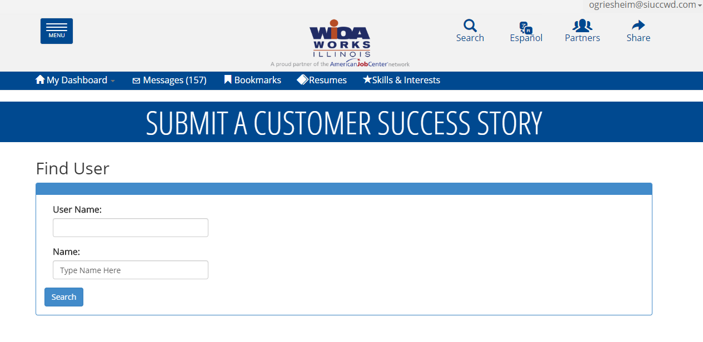
ILLINOIS WORKNET SUCCESS STORY: FINDING YOUR CUSTOMER
Step 6
Type in your customer’s:
  Username – This will be their Illinois workNet account username.
  OR
  Name – First & Last
  Then click Search

Slide 21
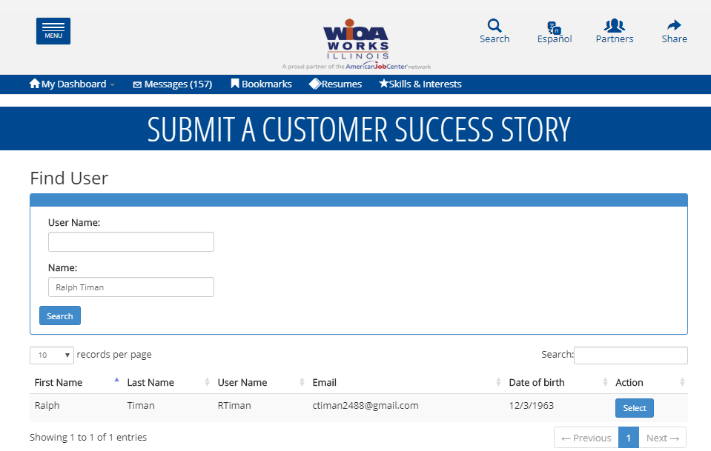
ILLINOIS WORKNET SUCCESS STORY: FINDING YOUR CUSTOMER
Step 7
A list of customers matching the information you entered will appear. Click Select next to the individual you would like to submit the story for.

Slide 22
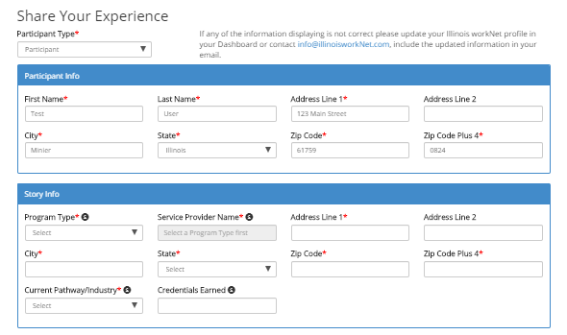
ILLINOIS WORKNET SUCCESS STORY: ADDING YOUR CUSTOMER’S STORY
Step 8
You will be directed to the Success Story Entry Page. The Participant Info will auto-populate. To auto-populate the story information you MUST first select the Program Type.

Slide 23
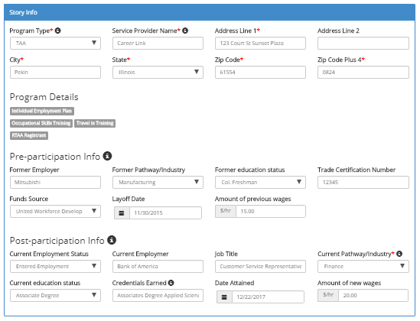
ILLINOIS WORKNET SUCCESS STORY: ADDING YOUR CUSTOMER’S STORY
Step 9
Review the auto-populated field to ensure the info is correct.
  If you find incorrect info, email info@illinoisowkrnet.com
Complete any blank fields. All required fields must be completed.

Slide 24
ILLINOIS WORKNET SUCCESS STORY: FORM FIELDS
Trade Adjustment Assistance & Dislocated Workers
Participant info
Pre-Participation info
*~First Name
*~Zip Plus 4
~Former employer
~Funding source
*~Last Name
*~Date of birth
~Former pathway/industry
~Layoff Date
*~Address
*~gender
~Former Education
~Amount of Previous wages
*~City
Submitter title
*~State
~Submitter phone number
~Trade certification number (TAA ONLY)
Post Participation info
*~Zip
~Submitter email
Story Info
~Current employment status
*Program type
~Current employer
Key
* = Required
~ = Auto-populate
Underline = Shows to Public
*~Service Provider Name
*~Address
~Job title
*~City
~Current pathway/industry
*~State
~Current education
*~Zip
*~Credential Earned/date attained
*~Zip Plus 4
*~Program Details
~Amount of New Wages

Slide 25
ILLINOIS WORKNET SUCCESS STORY: FORM FIELDS
WIOA Adult, WIOA Youth, Special Programs (i.e., EPIC & CYEP)
Participant info
Story Info
*~First Name
*~Program type
*~Last Name
*~Service Provider Name
Key
* = Required
~ = Auto-populate
Underline = Shows to Public
*~Address
*~Address
*~City
*~City
*~State
*~State
*~Zip
*~Zip
*~Zip Plus 4
*~Zip Plus 4
Submitter title
~Current pathway/industry
~Submitter phone number
*~Program Details
~Submitter email
*~Credential Earned/date attained

Slide 26
ILLINOIS WORKNET SUCCESS STORY: FORM FIELDS
Apprenticeship Plus, Incumbent Worker, NEG, Laid Off Workers
Participant info
Story Info
*~First Name
*Program type
*~Last Name
*Service Provider Name
Key
* = Required
~ = Auto-populate
Underline = Shows to Public
*~Address
*Address
*~City
*City
*~State
*State
*~Zip
*Zip
*~Zip Plus 4
*Zip Plus 4
Submitter title
Current pathway/industry
Submitter phone number
*Program Details
Submitter email
*Credential Earned/date attained

Slide 27
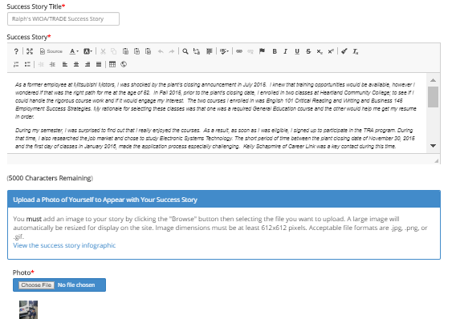
ILLINOIS WORKNET SUCCESS STORY: ADDING YOUR CUSTOMER’S STORY
Step 10
Give your customer’s story a Title
Add in the Body of your Customer’s Story
Upload a Picture of your Customer.

Slide 28
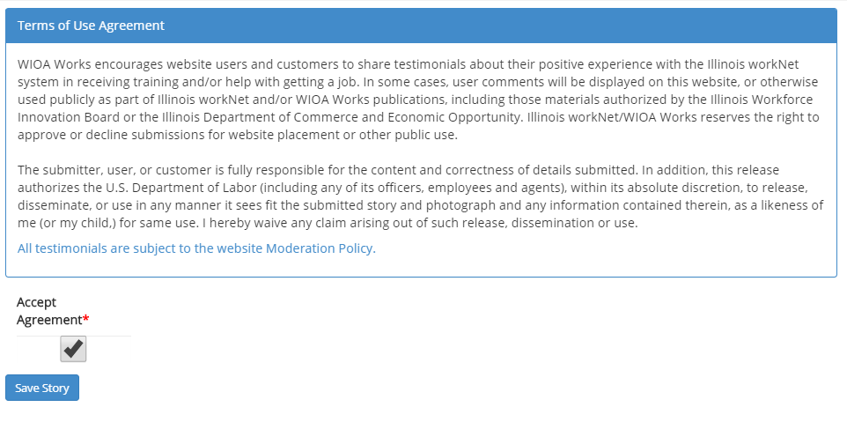
ILLINOIS WORKNET SUCCESS STORY: ADDING YOUR CUSTOMER’S STORY
Step 11
Agree to the Terms & Conditions
  Obtain a signed copy of your customer’s photo and story release and keep it in their file.
Click Save Story

Slide 29
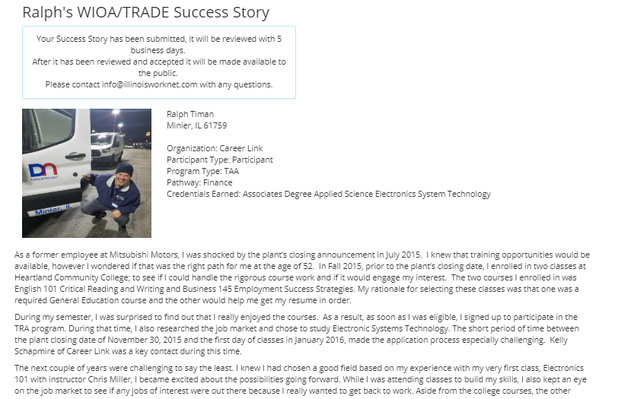
ILLINOIS WORKNET SUCCESS STORY: APPROVAL PROCESS
After Saving your customer success story you will directed to a preview of the story you submitted.
It will take up to 5 business days for your story to be reviewed and approved.
If there are questions you will be contacted via the submitter phone number or email you provided.

Slide 30

QUESTIONS?
THANKS FOR viewing!
Illinois workNet Success Stories
Where you can find and share success your workforce development success!
Contact us:
Follow us on:
www.illinoisworknet.com
facebook.com/Illinois.worknet
217-786-3010
@ILworkNet
info@illinoisworknet.com
Illinois workNet
The Illinois workNet Center System, an American Job Center, is an equal opportunity employer/program. Auxiliary aids and services are available upon request to individuals with disabilities. All voice telephone numbers may be reached by persons using TTY/TDD equipment by calling TTY (800) 526-0844 or 711. This workforce product was funded by a grant awarded by the U.S. Department of Labor’s Employment and Training Administration. For more information please refer to the footer at the bottom of www.illinoisworknet.com.

