Slide 1
Clarifying Sector Strategies for WIOA Regional Planning Sectoral Work vs. Sector Partnerships vs. Talent Pipeline Management
Presenters: Michael Baker, Manager, Planning Unit, DCEO
Kim Kuchenbrod, Business Engagement TPM Manager, NIU Consultant
Todd Lowery, Business Services, IDES
July 11, 2024
Notes:
Kelly- opening remarks
Our team will share how the Chicagoland Hospitality and Tourism Collaborative is employer-driven using these strategies to meet talent needs.

Slide 2
WHAT ARE SECTORAL ACTIVITIES?
Sectoral activities are workforce development efforts focused at an in-demand regional or statewide economic sector.
While these activities target businesses in demand industries, they are one-off efforts, working with a single business or small group of businesses convened for the purpose of the effort.
Do not rise to the level of Sector Strategies

Slide 3
WHAT ARE SECTOR STRATEGIES?
Sector Strategies are an employer-driven workforce development approach that directly aligns occupational skills training and other workforce development services with the needs of regional groups of similar businesses.
A group of like businesses, along with Local Workforce Boards, key training providers, Eco Dev, Secondary and Post-Secondary Education, community-based organizations, etc. form an ongoing Sector Partnership.

Slide 4
WHAT ARE SECTOR PARTNERSHIPS
Partnerships of companies, from the same industry and in a shared labor market region, along with education, workforce development, economic development, community organizations and other stakeholders that collectively focus on a set of priorities that matter to the health and competitiveness of their industry.
Work on regional business’ shared opportunities and pain points
Not just workforce issues

Slide 5
WHAT IS A TALENT PIPELINE MANAGEMENT (TPM) EMPLOYER-LED COLLABORATIVE?
Facilitated by a neutral convener
Employers determine the focus based on talent needs
Project critical job demands
Align and communicate job requirements with training providers
Identify new or improved industry-driven credentials.
Elevate known employability skills needed in the industry.
Utilize, enhance and improve work-based learning.
Analyze talent supply chains and resources
Build talent supply chains across all training providers in the region, community organizations, unions, local and state agencies
Develop resiliency planning and engage in continuous improvement to increase the employer ROI.
Coordinate regional business engagement efforts – business as a partner rather than only a customer.
Notes:
Industry sector partnerships accomplish this through the development and implementation of sector strategies.
Sector strategies do this by:
Bring business together with education and training providers to develop training that meets business needs and industry demands.
Increase the value of existing career and technical education at all levels.
Create or expand non-degree programs that area precisely aligned with industry requirements.
Build/rebuild programs around the industry credentials that industry employers trust and utilize.
Develop credentials that already have value for all industry employers across the region and beyond.
Identify the “soft” skills that businesses in the industry are looking for, and synthesize these into training.
Employ the work-based learning strategies (such as apprenticeships) that have the highest value to both employers and workers.

Slide 6
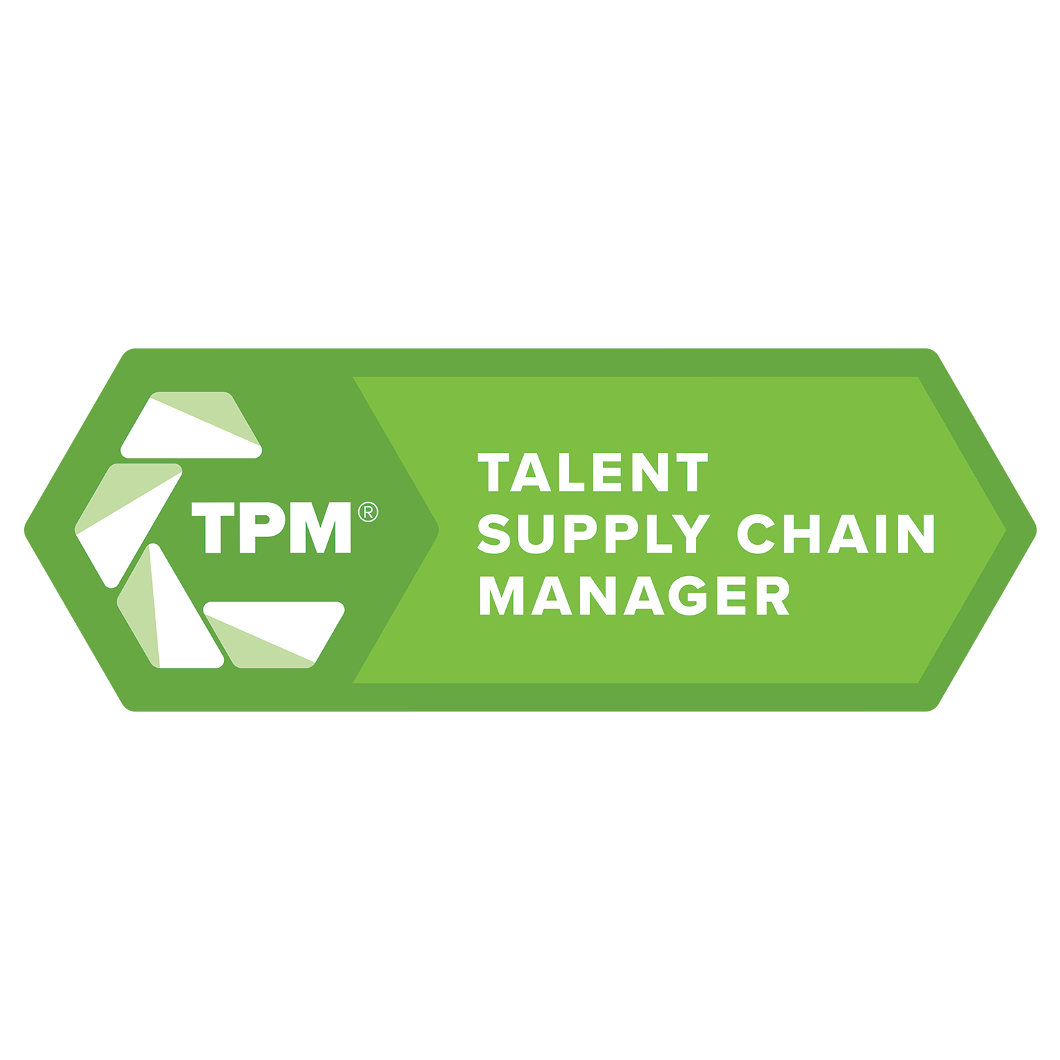
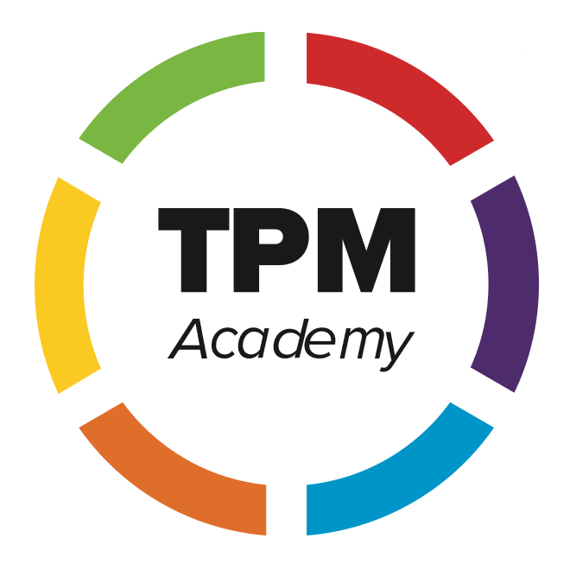
INDUSTRY SECTOR PARTNERSHIPS
THE ILLINOIS APPROACH
TALENT PIPELINE MANAGEMENT COLLABORATIVES
Train Title I and Title III Business Service Representatives and Apprenticeship Specialists on TPM strategies to serve as the neutral convener
Use industry best practices
Focus on employer-ROI
Authentically employer-led
Structured process for collective action and decision making
More empirical data on workforce demand provided by employer
Full spectrum of talent sourcing partners
Shared value, competitiveness, and accountability across all partners
Notes:
Illinois’ approach to industry sector partnerships is further defined by our preference for the Talent Pipeline Management approach, developed by the U.S. Chamber of Commerce.
It is characterized by these particular features:
Utilizes best practices of the industry targeted
Forthright about the need to prove value to employers
Leadership comes from business
Partners have a structured process to ensure responsiveness to employer needs
Data is developed at a level that can provide feedback and guidance to training activities
Designed to attract the full range of potential partners

Slide 7
INDUSTRY SECTOR PARTNERSHIPS MOVE FROM
TRANSACTIONAL TO TRANSFORMATIONAL ENGAGEMENT
Transactional
(The “Old Way”)
Transformational
(The “New Way”)
Fill job orders
Solve hiring, training, and pipeline challenges across occupations and skill levels
One-off job placement
Career pathways systems change
Workforce services loosely informed by employer needs through survey or one-off engagement
Education/training designed in partnership with employers
One-to-one relationship
One-to-many (industrial sector partnerships)
Notes:
Industry sector partnerships are designed to examine industry workforce needs holistically, and to solve them the same way.
Talent pipeline challenges are identified, and career pathways systems are modified to meet those challenges.
Employers take a direct part in developing education and training systems that will meet their workforce needs in the short term, but will also react and evolve to meet their workforce needs in the longer-term.

Slide 8
What Works Better
Scaling Up: Old School
Individual Companies
Business as Customers
Program or Institution Driven
Mysterious Unique Occurrence
Statewide Top Down/Too Local
Wishful Thinking
Workforce Only
Problem Driven
Target Populations First
Representation Oriented
Futile Search for Consensus
Organizations & Jurisdictions
Clusters of Companies
Business as Partners / Leaders
Industry Driven
Regional
Build on existing or emerging strengths
All Industry Competitiveness Issues
Opportunity Focused
Business Priorities First
Champion Led
Coalitions of the Willing
People & Relationships
Disciplined Repeatable Process
Content by Collaborative Economics

Slide 9
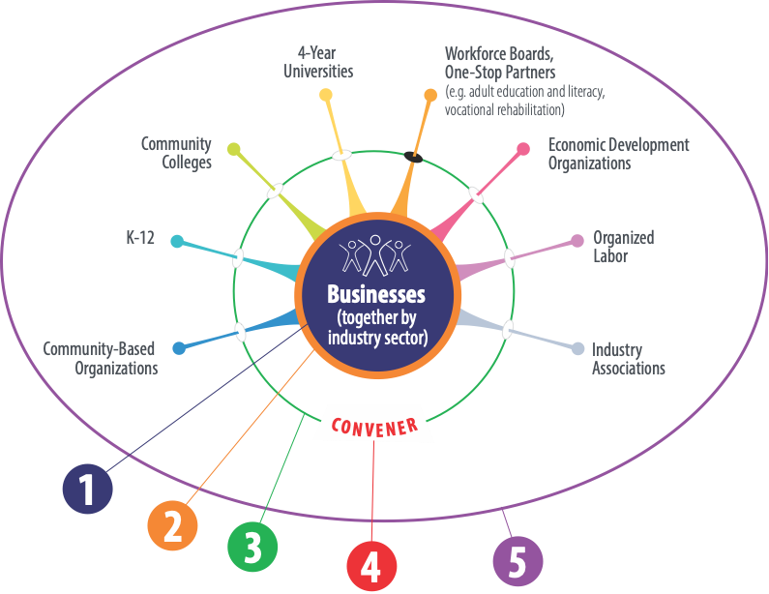
WHO ARE The Partners of an Industry Sector Partnership?
Partner roles in industry sector partnerships
1
Business at Center (Employer-led TPM Collaborative)
Industry as Partners
Aligned Community Partners
Qualified Convener
Regionally Focused
2
3
4
5
Notes:
Who are the partners in a regional industry sector partnership?
While the number of individual partners can vary widely, they are of three main types:
Business at the center, with industry associations and other allied groups as their direct partners in business involvement.
Community partners – Education (K-12, Community Colleges, Universities), Workforce Development (Workforce Boards, One-Stop Partners, Organized Labor), and Community Development (Economic Development, Community-Based Organizations) – align themselves to question, listen, and coordinate effective solutions for their business partners.
Equally important in the Convener, an individual or organization that doesn’t directly represent any of these partners, but is able to understand the industry and is trusted by all the partners to be fair and impartial in their charge to move the industry sector partnership forward.

Slide 10
1.C Talent Pipeline Management® Employer Collaboratives Examples
Manufacturing Collaborative
Manufacturing businesses across the region are actively engaged with the US Chamber of Commerce Foundation’s Talent Pipeline Management® initiative. The LWIA 23 Business Services Team has facilitated the Collaborative to Strategy Three of the TPM® six strategies.
Healthcare Collaborative
Healthcare employers across the region are actively engaged with the US Chamber of Commerce Foundation’s Talent Pipeline Management® initiative. The LWIA 23 Business Services Team has facilitated the Collaborative to Strategy Two of the TPM® six strategies.
IT Collaborative
IT employers across the region are actively engaged with the US Chamber of Commerce Foundation’s Talent Pipeline Management® initiative. The LWIA 23 Business Services Team has facilitated the Collaborative to Strategy One of the TPM® six strategies.
Hospitality Collaborative
Hospitality businesses across the region are actively engaged with the US Chamber of Commerce Foundation’s Talent Pipeline Management® initiative. The LWIA 23 Business Services Team has facilitated the Collaborative to Strategy Two of the TPM® six strategies.
At this stage, the workforce system is supporting the needs of the participating employers by facilitating dialogue, identifying common pain-points, and prioritizing pain-points in order to develop a solution-oriented plan.

Slide 11
1.C Talent Pipeline Management® Employer Collaboratives Examples
Funding for an individual company training program
Attending meetings to support an employer or sector initiative
Verbal support for a grantee focusing on a sector training needs
Participation in a career/job fair
Lack of aggregated data provided by employer talent needs
Information on association or community-based grant objectives and activities
Association grant activities related to sector support
Non-actionable activities not directly related to the needs of many
Misalignment with regional plan
Lack of collaborative leadership

Slide 12
KEY DISTINCTIONS RECAP
Sectoral Activities – Workforce efforts targeted at in-demand sectors
Sector Partnerships – Identifies all common challenges and opportunities
Talent Pipeline Management Collaborative – Focused on Talent Supply Chain (and related) issues
TPM is a type of sector strategy, but not all sector strategies are TPM.

Slide 13
SUMMARY – THE ASK
Review your regional plan Chapter 1 section related to sector partnerships and talent pipeline management to clearly define roles and focus area
Look for opportunities for the partnership to form a collaborative focus group
What role will you play
Review your regional plan to identify talent pipeline management collaboratives being led by your business service team/apprenticeship specialist.
Identify focus area
Current strategy level
Targeted talent needs
If you do not have active sector partnerships or talent pipeline management collaboratives
Describe your plans to assist in the development of a sector partnership or talent pipeline management collaborative
List sector focus
Will you need support or training

Slide 14
QUESTIONS/DISCUSSIONS
For further support contact:
Michael Baker, Manager, Planning Unit, DCEO Michael.Baker@Illinois.gov
Kim Kuchenbrod, Business Engagement TPM Manager, kmkuch1@ilstu.edu
NIU Consultant
Todd Lowery, Business Services, IDES Todd.Lowery@Illinois.gov

