Slide 1


Petition/Certification & Rapid Response
October 21, 2021

Slide 2
Petition/Certification
Dislocated workers must first be “certified” as trade-impacted workers by the U.S. Department of Labor’s Office of Trade Adjustment Assistance (DOL/OTAA) to receive any of the benefits that Trade provides.
The process of Trade certification begins with the filing of a petition asking that a group of workers be certified as Trade-impacted.

Slide 3
Petition/Certification (cont.)
A petition should be filed any time after worker separations or a threat of separations begins, but no later than one year after the earliest date on which workers lost their jobs with the employer.
A petition may be filed by any one of the following:
  A group of two or more workers from the same firm
  A certified or recognized union, or duly authorized representative of the group of workers
  The employer of the group of workers
  A State Workforce Official (Department of Commerce and Economic Opportunity (DCEO)/Illinois Department of Employment Security (IDES))
  One-stop center operators or one-stop partners (Workforce Innovation Opportunity Act (WIOA) Local Workforce Innovation Area (LWIA))

Slide 4
Petition/Certification (cont.)
To file a petition online, go to https://www.dol.gov/agencies/eta/tradeact
A copy of the petition must also be sent to Trade Merit Staff:
  Susan Boggs – susan.boggs@Illinois.gov
  Sheila Sloan – sheila.sloan@Illinois.gov
  Lori Graham – lori.graham@illinois.gov

Slide 5
Petition/Certification (cont.)
There are 6 sections on the petition:
  Section 1 Petitioner Information
  Section 2 Attestation of Information
  Section 3 Firm Employing the Group of Workers
  Section 4 Group of Workers
  Section 5 Trade Effects of Separations
  Section 6 Company Contact Information

Slide 6
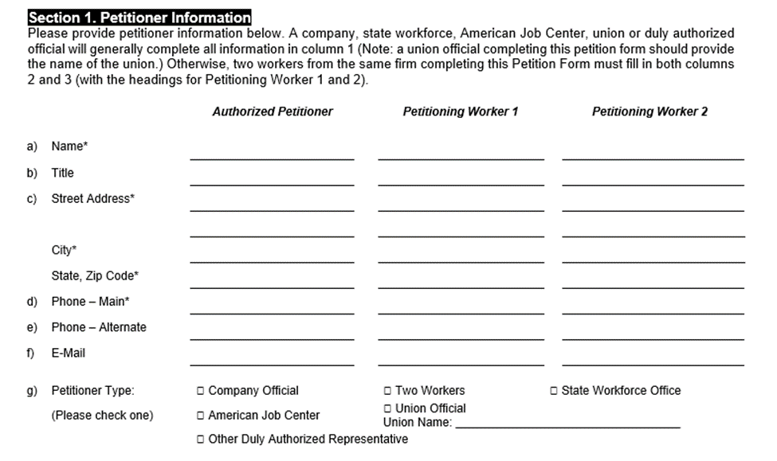
Section 1 – Petitioner Information

Slide 7
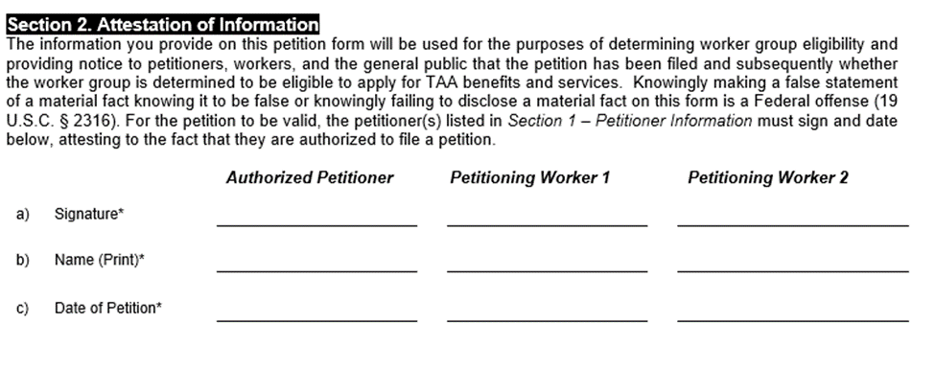
Section 2 – Attestation of Information

Slide 8
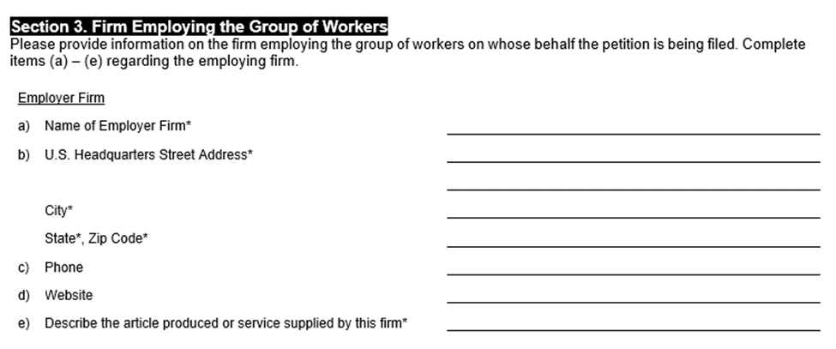
Section 3 – Firm Employing the Group of Workers

Slide 9
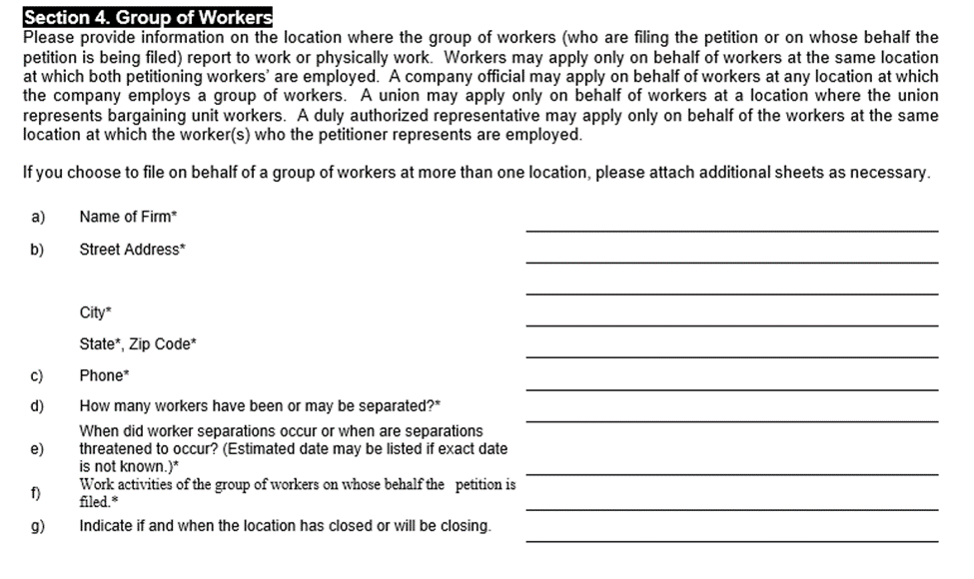
Section 4 – Group of Workers

Slide 10
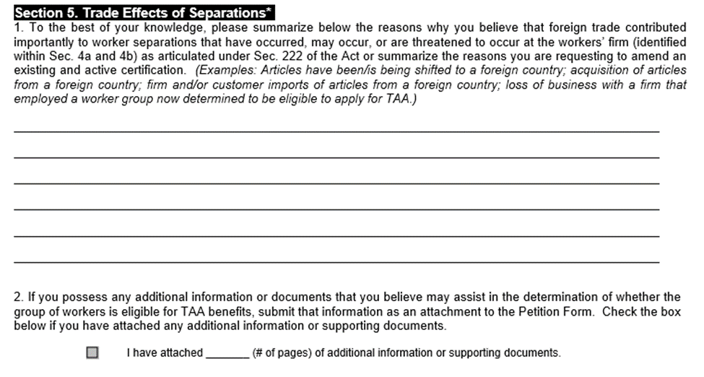
Section 5 – Trade Effects of Separations

Slide 11
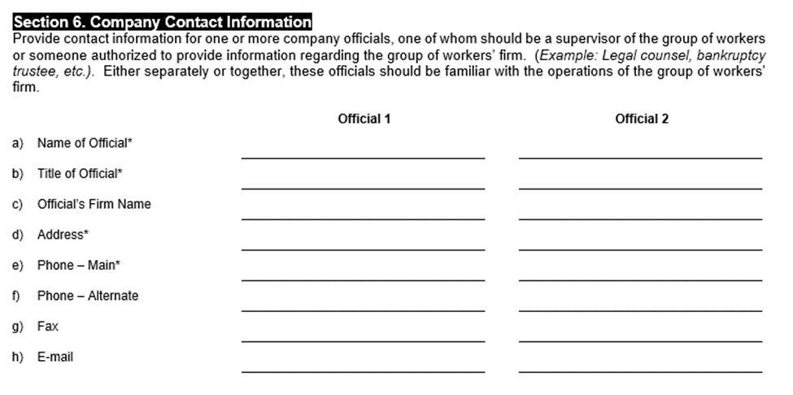
Section 6 – Company Contact Information

Slide 12
Petition Investigation
Once a petition has been filed, the OTAA will initiate an investigation to determine whether the group of workers covered by the petition meets the group eligibility requirements of the Trade Act.
20 CFR 618.225 contains a list of the criteria for certification of a group of workers.

Slide 13
Petition Determination
Affirmative determination – the investigation establishes that a group of workers meets the eligibility criteria. The Certifying Officer will issue a certification of worker group eligibility to apply for Trade Program benefits and services.
Negative determination or Denial – the investigation establishes that the group of workers does not meet the criteria for eligibility. The Certifying Officer will issue a denial. Workers denied certification are still dislocated workers.

Slide 14
Petition Determination (cont.)
Amended determination – an investigation has determined that an amendment is appropriate for reasons such as:
  Identifying ownership changes affecting the applicable firm
  Correcting technical errors
  Clarifying the identification of the worker group
  Other reasons

Slide 15
Petition Determination (cont.)
Termination of Certification
  Initiated when there is reason to believe that the total or partial separations or threat of separation from a firm, or appropriate subdivision, are no longer attributable to the criteria for certification.
  Notice published
  Opportunity to comment
  Investigation of termination
  Determination issued – may cover the entire worker group specified in the certification or a portion of that group.
  Only applies to total or partial separations occurring after the termination date specified in the determination notice and must only take effect after the determination becomes final.

Slide 16
Petition Determination (cont.)
Reconsideration of termination of an investigation, denial, or termination or partial termination of certification
  Must submit an application for reconsideration no later than 30 calendar days after the notice of the termination of the investigation, negative determination, or termination or partial termination of a certification has been published in the Federal Register.
  OTAA will conduct an investigation and issue a final determination affirming, reversing, or modifying the termination of the investigation, negative determination, or termination or partial termination of a certification.

Slide 17
Petition Determination (cont.)
The Certifying Officer issues a determination identifying the article(s) produced or service(s) provided and describing the worker group covered by the certification or denial and stating the reasons for the determination.
DOL provides a copy of the determination to the petitioner(s) and to the State(s) covered by the determination.

Slide 18
Petition Determination (cont.)
Once a determination has been issued, DCEO will notify via email the LWIA affected, the State Rapid Response staff, and IDES. This email:
  Notifies IDES staff that an affected worker list needs to be requested from the employer.
  Notifies Rapid Response staff and the LWIAs that Trade specific Rapid Response needs to be provided to the affected workers.
  Notifies Rapid Response staff that the Illinois Employer Business System (IEBS) needs to be updated.

Slide 19
Petition Determination (cont.)
IDES
  Sends out notice to IDES regional staff
  Obtains a list of affected employees from company and sends to DCEO
  Notifies other states if workers reside outside of Illinois
  Sends individual outreach letters to every affected worker
DCEO
  Provides list of affected employees to LWIAs
  Rapid Response Staff coordinate and conduct Trade Rapid Response Workshops for affected workers

Slide 20
Primary Parts of a Determination
The primary parts of the determination are:
  Petition Number (Could include multiple Petition Numbers and Suffix)
  Determination (Certified; denied; Terminated or Withdrawn)
  Worker Group Location (Defines the physical location of the affected workers)
  Petition Date (Date Petition was officially received by OTAA)
  Product (Defines what the workers produced)
  Worker Group affected (including on-site leased workers) (describes who is eligible to apply for benefits)
  Impact Date (The earliest date a layoff can occur to be covered for benefits)
  Certification/Decision Date (Date the Petition was approved)
  Expiration Date (The latest date a layoff can occur to be covered for benefits)
  Certifying Officer (The OTAA Officer that made the petition determination)

Slide 21
Primary Parts of a Determination (cont.)
Petition Number and Determination
UNITED STATES DEPARTMENT OF LABOR
Employment and Training Administration
TA-W- 96,751
FLEXITECH, INC.
BLOOMINGTON, ILLINOIS
Certification Regarding Eligibility
To Apply for Trade Adjustment Assistance for Workers

Slide 22
Primary Parts of a Determination (cont.)
Petition Date , Worker Group Location, Product, and Worker Group affected
In accordance with Section 223 of the Trade Act of 1974, as amended ("the Act"), 19 U.S.C. § 2273, the Department of Labor ("Department") herein presents the results of an investigation regarding certification of eligibility to apply for Trade Adjustment Assistance ("TAA") for workers.
The investigation was initiated in response to a TAA petition dated February 25, 2021 and filed on February 25, 2021 by a Company Official, on behalf of workers and former workers of Flexitech, Inc., Bloomington, Illinois (hereafter referred to as the "worker group"). In accordance with 20 C.F.R. 618.110 a worker group is defined as:, "inclusive of teleworkers and staffed workers."
The worker group is engaged in activities related to the production of automotive brake hoses and are not separately identifiable by product.

Slide 23
Primary Parts of a Determination (cont.)
Impact Date, Certification/Decision Date, Expiration Date, Certifying Officer
Conclusion
After careful review of the facts obtained in the investigation, I determine that workers of Flexitech, Inc., Bloomington, Illinois, who are engaged in activities related to the production of automotive brake hoses meet the worker group certification criteria under Section 222(a) of the Act, 19 U.S.C. § 2272(a). In accordance with Section 223 of the Act, 19 U.S.C. § 2273, I make the following certification: "All workers of Flexitech, Inc., Bloomington, Illinois, who became totally or partially separated from employment on or after February 25, 2020 through two years from the date of certification, and all workers in the group threatened with total or partial separation from employment on the date of certification through two years from the date of certification, are eligible to apply for adjustment assistance under Chapter 2 of Title II of the Trade Act of 1974, as amended."
Signed in Washington, D.C. this 9th day of April, 2021.
/s/ Del-Min Amy Chen
DEL-MIN AMY CHEN
Certifying Officer, Office of Trade Adjustment Assistance

Slide 24
Certification Timeline
Understanding the Certification Timeline
  Petitions generally cover all members of the specific worker group laid off during the three-year period beginning one year before the petition filing and ending two years after the date of the certification.
  Impact Date – Earliest date layoffs are covered by the certification
  Certification Date – Date certified by DOL
  Expiration Date – Generally two years after date of certification. There are exceptions to the two year-period.

Slide 25
Certification Timeline (cont.)
Below is an example of the three-year eligibility timeline of the above petition:

Slide 26
Certification Timeline (cont.)
A career planner must know the timeline dates (Impact Date, Certification Date, and Expiration Date) to determine if a participant is part of a worker group, and to determine when a participant must meet the enrollment deadline by either being Enrolled In Training or be Waived from the Training Requirement.
The enrollment deadline is either the later of the last day of the 26th week (8th week for 2021R) after the week of issuance of the certification of eligibility covering the worker, or the last day of the 26th week (16th week for 2021R) after the worker’s most recent total qualifying separation. (26/26 deadline - Petitions up to 97,999); (8/16 deadline – Petitions 98,000+)

Slide 27
Rapid Response (cont.)
20 CFR 685.300 outlines the requirements for Rapid Response under WIOA. The specific Rapid Response Activities for WIOA are described in 20 CFR 682.300-682.370.
WIOA requires Rapid Response activity in areas affected by disasters, mass layoffs, plant closings or other events.

Slide 28
Rapid Response (cont.)
Services that may be carried out as part of Rapid Response Activity include:
  Establishment of contact with the employer and employee representatives by the Rapid Response team.
  Provision of information and access to available employment and training activities.
  Assistance in establishing a Labor Management Committee (LMC), if desired by labor and management.
  Provision of emergency assistance adapted to the particular closing, layoff, relocation or disaster.

Slide 29
Rapid Response (cont.)
  Provision of assistance to the local community in developing a coordinated response and in obtaining State economic development assistance.
  If applicable, filing of an online Trade petition on behalf of the affected workers.
  Federal WARN Act Requirements
    Requires employers to provide notice (or pay) of sixty (60) days in advance of covered plant closings and mass layoffs
    Notice must be provided in writing, to the affected workers or their representatives (i.e., a labor union), the state WARN processing Unit and the appropriate unit of local government.
    Employers with one hundred (100) or more full-time employees are required to comply with these requirements.
    All full-time hourly and salaried workers are covered.

Slide 30
Rapid Response (cont.)
Illinois WARN Act Requirements
  Same as Federal except:
    Applies to employers with seventy-five (75) or more full-time workers.
    Covers all full-time and salaried employees, except those having worked less than six (6) months in the past year.

Slide 31
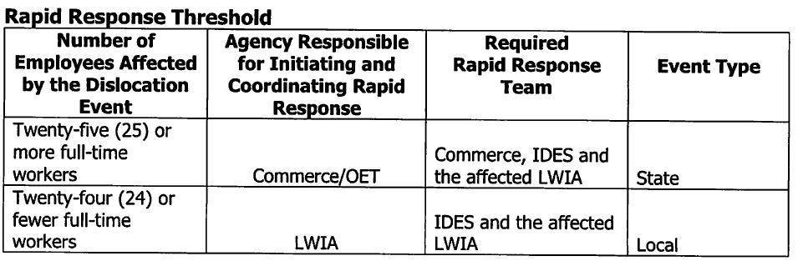
Rapid Response (cont.)
Rapid Response efforts are initiated and coordinated by the state or local areas based on these thresholds:

Slide 32
Rapid Response (cont.)
Rapid Response Procedures
  DCEO Workforce Development Specialist (WDS) will initiate and coordinate all phases of Rapid Response for permanent layoffs, closing, and relocations affecting twenty-five (25) or more full-time workers. These events will be considered state-level events.
  LWIAs will initiate and coordinate all phases of Rapid Response for permanent layoffs, closings, and relocations affecting twenty-four (24) or fewer full-time workers. These events will be considered local events.
  If employers voluntarily issue a WARN notice, the initiation and coordination of a Rapid Response event will abide by the same threshold.
  The same threshold also applies to all Trade-impacted dislocation events.

Slide 33
Rapid Response (cont.)
The Rapid Response team for state-level events will be led by the WDS.
Mandatory partners include:
  IDES
  Department of Commerce
  LWIA
IDES staff from Employment Security, Unemployment Insurance and Trade, as appropriate, participate in Rapid Response activities.

Slide 34
Rapid Response (cont.)
Sequential Phases of Rapid Response
  Layoff Notice Processing
  Initial Meeting
  Rapid Response Outreach Meetings
  Management of Services
Specific procedures for each phase are outlined in the Rapid Response Procedures Manual located on the ePolicy portal under Chapter 9. https://apps.illinoisworknet.com/WIOAPolicy/Policy/Home

Slide 35
Rapid Response
Once the Trade petition is certified, specific Trade rapid response services are required to be provided to trade-affected workers.
20 CFR 618.816 outlines the States responsibilities for provision of Rapid Response services to trade affected workers
  Paragraph (b) requires States to ensure that rapid response assistance and appropriate career services are made available to members of a group of workers for whom a petition has been filed.
  Paragraph (e)(5) states that upon receipt of a copy of a certification issued by DOL, the State must perform outreach to, intake of, and orientation for trade-affected workers covered by the certification with respect to assistance and benefits available.

Slide 36
Rapid Response (cont.)
  Paragraph (f) requires that States:
    (1) Advise each trade-affected worker, as soon as practicable after the worker is separated from adversely affected employment, or, after a certification is issued, or upon notice of the worker’s threatened status, of the benefits and services available, including the qualifying requirements, procedures, and deadlines for applying for such benefits and services.
    (2) Perform an intake interview for each trade-affected worker (unless the worker declines the interview) as soon as practicable after the worker is separated from adversely affected employment, after a certification is issued, or upon notice of the worker’s threatened status. The interview must be scheduled in time for the worker to meet the training enrollment deadline. During the interview, the State must provide information about all of the benefits available.

Slide 37
Rapid Response (cont.)
Trade Rapid Response Requirements in 20 CFR 618.816 handled by IDES:
  Paragraph (e)(2) requires: Upon certification the State must provide a written notice through the mail, of the benefits available to each worker known to be covered by the certification when the worker becomes partially or totally separated or as soon as possible after the certification is issued if the worker is already partially or totally separated from adversely affected employment.
  Paragraph (e)(3) requires the State to obtain the names and addresses of all workers who were partially or total separated from adversely affected employment.
  Paragraph (e)(4) requires the State to publish a notice of the certification in a newspaper and other modern methods of communication.

Slide 38
Rapid Response (cont.)
Rapid Response events for trade affected workers are conducted the same as Rapid Response events for other layoffs and closings except, the following activities will be done at the Trade Rapid Response event:
  IDES staff will present information to the trade affected workers on the Trade Readjustment Allowance, ATAA and RTAA program benefits.
  The Rapid Response Coordinator of the event will read in its entirety the Benefit Rights and Obligations (BRO) (Form #001) to the trade affected workers.
    The BRO will be signed by the participant at the event and a copy of the signed form will be given to the worker.
  For 2021R trade affected workers, the Form #004 2021R Trade Bona Fide Application will also be completed by the participant and career planner at the Trade Rapid Response event.
  Initial testing and/or enrollment meetings between the trade affected worker and a career planner should be set up at this event to ensure enrollment deadlines are met.

Slide 39
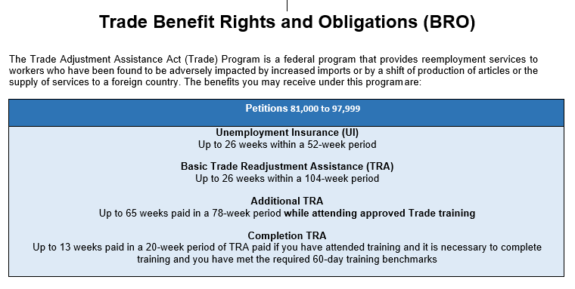
Benefits Rights and Obligations (BRO)
BRO for Certifications 81,000 to 97,999. See Illinois workNet for applicable BRO for participant being served.

Slide 40
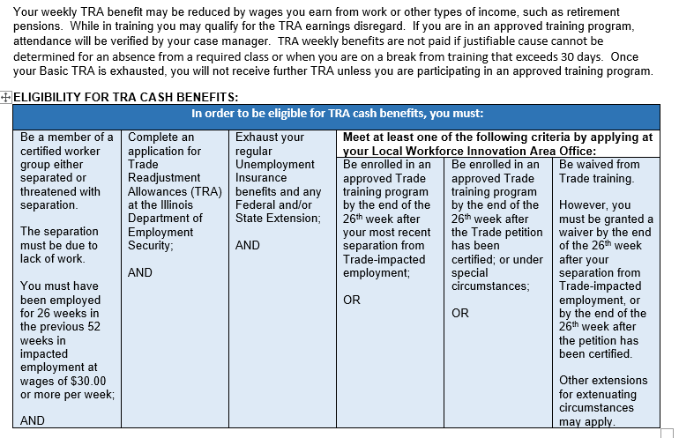
BRO (cont.)

Slide 41
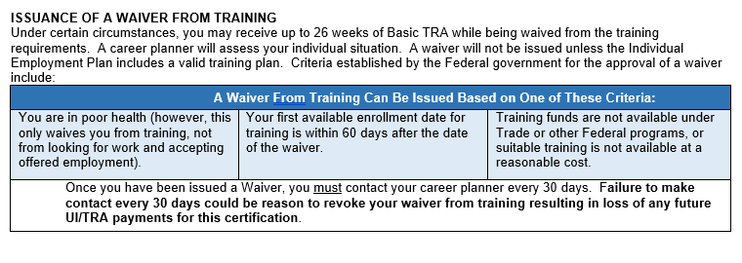
BRO (cont.)

Slide 42
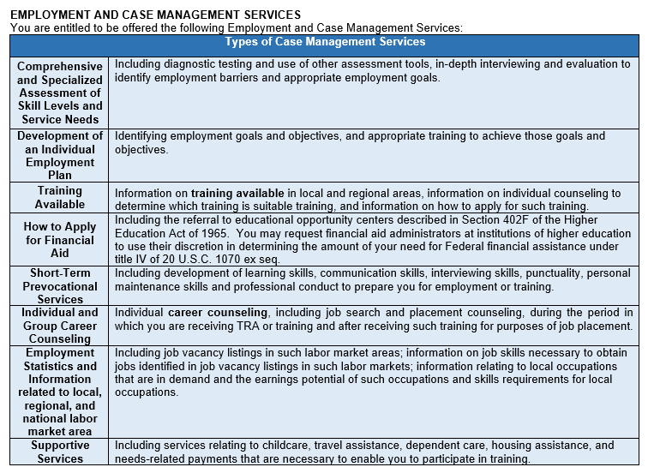
BRO (cont.)

Slide 43
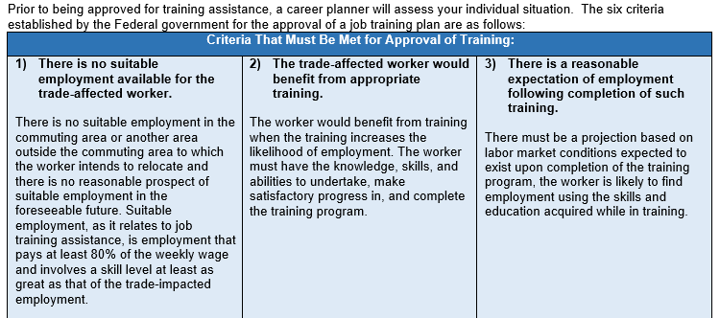
BRO (cont.)

Slide 44
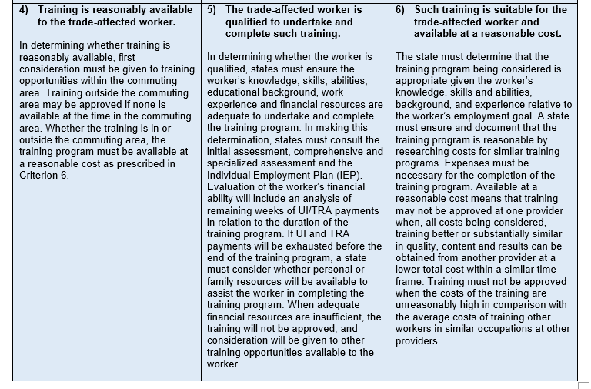
BRO (cont.)

Slide 45
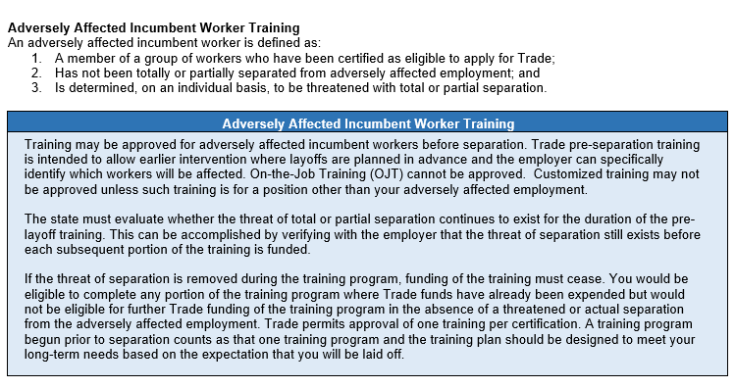
BRO (cont.)

Slide 46
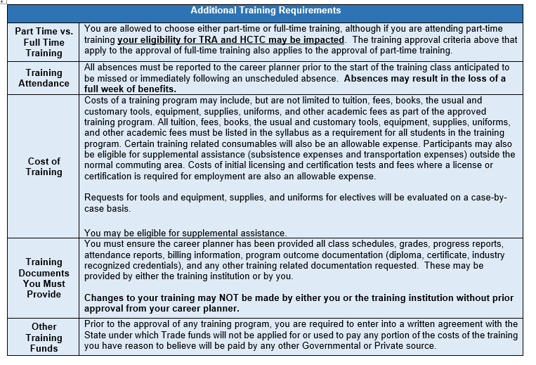
BRO (cont.)

Slide 47
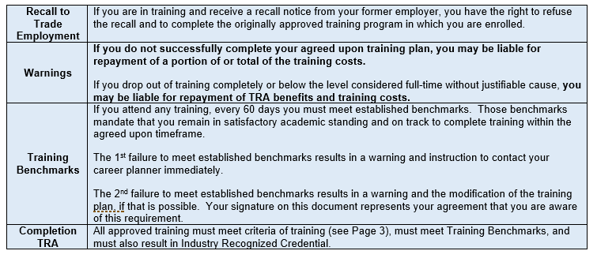
BRO (cont.)

Slide 48
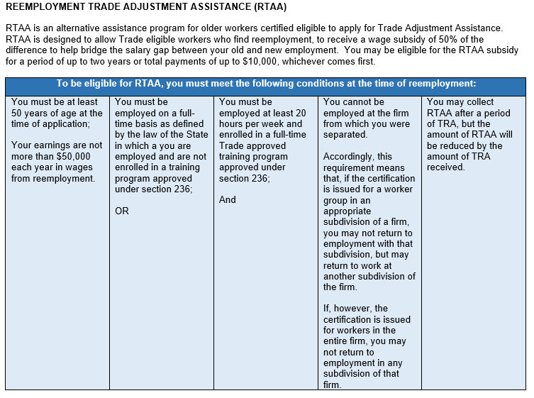
BRO (cont.)

Slide 49
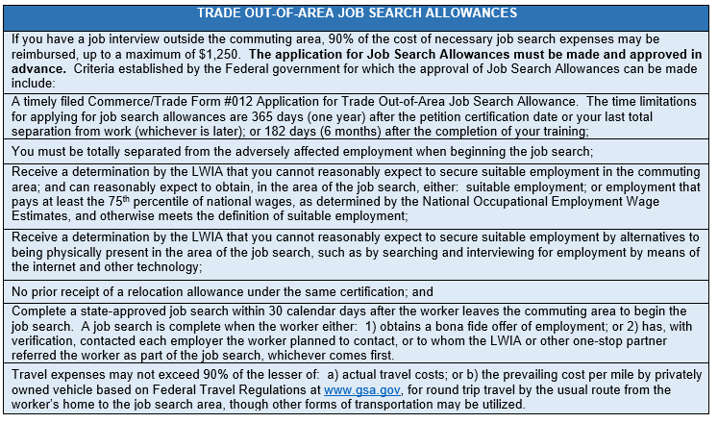
BRO (cont.)

Slide 50
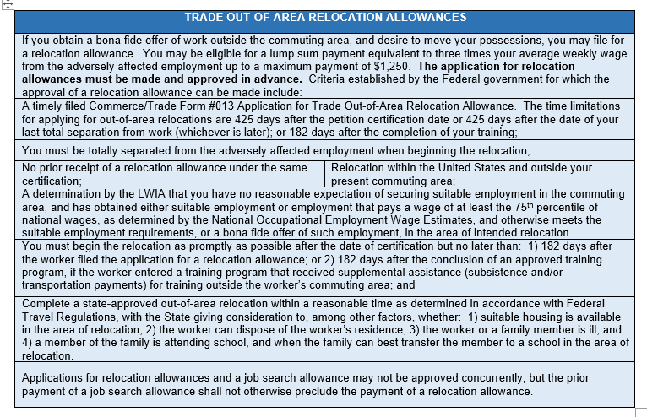
BRO (cont.)

Slide 51
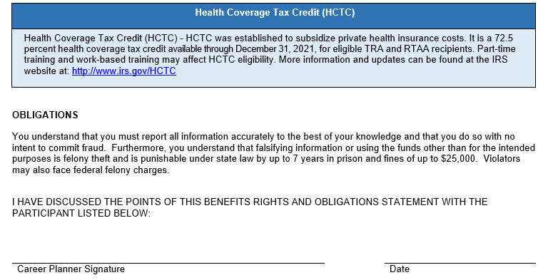
BRO (cont.)

Slide 52
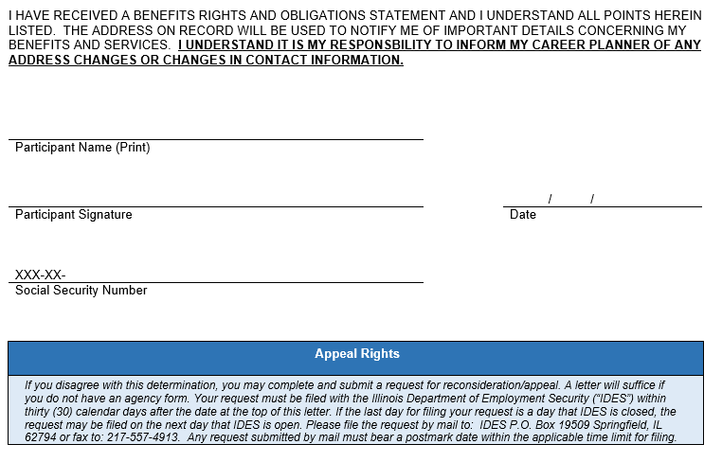
BRO (cont.)

Slide 53
BRO 2021R
The BRO for 2021R affected workers differs in some of the services and benefits. The RTAA is replaced with ATAA and the deadlines for enrollment are 8/16 instead of 26/26.
A copy of the 2021R BRO and all Trade forms can be found at the following on Illinois workNet at the following:
  https://www.illinoisworknet.com/tradeforms

Slide 54
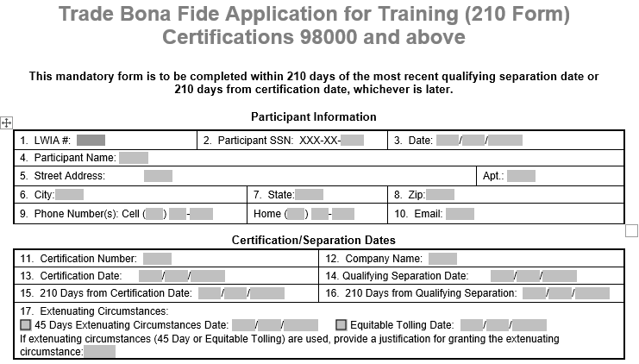
Form #004 2021R Bona Fide Application for Trade Training

Slide 55
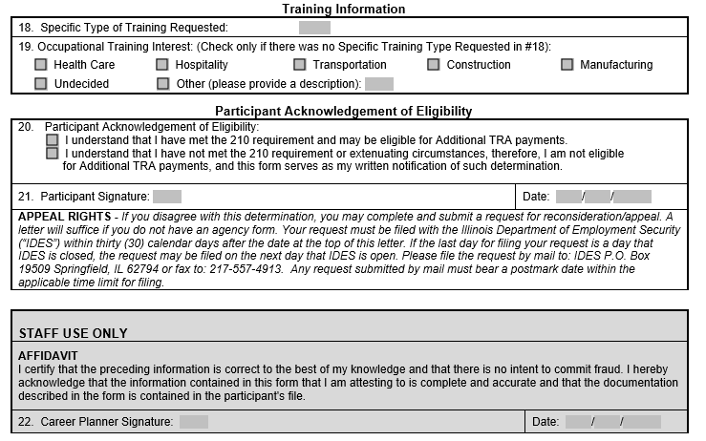
Form #004 (cont.)

Slide 56
DCEO Trade Contacts
Susan Boggs
TAA Coordinator
susan.boggs@illinois.gov
Sheila Sloan
Quality Assurance
sheila.sloan@illinois.gov
217-685-2513
Crystal Bigelow
Trade Grants
crystal.Bigelow@illinois.gov
Lori Graham
Manpower Planner
lori.graham@illinois.gov
309-830-8458

Slide 57
IDES Trade Unit Contacts
John Ferry
Special Programs Manager
john.ferry@illinois.gov
Erik Hack
ATAA/RTAA Coordinator
erik.hack@illinois.gov
Amy Saumur
TRA & UI Claims
amy.saumur@illinois.gov
Angela Mosley
Petition Lists, TRA & UI Claims
angela.mosley@illinois.gov
TRADE UNIT PHONE NUMBER:
217-524-7826

Slide 58
Upcoming Training
  October 28 – Eligibility, Enrollment, Agent/Liable, & 2021R Program Differences
  November 4 – Waivers & Completion of Waiver Form
  November 18 – Training (including completion of Form #006 Verification of Trade Training Enrollment, Form #005 Eligibility Determination of Travel-Subsistence Assistance, and Form #006d/e Program Tracking Form)
  December 2 – Attendance, Benchmarks, Breaks in Training (including completion of the Form #006a Bi-Weekly Verification of Training Attendance)
  December 9 – Alternative/Reemployment Trade Adjustment Assistance (A/RTAA)
  December 16 – Credential & Measurable Skill Gains, Exiting Participants
  January 6 – TAPR/GRS (this is geared more towards the fiscal staff responsible for entries in GRS and uploading of the quarterly TAPR costs in IWDS)
  January 13 – Appeals, Fraud, Overpayments & Monitoring
  Additional training if needed

Slide 59

Questions

