Slide 1


Navigating Difficult Conversations in Workforce Settings: Building Confidence and Connection
July 16, 2025
Notes:
1

Slide 2

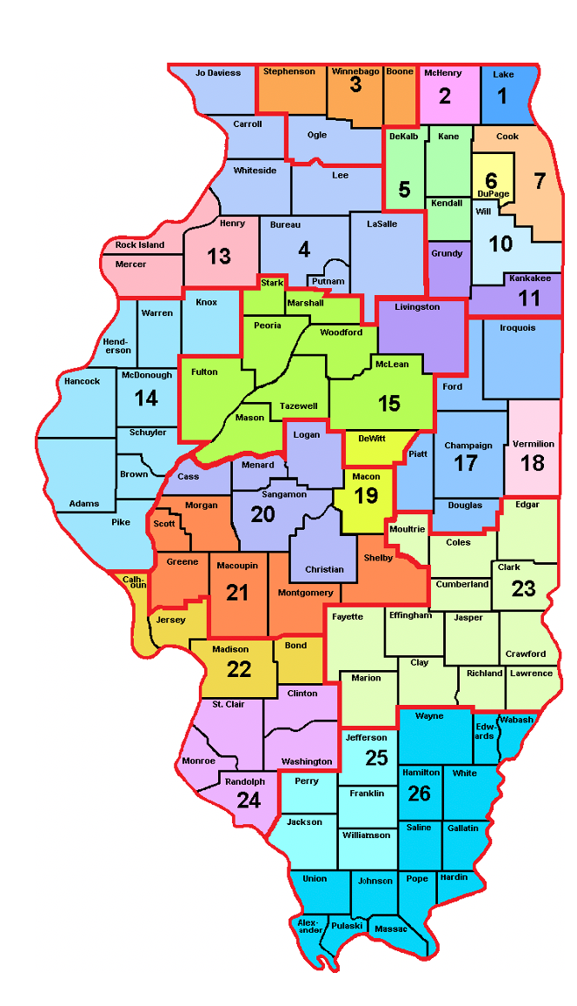
Where is Your Local Area?

Slide 3







































Title I
Job Corps
Adult Ed
Second Chance
Wagner Peyser
Which partner do you best represent?
Youth Build
Voc Rehab
Chief Elected Official
SCSEP
One stop partners
CTE
Board Member
Migrant
Farmworker s
TANF
Business
HUD
TAA
CSBG
UI
Veterans

Slide 4
Please share in the chat:
  Name, Company, Title, Location, and one reason why you’re attending today

Slide 5
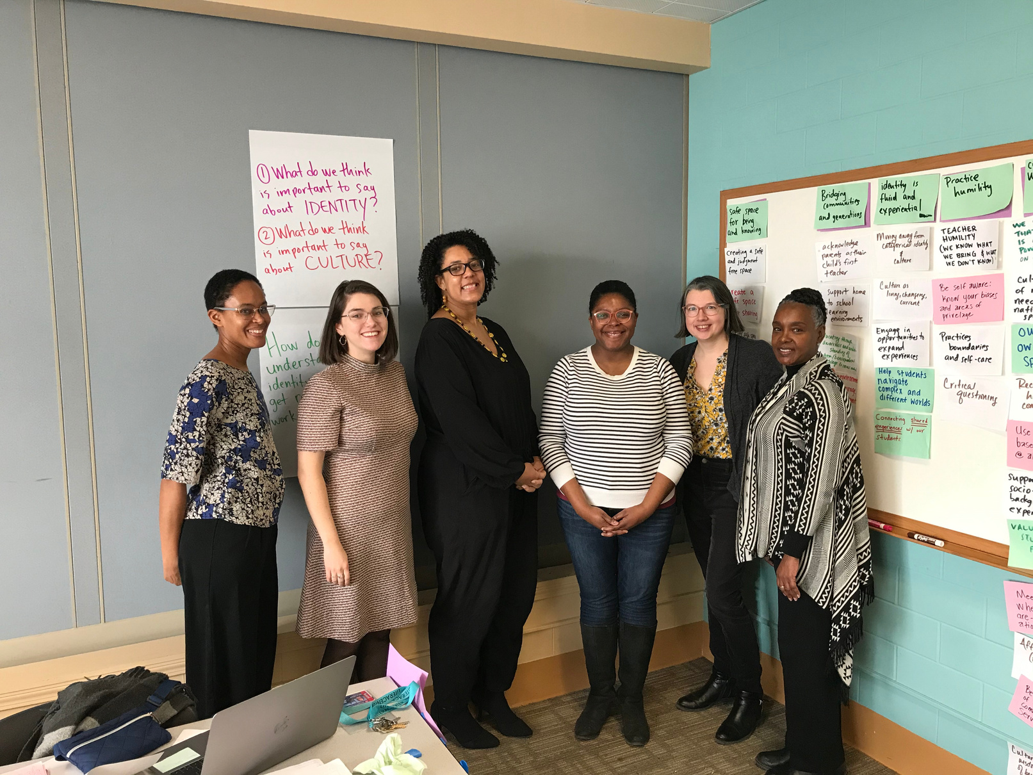
Yolaine Jean
  Title II Consultant, Adult Education and Workforce
  Adult Ed Instructor (ABE/GED), Program Management, Workforce Education Coordinator, and Leadership Development Facilitator
  Group Facilitation, Focused Conversations, Strategic Planning, Communities of Practice, and building Bridge and ICAPS programs
Megan Wells
  Title II Consultant, Adult Education and Workforce
  Adult Ed Instructor (ABE/GED, ESL, and Bridge), Program Manager, Volunteer Literacy Coordinator
  Participatory Facilitation, Consensus, Action Planning, Strategic Planning, and Learning Design

Slide 6
Learning Outcomes
  Implement practical frameworks to navigate difficult conversations in workforce settings
  Understanding the value of community agreements and setting clear expectations to foster inclusive environments
  Demonstrate self-awareness
  Prepare for conversations to increase confidence and connection while addressing challenging topics

Slide 7
Goals of the Workshop
  Rational Aim
    Understand and reflect on a few strategies to navigate difficult conversations
  Experiential Aim
    To build confidence and feel empowered to constructively engage in conversations around challenging topics in workplace settings

Slide 8

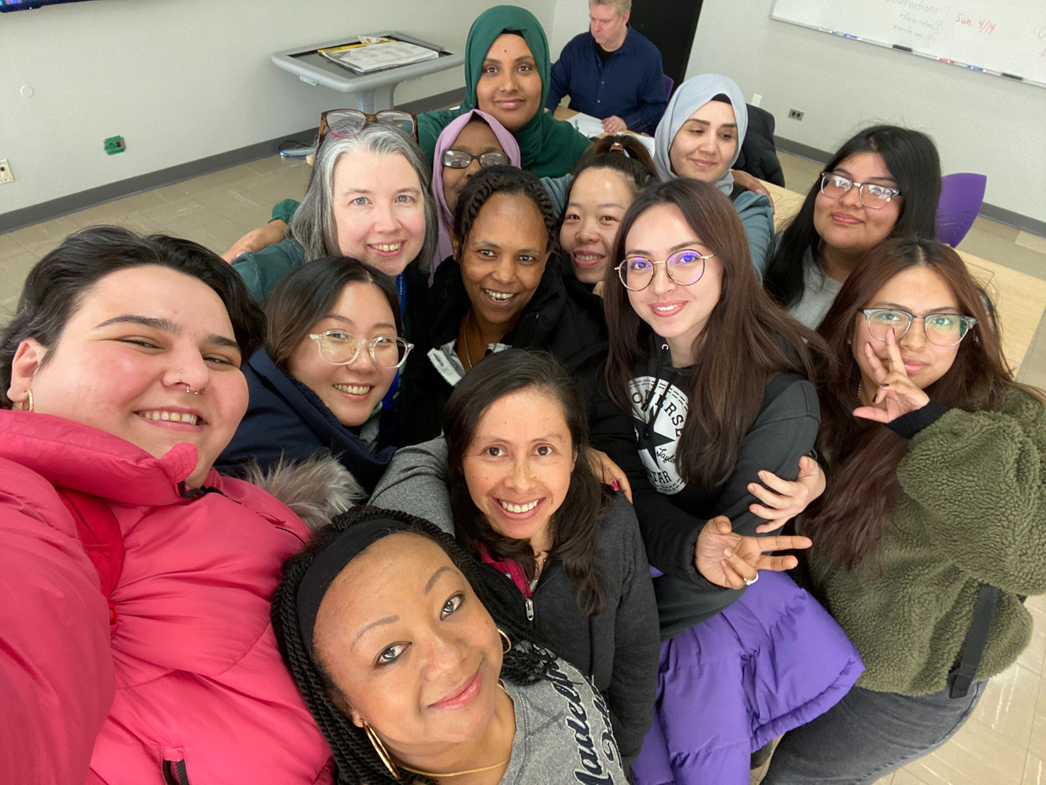
Community Agreements
Create an intentional meeting space by setting up intentional meeting norms
“What do we need to actively participate?”

Slide 9

Effective Community Agreements
  Meaningful dialogue
  Trust building
  Participatory decision-making
  Equitable engagement
  Shared accountability

Slide 10
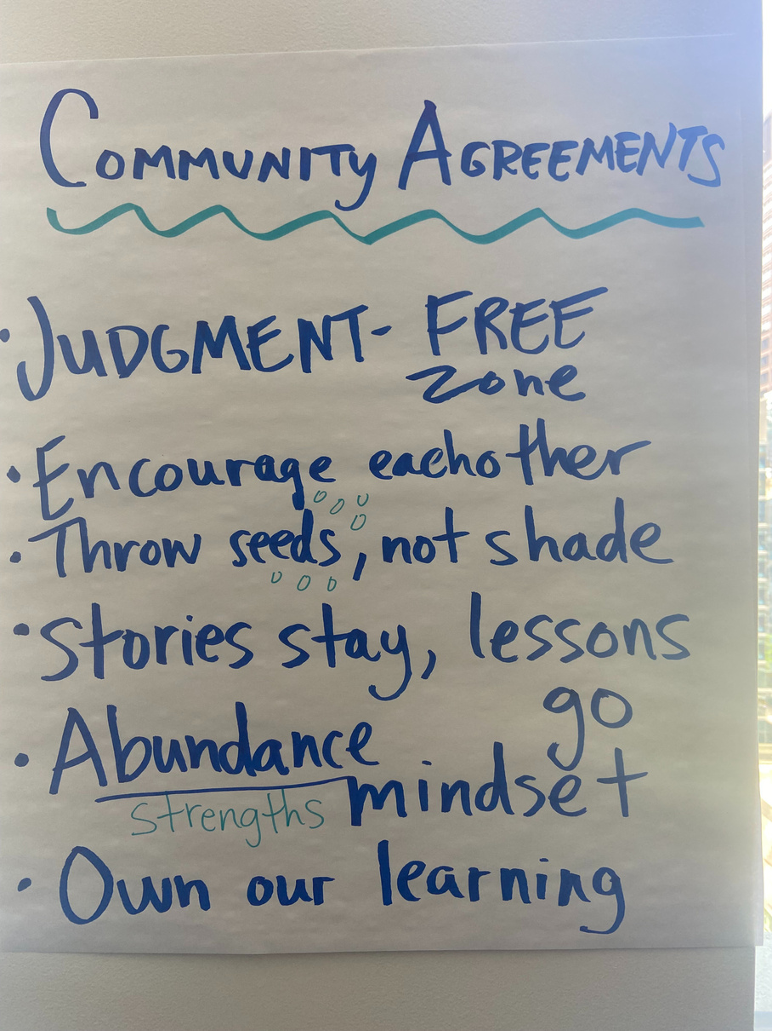
Sample Community Agreements
  Make “I” statements
  Make space, take space
  Intent vs. Impact
  Practice active listening
  We are all learners
  Honor confidentiality
  Accommodate access needs
  Take care of yourself
  What else? Please share in the chat

Slide 11
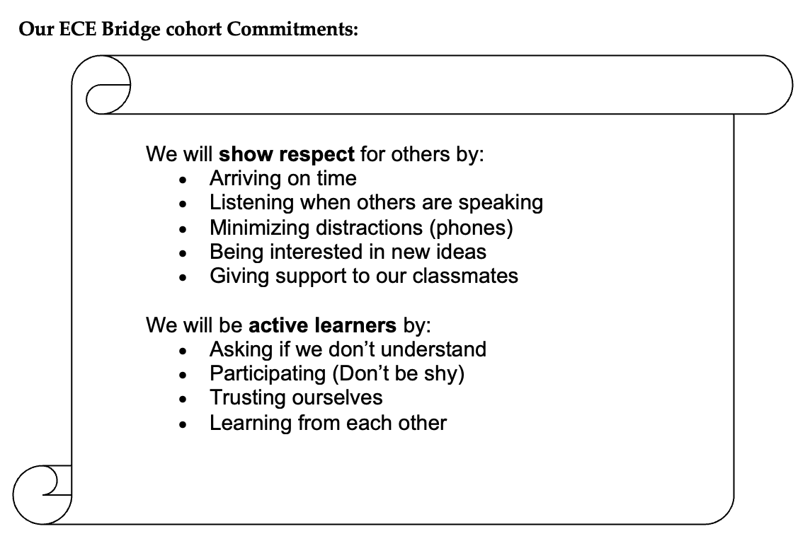

Slide 12
Please share in the chat:
What is one group agreement that you might suggest for your next team conversation?

Slide 13




Self-Awareness
SYSTEMS
TEAM
INTERPERSONAL
PERSONAL

Slide 14

Aims
Establish shared expectations
What do we, as a group, hope to achieve with this conversation?
Technology of Participation ToP Methods, Institute of Cultural Affairs

Slide 15





Preparing a Focused Conversation
OBJECTIVE
REFLECTIVE
INTERPRETIVE
INTERPRETIVE
DECISIONAL
Facts
React
Explore Meaning
Explore Meaning
Deciding
Technology of Participation ToP Methods, Institute of Cultural Affairs

Slide 16
Objective
OBJECTIVE
Technology of Participation ToP Methods, Institute of Cultural Affairs

Slide 17
Reflective
REFLECTIVE
Technology of Participation ToP Methods, Institute of Cultural Affairs

Slide 18

Interpretive
INTERPRETIVE
Technology of Participation ToP Methods, Institute of Cultural Affairs

Slide 19

Decisional
DECISIONAL
Technology of Participation ToP Methods, Institute of Cultural Affairs

Slide 20
Preparing a Focused Conversation
OBJECTIVE
REFLECTIVE
INTERPRETIVE
INTERPRETIVE
DECISIONAL
Facts
React
Explore Meaning
Explore Meaning
Deciding
Technology of Participation ToP Methods, Institute of Cultural Affairs

Slide 21

Scenarios
Let’s practice using these concepts using the following scenarios

Slide 22

Pick a Scenario
On pages 3 and 4 of the Workforce Wednesday 2025 Fillable Workbook choose one of the provided scenarios:
    Missed Deadlines and Accountability (Red)
    Constructive Feedback on Team Dynamics (Orange)
    Resource Allocation Conflicts (Blue)
    Managing Client Expectations When Resources are Limited (Silver)
    Addressing Client Complaints or Dissatisfaction with Program Services (White)
Consider your role (coordinator, manager, director, or support staff) in the scenarios. Using the scenario Key Fact Points and planning questions on pages 5 and 6, craft an approach using the ORID method.

Slide 23

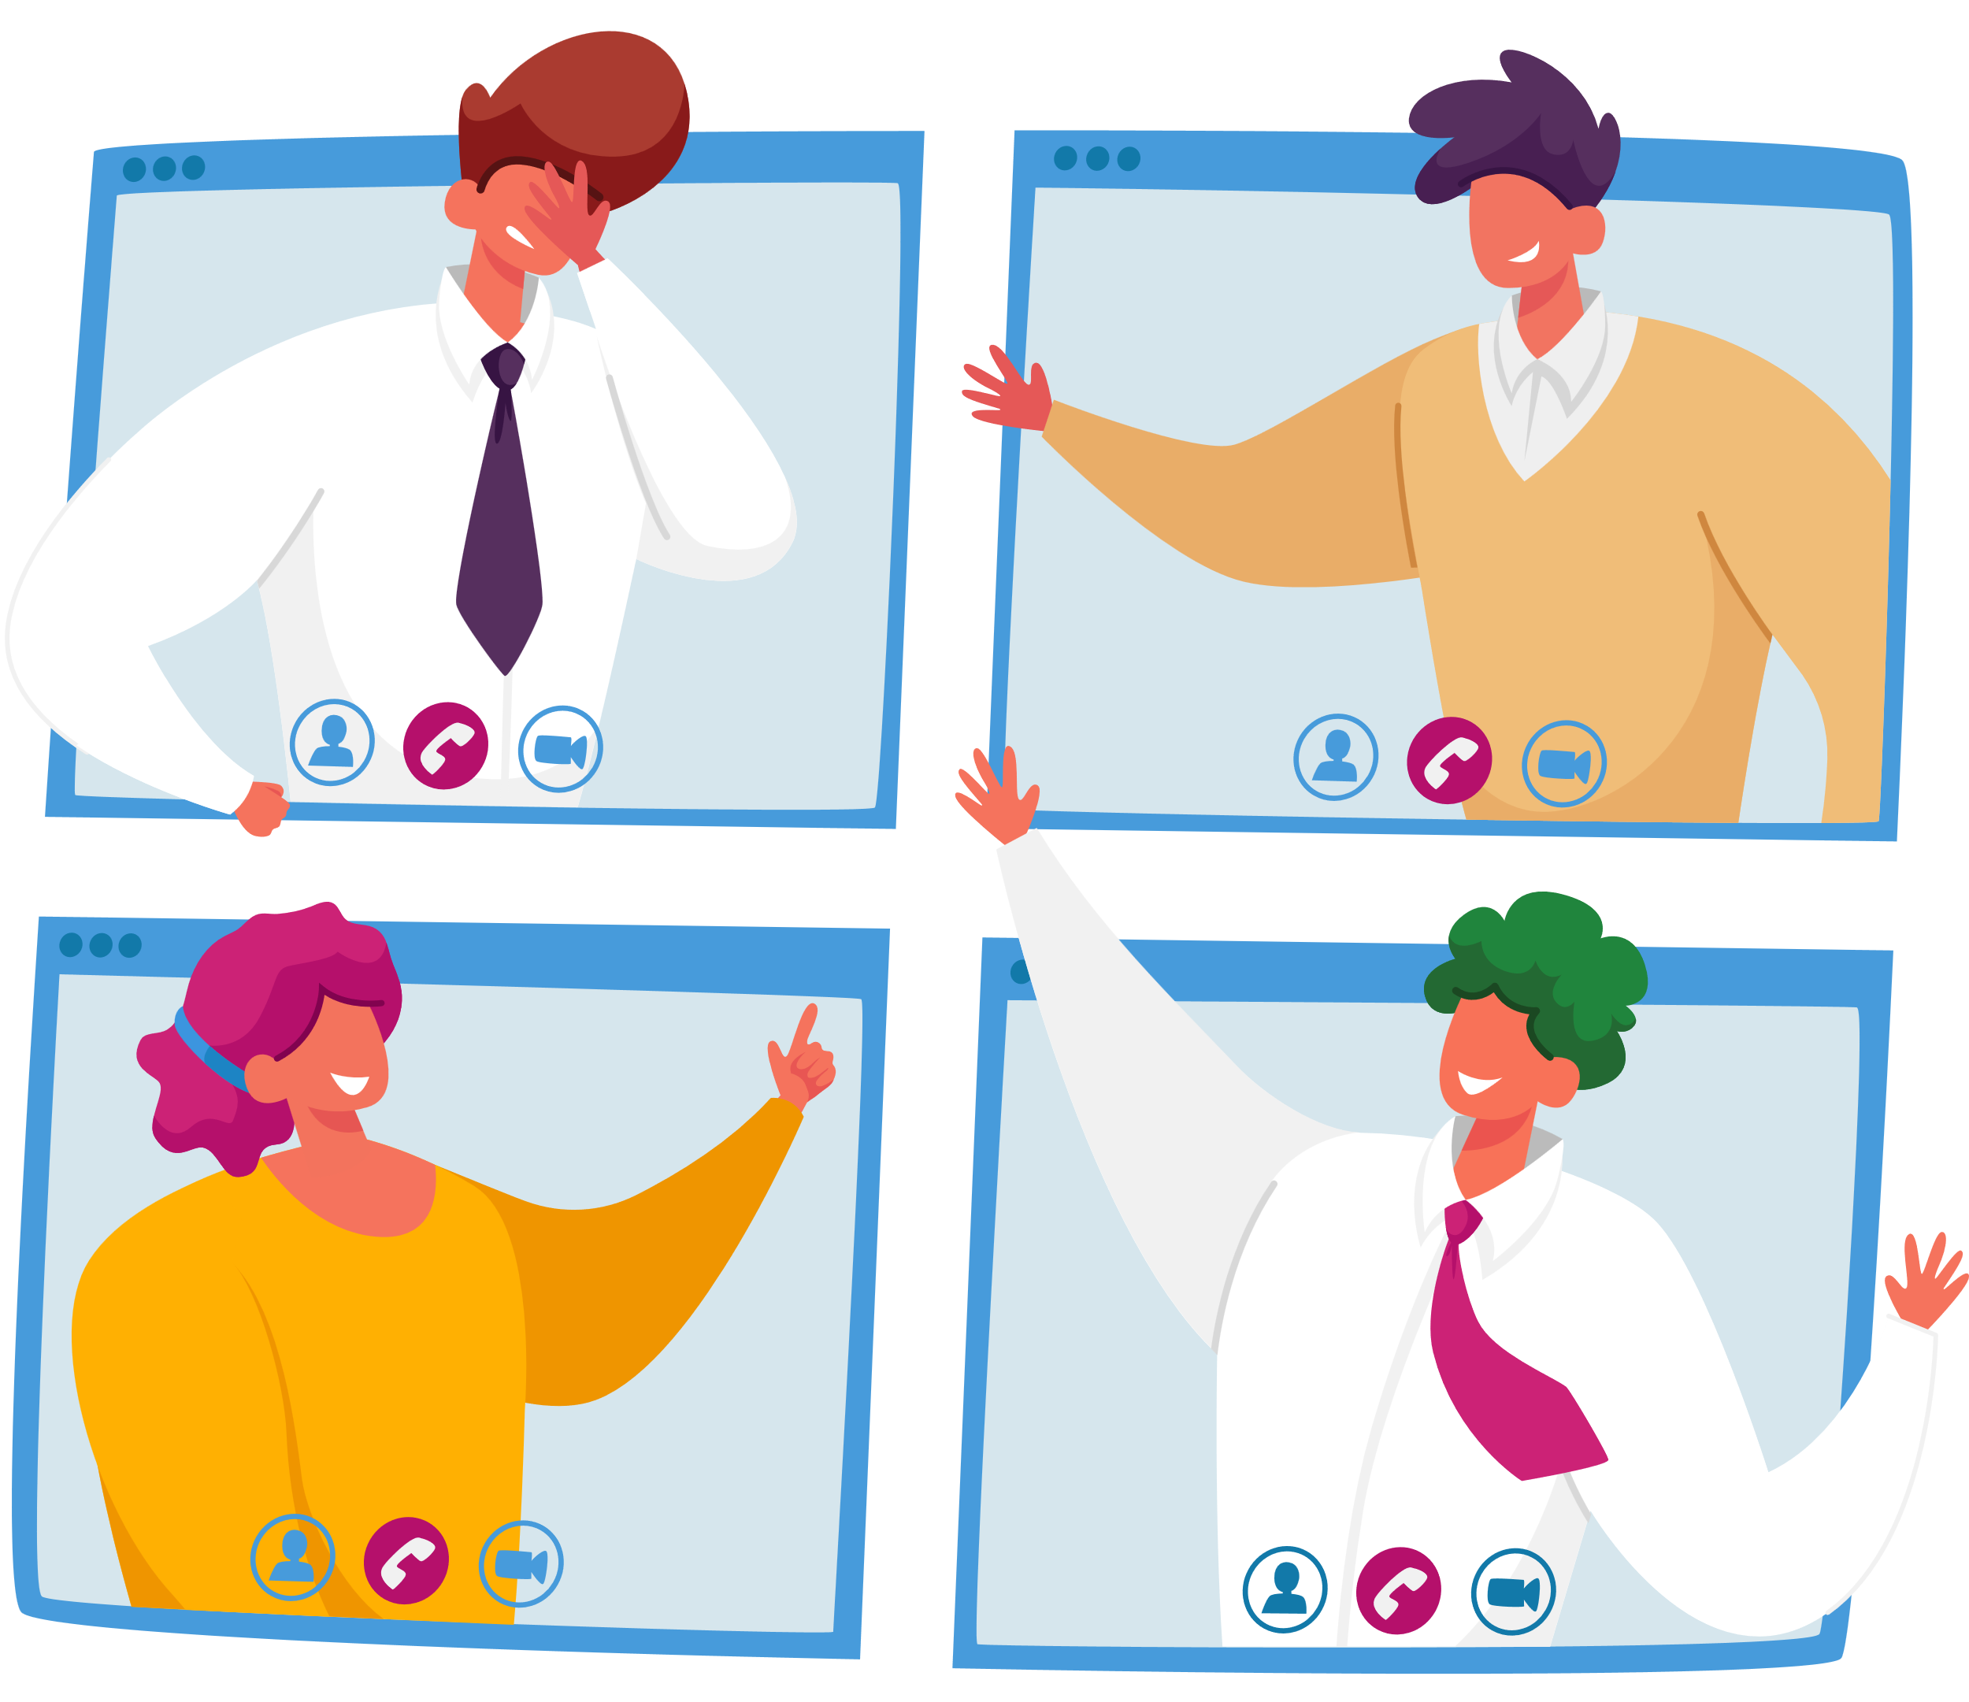
Debrief
Notes:
What questions could you ask to lead this conversation with compassion and promoting connection?

Slide 24

Closing
What will you take back with you?

Slide 25

Questions?

Slide 26

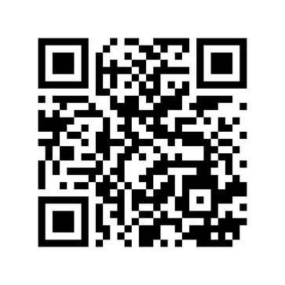
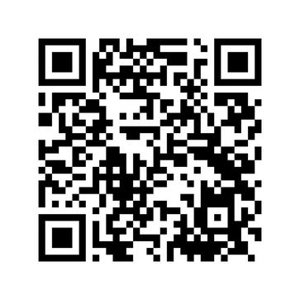
Thank You!
Let’s Connect!
Megan Wells ~ mwells2connect@gmail.com
Yolaine Jean ~ yolainejean606@gmail.com

Slide 27
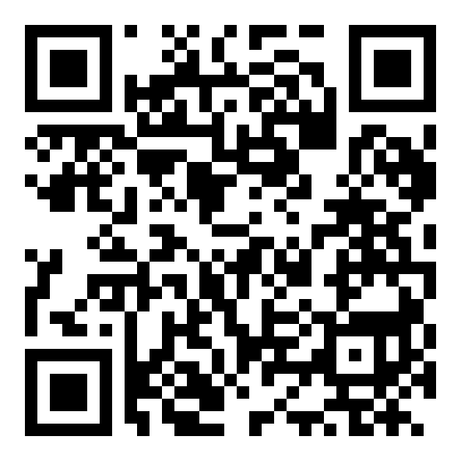
Optional Survey

