Slide 1

Local System Administrator
Training
User IDs for IWDS/IBIS/IES
November 4, 2025

Slide 2
Local System Administrator Training – User ID’s
Acronyms used in this presentation
DCEO – Department of Commerce and Economic Opportunity
OET – DCEO Office of Employment and Training
IWDS – Illinois Workforce Development System
IBIS – Illinois Benefit Information System
IES – Integrated Eligibility System
IwNC* – Illinois workNet Center
SDA – Shared Data Agreement
LSA – Local System Administrator
ASA – Agency Security Administrators with IES

Slide 3
Local System Administrator Training - User ID’s
Systems for User Access
IWDS – Local LWIA
IBIS
IES
Illinois Benefit Information System
Integrated Eligibility System
Illinois Workforce Development System

Slide 4
Local System Administrator Training - User ID’s
Different Systems for User Access
IWDS – Local LWIA & LWIA 90 (State-Wide Grants)
    System owned by DCEO
IBIS
    System owned by IDES (IL Department of Employment Security)
IES
    System jointly owned by HFS (IL Department of Healthcare and Family Services) and DHS (IL Department of Human Services)

Slide 5
Local System Administrator Training - User ID’s
IDES Data Sharing Agreement
To obtain access to IWDS, IBIS or IES, each user must have a signed IDES Data Sharing Agreement Acknowledgement Form - “ ATTACHMENT D SHARED DATA AGREEMENT (18-SDA-62)” on file with OET. This form needs to be filed with the SDA Liaison via email before any access rights to IWDS are granted, either by the IWDS System Administrators or the LWIA Local System Administrators.
LSAs are not to add new Users to IWDS until they submit the IDES Data Sharing Agreement Acknowledgment Form to the SDA Liaison with OET. The LSA does not need to wait for confirmation. The LSA will only be contacted by the SDA Liaison about the SDA form if there is an issue.

Slide 6
Local System Administrator Training - User ID’s
IDES Data Sharing Agreement
If the user changes their name, work address and/or their work email, then the LSA will need to submit a new SDA form for the user with their updated information.
So if you have an employee with a legal name change (usually marriage or divorce), or an employee that moves office locations, or an employee is issued a new work email, then the LSA will need to submit an updated SDA form for the employee.
Due to increasing USDOL user audits, it is imperative that the LWIAs be organized and stay current with this.

Slide 7
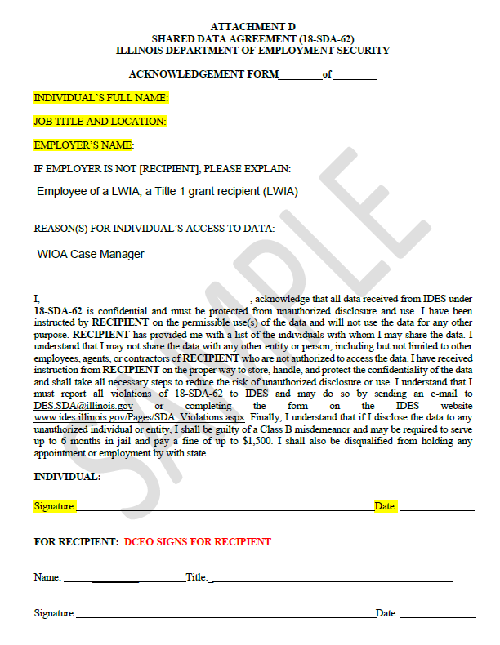
Local System Administrator Training - User ID’s
IDES Data Sharing Agreement
The LSA should fill out the IDES Data Sharing Agreement Acknowledgment Form and have the employee sign it before submitting to the SDA Liason.
Once the SDA form is submitted, you can create the IWDS ID. If there is an issue, the SDA Liaison will contact you.
Please submit separate PDFs for multiple users.

Slide 8
Local System Administrator Training - User ID’s
IWDS – Local LWIA
Create new IWDS LWIA staff users and new IWDS Local System Administrators.
Grant or remove user roles to those IWDS IDs.
Re-enable IWDS LWIA users that have been disabled.
Reset IWDS LWIA user passwords.
Disable IWDS users who are no longer employed by the LWIA.

Slide 9
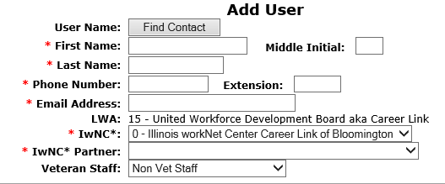
Local System Administrator Training - User ID’s
IWDS – Local LWIA
CREATING A NEW IWDS USER:
The Add User screen requires:
  First Name
  Last Name
  Phone Number (work)
  Email Address (work)
The LWIA is auto filled, and the choices for the IwNC* (Illinois workNet Center) are populated by the locations associated with that LWIA.

Slide 10
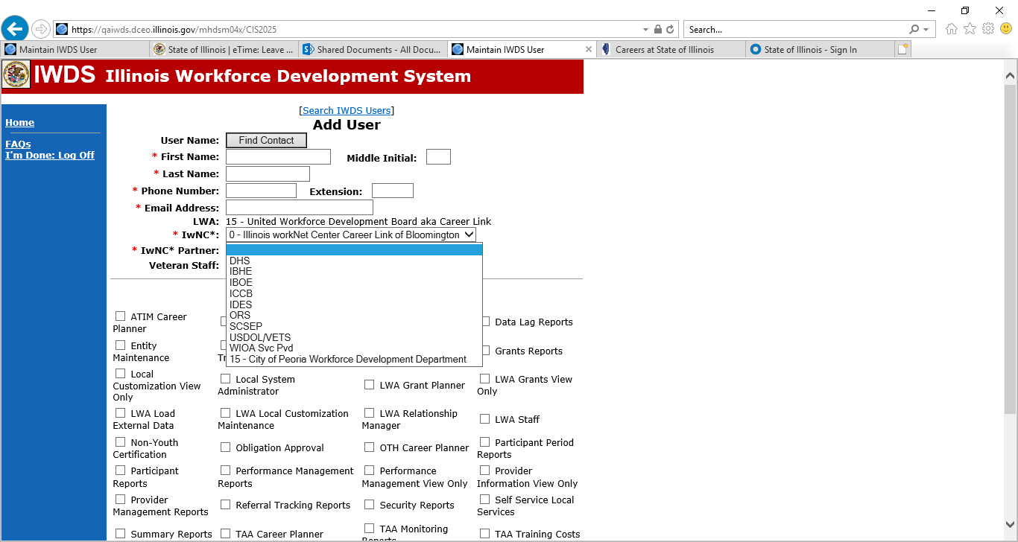
Local System Administrator Training - User ID’s
IWDS – Local LWIA
CREATING A NEW IWDS USER:
The IwNC* Partner field drop down has the following choices.
The last choice in the dropdown will always be the location associated with the LSA’s LWIA:

Slide 11
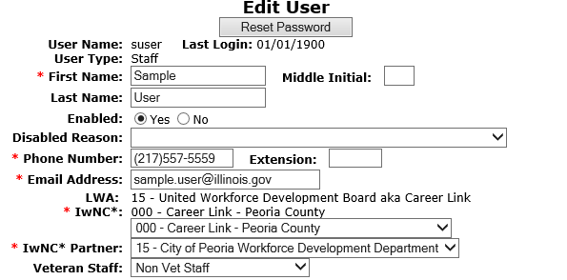
Local System Administrator Training - User ID’s
IWDS – Local LWIA
CREATING A NEW IWDS USER:
This is what the User should look like when complete.

Slide 12
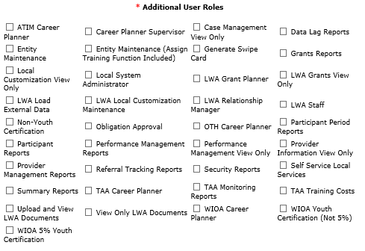
Local System Administrator Training - User ID’s
IWDS – Local LWIA
CREATING A NEW IWDS USER:
The bottom section of the Add User screen has the available user roles that the LSA can grant to the user.
Each role allows users to access different features in IWDS. There are roles that are view only, data entry, access to run reports, a supervisor role, and the Local System Administrator role.

Slide 13
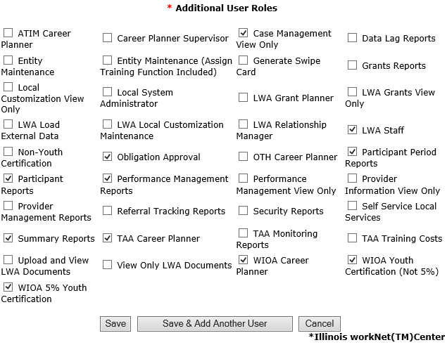
Local System Administrator Training - User ID’s
IWDS – Local LWIA
CREATING A NEW IWDS USER:
Select the IWDS user roles based on the user’s position at the LWIA. Career Planner, Grant Manager, Supervisor etc.
When all roles are added, click “Save” to continue.

Slide 14

Local System Administrator Training - User ID’s
IWDS – Local LWIA
CREATING A NEW IWDS USER:
IWDS will generate a pop-up message at the top of the screen with the new IWDS Username “suser” (Sample User) and Password “8436555”.
If there is already a “suser”, the system will create “suser1” or “suser2”, and so on.
IWDS will also create an IL workNet ID and Password for the new user.

Slide 15
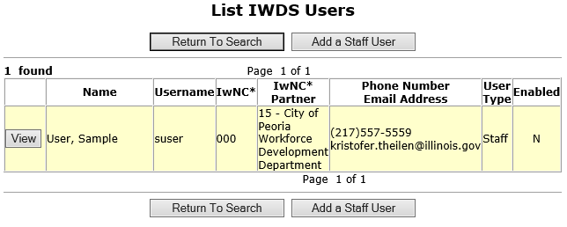
Local System Administrator Training - User ID’s
IWDS – Local LWIA
IWDS USER MANAGEMENT:
As a Local System Administrator, you will have to re-enable disabled IWDS users and reset passwords.
IWDS will automatically disable any user that has not logged into the system within the past 35 days.
The far-right column “Enabled” shows a “N” for No.

Slide 16
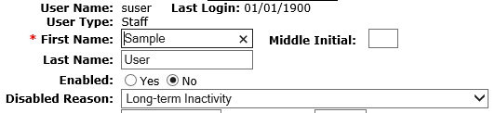
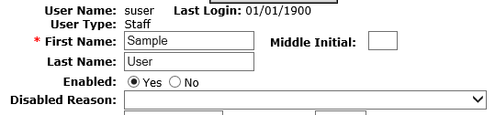
Local System Administrator Training - User ID’s
IWDS – Local LWIA
IWDS USER MANAGEMENT:
To re-enable a User, change “Enabled” from “No” to “Yes” and change the “Disabled Reason” by using the dropdown arrow to the top which is the blank line.
Then click “Save”.
If you need to re-enable the ID and do a password reset, treat it as 2 separate tasks. You cannot do both at the same time.

Slide 17
Local System Administrator Training - User ID’s
IWDS – Local LWIA
IWDS USER MANAGEMENT:
Once you have re-enabled a user for Long Term Inactivity, they have to log into IWDS the same day.
Otherwise the IWDS system will automatically disable their account overnight for Long Term Inactivity again.

Slide 18
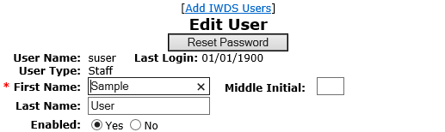
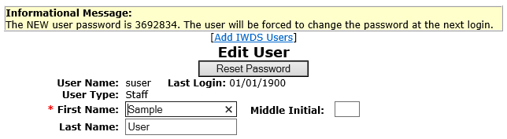
Local System Administrator Training - User ID’s
IWDS – Local LWIA
IWDS USER MANAGEMENT:
To reset the password for the IWDS ID, click the “Reset Password” button.
IWDS will generate a pop-up message with the temporary password. This password is good until it is used, then the IWDS system will force the user to update their password.

Slide 19

Local System Administrator Training - User ID’s
IWDS – Local LWIA
IWDS USER MANAGEMENT:
You can also look at the IWDS user record to see when their last login to IWDS occurred.
If Last Login is 01/01/1900, then the user has not logged into IWDS since the ID was created.

Slide 20


Local System Administrator Training - User ID’s
IWDS – Local LWIA
IWDS USER DEACTIVATION:
To disable an IWDS user who has left LWIA employment, change “Enabled” from “Yes” to “No” and change the “Disabled Reason” to “No Longer Employed by Partner”.
There are multiple options in the drop down for the disabled reason, please select the appropriate one for the user.
IWDS is a reporting legacy system that stores user data in relation to client data. IWDS does not delete users, only disables them.

Slide 21
Local System Administrator Training - User ID’s
IWDS – Local LWIA
IWDS USER DEACTIVATION:
It is the responsibility of the LWIA Local System Administrator to deactivate any LWIA employee or subcontractor that is no longer employed by the LWIA in a timely manner.
Ideally, you should be disabling the user on the same day employment was terminated.
Please make sure to notify the IWDS System Administrators that the employee has left employment. We will discuss the deactivation email later in the training.

Slide 22
Local System Administrator Training - User ID’s
User Access Requests
Local System Administrators are the only people at the LWIA with authorization to make user access or removal requests to OET for the IBIS, IES or IWDS systems.
Emails are to be sent with the necessary forms to the appropriate OET staff for all LWIA users.

Slide 23
Local System Administrator Training - User ID’s
User Access Requests
If OET is contacted directly by a user for access or for a password reset they will be instructed to contact their LWIA Local System Administrators.
The users should not contact the State Help Desk for user access or a password reset. The State Help Desk will contact OET and will be told not to reset the password.

Slide 24
Local System Administrator Training - User ID’s
IWDS –LWIA 90
IWDS LWIA 90 (state-wide grants) access is requested through the IWDS System Administrators. Requests should be submitted by the OET Grant Manager or by the LSA with the OET grant manager cc’d on the email.
All LWIA 90 users must have an IDES Data Sharing Agreement Acknowledgment Form on file with OET before LWIA 90 access is granted.
The LSA should contact the IWDS System Administrators at OET for IWDS LWIA 90 user password resets or to disable LWIA 90 users.

Slide 25
Local System Administrator Training - User ID’s
IWDS –LWIA 90
Any corrections to a LWIA 90 client application information will need to be submitted to the IWDS System Administrators at OET.
Any assistance with exits or performance on LWIA 90 clients need to be submitted to the WIOA Performance Measures Staff at OET, with a cc: to the IWDS System Administrators.
When LWIA 90 users who are no longer employed by the LWIA, or no longer need LWIA 90 access, email the IWDS System Administrators and the SDA Liaison to inform them of the change so the LWIA 90 ID can be disabled.

Slide 26
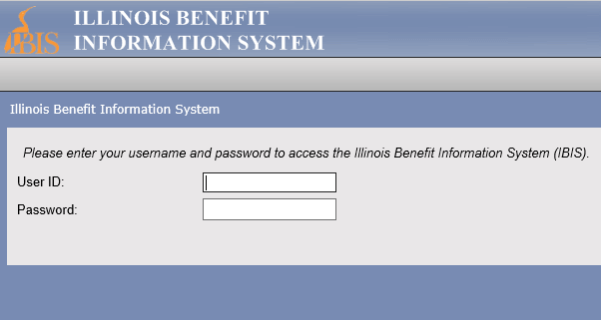
Local System Administrator Training - User ID’s
IBIS
IBIS (Illinois Benefit Information System) is a program owed by IDES (Illinois Department of Employment Security) that contains unemployment benefit information.
To access the IBIS system, users will need both a PKI Digital ID and a RACF ID.
Requests to add, remove, or reset passwords for IBIS users must be submitted by LWIA Local System Administrators to the IBIS Coordinator.

Slide 27
Local System Administrator Training - User ID’s
IBIS
GAINING ACCESS TO IBIS:
IBIS access is requested by Local System Administrators by submitting the Bureau of Agency Services-I.T.M External User I.D. Request Form to the IBIS Coordinator. Users must have an IDES Data Sharing Agreement Acknowledgment Form on file before IBIS access will be granted. These forms can be submitted at the same time. Please submit separate PDFs for each individual user.
Any changes to user information (name, work address, work email, work phone) should be submitted to the IBIS Coordinator and the SDA Liaison via email to update User information.
OET is only authorized to process IBIS access for LWIA employees that are using the system for WIOA activities.

Slide 28
Local System Administrator Training - User ID’s
IBIS
GAINING ACCESS TO IBIS:
Once the IBIS Coordinator receives the completed signed form and verifies the user has a SDA on file, then they will submit to the RACF Security Group to have a RACF ID created. The IBIS Coordinator only submits to the RACF Security Group once a week, usually on Friday afternoons.
After the RACF Security Group issues the RACF IDs, the new RACF IDs are submitted to another security group at IDES to assign IBIS access to the IDs.
Once that is completed, the IBIS Coordinator will send an email back the LSA with several attachements detailing how to reset the password on the new RACF ID, changes that need made to the Microsoft Edge browser, and instructions on how to log into IBIS.
This process usually takes 1-2 weeks.

Slide 29
Local System Administrator Training - User ID’s
IBIS
GAINING ACCESS TO IBIS:
This process usually takes 1-2 weeks.
So, if a LWIA LSA submits a new user a completed and signed PDF form on Monday, then the user will not be submitted until that Friday. In the best case scenario, then the LSA will likely receive the user’s new RACF ID and instructions for set up on the following Friday. But it would not be unlikely for it to take a second week to be completed.
So if you submit a RACF form for a new user and you don’t hear anything back within 3 Fridays, contact the DCEO IBIS Coordinator to check on the status.

Slide 30
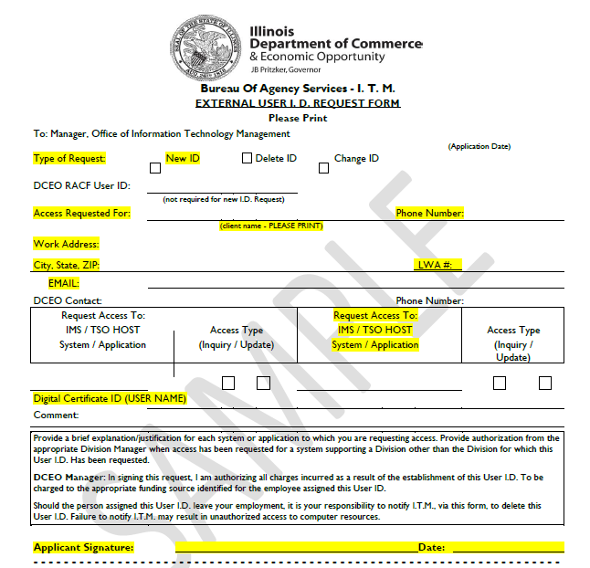
Local System Administrator Training - User ID’s
IBIS
GAINING ACCESS TO IBIS:
All required fields highlighted on the sample Bureau of Agency Services-I.T.M External User I.D. Request Form must be completed in order to be processed.

Slide 31
Local System Administrator Training - User ID’s
IBIS
GAINING ACCESS TO IBIS:
The field “Digital Certificate ID (USER NAME)” refers to the applicant getting a PKI Digital ID. To obtain this ID the user must access the Department of Innovation and Technology (DoIT) website to create their own unique ID (it is not assigned).
Please make sure your users understand that this is NOT their IWDS ID. This is a separate step they MUST complete on their own. They will need their State of Illinois Driver’s License number in the process of creating this unique ID.

Slide 32
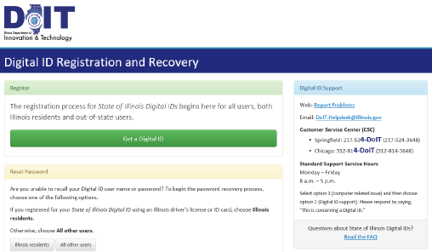
Local System Administrator Training - User ID’s
IBIS
GAINING ACCESS TO IBIS:
To create or reset a PKI Digital ID, go to: https://enroll.pki.illinois.gov/UserRegistration/en_US/Homepage.html
If you have problems, do not contact OET. You will need to call the help desk at either (217) 524-3648 or (312) 814-3648 and select Option 1 (Computer Related Issue) or Option 2 (Digital ID support), then respond by saying “This is concerning a Digital ID”.

Slide 33
Local System Administrator Training - User ID’s
IBIS
GAINING ACCESS TO IBIS:
When the user is sent their new RACF user ID, they will also receive several PDFs with required system settings in order to make IBIS work in Microsoft Edge (Edge is the only browser approved by IDES. No other browser will work properly and use of Chrome or Firefox or Safari can actually cause issues).
Failure to do these browser settings and/or whitelisting the IBIS urls with the local IT Department firewalls are the main reasons that users cannot access IBIS.

Slide 34
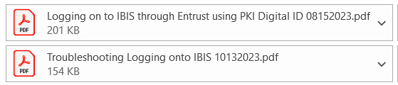
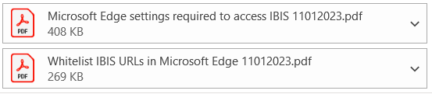

Local System Administrator Training - User ID’s
IBIS
GAINING ACCESS TO IBIS
These are the 5 current PDFs with the required setting changes to make IBIS work on your pc/laptop. These are sent out via email along with the initial new user ID PDF. These are updated when we are notified by IDES of a change. There are browser settings in Edge, firewall/whitelist settings, and more. The user may have to contact your local LWIA or location IT department.
Once all of these are done, the next step in using their new RACF ID to access IBIS is resetting the password.

Slide 35
Local System Administrator Training - User ID’s
IBIS
GAINING ACCESS TO IBIS
It has come to our attention that when Microsoft sends out an update to Edge, it can revert all settings back to the factory settings.
If your users are getting blank screens or other issues unrelated to the password, it is suggested that you have them re-do the settings.

Slide 36
Local System Administrator Training - User ID’s
IBIS
RACF/IBIS PASSWORD RESETS:
If the IBIS user needs a password reset or the user gets an error message that the RACF ID is revoked or suspended, the LSA will email both the RACF ID (MHDxxxx) and the user’s name to the IBIS Coordinator, who will first verify the user and RACF ID, then submit to the DCEO RACF Security Group for a reset.
OET is only authorized to process RACF password resets for users that are in the OET IBIS user database list and needing the password reset to access IBIS (not GRS, SNAP, or any other State of IL program).
The temporary password is only good for 48 hours.

Slide 37
Local System Administrator Training - User ID’s
IBIS
RACF/IBIS PASSWORD RESETS:
If the IBIS user gets an error message that the RACF ID is expired, that means they can change the password WITHOUT a reset. Expired just means that it has been between 30-34 days since they last changed their password.
IBIS users can change their password any time they want to. They just need to use the link https://neonwebh.cmcf.state.il.us/changepassword.
Users CANNOT change their password from the IBIS website.

Slide 38
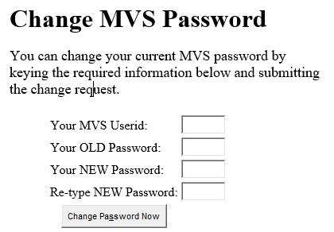
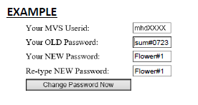
Local System Administrator Training - User ID’s
IBIS
RACF/IBIS PASSWORD RESETS:

Slide 39
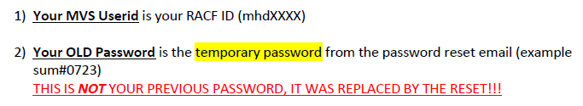
Local System Administrator Training - User ID’s
IBIS
RACF/IBIS PASSWORD RESETS:

Slide 40
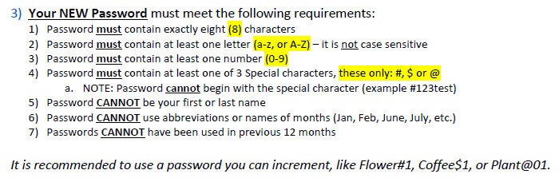
Local System Administrator Training - User ID’s
IBIS
RACF/IBIS PASSWORD RESETS:

Slide 41
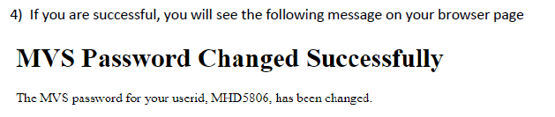
Local System Administrator Training - User ID’s
IBIS
RACF/IBIS PASSWORD RESETS:

Slide 42
Local System Administrator Training - User ID’s
IBIS
RACF/IBIS PASSWORD RESETS:
Common Errors by IBIS users resetting passwords:
They try to do the reset on the IBIS website instead of neonweb.
They use a browser other than Microsoft Edge.
They try to use their previous password in the OLD Password field instead of the temporary password they were just issued.
They don’t bother to read the password instructions. Most common issue is either not using one of the 3 symbols # $ @ or they try to use a symbol other than # $ @ in the new password.

Slide 43
Local System Administrator Training - User ID’s
IBIS
RACF/IBIS PASSWORD RESETS:
If contacting OET with a problem with the accessing IBIS, please include a screen shot of the error and what screen the user is on.
That can speed up the process of elimination of what might be causing the error.

Slide 44
Local System Administrator Training - User ID’s
IBIS
DEACTIVATING IBIS USERS:
If the IBIS user needs their access disabled, email the IBIS Coordinator at OET. The IBIS Coordinator will create the deactivation request forms and submit them to the DCEO RACF Security Group once per week.
If a LWIA employee leaves your employment, the LWIA must notify the IBIS Coordinator and SDA Liaison as soon as possible. It could be a violation of the data sharing agreement if a user accessed IBIS who was no longer employed by your LWIA.

Slide 45
Local System Administrator Training - User ID’s
IES
IES (Integrated Eligibility System) is a computer based public benefits application and management system. It is a joint initiative by HFS (Illinois Department of Healthcare and Family Services) and DHS (Illinois Department of Human Services) where users can view client eligibility information. Users will be able to see all benefits (Medical, SNAP, TANF) for at least the last 12 months, earned and unearned income used to determine benefit eligibility, client notices, dates, and family members included in the case.
IES access is granted to LWIAs as a Subcontractor to OET through a Shared Data Agreement between DCEO and DHS. If you have any questions regarding your Agency’s access to the IES system, please contact the SDA Liaison.

Slide 46
Local System Administrator Training - User ID’s
IES
IES has slightly different rules to the Local System Administrator.
IES has designated Agency Security Administrators or ASAs, and each LWIA is required to have 2 ASAs assigned.
DCEO requires that the ASAs also be IWDS LSAs for consistency.
The 2 ASAs are the only LSAs that can request to add or delete an IES user .

Slide 47
Local System Administrator Training - User ID’s
IES
GAINING ACCESS TO IES:
IES access is requested by the LWIA ASA’s to the OET SDA Liaison. Each staff person from your agency, who requests access to IES, will need to:
Have the signed IDES Data Sharing Agreement Acknowledgment Form on file with OET. (18-SDA-62 Attachment D form)
Complete Systems Access Request IL444-2022 Form (IGA/DSA# 2022-267-DSA-FCS)
Review the HIPPA and Privacy Policy Training for Externals and the External Security Awareness Training.
Complete and sign the IES HIPPA Privacy Policy Training Attestation and the IES Certificate of Understanding. Both forms are to be sign by user’s supervisor and must be completed ANNUALLY.
Submit all forms to the SDA Liaison.

Slide 48
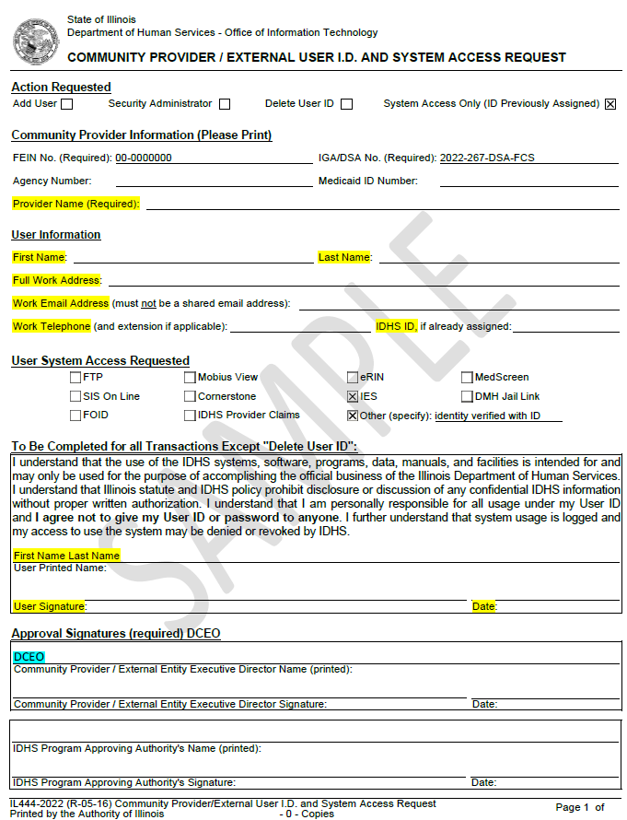
Local System Administrator Training - User ID’s
IES
Required Forms for IES Access:
Community Provider/External User ID and Systems Access Request IL444-2022 Form
The user completes the highlighted User Information fields and signs the form. DCEO signs as the Community Provider.
The ASA sends the Request Form, the IES HIPPA Privacy Policy Training Attestation, and the IES Certificate of Understanding to the OET SDA Liaison.

Slide 49
Local System Administrator Training - User ID’s
IES
Required Forms for IES Access:
This form is required to activate, deactivate, and reactivate a user. The ASA will have to fill this form each time.
If a user does not log into IES for 60 days and their password expires, then their access is revoked. IES does not do password resets.
The ASA will have to fill this form out again and resubmit as a reactivation to the SDA liaison.

Slide 50
Local System Administrator Training - User ID’s
IES
UPDATING USER INFORMATION:
To update user information (name change, work address, work email, work phone) for IES, the LSA submits a new completed Access Request IL444-2022 Form and forward to the SDA Liaison.
INACTIVE USER RESETS:
Users are required to CHANGE THEIR PASSWORD and LOGIN every 60 days!!! If the user fails to change their password, they will be locked out of IES, and their status will automatically change to ‘Inactive’.
If the user account becomes inactive, the LSA will need to resubmit an Access Request IL444-2022 Form for the user to the SDA Liaison for reactivation.
DEACTIVATING USERS:
Any time a user leaves an agency the Local System Administrators MUST complete and submit to the SDA Liaison via email the Access Request IL444-2022 Form to delete the user in order to stay compliant with the DCEO/DHS Shared Data Agreement. The Deactivation Request does NOT require the User’s signature.

Slide 51
Local System Administrator Training - User ID’s
IES
IES User Request Processing Time:
When the ASA submits an Access Request IL444-2022 Form for the users to the SDA Liaison for activation/reactivation, the SDA Liaison has to review, sign as “Community Provider” on behalf of DCEO, and submit that for to DHS for them to process.
The SDA Liaison and OET have no control over how long it will take for DHS to process the form and activate the users. Sometimes its less than a week, sometimes it can be over a month. If it has been over 2 weeks, the ASA can ask the SDA Liaison to email DHS and ask for an update.

Slide 52
Local System Administrator Training - User ID’s
SUMMARY: ACTIVATING USERS
NEW USERS – all forms/requests must be submitted by a LWIA Local System Administrator
• A SDA from must be on file in order to get any user ID (IWDS/IBIS/IES).
New IWDS IDs - The Shared Data Agreement Acknowledgement forms are to be signed and sent to Carrie Compardo at Carrie.Compardo@Illinois.gov AND Kris Theilen at Kristofer.Theilen@illinois.gov at DCEO.
Once the SDA is submitted to DCEO, the LSA can activate the local LWIA IWDS ID.
New IWDS LWIA 90 requests are to be submitted to Kris Theilen at Kristofer.Theilen@illinois.gov at DCEO. The DCEO grant manager needs to be CC’d on the email.
New IES user request and reactivation forms are to be signed and submitted to Carrie Compardo at Carrie.Compardo@Illinois.gov AND cc Kris Theilen at Kristofer.Theilen@illinois.gov at DCEO.
New IBIS user request forms are to be signed and submitted to Kris Theilen at Kristofer.Theilen@illinois.gov at DCEO. Please submit separate PDFs and separate emails for each user.
On the Shared Data Agreement Acknowledgement form, please make sure the LWIA/Provider and location are filled out, otherwise it will be returned to you requesting the missing information. When submitting the form, please send the user email address and the location address in the body of the email.

Slide 53
Local System Administrator Training - User ID’s
SUMMARY: DEACTIVATING USERS
DEACTIVATING USERS – –all forms/requests must be submitted by a LWIA Local System Administrator
Local LWIA IWDS ID: The LWIA Local System Administrators are responsible for disabling the local LWIA IWDS ID and changing the disabled reason to “NO LONGER EMPLOYED BY PARTNER” in IWDS. Then you need to notify Kris Theilen at Kristofer.Theilen@illinois.gov at DCEO (this will be forwarded to the Shared Data Agreement liaison).
LWIA 90 IWDS ID: you need to notify Kris Theilen at Kristofer.Theilen@illinois.gov at DCEO.
IES ID: you need send the IES deactivate form to Carrie Compardo at Carrie.Compardo@Illinois.gov AND cc Kris Theilen at Kristofer.Theilen@illinois.gov at DCEO. If you don’t have the form on the email, you will be contacted later to complete it.
IBIS/RACF ID: you need to notify Kris Theilen at Kristofer.Theilen@illinois.gov at DCEO (no need to fill out a form, it is generated from the IBIS user database system).
IL workNet/IPATS/IEBS access: you need to send the user’s name and email address to IL workNet by email to info@illinoisworkNet.com.
You can send one email to all necessary recipients to deactivate everything at once. Make sure to include the user email address for IL workNet.

Slide 54
Local System Administrator Training - User ID’s
SUMMARY: DEACTIVATING USERS
Example of LSA deactivating all system account in one email to all necessary recipients:
Please remove user John Doe from IBIS, IES, and IL workNet. His email was john.doe@wioaworks.org. He has already been deactivated in IWDS.
Thanks!
LWIA LSA

Slide 55
Local System Administrator Training - User ID’s
POSSIBLE SYSTEM MISUSE
If for any reason, you suspect that an LWIA employee or subcontractor is misusing their access to any system (IWDS, IWDS – LWIA 90, IBIS, IES, IEBS or IL workNet), please contact the IWDS System Administrators at DCEO immediately.
Misuse includes accessing the systems for outside employment purposes (non-LWIA WIOA related), using the systems for personal gain, or using the systems to look up information on family members, co-workers, or celebrities.

Slide 56
Local System Administrator Training - User ID’s
OET Contacts
IWDS SYSTEM ADMINISTATORS
Kris Theilen: (217) 299-2161, Kristofer.Theilen@illinois.gov
IBIS COORDINATOR
Kris Theilen: (217) 299-2161, Kristofer.Theilen@illinois.gov
WIOA PERFORMANCE MEASURES STAFF
Mark Burgess: (217) 970-0061, Mark.A.Burgess@illinois.gov
Paula Barry: Paula.Barry@illinois.gov
Ray Al-Amin: Ramon.Al-Amin@illnois.gov
SDA LIAISON - IES ACCESS
Carrie Compardo: (217) 986-1397, Carrie.Compardo@illinois.gov

Slide 57
Local System Administrator Training - User ID’s
QUESTIONS?
The Illinois workNet® Center System, an American Job Center, is an equal opportunity employer/program. Auxiliary aids and services are available upon request to individuals with disabilities. All voice telephone numbers may be reached by persons using TTY/TDD equipment by calling TTY (800) 526-0844 or 711. This workforce product was funded by a grant awarded by the U.S. Department of Labor Employment and Training Administration. For more information please refer to the footer at the bottom of any webpage at illinoisworknet.com. – December 2019, v3

