Slide 1

Local System Administrator
Training
User ID’s
March 23, 2021

Slide 2
Local System Administrator Training – User ID’s
Acronyms used in this presentation
DCEO – Department of Commerce and Economic Opportunity
OET – DCEO Office of Employment and Training
IWDS – Illinois Workforce Development System
IBIS – Illinois Benefit Information System
IES – Integrated Eligibility System
IwNC* – Illinois workNet Center
SDA – Shared Data Agreement
LSA – Local System Administrator

Slide 3
Local System Administrator Training - User ID’s
Systems for User Access
IWDS – Local LWIA
IBIS
IES
Illinois Benefit Information System
Integrated Eligibility System
Illinois Workforce Development System

Slide 4
Local System Administrator Training - User ID’s
Different Systems for User Access
IWDS – Local LWIA & LWIA 90 (State-Wide Grants)
    System owned by DCEO
IBIS
    System owned by IDES (IL Department of Employment Security)
IES
    System jointly owned by HFS (IL Department of Healthcare and Family Services) and DHS (IL Department of Human Services)

Slide 5
Local System Administrator Training - User ID’s
IDES Data Sharing Agreement
To obtain access to IWDS or IBIS, each user must have a signed IDES Data Sharing Agreement Acknowledgement Form - “ATTACHMENT D SHARED DATA AGREEMENT” on file with OET. This form needs to be filed with the SDA Liaison via email before any access rights are granted, either by the IWDS System Administrators or the LWIA Local System Administrators.
LSAs are not to add new Users to IWDS until they submit the IDES Data Sharing Agreement Acknowledgment Form to the SDA Liaison with OET.

Slide 6
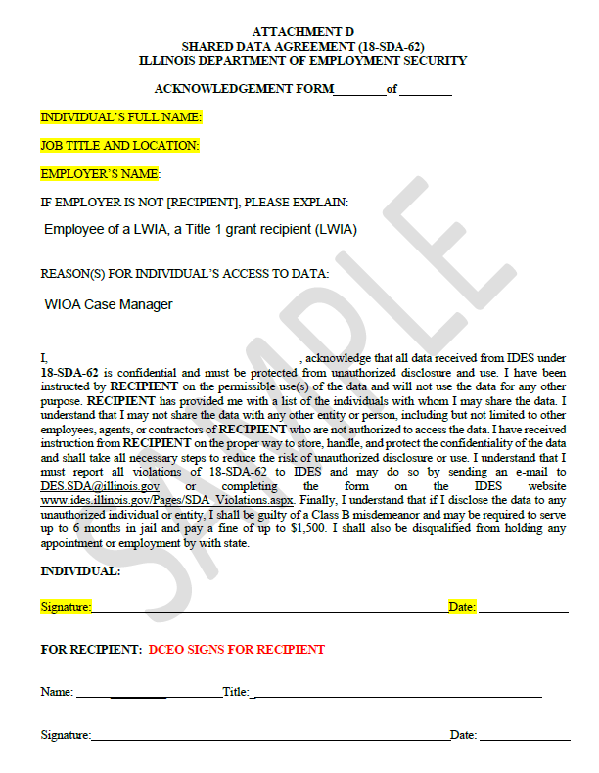
Local System Administrator Training - User ID’s
IDES Data Sharing Agreement
The LSA should not add new users to IWDS until the IDES Data Sharing Agreement Acknowledgment Form is on file with OET.

Slide 7
Local System Administrator Training - User ID’s
IWDS – Local LWIA
Create new IWDS LWIA staff users and new IWDS Local System Administrators.
Grant or remove user roles to those IWDS IDs.
Re-enable IWDS LWIA users that have been disabled.
Reset IWDS LWIA user passwords.
Disable IWDS users who are no longer employed by the LWIA.

Slide 8
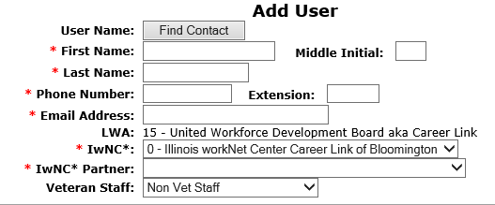
Local System Administrator Training - User ID’s
IWDS – Local LWIA
CREATING A NEW IWDS USER:
The Add User screen requires:
  First Name
  Last Name
  Phone Number (work)
  Email Address (work)
The LWIA is auto filled, and the choices for the IwNC* (Illinois workNet Center) are populated by the locations associated with that LWIA.

Slide 9
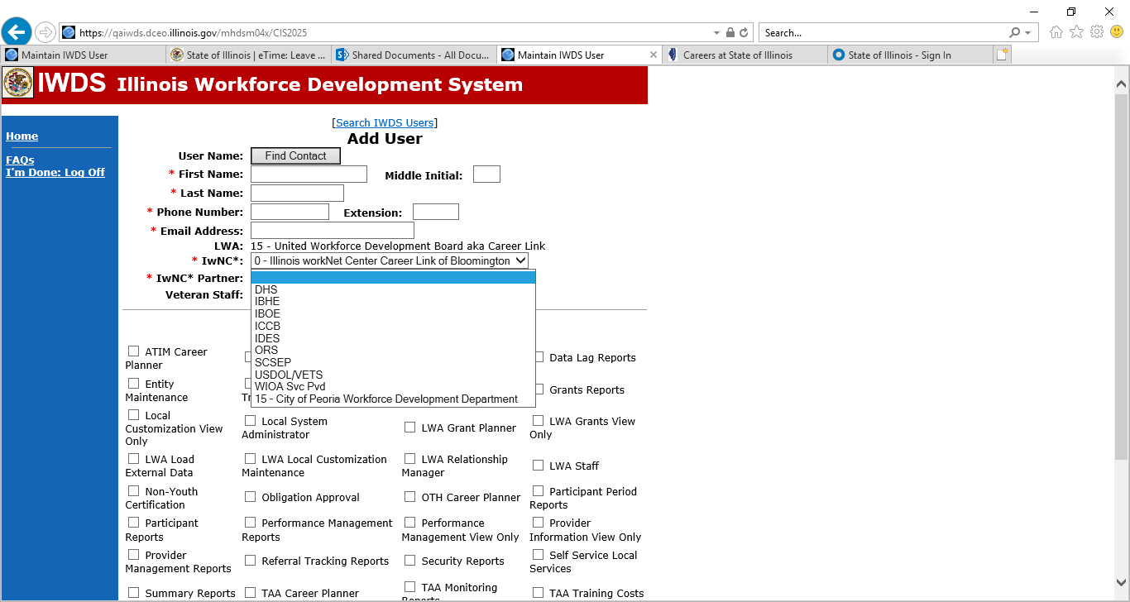
Local System Administrator Training - User ID’s
IWDS – Local LWIA
CREATING A NEW IWDS USER:
The IwNC* Partner field drop down has the following choices.
The last choice will always be associated with your LWIA:

Slide 10
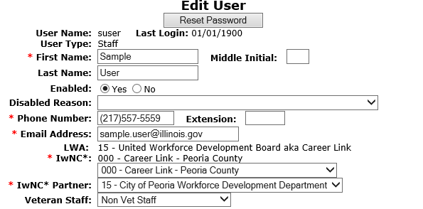
Local System Administrator Training - User ID’s
IWDS – Local LWIA
CREATING A NEW IWDS USER:
This is what the User should look like when complete.

Slide 11
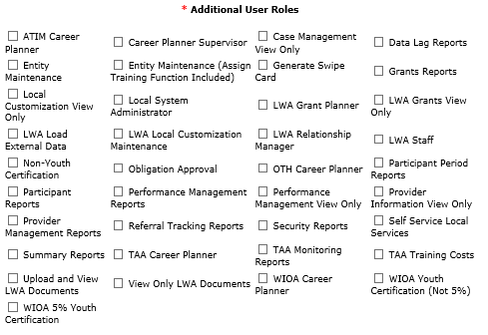
Local System Administrator Training - User ID’s
IWDS – Local LWIA
CREATING A NEW IWDS USER:
The bottom section of the Add User screen has the available user roles that the LSA can grant.
Each role allows users to access features in IWDS. There are roles that are view only, data entry, access to run reports, a supervisor role, and the Local System Administrator role.

Slide 12
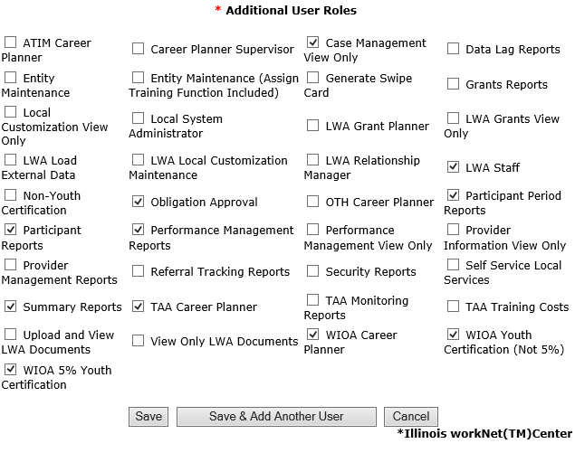
Local System Administrator Training - User ID’s
IWDS – Local LWIA
CREATING A NEW IWDS USER:
Select roles based on the User’s position at the LWIA. Career Planner, Grant Manager, Supervisor etc.
When all roles are added, click “Save” to continue.

Slide 13

Local System Administrator Training - User ID’s
IWDS – Local LWIA
CREATING A NEW IWDS USER:
IWDS will generate a pop-up message at the top of the screen with the new IWDS Username “suser” (Sample User) and Password “8436555”.
If there is already a “suser”, the system will create “suser1” or “suser2”, and so on.
IWDS will also create an IL workNet ID and Password for the new user.

Slide 14
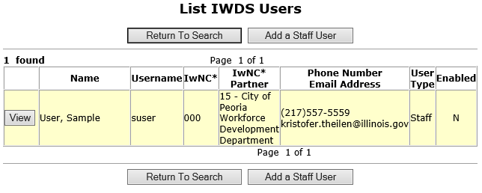
Local System Administrator Training - User ID’s
IWDS – Local LWIA
IWDS USER MANAGEMENT:
As a Local System Administrator, you will have to re-enable disabled IWDS users and reset passwords.
IWDS will automatically disable any user that has not logged into the system within the past 35 days.
The far-right column “Enabled” shows a “N” for No.

Slide 15
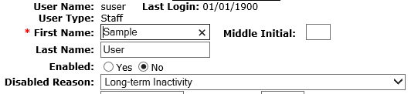
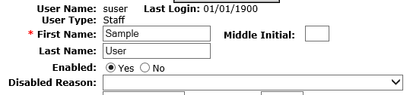
Local System Administrator Training - User ID’s
IWDS – Local LWIA
IWDS USER MANAGEMENT:
To re-enable a User, change “Enabled” from “No” to “Yes” and change the “Disabled Reason” by using the dropdown arrow to the top which is the blank line.
Then click “Save”.
If you need to re-enable the ID and do a password reset, treat it as 2 separate tasks. You cannot do both at the same time.

Slide 16
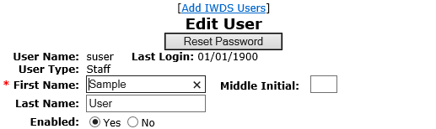
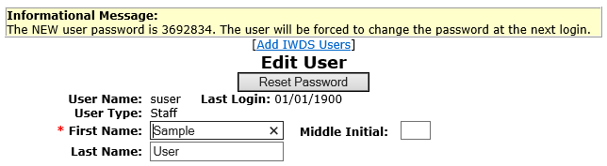
Local System Administrator Training - User ID’s
IWDS – Local LWIA
IWDS USER MANAGEMENT:
To reset the password for the IWDS ID, click the “Reset Password” button.
IWDS will generate a pop-up message with the temporary password. This password is good until it is used, then the IWDS system will force the user to update their password.

Slide 17

Local System Administrator Training - User ID’s
IWDS – Local LWIA
IWDS USER MANAGEMENT:
You can also look at the user to see when their last login to IWDS occurred.
If Last Login is 01/01/1900, the user has not logged into IWDS since the ID was created.

Slide 18


Local System Administrator Training - User ID’s
IWDS – Local LWIA
IWDS USER MANAGEMENT:
To disable an IWDS user who has left LWIA employment, change “Enabled” from “Yes” to “No” and change the “Disabled Reason” to “No Longer Employed by Partner”.
There are multiple options to disable a user, select the appropriate reason.
IWDS is a reporting legacy system that stores user data in relation to client data. IWDS does not delete users, only disables them.

Slide 19
Local System Administrator Training - User ID’s
User Access Requests
Local System Administrators are the only people at the LWIA with authorization to make user access or removal requests to OET for the IBIS, IES or IWDS systems.
Emails are to be sent with the necessary forms to the appropriate OET staff for all LWIA users.

Slide 20
Local System Administrator Training - User ID’s
IWDS –LWIA 90
IWDS LWIA 90 (state-wide grants) access is requested through the IWDS System Administrators. Requests should be submitted by the OET Grant Manager or by the LSA with the OET grant manager cc’d on the email.
All LWIA 90 users must have an IDES Data Sharing Agreement Acknowledgment Form on file with OET before LWIA 90 access is granted.
The LSA should contact the IWDS System Administrators at OET for IWDS LWIA 90 user password resets or to disable LWIA 90 users.

Slide 21
Local System Administrator Training - User ID’s
IWDS –LWIA 90
Any corrections to a LWIA 90 client application information will need to be submitted to the IWDS System Administrators at OET.
Any assistance with exits or performance on LWIA 90 clients need to be submitted to the WIOA Performance Measures Staff at OET, with a cc: to the IWDS System Administrators.
When LWIA 90 users who are no longer employed by the LWIA, or no longer need LWIA 90 access, email the IWDS System Administrators and the SDA Liaison to inform them of the change so the LWIA 90 ID can be disabled.

Slide 22
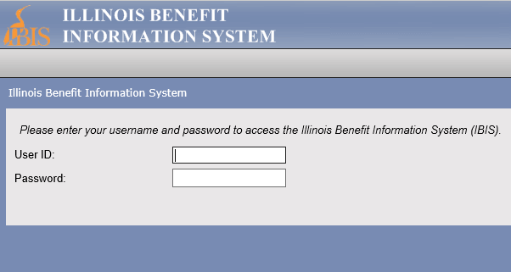
Local System Administrator Training - User ID’s
IBIS
IBIS (Illinois Benefit Information System) is a program owed by IDES (Illinois Department of Employment Security) that contains unemployment benefit information.
To access the IBIS system, users will need both a PKI Digital ID and a RACF ID.
Requests to add, remove, or reset passwords for IBIS users must be submitted by Local System Administrators.

Slide 23
Local System Administrator Training - User ID’s
IBIS
GAINING ACCESS TO IBIS:
IBIS access is requested by Local System Administrators by submitting the Bureau of Agency Services-I.T.M External User I.D. Request Form. User must have an IDES Data Sharing Agreement Acknowledgment Form on file before IBIS access will be granted. These forms can be submitted at the same time.
Any changes to user information (name, work address, work email, work phone) should be submitted to the IBIS Coordinator and the SDA Liaison via email to update User information.
OET is only authorized to process IBIS access for LWIA employees that are using the system for WIOA activities.

Slide 24
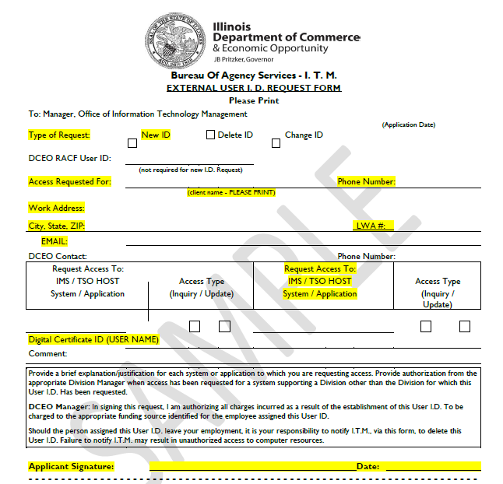
Local System Administrator Training - User ID’s
IBIS
GAINING ACCESS TO IBIS:
All required fields highlighted on the sample Bureau of Agency Services-I.T.M External User I.D. Request Form must be complete to be processed.
The field “Digital Certificate ID (USER NAME)” refers to the applicant getting a PKI Digital ID. To obtain this ID the user must access the Department of Innovation and Technology (DoIT) website to create their own unique ID (it is not assigned).

Slide 25
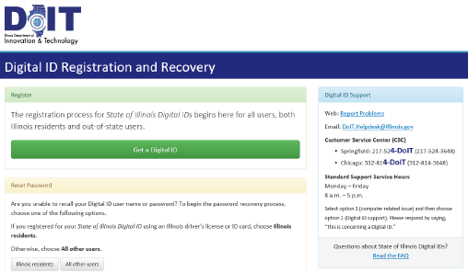
Local System Administrator Training - User ID’s
IBIS
GAINING ACCESS TO IBIS:
To create or reset a PKI Digital ID, go to: https://enroll.pki.illinois.gov/UserRegistration/en_US/Homepage.html
If you have problems, do not contact OET. You will need to call the help desk at either (217) 524-3648 or (312) 814-3648 and select Option 1 (Computer Related Issue) or Option 2 (Digital ID support), then respond by saying “This is concerning a Digital ID”.

Slide 26
Local System Administrator Training - User ID’s
IBIS
RACF/IBIS PASSWORD RESETS:
If the IBIS user needs a password reset or is revoked, email both the RACF (MHDxxxx) and the user’s name to the IBIS Coordinator, who will first verify the user, then submit to the DCEO RACF Security Group for a reset.
OET is only authorized to process RACF password resets for users that are in the OET IBIS user database list and needing the password reset to access IBIS (not GRS, SNAP, or any other State of IL program).
The temporary password is only good for 48 hours.

Slide 27
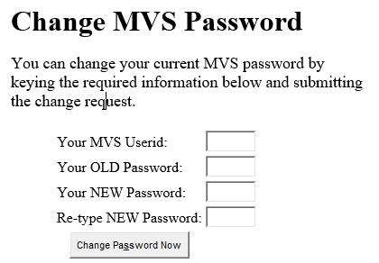
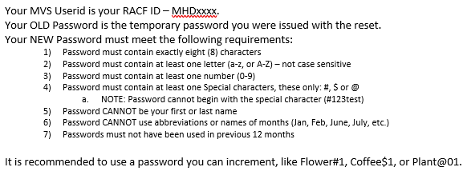
Local System Administrator Training - User ID’s
IBIS
RACF/IBIS PASSWORD RESETS:

Slide 28
Local System Administrator Training - User ID’s
IBIS
DEACTIVATING IBIS USERS:
If the IBIS user needs their access disabled, email the IBIS Coordinator at OET. The IBIS Coordinator will create the deactivation request forms and submit them to the DCEO RACF Security Group once per week.
If a LWIA employee leaves your employment, the LWIA must notify the IBIS Coordinator and SDA Liaison as soon as possible. It could be a violation of the data sharing agreement if a user accessed IBIS who no longer was employed by your LWIA.

Slide 29
Local System Administrator Training - User ID’s
IES
IES (Integrated Eligibility System) is a computer based public benefits application and management system. It is a joint initiative by HFS (Illinois Department of Healthcare and Family Services) and DHS (Illinois Department of Human Services) where users can view client eligibility information. Users are able to see all benefits (Medical, SNAP, TANF) for at least the last 12 months, earned and unearned income used to determine benefit eligibility, client notices, rede dates, family members included in the case.
IES access is granted to LWIAs as a Subcontractor to OET through a Shared Data Agreement between DCEO and DHS. If you have any questions regarding your Agency’s access to the IES system, please contact the SDA Liaison.

Slide 30
Local System Administrator Training - User ID’s
IES
GAINING ACCESS TO IES:
IES access is requested by Local System Administrators to the OET SDA Liaison. Each staff person from your agency, who requests access to IES, will need to:
Complete Systems Access Request IL444-2022 Form.
Review the HIPPA and Privacy Policy Training for Externals and the External Security Awareness Training.
Complete and sign the IES HIPPA Privacy Policy Training Attestation and the IES Certificate of Understanding. Both form are to be sign by user’s supervisor
Obtain an external ID (Username and Password).
All forms are to be submitted to the SDA Liaison.
To update user information (name, work address, work email, work phone), DHS/IES – Local System Administrators would have the user complete and submit a new IL444-2022 Access Request Form (DHS Contract) and forward to the SDA liaison.

Slide 31
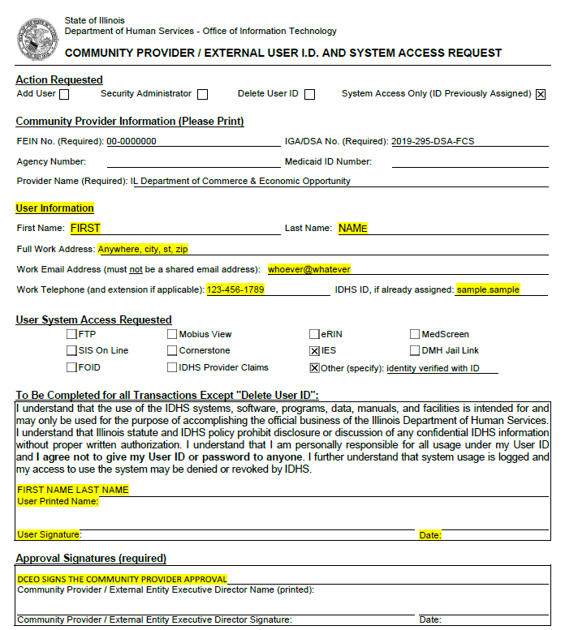
Local System Administrator Training - User ID’s
IES
Required Forms for IES Access:
Community Provider/External User ID and Systems Access Request IL444-2022 Form
The user completes the highlighted User Information fields and signs the form.
The LSA sends the Request Form and the IES HIPPA Privacy Policy Training Attestation and the IES Certificate of Understanding to the SDA Liaison.

Slide 32
Local System Administrator Training - User ID’s
IES
CREATING THE EXTERNAL ID:
Each staff person from your agency, who requires access to IES, will first need to obtain an external ID at the DoIT Identity Management website.
This is a self-service account management system that allows users to create an Illinois.gov ID and/or reset their account password.
The user will use the external ID (Username) and password they create through this process to log in to IES.

Slide 33
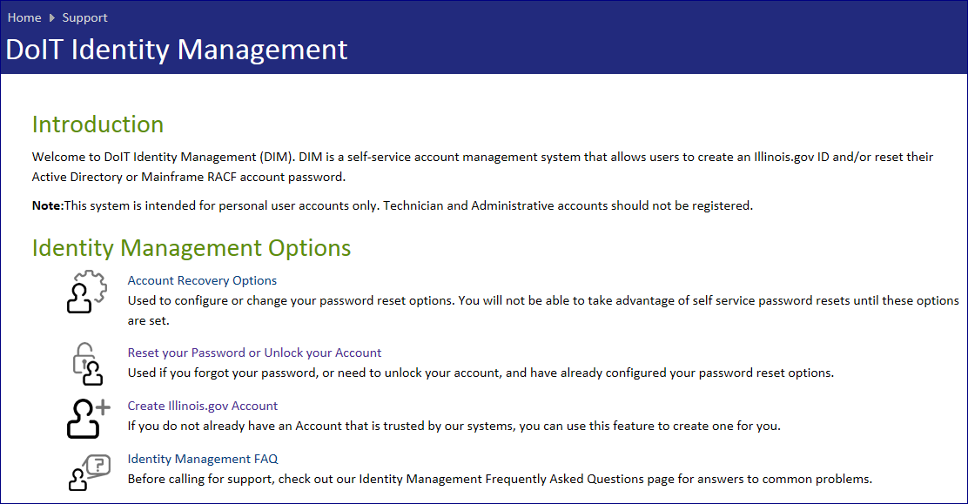
Local System Administrator Training - User ID’s
IES
CREATING THE EXTERNAL ID:
Begin by going to: http://id.illinois.gov and click on the third option on the page.
The information you enter must match your Driver’s License exactly! If your information is not entered exactly as it appears on your Driver’s License, it could cause your registration to fail. Employees who do not have an Illinois Driver's License are not eligible to register via this automated system. A State Of Illinois ID cannot be used instead of a Driver's License. You will need to notify your agency lead who will in turn notify their HFS or DHS Liaison. An Enterprise Service Request (ESR) will be created so that an ID can be created manually for you.

Slide 34
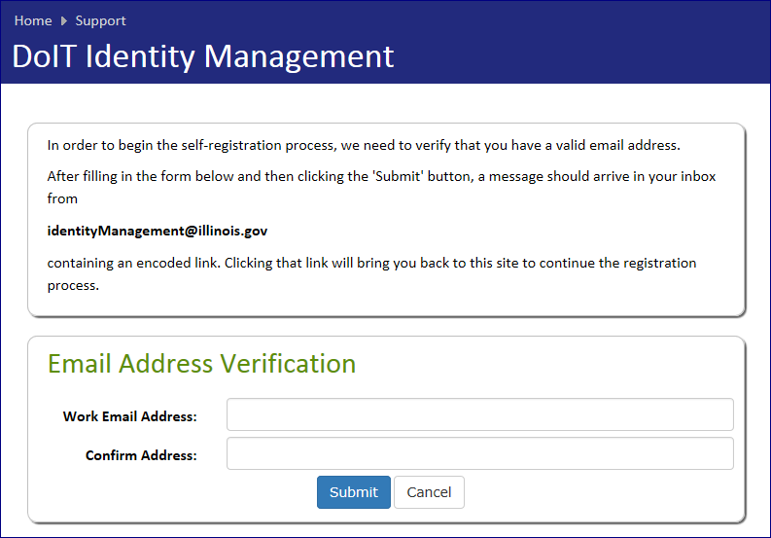
Local System Administrator Training - User ID’s
IES
CREATING THE EXTERNAL ID:
DoIT requires an email address verification and will send a confirmation email when completed.
The user will click on the link in the email they receive, and they will be returned to the DoIT site to complete the self-registration form.

Slide 35
Local System Administrator Training - User ID’s
IES
UPDATING USER INFORMATION FOR IES:
To update user information (name, work address, work email, work phone) for IES, the LSA submits a new completed Access Request IL444-2022 Form and forward to the SDA Liaison.
If the user email changes, they must create a new External ID and submit a new Access Request IL444-2022 Form to become active in IES with their new email. Because of Multi-Factor Authentication, it is very important that their IES Account has an accurate work email.

Slide 36
Local System Administrator Training - User ID’s
IES
IES PASSWORD/USER RESETS:
Users are required to change their password every 60 days. If the user fails to change their password, they will be locked out of IES until they make the change.
Additionally, users who are inactive in IES for 60 days will automatically have their status changed to ‘Inactive’. If the user account becomes inactive, the LSA will need to resubmit an Access Request IL444-2022 Form for the user to the SDA Liaison for reactivation.

Slide 37
Local System Administrator Training - User ID’s
IES
GAINING ACCESS TO IES:
To sign in to IES, the user will enter the username including domain that the user was given when the user obtained their external ID through DoIT (for example, mary.smith@external.illinois.gov). The user will have also received a system generated notification when the user’s name was added to IES. The username from DoIT should match the user ID in the notification! If the names do not match, this will cause an error and prevent the user from logging in to IES. Notify the SDA Liaison to correct this problem.

Slide 38
Local System Administrator Training - User ID’s
IES
DEACTIVATING IES USERS:
Local System Administrators complete and submit an Access Request IL444-2022 Form to delete access to the SDA Liaison.

Slide 39
Local System Administrator Training - User ID’s
Possible System Misuse
If for any reason, you suspect that an LWIA employee or subcontractor is misusing their access to any system (IWDS, IWDS – LWIA 90, IBIS, or IES), contact the IWDS System Administrators at DCEO immediately.
Misuse includes accessing the systems for outside employment (non-LWIA related) or using the systems to look up family members, co-workers, or celebrities.

Slide 40
Local System Administrator Training - User ID’s
OET Contacts
IWDS SYSTEM ADMINISTATORS
Jim Potts: (217) 558-2456, james.potts@illinois.gov
Kris Theilen: (217) 557-5559, kristofer.theilen@illinois.gov
IBIS COORDINATOR
Kris Theilen: (217) 557-5559, kristofer.theilen@illinois.gov
WIOA PERFORMANCE MEASURES STAFF
Mark Burgess: (217) 785-6387, mark.a.burgess@illinois.gov
Paula Barry: (217) 524-5500, paula.barry@illinois.gov
SDA LIAISON - IES ACCESS
Janet Q. Davis: (217) 785-0789, janet.q.davis@illinois.gov

Slide 41
TITLE PLACEHOLDER
QUESTIONS?
The Illinois workNet® Center System, an American Job Center, is an equal opportunity employer/program. Auxiliary aids and services are available upon request to individuals with disabilities. All voice telephone numbers may be reached by persons using TTY/TDD equipment by calling TTY (800) 526-0844 or 711. This workforce product was funded by a grant awarded by the U.S. Department of Labor Employment and Training Administration. For more information please refer to the footer at the bottom of any webpage at illinoisworknet.com. – December 2019, v3

