Slide 1

Local System Administrator
Training
Entities, Locations, and Relationships
March 25, 2021

Slide 2
Local System Administrator Training – Entities, Locations, and Relationships
Acronyms used in this presentation
DCEO – Department of Commerce and Economic Opportunity
OET – DCEO Office of Employment and Training
IWDS – Illinois Workforce Development System
LSA – Local System Administrator

Slide 3
Local System Administrator Training – Entities, Locations, and Relationships
IWDS Entity Infrastructure
Entity
Locations
Relationships

Slide 4
Local System Administrator Training – Entities, Locations, and Relationships
Overview
What is an Entity?
An Entity is a business or organization unit, each with its own unique FEIN.
Two or more businesses can have the same name, but different FEINs.
Every unique FEIN should be a separate Entity record or entry into IWDS – i.e. Walgreens.

Slide 5
Local System Administrator Training – Entities, Locations, and Relationships
Overview
What is a Location?
A Location is a geographical address from which an Entity provides goods and services to the public.
An Entity can have multiple Locations using the same FEIN.

Slide 6
Local System Administrator Training – Entities, Locations, and Relationships
Overview
What is a Relationship?
A Relationship allows a Location to be a service provider for an LWIA.
A Location can have multiple Relationships with the same LWIA or with multiple LWIAs.
The Relationship number is a unique identifier that is created by the Local System Administrator.

Slide 7
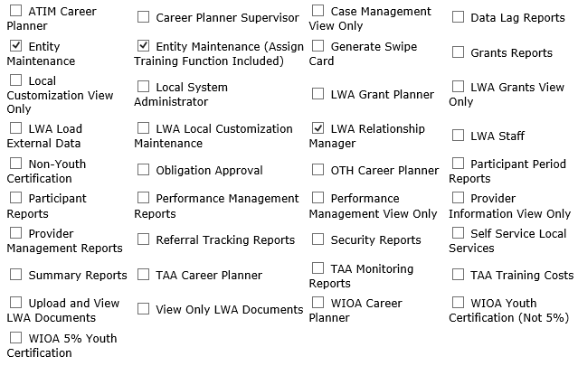
Local System Administrator Training – Entities, Locations, and Relationships
Overview
IWDS User Roles Needed
Entity Maintenance
Add/Edit Entity, Location, Contact, Relationships
Entity Maintenance (Assign Training Function Included)
Add/Edit Entity, Location, Contact, Relationships
Ability to Assign Training Function to Location
LWA Relationship Manager
Add/Edit Relationships

Slide 8
Local System Administrator Training – Entities, Locations, and Relationships
Entering a Company into IWDS
Create Entity
Add Location
Add Contact
Add Relationship

Slide 9
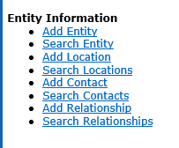
Local System Administrator Training – Entities, Locations, and Relationships
Creating an Entity in IWDS
Before entering the Entity in IWDS, search for the Company from the Staff Menu page.
Click on “Search Entity”.

Slide 10
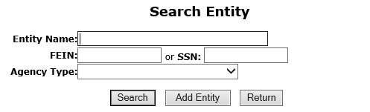
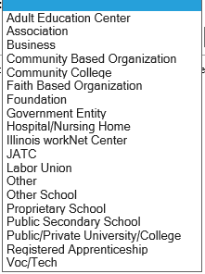
Local System Administrator Training – Entities, Locations, and Relationships
Creating an Entity in IWDS
There are 4 ways to search for an Entity.
Name
FEIN of the Business
SSN (if the business uses the owner’s SSN instead of a FEIN)
Agency Type (from the dropdown menu)

Slide 11
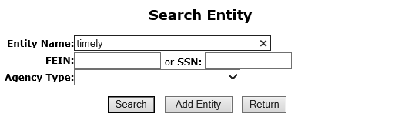
Local System Administrator Training – Entities, Locations, and Relationships
Creating an Entity in IWDS
When searching by the Entity Name it is suggested to use a partial name.
IWDS will search for a match of exactly what is entered.
“Ti” would return “Tim”, “Time”, “Tire”, and “Timberline”, but “Timely” would only return “Timely”.

Slide 12
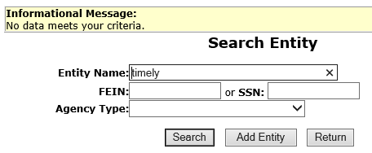
Local System Administrator Training – Entities, Locations, and Relationships
Creating an Entity in IWDS
When no match is found with a partial name search, the Entity must be created.
Click “Add Entity”.

Slide 13
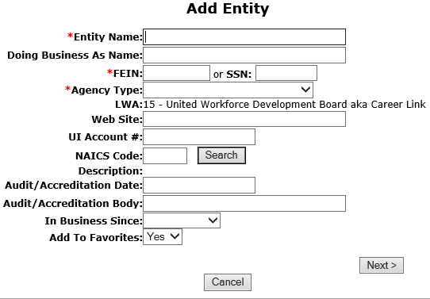
Local System Administrator Training – Entities, Locations, and Relationships
Creating an Entity in IWDS
Any fields marked with the red * are required in order to save the record.
OET recommends entering as much information as you can, as it may help users to differentiate between Entities with the same name.

Slide 14
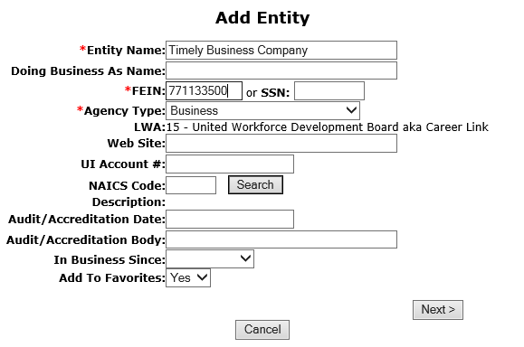
Local System Administrator Training – Entities, Locations, and Relationships
Creating an Entity in IWDS
Enter the Entity Name, FEIN, Agency Type and any additional information provided.
Click “Next” to save the Entity and IWDS will take the user to the Add Location screen.

Slide 15
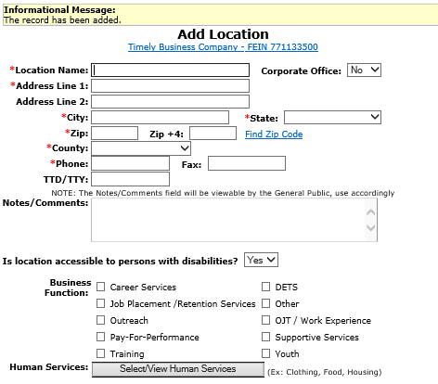
Local System Administrator Training – Entities, Locations, and Relationships
Creating a Location in IWDS
The Informational Message states “The record has been added”.
The Entity is now saved.
One Location where the Entity is doing business is required.

Slide 16
Local System Administrator Training – Entities, Locations, and Relationships
Creating a Location in IWDS
The Location information includes;
Location Name (which could be different from the Entity Name).
Geographical address and phone number.
If the Location is ADA accessible and
Type of Business Functions and Human Services the Location provides.
Fields with the * are required to save the record.

Slide 17
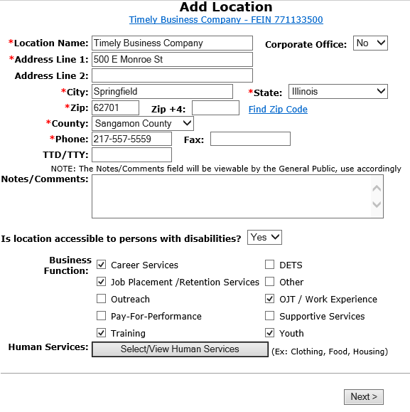
Local System Administrator Training – Entities, Locations, and Relationships
Creating a Location in IWDS
Business Functions are to be entered for the various types of services this Location will be offering.
Click “Select/View Human Services” for the Provider Management – Select Human Services screen.

Slide 18
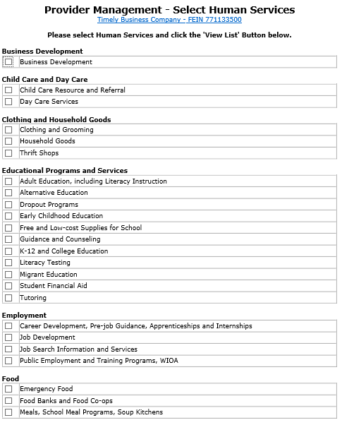
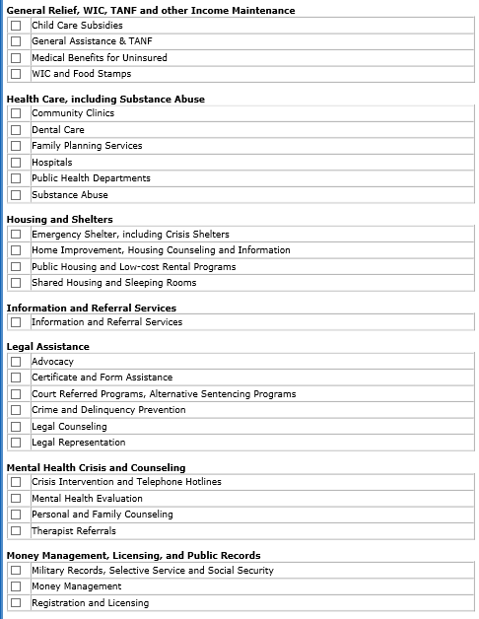
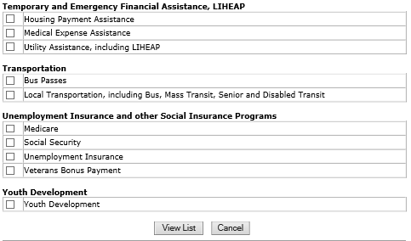
Local System Administrator Training – Entities, Locations, and Relationships
Creating a Location in IWDS
Provider Management – Select Human Services
Select all services that apply to the Location.
Click “View List”

Slide 19
Local System Administrator Training – Entities, Locations, and Relationships
Creating a Location in IWDS
All Services selected will be listed.
Click “View List”

Slide 20
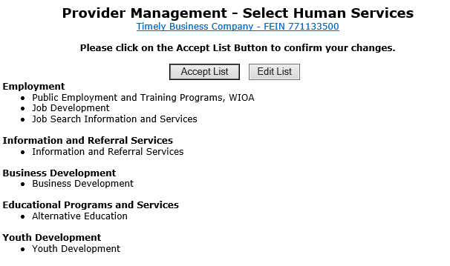
Local System Administrator Training – Entities, Locations, and Relationships
Creating a Location in IWDS
If changes are needed to add or remove items from the list, click “Edit List”.
Once complete, click “Accept List”.

Slide 21
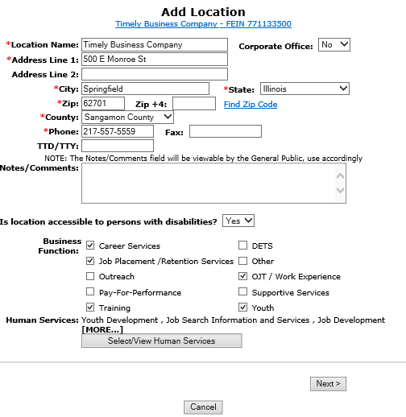
Local System Administrator Training – Entities, Locations, and Relationships
Creating a Location in IWDS
Review all information, click “Next” to save the Location and IWDS will take the user to the Add Contacts screen.

Slide 22
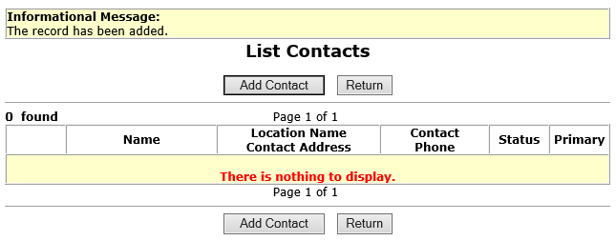
Local System Administrator Training – Entities, Locations, and Relationships
Creating a Contact in IWDS
The Informational Message states, “the record has been added”. The Location is now saved.
The user may enter at least one Contact for the Location. The Entity should identify their Location contacts to the user, including the contact who will enter the Training Programs for the Location if needed.

Slide 23
Local System Administrator Training – Entities, Locations, and Relationships
Creating a Contact in IWDS
To add a Contact, click “Add Contact” and IWDS will take the user to the Search Contact screen.
NOTE: IWDS does not require a contact for the Location. If there is no contact information recorded, the Local System Administrator will have the responsibility to enter Training Programs for the Location.
The user could skip this step by selecting “Return”.

Slide 24
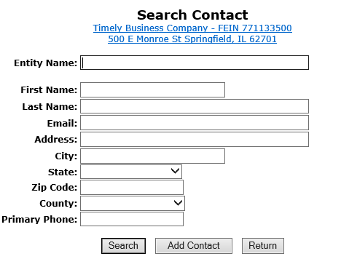
Local System Administrator Training – Entities, Locations, and Relationships
Creating a Contact in IWDS
To search for existing contacts, the user can enter information in any of the fields and click “Search”.
Since this Entity/Location was just created, the Contact will need to added.
Click “Add Contact”.

Slide 25
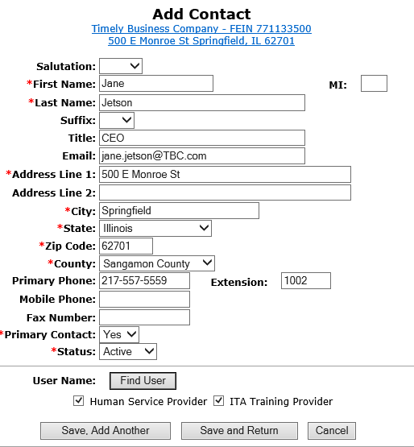
Local System Administrator Training – Entities, Locations, and Relationships
Creating a Contact in IWDS
Fields marked with the * are required in order to save the record.
The “Primary Contact” is the main contact for this Location, not the overall Entity.
If more than one contact is provided for the location, click “Save, Add Another”.
When finished “Save and Return”.

Slide 26
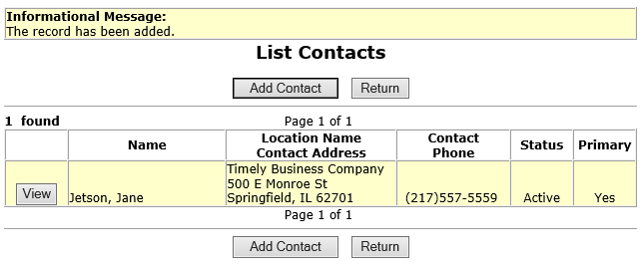
Local System Administrator Training – Entities, Locations, and Relationships
Creating a Contact in IWDS
The Informational Message states “The record has been added”.
The Contact is now saved.
Once the contact is “Saved” the IWDS User Name (login ID) has been assigned to the Entity on the IWDS Public Side login.
Click “View” to review Contact Information.

Slide 27
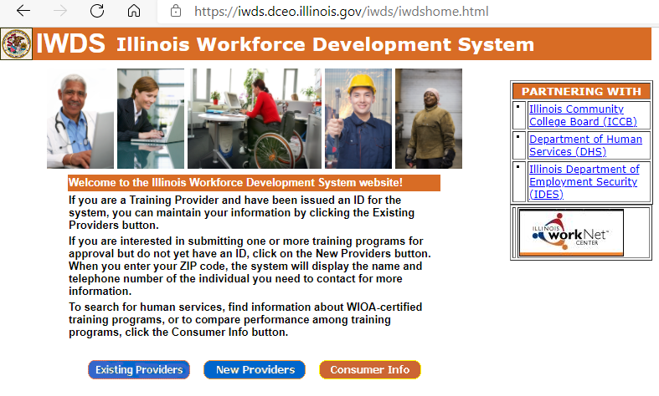
Local System Administrator Training – Entities, Locations, and Relationships
Creating a Contact in IWDS
IWDS PUBLIC SIDE URL:
https://iwds.dceo.illinois.gov/iwds/iwdshome.html
The IWDS login page for the Training Providers appears different from the IWDS Staff login page. It is orange and blue instead of red.

Slide 28
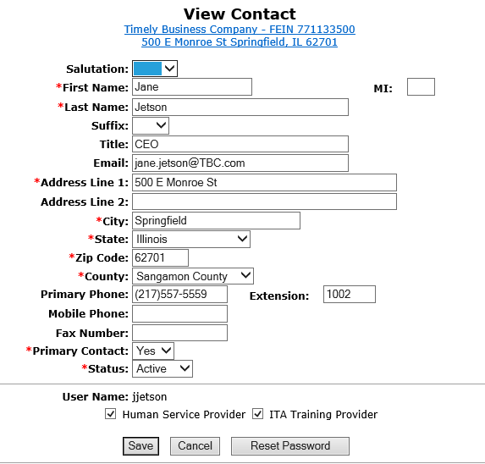
Local System Administrator Training – Entities, Locations, and Relationships
Creating a Contact in IWDS
At the bottom of the View Contact page, the screen shows “User Name: jjetson”.
If your Contact will be entering Training Programs into IWDS for the LWIA to approve/deny, this is the login ID that they will use.

Slide 29

Local System Administrator Training – Entities, Locations, and Relationships
Creating a Contact in IWDS
At the bottom of the View Contact page, the screen shows “User Name: jjetson”

Slide 30
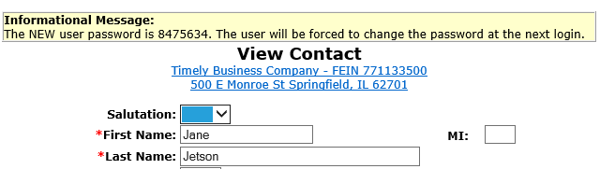
Local System Administrator Training – Entities, Locations, and Relationships
Creating a Contact in IWDS
To reset the password for the contact, click “Reset Password”.
The password reset will appear at the top of the screen. You can either use copy/paste or a screenshot to capture this information to send to the user via email.

Slide 31
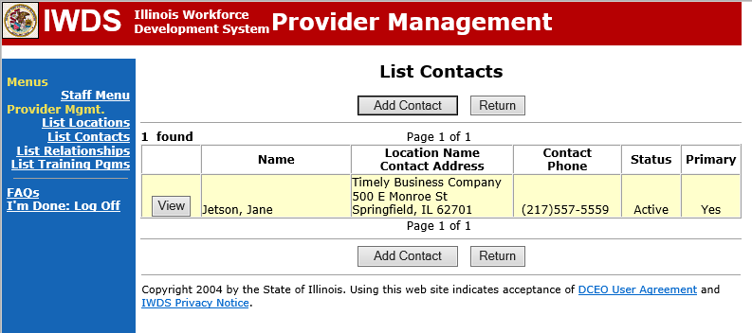
Local System Administrator Training – Entities, Locations, and Relationships
Creating a Contact in IWDS
Click “Add Contact” for an additional contact.
Click “List Relationships” in the blue section on the left to review Relationships the Entity and Location have set up.

Slide 32
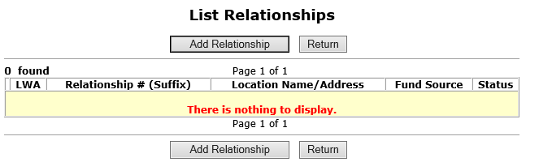
Local System Administrator Training – Entities, Locations, and Relationships
Creating a Relationship in IWDS
Newly created Entities and Locations will not have any existing Relationships between them and the LWIA.
Click “Add Relationship” takes you to the “Search Location” screen.

Slide 33
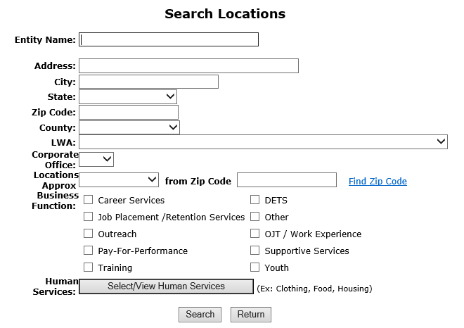
Local System Administrator Training – Entities, Locations, and Relationships
Creating a Relationship in IWDS
Search for the Location to be used to set up the Relationship.

Slide 34
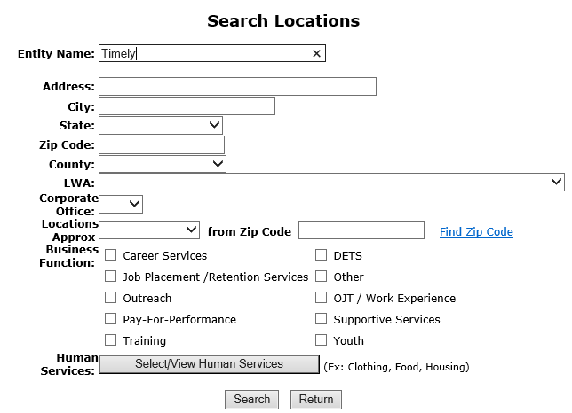
Local System Administrator Training – Entities, Locations, and Relationships
Creating a Relationship in IWDS
A partial Name can be used for the search on the Entity Name.
Address information could be included when you know there is more than one Location for the Entity.
Click “Search”

Slide 35
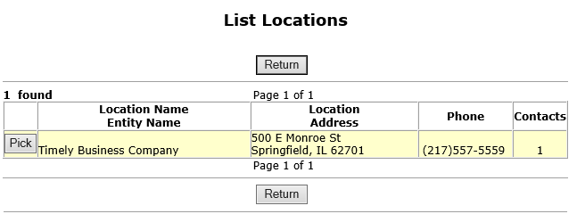
Local System Administrator Training – Entities, Locations, and Relationships
Creating a Relationship in IWDS
Select your location in the results, click “Pick”.

Slide 36
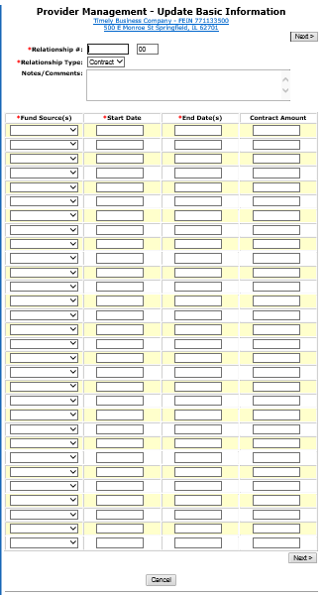
Local System Administrator Training – Entities, Locations, and Relationships
Creating a Relationship in IWDS
The first step in creating the Relationship is the Provider Management – Update Basic Information screen.

Slide 37
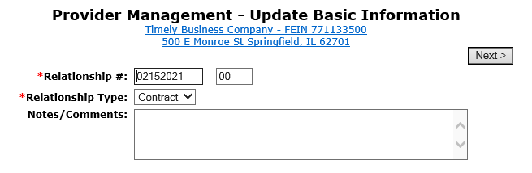
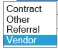
Local System Administrator Training – Entities, Locations, and Relationships
Creating a Relationship in IWDS
When creating the “Relationship #” it should be a unique identifier using alpha/numeric characters.
Select “Relationship Type” from the drop-down menu.
Scroll down the Provider Management – Update Basic Information page to enter the Fund Source/Grant Information.

Slide 38
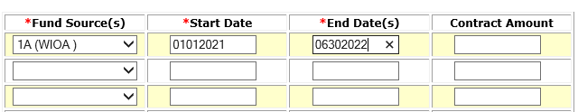
Local System Administrator Training – Entities, Locations, and Relationships
Creating a Relationship in IWDS
Enter Location Grant information
Fund Source
Start Date
End Date
The Fund Source is the Title (1A, 1D, 1E, 1N, TAA, 1DC, 1EC, etc.).

Slide 39
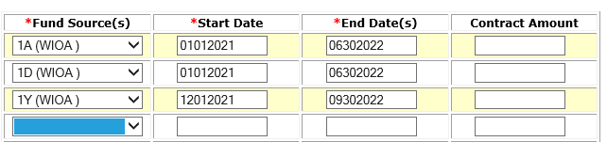
Local System Administrator Training – Entities, Locations, and Relationships
Creating a Relationship in IWDS
Once saved, the Start Date cannot be changed.
Once saved, he End Date can be change to be greater than the current End Date (future), but never less than the current End Date (past).
If the grant is extended, the LSA can change the end date to extend the relationship with this Entity/Location for the selected Fund Source.

Slide 40
Local System Administrator Training – Entities, Locations, and Relationships
Creating a Relationship in IWDS
The user can enter a Start Date that is in the future (greater than today’s date).
In this case, the 1Y grant will start in December 2021. Even though they are entering the Fund Source with a future Start Date, this part of the relationship won’t affect the 1Y client services unless those services are within the date range of 12/01/2021 to 9/30/2022 for this provider.

Slide 41
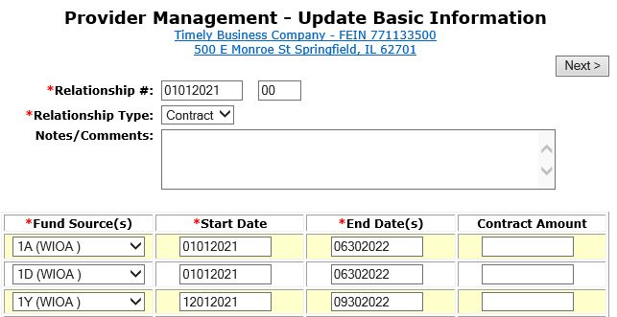
Local System Administrator Training – Entities, Locations, and Relationships
Creating a Relationship in IWDS
Click “Next” to save the fund source information and go to Add Program Activities.

Slide 42
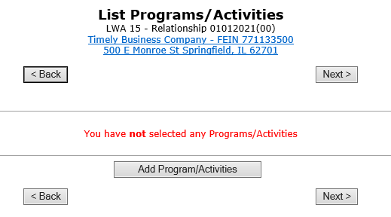
Local System Administrator Training – Entities, Locations, and Relationships
Creating a Relationship in IWDS
Click “Add Programs/Activities” to choose Titles (1A, 1D, etc.) to add services to the Relationship.

Slide 43
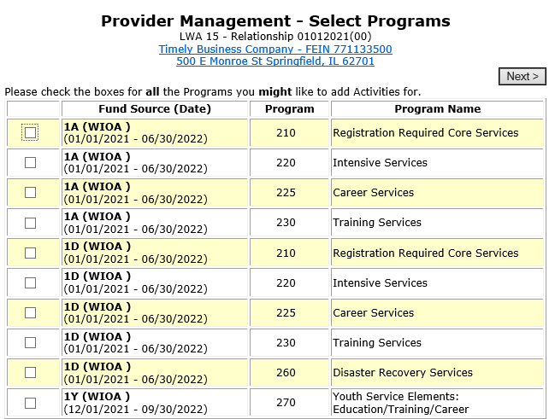
Local System Administrator Training – Entities, Locations, and Relationships
Creating a Relationship in IWDS
Select each Title/Service type needed for the Relationship.

Slide 44
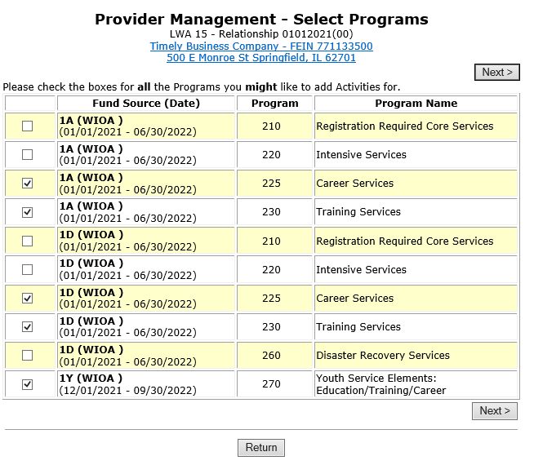
Local System Administrator Training – Entities, Locations, and Relationships
Creating a Relationship in IWDS
Check all Programs you might want to add Activities for.
Click “Next” to view list.

Slide 45
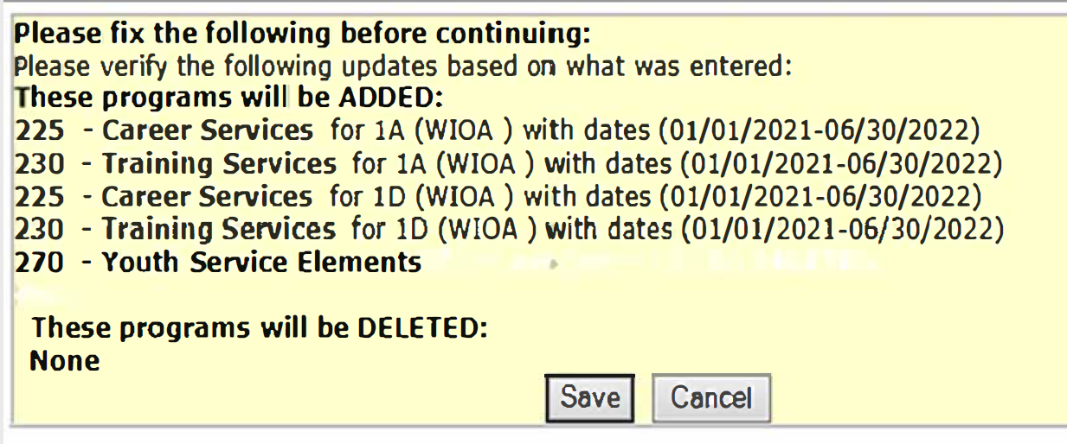
Local System Administrator Training – Entities, Locations, and Relationships
Creating a Relationship in IWDS
Review your selections, click “Save” to select services per Funding Source.

Slide 46
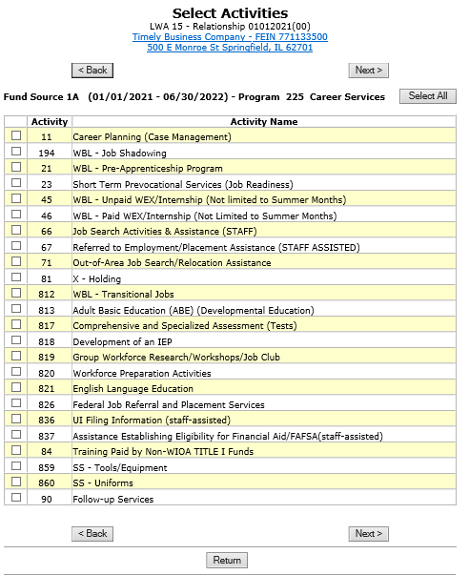
Local System Administrator Training – Entities, Locations, and Relationships
Creating a Relationship in IWDS
Select the specific services for each Title/Service Level allowed by the grant.
Click “Next” to move to the next Title/Service Level.

Slide 47
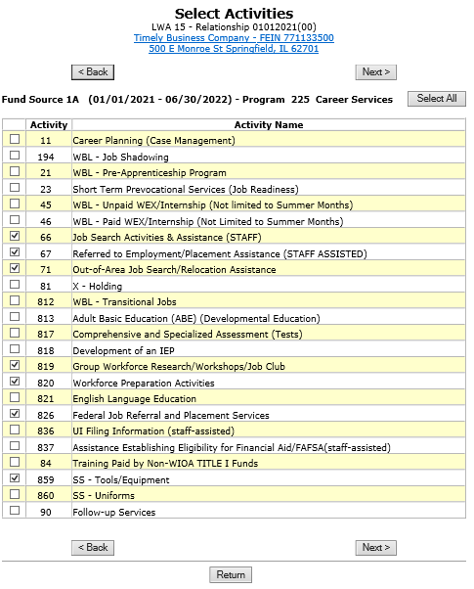
Local System Administrator Training – Entities, Locations, and Relationships
Creating a Relationship in IWDS
The services chosen on the “Select Activities” screens will be the WIOA services that will appear as a provider choice during the time period entered on the relationship for the Entity.
Click “Next” to move to the next Title/Service Level.

Slide 48
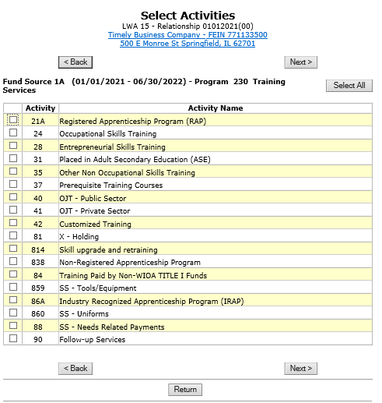
Local System Administrator Training – Entities, Locations, and Relationships
Creating a Relationship in IWDS
The next Title/Service Level is 1A Training Services.

Slide 49
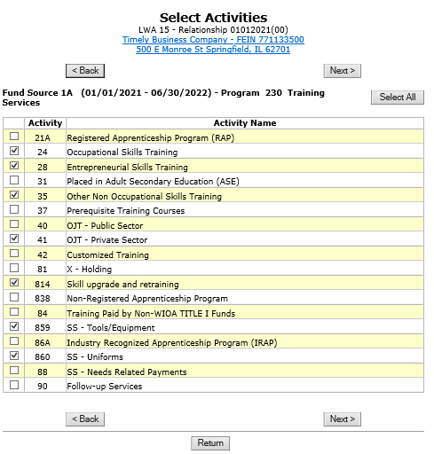
Local System Administrator Training – Entities, Locations, and Relationships
Creating a Relationship in IWDS
Select the 1A Training Services and click “Next” to move to the next Title/Service Level.

Slide 50
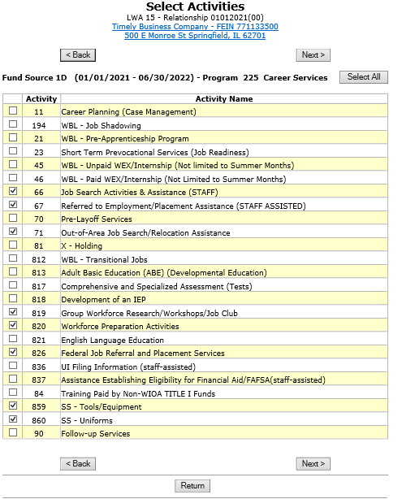
Local System Administrator Training – Entities, Locations, and Relationships
Creating a Relationship in IWDS
Select 1D Career Services and click “Next” to move to the next Title/Service Level.

Slide 51
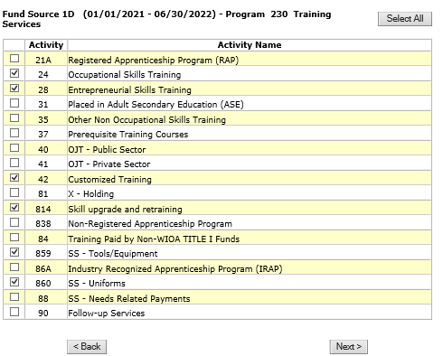
Local System Administrator Training – Entities, Locations, and Relationships
Creating a Relationship in IWDS
Select 1D Training Services and click “Next” to move to the next Title/Service Level.

Slide 52
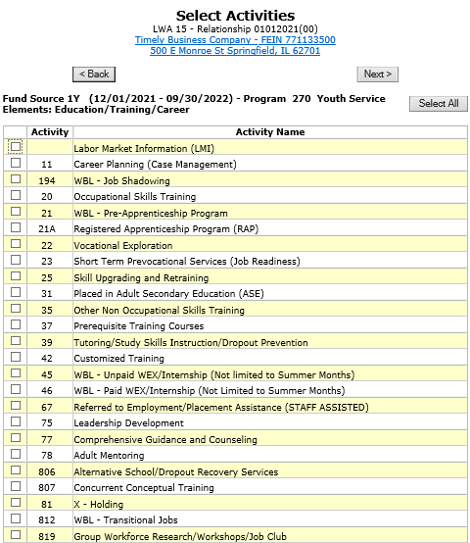
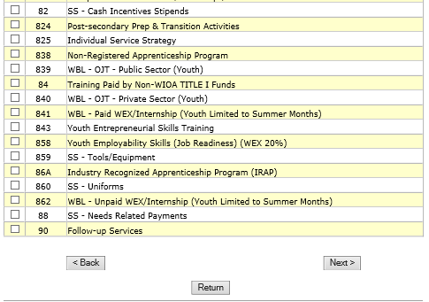
Local System Administrator Training – Entities, Locations, and Relationships
Creating a Relationship in IWDS
Select 1Y Youth Service Elements: Education/ Training/ Career.
Click “Next” to complete the service selections.

Slide 53
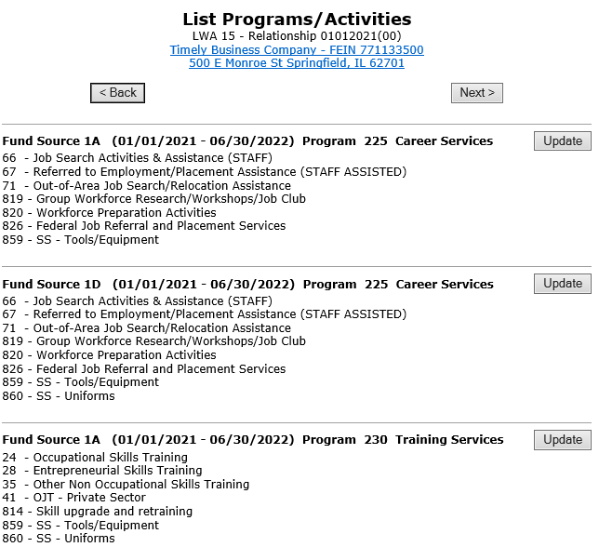
Local System Administrator Training – Entities, Locations, and Relationships
Creating a Relationship in IWDS
Review the services selected in each Title/Service.

Slide 54
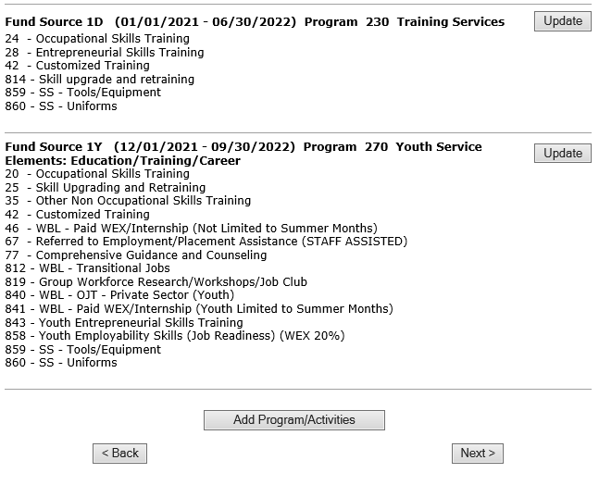
Local System Administrator Training – Entities, Locations, and Relationships
Creating a Relationship in IWDS
Click “Update” in any section to edit the service choices.
When finished, click “Next” to save your choices.

Slide 55
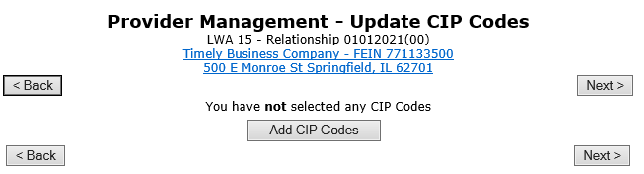
Local System Administrator Training – Entities, Locations, and Relationships
Creating a Relationship in IWDS
Provider Management – Update CIP Codes screen.
OET does not recommend adding any CIP Codes to the Relationship.
Click “Next”.
CIP Codes - Classification of Instructional Program.

Slide 56
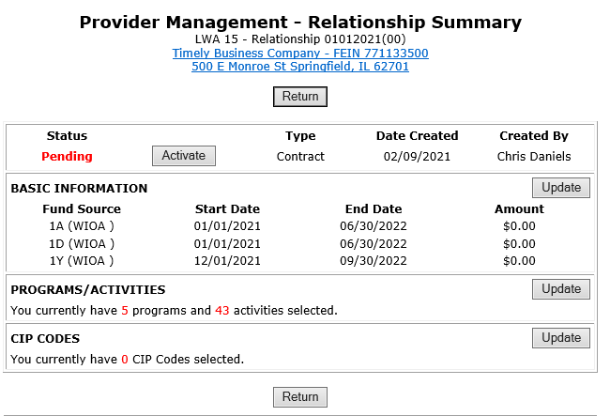
Local System Administrator Training – Entities, Locations, and Relationships
Creating a Relationship in IWDS
Review the Relationship Summary.
Status
Basic Information
Program Activities
CIP Codes
Click “Activate” to accept and turn on the Relationship.

Slide 57
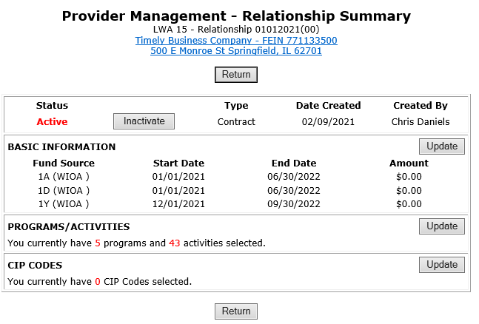
Local System Administrator Training – Entities, Locations, and Relationships
Creating a Relationship in IWDS
“Active” Status indicates that the Entity/Location will be available as a provider choice in the selected services in the selected titles during the selected date periods.

Slide 58

Local System Administrator Training – Entities, Locations, and Relationships
Creating a Relationship in IWDS
To show an example of how the provider should appear in the client services, we will open a service in our test client

Slide 59

Local System Administrator Training – Entities, Locations, and Relationships
Creating a Relationship in IWDS
This is an example of how the provider should appear in the service if your service is within the date range and your title and service is selected in the relationship.
In the Client Record, add a service. In this case, we are choosing Title 1A, and a Training Service starting on 1/25/2021.

Slide 60


Local System Administrator Training – Entities, Locations, and Relationships
Creating a Relationship in IWDS
Select an Activity and Training Type, ITA Funded = Yes/No Contract Funded = Yes/No.
Then click “Next”.

Slide 61

Local System Administrator Training – Entities, Locations, and Relationships
Creating a Relationship in IWDS
Click “Search Providers”

Slide 62

Local System Administrator Training – Entities, Locations, and Relationships
Creating a Relationship in IWDS
Click “Show All” or add the Provider Relationship Name and/or the Relationship Number and click “Search”.

Slide 63


Local System Administrator Training – Entities, Locations, and Relationships
Creating a Relationship in IWDS
“Show All” lists Providers in alphabetical order.
Click “Next Page” to scroll though pages to find the desired Provider.
Click “Pick” to select.

Slide 64

Local System Administrator Training – Entities, Locations, and Relationships
Creating a Relationship in IWDS
This is how the Relationship works.
The service was:
In the Relationship
In the right Title
Inside the active Date Range
If your Provider is not showing up in a service, these are the first things to troubleshoot.

Slide 65
Local System Administrator Training – Entities, Locations, and Relationships
Maintaining LWIA Relationships in IWDS
Each LWIA across the State should have at least one Local System Administrator that has the responsibility of maintaining the Provider/Entity Relationships.
Those Local System Administrators should establish and maintain a schedule for updating the Relationship end dates.

Slide 66
Local System Administrator Training – Entities, Locations, and Relationships
Maintaining LWIA Relationships in IWDS
Different ways to schedule the review of your Relationships:
End of program year
Schedule towards the latter part of June every year and make sure all of their relationships that are scheduled to end in the next 12 months are updated.
End of calendar year
Schedule towards the latter part of December every year and make sure all of their relationships that are scheduled to end in the next 12 months are updated.
Twice a year
Schedule every 6 months and update/review half of your relationships in December and half in June.
Quarterly
Schedule quarterly and update/review a portion of your relationships every 3 months.

Slide 67
Local System Administrator Training – Entities, Locations, and Relationships
Maintaining LWIA Relationships in IWDS
There is no required direction from OET for maintaining those Relationship end dates to ensure the Relationships stays current, but this is something each Local System Administrator who is assigned the responsibility for the Provider/Entity Relationships at the LWIA must keep the information up to date.
If the LWIA does not maintain their Relationships, they run the risk that they will expire and that will restrict their various Career Planner staff from recording services on client records in IWDS.

Slide 68
Local System Administrator Training – Entities, Locations, and Relationships
DCEO Contacts
IWDS SUPPORT
Jim Potts: (217) 558-2456, james.potts@illinois.gov
Kris Theilen: (217) 557-5559, kristofer.theilen@illinois.gov
IWDS PERFORMANCE MEASURES
Mark Burgess: (217) 785-6387, mark.a.burgess@illinois.gov
Paula Barry: (217) 524-5500, paula.barry@illinois.gov

Slide 69
Local System Administrator Training – Entities, Locations, and Relationships
QUESTIONS?
The Illinois workNet® Center System, an American Job Center, is an equal opportunity employer/program. Auxiliary aids and services are available upon request to individuals with disabilities. All voice telephone numbers may be reached by persons using TTY/TDD equipment by calling TTY (800) 526-0844 or 711. This workforce product was funded by a grant awarded by the U.S. Department of Labor Employment and Training Administration. For more information please refer to the footer at the bottom of any webpage at illinoisworknet.com. – December 2019, v3

