Slide 1

Local System Administrator
Training
Entities, Locations, and Relationships
January 7, 2025

Slide 2
Local System Administrator Training – Entities, Locations, and Relationships
Acronyms used in this presentation
DCEO – Department of Commerce and Economic Opportunity
OET – DCEO Office of Employment and Training
IWDS – Illinois Workforce Development System
LWIA – Local Workforce Innovation Area
LSA – Local System Administrator
FEIN – Federal Employer Identification Number

Slide 3
Local System Administrator Training – Entities, Locations, and Relationships
IWDS Entity Infrastructure
Entity
Locations
Relationships

Slide 4
Local System Administrator Training – Entities, Locations, and Relationships
Overview
What is an Entity in IWDS?
An Entity is a business or organization unit, each with its own unique FEIN. FEIN stands for Federal Employer Identification Number and is a unique 9 digit number issued by the IRS to business entities operating in the United States for purposes of identification.
Two or more entities can all have the same business name, but they will have different FEINs.
Every unique FEIN should have a separate Entity record in IWDS
  for example: most Walgreens or McDonald’s will have individual FEINs for each physical building and/or franchisee.

Slide 5
Local System Administrator Training – Entities, Locations, and Relationships
Overview
What is a Location in IWDS?
A Location is a physical (geographical) “brick and mortar” address from which an Entity provides goods and/or services to the public.
An Entity may have multiple Locations that are all using the same FEIN.

Slide 6
Local System Administrator Training – Entities, Locations, and Relationships
Overview
What is a Relationship in IWDS?
A Relationship is entered into IWDS for a Location to be a service provider for a LWIA. One Relationship can cover multiple titles (1A, 1D, 1Y, TAA, etc.) and multiple services within those titles.
A Location can have multiple Relationships with the same LWIA and/or with multiple LWIAs.
The Relationship number is a unique identifier that is selected by the Local System Administrator when they create the Relationship in IWDS.

Slide 7
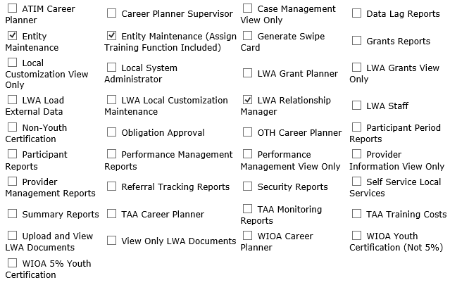
Local System Administrator Training – Entities, Locations, and Relationships
Overview
IWDS User Roles Needed
Entity Maintenance
Add/Edit Entity, Location, Contact, Relationships
Entity Maintenance (Assign Training Function Included)
Add/Edit Entity, Location, Contact, Relationships
Ability to Assign Training Function to Location
LWA Relationship Manager
Add/Edit Relationships

Slide 8
Local System Administrator Training – Entities, Locations, and Relationships
Entering a Company into IWDS
Create Entity
Add Location
Add Contact
Add Relationship

Slide 9
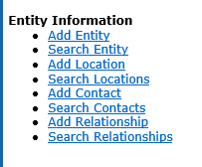
Local System Administrator Training – Entities, Locations, and Relationships
Creating an Entity in IWDS
Before entering the Entity in IWDS, search for the Company from the Staff Menu page.
Click on “Search Entity”.

Slide 10
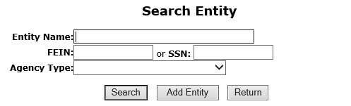
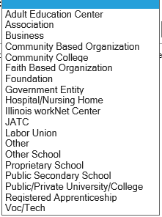
Local System Administrator Training – Entities, Locations, and Relationships
Creating an Entity in IWDS
There are 4 ways to search for an Entity.
Name
FEIN of the Business
SSN (if the business uses the owner’s SSN instead of a FEIN)
Agency Type (from the dropdown menu)

Slide 11
Local System Administrator Training – Entities, Locations, and Relationships
Creating an Entity in IWDS
A FEIN search would be the easiest way to narrow your search as it is a unique identifier.
No two entities in IWDS will have the same FEIN.

Slide 12
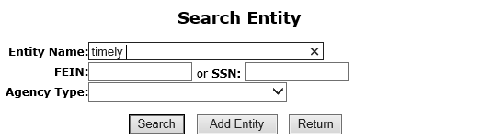
Local System Administrator Training – Entities, Locations, and Relationships
Creating an Entity in IWDS
When searching by the Entity Name it is suggested to use a partial name search if you don’t have the FEIN.
IWDS will search for a match of everything that begins with the letters that are entered.
So “Ti” would return “Tim”, “Time”, “Tire”, and “Timberline”, but “Timely” will return “Timely” or “Timely’s” or “Timely Watch Company”.

Slide 13
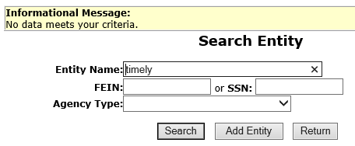
Local System Administrator Training – Entities, Locations, and Relationships
Creating an Entity in IWDS
When no match is found with your search, the Entity will need to be created in IWDS.
Click “Add Entity”.

Slide 14
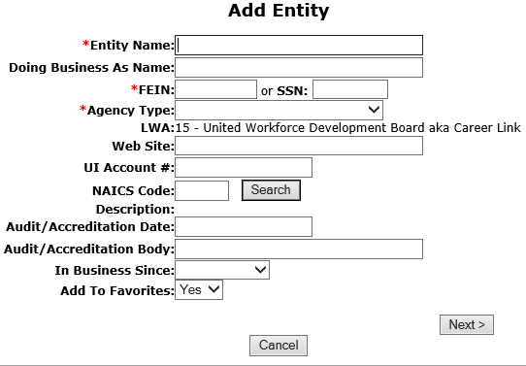
Local System Administrator Training – Entities, Locations, and Relationships
Creating an Entity in IWDS
Any fields marked with the red * are required in order to save the record.
OET recommends entering as much information as you can, as it may help other IWDS users to differentiate between Entities that have the same business names.

Slide 15
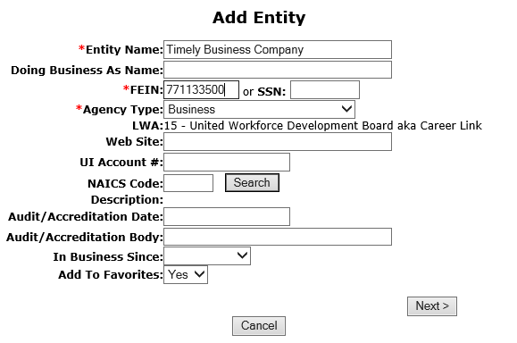
Local System Administrator Training – Entities, Locations, and Relationships
Creating an Entity in IWDS
Enter the Entity Name, FEIN, Agency Type and any additional information provided.
Click “Next” to save the Entity and IWDS will take the user to the Add Location screen.

Slide 16
Local System Administrator Training – Entities, Locations, and Relationships
QUESTIONS?
The Illinois workNet® Center System, an American Job Center, is an equal opportunity employer/program. Auxiliary aids and services are available upon request to individuals with disabilities. All voice telephone numbers may be reached by persons using TTY/TDD equipment by calling TTY (800) 526-0844 or 711. This workforce product was funded by a grant awarded by the U.S. Department of Labor Employment and Training Administration. For more information please refer to the footer at the bottom of any webpage at illinoisworknet.com. – December 2019, v3

Slide 17
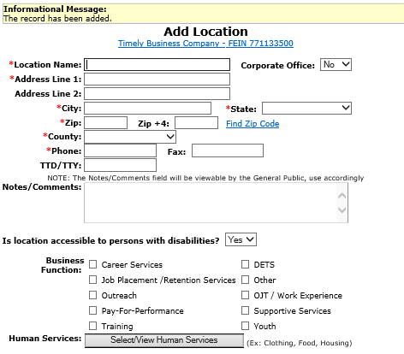
Local System Administrator Training – Entities, Locations, and Relationships
Creating a Location in IWDS
The Informational Message at the top of the screen will state “The record has been added”. The Entity is now saved.
At least one Location where the Entity is doing business is required. However, you may enter more than one location.

Slide 18
Local System Administrator Training – Entities, Locations, and Relationships
Creating a Location in IWDS
The Location information includes:
Location Name (which may be different from the Entity Name –for example entity Niemann Foods with location County Market or Harvest Market).
Geographical address and phone number.
ADA accessibility
Types of Business Functions and Human Services the Location provides.
Fields with the * are required to save the record.

Slide 19
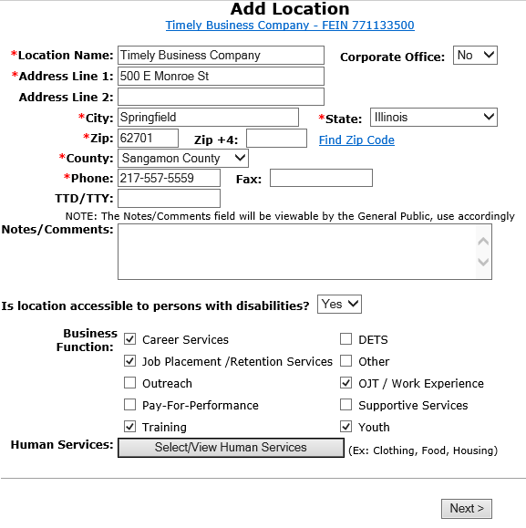
Local System Administrator Training – Entities, Locations, and Relationships
Creating a Location in IWDS
The LSA will need to select the Business Functions for the various types of services this Location will be offering to the LWIAs.
Click “Select/View Human Services” for the Provider Management – Select Human Services screen.

Slide 20
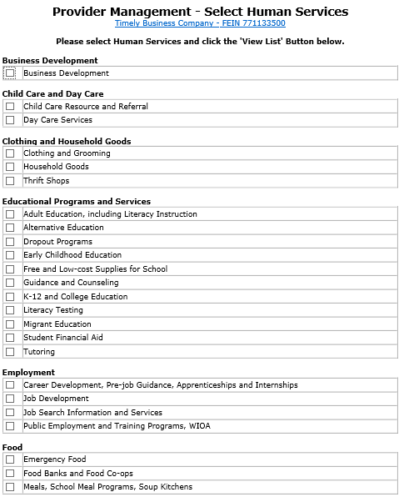
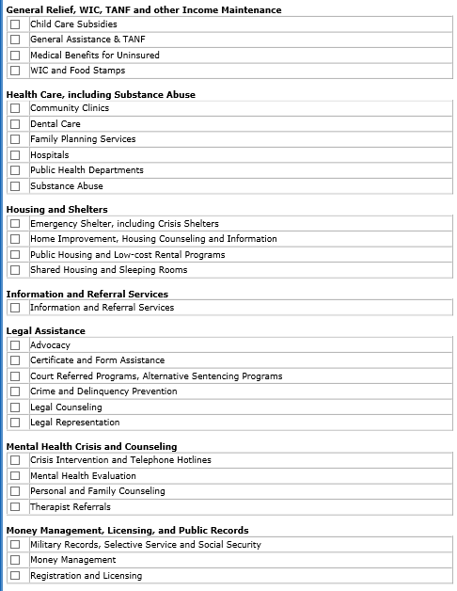
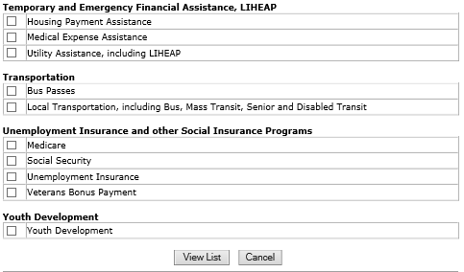
Local System Administrator Training – Entities, Locations, and Relationships
Creating a Location in IWDS
Provider Management – Select Human Services
Select all services that apply to the Location.
Then click “View List”

Slide 21
Local System Administrator Training – Entities, Locations, and Relationships
Creating a Location in IWDS
All Services selected will be listed.
Click “View List”

Slide 22
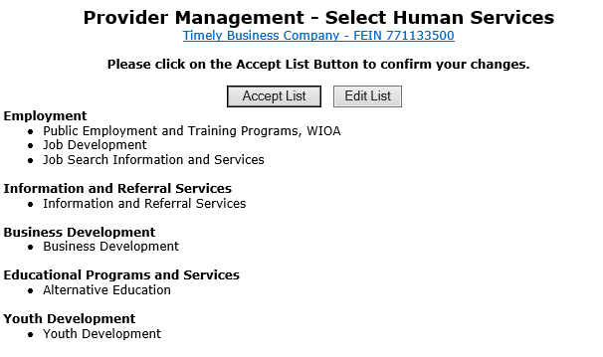
Local System Administrator Training – Entities, Locations, and Relationships
Creating a Location in IWDS
If changes are needed to add or remove items from the list, click “Edit List”.
When finished, click “Accept List”.

Slide 23
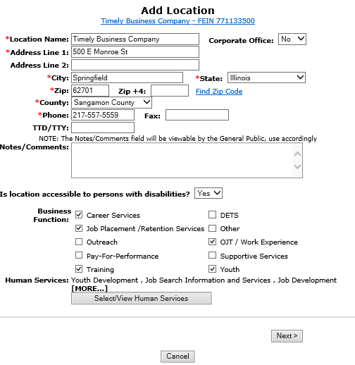
Local System Administrator Training – Entities, Locations, and Relationships
Creating a Location in IWDS
The LSA should review all of the entered information on the screen. Then click “Next” to save the Location and IWDS will take the user to the Add Contacts screen.

Slide 24
Local System Administrator Training – Entities, Locations, and Relationships
QUESTIONS?
The Illinois workNet® Center System, an American Job Center, is an equal opportunity employer/program. Auxiliary aids and services are available upon request to individuals with disabilities. All voice telephone numbers may be reached by persons using TTY/TDD equipment by calling TTY (800) 526-0844 or 711. This workforce product was funded by a grant awarded by the U.S. Department of Labor Employment and Training Administration. For more information please refer to the footer at the bottom of any webpage at illinoisworknet.com. – December 2019, v3

Slide 25
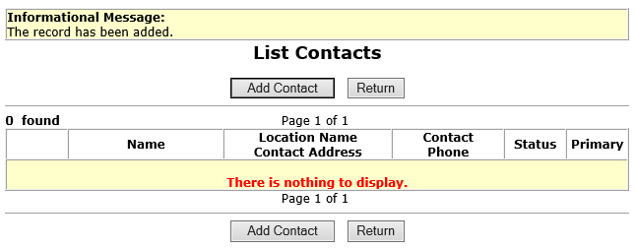
Local System Administrator Training – Entities, Locations, and Relationships
Creating a Contact in IWDS
The Informational Message at the top of the screen will state, “the record has been added”. The Location is now saved.
It is recommended by OET that the user should enter at least one Contact for the Location.
The Entity should identify their Location contacts to the LWIA LSA, including the contact who will enter the Training Programs for the Location if needed.

Slide 26
Local System Administrator Training – Entities, Locations, and Relationships
Creating a Contact in IWDS
To add a Contact, click “Add Contact” and IWDS will take the user to the Search Contact screen.
NOTE: IWDS does not require a contact for the Location. If there is no contact information recorded, the Local System Administrator will be responsible to enter any Training Programs for the Location.
The user may skip this step by selecting “Return”.

Slide 27
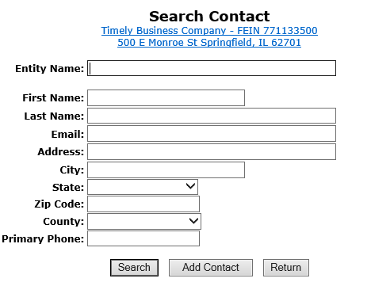
Local System Administrator Training – Entities, Locations, and Relationships
Creating a Contact in IWDS
To search for existing contacts, the user can enter information in any of the fields and click “Search”. In the case of multiple Locations for one Entity, you may have the same Contact for some or all of the Locations.
If the contact you are looking for is already in IWDS and you find them with the search, you can add them to the new Location.

Slide 28
Local System Administrator Training – Entities, Locations, and Relationships
Creating a Contact in IWDS
Since this Entity/Location was just created, its very likely the Contact will need to added.
Click “Add Contact”.

Slide 29
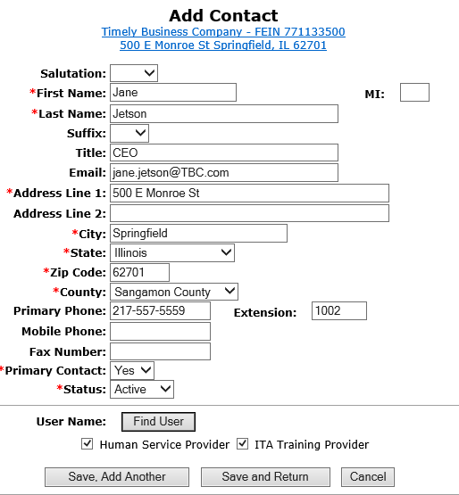
Local System Administrator Training – Entities, Locations, and Relationships
Creating a Contact in IWDS
Fields marked with the * are required in order to save the record.
The “Primary Contact” is the main contact for this Location, not the overall Entity.
If more than one contact is provided for the location, click “Save, Add Another”.
When finished click “Save and Return”.

Slide 30
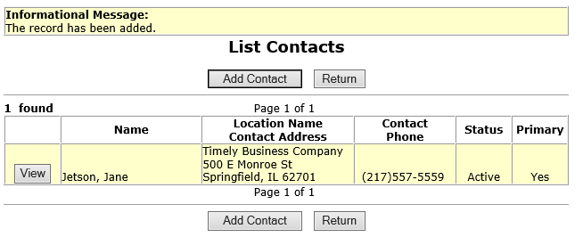
Local System Administrator Training – Entities, Locations, and Relationships
Creating a Contact in IWDS
The Informational Message at the top of the screen will state“The record has been added”.
The Contact is now saved on this Location.
Once the contact is “Saved”, an IWDS User Name (login ID) will be assigned to the Contact for the IWDS Public Side login.
Click “View” to review Contact Information and to see the User ID assigned.

Slide 31
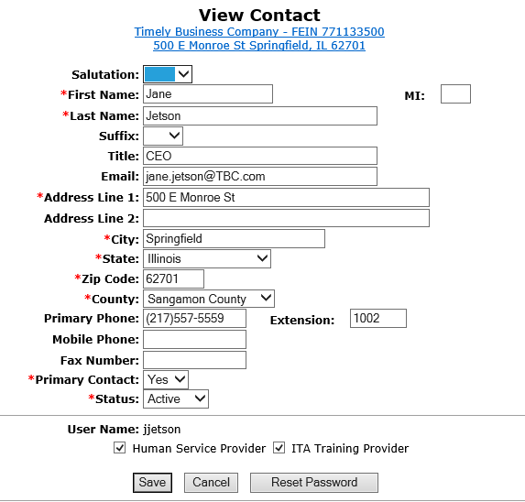
Local System Administrator Training – Entities, Locations, and Relationships
Creating a Contact in IWDS
At the bottom of the View Contact page, the screen shows “User Name: jjetson”.
If your Contact will be entering Training Programs into IWDS for the LWIA to approve/deny, this is the login ID that they will use on the IWDS Public Side page.

Slide 32

Local System Administrator Training – Entities, Locations, and Relationships
Creating a Contact in IWDS
At the bottom of the View Contact page, the screen shows “User Name: jjetson”

Slide 33
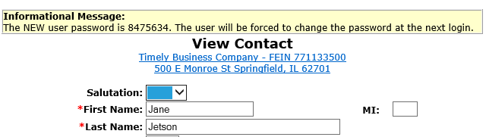
Local System Administrator Training – Entities, Locations, and Relationships
Creating a Contact in IWDS
To reset the password for the contact, click “Reset Password” at the bottom of the page.
The password reset will appear at the top of the screen. You can either use copy/paste or a screenshot to capture this information to send to the user via email.

Slide 34
Local System Administrator Training – Entities, Locations, and Relationships
Creating a Contact in IWDS
The Location Contact will need their user name, a password, and the URL for the IWDS Public Side login in order to enter training program information for their Location.
IWDS PUBLIC SIDE URL:
https://iwds.dceo.illinois.gov/iwds/iwdshome.html

Slide 35
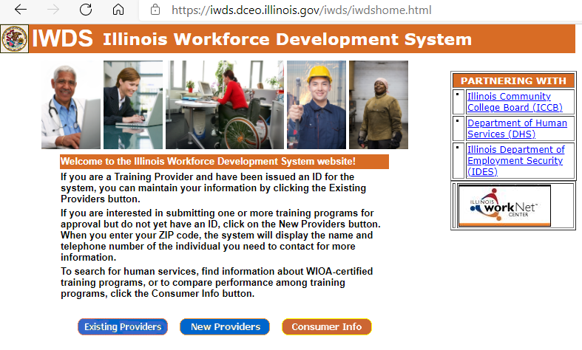
Local System Administrator Training – Entities, Locations, and Relationships
Creating a Contact in IWDS
IWDS PUBLIC SIDE URL:
https://iwds.dceo.illinois.gov/iwds/iwdshome.html
The IWDS login page for the Training Providers appears different from the IWDS Staff login page. It is orange and blue instead of red and blue.

Slide 36
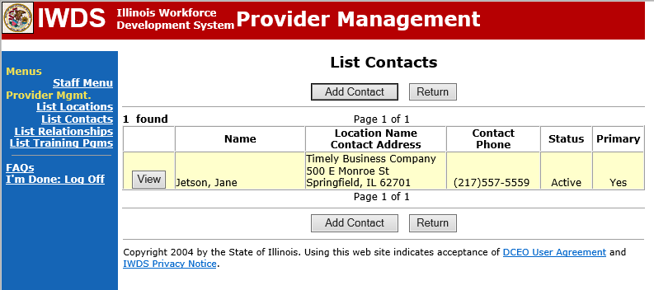
Local System Administrator Training – Entities, Locations, and Relationships
Creating a Contact in IWDS
If you need to add more contacts to the Location, click “Add Contact” to add an additional contact.
You can add as many contacts to a Location as you want.

Slide 37
Local System Administrator Training – Entities, Locations, and Relationships
Creating a Contact in IWDS
When you have finished adding Contacts, you can click on the link for “List Relationships” in the blue navigation panel on the left side of the screen.
From there the user may review Relationships the Entity and Location already have set up and/or enter new Relationships with the Location.

Slide 38
Local System Administrator Training – Entities, Locations, and Relationships
QUESTIONS?
The Illinois workNet® Center System, an American Job Center, is an equal opportunity employer/program. Auxiliary aids and services are available upon request to individuals with disabilities. All voice telephone numbers may be reached by persons using TTY/TDD equipment by calling TTY (800) 526-0844 or 711. This workforce product was funded by a grant awarded by the U.S. Department of Labor Employment and Training Administration. For more information please refer to the footer at the bottom of any webpage at illinoisworknet.com. – December 2019, v3

Slide 39
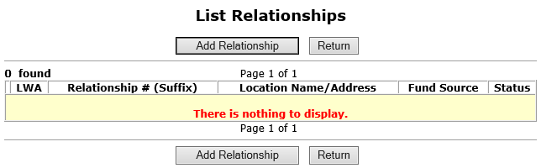
Local System Administrator Training – Entities, Locations, and Relationships
Creating a Relationship in IWDS
Newly created Entities and Locations will not have any existing Relationships between them and the LWIAs.
The LWIA LSAs will only be able to see Relationships between the Location and their own LWIA. The user will not be able to see other LWIAs’ relationships.
Clicking “Add Relationship” will take you to the “Search Location” screen to begin adding a new Relationship.

Slide 40
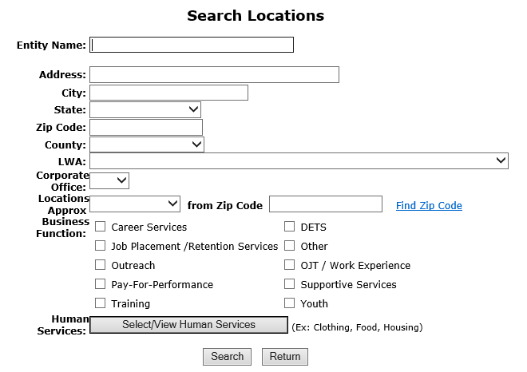
Local System Administrator Training – Entities, Locations, and Relationships
Creating a Relationship in IWDS
Search for the Location to be used to set up the Relationship.
If you have multiple Locations for the same Entity providing service to your LWIA, you will need multiple Relationships.
Each Location will need to have their own Relationship set up with the LWIA.

Slide 41
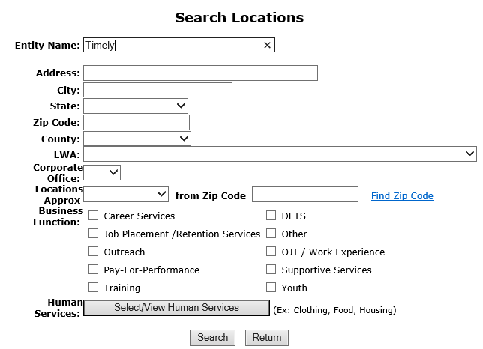
Local System Administrator Training – Entities, Locations, and Relationships
Creating a Relationship in IWDS
A partial Name can be used for the search on the Entity Name.
Address/City/Zip Code/County information could be included to narrow the search when you know there is more than one Location for the Entity.
Click “Search”

Slide 42
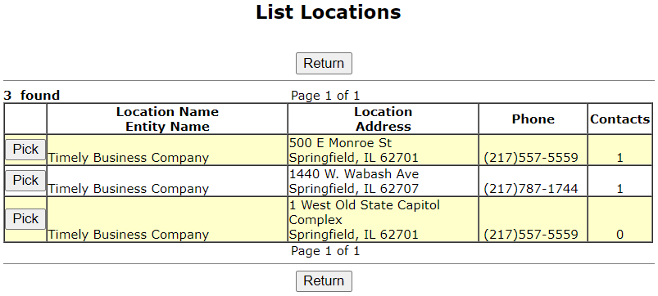
Local System Administrator Training – Entities, Locations, and Relationships
Creating a Relationship in IWDS
Select your location in the results by clicking “Pick” next to the Location Name.
If the Location you are looking for isn’t here, click “Return” and try your search again.
In this case, we will pick the Location at 1 West Old State Capitol Complex.

Slide 43
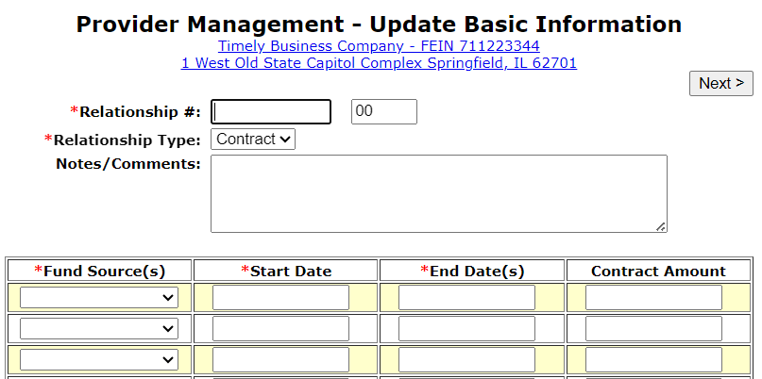
Local System Administrator Training – Entities, Locations, and Relationships
Creating a Relationship in IWDS
The first step in creating the Relationship is the Provider Management – Update Basic Information screen.

Slide 44
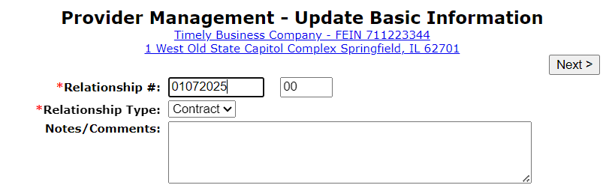
Local System Administrator Training – Entities, Locations, and Relationships
Creating a Relationship in IWDS
When creating the “Relationship #” it should be a unique identifier using alpha/numeric characters.
The LSA entering the Relationships can choose whatever naming convention they are comfortable with. OET recommends that you use something that makes it easy for you to identify the Relationship.
In this case, I’m choosing a date based “01072025” and “00”.

Slide 45
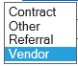
Local System Administrator Training – Entities, Locations, and Relationships
Creating a Relationship in IWDS
Select the “Relationship Type” from the drop-down menu.
Next, scroll down the Provider Management – Update Basic Information page to enter the Fund Source/Grant Information section.

Slide 46
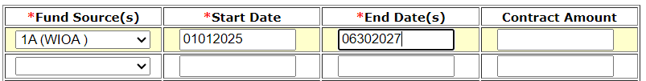
Local System Administrator Training – Entities, Locations, and Relationships
Creating a Relationship in IWDS
Enter Location Grant information in the required fields:
Fund Source
Start Date
End Date
The Fund Source is the Title (1A, 1D, 1E, 1N, TAA, 1DC, 1EC, etc.).

Slide 47
Local System Administrator Training – Entities, Locations, and Relationships
Creating a Relationship in IWDS
It is recommended by OET to leave the Contract Amount blank.
It is not a required field and entering a dollar amount here could trigger other programming edits in IWDS that may cause issues.

Slide 48
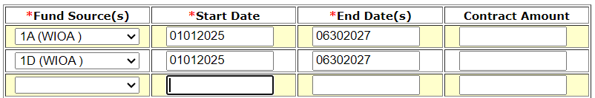
Local System Administrator Training – Entities, Locations, and Relationships
Creating a Relationship in IWDS
When entering a Fund Source, the start date can be in the past, the present date, or in the future.
The date range entered for the Fund Source will affect what services are available with this provider on dates before, during, and after the date range.

Slide 49
Local System Administrator Training – Entities, Locations, and Relationships
Creating a Relationship in IWDS
Once saved, the Start Date cannot be changed. Not even by the IWDS System Administrators.

Slide 50
Local System Administrator Training – Entities, Locations, and Relationships
Creating a Relationship in IWDS
Once saved, the End Date can be changed to be greater than the current End Date (future), but never less than the current End Date (past).
If the grant is extended, the LSA can change the end date to extend the relationship with this Entity/Location for the selected Fund Source.

Slide 51
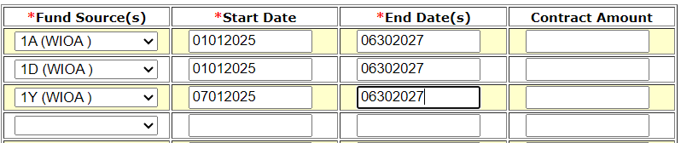
Local System Administrator Training – Entities, Locations, and Relationships
Creating a Relationship in IWDS
In this case, the 1Y grant will start in the future (greater than today’s date) July 2025.
Even though they are entering the Fund Source with a future Start Date, this part of the relationship won’t affect the 1Y client services unless those services are within the date range of 7/1/2023 to 6/30/2024 for this provider.

Slide 52
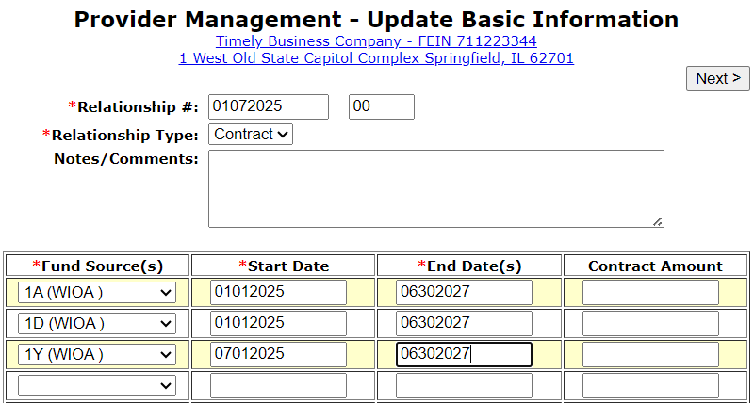
Local System Administrator Training – Entities, Locations, and Relationships
Creating a Relationship in IWDS
Click “Next” to save the fund source information and go to Add Program Activities.

Slide 53
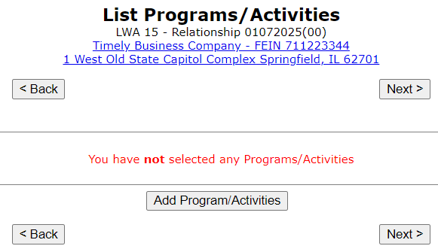
Local System Administrator Training – Entities, Locations, and Relationships
Creating a Relationship in IWDS
Click “Add Programs/Activities” to choose Titles (1A, 1D, TAA, etc.) to add services to the Relationship.

Slide 54
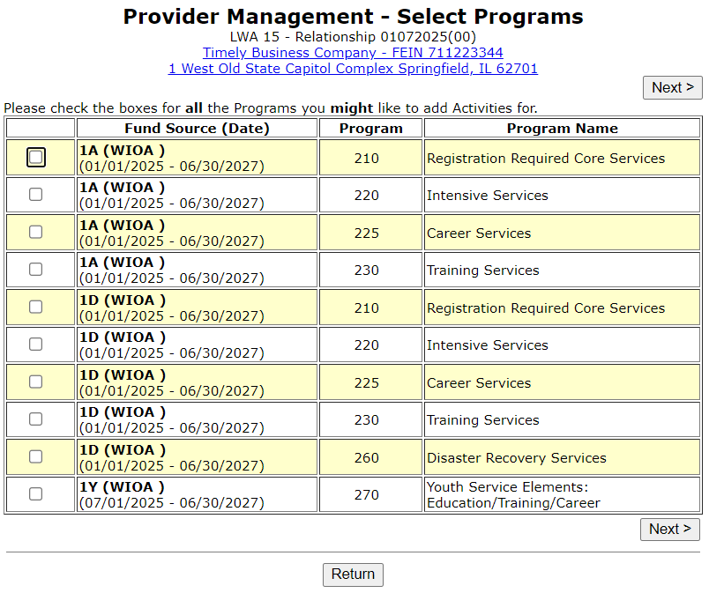
Local System Administrator Training – Entities, Locations, and Relationships
Creating a Relationship in IWDS
Select each Title/Service type needed for the Relationship.
Make sure you are selecting “Career Services” and “Training Services” for 1A/1D/1E/1N/1DC/1EC and not “Registration Required Core Services” or “Intensive Services” as those Program Types no longer apply to WIOA.

Slide 55
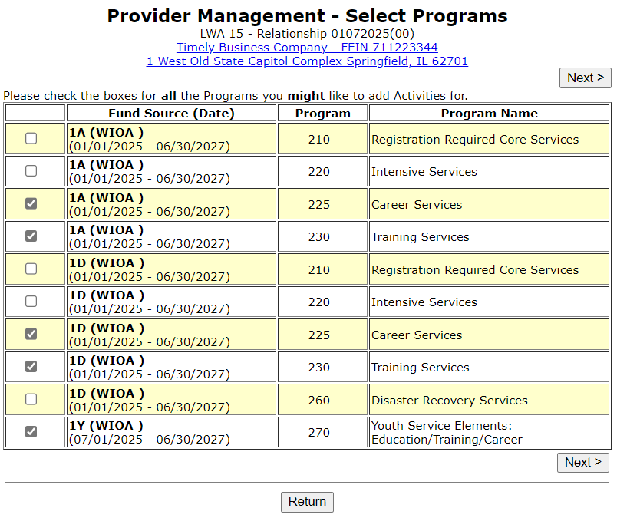
Local System Administrator Training – Entities, Locations, and Relationships
Creating a Relationship in IWDS
Check all Programs you might want to add Activities for.
You will need to select Career and Training levels separately for each Fund Source.
Click “Next” to view list.

Slide 56
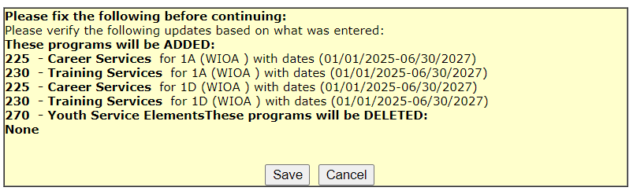
Local System Administrator Training – Entities, Locations, and Relationships
Creating a Relationship in IWDS
Review your selections, click “Save” to select services per Funding Source.

Slide 57
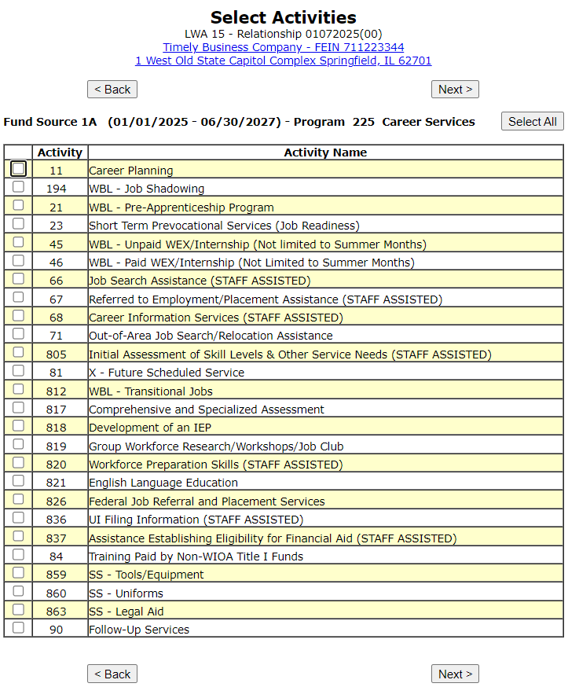
Local System Administrator Training – Entities, Locations, and Relationships
Creating a Relationship in IWDS
Select the specific services for each Title/Service Level allowed by the grant.
This example is starting with 1A Career level services.

Slide 58
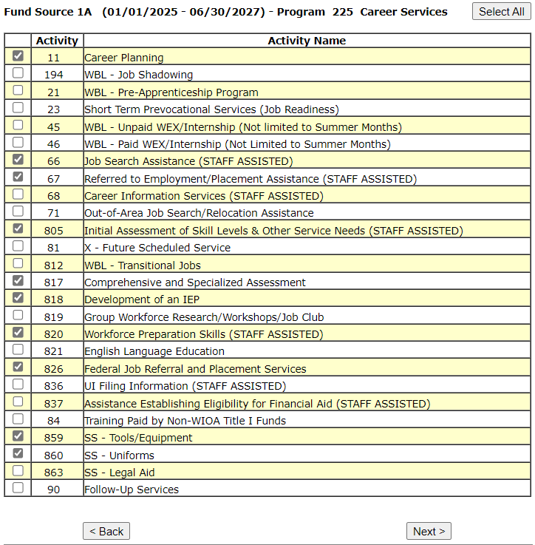
Local System Administrator Training – Entities, Locations, and Relationships
Creating a Relationship in IWDS
The services chosen on the “Select Activities” screens will be the WIOA services that will appear as a provider choice during the time period entered on the relationship for the Entity.
Click “Next” to move to the next Title/Service Level.

Slide 59
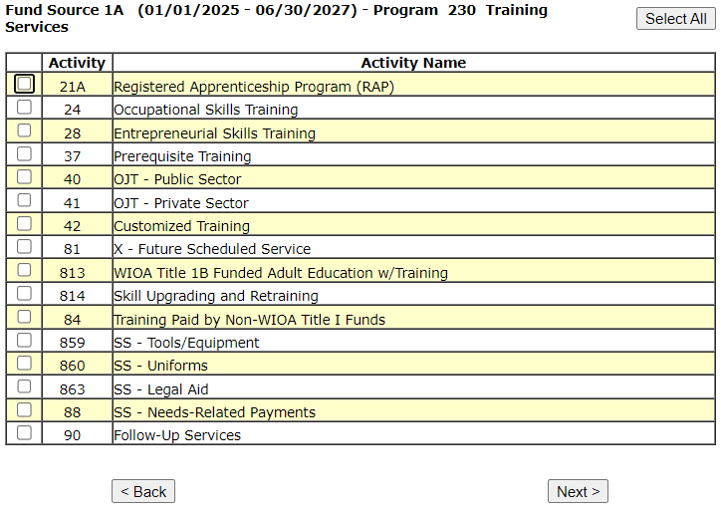
Local System Administrator Training – Entities, Locations, and Relationships
Creating a Relationship in IWDS
The next Title/Service Level is 1A Training Services.

Slide 60
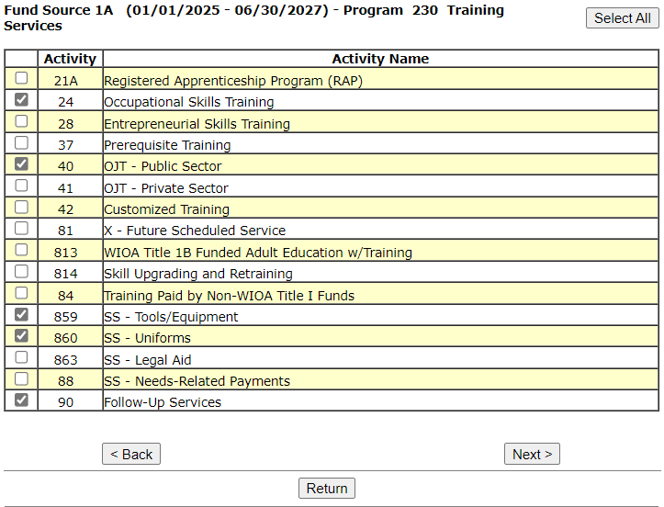
Local System Administrator Training – Entities, Locations, and Relationships
Creating a Relationship in IWDS
Select the 1A Training Services and click “Next” to move to the next Title/Service Level.

Slide 61
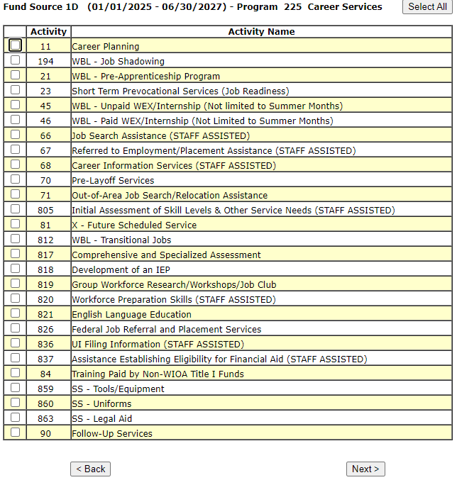
Local System Administrator Training – Entities, Locations, and Relationships
Creating a Relationship in IWDS
Select the 1D Career Services and then click “Next” to move to the next Title/Service Level.

Slide 62
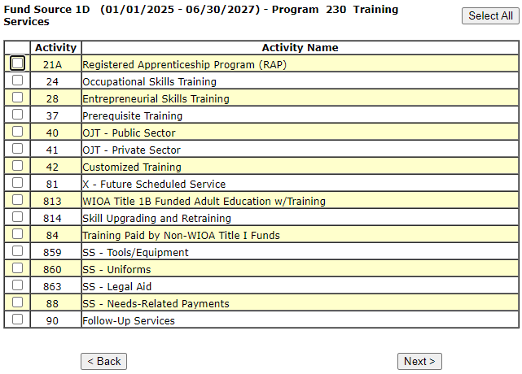
Local System Administrator Training – Entities, Locations, and Relationships
Creating a Relationship in IWDS
Select 1D Training Services and click “Next” to move to the next Title/Service Level.

Slide 63
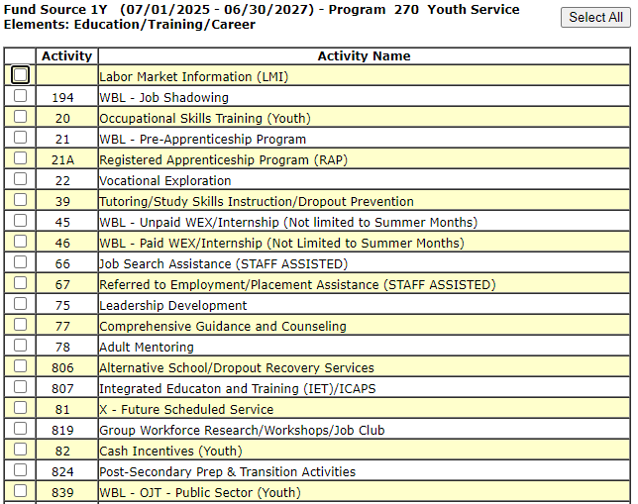
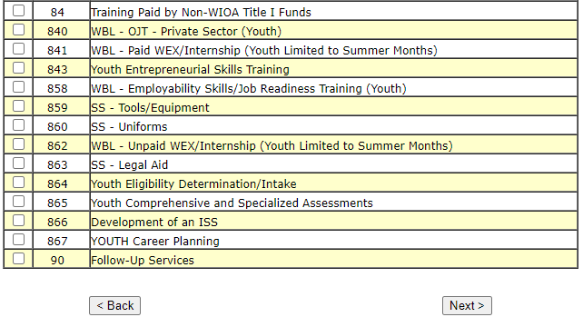
Local System Administrator Training – Entities, Locations, and Relationships
Creating a Relationship in IWDS
Select 1Y Youth Service Elements: Education/ Training/ Career.
Click “Next” to complete the service selections.

Slide 64
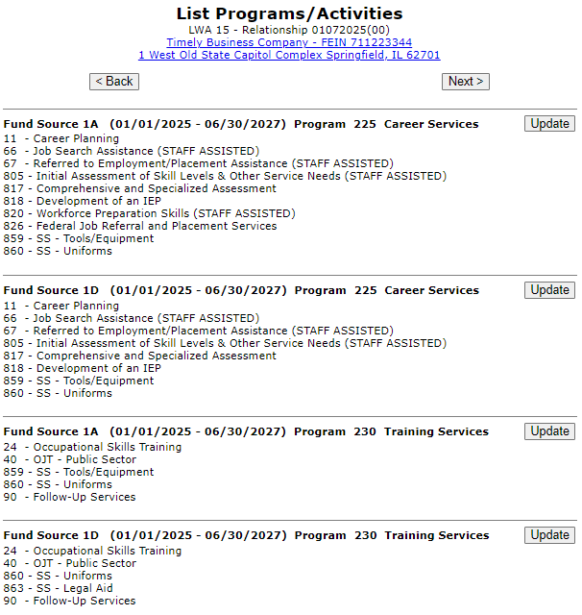
Local System Administrator Training – Entities, Locations, and Relationships
Creating a Relationship in IWDS
Review the services selected in each Title/Service.

Slide 65
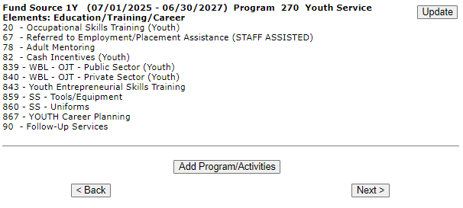
Local System Administrator Training – Entities, Locations, and Relationships
Creating a Relationship in IWDS
Click “Update” in any section to edit the service choices.
When finished, click “Next” to save your choices.

Slide 66
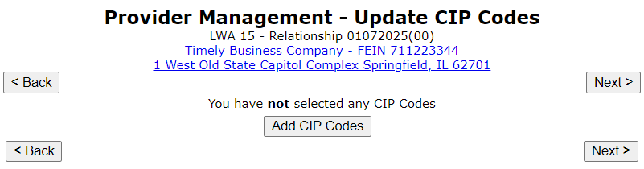
Local System Administrator Training – Entities, Locations, and Relationships
Creating a Relationship in IWDS
Provider Management – Update CIP Codes screen.
OET does not recommend adding any CIP Codes to the Relationship. This can cause issues that limit the services that are available.
Click “Next”.
CIP Codes - Classification of Instructional Program Codes.

Slide 67
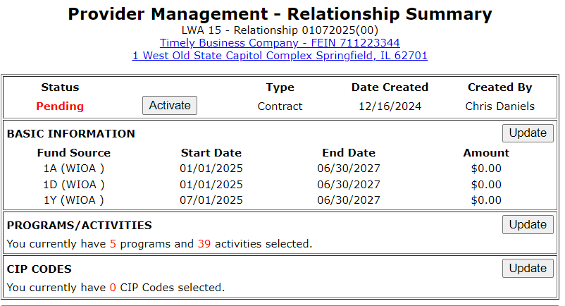
Local System Administrator Training – Entities, Locations, and Relationships
Creating a Relationship in IWDS
Review the Relationship Summary.
Status
Basic Information
Program Activities
CIP Codes
Click “Activate” to accept and turn on the Relationship.

Slide 68

Local System Administrator Training – Entities, Locations, and Relationships
Creating a Relationship in IWDS
“Active” Status indicates that the Entity/Location will be available as a provider choice in the selected services in the selected titles during the selected date periods.

Slide 69


Local System Administrator Training – Entities, Locations, and Relationships
Creating a Relationship in IWDS
To show an example of how the provider should appear in the client services, we will open a new 1A service in our test client

Slide 70


Local System Administrator Training – Entities, Locations, and Relationships
Creating a Relationship in IWDS
This is an example of how the provider should appear in the service if your service is within the date range and your title and service is selected in the relationship.
In the Client Record, add a service. In this case, we are choosing Title 1A, and a Training Service starting on 1/2/2025.

Slide 71


Local System Administrator Training – Entities, Locations, and Relationships
Creating a Relationship in IWDS
Select an Activity and Training Type, ITA Funded = Yes/No Contract Funded = Yes/No.
Then click “Next”.

Slide 72

Local System Administrator Training – Entities, Locations, and Relationships
Creating a Relationship in IWDS
Fill in the required fields.
Then click “Search Providers”

Slide 73

Local System Administrator Training – Entities, Locations, and Relationships
Creating a Relationship in IWDS
Click “Show All” or add the Provider Relationship Name and/or the Relationship Number and click “Search”.

Slide 74


Local System Administrator Training – Entities, Locations, and Relationships
Creating a Relationship in IWDS
“Show All” lists Providers in alphabetical order. If a Location has multiple active Relationships with the LWIA, there could be multiple results with the same Location name.
Click “Next Page” to scroll though pages to find the desired Provider/Relationship ID.
Click “Pick” to select the correct Provider/Relationship ID for the service.

Slide 75

Local System Administrator Training – Entities, Locations, and Relationships
Creating a Relationship in IWDS
This is how the Relationship works.
The service was:
In the Relationship
In the right Title
Inside the active Date Range
If your Provider is not showing up in a service, these are the first 3 things to troubleshoot.

Slide 76
Local System Administrator Training – Entities, Locations, and Relationships
Maintaining LWIA Relationships in IWDS
Each LWIA across the State should have at least one Local System Administrator that has the responsibility of maintaining the Provider/Entity Relationships.
Those Local System Administrators should establish and maintain a schedule for updating the Relationship end dates.

Slide 77
Local System Administrator Training – Entities, Locations, and Relationships
Maintaining LWIA Relationships in IWDS
Different ways to schedule the review of your Relationships:
End of program year
Schedule towards the latter part of June every year and make sure all of their relationships that are scheduled to end in the next 12 months are updated.
End of calendar year
Schedule towards the latter part of December every year and make sure all of their relationships that are scheduled to end in the next 12 months are updated.
Twice a year
Schedule every 6 months and update/review half of your relationships in December and half in June.
Quarterly
Schedule quarterly and update/review a portion of your relationships every 3 months.

Slide 78
Local System Administrator Training – Entities, Locations, and Relationships
Maintaining LWIA Relationships in IWDS
There is no required direction from OET for maintaining those Relationship end dates to ensure the Relationships stays current, but this is something each Local System Administrator who is assigned the responsibility for the Provider/Entity Relationships at the LWIA must keep the information up to date.
If the LWIA does not maintain their Relationships, they run the risk that they will expire and that will restrict their various Career Planner staff from recording services on client records in IWDS.

Slide 79

Local System Administrator Training – Entities, Locations, and Relationships
LWIA Point of Contact for Training Providers
It is very important for the LWIA to keep the contact information on the Public Side of IWDS up to date.
If the Local System Administrator who was the main contact for the LWIA has left, this information must be updated ASAP.
To see who is listed in your LWIA, click “new providers”

Slide 80

Local System Administrator Training – Entities, Locations, and Relationships
LWIA Point of Contact for Training Providers
Enter a zip code in your LWIA and click “Return”

Slide 81

Local System Administrator Training – Entities, Locations, and Relationships
LWIA Point of Contact for Training Providers
This will display who the main LWIA point of contact is for training providers.
If any of this information has changed, email the IWDS Performance Measures staff and cc: the IWDS System Administrators to have the information updated.

Slide 82
Local System Administrator Training – Entities, Locations, and Relationships
DCEO Contacts
IWDS SYSTEM ADMINISTRATORS
Jim Potts: (217) 299-4532, james.potts@illinois.gov
Kris Theilen: (217) 299-2161, kristofer.theilen@illinois.gov
WIOA PERFORMANCE MEASURES STAFF
Mark Burgess: (217) 970-0061, mark.a.burgess@illinois.gov
Paula Barry: paula.barry@illinois.gov
Ray Al-Amin: ramon.al-amin@illnois.gov

Slide 83
Local System Administrator Training – Entities, Locations, and Relationships
QUESTIONS?
The Illinois workNet® Center System, an American Job Center, is an equal opportunity employer/program. Auxiliary aids and services are available upon request to individuals with disabilities. All voice telephone numbers may be reached by persons using TTY/TDD equipment by calling TTY (800) 526-0844 or 711. This workforce product was funded by a grant awarded by the U.S. Department of Labor Employment and Training Administration. For more information please refer to the footer at the bottom of any webpage at illinoisworknet.com. – December 2019, v3

