Slide 1

Local System Administrator
Training
Editing IWDS Client Screens
March 23, 2021

Slide 2
Local System Administrator Training – Editing IWDS Client Screens
Acronyms used in this presentation
DCEO – Department of Commerce and Economic Opportunity
OET – DCEO Office of Employment and Training
IWDS – Illinois Workforce Development System
IwNC – Illinois workNet Center
LSA – Local System Administrator

Slide 3
Local System Administrator Training – Editing IWDS Client Screens
Overview
This training is not meant to be a substitute for the WIOA training series offered by OET.
This training is about what a Local System Administrator can change/edit on client screens after the client has been certified and how to submit for client modifications that need assistance from OET.

Slide 4
Local System Administrator Training – Editing IWDS Client Screens
Overview
Please be aware that just because something can be changed doesn’t always mean it should be changed.
The LSA needs to be aware of how those changes can affect client eligibility before making any alterations.

Slide 5
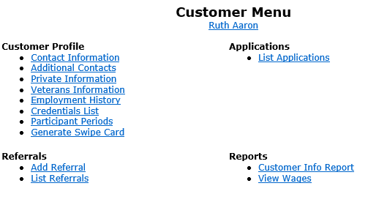
Local System Administrator Training – Editing IWDS Client Screens
IWDS Client Levels
IWDS has 2 distinct levels for data entry.
Customer Level is where the most up to date information is stored. If a new application is added to an existing client, the customer information from that newest application will overwrite the existing Customer Level data. An IWDS user can also manually update the Customer Level data at any time.
There is only one Customer Level record per client.

Slide 6
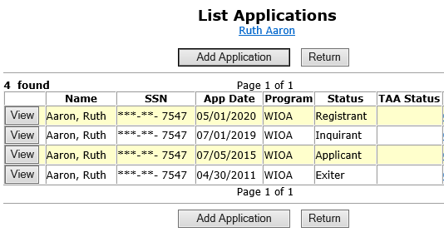
Local System Administrator Training – Editing IWDS Client Screens
IWDS Client Levels
The Application Level is where the client services are recorded.
A client can have multiple Application Level records. The client could be co-enrolled, or they could have pre-existing Inquirant or Exiter records.

Slide 7
Local System Administrator Training – Editing IWDS Client Screens
IWDS Client Levels
Each Application Level record is a “Snapshot in time”. Each Application should have the client’s correct information AT THE DATE/TIME OF THE APPLICATION.
So, if this client got married, moved, or had any other changes after the 5/1/2020 App Date, then the updated information would go on the Customer Level, as the Application Level was accurate on 5/1/2020.

Slide 8
Local System Administrator Training – Editing IWDS Client Screens
IWDS Client Records
Sometimes when a client comes into an LWIA, the career planner may forget to search for an existing IWDS record for the client or they may not find the existing record due to a name change or a spelling error.
Usually, what will happen is the career planner will get an error on the SSN when they try to save the new record. If this happens, the LSA should instruct the career planner to try 4 simple searches.

Slide 9
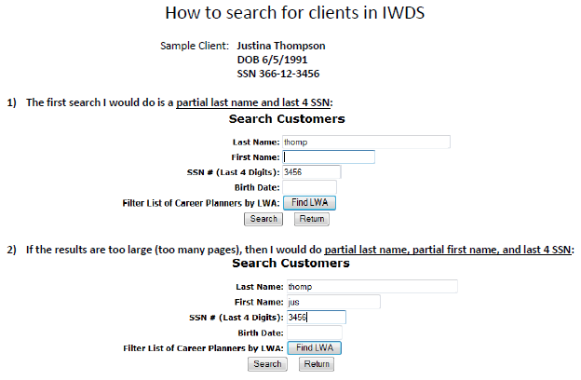
Local System Administrator Training – Editing IWDS Client Screens
IWDS Client Records
There are 4 simple searches that will find 99.9% of existing IWDS clients. The 4 searches will take approximately 2 minutes to complete:
Partial Last Name and Last 4 SSN
Partial Last Name and Partial First Name (with or without Last 4 SSN)

Slide 10
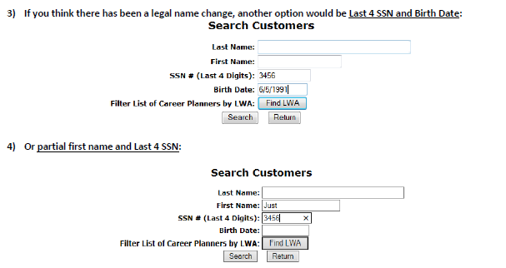
Local System Administrator Training – Editing IWDS Client Screens
IWDS Client Records
3) Last 4 SSN and Birth Date
4) Partial First Name and Last 4 SSN
These last two searches are essential if you think there could be a legal name change (especially if the client is female – more likely to have a legal name change with a marriage or divorce).
You could have 1 client with multiple applications with different last names.

Slide 11
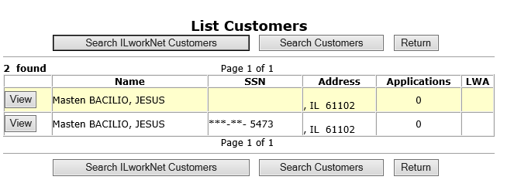
Local System Administrator Training – Editing IWDS Client Screens
IWDS Client Records
If you discover that a client has multiple client level records and you are positive they are for the same person, there are 2 choices: delete the bad record(s) or request to merge the records.

Slide 12
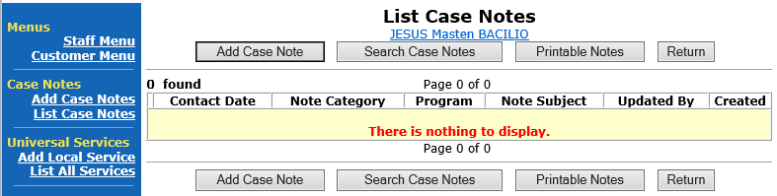
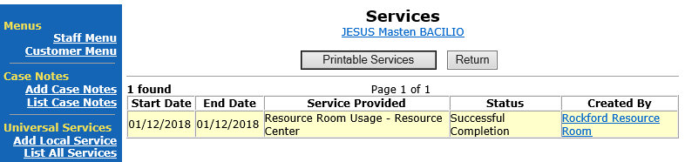
Local System Administrator Training – Editing IWDS Client Screens
IWDS Client Records
If the “bad record” has Case Notes or Universal Services, then OET recommends requesting a “merge”. If not, then request a “delete”.

Slide 13
Local System Administrator Training – Editing IWDS Client Screens
IWDS Client Records
To request to merge or delete the records, the LSA will need to send an email to the IWDS System Administrators with a screen shot of the customer records (like the one on the right) and detail which record has the customer level information you want to keep on the merged record or which records to delete from IWDS.

Slide 14
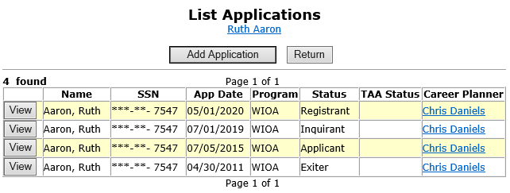
Local System Administrator Training – Editing IWDS Client Screens
Making Corrections to IWDS Clients
There are 4 different stages for an Application Level record:
Inquirant – Application started, but not certified
Applicant – Application certified, but no services entered
Registrant – Application certified, at least one service entered
Exiter – application certified, client services all closed, exit screen completed

Slide 15
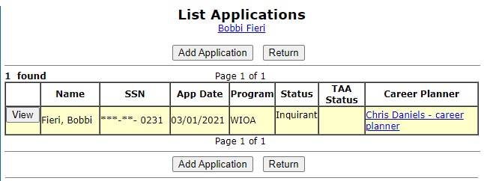
Local System Administrator Training – Editing IWDS Client Screens
Making Corrections to IWDS Clients
If the client is still in Inquirant status, the career planner can edit the client themselves as none of the fields are locked.

Slide 16
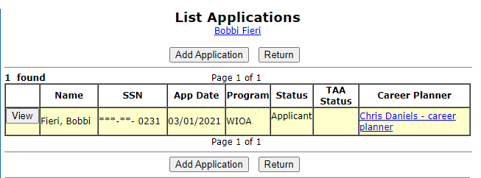
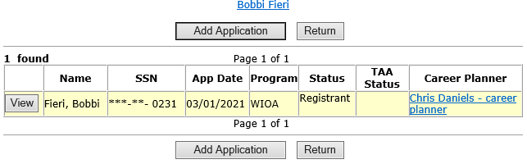
Local System Administrator Training – Editing IWDS Client Screens
Making Corrections to IWDS Clients
If the client is in Applicant or Registrant status, the LSA and the Career Planner can only edit unlocked fields.
Any locked fields will require a Modification Request form.

Slide 17
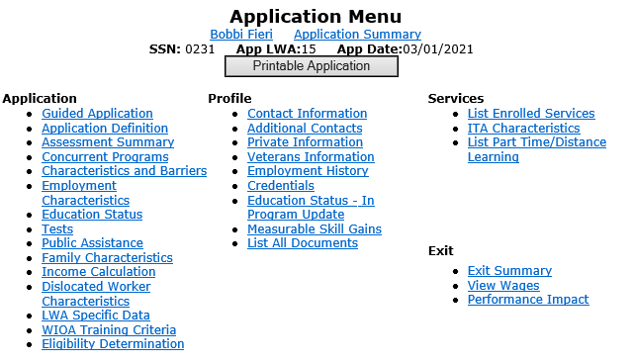
Local System Administrator Training – Editing IWDS Client Screens
Making Corrections to IWDS Clients
The Local System Administrator can edit fields, delete services, even delete eligibility certifications.

Slide 18
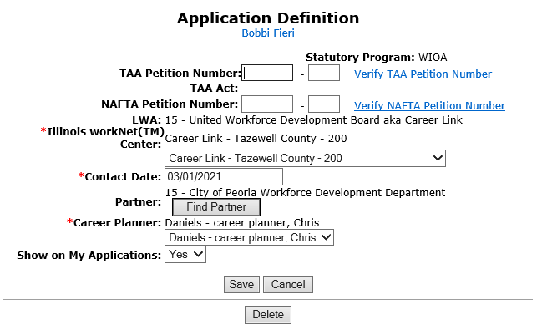
Local System Administrator Training – Editing IWDS Client Screens
Making Corrections to IWDS Clients
On the Application Definition screen, the LSA can change the IwNC or the Career Planner with the options in the dropdowns. The only choices in these 2 dropdown menus will be specific to the LWIA where the Local System Administrator is assigned.
If the client is not showing up in the career planner’s “My Customers” menu, check to be sure the “Show on My Applications” field = Yes
If you change the “Contact Date”, the IWDS system will not let the date be greater than the application date.

Slide 19
Local System Administrator Training – Editing IWDS Client Screens
Making Corrections to IWDS Clients
On the Application Definition screen, the LSA can also delete the entire Application by clicking the DELETE button.
CAUTION – this will delete almost EVERYTHING connected to this application. Services, certification, client data, test data, and more will all be deleted.
This will not delete case notes

Slide 20
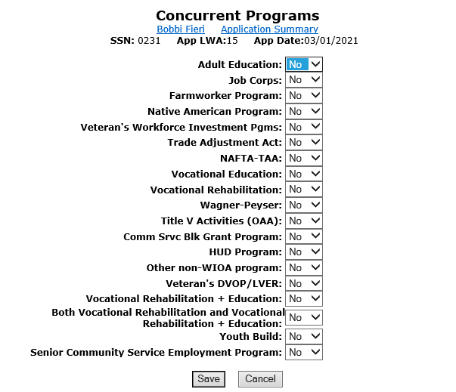
Local System Administrator Training – Editing IWDS Client Screens
Making Corrections to IWDS Clients
On the Concurrent Programs screen, the LSA can change all of the choices.
Keep in mind, this should reflect concurrent programs for the client on the Application Date, not programs added after that date.

Slide 21
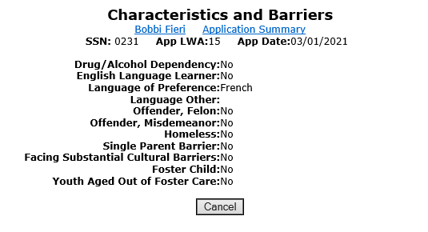
Local System Administrator Training – Editing IWDS Client Screens
Making Corrections to IWDS Clients
On the Characteristics and Barriers screen, the LSA cannot change any fields.
Any changes to this screen will require an IWDS Modification Request form.

Slide 22
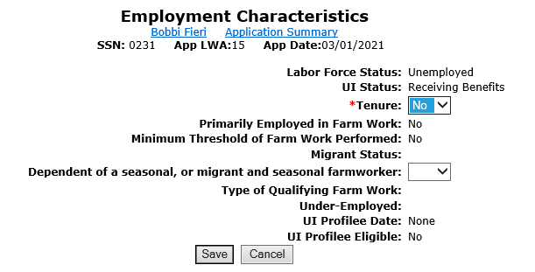
Local System Administrator Training – Editing IWDS Client Screens
Making Corrections to IWDS Clients
On the Employment Characteristics screen, the LSA can only change the “Tenure” and the “Dependent of a seasonal, or migrant and seasonal farmworker” fields.
Changes to any other field on this screen will require an IWDS Modification Request form.

Slide 23
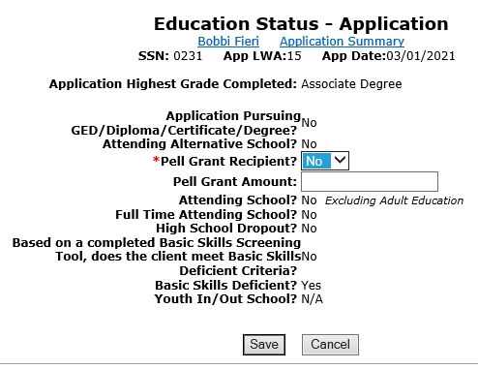
Local System Administrator Training – Editing IWDS Client Screens
Making Corrections to IWDS Clients
On the Employment Status – Application screen, the LSA can only change the “Pell Grant Recipient” and the “Pell Grant Amount” fields.
Changes to any other field on this screen will require an IWDS Modification Request form.

Slide 24
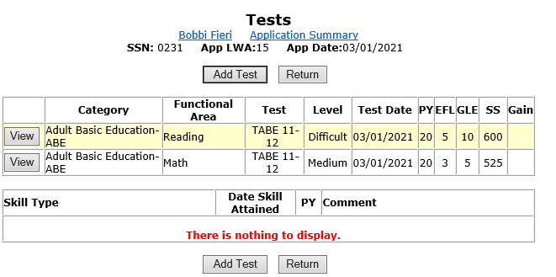
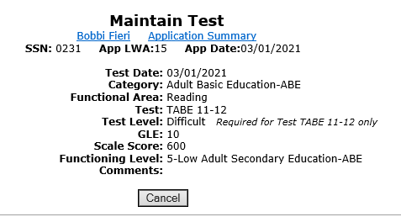
Local System Administrator Training – Editing IWDS Client Screens
Making Corrections to IWDS Clients
On the Tests screens, the LSA can not make any changes to existing tests.
Changes to any other field on the Maintain Test screen or a request to delete a test record will require an IWDS Modification Request form.

Slide 25
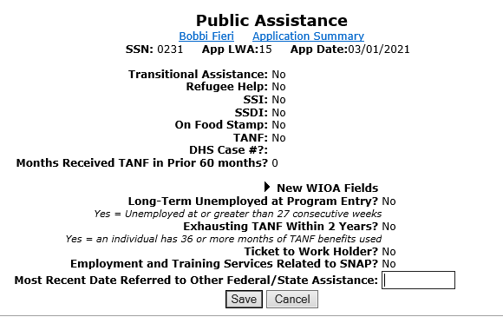
Local System Administrator Training – Editing IWDS Client Screens
Making Corrections to IWDS Clients
On the Public Assistance screen, the LSA can only change the “Most Recent Date Referred to Other Federal/State Assistance” field.
Changes to any other field on this screen will require an IWDS Modification Request form.

Slide 26
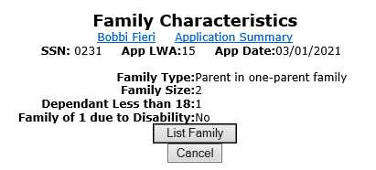
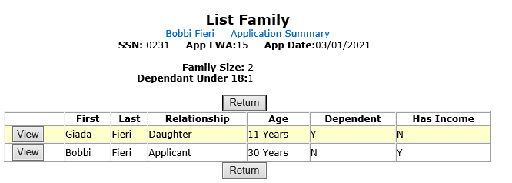
Local System Administrator Training – Editing IWDS Client Screens
Making Corrections to IWDS Clients
On the Family Characteristics and List Family screens, the LSA cannot change any fields.
Any changes to this screen including adding or removing family members will require an IWDS Modification Request form.

Slide 27
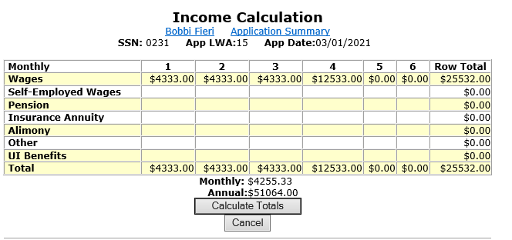
Local System Administrator Training – Editing IWDS Client Screens
Making Corrections to IWDS Clients
On the Income Calculation screen, the LSA cannot change any fields.
Any changes to this screen will require an IWDS Modification Request form.

Slide 28
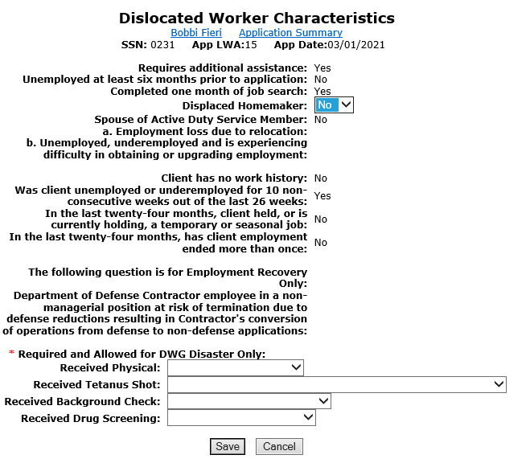
Local System Administrator Training – Editing IWDS Client Screens
Making Corrections to IWDS Clients
On the Dislocated Worker Characteristics screen, the LSA can only change the “Displaced Homemaker” field and the 4 DWG Disaster fields.
Changes to any other field on this screen will require an IWDS Modification Request form.

Slide 29
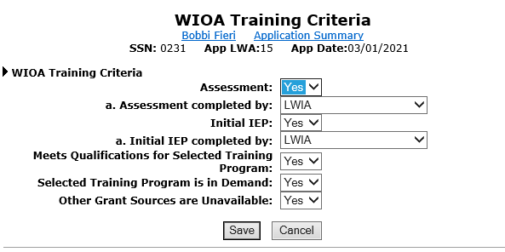
Local System Administrator Training – Editing IWDS Client Screens
Making Corrections to IWDS Clients
On the WIOA Training Criteria screen, the LSA can only change all of the fields.

Slide 30
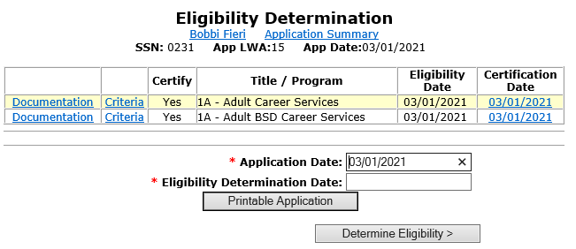
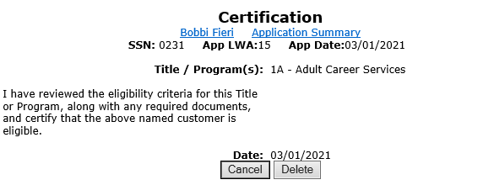
Local System Administrator Training – Editing IWDS Client Screens
Making Corrections to IWDS Clients
On the Eligibility Determination screen, the LSA can add new Title/Program eligibility and certify it.
They can also delete previously certified Title/Program eligibility.
However, the LSA should be very careful to make sure any related services are deleted before deleting a certification.

Slide 31
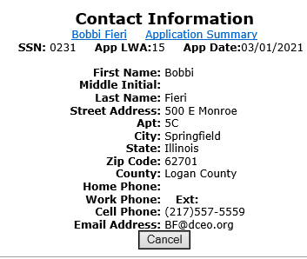
Local System Administrator Training – Editing IWDS Client Screens
Making Corrections to IWDS Clients
On the Contact Information screen, the LSA cannot change any fields.
Any changes to this screen will require an IWDS Modification Request form.
However, the LSA should verify that any changes to this screen were accurate on the application date.
Any changes that occurred after the application date should be made to the Contact Information screen on the Customer Level.

Slide 32
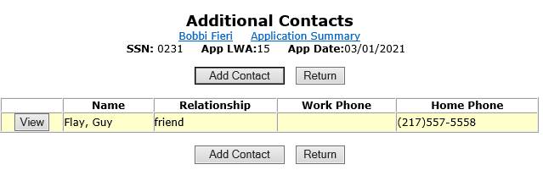
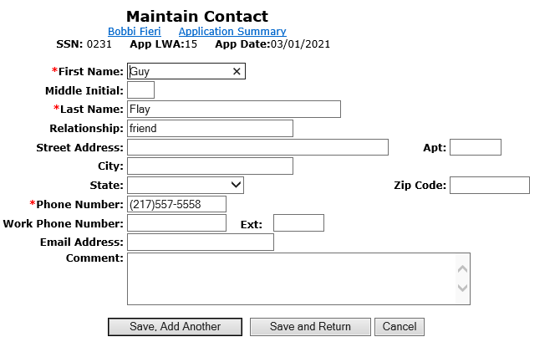
Local System Administrator Training – Editing IWDS Client Screens
Making Corrections to IWDS Clients
On the Additional Contacts screen, the LSA can add new contacts and change any fields on an existing contact.
To remove a contact will require an IWDS Modification Request form.
However, the LSA should verify that any changes to this screen were accurate on the application date.
Any changes that occurred after the application date should be made to the Additional Contacts screen on the Customer Level.

Slide 33
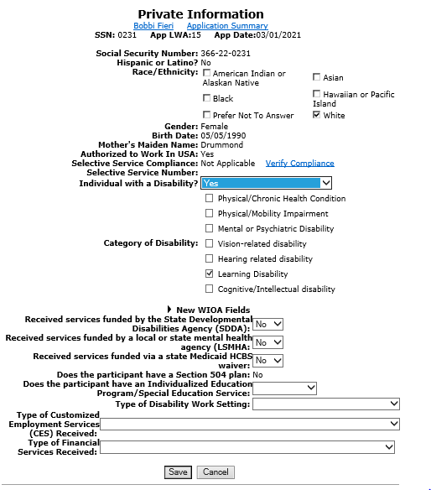
Local System Administrator Training – Editing IWDS Client Screens
Making Corrections to IWDS Clients
On the Private Information screen, the LSA can change the “Race/Ethnicity”, “Individual with a Disabilty”, “Category of Disability”, and all of the New WIOA Fields.
Any changes to the other fields on this screen will require an IWDS Modification Request form.
However, the LSA should verify that any changes to this screen were accurate on the application date.
Any changes that occurred after the application date should be made to the Private Information screen on the Customer Level.

Slide 34
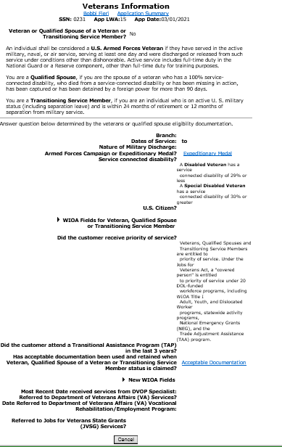
Local System Administrator Training – Editing IWDS Client Screens
Making Corrections to IWDS Clients
On the Veterans Information screen, the LSA cannot change any fields.
Any changes to the fields on this screen will require an IWDS Modification Request form.
However, the LSA should verify that any changes to this screen were accurate on the application date.
Any changes that occurred after the application date should be made to the Veterans Information screen on the Customer Level.

Slide 35
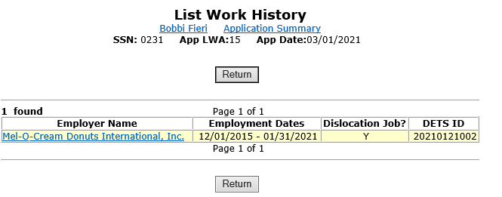
Local System Administrator Training – Editing IWDS Client Screens
Making Corrections to IWDS Clients
On the List Work History screen, the LSA cannot add any new records.
The LSA can click on any employer record to make changes on that record.

Slide 36
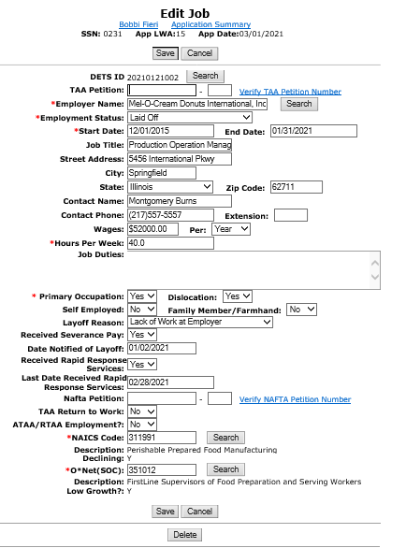
Local System Administrator Training – Editing IWDS Client Screens
Making Corrections to IWDS Clients
On the Edit Job screen, the LSA can change all of the fields.
To remove an employer, the LSA can click the DELETE button.
However, the LSA should verify that any changes to this screen were accurate on the application date.
Any changes that occurred after the application date should be made to the List Work History screen on the Customer Level.

Slide 37
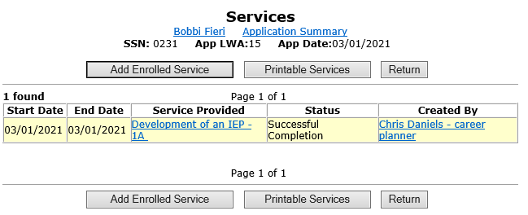
Local System Administrator Training – Editing IWDS Client Screens
Making Corrections to IWDS Clients
On the Services screen, the LSA will need to click on the individual service record to see if they can make changes.
In this case, they will click on the Development of the IEP service.

Slide 38
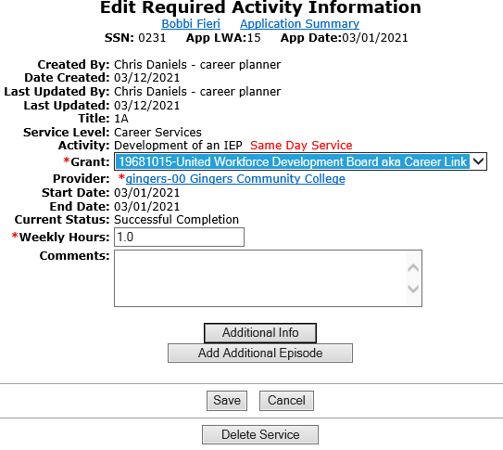
Local System Administrator Training – Editing IWDS Client Screens
Making Corrections to IWDS Clients
On this service, the LSA can change the “Grant”, “Provider”, “Weekly Hours”, and “Comments” fields.
Any changes to the other fields on this screen will require an IWDS Modification Request form.
The LSA also has the option to delete this service with the “Delete Service” button.
Different services will have different fields open and closed.

Slide 39
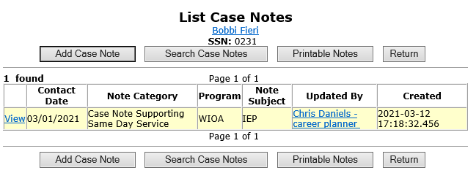
Local System Administrator Training – Editing IWDS Client Screens
Making Corrections to IWDS Clients
On the List Case Notes screen, the LSA will need to click on the individual case note they want to update.
The LSA cannot delete case notes. Any case notes that need deleted will require an IWDS Modification Request form.

Slide 40
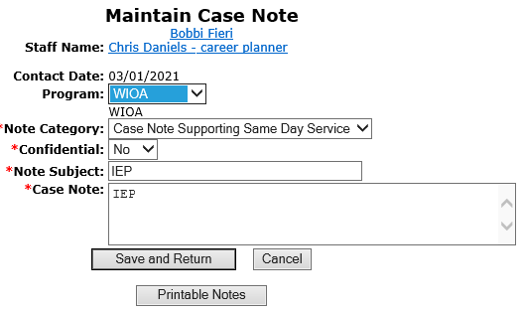
Local System Administrator Training – Editing IWDS Client Screens
Making Corrections to IWDS Clients
On the Maintain Case Notes screen, the LSA can edit the “Program”, “Note Category”, “Confidential”, “Note Subject”, and “Case Note” fields.
The LSA cannot change the “Staff Name” or “Contact Date”. If those fields need changed, the LSA will need to delete the record and re-enter the case note.
Any case notes that need deleted will require an IWDS Modification Request form.

Slide 41
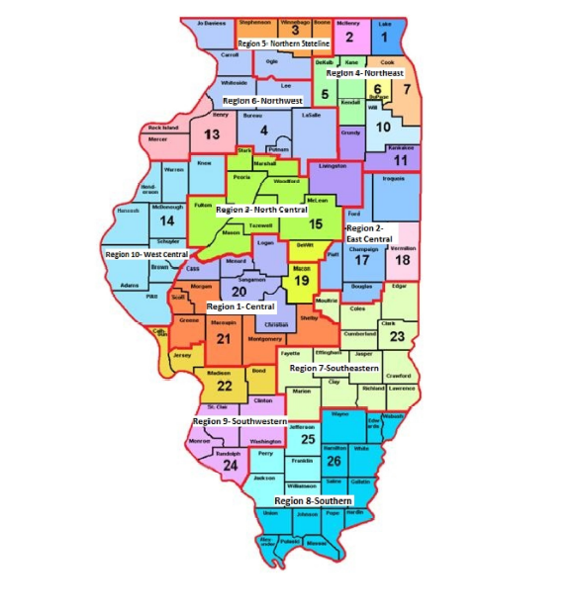
Local System Administrator Training – Editing IWDS Client Screens
Submitting to Monitors for IWDS Modifications
When submitting to the OET Monitoring staff for IWDS modifications, the LWIAs are separated into 1 of 3 regions.

Slide 42
Local System Administrator Training – Editing IWDS Client Screens
Submitting to Monitors for IWDS Modifications
Northern Region: LWIA’s 1, 2, 3, 5, 6, 7, 10, 11
Central Region: LWIA’s 4, 13, 14, 15, 17, 18, 19, 20, 21, 23
Southern Region: LWIA’s 22, 24, 25, 26

Slide 43
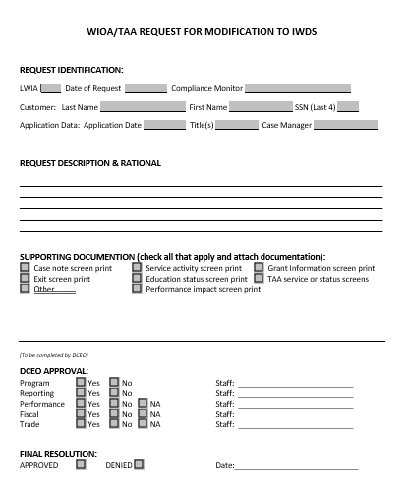
Local System Administrator Training – Editing IWDS Client Screens
Submitting to Monitors for IWDS Modifications
This is the current version of the IWDS Modification form. The LWIA can request a copy from the OET Monitoring staff.
The Local System Administrator will fill this out and email the form and supporting documentation for the modification to their assigned OET Monitoring staff member.
The OET Monitoring staff will review the request, and if approved, forward it to the IWDS Support staff to complete the modification.

Slide 44
Local System Administrator Training - Editing IWDS Client Screens
OET Contacts
IWDS SYSTEM ADMINISTATORS
Jim Potts: (217) 558-2456, james.potts@illinois.gov
Kris Theilen: (217) 557-5559, kristofer.theilen@illinois.gov
WIOA PERFORMANCE MEASURES STAFF
Mark Burgess: (217) 785-6387, mark.a.burgess@illinois.gov
Paula Barry: (217) 524-5500, paula.barry@illinois.gov
MONITORING STAFF SUPERVISORS
NORTHERN REGION – Kelly Lapetino: (773) 360-4628, kelly.lapetino@illinois.gov
CENTRAL REGION – Annamarie Dorr: (312) 636-1257, annamarie.dorr@illinois.gov
SOUTHERN REGION - Brian Ellis: (618) 993-7237, bryan.ellis@illinois.gov

Slide 45
Local System Administrator Training - Editing IWDS Client Screens
QUESTIONS?
The Illinois workNet® Center System, an American Job Center, is an equal opportunity employer/program. Auxiliary aids and services are available upon request to individuals with disabilities. All voice telephone numbers may be reached by persons using TTY/TDD equipment by calling TTY (800) 526-0844 or 711. This workforce product was funded by a grant awarded by the U.S. Department of Labor Employment and Training Administration. For more information please refer to the footer at the bottom of any webpage at illinoisworknet.com. – December 2019, v3

