Slide 1

Local System Administrator
Training
Editing IWDS Client Screens
January 6, 2025

Slide 2
Local System Administrator Training – Editing IWDS Client Screens
Acronyms used in this presentation
DCEO – Department of Commerce and Economic Opportunity
OET – DCEO Office of Employment and Training
IWDS – Illinois Workforce Development System
IwNC – Illinois workNet Center
LSA – Local System Administrator

Slide 3
Local System Administrator Training – Editing IWDS Client Screens
Overview
This training is not meant to be a substitute for the WIOA training series offered by OET with Jim Potts.
This training is concentrated on what an IWDS Local System Administrator can change/edit on client screens after the client has been certified and how to submit for client modifications that need assistance from OET.

Slide 4
Local System Administrator Training – Editing IWDS Client Screens
Overview
Please be aware that just because something can be changed doesn’t always mean it should be changed.
The LSA needs to be aware of how certain changes to a client record can affect client eligibility before making any alterations or submitting for modification.
The edit could be changing an item that was the only thing that made the client eligible for things like Basic Skills Deficient or Low Income or for particular titles that already have services entered in IWDS.

Slide 5
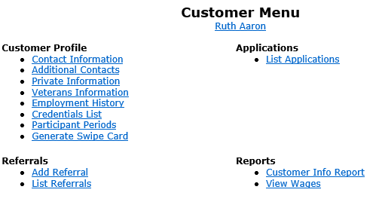
Local System Administrator Training – Editing IWDS Client Screens
IWDS Client Levels
IWDS has 2 distinct levels for client data entry.
The Customer Level is where the most up to date information is stored. There is only one Customer Level record per client. An IWDS user can also manually update the Customer Level data at any time.
If a new application is added to an existing client, the client information from the newest application will overwrite the existing Customer Level customer profile data.

Slide 6
Local System Administrator Training – Editing IWDS Client Screens
IWDS Client Levels
The Customer Level is where the career planner would record any changes in the customer record after certification.
Address updates, legal name changes (marriage, divorce, other), new phone number, new email address, new job, and any other changes that occur after the application record was certified would be recorded here.

Slide 7
Local System Administrator Training – Editing IWDS Client Screens
IWDS Client Levels
The one exception to the “snapshot in time” rule is Selective Service.
If your client is a male who is under 18 at the time of certification, who then registers with Selective Service after the certification date, the Selective Service Number has to be added to the Application Level (which will then update the Customer Level automatically).
You will need to contact the IWDS System Administrators to update the Selective Service.

Slide 8
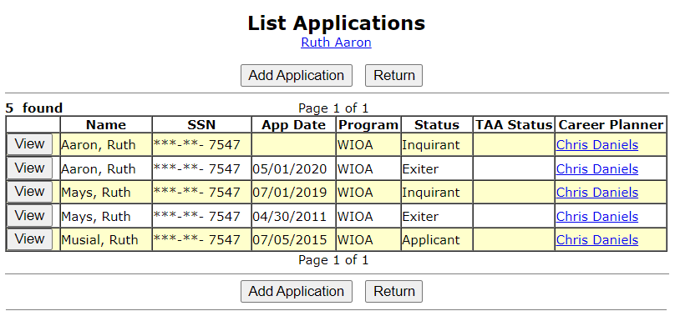
Local System Administrator Training – Editing IWDS Client Screens
IWDS Client Levels
The Application Level is where the client services are recorded.
A client can have multiple Application Level records. The client could be co-enrolled, or they could have pre-existing Inquirant or Exiter records.

Slide 9
Local System Administrator Training – Editing IWDS Client Screens
IWDS Client Levels
Each Application Level record is a “Snapshot in time”. Each Application should have the client’s correct information AT THE DATE/TIME OF THE APPLICATION.
So, if this client got married, moved, or had any other changes after the 5/1/2020 App Date, then the updated information would go on the Customer Level, as the Application Level was accurate on 5/1/2020.

Slide 10
Local System Administrator Training – Editing IWDS Client Screens
IWDS Client Levels
Notice that this client has different last names. This is very common in IWDS, especially for (but not limited to) female clients.
In this case its very likely she was single, then married, divorced, and then married again.

Slide 11
Local System Administrator Training – Editing IWDS Client Screens
IWDS Client Levels
Question: if Ruth Aaron legally changed her name back to Ruth Mays due to a life event (divorce) on 9/1/2023 while still enrolled as a Registrant in IWDS, what needs to happen in IWDS (besides a case note)?
1- change the name on the current application
2- change the name on all applications
3- change the name on the customer level
4- nothing

Slide 12
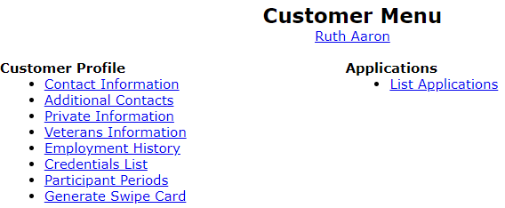
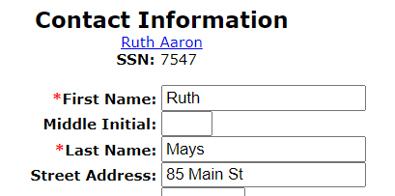
Local System Administrator Training – Editing IWDS Client Screens
IWDS Client Levels
Answer: Change the name on the Customer Level. Go to Customer menu, click on Contact Information, and update the last name there.
1- change the name on the current application
2- change the name on all applications
3- change the name on the customer level
4- nothing

Slide 13
Local System Administrator Training – Editing IWDS Client Screens
IWDS Client Records
Sometimes when a client comes into an LWIA, the career planner may forget to search for an existing IWDS record for the client or they may not find the existing record due to a name change or a spelling error. So they create a duplicate IWDS client record.
Usually, what will happen is the career planner will get an error on the SSN when they try to save the new record. If this happens, the LSA should instruct the career planner to try 4 simple searches.

Slide 14
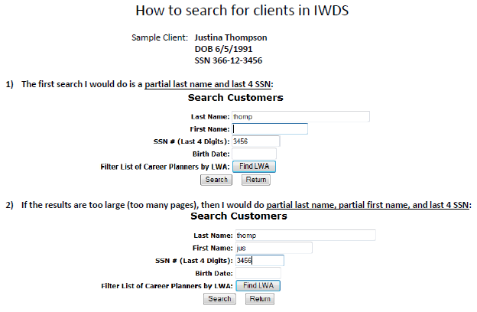
Local System Administrator Training – Editing IWDS Client Screens
Searching IWDS Client Records
There are 4 simple searches that will find 99.9% of existing IWDS clients. The 4 searches will take approximately 2 minutes to complete and can be done for Customer Level and Application Level.
We are going to use sample client Justina Thompson for the examples.

Slide 15
Local System Administrator Training – Editing IWDS Client Screens
Searching IWDS Client Records
Partial Last Name and Last 4 SSN
The reason we recommend partial names is that the search function will look for what you type in.
If the client’s name is marK, but you search for marC, it will not be in the results.
But a search for mar will return both mark, marc, markus, marcus, marchand, marcel, etc…

Slide 16
Local System Administrator Training – Editing IWDS Client Screens
Searching IWDS Client Records
2) Partial Last Name and Partial First Name (with or without Last 4 SSN)
By adding more search field criteria, it will reduce the results to a list of more concentrated specific results.

Slide 17
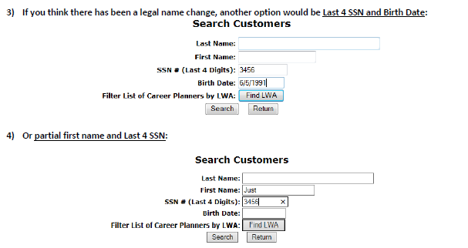
Local System Administrator Training – Editing IWDS Client Screens
Searching IWDS Client Records
3) Last 4 SSN and Birth Date
4) Partial First Name and Last 4 SSN
These last two searches are essential if you think there could be a legal name change (especially if the client is female – much more likely to have a legal name change with a marriage or divorce).
You can have 1 client with multiple applications with different last names.

Slide 18
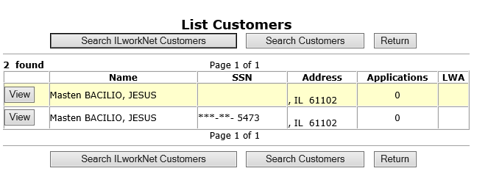
Local System Administrator Training – Editing IWDS Client Screens
Searching IWDS Client Records
If you discover that a client has multiple client level records and you are positive they are for the same person, there are 2 choices: delete the bad record(s) or request to merge the records.

Slide 19
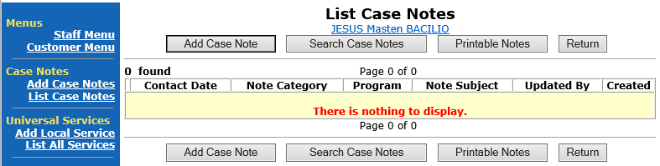
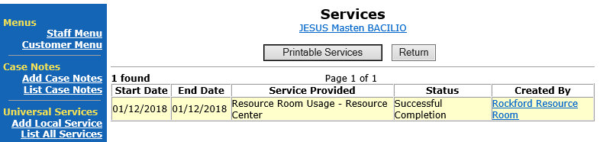
Local System Administrator Training – Editing IWDS Client Screens
Merging/Deleting Multiple IWDS Client Records
If the “bad record” has Case Notes or Universal Services, then OET recommends requesting a “merge”.
If there are no case notes or services, then request a “delete”.

Slide 20
Local System Administrator Training – Editing IWDS Client Screens
Merging/Deleting Multiple IWDS Client Records
To request to merge or delete the client records, the LSA will need to send an email to the IWDS System Administrators with a screen shot of the customer records (like the example on the right) and detail which record has the customer level information you want to keep on the merged record or which records to delete from IWDS.

Slide 21
Local System Administrator Training – Editing IWDS Client Screens
Questions
Are there any questions
about
Searching for IWDS clients
or
Merging/Deleting IWDS client records?

Slide 22
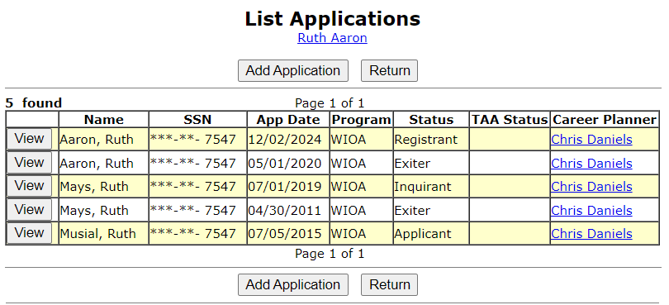
Local System Administrator Training – Editing IWDS Client Screens
Making Corrections to IWDS Clients
There are 4 different stages for an Application Level record:
Inquirant – Application started, but not certified
Applicant – Application certified, but no services entered
Registrant – Application certified, at least one service entered
Exiter – application certified, client services all closed, exit screen completed

Slide 23
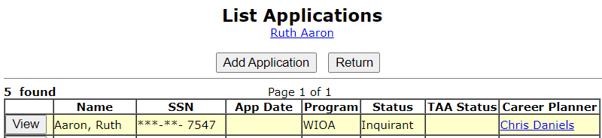
Local System Administrator Training – Editing IWDS Client Screens
Making Corrections to IWDS Clients
If the application is still in Inquirant status, the career planner should still be able to edit all of the client fields in the record as none of the fields will be locked.

Slide 24
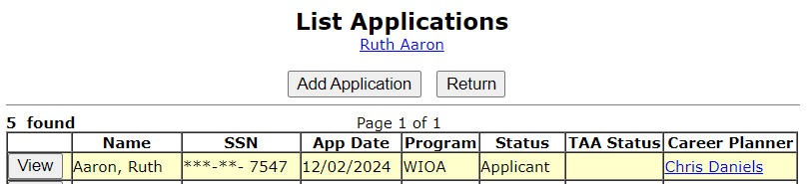
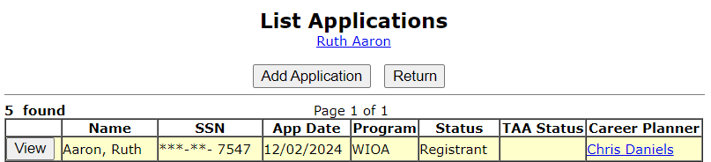
Local System Administrator Training – Editing IWDS Client Screens
Making Corrections to IWDS Clients
If the application is in Applicant or Registrant status, the LSA and/or the Career Planner can only edit unlocked fields. The LSA will be able to edit more fields than an IWDS user with the case manager supervisor or career planner roles.
Any locked fields will require an IWDS Modification Request form. There will be an example of this form later in the presentation.

Slide 25
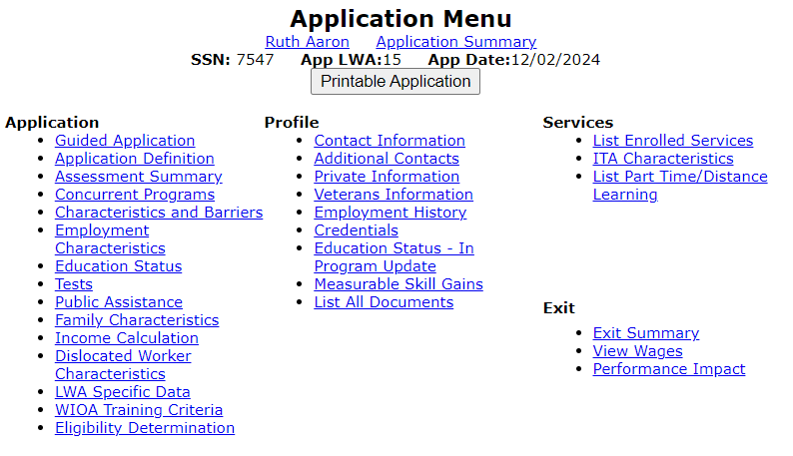
Local System Administrator Training – Editing IWDS Client Screens
Making Corrections to IWDS Clients
The Local System Administrator can edit fields, delete services, even delete eligibility certifications in an application.

Slide 26
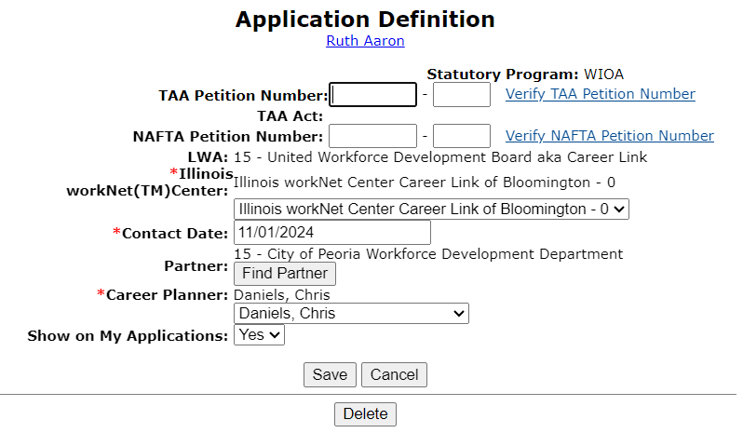
Local System Administrator Training – Editing IWDS Client Screens
Making Corrections to IWDS Clients
On the Application Definition screen, the LSA can change the IwNC or the assigned Career Planner with the options in the dropdowns.
The only choices available in these 2 dropdown menus will be specific to the LWIA where the client is assigned.

Slide 27
Local System Administrator Training – Editing IWDS Client Screens
Making Corrections to IWDS Clients
If you try to change the “Contact Date”, the IWDS system will not allow the new date to be greater than the application date.
If the client is not showing up in the career planner’s “My Customers” menu, check to be sure the “Show on My Applications” field = Yes

Slide 28
Local System Administrator Training – Editing IWDS Client Screens
Making Corrections to IWDS Clients
From the Application Definition screen, the LSA has the ability to delete the entire Application by clicking the DELETE button.
CAUTION – this will delete almost EVERYTHING connected to this application. Services, certification, client data, test data, and more will all be deleted.
This will not delete case notes, Universal Services or Customer Level client information.

Slide 29
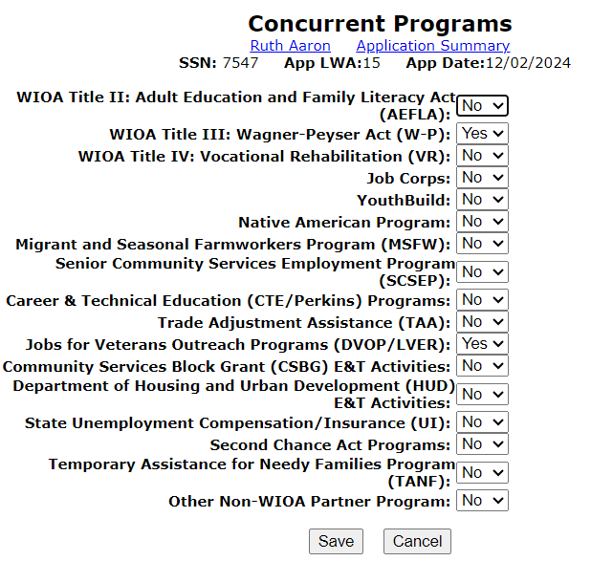
Local System Administrator Training – Editing IWDS Client Screens
Making Corrections to IWDS Clients
On the Concurrent Programs screen, the LSA can change all the choices.
Keep in mind, this screen should reflect concurrent programs for the client on the Application Date, not programs added after that date.

Slide 30
Local System Administrator Training – Editing IWDS Client Screens
Making Corrections to IWDS Clients
During participation in WIOA, IF the client gets involved with any of the other programs that originally had a response of “No”, it is correct to change the response to “Yes”, and case note what occurred.
As an example, when the client first entered the WIOA program, they were not approved for a Temporary Assistance for Needy Family (TANF), but later during participation, the client went on TANF. Then it would be correct to update the question associated with TANF on the Concurrent Programs from a “No” to “Yes” and add a case note explaining this.

Slide 31
Local System Administrator Training – Editing IWDS Client Screens
Making Corrections to IWDS Clients
However, you should NEVER switch a response on the Concurrent Programs from a “Yes” at application to a “No” during participation.
The only exception to this would be if it was a data entry error at time of application/certification and the particular “Yes” was incorrectly recorded. Then change to “No” and provide a descriptive case note that this change was made due to data entry error.

Slide 32
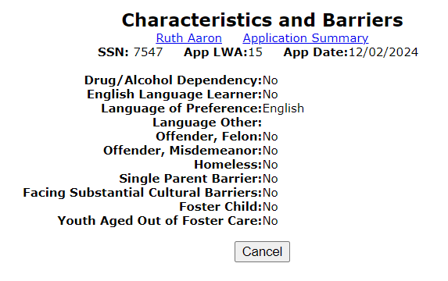
Local System Administrator Training – Editing IWDS Client Screens
Making Corrections to IWDS Clients
On the Characteristics and Barriers screen, the LSA cannot change any fields.
Any changes to this screen will require an IWDS Modification Request form.

Slide 33
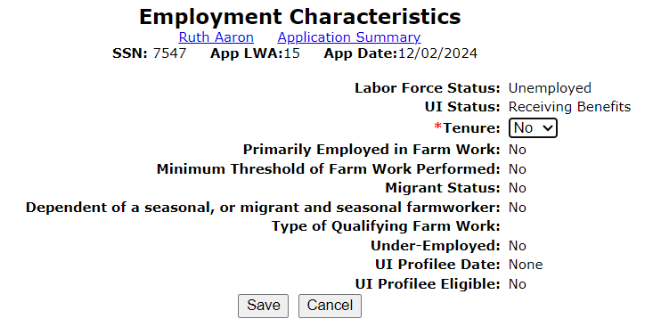
Local System Administrator Training – Editing IWDS Client Screens
Making Corrections to IWDS Clients
On the Employment Characteristics screen, the LSA can only change the “Tenure” and the “Dependent of a seasonal, or migrant and seasonal farmworker” fields.
Changes to any other field on this screen will require an IWDS Modification Request form.

Slide 34
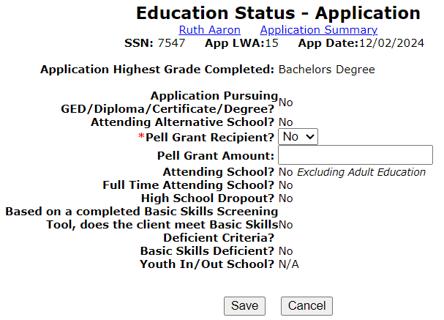
Local System Administrator Training – Editing IWDS Client Screens
Making Corrections to IWDS Clients
On the Employment Status – Application screen, the LSA can only change the “Pell Grant Recipient” and the “Pell Grant Amount” fields.
Changes to any other field on this screen will require an IWDS Modification Request form.

Slide 35
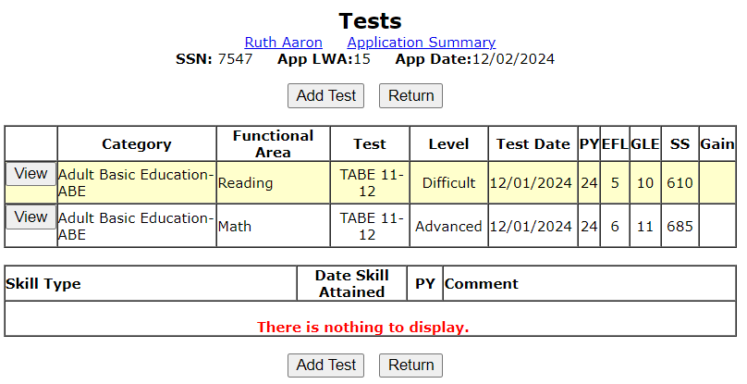
Local System Administrator Training – Editing IWDS Client Screens
Making Corrections to IWDS Clients
On the Tests screens, the LSA can not make any changes to existing tests.
The LSA and the career planner can both add new tests to the application.
If you click “view” on a test, you go to the Maintain Test screen which shows the detail information for the selected test.

Slide 36
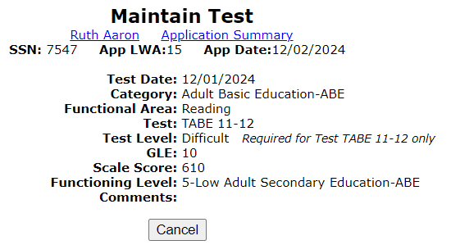
Local System Administrator Training – Editing IWDS Client Screens
Making Corrections to IWDS Clients
On the Maintain Test screens, the LSA can not make any changes to the test record.
Changes to all fields on the Maintain Test screen or a request to delete a test record will require an IWDS Modification Request form.
Be aware that changes to test dates and test scores could affect eligibility.

Slide 37
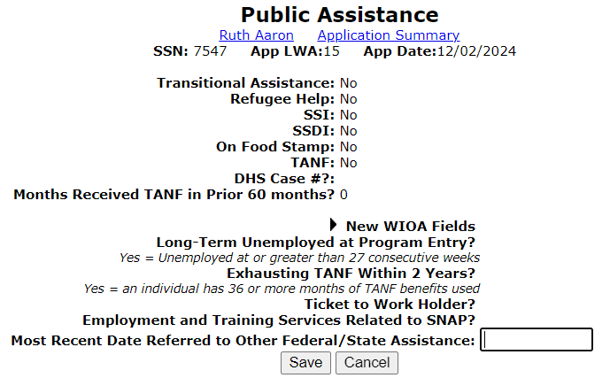
Local System Administrator Training – Editing IWDS Client Screens
Making Corrections to IWDS Clients
On the Public Assistance screen, the LSA can only change the “Most Recent Date Referred to Other Federal/State Assistance” field.
Changes to any other field on this screen will require an IWDS Modification Request form.
Be aware that changes to fields on this screen could affect eligibility.

Slide 38
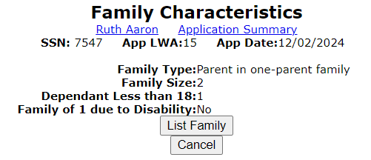
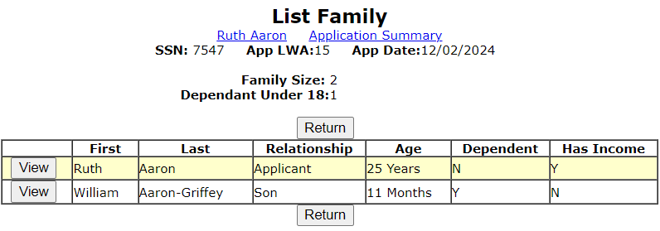
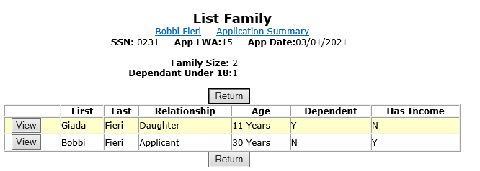
Local System Administrator Training – Editing IWDS Client Screens
Making Corrections to IWDS Clients
On the Family Characteristics and List Family screens, the LSA cannot change any fields.
Any changes to this screen including adding or removing family members will require an IWDS Modification Request form.

Slide 39
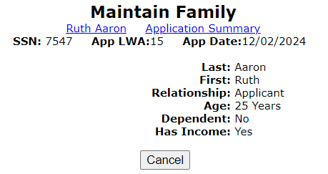
Local System Administrator Training – Editing IWDS Client Screens
Making Corrections to IWDS Clients
On the Maintain Family screen, the LSA cannot change any fields.
Any changes to this screen to update or remove family members will require an IWDS Modification Request form.

Slide 40
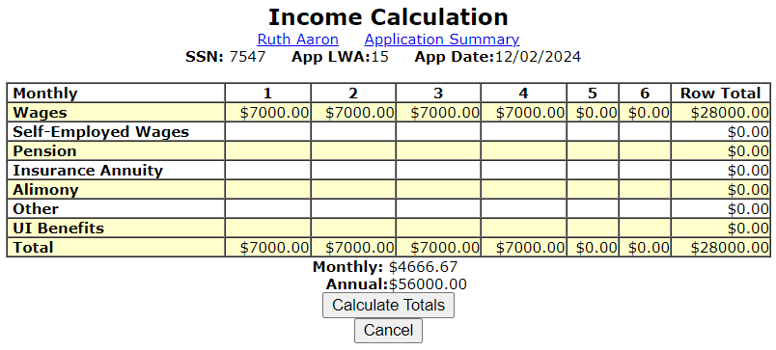
Local System Administrator Training – Editing IWDS Client Screens
Making Corrections to IWDS Clients
On the Income Calculation screen, the LSA cannot change any fields.
Any changes to this screen will require an IWDS Modification Request form.
Please be aware that changes to the income fields on this screen could potentially affect the low income eligibility of the client.

Slide 41
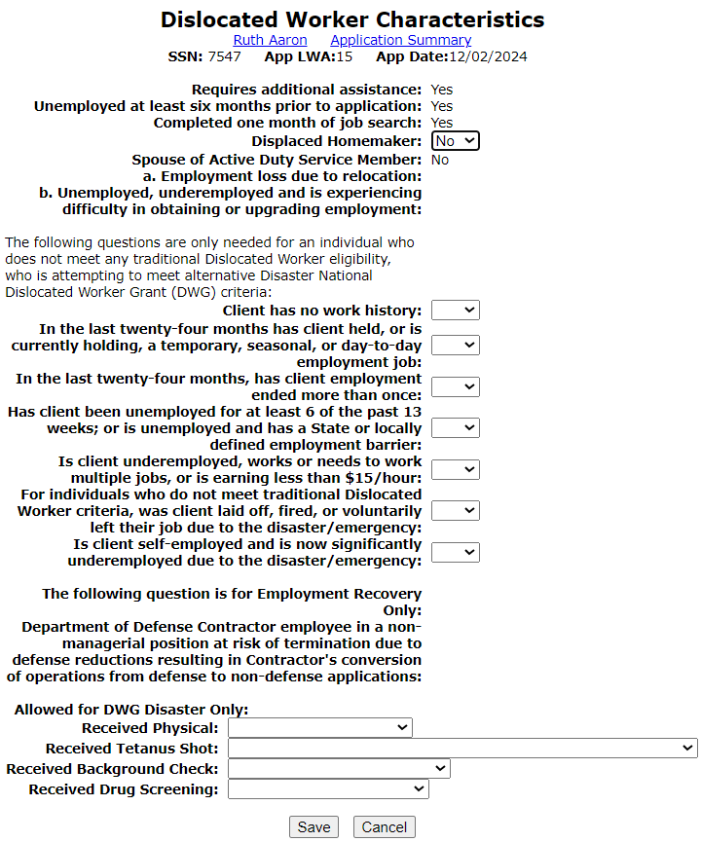
Local System Administrator Training – Editing IWDS Client Screens
Making Corrections to IWDS Clients
On the Dislocated Worker Characteristics screen, the LSA can only change the “Displaced Homemaker” field (only from “No” to “Yes”, field will be locked if already answered “Yes”) and the DWG Disaster fields.
Changes to any other field on this screen will require an IWDS Modification Request form.

Slide 42
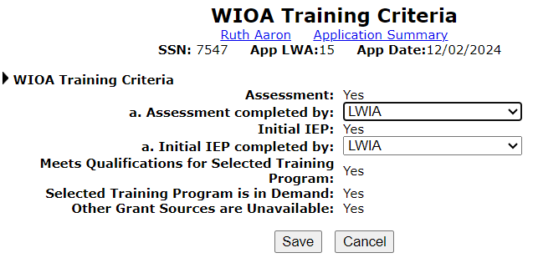
Local System Administrator Training – Editing IWDS Client Screens
Making Corrections to IWDS Clients
On the WIOA Training Criteria screen, the LSA can only change the “Assessment Completed By” and “Initial IEP Completed By” fields.
Changes to any other field on this screen will require an IWDS Modification Request form.

Slide 43
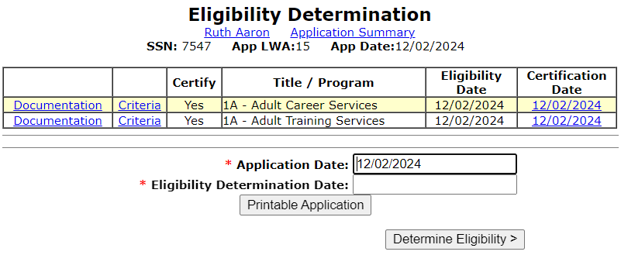
Local System Administrator Training – Editing IWDS Client Screens
Making Corrections to IWDS Clients
On the Eligibility Determination screen, the LSA can add a new Title/Program eligibility and certify it.

Slide 44
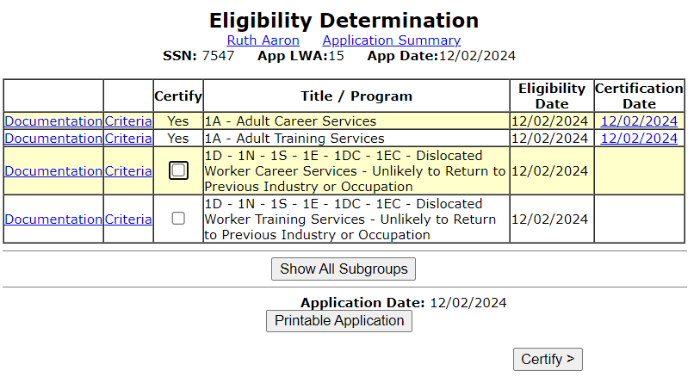
Local System Administrator Training – Editing IWDS Client Screens
Making Corrections to IWDS Clients
Enter an “Eligibility Determination Date” that is on or after the “Application Date” and if there are any other Title/Programs that the client is currently eligible for (with the client information already saved), they will appear as choices.
In this case, the client is also eligible for Dislocated Worker Career and Training services.

Slide 45
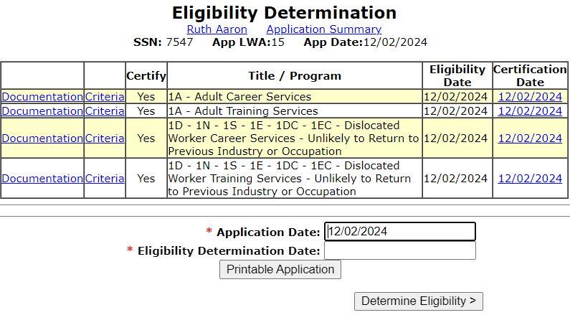
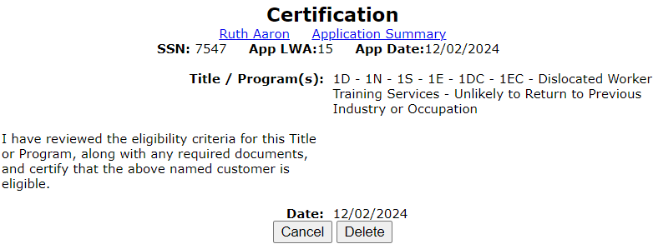
Local System Administrator Training – Editing IWDS Client Screens
Making Corrections to IWDS Clients
If you click on the Certification Date for a particular Title/Program, the LSA has the ability to delete the previously completed Title/Program certification by clicking “Delete”.
However, the LSA should be very careful to make sure any and all related services are deleted before deleting a certification.
If you are removing both Career and Training certification in the same title, remove the Training certification first.

Slide 46
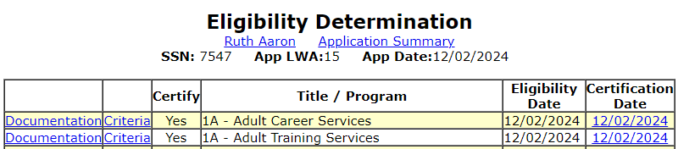
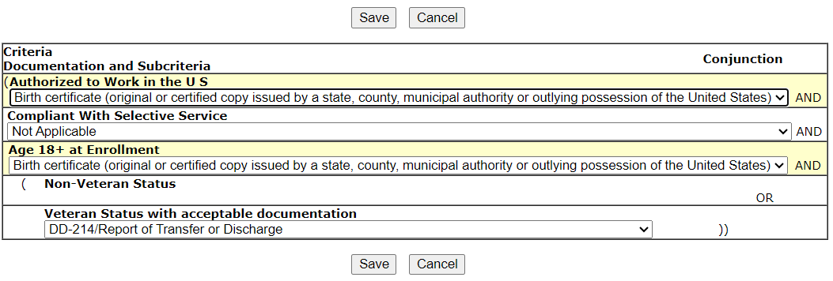
Local System Administrator Training – Editing IWDS Client Screens
Making Corrections to IWDS Clients
If you click on the “Documentation” for a Title/Program certification, you will see the Eligibility Documentation screen.
The LSA can change all of the selected documentation drop downs on an eligibility criteria if needed.
If you do this, it is strongly recommended to add a case note detailing the change.

Slide 47
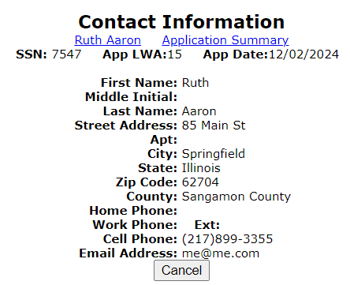
Local System Administrator Training – Editing IWDS Client Screens
Making Corrections to IWDS Clients
On the Contact Information screen, the LSA cannot change any fields.
Any changes to this screen will require an IWDS Modification Request form.
However, the LSA should verify that any changes to this screen were accurate on the application date.
Any changes that occurred after the application date should be made to the Contact Information screen on the Customer Level.

Slide 48
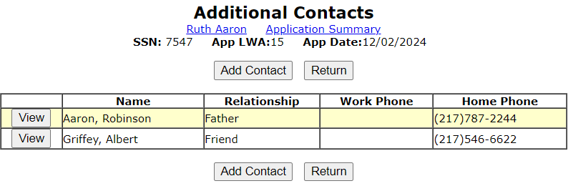
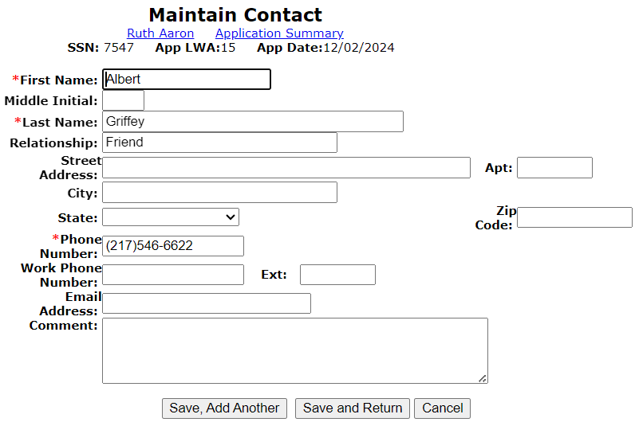
Local System Administrator Training – Editing IWDS Client Screens
Making Corrections to IWDS Clients
On the Additional Contacts screen, the LSA can add new contacts and change any fields on an existing contact.
To remove a contact will require an IWDS Modification Request form.
However, the LSA should verify that any changes to this screen were accurate on the application date.
Any changes that occurred after the application date should be made to the Additional Contacts screen on the Customer Level.

Slide 49
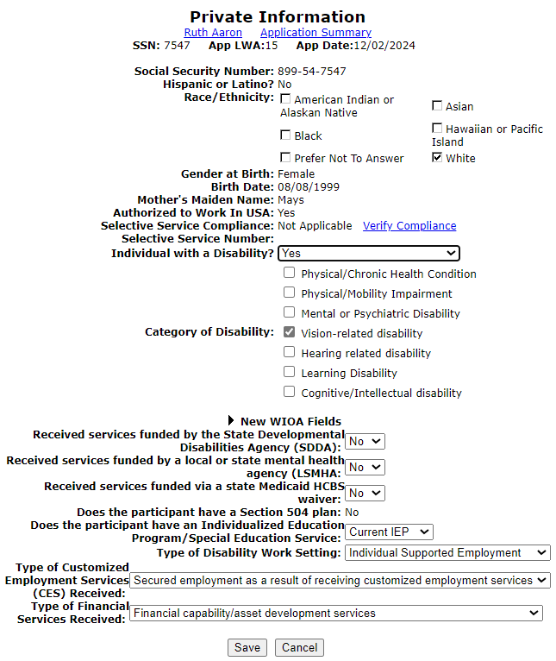
Local System Administrator Training – Editing IWDS Client Screens
Making Corrections to IWDS Clients
On the Private Information screen, the LSA can change the “Race/Ethnicity”, “Individual with a Disability”, “Category of Disability”, and all of the “New WIOA Fields”.
Any changes to the other fields on this screen will require an IWDS Modification Request form.
However, the LSA should verify that any changes to this screen were accurate on the application date.
Any changes that occurred after the application date should be made to the Private Information screen on the Customer Level.

Slide 50
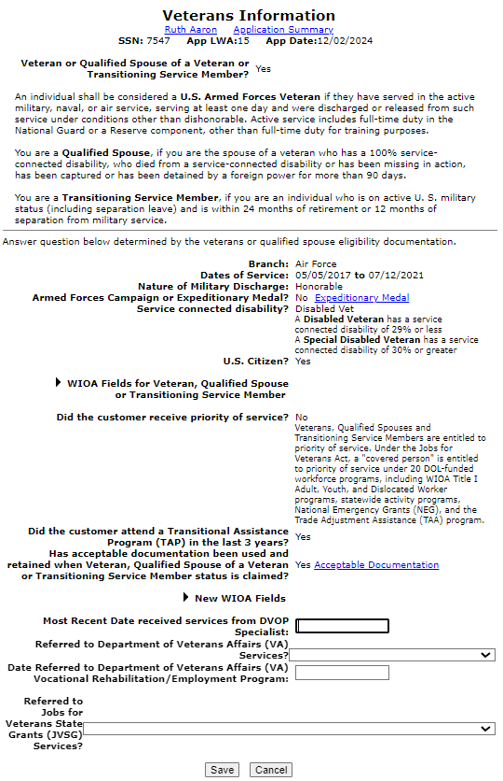
Local System Administrator Training – Editing IWDS Client Screens
Making Corrections to IWDS Clients
On the Veterans Information screen, the LSA cannot change any fields about the service information. However, they can change the “New WIOA fields”.
Any changes to the fields on this screen will require an IWDS Modification Request form.
However, the LSA should verify that any changes to this screen were accurate on the application date.
Any changes that occurred after the application date should be made to the Veterans Information screen on the Customer Level.

Slide 51
Local System Administrator Training – Editing IWDS Client Screens
Making Corrections to IWDS Clients
On the Veterans Information screen, the LSA can update all of the “New WIOA fields”.
However, the LSA should verify that any changes to this screen were accurate on the application date.
Any changes that occurred after the application date should be made to the Veterans Information screen on the Customer Level, and not on the Application level record.

Slide 52
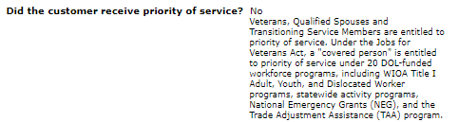
Local System Administrator Training – Editing IWDS Client Screens
Making Corrections to IWDS Clients
On the Veterans Information screen, there is one field that career planners may not understand.
Veteran’s priority of service means that a veteran client is to go to the top of the list for service. They should not have to wait “in line”.
The questions “Did the customer receive priority of service?” should only be answered “NO” if the client was actually DENIED priority of service. Meaning the career planner deliberately chose to wait on another client and made the veteran wait for service.
If there was no one “in line” ahead of the veteran, then the client still received priority.

Slide 53
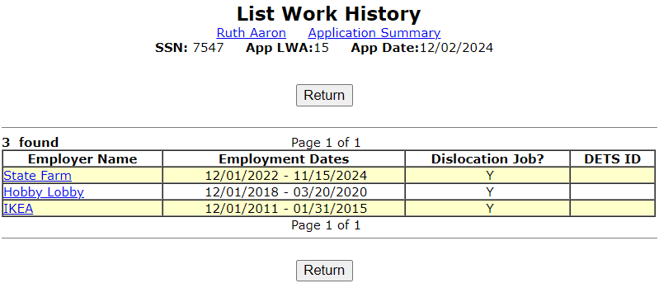
Local System Administrator Training – Editing IWDS Client Screens
Making Corrections to IWDS Clients
On the List Work History screen, neither the career planner nor the LSA can add any new records after certification. If you need to add a job where the client was employed on or prior to the application date, you will need to turn in an IWDS Modification Request form.
Any new job the client started after the application date may be entered on the Customer Level by the career planner.
However, the LSA can click on any existing employer record to make changes on that record.

Slide 54
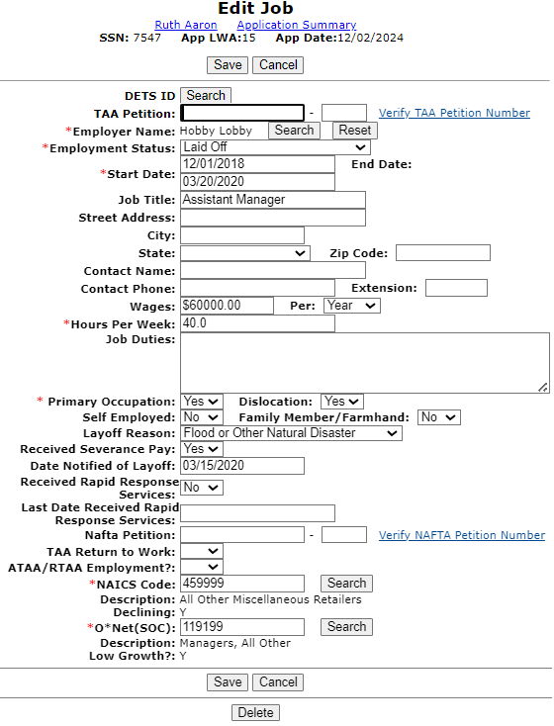
Local System Administrator Training – Editing IWDS Client Screens
Making Corrections to IWDS Clients
On the Edit Job screen, the LSA can change all of the fields.
To completely remove an employer, the LSA can click the DELETE button.
However, the LSA should verify that any changes to this screen were accurate on the application date. Any changes that occurred after the application date should be made to the List Work History screen on the Customer Level. The exception would be for any jobs associated with the DW Eligibility. Those changes will not transfer over since the job at the application level that had eligibility criteria is locked

Slide 55
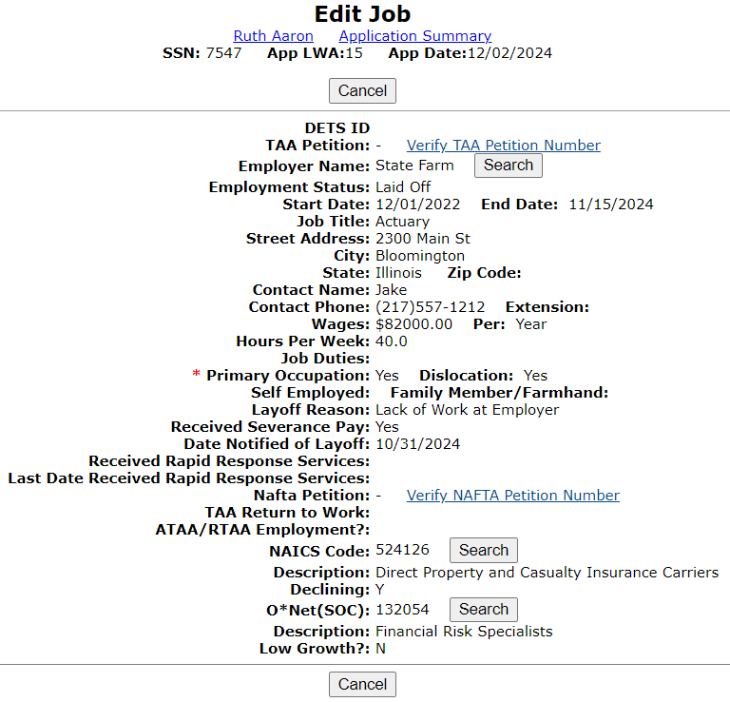
Local System Administrator Training – Editing IWDS Client Screens
Making Corrections to IWDS Clients
The exception is that any job associated with the WIOA Dislocated Worker eligibility criteria cannot be updated by the LSA at the application level.
This will require a Request for IWDS Modification form submission to make any changes.

Slide 56
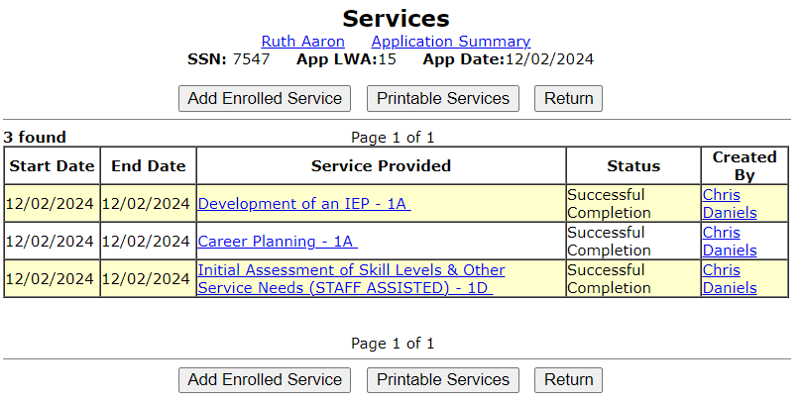
Local System Administrator Training – Editing IWDS Client Screens
Making Corrections to IWDS Clients
Some services will allow the LSA to make changes. On the Services screen, the LSA will need to click on the individual service record to see if they can make changes.
In this case, the LSA will click on the Development of the IEP service.

Slide 57
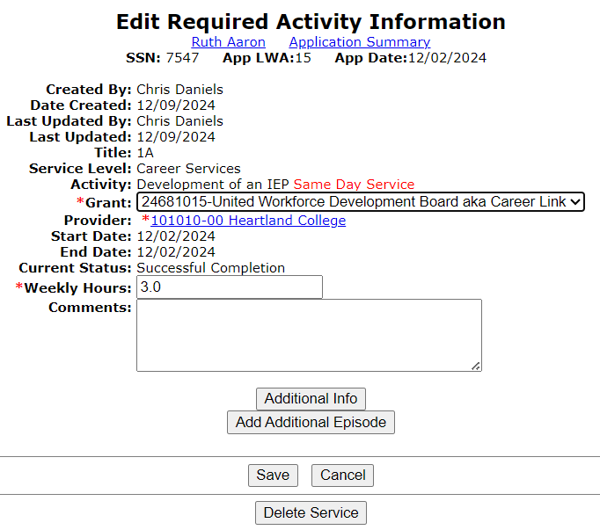
Local System Administrator Training – Editing IWDS Client Screens
Making Corrections to IWDS Clients
On this service, the LSA can change the “Grant”, “Weekly Hours”, and “Comments” fields.
Any changes to the other fields on this screen will require an IWDS Modification Request form.
The LSA also has the option to delete this service with the “Delete Service” button.
Different services will have different fields open and closed.

Slide 58
Local System Administrator Training – Editing IWDS Client Screens
Making Corrections to IWDS Clients
If the start date of a service is wrong, that service will need to be deleted and re-entered with the correct start date.
Even the IWDS System Administrators cannot change the start date on a service.

Slide 59
Local System Administrator Training – Editing IWDS Client Screens
Making Corrections to IWDS Clients
Some services may not allow the LSA to delete them if other services are present on the client that require that pre-requisite service.
In that case, contact the IWDS System administrators with the screen shot of the error message.

Slide 60
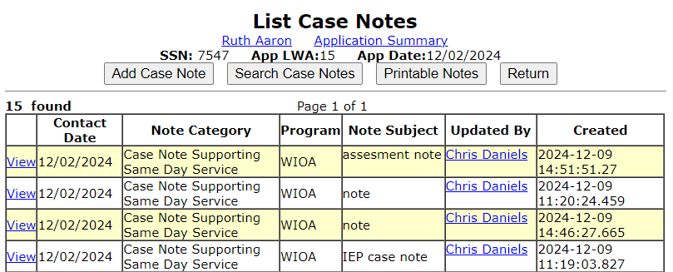
Local System Administrator Training – Editing IWDS Client Screens
Making Corrections to IWDS Clients
On the List Case Notes screen, the LSA will need to click on the individual case note they want to update.
The LSA cannot delete case notes. Any case notes that need to be deleted will require an IWDS Modification Request form.

Slide 61
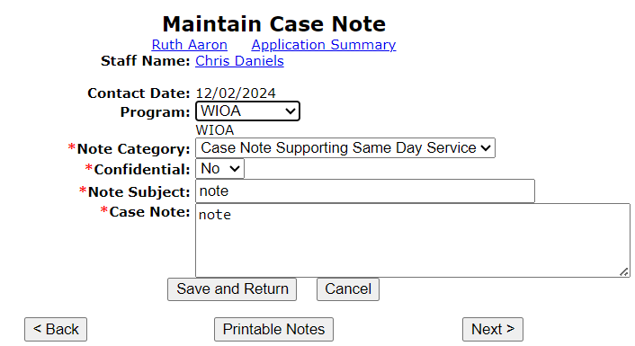
Local System Administrator Training – Editing IWDS Client Screens
Making Corrections to IWDS Clients
On the Maintain Case Notes screen, the LSA can edit the “Program”, “Note Category”, “Confidential”, “Note Subject”, and “Case Note” fields.
The LSA cannot change the “Staff Name” or “Contact Date”. If those fields need changed, the LSA will need to have the record deleted and then have the career planner re-enter the case note.

Slide 62
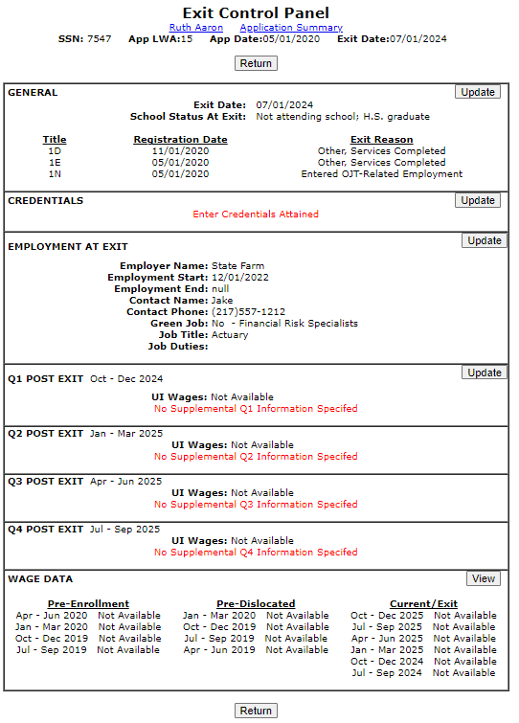
Local System Administrator Training – Editing IWDS Client Screens
Making Corrections to IWDS Clients
Anything involving an application in “exiter” status needs to be sent to the WIOA Performance Measures Staff and cc: the IWDS System Administrators. Sometimes corrections may affect past quarters that have already been reported.
The WIOA Performance Measures Staff also handles exiting clients that are over the date limit as well as removing exits from clients.

Slide 63
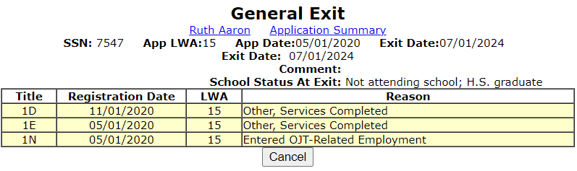
Local System Administrator Training – Editing IWDS Client Screens
Making Corrections to IWDS Clients
The LSA cannot do anything on the General Exit screen after the client has been exited.
They will have to submit an email to the WIOA Performance Measures Staff and cc: the IWDS System Administrators. This can also be submitted with a Request for IWDS Modification form submission to make any changes.

Slide 64

Local System Administrator Training – Editing IWDS Client Screens
Submitting IWDS Modifications to Monitors
When submitting IWDS modifications to the OET Monitoring staff, the LWIAs are separated into 1 of 3 regions.

Slide 65
Local System Administrator Training – Editing IWDS Client Screens
Submitting IWDS Modifications to Monitors
Northern Region: LWIA’s 1, 2, 3, 5, 6, 7, 10, 11, 27 (National Able)
Central Region: LWIA’s 4, 13, 14, 15, 17, 18, 19, 20, 21
Southern Region: LWIA’s 22, 23, 24, 25, 26

Slide 66
Local System Administrator Training – Editing IWDS Client Screens
Submitting IWDS Modifications to Monitors
The OET contacts for each region are:
Northern Region: Matt Hillen
Central Region: Bryan Tippy
Southern Region: Elizabeth Shew
(The contact information is listed at the end of the slideshow)

Slide 67

Local System Administrator Training – Editing IWDS Client Screens
Submitting IWDS Modifications to Monitors
This is the current version of the IWDS Modification form. The LWIA can request a copy of this form from the OET Monitoring staff.
The Local System Administrator should fill this out and email the form and supporting documentation and/or screen shots for the modification to their assigned OET Monitoring staff member.
The OET Monitoring staff will review the request, and if approved, forward it to the IWDS Support staff to complete the modification.

Slide 68
Local System Administrator Training – Editing IWDS Client Screens
Submitting IWDS Modifications to Monitors
If possible, when submitting a Request for Modification please include a screen shot of the error as well as a copy of any supporting documentation for the change.
In general, any time you are emailing the IWDS System Administrators, the Performance Measures staff, or the Monitoring staff about an IWDS client it is best to include screen shots of the error/issue.

Slide 69
Local System Administrator Training – Editing IWDS Client Screens
Transferring Clients Between LWIAs
Sometimes, clients will have a reason to switch LWIAs. It could be a physical move or another valid reason.
To begin the process of transferring the client from one LWIA to another, the giving and receiving LWIA’s need to agree to make the transfer. It needs to be understood that the gaining LWIA is accepting the client for Performance Outcomes and for any future monitoring or data validation that might occur with the client.
The receiving LWIA does not have to accept the transfer if they don’t want to be responsible for the client, such as if the client would be a negative affect on their performance outcomes.

Slide 70
Local System Administrator Training – Editing IWDS Client Screens
Transferring Clients Between LWIAs
Once all parties have agreed to the client transfer, the Local System Administrator for the LWIA (either the giving or receiving) sends an email to both of the IWDS System Administrators, with the Local System Administrator from the other LWIA cc’d on the email.
The email will detail the customer’s name, last 4 SSN, the Illinois WorkNet Center location, and the name of the case manager who will be taking over the client in the receiving LWIA.
The receiving LWIA’s Local System Administrator must either state in the original email or send a reply to this email that their LWIA is accepting the transfer.
Once all of this has occurred, the IWDS System Administrators will submit the transfer to the programming staff, and they will notify the LWIAs when the transfer is completed.

Slide 71
Local System Administrator Training – Editing IWDS Client Screens
Transferring Clients Between LWIAs
Finally, the receiving LWIA must receive the original hard copy files with all the supporting documentation. Not copies. The original documents should follow the client to the new LWIA.
Sometimes the giving LWIA will choose to keep a copy of everything for their records, since they expended grant money on the client.

Slide 72
Local System Administrator Training - Editing IWDS Client Screens
OET Contacts
IWDS SYSTEM ADMINISTRATORS
Jim Potts: (217) 299-4532, james.potts@illinois.gov
Kris Theilen: (217) 299-2161, kristofer.theilen@illinois.gov
WIOA PERFORMANCE MEASURES STAFF
Mark Burgess: (217) 970-0061, mark.a.burgess@illinois.gov
Paula Barry: paula.barry@illinois.gov
Ray Al-Amin: ramon.al-amin@illnois.gov

Slide 73
Local System Administrator Training - Editing IWDS Client Screens
OET Contacts
REGIONAL MANAGERS
NORTHERN REGION – Kelly Lapetino: (773) 360-4628, kelly.lapetino@illinois.gov
CENTRAL REGION – temporarily contact Kelly Lapetino or Bryan Ellis
SOUTHERN REGION - Bryan Ellis: (618) 363-2417, bryan.ellis@illinois.gov
MONITORING STAFF
NORTHERN REGION – Matt Hillen: (312) 805-9336, Matt.J.Hillen@illinois.gov
CENTRAL REGION – Bryan Tippy: (217) 685-0587, Bryan.Tippy@illinois.gov
SOUTHERN REGION – Elizabeth Shew: (618) 969-2126, Elizabeth.Shew@illinois.gov
FISCAL/PROGRAMMATIC MONITORING MANAGER
Tamika Chism: (312) 579-6901, Tamika.Chism@Illinois.gov

Slide 74
Local System Administrator Training - Editing IWDS Client Screens
QUESTIONS?
The Illinois workNet® Center System, an American Job Center, is an equal opportunity employer/program. Auxiliary aids and services are available upon request to individuals with disabilities. All voice telephone numbers may be reached by persons using TTY/TDD equipment by calling TTY (800) 526-0844 or 711. This workforce product was funded by a grant awarded by the U.S. Department of Labor Employment and Training Administration. For more information please refer to the footer at the bottom of any webpage at illinoisworknet.com. – December 2019, v3

