Slide 1
Career Pathways Information Session
JTED NOFO
Thank you for joining!
We will get started shortly

Slide 2
Agenda
Welcome from DCEO and EdSystems
Background on EdSystems
Use Pathways Progression Frameworks
Pathway Creation: Aligning to Labor Market Information
Pathway Creation: Aligning Competencies and Skill Progression
Quick Notes:
Highly encourage Q&A and Chat Box
This webinar is being recorded
Slide deck will be linked in the chat

Slide 3

EdSystems Staff
Juan Jose Gonzalez
Pathways Director

Slide 4






The EdSystems Mission
Shape and strengthen education and workforce systems to advance racial equity and prepare more young people for productive careers and lives in a global economy.
Statewide
Community Networks
College &
Career Pathways
Bridges to
Postsecondary
Data Impact &
Leadership
Strategic Projects

Slide 5
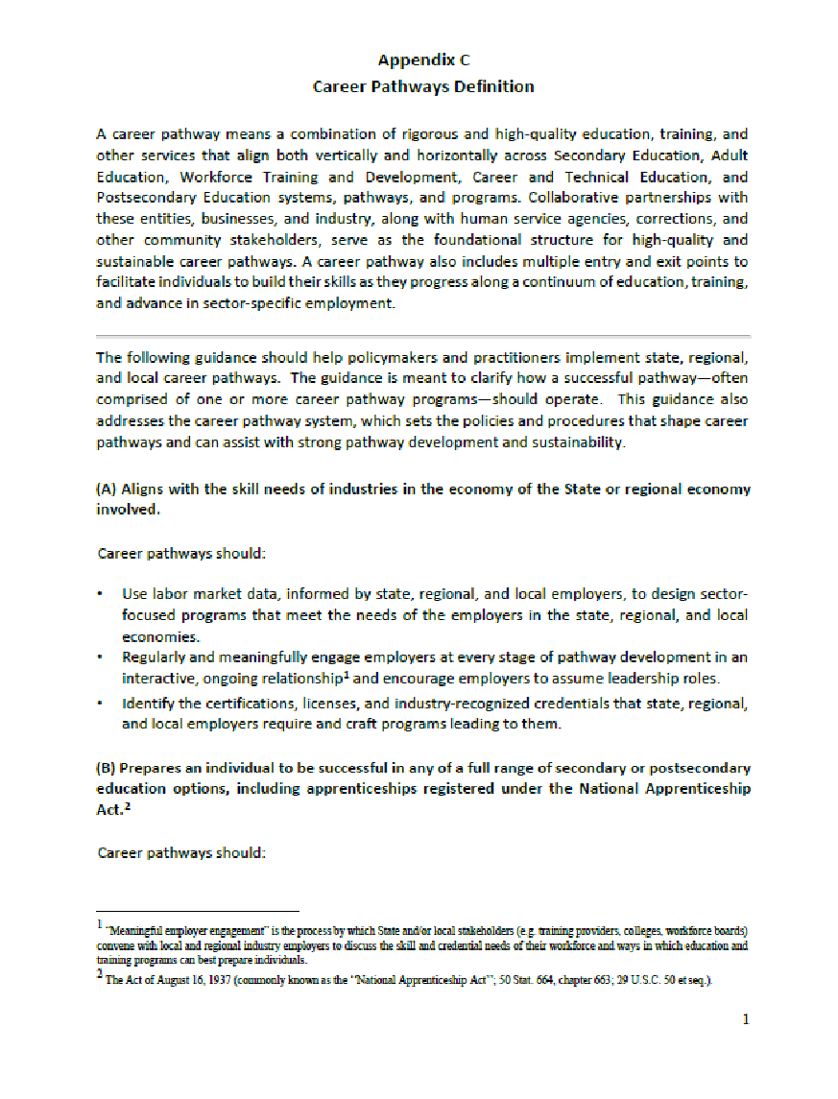
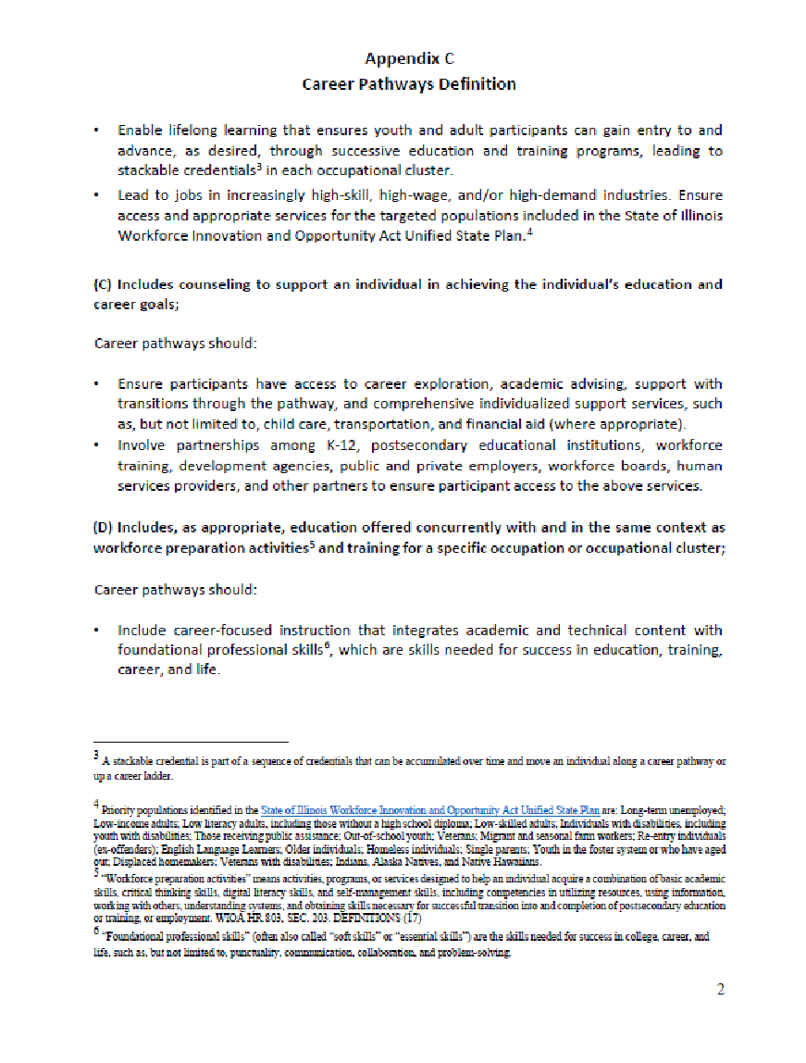
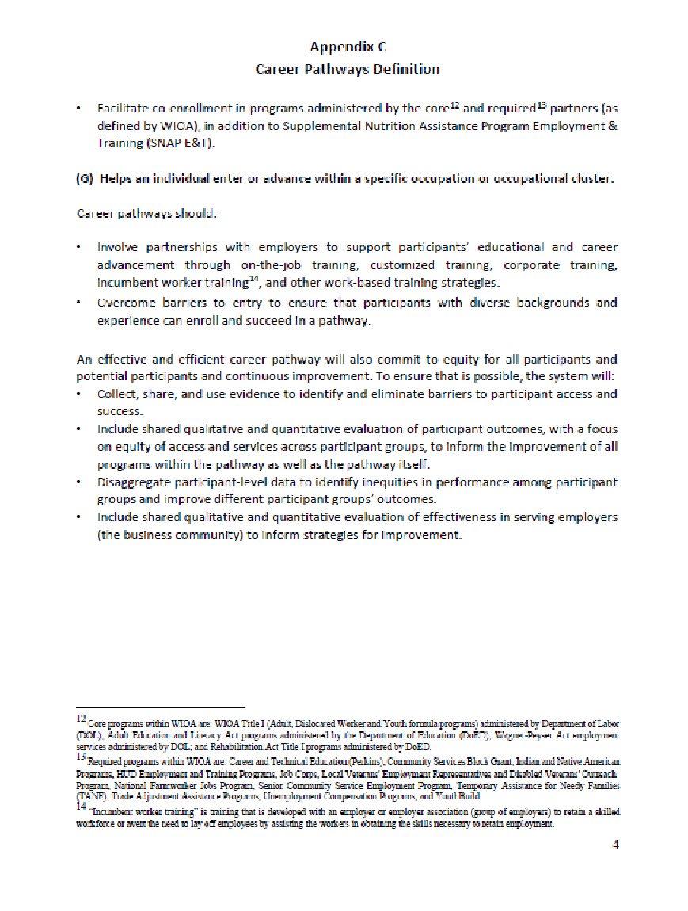
Career Pathways Definition: Multiple pages!
Notes:
Also in Career Pathways Dictionary: https://edsystemsniu.org/wp-content/uploads/2018/11/CP_Dictionary_11-13-18__FINAL.pdf

Slide 6
Useful Pathways Progression Frameworks

Slide 7



State Career Pathways Framework
Individualized Planning
OUTCOMES:
Individuals Earn Promising Credentials for Priority Occupations
&
Economic Advancement
Endorsement
Secondary Pathway
Postsecondary Pathway
Career Focused Instruction
Internships
/CDE
Low-Skilled
Jobs
Semi-
Skilled
Jobs
Middle-
Skilled Jobs
Advanced-
Skilled Jobs
Work-Based Learning
Stackable
Credentials
Stackable
Credentials
AA/AAS
BA/BS
Core Academics
Notes:
JF

Slide 8
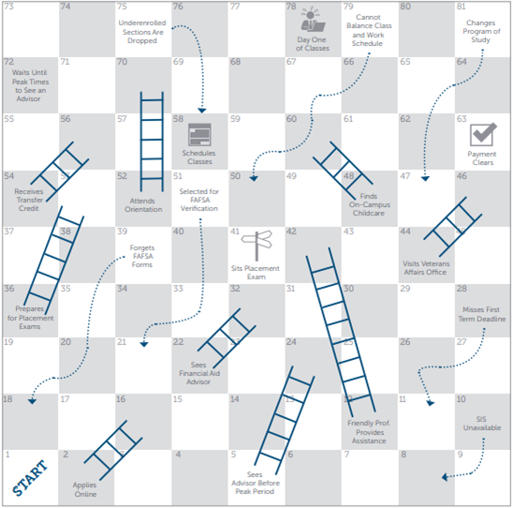
System Design vs. Student Reality
EAB Infographic: Is your enrollment process a game of Chutes and Ladders? https://eab.com/insights/infographic/community-college/is-your-enrollment-process-a-game-of-chutes-and-ladders/

Slide 9
Pathway Progression Strategies
Coherent strategies that incorporate program sequencing, instructional design models, articulation systems, and related participant supports structured to facilitate an individual’s entry into and movement through stackable credentials culminating in a Promising Credential and Living-wage employment.
Bridge Programs:
Prepare adults with limited academic or English skills for postsecondary, leading to in-demand, middle- and advanced-skills occupations.
Non-Credit Articulation:
Agreement between a community-based or nonprofit program provider and CCC to award credit toward a CCC Credential Pathway.
Guided Transfer:
Support system for those who have or are pursuing an associate degree to transfer into a related bachelor’s degree program with no or minimal credit loss.
Acceleration Strategies:
Enabling individuals to attain Promising Credentials in less time and at lower cost than through typical CC Credential Pathway program timelines.
One method:
Prior Learning
Prior Learning
Competency-Based Education
College and Career Pathway Endorsement

Slide 10
Pathways System Framework
Bridge Programs
Non-Credit Articulation
High School Student
Adult or Opportunity Youth Without GED
Adult With GED or HS Diploma
Adult With Existing Credentials
and/or Prior Experience
Pathway
Progression Strategies
&
&/or
HS CCPE
CC Credential Pathways
Guided Transfer
High School Diploma or GED
Short-term Credential
Basic Certificate
Advanced Certificate
Associate Degree
Bachelor’s Degree
Advanced Degrees & Continued Upskilling
Occupation 1
Occupation 2
Occupation 3
Occupation 4
Occupation 5
Occupation 6
Entry-Level
Early-Skills
Middle-Skills
Advanced-Skills

Slide 11

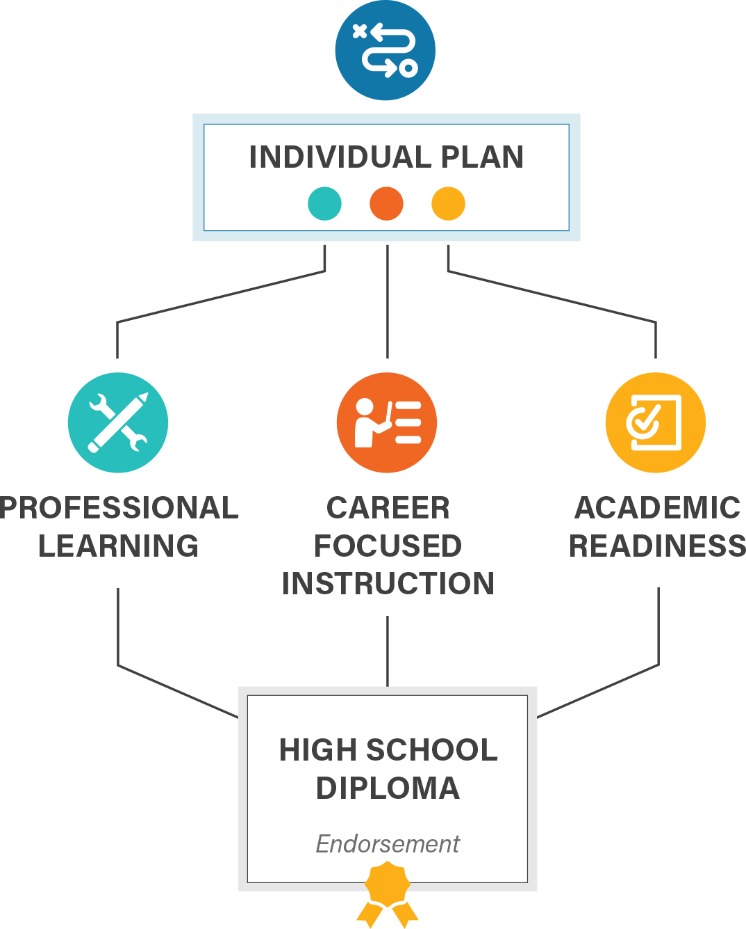
INDIVIDUAL PLAN
College and Career
Pathway Endorsement Framework
Each student completing an endorsement must have an individualized plan, which includes college planning linked to early understanding of career goals, financial aid, resume, and personal statement.
PROFESSIONAL LEARNING
Awareness, exploration, and preparation activities that provide opportunities for students to interact with adults in their workplace
9th
10th
11th
12th
At least 2 career exploration activities or 1 intensive experience
60 cumulative hours of paid or credit supervised career development experience with a professional skills assessment
At least 2 team-based challenges with adult mentoring
Through these experiences, a student gains essential employability and technical competencies in their identified sector.
CAREER-FOCUSED INSTRUCTIONAL SEQUENCE
Two years of secondary coursework, or equivalent competencies, that articulate to a postsecondary credential with labor market value. Must include at least 6 hours of early college credit.
9th
10th
11th
12th
Orientation / Introduction
Skill Development
Capstone / Advanced Courses
ACADEMIC READINESS
Ready for non-remedial coursework in reading and math by high school graduation through criteria defined by district and local community college
Notes:
https://edsystemsniu.org/college-and-career-pathway-endorsements/

Slide 12
Pathway Creation: Aligning to Labor Market Information

Slide 13

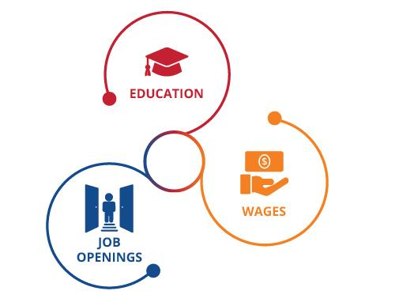



Criteria for Pathway Occupations
What minimum typical entry education level is needed for the role or industry field
Make sure occupations have sufficient projected annual openings
Set a median wage threshold based on living wage criteria

Slide 14
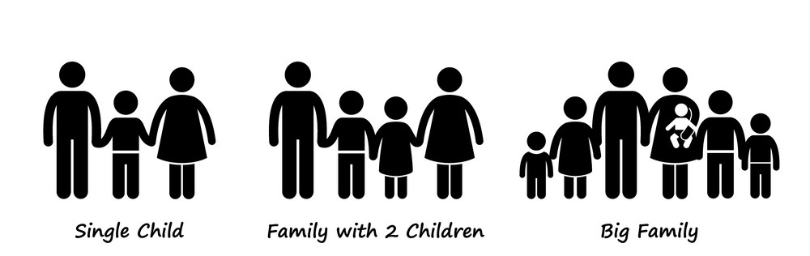
Living Wage = The minimum salary you would need in order to cover the cost of living expenses (i.e. pay all your bills) in your community based on typical expenses for that area.
Depends on 1) how many adults and children are in your family 2) how many adults are working 3) where you live.
A very popular tool is the MIT Living Wage Calculator by MIT, which breaks down the living wage by family size and region of the country. Updates Annually.

Slide 15
What info do we have for various jobs?
Department of Labor:
  Surveys workplaces and collects information about number people employed, education required, skills needed, typical roles, and salaries.
  Surveys individual employees and job experts, getting a sense of educational attainment, salaries, day to day work experience, etc.
  Data is available at a federal and state level, and sometimes local level

Slide 16
Let’s Explore Together
Go to this link: https://www.careeronestop.org/ExploreCareers/explore-careers.aspx
Roles
Registered Nurse

Slide 17
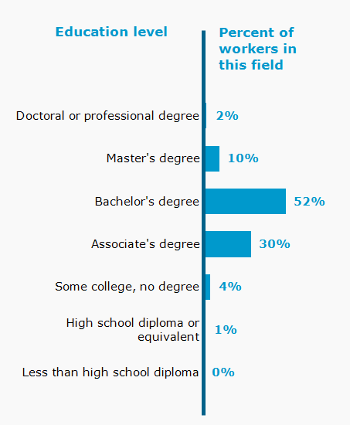
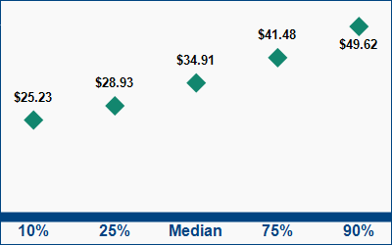
Wages
Education Level
Living Wage
Education and experience to get started: Bachelor’s Degree

Slide 18
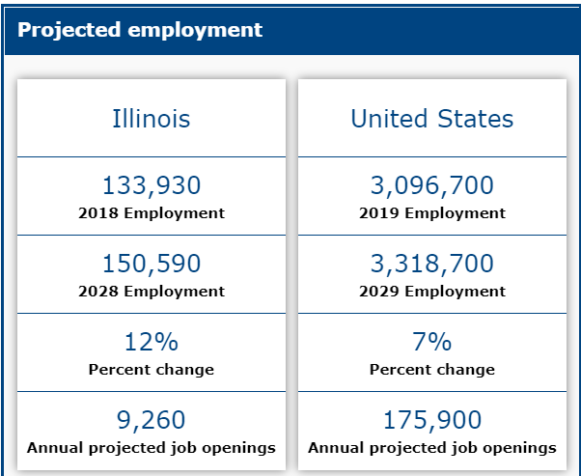
Projected Employment
Notes:
Openings can occur because some workers retire or change jobs and someone else needs to be hired to replace them.
There are also calculations about whether the number of positions for certain jobs will grow or decline over a 10- year period.
As you can imagine, the need for some jobs (e.g. Wind Turbine Technicians) are increasing and the need for other jobs (e.g. Taxi Drivers) are decreasing or hardly changing

Slide 19
Existing Labor Market Analyses

Slide 20


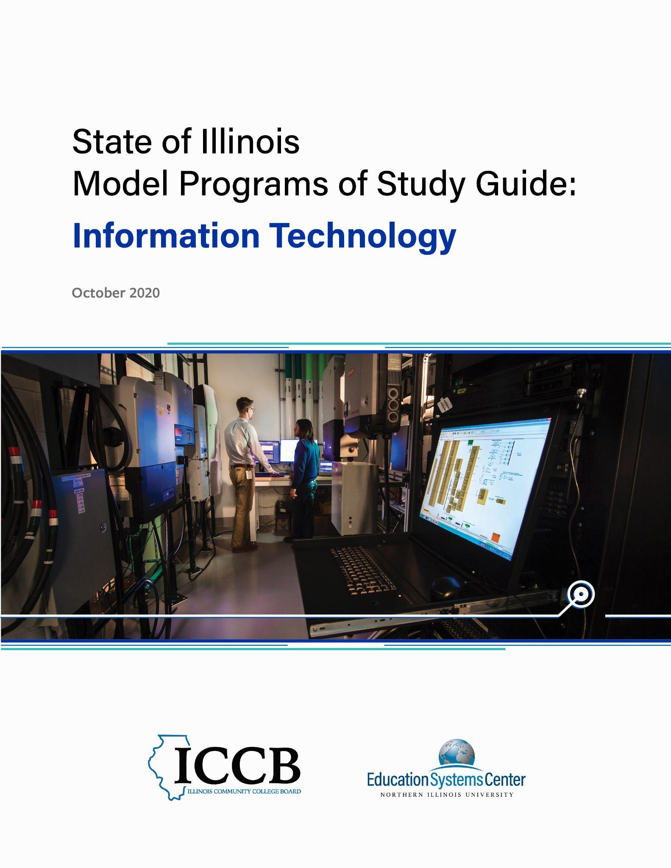



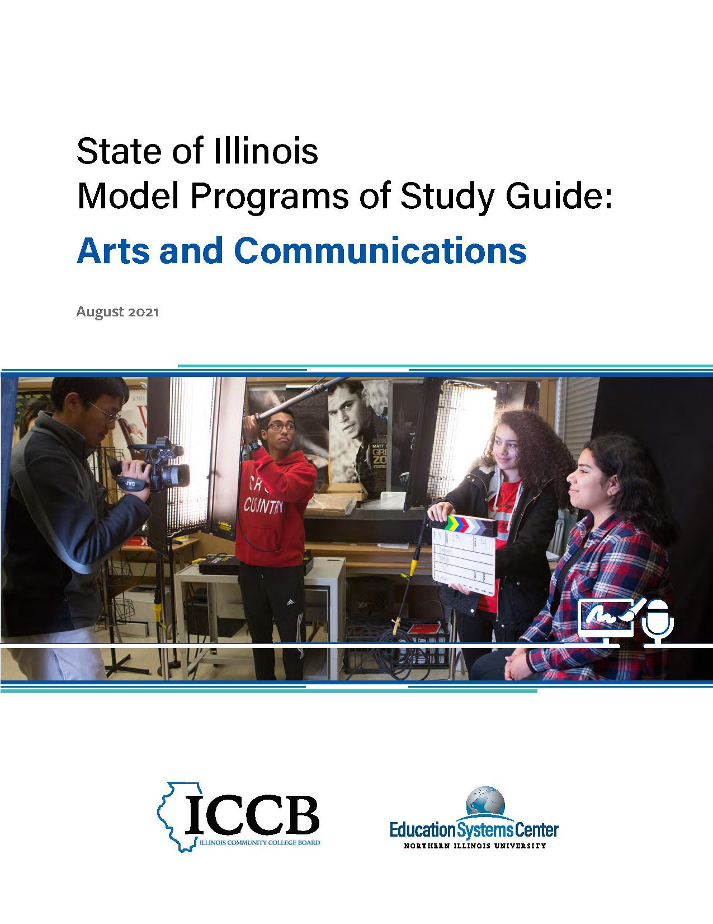
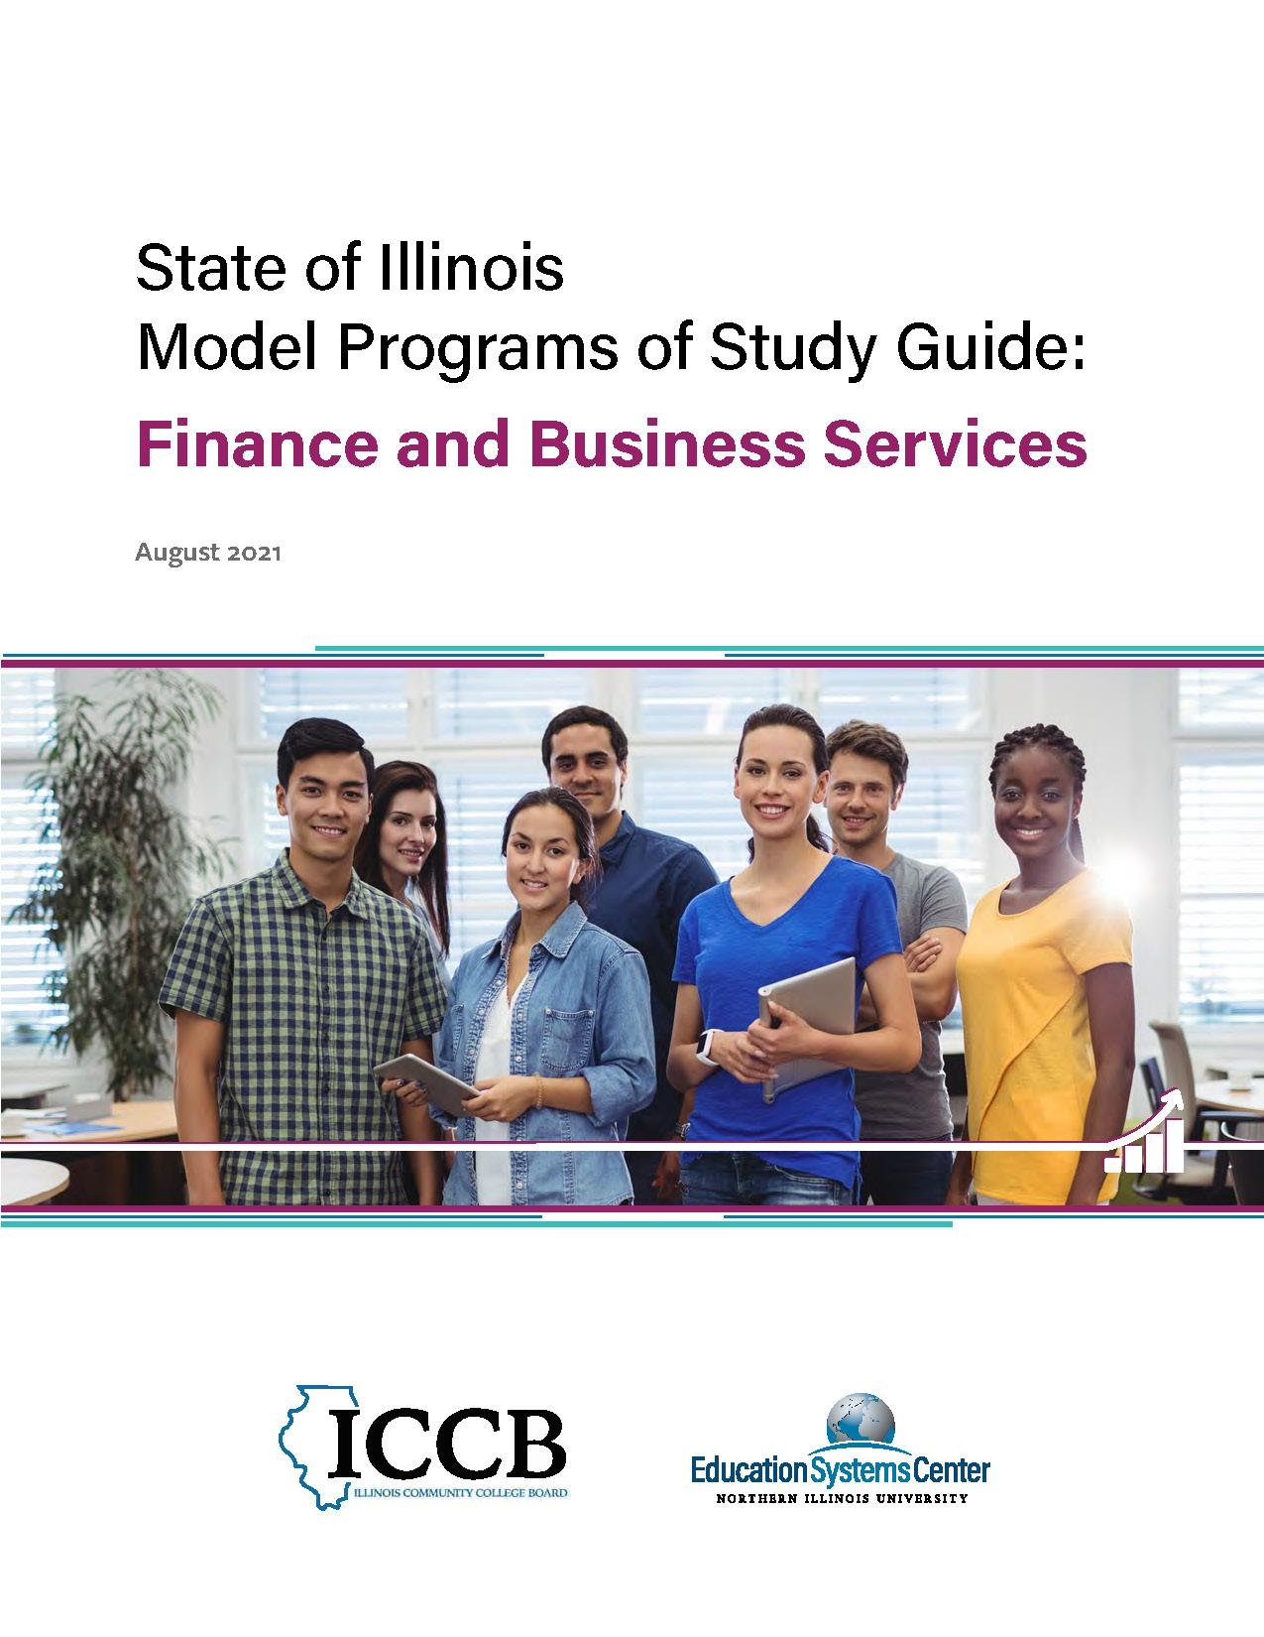
ICCB Model POS of Study Guides
Education
Health Sciences
Information Technology
Manufacturing and Engineering
Agriculture, Food and Natural Resources
Architecture, Construction and Energy
Arts and Communications
Finance and Business Services
edsystemsniu.org/guides

Slide 21

High Priority Occupations & Promising Credentials
Using Department of Labor data and the MIT Living Wage Calculator for the State of Illinois as a reference, High Priority Occupation defined
  Occupations with a positive growth outlook and
  Occupations whose salaries are near or greater than the “Living Wage” of 1 Adult + 1 Child in Illinois.
A “promising credential” is a degree or college certification that immediately prepares an individual for entry into a high-priority occupation, with a focus on credentials available in typical Illinois Community College.
  Credential may also be is a clear precursor to or stackable credential for a high-priority occupation

Slide 22
Finance/Business Example | Median Wage Hourly | Living Wage? | Growth? | Entry Education | Annual Job Openings | Percentage Growth (2016-2026)
Accountants and Auditors | 33.89 | Yes | Yes | Bachelor's Degree | 5,510 | 8%
Business Operations Specialist | 36.81 | Yes | Yes | Bachelor's Degree
Financial Analyst | 39.29 | Yes | Yes | Bachelor's Degree | 1,310 | 7%
Actuary | 49.34 | Yes | Yes | Bachelor's Degree | 140 | 23%
Market Research Analysts and Marketing Specialists | 29.15 | Yes | Yes | Bachelor's Degree | 2960 | 22%
Human Resource Specialist | 28.79 | Yes | Yes | Bachelor's Degree | 2230 | 6%
First-Line Supervisor of Retail Sales Workers | 18.74 | No | Yes | High school diploma | 5,620 | 3%
First-Line Supervisor of Office & Administrative Support Workers | 28.3 | Yes | No | High school diploma | 4,450 | 0%
First-Line Supervisor of Non-Retail Sales Workers | 34.04 | Yes | Yes | High school diploma | 1,070 | 3%
Human Resource Assistant | 19.49 | No | No | Postsecondary nondegree award | 380 | -4%
Lodging Manager | 21.62 | No | Yes? | High school diploma or equivalent | 180 | 9%
Insurance Claims and Policy Processing Clerks | 19.94 | No | Yes | High school diploma or equivalent | 1090 | 10%
Notes:
Our recommendation is to keep the ones in green because of wages and growth
Discussion Question: Are the green dots correct or is the LMI data missing something?
Discussion Question: To be a human resource specialist, do you need a bachelor’s degree? will an associate be sufficient to get you started?

Slide 23
Common CC Programs
Leading to Occupations/Careers
Guided Transfer
Business AA**^^
Accounting AA**^^
Actuary AA^^
Business AAS, with specialities/certs^^
General,**
Insurance,
HR,**
Entrepreneurship,**
Management,**
Marketing,**
Hospitality**
Supply Chain
Supply Chain AAS, AA/AS^^
Accounting
Accounting AAS**^^
Entry Level Bachelor’s Degree Positions
Business Operations Specialist OR Financial Analyst OR Market Research Analysts OR Human Resource Specialist
Accountants and Auditors
Actuary
Small/Local Business
First-Line Supervisor of Retail Sales Workers OR Office & Administrative Support Workers OR First-Line Supervisor of Non-Retail Sales Workers
Human Resource Assistant OR Lodging Manager OR Insurance Claim Clerk
Supply Chain
Supply Chain Manager OR Production, Planning,
& Expediting Clerks
Clerk Roles
Payroll & Timekeeping, OR, Bookkeeping, Accounting,
& Auditing Clerk, OR Billing and Posting Clerks
** Aligns with ISBE CTE Program of Study Matrix ^^Degree Stacks
Notes:
Potential Potential Poll Questions
Are we aligning the right jobs to the right programs
Are we making the right assumptions about stackability

Slide 24





Middle Skills Pathways:
Occupational Framework Definitions
High Priority Occupation
An occupation that is both an In-Demand and Living Wage occupation.
In-Demand
An occupation with positive growth potential based upon labor market information that includes Department of Labor 10-year growth projections and employer input.
Gateway Occupation
An In-Demand occupation that, while not a Living Wage occupation, either (i) provides advancement opportunities into career ladder roles that pay a Living Wage, or (ii) provides necessary experience for a subsequent Stackable Credential that leads to and prepares for a High-Priority Occupation.
Living Wage
An hourly wage level that, at its median for that role, is at least 85% of the “Living Wage” threshold for 1 Adult and one Child in the Chicago-Naperville-Elgin Metro Statistical Area, based on MIT’s Living Wage Calculator
Recommended focus for additional career pathway support systems to provide career ladder advancement

Slide 25
Illinois DOTL Framework (Adopted March 2021)
A minimum typical entry education level of High School diploma + moderate OJT and maximum typical entry level of Bachelors Degree + long-term OJT
Projected annual openings equal to at least 0.01% of statewide employment (646 annual openings)
A median wage of 85% of the Living Wage for 1 adult& 1 child (85% of $26.48=$22.51)

Slide 26
Pathway Creation: Aligning Competencies and Skill Progression

Slide 27
State Pathways Policy Framework: College, Career and Life Ready
3
Academically Ready for College
Required success in College-Level, career-focused coursework and electives
Required placement college-level placement in Math and English (through collaboration with local Community College)
2
Accelerated Towards a Career Area
Multiple years of coursework and content, increasing commitment to the field
Emphasis on college coursework in “Career-focused” subjects
Courses go Beyond Traditional High School CTE and Industry Credentials, include Complementary General Education Courses
Foundational Skills for All Careers
General employability and entrepreneurial skills embedded in HS experience
Student have a familiarity with work-based setting and robust experience in problem-based learning
1

Slide 28

Broad Pathway Areas

Slide 29
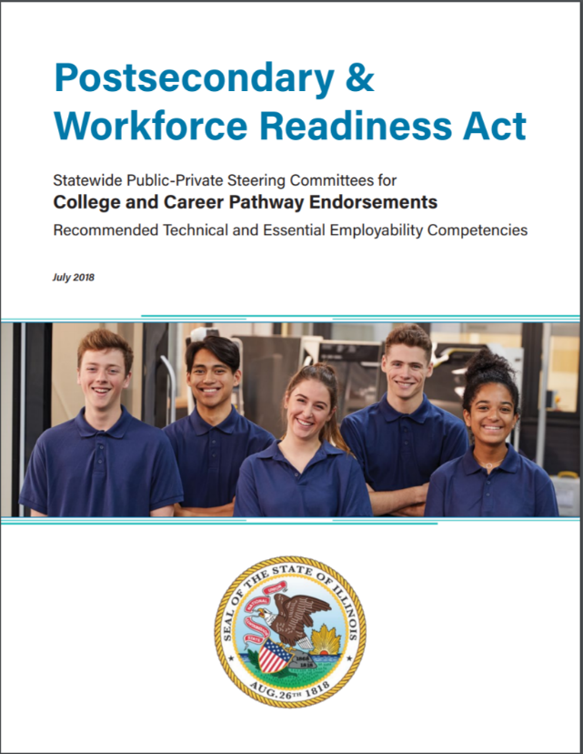
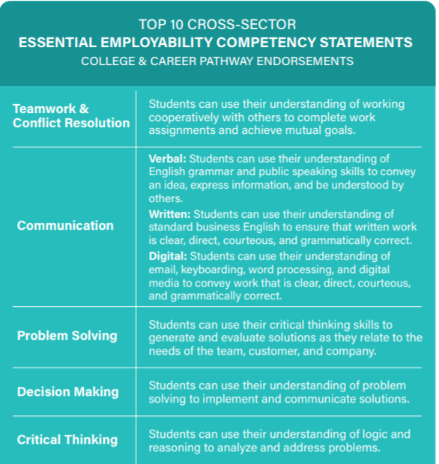
Recommended Technical & Employability Competencies
29

Slide 30
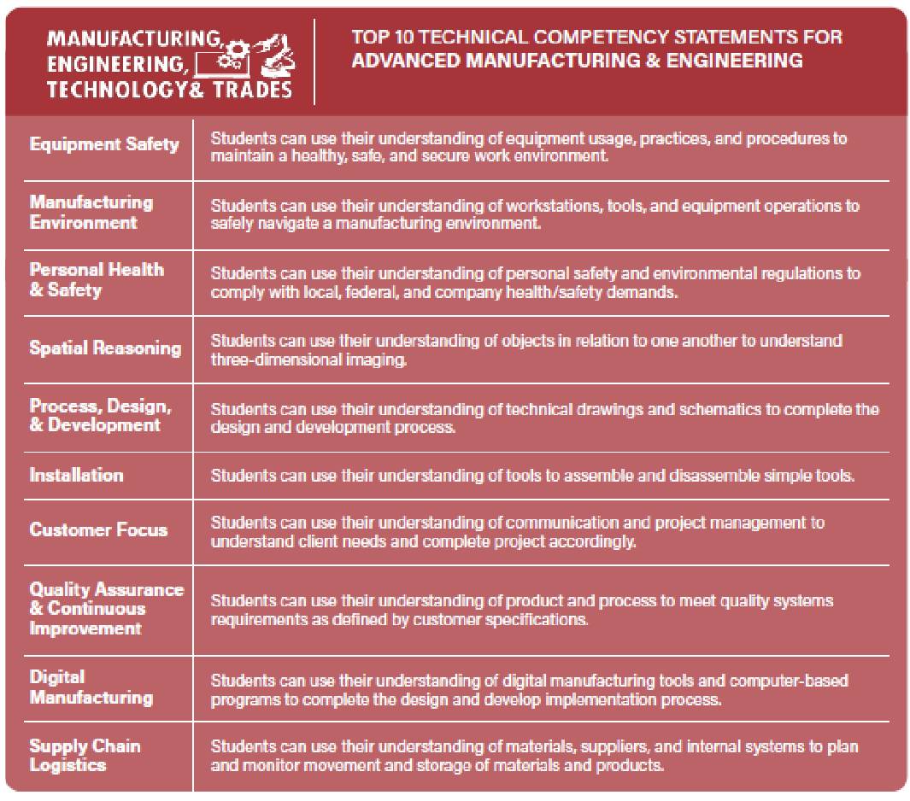
Recommended Technical & Employability Competencies

Slide 31
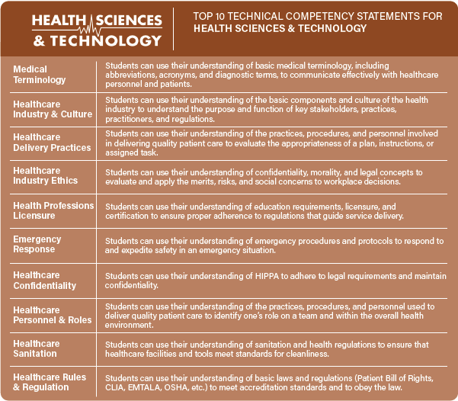
Recommended Technical & Employability Competencies

Slide 32
ICCB Model POS of Study Guides
Education
Health Sciences
Information Technology
Manufacturing and Engineering
Agriculture, Food and Natural Resources
Architecture, Construction and Energy
Arts and Communications
Finance and Business Services
edsystemsniu.org/guides

Slide 33

Identify Strategic Community College Courses
Analyze “promising credential” program requirements at various Community Colleges in the state
Tally and label all of the “career-focused” & “general education” courses across programs to determine which of these courses:
  Are most common across targeted programs,
  Are more likely accessible for credit among HS enrollees or recent graduates and
  Have the potential for transferability and currency or have industry credentials

Slide 34

Map Secondary to Postsecondary Sequence
Recommend early college courses reasonably accessible
Keep open possibility for unique opportunities, i.e. work-based learning or capstone course
Consider typical teacher and faculty credentials, as well as course delivery and approval processes
Suggest initial post secondary courses and sequences that continue to accelerate student
Recommend sequence in general education subject areas

Slide 35
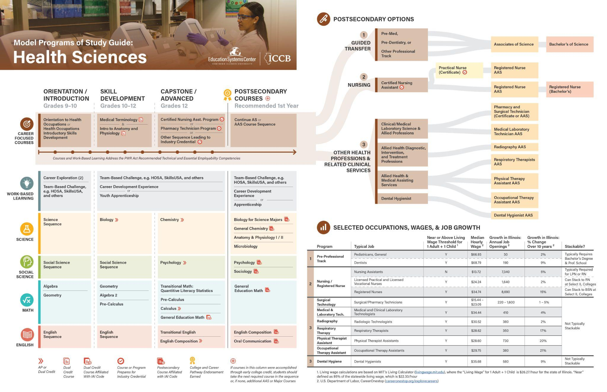
Notes:
Overall Map

Slide 36
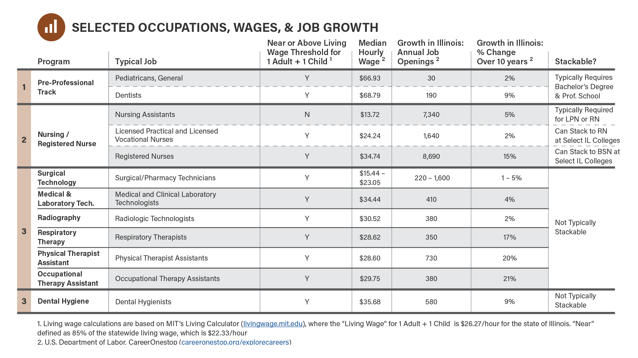
Notes:
Selected High Priority Occupations

Slide 37
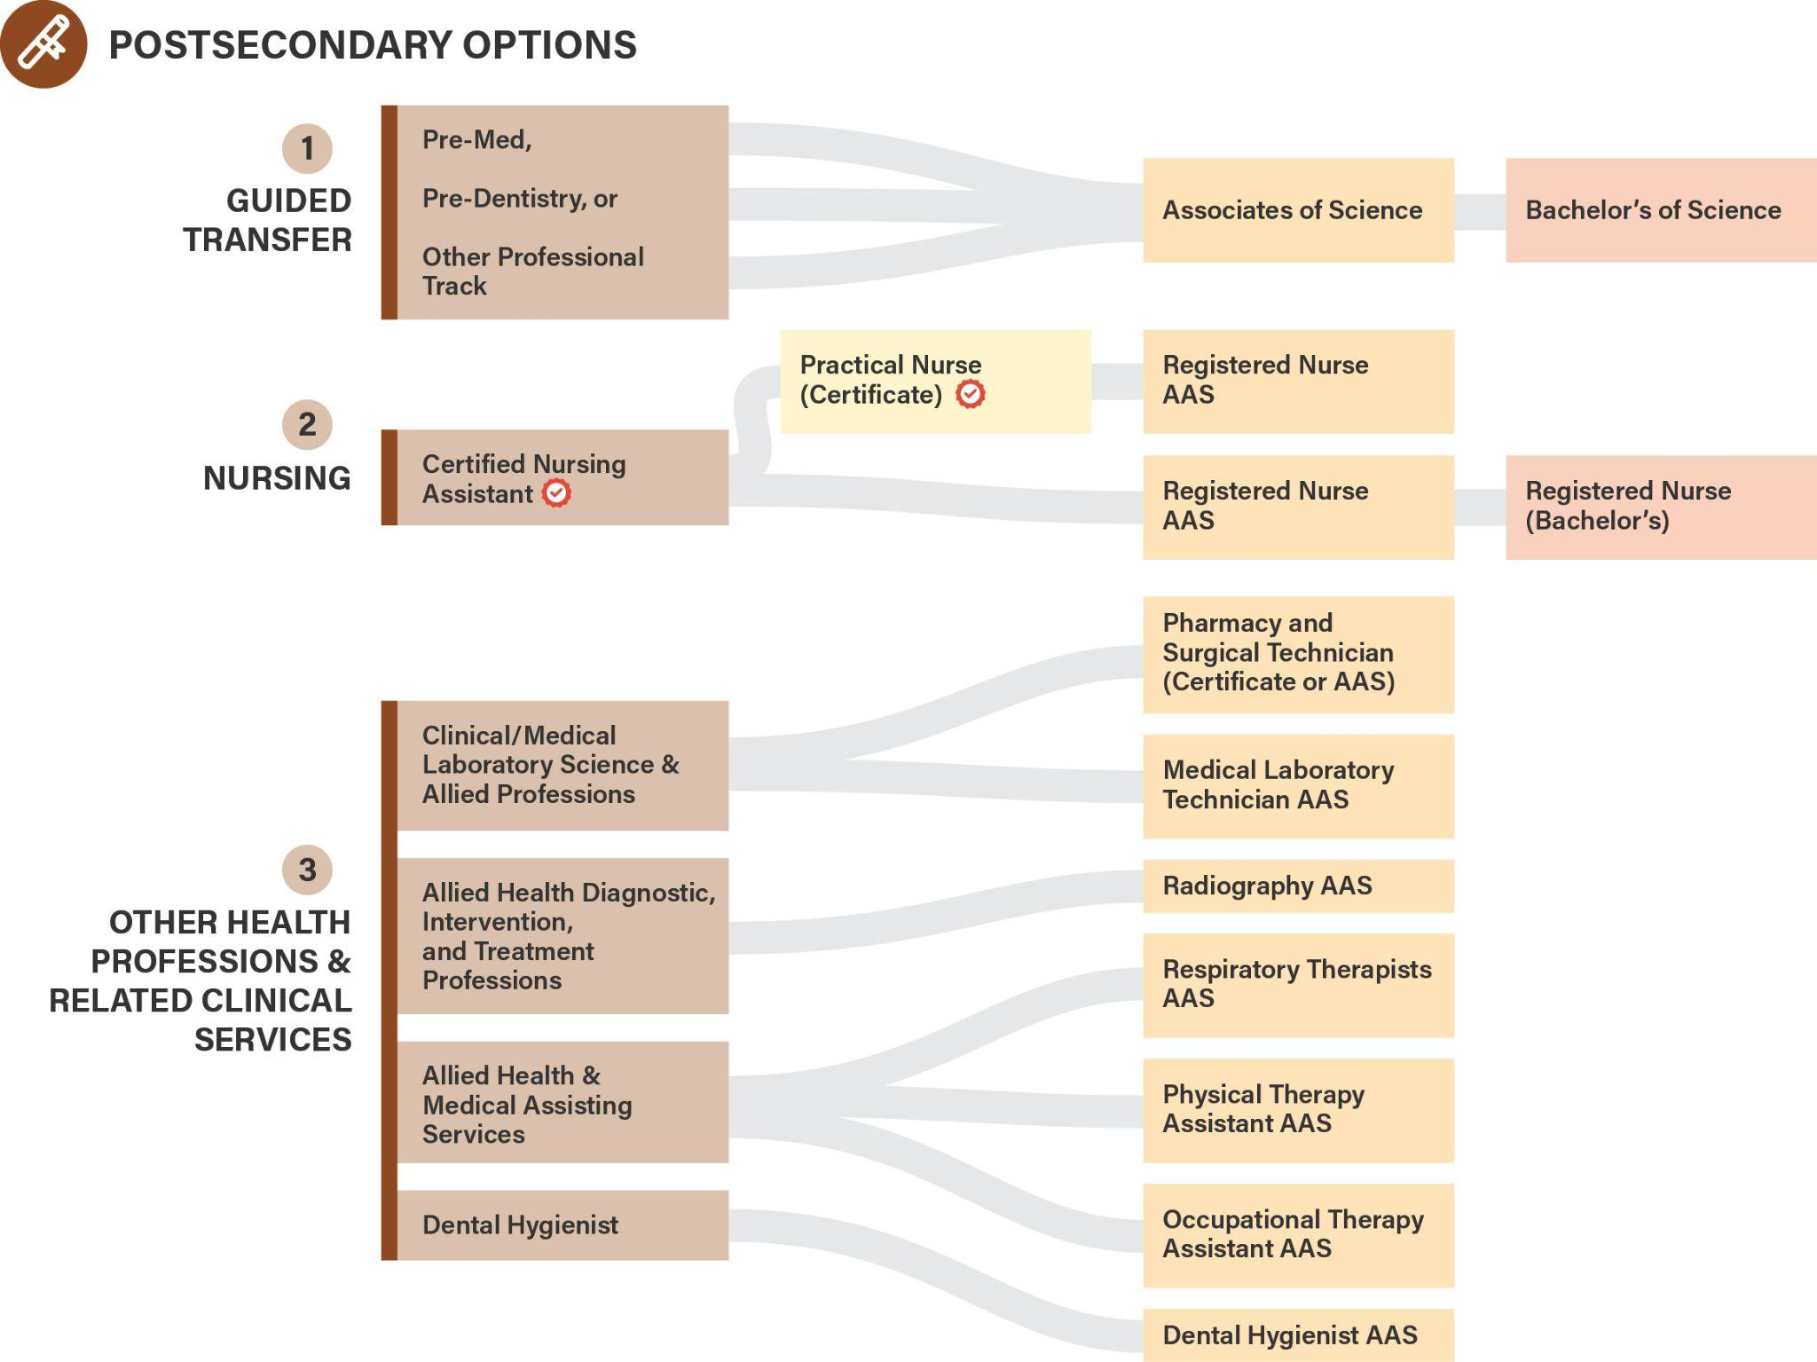
Notes:
Promising Credential programs available at several Community Colleges

Slide 38
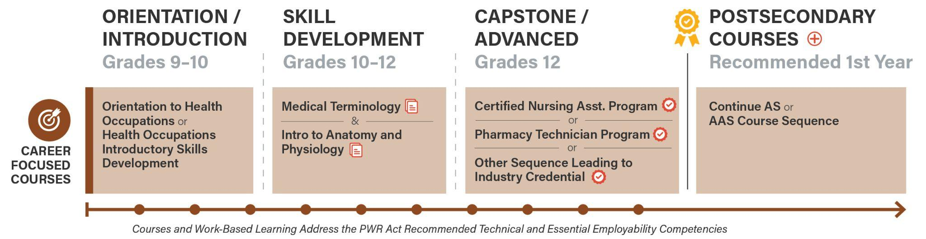
Notes:
Aligned to ISBE CTE as well

Slide 39
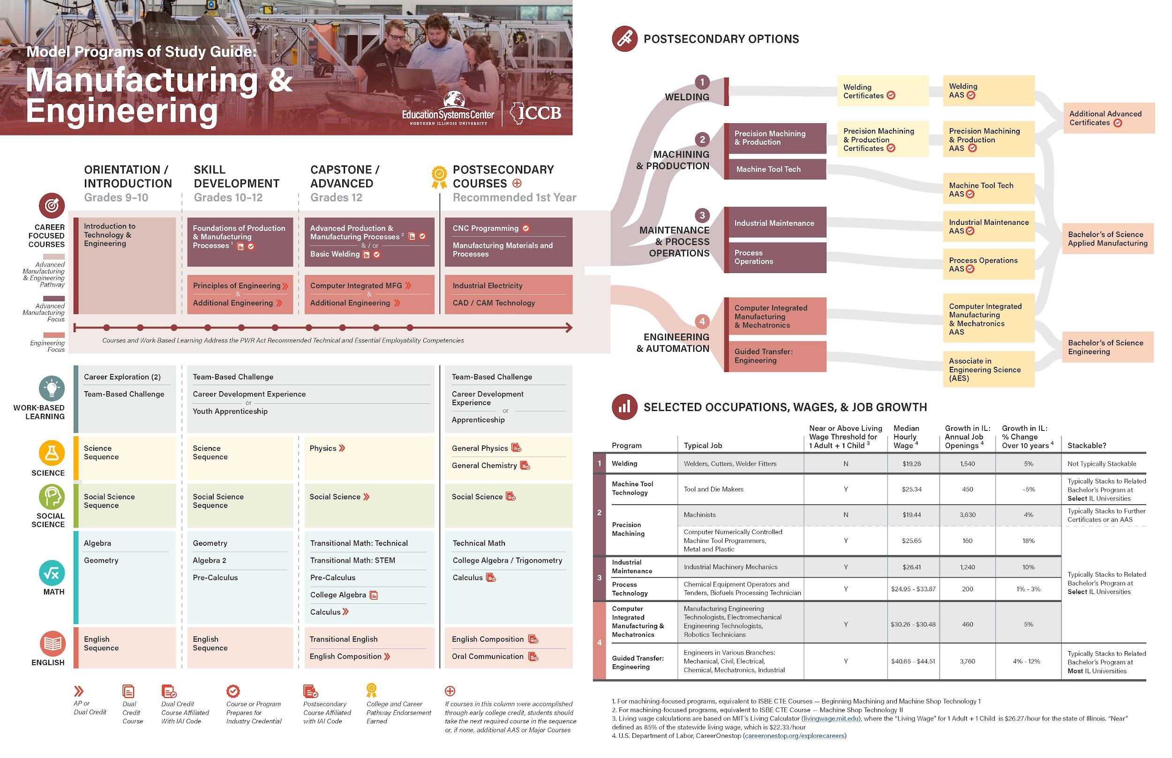
Notes:
Jon Begins to Speak here.

Slide 40
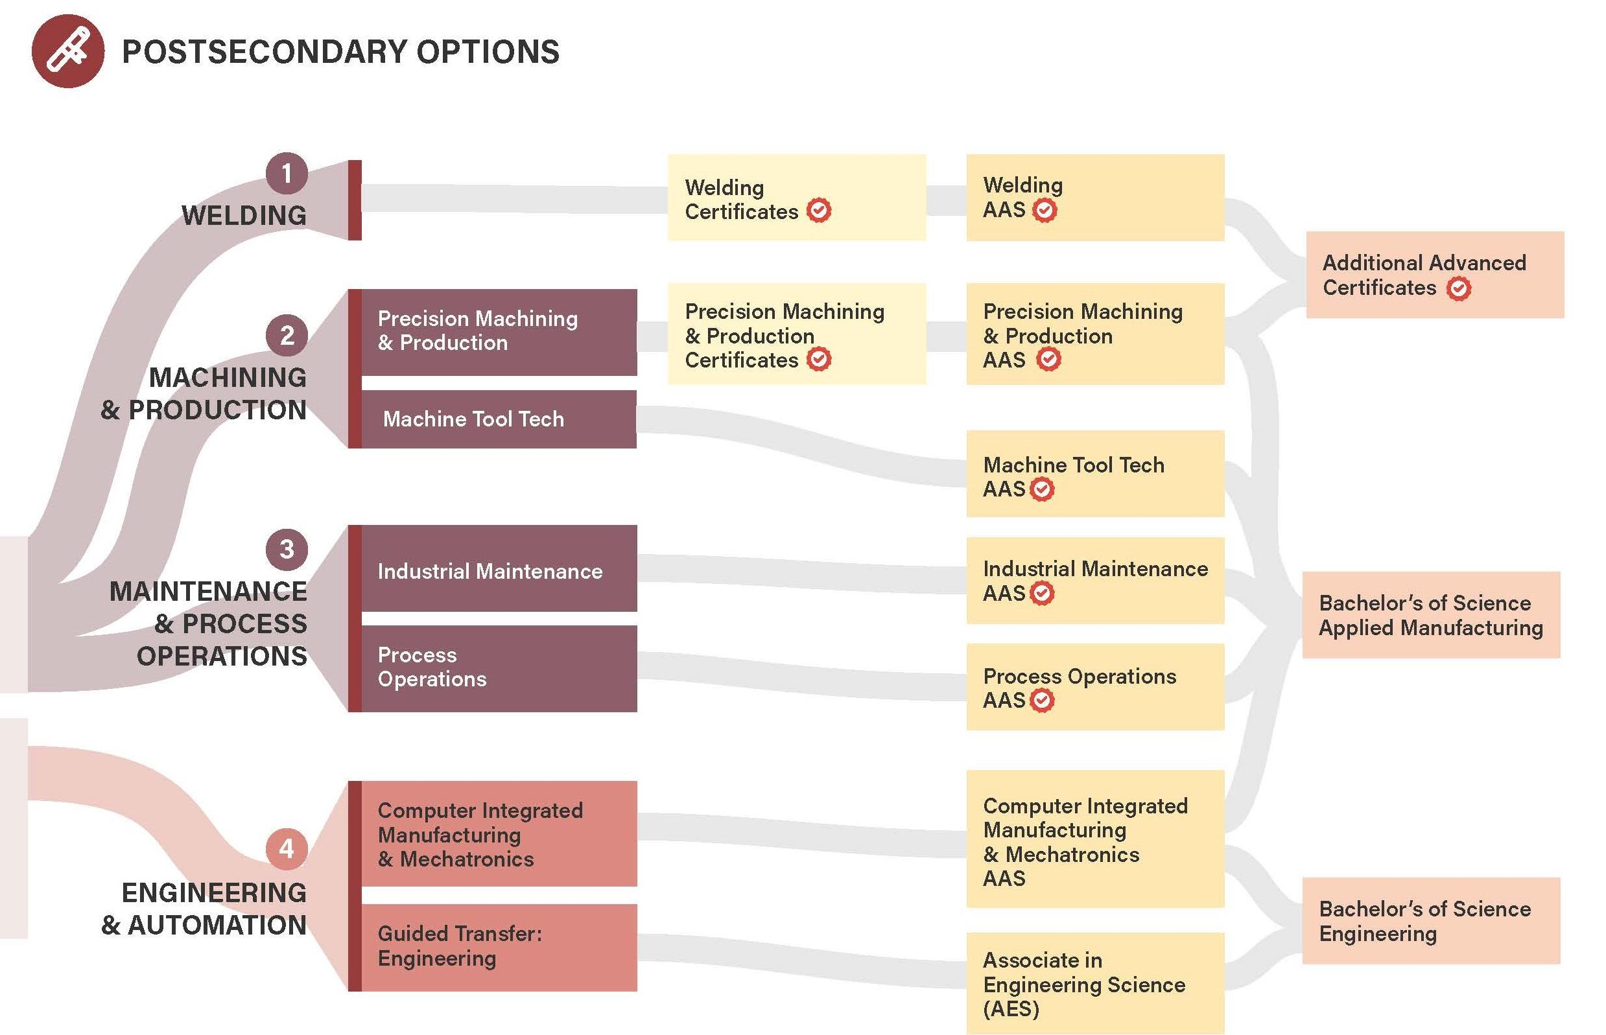

Slide 41
Credentials / Certificates

Slide 42
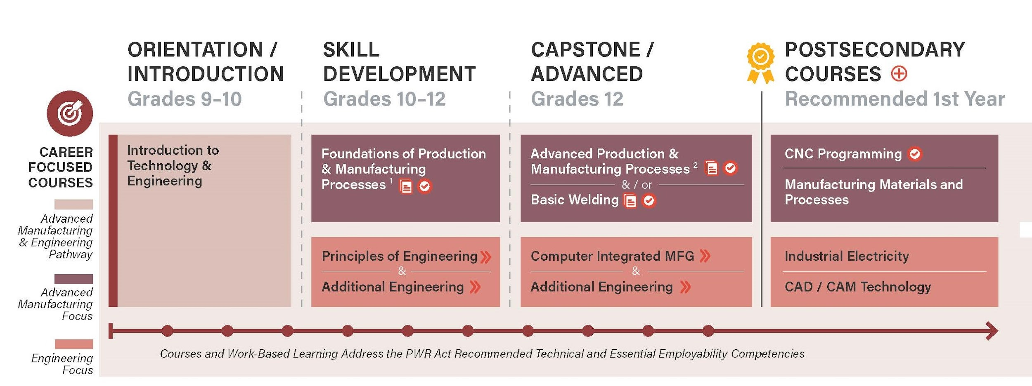

Slide 43

Strategic Skill Development Course Competencies

Slide 44
Thank You
Guides: edsystemsniu.org/guides
Middle Skills: https://edsystemsniu.org/middle-skills-pathways-in-chicago/

