Slide 1
Illinois Youth Career Pathway Grant Opportunity Technical Assistance Session: Business Engagement
Illinois Department of Commerce and Economic Opportunity

Slide 2
Moderator & Technology Support
Kiersten Baer
Online Marketing Coordinator
Illinois Center for Specialized Professional Support
ksheary@ilstu.edu

Slide 3
Access and Participation Guidelines
Meeting Access
Meeting Participation
Select the “Call Me” option on Zoom to use your phone for audio while using the video option, if you choose.
This webinar will be recorded and posted to IWN.
Everyone will be muted for this webinar.
A FAQs Page has been created to track questions raised during the webinar.
Materials shared during the meeting will be available on workNet.

Slide 4
Mission:
Amplify voices of young adults in the political process and expand economic opportunity for our generation

Slide 5
Why Business Engagement Matters
From the NOFO:
“ Employers should have a leadership role in developing and supporting the career pathway programs that integrate work-based learning opportunities through experience. Businesses are best suited to ensure current content for programs and careers that are high demand/higher skill at the local, regional, or state level.”
“...Businesses must note their commitment to either interview youth who complete the training program, provide recommendations for participants, or hire participants who complete it. As WIOA emphasizes deeper investments in a system that supports employer demand-driven sector-based programs addressing youth's diverse needs, the expectation for a sustainable and successful grant applicant must increase the number of businesses committed to employing youth served.”

Slide 6
How do you engage businesses?

Slide 7
Agenda
Common obstacles with employer engagement
Steps for employer engagement
“Selling” your program to employers
Speaking the language of business
Q&A

Slide 8
Challenges with Engaging Employers
Which companies should we target?
Who should we speak with?
When should I approach them?
How do I help them overcome their fears of working with youth?

Slide 9
Steps for Engaging Businesses
Develop a targeted list of employers
Reach out to businesses
Identify the businesses’ needs
Pitch your services
Confirm agreement
Maintain the relationship

Slide 10
Step 1: Create a List of Businesses

Slide 11
Know Your Targets
Before you can target employers, you should know:
Your program model
Target population
Youth with disabilities
Youth Apprenticeship
Short-term career
Young parents
Pre-apprenticeship
Paid work experience
Notes:
Your first step is to id 5-10 companies where apprenticeship does fit.
Review what to look for in apprenticeship:
Can work with your local lwia, chamber, BLS to find growing industries. Remind them that apprenticeship is 84% manufacturing in the state, but that doesn’t reflect the diversity of industries throughout state and/or unique to particular regions (id apprenticeships in new fields like IT, medicine, ECE, and insurance are examples from CO)
Use indeed.com, IL WorkNet to see vacancies in targeted industries and read though postings to recognize patterns that might indicate apprenticeable opportunities, which we define in the next slide
Share that once you ID apprenticeable companies, read through specific job descriptions within those, check DOL to see if occupation already has been vetted by industry

Slide 12
Know Your Targets
Create a list of 5-10 companies to target by researching:
Growing sectors and businesses in your region
Greying industries
Youth-friendly opportunities
Notes:
After you confirm your program model, you must id which businesses would best fit with your needs. that fits all businesses, your first step is to id 5-10 companies where apprenticeship does fit.
Review what to look for in apprenticeship:
Can work with your local lwia, chamber, BLS to find growing industries. Remind them that apprenticeship is 84% manufacturing in the state, but that doesn’t reflect the diversity of industries throughout state and/or unique to particular regions (id apprenticeships in new fields like IT, medicine, ECE, and insurance are examples from CO)
Use indeed.com, IL WorkNet to see vacancies in targeted industries and read though postings to recognize patterns that might indicate apprenticeable opportunities, which we define in the next slide
Share that once you ID apprenticeable companies, read through specific job descriptions within those, check DOL to see if occupation already has been vetted by industry

Slide 13
Know Your Targets:
Identifying Growing Sectors
Places to search:
Formal data sources:
Bureau of Labor Statistics: For 10 year projections
Illinois Department of Employment and Security
Chambers of Commerce
LWIAs
Informal sources:
LinkedIn, Indeed, Glassdoor
Personal and professional networks
Company website
Press releases/news

Slide 14
Greying Industries
Retirement booms in:
Manufacturing
Government
Agriculture

Slide 15
Know Your Targets:
Identifying Youth-Friendly Companies
Youth-friendly looks like:
Accessibility
Entry-level jobs
Beware of education inflation
Mentorship
Civic-minded or corporate social responsibility plans
Safety
Youth-oriented industries
Locally-owned

Slide 16
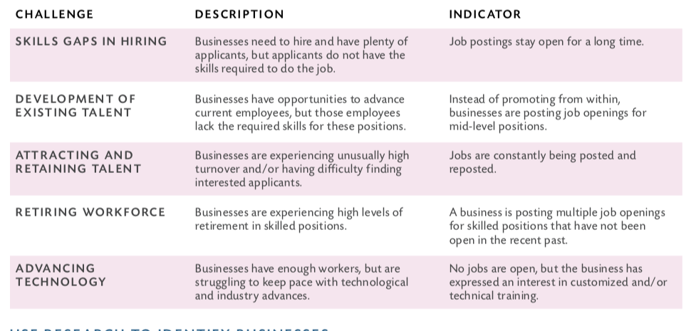
Indicators of Good Targets
Source: A Targeted Approach to Apprenticeship Business Engagement
Notes:
Note that IDing patterns takes time, especially when trying to see if postings stay open for long periods of time or are continuously reposted. Again, chambers and lwia’s can also point this out.
Highlight industry examples where this might occur (ie the grey wave in manufacturing means multiple job openings for skilled labor are open at same company)

Slide 17
Step 2: Contact Targeted Businesses
Notes:
Listen 75% to their needs, speak 25%. Questions to ask (from DOL’s guidebook):
WHAT JOBS DO YOU HAVE THE MOST DIFFICULTY FILLING? HOW EASILY ARE YOU ABLE TO FIND WORKERS WITH THE RIGHT SKILL SETS?
üWHAT POSITIONS HAVE THE HIGHEST TURNOVER?
üDO YOU ANTICIPATE THE RETIREMENT OF HIGHLY SKILLED WORKERS SOON?
üWHAT CHALLENGES HAVE YOU ENCOUNTERED HELPING WORKERS KEEP PACE WITH INDUSTRY ADVANCES?
üIF YOUR COMPANY HAS DIVERSITY GOALS AND STRATEGIES, DO YOU HAVE DIFFICULTY ATTRACTING NEW AND MORE DIVERSE TALENT POOLS?
üHOW ARE YOU CURRENTLY ADDRESSING THESE CHALLENGES? WHICH SOLUTIONS HAVE BEEN MOST SUCCESSFUL? LESS SUCCESSFUL?

Slide 18
Contact Targeted Businesses
Identify who in the company has knowledge of hiring and operations
May need to interview more than one person
Request an interview
Speak to business’ needs: “We’d like to speak with you about how we could support your recruitment and retention goals”
Notes:
Now that you have the list of 5-10 businesses, must arrange a meeting with the HR team and/or other leaders to identify their needs. You can, however, go into the meeting armed with some assumptions of their needs (based on research) and be prepared to talk about how your program can meet those needs

Slide 19
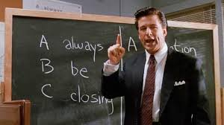
Do I have to become a salesperson?
Notes:
Yes and no. You do have to promote but all good salespeople really serve as consultants
Sales consultant=Identify and speak to a need

Slide 20
Step 3: The Interview
Notes:
Listen 75% to their needs, speak 25%. Questions to ask (from DOL’s guidebook):
WHAT JOBS DO YOU HAVE THE MOST DIFFICULTY FILLING? HOW EASILY ARE YOU ABLE TO FIND WORKERS WITH THE RIGHT SKILL SETS?
üWHAT POSITIONS HAVE THE HIGHEST TURNOVER?
üDO YOU ANTICIPATE THE RETIREMENT OF HIGHLY SKILLED WORKERS SOON?
üWHAT CHALLENGES HAVE YOU ENCOUNTERED HELPING WORKERS KEEP PACE WITH INDUSTRY ADVANCES?
üIF YOUR COMPANY HAS DIVERSITY GOALS AND STRATEGIES, DO YOU HAVE DIFFICULTY ATTRACTING NEW AND MORE DIVERSE TALENT POOLS?
üHOW ARE YOU CURRENTLY ADDRESSING THESE CHALLENGES? WHICH SOLUTIONS HAVE BEEN MOST SUCCESSFUL? LESS SUCCESSFUL?

Slide 21
The Interview
Understand the businesses’ needs
What entry level jobs do you have the most difficulty filling?
How easily are you able to find workers with the right skill sets?
What positions have the highest turnover?
Do you anticipate the retirement of highly skilled workers soon?
If your company has diversity goals and strategies, do you have difficulty attracting new and more diverse talent pools?
Understand their fit with youth
Do you have staff available who could serve as mentors?
How common is it for this occupation to be a young person’s first job?
What kind of training is used to onboard new staff?
How do you invest in your employees?
Notes:
Listen 75% to their needs, speak 25%. Questions to ask (from DOL’s guidebook):
WHAT JOBS DO YOU HAVE THE MOST DIFFICULTY FILLING? HOW EASILY ARE YOU ABLE TO FIND WORKERS WITH THE RIGHT SKILL SETS?
üWHAT POSITIONS HAVE THE HIGHEST TURNOVER?
üDO YOU ANTICIPATE THE RETIREMENT OF HIGHLY SKILLED WORKERS SOON?
üWHAT CHALLENGES HAVE YOU ENCOUNTERED HELPING WORKERS KEEP PACE WITH INDUSTRY ADVANCES?
üIF YOUR COMPANY HAS DIVERSITY GOALS AND STRATEGIES, DO YOU HAVE DIFFICULTY ATTRACTING NEW AND MORE DIVERSE TALENT POOLS?
üHOW ARE YOU CURRENTLY ADDRESSING THESE CHALLENGES? WHICH SOLUTIONS HAVE BEEN MOST SUCCESSFUL? LESS SUCCESSFUL?

Slide 22
Potential Pain Points
Recruitment
Locating and attracting talent
Diversifying the pipeline
Persistent Vacancies
Retiring workforce
Skills gap in community
Frequent turnover
Low employee retention rate
Wage chasing
Turnover
Benefit/pay structure
High training costs
Source:
https://www.doleta.gov/oa/employers/apprenticeship_toolkit.pdf

Slide 23
Step 4: Pitch Your Services

Slide 24
Youth Employment Charity
Speak to how your youth employment program can address one or more business needs `
Notes:
Listen 75% to their needs, speak 25%. Questions to ask (from DOL’s guidebook):
WHAT JOBS DO YOU HAVE THE MOST DIFFICULTY FILLING? HOW EASILY ARE YOU ABLE TO FIND WORKERS WITH THE RIGHT SKILL SETS?
üWHAT POSITIONS HAVE THE HIGHEST TURNOVER?
üDO YOU ANTICIPATE THE RETIREMENT OF HIGHLY SKILLED WORKERS SOON?
üWHAT CHALLENGES HAVE YOU ENCOUNTERED HELPING WORKERS KEEP PACE WITH INDUSTRY ADVANCES?
üIF YOUR COMPANY HAS DIVERSITY GOALS AND STRATEGIES, DO YOU HAVE DIFFICULTY ATTRACTING NEW AND MORE DIVERSE TALENT POOLS?
üHOW ARE YOU CURRENTLY ADDRESSING THESE CHALLENGES? WHICH SOLUTIONS HAVE BEEN MOST SUCCESSFUL? LESS SUCCESSFUL?

Slide 25
Top Reasons for Businesses to Engage in Youth Employment
From a United Way Study in Northeast FL:
Diversity
Ability to tap into a future labor force
Unfair hiring advantages
Cost effective employees
Temporary work opportunities/alternative work times.
“While the majority of respondents believed that participating in youth employment initiatives was beneficial to the community, this reason alone did not serve as a significant impetus for participation.”
Source: https://unitedwaynefl.org/wp-content/uploads/2018/10/18-YEP-Executive-Summary.pdf
Notes:
When asked “What would make businesses want to participate in youth employment initiatives?”, five primary incentives for participating in youth employment initiatives emerged:

Slide 26
Top Reasons that Businesses Do NOT Engage in Youth Employment
From a United Way Study in Northeast FL:
Disconnect between opportunities and youth applicants
Finances
Time
Transportation
Limitation of Public Resources
Source: https://unitedwaynefl.org/wp-content/uploads/2018/10/18-YEP-Executive-Summary.pdf
Notes:
“What prevents businesses from participating in youth employment initiatives?” five key factors in addition to preconceived notions of internships, youth, and youth employment emerged: 1) disconnect between opportunities and youth applicants, 2) finances, 3) time, 4) transportation, and 5) limitation of public resources.

Slide 27
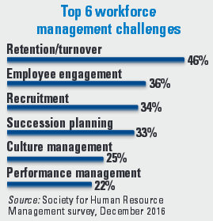
Value Proposition
After interview, paraphrase the needs using business language
Share your agency’s value-add that speak to their needs

Slide 28
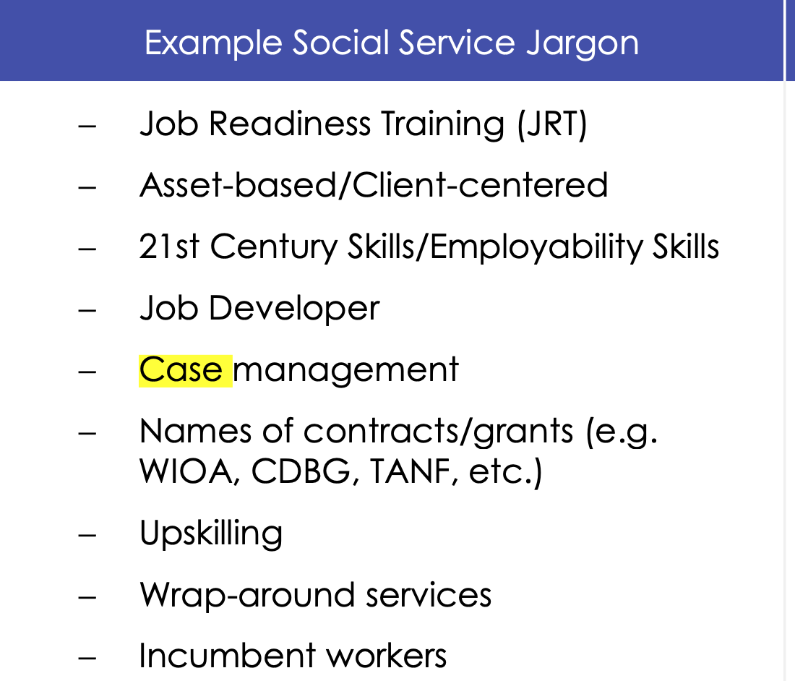
Speaking the Language of Business
CBO Jargon
Job Readiness Training (JRT)
Asset-based/client-centered
21st Century/Employability Skills
Job Developer
Case management/wraparound services
WIOA/CBDG/TANF
Business Language
Trained or Ready to Work
Focused on connecting qualified candidates with quality employment opportunities
Employees who have customer service skills, are team-oriented, effective at time management, etc.
Staffing specialist
Employee Assistance Services/Retention Services
Funding to offset costs
Source: Reimagining Employer Engagement

Slide 29
Speaking the Language of Business
Research terminology unique to that business/industry by visiting:
O*net
Trade magazines
Company websites
Newspaper articles

Slide 30
Step 5: Confirm the Agreement
Notes:
Listen 75% to their needs, speak 25%. Questions to ask (from DOL’s guidebook):
WHAT JOBS DO YOU HAVE THE MOST DIFFICULTY FILLING? HOW EASILY ARE YOU ABLE TO FIND WORKERS WITH THE RIGHT SKILL SETS?
üWHAT POSITIONS HAVE THE HIGHEST TURNOVER?
üDO YOU ANTICIPATE THE RETIREMENT OF HIGHLY SKILLED WORKERS SOON?
üWHAT CHALLENGES HAVE YOU ENCOUNTERED HELPING WORKERS KEEP PACE WITH INDUSTRY ADVANCES?
üIF YOUR COMPANY HAS DIVERSITY GOALS AND STRATEGIES, DO YOU HAVE DIFFICULTY ATTRACTING NEW AND MORE DIVERSE TALENT POOLS?
üHOW ARE YOU CURRENTLY ADDRESSING THESE CHALLENGES? WHICH SOLUTIONS HAVE BEEN MOST SUCCESSFUL? LESS SUCCESSFUL?

Slide 31
Confirm the Agreement
Send a summary of your meeting that outlines:
Identified needs
How apprenticeship can address those needs
What your agency can offer
May also summarize benefits of working with youth
Include employer references

Slide 32
Step 6: Maintain the Relationship
Notes:
Listen 75% to their needs, speak 25%. Questions to ask (from DOL’s guidebook):
WHAT JOBS DO YOU HAVE THE MOST DIFFICULTY FILLING? HOW EASILY ARE YOU ABLE TO FIND WORKERS WITH THE RIGHT SKILL SETS?
üWHAT POSITIONS HAVE THE HIGHEST TURNOVER?
üDO YOU ANTICIPATE THE RETIREMENT OF HIGHLY SKILLED WORKERS SOON?
üWHAT CHALLENGES HAVE YOU ENCOUNTERED HELPING WORKERS KEEP PACE WITH INDUSTRY ADVANCES?
üIF YOUR COMPANY HAS DIVERSITY GOALS AND STRATEGIES, DO YOU HAVE DIFFICULTY ATTRACTING NEW AND MORE DIVERSE TALENT POOLS?
üHOW ARE YOU CURRENTLY ADDRESSING THESE CHALLENGES? WHICH SOLUTIONS HAVE BEEN MOST SUCCESSFUL? LESS SUCCESSFUL?

Slide 33
Maintaining the Relationships
Send great candidates!
Use business language to address any challenges
Eg: Instead of case management, refer to retention efforts with your young adults
Offer on-going technical assistance
Eg: Employee/mentor trainings
Create a schedule for check-ins
Develop MOUs

Slide 34
References and Resources
Aspen Institute: A Toolkit to Engage Employers and Opportunity Youth on the Future of Work
Reimagine Retail Chicagoland: Reimagining Employer Engagement: A Toolkit for Providers
Department of Labor: A Targeted Approach to Apprenticeship Business Engagement
United Way of Northeast Florida: Executive Summary of Youth Employment
Urban League: Employer Engagement by Community-Based Organizations

Slide 35
Feel Free to Reach Out
Morgan Diamond
Midwest Program Manager
Young Invincibles
morgan.diamond@younginvincibles.org

Slide 36
Questions?

