Slide 1


Eligibility, Enrollment, Agent/Liable, 2021R Program
October 28, 2021

Slide 2
Today’s Topics
Eligibility for Trade Benefits and Services
Trade Readjustment Assistance (TRA)
Trade Enrollment Process
  Documentation
  Individual Employment Plan (IEP)
  Assessments
  Extenuating Circumstances
  Co-Enrollment
  Case Management Services
  Trade Services
Liable and Agent State Responsibilities
2021R Program Differences

Slide 3
Eligibility
To be eligible to apply for Trade benefits and services, a participant:
  Must be a part of the affected certified worker group.
  Must have a Qualifying separation date between Impact and Expiration of a Trade Certification.
    Qualifying separation means any total or partial separation of an adversely affected worker from adversely affected employment within the certification period.
  Must be laid off due to lack of work or plant closure.

Slide 4
Eligibility (cont.)
A career planner must know the timeline dates (Impact Date, Certification Date, and Expiration Date) to determine if a participant is part of a worker group, and to determine when a participant must meet the enrollment deadline by either being Enrolled In Training or be Waived from the Training Requirement.
The TRA enrollment deadline is either the later of the last day of the 26th week (8th week for 2021R) after the week of issuance of the certification of eligibility covering the worker, or the last day of the 26th week (16th week for 2021R) after the worker’s most recent total qualifying separation. (26/26 deadline - Petitions up to 97,999); (8/16 deadline – Petitions 98,000+).

Slide 5
Eligibility (cont.)
Conclusion Paragraph from a certification:
After careful review of the facts obtained in the investigation, I determine that workers of Acuity Brands Lighting, Inc., Juno Lighting division, a subsidiary of Acuity Brands, Inc., including on-site leased workers from Superior Staffing, Des Plaines, Illinois, who are engaged in activities related to the production of lighting fixtures, primarily used in a residential or retail location, meet the worker group certification criteria under Section 222(a) of the Act, 19 U.S.C. § 2272(a). In accordance with Section 223 of the Act, 19 U.S.C. § 2273, I make the following certification: "All workers of Acuity Brands Lighting, Inc., Juno Lighting division, a subsidiary of Acuity Brands, Inc., including on-site leased workers from Superior Staffing, Des Plaines, Illinois, who became totally or partially separated from employment on or after September 17, 2017, through two years from the date of certification, and all workers in the group threatened with total or partial separation from employment on the date of certification through two years from the date of certification, are eligible to apply for adjustment assistance under Chapter 2 of Title II of the Trade Act of 1974, as amended."Signed in Washington, D.C. this 9th day of October 2018.
In this example, these are the dates for this certification:
  Certification Date: October 9, 2018.
  Impact Date: September 17, 2017.
  Expiration Date: October 9, 2020.

Slide 6
Trade Readjustment Assistance (TRA)
Income support in the form of cash payments for a Trade participant.
Participant must file a UI/TRA claim with Illinois Department of Employment Security (IDES).
Initial eligibility for TRA is established at the beginning and must be maintained throughout the participant’s progression through the reemployment plan.
Determinations for eligibility for TRA are made by IDES.

Slide 7
TRA (cont.)
Three types of TRA (Basic, Additional, and Completion).
  Basic – payable if the participant has been issued a waiver from the training requirement, is enrolled in or participating in Trade approved training, or has completed training.
  Additional – payable only if the participant is participating in Trade approved training and has exhausted all rights to Basic TRA.
  Completion - (an additional period of up to 13 weeks of income support) is payable only if the participant is participating in Trade approved training and has exhausted all rights to Basic TRA and Additional TRA. Participant must have met all required Benchmarks to be eligible for Completion TRA.

Slide 8
Trade Enrollment - General
Following Trade rapid response, the career planner schedules a Trade enrollment meeting with the participant.
General eligibility should be pre-determined prior to inviting participants to an enrollment meeting.
  Check the layoff list for the participant’s name
  Check the layoff dates
  Check IBIS to verify participants are within the 26/26 or 8/16 (for 2021R) enrollment deadline.
    If it appears a participant may not be within the 26/26 or 8/16 (for 2021R) enrollment deadlines, the participant will need to bring additional documentation to support any extenuating circumstances.

Slide 9
Trade Enrollment – Documentation
The career planner will do the following:
  Review the certification and any amendments.
  Obtain documentation supporting the participant’s attachment to the certified worker group.
    Confirm the participant is on the affected employee list.
    Print the IBIS documentation:
      TRA Claim Details reflecting Petition Number, Employer, Certification Date, Expiration Date, Impact Date, Last Qualifying Separation Date, and Benefit Period End Date (BPE).
      UI Basic Claim Details reflecting Lack of Work as the layoff reason.
    Document Labor Market Information (LMI) data for the Trade impacted job.
    Collect all required Workforce Innovation and Opportunity Act (WIOA) co-enrollment documentation (i.e. Selective Service, etc.)

Slide 10
Trade Enrollment – Documentation (cont.)
The participant will provide documentation to support:
  U.S. Citizenship (Birth Certificate, U.S. Passport)
  Marriage License (proof of name change, if applicable).
  Photo ID.
  Social Security Card.
  DD214 (Veterans).
  Selective Service record for men born January 1, 1960, or after.
  Trade Certified Company Layoff Letter, if available.

Slide 11
Trade Enrollment – Documentation (cont.)
  If not a U.S. Citizen, documentation for Authorization to Work in U.S.
    Not entitled to benefits or services if this cannot be documented.
    Services cannot continue after expiration date of authorization.
    Can be verified via the Systematic Alien Verification for Entitlement (SAVE) U.S. Customs and Immigration System.
    Immigration Status must reverified if the documentation provided initially will expire during the period in which the participant is potentially eligible to receive benefits.
The career planner will validate the authenticity of each document, copy them, and place in the participant file.
See the WIOA Title 1 Eligibility Documentation Sources for specific documentation that can be used to support eligibility.

Slide 12
Individual Employment Plan (IEP)
IEPs must be made available to participants per Trade regulations. (20 CFR 618.350)
Must make participant aware of the advantages of receiving an IEP. Helps to identify:
    Transferrable skills.
    Barriers to employment.
    Prior work history.
    Education history.
    Occupational goals.
    Determination of services.
    Participant responsibilities.
Participant may refuse to complete an IEP.
  May result in denial of benefits and services.
  Portions necessary to determine eligibility
    Job Search Allowance
    Training

Slide 13
IEP (cont.)
Participant issued one IEP.
May be developed by partner program.
  Must contain required components of Trade.
  Supplemented.
Career planner must monitor progress of the participant in meeting the participant’s responsibilities listed in the IEP.
  Attendance.
  Achievement in the approved training program.

Slide 14
IEP (cont.)
Must be modified when changes occur in the re-employment plan.
  Changes in costs (increase or decrease).
  Change in the training program.
  Receipt of supplemental assistance (travel or subsistence payments).
Modification details must be recorded in the IEP Status Record Comment Box and in Case Notes.
Modification requires an IEP Modification approval by state merit staff.

Slide 15
IEP (cont.)
IEP must use results of Initial and Comprehensive and Specialized assessments.
  Document a strategy to provide the participant with services needed to obtain employment including:
    Participant’s employment goal, including the targeted occupation and industry;
    The training program proposed, if any;
    Any services needed by the participant to obtain suitable employment:
      Career services.
      Supportive services.
      Post-training case management services.
      Supplemental assistance (transportation or subsistence payments).
      Participant’s responsibilities under the plan.

Slide 16
IEP (cont.)
Eight Required Trade Case Management Services (20 CFR 618.310).
All eight of the items listed below must be discussed and offered to the participant.
Date the service was offered must be entered on the IEP.
If the service was provided, the date provided must be entered on the IEP.
If the participant is referred to a partner program that provides the service, the date the referral was made should be entered on the date offered.

Slide 17
IEP (cont.)
Eight required case management services.
  Comprehensive and Specialized assessment of skill levels and service needs, including:
    Diagnostic testing/use of assessment tools (to address interests, skills, aptitudes, and abilities).
    In-depth interviewing (to identify employment barriers and employment goals).
  Development of an IEP (to identify goals, objectives, and appropriate training needs).
  Information on training available in local and regional areas, information on individual counseling to determine which training is suitable training, and information on how to apply for such training.
  Financial aid information (may include referral of participants to educational centers to apply for financial aid and determination of worker need for financial assistance using current year income, at discretion of educational center).

Slide 18
IEP (cont.)
  Short-term prevocational services, including development of learning skills, communications skills, interviewing skills, punctuality, personal maintenance skills, and professional conduct skills.
  Individual and group career counseling, including job search and placement counseling during the training period and after training period has been completed.
  Employment statistics information related to local, regional, and national labor market area including job vacancies, job skills necessary for job listings, in demand occupations, and potential earnings.
  Supportive services available through partner programs, including childcare, dependent care, transportation, housing assistance, and needs related payments.

Slide 19
IEP (cont.)
Participants must also complete registrations with:
  Illinois Job Link.
  Illinois workNet.

Slide 20
Assessments
Assessments are required by Trade regulations. (20 CFR 618.330)
Forms the basis for determining which Trade Program benefits and services, including training, are necessary to enable the participant to successfully obtain reemployment.
Initial assessment must allow sufficient time and information for the participant to consider, request, and enroll in training or obtain a waiver of the training requirement to protect the participant’s eligibility to receive TRA.

Slide 21
Assessments (cont.)
Administered with cooperation of the participant and should include a discussion of the participant’s:
  Interests
  Skills
  Aptitudes
  Abilities
Results must be documented in the case file and case notes.
Assessments administered by a partner program must be reviewed to ensure it contains the required Trade components:
  20 CFR 618.335 for an initial assessment and, if necessary,
  20 CFR 618.345 for a comprehensive and specialized assessment.
  Assessments that do not contain all Trade program requirements must be supplemented to ensure compliance.

Slide 22
Assessments (cont.)
Initial Assessment must take into consideration the following factors:
  Prevailing local labor market conditions, including the unemployment rate, local employer skill demands and hiring prerequisites;
  The participant’s knowledge, skills, and abilities from his/her education and previous employment;
  Transferable skills that the participant may possess that would be of interest to other local employers;

Slide 23
Assessments (cont.)
  Evaluation of a participant’s skill levels (including literacy, numeracy, and English language proficiency), aptitudes, abilities (including skills gaps), and supportive service needs; and
    The basic skills test scores may not be more than one year old.
    If the Reading, Math and or English test scores are deficient, it may indicate the need for Remedial Training, prior to or in conjunction with occupational training.
    If the participant’s primary language is other than English, English Language Acquisition (ELA) may also be a necessary component to include in the training plan.

Slide 24
Assessments (cont.)
  Any barriers to the participant’s reemployment, such as:
    Lack of applicability of skills from the participant’s present occupation to other occupations;
    Skills that are in excess supply in the labor market area; or
    Other barriers as outlined in WIOA sec. 3(24).

Slide 25
Assessments (cont.)
  Based upon the information gathered in the initial assessment, the career planner may:
    Determine that suitable employment is available to the participant, and if so, the career planner must make available employment and case management services.
      If the participant disagrees with the determination, the career planner must make available to the participant a comprehensive and specialized assessment (under 20 CFR 618.345) to obtain additional information to determine whether the initial assessment was correct.
    Determine that no suitable employment is available to the participant and, if so, the career planner must make available services as described in 20 CFR 618.310 (responsibilities for the delivery of employment and case management services) and a comprehensive and specialized assessment (as described in 20 CFR 618.345) to develop a comprehensive service strategy for the participant.

Slide 26
Assessments (cont.)
  If the career planner determines that suitable employment is not available to a participant, even with additional employment and case management services, the career planner must advise the participant to apply for training.
    The training plan must consider the allowable training weeks and include all training necessary for the participant to secure suitable employment of a long-term duration.

Slide 27
Assessments (cont.)
Comprehensive and specialized assessments must be made available to all participants.
  It must take into account the participant’s goals and interests as they relate to employment opportunities either in the participant’s commuting area or, where there is no reasonable expectation of securing employment in the participant’s commuting area and the participant is interested in relocation, the employment opportunities and demand in the area to which the participant proposes to relocate.

Slide 28
Assessments (cont.)
  It must expand upon the initial assessment regarding the participant’s interests, skills, aptitudes, and abilities. This may include use of diagnostic testing tools and instruments and in-depth interviewing and evaluation to identify barriers to employment and appropriate employment goals. The in-depth interviewing of participants must include discussion of training opportunities reasonably available to each participant; reviewing the opportunities with each participant; and informing each participant of the requirements for participating in training, including the enrollment deadlines required for TRA eligibility.
  The career planner may use information from the comprehensive and specialized assessment to determine whether the participant has met the six criteria for approval of training.
  The participant may be asked to take the Illinois workNet Skills and Interest Profiler, O*NET Interest Profiler, Career Scope, or Career One Stop Skills Assessment, to assist in making an informed career/training choice.

Slide 29
Trade Enrollment - Application & Testing
The career planner assists the participant in completing the following tasks:
  Ensure the Benefits, Rights and Obligations (BRO) has been presented and signed.
  Ensure Form #004 Trade Bona Fide Application is completed and signed, if applicable. (2002 and 2021R participants only)
  Complete the WIOA-TAA Guided Application in IWDS or the paper IWDS-WIOA Standard Application.
  Signing local release of information documents.
  Complete basic skills testing for all except English Language Learners:
    Test for Adult Basic Education (TABE) 11 & 12 Reading and Math; or
    Comprehensive Adult Student Assessment Systems (CASAS) GOALS Reading and Math

Slide 30
Trade Enrollment – Application & Testing (cont.)
  Basic Skills testing for English Language Learners (English Language Acquisition (ELA)):
    BEST Literacy.
    BEST Plus 2.0
    CASAS Life and Work Reading Assessments.
  See WIOA Policy 5.9 Basic Skills Deficiency Assessment Requirements Document.
  Complete a full assessment of the participant’s skills and abilities and start developing the Form #014 Individual Employment Plan (IEP).
  Review and file all required eligibility documentation.

Slide 31
Trade Enrollment – Extenuating Circumstances
Granting Extenuating Circumstances
  May be available to be used when the 26/26 or 8/16 (for 2021R) deadline was missed through no fault of the participant.
  Must be documented.
  Should be rare.
  Handled on a case-by-case basis.
  Must consider the circumstances in a specific order based on applicability for each Trade program year. See chart on next slide.

Slide 32
Trade Enrollment – Extenuating Circumstances (cont.)
Granting Extenuating Circumstances
Petitions 69,999 and Below | Petitions 70,000 thru 79,000 | Petitions 80,000 thru 80,999 | Petitions 81,000 thru 97,999 | Petitions 98,000 and above
2002 Law Benefits | 2009 Law Benefits | 2011 Law Benefits | 2015 Law Benefits | 2021R Law Benefits
45 Days Equitable Tolling | 45 Days 60 Days Upon Proper Notification State Good Cause Equitable Tolling | 45 Days Federal Good Cause Equitable Tolling | 45 Days 60 Days Upon Proper Notification Federal Good Cause Equitable Tolling | 45 Days Equitable Tolling

Slide 33
Trade Enrollment – Extenuating Circumstances (cont.)
45-Day Extenuating Circumstances (20 CFR 618.725(a)(3)): (Applies to all Trade Laws) A participant may be issued a waiver or enrolled in training within 45 additional days after the 26/26 or 8/16 (for 2021R) deadline if there are extenuating circumstances that justify the extension. Circumstances that would justify the extension must be for good cause, which means the participant acted diligently yet was unable to enroll because of exigent circumstances.

Slide 34
Trade Enrollment – Extenuating Circumstances (cont.)
State Good Cause: (Applies Only to 2009 Trade Law) A state Unemployment Insurance (UI) Good Cause provision (law, policy or practice) may be used to waive time limitations governing TRA and enrollment in training. The participant must meet one of the criteria below:
1) The worker was unaware of his/her rights under the act;
2) There was a failure by the State or the employer to discharge its
responsibilities or obligations under the act or the rules;
3) Any act by the employer in coercing, warning or instructing the
worker not to pursue his/her benefits or rights; or
4) Other circumstances beyond the worker’s control.

Slide 35
Trade Enrollment – Extenuating Circumstances (cont.)
60 Day Proper Notification Exception (20 CFR 618.725(a)(4)): (Applies Only to 2009 and 2015 Trade Law) Upon the state’s failure to provide the participant with timely information regarding the applicable training enrollment deadline, the participant must be issued a waiver by the Monday of the first week occurring 60 consecutive calendar days following the date the participant was properly notified.

Slide 36
Trade Enrollment – Extenuating Circumstances (cont.)
Federal Good Cause Provisions (20 CFR 618.730): (Applies to 2011 and 2015 Trade Law) States must waive the time limitations with respect to an application for TRA, enrollment in training, or receipt of a training waiver if the participant shows good cause. The following factors should be considered when determining whether good cause exists:
1) Whether the State failed to provide timely notice of the need to act before the deadline passed;
2) Whether factors outside the control of the worker prevented the worker from taking timely action to meet the deadline;
3) Whether the worker attempted to seek an extension of time by promptly notifying the State;
4) Whether the worker was physically unable to take timely action to meet the deadline;
5) Whether the employer warned, instructed, threatened, or coerced the worker in any way that prevented the worker’s timely
filing of an application for TRA or enrolling in training;
6) Whether the State failed to perform its affirmative duty to provide advice reasonably necessary for the protection of the
worker’s entitlement to TRA; and
7) Other compelling reasons or circumstances that would prevent a reasonable person from meeting a deadline.

Slide 37
Trade Enrollment – Extenuating Circumstances (cont.)
Equitable Tolling (20 CFR 618.888): (Applies to all Trade Laws) A Trade Program deadline must be equitably tolled when:
1) an extraordinary circumstance prevented an individual’s timely action; and
2) the individual otherwise acted with diligence
3) When an individual fails to take timely action because the State failed to give notice required
under this part, that failure is prima facie evidence of an extraordinary circumstance.
4) If the individual did not receive the required notice, but otherwise received actual notice with
sufficient time to take timely action, the last of receipt of the required notice is not evidence of an
extraordinary circumstance.
5) A Trade Program deadline equitably tolled under this section is tolled for the time period during which
the extraordinary circumstance exists. Once that circumstance is resolved, the time period that was tolled
begins to run again.
6) Equitable tolling may extend an otherwise expired Trade Program deadline by no more than 36 months.

Slide 38
Trade Enrollment – Co-Enrollment
Co-Enrollment in WIOA Dislocated Worker Program and any other appropriate partner programs required.
Eligibility criteria of a dislocated worker defined at WIOA sec. 3(15).
Selective Service registration requirement
  Co-enrollment exemption for those who do not meet.
Co-enrollment allows for coordination of funds for training and services.
  WIOA may pay for reemployment services, training, and supportive services not payable with Trade Program funds.
Participants may choose to decline co-enrollment in WIOA.
Participants cannot be denied benefits or services under the Trade Program based on ineligibility for or declining co-enrollment in WIOA.
WIOA follow-up services
  Provided for participants in unsubsidized employment.
  Up to 12 months after the first day of employment.
See the WIOA Title 1B Service Matrix.

Slide 39
Enrollment - Application
All participants must have a completed application.
  WIOA-TAA Guided Application in IWDS.
    Must be printed, signed, dated and placed in participant file.
  Form #002 Trade-WIOA Standard Application (paper).
    The WIOA-TAA Guided Application in IWDS is still required.
Things to pay close attention to when completing the guided application:
  Trade impacted job should be the only one marked as “Yes” for Dislocation Job.

Slide 40
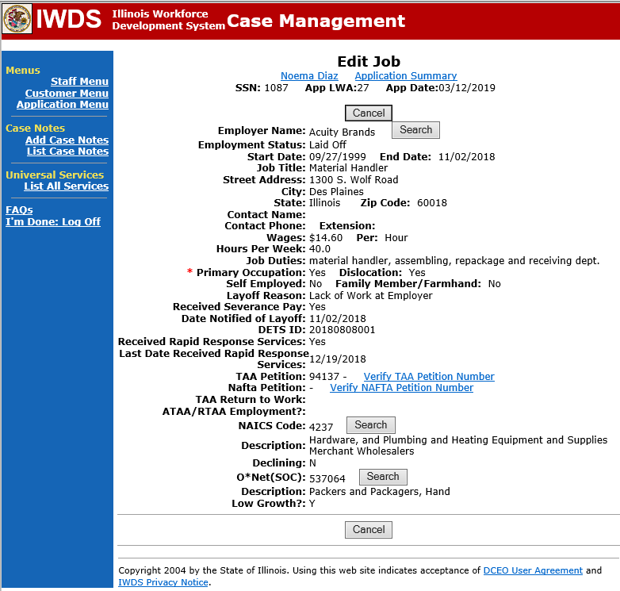
Enrollment – Application (cont.)
Employment History for the Trade job must have all fields completed, including:
  Rapid Response Services (Y/N) –this should always be Y (BRO presentation)
  Last Date the participant Received Rapid Response Services.

Slide 41
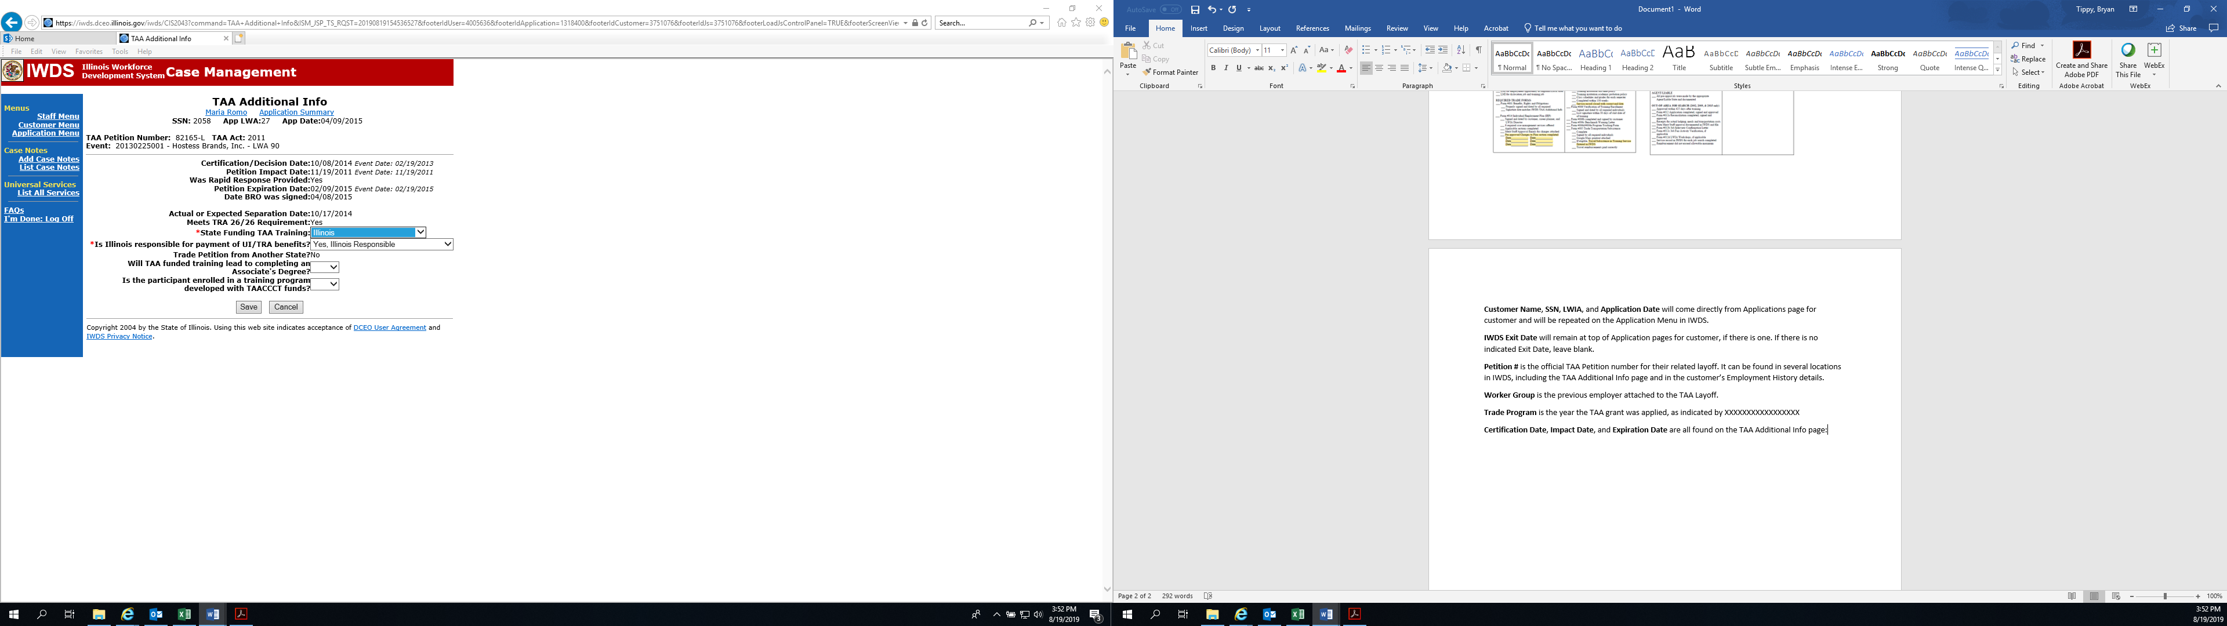
Enrollment – Application (cont.)
Verify dates from Illinois Business Information System (IBIS):
  Petition Number (auto fills from the Illinois Employment Business System (IEBS).
  Certification/Decision Date (auto fills from IEBS).
  Petition Impact Date (auto fills from IEBS).
  Expiration Date (auto fills from IEBS).
  Actual or Expected Separation Date (entered by career planner).
All other fields must be verified and entered by the career planner.

Slide 42
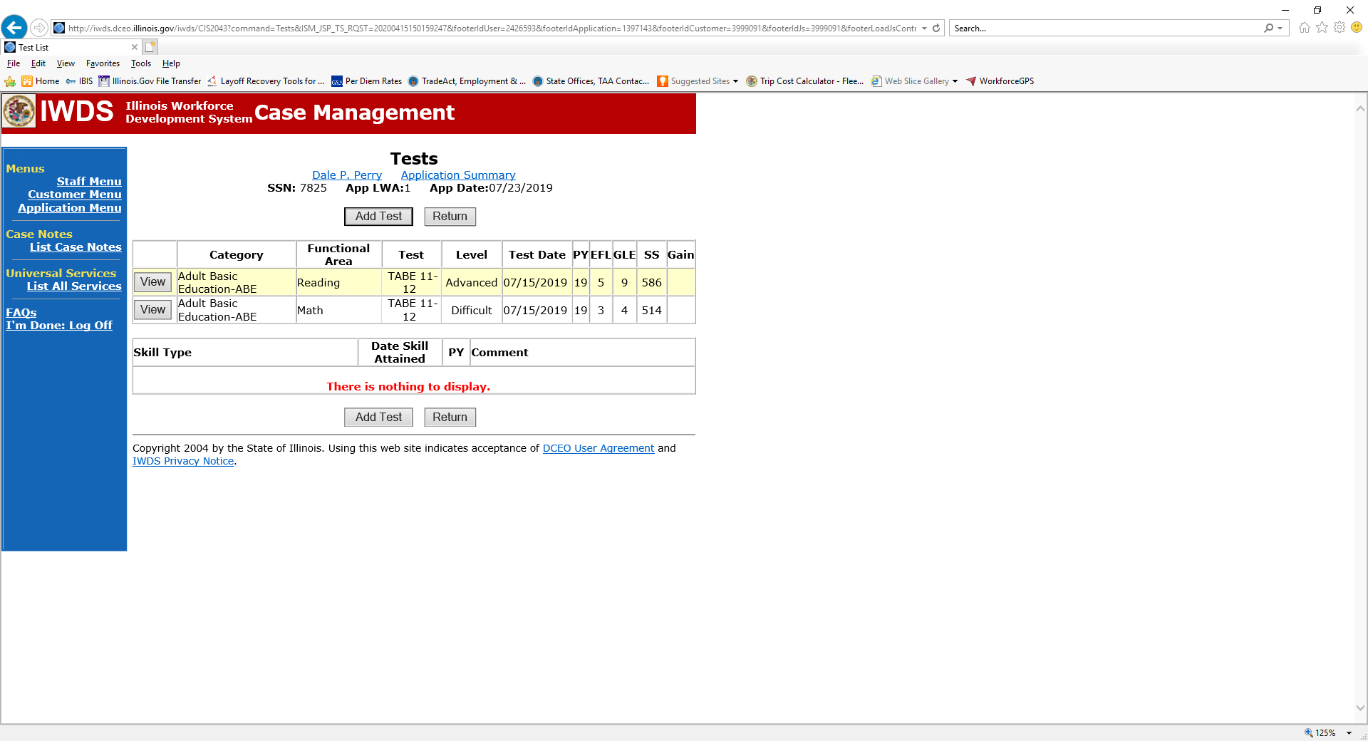
Enrollment – Application (cont.)
Verify test scores and dates in IWDS match the official test documents.

Slide 43
TAA Services – Case Management Service
Case Management Services are entered in IWDS on both the WIOA and Trade applications based on the certification the participant is covered under.
For participants covered by certifications numbered up to 97,999:
  Trade Application:
    Add a Trade Case Management Service.
    Add episodes to this service as appropriate.

Slide 44
TAA Services – Case Management Service (cont.)
  WIOA Application:
    For participants who received a Career Planning (Case Management) 1DC/1EC service funded by WIOA, continue to enter episodes to the Career Planning (Case Management) 1DC/1EC service record on the WIOA Application as they occur. Do not add Career Planning episodes on the WIOA Application for any case management activities that are being funded by Trade.
    Add any additional services (defined in the WIOA Service Matrix) provided to a TAA/WIOA Co-enrolled customer that are funded by the WIOA Title I formula grant (i.e., Supportive Services including receiving travel reimbursement from WIOA, childcare paid by WIOA, Other Supportive Services (glasses, vehicle repairs, etc.). Each supportive service provided must be recorded in addition to a Career Planning (Case Management) service episode, not only cased noted.
    For any new participants that are TAA/WIOA co-enrolled, enter a new Career Planning (Case Management) service upon initial application entry. Enter new Career Planning episodes as necessary and any additional WIOA services as outlined in the dot point above.

Slide 45
TAA Services – Case Management Service (cont.)
Trade funds cannot be utilized to support case management activities for Trade participants covered by certifications numbered 98,000 and greater. These case management services must be paid for with WIOA funding. DCEO will be issuing new funding under the 1EC to be used for the case management services for these participants.
For those participants covered by certifications numbered 98,000+ (2021R) do the following:
  TAA Application: No Entry.

Slide 46
TAA Services – Case Management Service (cont.)
  WIOA Application:
    Enter a Career Planning (Case Management) 1DC/1EC service upon initial application entry. Enter episodes to the Career Planning (Case Management) 1DC/1EC service record on the WIOA Application as they occur. Enter new Career Planning episodes as necessary and any additional WIOA services as outlined in the dot point below.
    Add any additional services (defined in the WIOA Service Matrix) provided to a TAA/WIOA Co-enrolled customer that are funded by the WIOA Title I formula grant (i.e., Supportive Services including receiving travel reimbursement from WIOA, childcare paid by WIOA, Other Supportive Services (glasses, vehicle repairs, etc.). Each supportive service provided must be recorded in addition to a Career Planning (Case Management) service episode, not only cased noted.

Slide 47
Trade Services
Prior to conclusion of enrollment meeting:
  Overview of services Trade provides.
  Remind of deadlines the participant must meet.
  Ask which Trade services the participant wishes to pursue.
  Provide participant with a career/training research packet.
    Training provider research information;
    Program research;
    Trade training forms;
    LMI information;
    Job Search forms;
    Websites.
  List of additional documentation required to continue enrollment process.

Slide 48
Liable and Agent State (20 CFR 618.824)
Liable state is the state whose state UI law is the applicable state law.
Agent state is a state, other than a liable state that provides benefits or services to a participant.
In most cases, a state serves as both liable and agent state.
Liable state responsible for providing general program information and provision of appropriate career services.
Liable state activities include:
  Obtaining the affected worker list
  Publishing newspaper notices
  Conducting outreach
  Providing Trade rapid response
  Must provide a list of Trade and Alternative/Reemployment Trade Adjustment Assistance (A/RTAA) participants to the Internal Revenue Services (IRS) for Health Care Tax Credit (HCTC) purposes.

Slide 49
Liable and Agent State (cont.)
Liable state is responsible for making all determinations, redeterminations, and decisions on appeals on all claims for program benefits:
  Trade eligibility.
  UI/TRA benefits (including extenuating circumstances).
  Waiver (issuances, extensions, criteria changes, and revocations).
  Training (approvals, extensions, revisions, and cessations).
  Transportation/Subsistence assistance (approvals and revisions).
  Job Search and Relocation Allowances (approvals and reconciliations).
  A/RTAA benefits (approvals, revisions, and payments).

Slide 50
Liable and Agent State (cont.)
As the Liable State, the career planners in Illinois have the following responsibilities:
  Ensuring an Illinois Employment Business System (IEBS) Event is set up and updated to include workers from the agent state.
  The Illinois career planner will contact the agent state Trade coordinator/career planner to discuss the preferred method of communication for approvals, required forms, monthly contact and notification of issues that may affect the participant’s status and payment of benefits.
  Ensuring Trade rapid response workshops occur and include out-of-state workers, if possible. The rapid response workshops should include representatives from the agent state, other appropriate LWIAs that may be serving participants from the certification, and other partner agencies. During the Trade rapid response workshop, inform the participant of his/her responsibility of securing eligibility for Trade/TRA benefits and applicable deadlines. Specifically, inform the participant of the following:
    He/she must file a UI/TRA claim with IDES to secure eligibility for those benefits.
    Ensure that the participant understands that he/she must work and cooperate with both states to receive Trade services and benefits.

Slide 51
Liable and Agent State (cont.)
  The liable state determines eligibility for all benefits and services. Any approval must be in writing to the agent state prior to the start of services. Illinois state merit staff approval is also required. Make related entries in IWDS.
  The career planner must check the appropriate boxes on the TAA additional info screen in IWDS to indicate if the participant is an agent/liable participant and what state is paying the UI benefits.

Slide 52
Liable and Agent State (cont.)
Agent state is responsible for cooperating fully with the liable state to:
  Obtain pre-approval from the liable state before any benefits or services are provided to the participant.
  Communicate with the liable state to ensure proper payment of benefits.
  Provide information needed to issue determinations, redeterminations and decisions on benefits, services and/or appeals.

Slide 53
Liable and Agent State (cont.)
As the Agent State, the career planners in Illinois have the following responsibilities:
  Contact and confirm with the liable state that the participant meets all Trade and WIOA eligibility requirements.
  Contact the liable state career planner to discuss the preferred method of communication for approvals, required forms, monthly contact and notification of issues that may affect the participant’s status and payment of benefits.
  Confirm with the liable state career planner that the participant received Trade rapid response. If not, the Illinois career planner will provide Trade rapid response.
  An IEBS Event is not required when Illinois is the agent state because the requirement for Trade rapid response is the responsibility of the liable state. However, if the LWIA is serving multiple participants from the same out of state certification, the LWIA may set up a Local Trade IEBS event to track the participants.

Slide 54
Liable and Agent State (cont.)
  Ensure that the participant understands that they must work and cooperate with both states to receive Trade services and benefits.
  Request any Trade paperwork, forms, documentation from the liable state. If the paperwork received does not include the required information to register the participant in IWDS, the career planner will work with the participant and the liable sate to obtain additional information.
  Obtain pre-approval in writing from the liable state prior to the start of the benefit or service. Illinois state merit staff approval is also required. Make related entries in IWDS.
  Check the appropriate boxes on the TAA additional info screen under the application section of IWDS to indicate if the participant is being served as an agent or liable state participant, the state funding the training, the state paying the UI/TRA benefits and if the petition is from another state.
Chapter 4: Trade Liable and Agent State Responsibilities

Slide 55
2021R Program Differences
Certifications only cover the listed workers.
  Does not automatically include on-site leased workers (temp agency workers).
Manufacturing Sector Workers only.
Enrollment deadlines are the later of the last day of:
  The last day of the 8th week after the week of issuance of the certification of eligibility cover the worker, or
  The last day of the 16th week after the worker’s most recent total qualifying separation.
Must submit a Trade Form #004 2021R Trade Bona Fide Application for Training within 210 days of the later of the date of certification or the date of the worker’s total or partial separation. This should be done at the same time as the BRO.

Slide 56
2021R Program Differences (cont.)
45 Days and Equitable Tolling are the only Extenuating Circumstances available to extend enrollment deadlines.
Alternative Trade Adjustment Assistance (ATAA) is specific to 2021R.
No OJT along with ATTA.
Cannot combine Training and ATAA.
Cannot access TAA benefits and services prior to separation.

Slide 57
2021R Program Differences (cont.)
Military service exceptions to deadlines, training duration, etc. are removed.
Trade Case Management Funds cannot be provided to LWIAs.
Part-time training (with TRA payments) is allowable.
Work Based Training is the preferred method of training.
(NOTE: Information on the search for work based training opportunities will be required to be included
in the 6 criteria for training approval case note along with a justification for not selecting a work based
training opportunity).

Slide 58
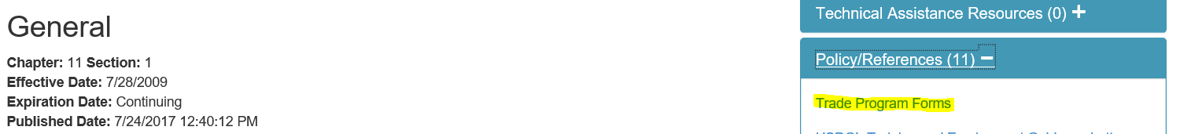
FORMS - General
Link to forms in e-Policy on Illinois workNet.
https://apps.illinoisworknet.com/WIOAPolicy/Policy/Home
Always double check the workNet site for the most recent forms.
https://www.illinoisworknet.com/tradeforms

Slide 59
Correspondence
Emails.
  Send all emails regarding Trade participants to state merit staff: Susan Boggs (susan.boggs@illinois.gov), Sheila Sloan (sheila.sloan@illinois.gov), and Lori Graham (lori.graham@illinois.gov).
  Send all emails regarding Trade grants to Crystal Bigelow (crystal.bigelow@illinois.gov).
  Always include a clear subject line that includes the LWIA, the purpose of email and participant name.
    LWIA XX - IEP & New Occupational Training Approval Request for (participant name).
  Do not combine information in emails for multiple participants. Each email should be for one participant only.

Slide 60
Websites
Illinois workNet Trade Forms
  https://www.illinoisworknet.com/tradeforms
US Department of Labor Employment & Training Trade Site
  https://www.dol.gov/agencies/eta/tradeact
Illinois Workforce Development System (IWDS)
  https://iwds.dceo.Illinois.gov/iwds/staffhome.html
US General Services Administration (GSA)
  http://www.gsa.gov
Workforce GPS (Trade 101 Resources)
  https://taa.workforcegps.org/

Slide 61
DCEO Trade Contacts
Susan Boggs
TAA Coordinator
susan.boggs@illinois.gov
Sheila Sloan
Quality Assurance
sheila.sloan@illinois.gov
217-685-2513
Crystal Bigelow
Trade Grants
crystal.Bigelow@illinois.gov
Lori Graham
Manpower Planner
lori.graham@illinois.gov
309-830-8458

Slide 62
IDES Trade Unit Contacts
John Ferry
Special Programs Manager
john.ferry@illinois.gov
Erik Hack
ATAA/RTAA Coordinator
erik.hack@illinois.gov
Amy Saumur
TRA & UI Claims
amy.saumur@illinois.gov
Angela Mosley
Petition Lists, TRA & UI Claims
angela.mosley@illinois.gov
TRADE UNIT PHONE NUMBER:
217-524-7826

Slide 63
Upcoming Trade Training
Upcoming Training (Thursday Zoom Meetings):
Invitations sent out from Kiersten Baer at ISU
  November 4 – Waivers & Completion of Waiver Form.
  November 18 – Training (including completion of Form #006 Verification of Trade Training Enrollment, Form #005 Eligibility Determination of Travel-Subsistence Assistance, and Form #006d/e Program Tracking Form).
  December 2 – Attendance, Benchmarks, Breaks in Training (including completion of the Form #006a Bi-Weekly Verification of Training Attendance), IEP Modifications.

Slide 64
Upcoming Trade Training (cont.)
  December 9 – Alternative/Reemployment Trade Adjustment Assistance (A/RTAA), Job Search Allowance, Relocation Allowance.
  December 16 – Credential & Measurable Skill Gains, Exiting Participants.
  January 6 – TAPR/GRS (this is geared more towards the fiscal staff responsible for entries in GRS and uploading of the quarterly TAPR costs in IWDS).
  January 13 – Appeals, Fraud, Overpayments & Monitoring.
  Training recordings, presentations, and materials posted at:
    https://www.illinoisworknet.com/WIOA/Resources/Pages/Archived-Training.aspx
  Additional training if needed.

Slide 65

Questions

