Slide 1
Creating a co-enrolled (WIOA/TAA) client in IWDS

Slide 2
Sections
Searching for existing clients
Eligibility (WIOA and TAA)
Searching for TAA Petition and IEBS Event
Entering the IWDS (Illinois Workforce Development System) client record
Certifying the record
Entering Services and Statuses
Entering Case Notes
Document Upload

Slide 3
Searching for Existing IWDS Clients
Why do this?
Answer – if the SSN already exists in IWDS, you will not be able to complete your application.
What if I do all the searches, find nothing, but still get a SSN error when entering my client?
Contact Kris Theilen (kristopher.theilen@illinois.gov) or Jim Potts (james.potts@illinois.gov) . We can search for the full SSN. Sometimes people make up fake SSNs in the Resource Room. We will need to remove those records.

Slide 4
Searching for Existing IWDS Clients
Sample Client: Justina Thompson
DOB 6/5/1991
SSN 366-12-3456
The first search I would do is a partial last name and last 4 SSN:

Slide 5
Searching for Existing IWDS Clients
If the results are too large (too many pages of results), then I would do partial last name, partial first name, and last 4 SSN.

Slide 6
Searching for Existing IWDS Clients
If you think there has been a legal name change (marriage, divorce, etc.), another option would be last 4 SSN and Birth Date.

Slide 7
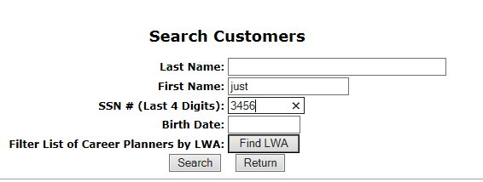
Searching for Existing IWDS Clients
Or partial first name and Last 4 SSN:

Slide 8
Before we get into Eligibility
U.S. Department of Labor put out guidance on Handling and Protection of Personally Identifiable Information (PII) in TEGL No. 39-11.
Dated June 28th, 2012; it states: Federal Law, OMB Guidance, and Departmental and ETA policies require that PII and other sensitive information be protected.

Slide 9
Before we get into Eligibility
Grantees must ensure PII is not transmitted to unauthorized users.
Grantees must take the steps necessary to ensure the privacy of all PII obtained from participants and/or other individuals and to protect such information from unauthorized disclosure.

Slide 10
Protection of PII
A few security measures taken within Illinois Workforce Development System (IWDS) as a result of Protection of PII:
Ability to search for a client by their full Social Security Number (SSN) was removed as an option
Full SSN was removed from any view other than the Private Information screen where it is put in IWDS
Full SSN is not displayed on any of the reports that are available in IWDS

Slide 11
Protection of PII
Bottom line – you must keep all client personal information protected from unauthorized personnel. Ultimately, you are responsible for the protection of PII.

Slide 12
General WIOA Eligibility Requirements
All clients must be authorized to work in the U.S.
All clients must be compliant with Selective Service.

Slide 13
Selective Service Compliant
All male clients born on or after January 1st, 1960 must be compliant with Selective Service before they can receive WIOA Services.
DCEO Policy No. 11-PL-02 is the guidance you must be familiar with in regards to Selective Service.

Slide 14
Selective Service Compliant
Selective Service Compliant is documented on the Private Information Screen within the IWDS application of every male client who is at least 18 years of age and was born on or after January 1st, 1960.

Slide 15
Selective Service Compliant
Again, all male clients born on or after January 1st, 1960 must be compliant with Selective Service before they can receive WIOA Services OR, if not compliant, they must have a Locally Approved Selective Service Waiver.
Selective Service Compliant is documented on the Private Information Screen within the IWDS application of every client.

Slide 16
Selective Service Compliant
If the client is female or a male born prior to January 1st, 1960 you would just select “Not Applicable” for “Selective Service Compliant” question.

Slide 17
Selective Service Compliant
XXX-XX

Slide 18
Selective Service Compliant
If compliant with Selective Service it is simple, just document the question of Selective Service Compliant with a ‘Yes’.

Slide 19
Selective Service Compliant
XXX-XX

Slide 20
Selective Service Compliant
If compliant with Selective Service it is simple, just document the question of Selective Service Compliant with a ‘Yes’.
Then document the Selective Service Number by going into the Selective Service Website and putting the clients last name, Date of Birth and SSN.

Slide 21
Selective Service Compliant

Slide 22
Selective Service Compliant

Slide 23
Selective Service Compliant

Slide 24
Selective Service Compliant
Transcribe the selective service number from the website over into the application “Private Information” screen in the block for “Selective Service Number”.

Slide 25
Selective Service Compliant
XXX-XX

Slide 26
Selective Service Compliant
The real issue comes into play when a male client who was born on or after 1/1/1960 is not compliant with Selective Service.
What happens then?
If the client is under age 26 he would simply need to register with selective service before you could enroll him in WIOA services.
If the client was over the age of 26 and not compliant with Selective Service, the only way for him to receive WIOA services is to have a Locally Approved Selective Service Waiver.

Slide 27
Selective Service Compliant
XXX-XX

Slide 28
Selective Service Compliant
To have a Locally Approved Selective Service Waiver completed on a male client over age 26 you must be familiar with DCEO Policy No. 11-PL-02 – Selective Service Requirements for WIOA Eligibility.
On page 4 of DCEO Policy No. 11-PL-02 it begins to address the steps necessary for a Locally Approved Selective Service Waiver.

Slide 29
Selective Service Compliant
What are the steps needed for a Locally Approved Selective Service Waiver?
Who approves a Locally Approved Selective Service Waiver?

Slide 30
Selective Service Compliant
Guidance on Locally Approved Selective Service Waiver
Please look at page 6 of DCEO Policy No. 11-PL-02 which addresses requirements for Locally Approved Selective Service Waiver.
Subparagraph C. All grantees must have a written local policy to address compliance.
Bottom line is you must find out the approval authority within your LWIA based on local policy.

Slide 31
Selective Service Compliant
In all instances, if you have a male client born on or after 1/1/1960 who did not register for Selective Service you would have your client complete the Selective Service Verification Form (DCEO/SS Form #001).
The client must prove he did not willingly and knowingly fail to register.
Must obtain a Status Information Letter (SIL) from Selective Service – Unless ?

Slide 32
Selective Service Compliant
Whoever, according to your local policy, is the approval authority for the locally approved selective service waiver must take the following into consideration:
Circumstances of why the man did not register (This should be documented on the DCEO/SS Form #001).
If required, the approval authority would review the DCEO/SS Form #001 and the SIL and then the grantee must determine if the client did not knowingly and willfully fail to register for Selective Service.

Slide 33
Selective Service Compliant
Guidance on Locally Approved Selective Service Waiver - please look at page 7 of DCEO Policy No. 11-PL-02 which states “if the failure is not deemed knowing and willful then he may be granted the Locally Approved Selective Service Waiver and registered and enrolled in services”.
If Waiver is approved, then the IWDS record would be populated with “Locally Approved Selective Service Waiver” in the Selective Service Compliance block on the Private Information Screen. (see next slide)

Slide 34
Selective Service Compliant
XXX-XX

Slide 35
Selective Service Compliant
If Locally Approved Selective Service Waiver is approved, all documentation supporting the approved waiver needs to be placed in the clients record so when the file is monitored all information is present to support the waiver.

Slide 36
Selective Service Compliant
Guidance on Locally Approved Selective Service Waiver - please look at page 7 of DCEO Policy No. 11-PL-02 which states “if the failure is deemed knowing and willful then he must be denied WIOA services”.
Decisions are to be made on a case-by-case basis meaning there should never be a one-size fits all approval process.

Slide 37
Selective Service Compliant
Ok, that is about it for Selective Service, any questions about Selective Service?

Slide 38
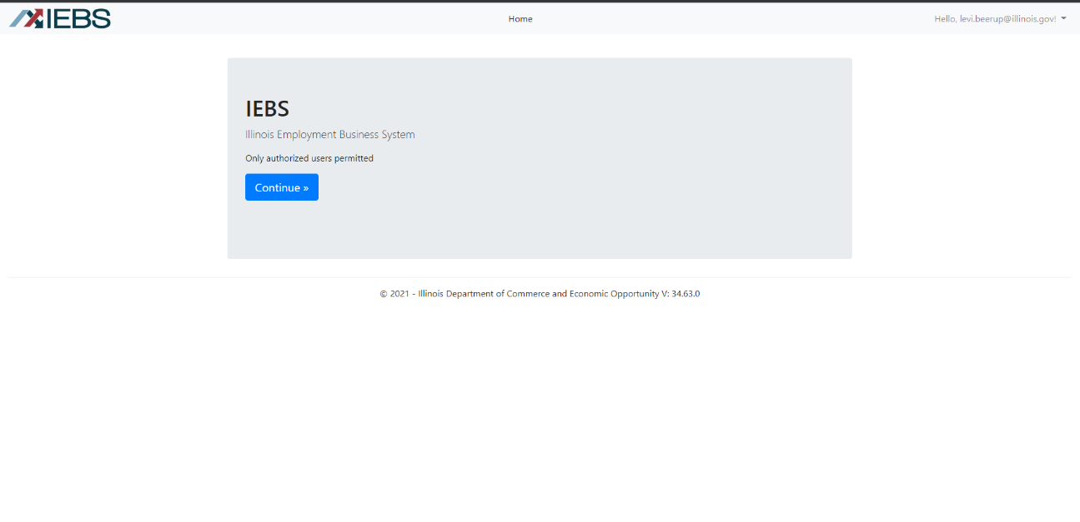
Search for the IEBS Event and TAA Petition
Log into IEBS using the url:
https://apps.illinoisworknet.com/iebs/
Use your Illinois workNet account to sign in

Slide 39
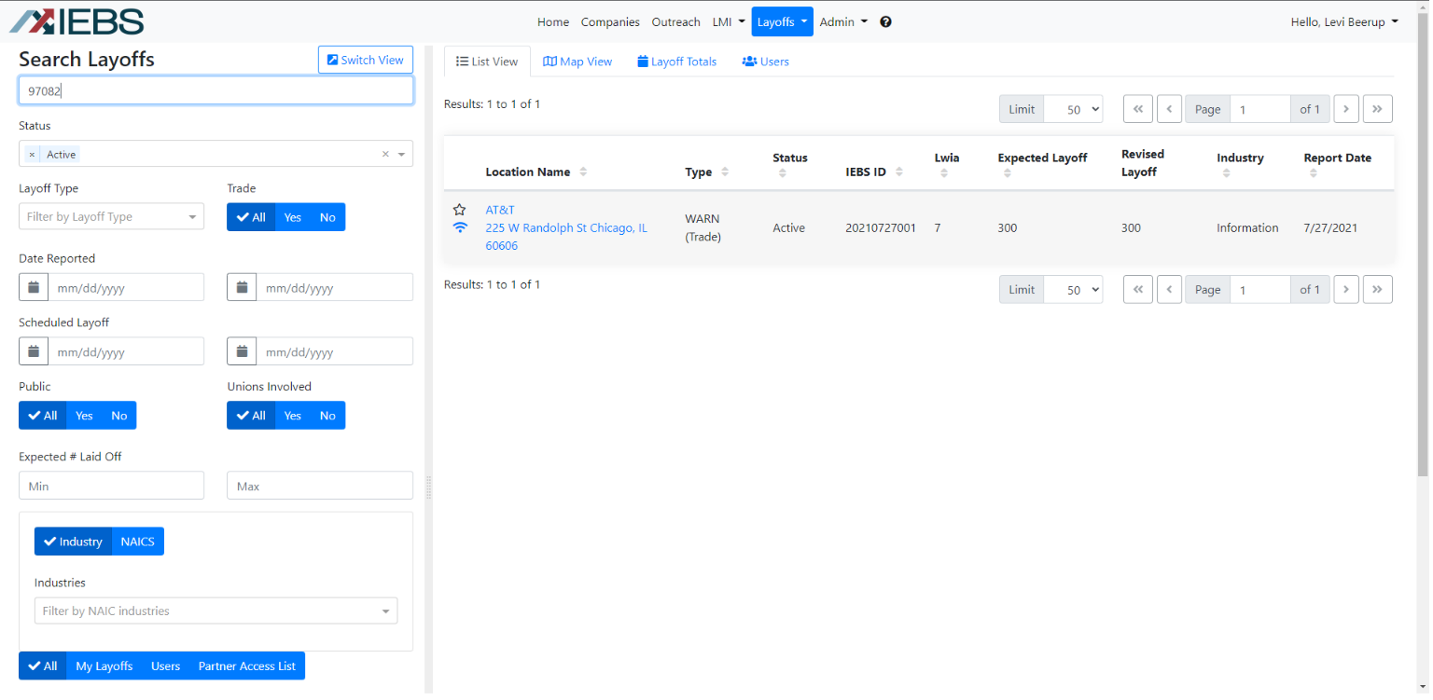
Search for the IEBS Event and TAA Petition
Enter the TAA Petition # (or the IEBS # if you want to verify the event information).

Slide 40
Search for the IEBS Event and TAA Petition
If the TAA Petition # is associated with an Event in IEBS, that result will appear.

Slide 41
Search for the IEBS Event and TAA Petition
Record the IEBS Event # for use on the customer record.

Slide 42
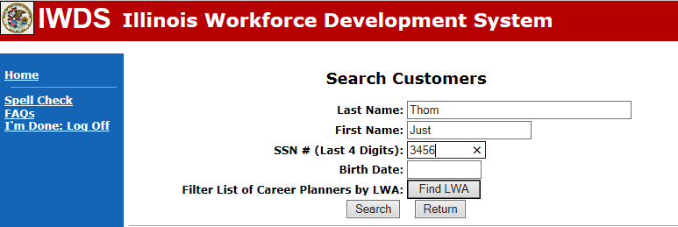
Entering the Client in IWDS
First, we search for the client again.

Slide 43
Entering the Client in IWDS
Then we search Illinois workNet.

Slide 44
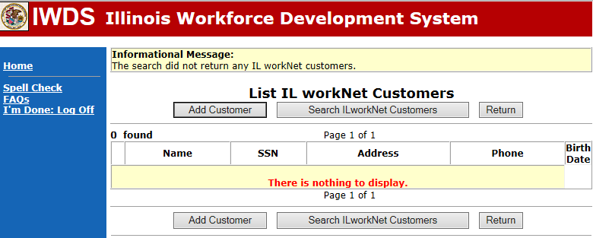
Entering the Client in IWDS
Now we click “Add Customer”.

Slide 45
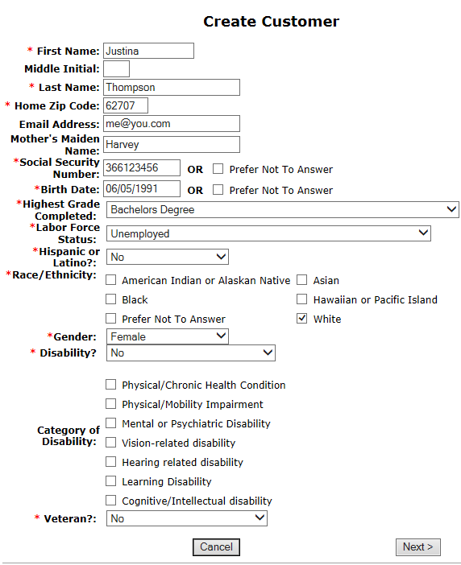
Entering the Client in IWDS
Add the client
information.

Slide 46
Entering the Client in IWDS
You will be issued a Illinois workNet ID and password for your client.
Record and keep this information for them.

Slide 47
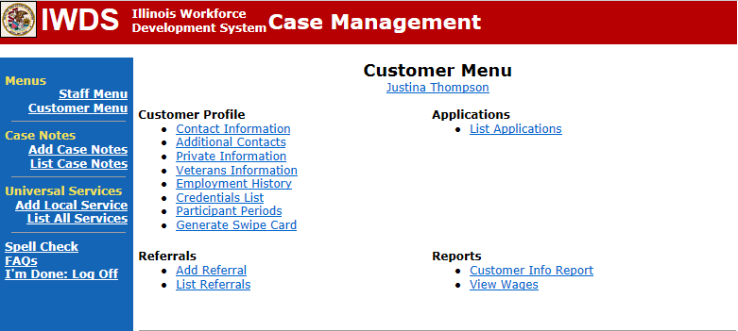
Entering the Client in IWDS
This is the IWDS customer menu.

Slide 48
Entering the Client in IWDS
The customer level is where you make changes after certification of your client; such as: legal name changes (marriage/divorce/etc.), address changes, etc.
The application level is a snapshot in time. The information at the time of certification IS NOT TO BE CHANGED unless it is proven to have been wrong AT THE TIME OF ENTRY.

Slide 49
Entering the Client in IWDS
Click “List Applications”

Slide 50
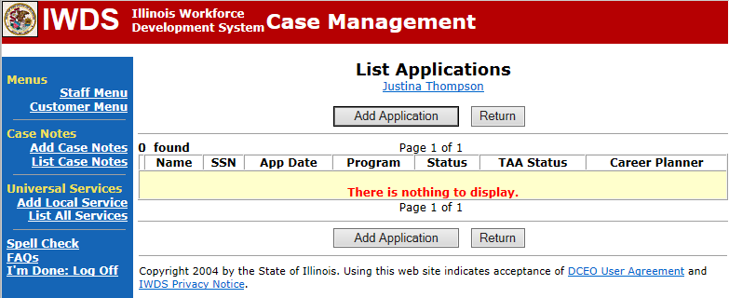
Entering the Client in IWDS
Click “Add Application”

Slide 51
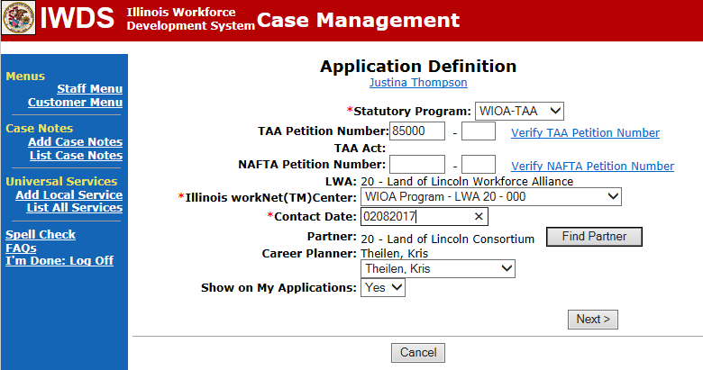
Entering the Client in IWDS
For co-enrolled, choose WIOA-TAA. Fill in your Petition # and contact date.

Slide 52
Entering the Client in IWDS
From here, choose “Guided Application”

Slide 53
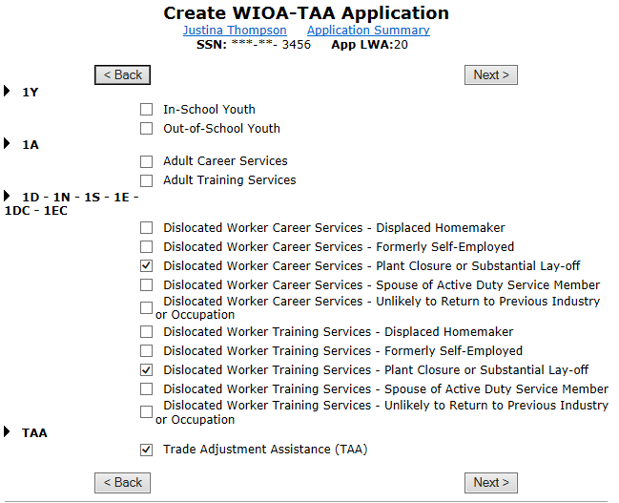
Entering the Client in IWDS
Choose TAA and a 1DC/1EC WIOA option.
Find the same
choice for both
career and
training services.

Slide 54
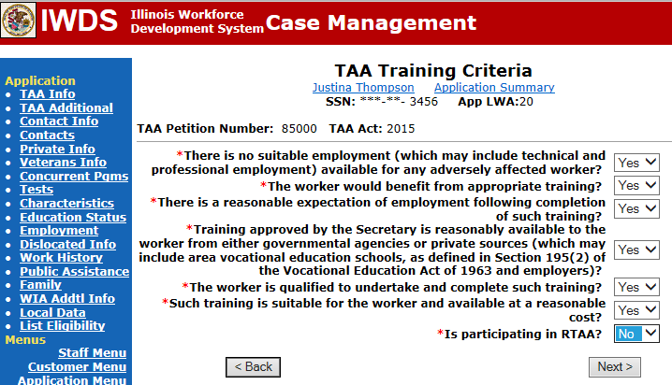
Entering the Client in IWDS
Answer the TAA Training Criteria questions.

Slide 55
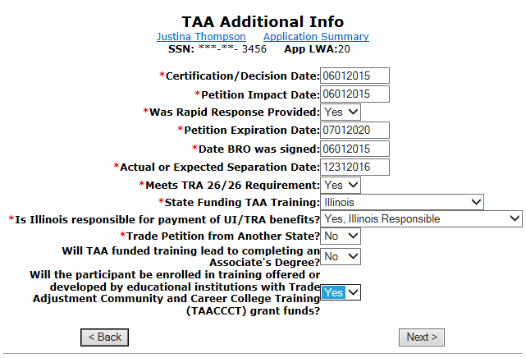
Entering the Client in IWDS
Answer the questions about the TAA Petition.

Slide 56
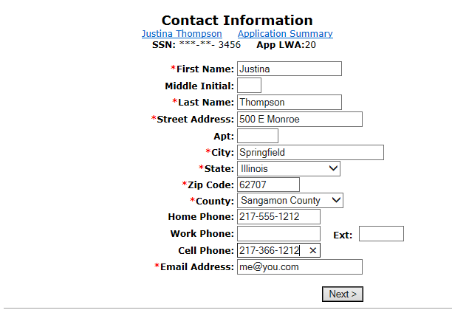
Entering the Client in IWDS
Fill in the contact information.

Slide 57
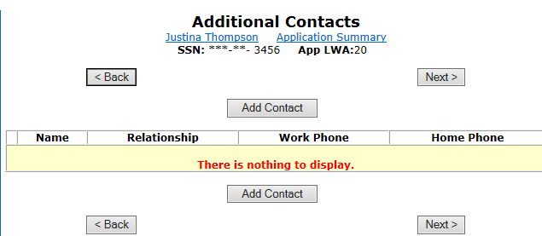
Entering the Client in IWDS
Click “Add Contact”

Slide 58
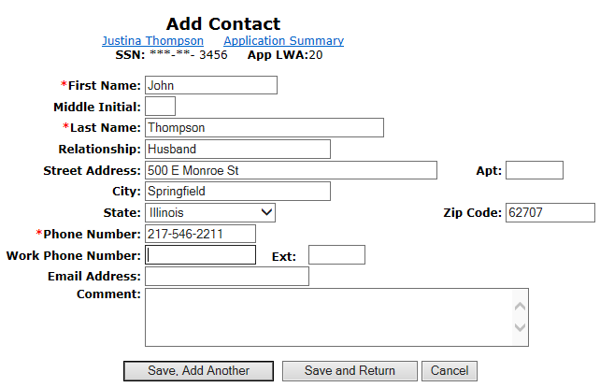
Entering the Client in IWDS
Fill in Contact Information. You can enter more than one contact.

Slide 59
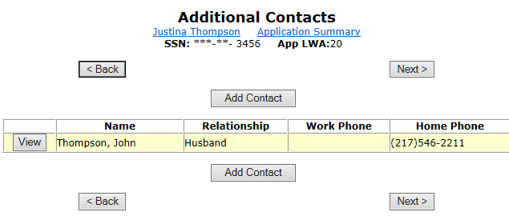
Entering the Client in IWDS
Review the contact information.

Slide 60
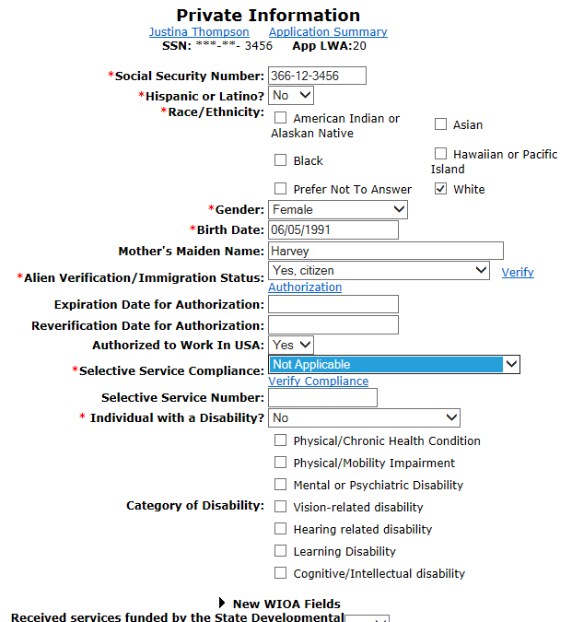
Entering the Client in IWDS
Fill in client
information.
Notice at the
bottom…scroll
down.

Slide 61
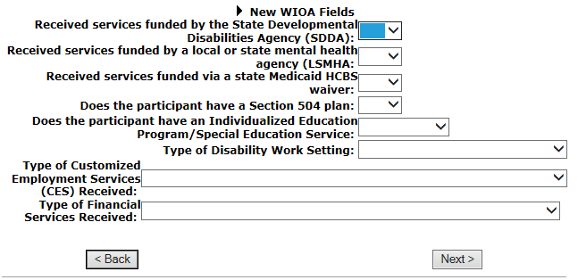
Entering the Client in IWDS
These fields are new as of 2017. You only fill these out if the client reports a disability.

Slide 62
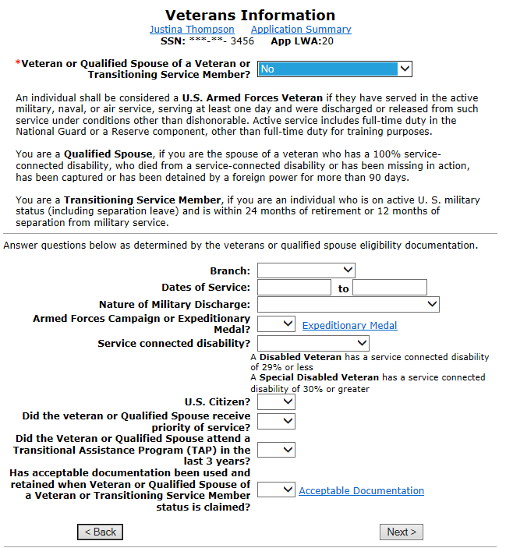
Entering the Client in IWDS
If your client is
a Veteran, make
sure you get a
copy of the
DD-214.

Slide 63
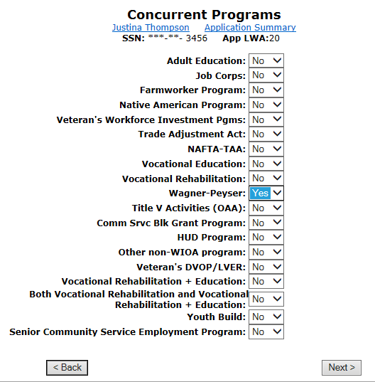
Entering the Client in IWDS
Choose any
concurrent
programs that
your client is
currently in.

Slide 64
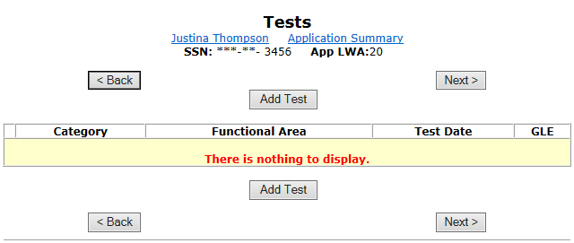
Entering the Client in IWDS
Add your test scores.

Slide 65
Entering the Client in IWDS

Slide 66
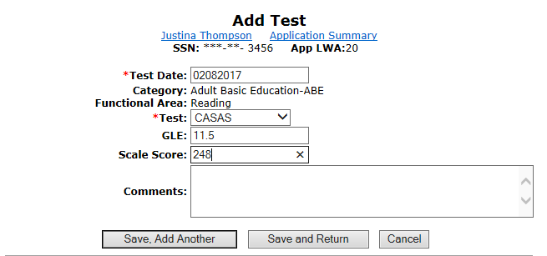
Entering the Client in IWDS
Mainly looking for Math and Reading.

Slide 67
Entering the Client in IWDS

Slide 68
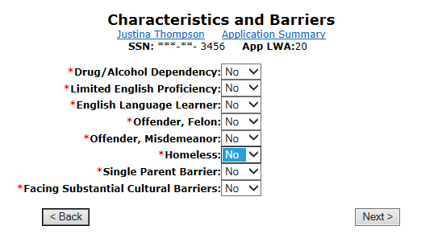
Entering the Client in IWDS
If applicable, select any barriers to employment.

Slide 69
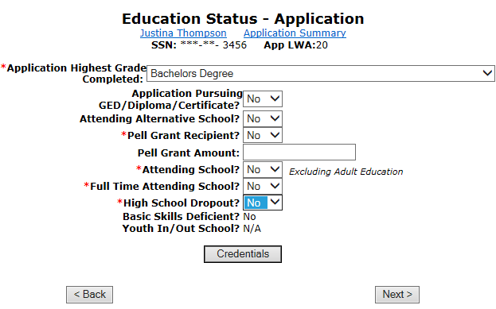
Entering the Client in IWDS
Enter Education Status

Slide 70
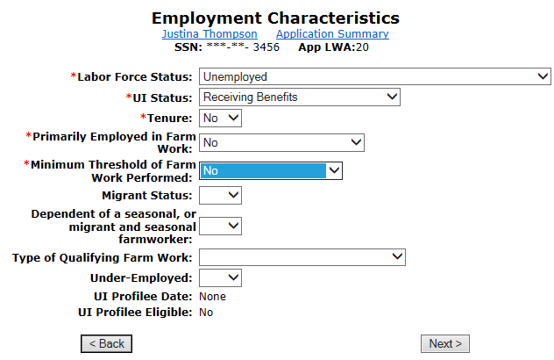
Entering the Client in IWDS
Enter Employment Characteristics

Slide 71
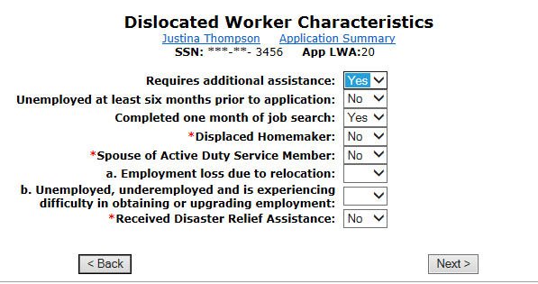
Entering the Client in IWDS
Fill in Dislocated Worker characteristics

Slide 72
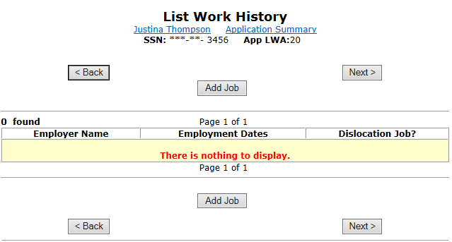
Entering the Client in IWDS
Enter the Dislocation Job that has the TAA Petition and IEBS Event that we verified earlier for this client.

Slide 73
Entering the Client in IWDS
Next to the Employer Name click “Search”.

Slide 74
Entering the Client in IWDS
Enter the Company Name and click “Search”.

Slide 75
Entering the Client in IWDS
Select the one that matches your FEIN from the TAA Petition number.

Slide 76
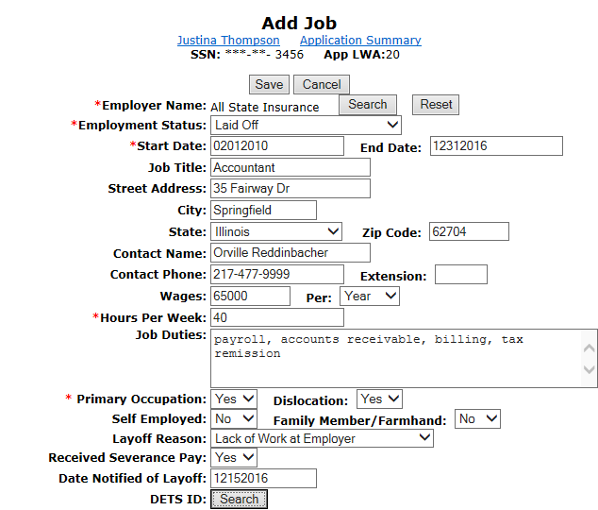
Entering the Client in IWDS
Fill in the
Job Info.
When you get
To IEBS ID,
click “Search”.

Slide 77
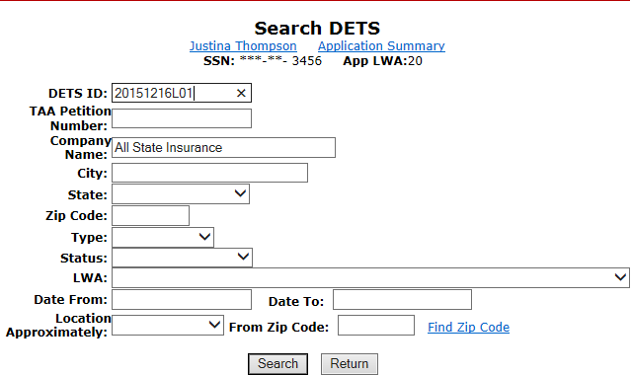
Entering the Client in IWDS
Enter the IEBS number we searched for earlier and click “Search”.

Slide 78
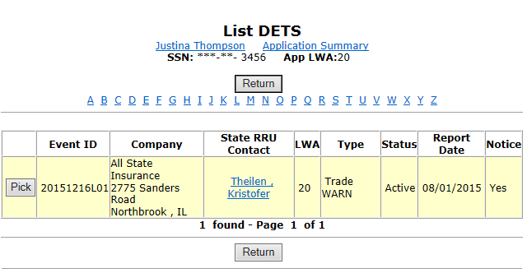
Entering the Client in IWDS
Select the IEBS Event

Slide 79
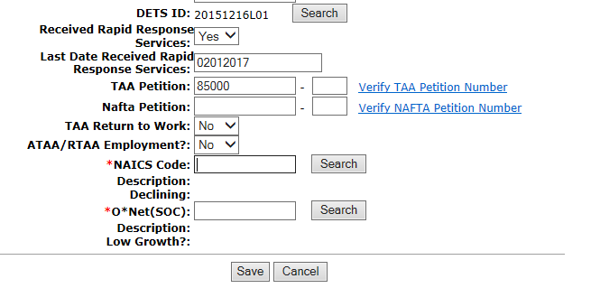
Entering the Client in IWDS
Keep filling in Job information, until you get to the NAICS code. Once here click “Search”.

Slide 80
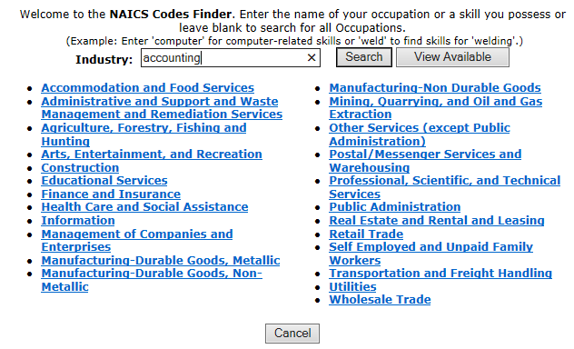
Entering the Client in IWDS
Search for the job industry type.

Slide 81
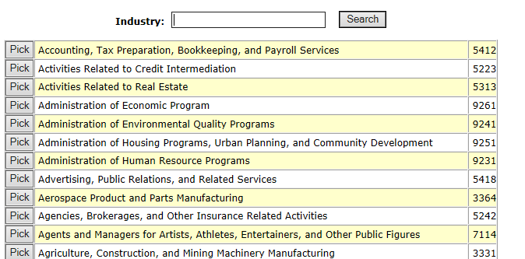
Entering the Client in IWDS
Pick the one that is closest to your job.
We are choosing the first one.

Slide 82
Entering the Client in IWDS
Now click “Search” on O*Net.

Slide 83
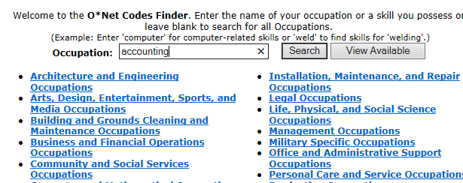
Entering the Client in IWDS
I recommend using the same keyword.

Slide 84
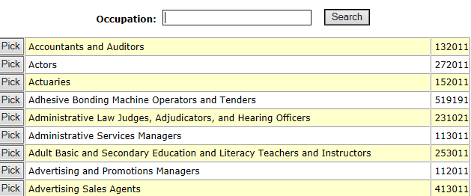
Entering the Client in IWDS
Find your closest match.

Slide 85
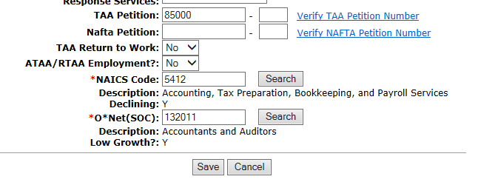
Entering the Client in IWDS
Click “Save” to save the job record.

Slide 86
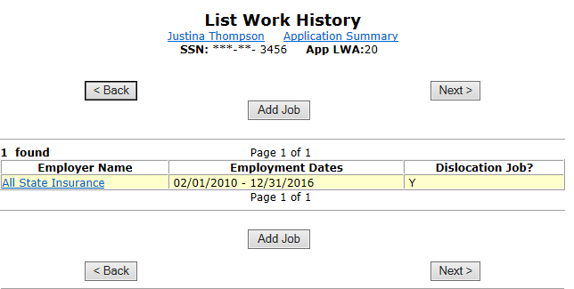
Entering the Client in IWDS
Make sure it shows as a Dislocation Job.

Slide 87
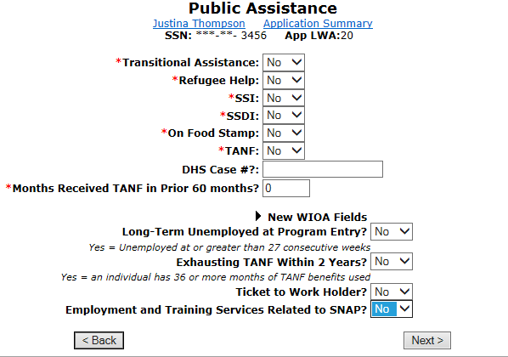
Entering the Client in IWDS
Enter the Public Assistance information.

Slide 88
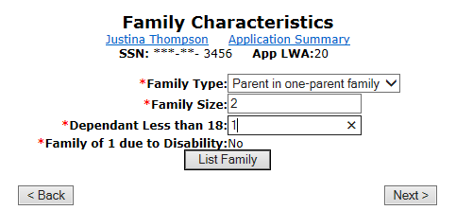
Entering the Client in IWDS
Fill in the Family Characteristics. If anyone else is in the “family” besides the applicant, click “list family”.

Slide 89
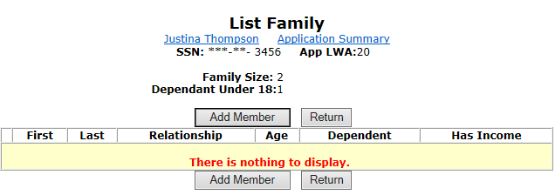
Entering the Client in IWDS
To add a person click “Add Member”.

Slide 90
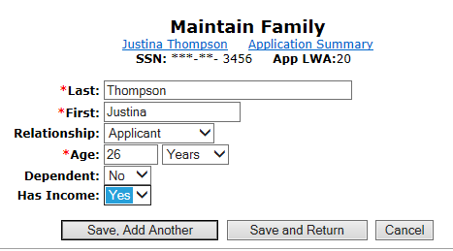
Entering the Client in IWDS
Start with the applicant.

Slide 91
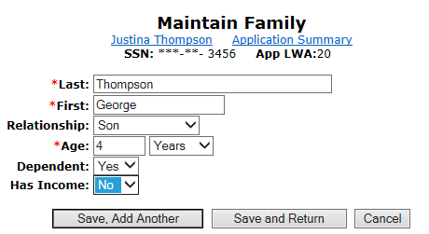
Entering the Client in IWDS
Then add the other family members.

Slide 92
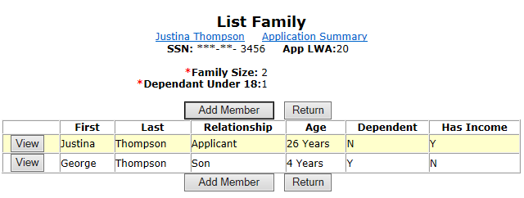
Entering the Client in IWDS
Please review and click “Return”.

Slide 93
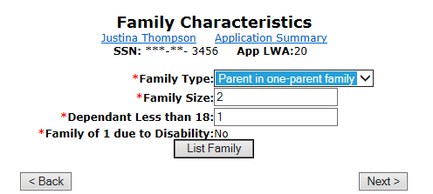
Entering the Client in IWDS
Click “Next”

Slide 94
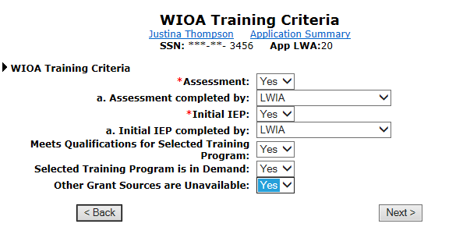
Entering the Client in IWDS
Answer the WIOA Training Criteria.

Slide 95
Entering the Client in IWDS
Add any comments for Custom Eligibility Data.

Slide 96
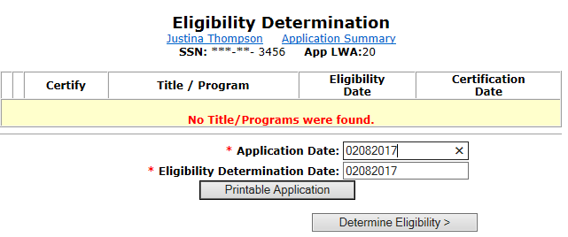
Entering the Client in IWDS
Enter your Application Date and your Eligibility Date (which can be later than the Application Date).

Slide 97
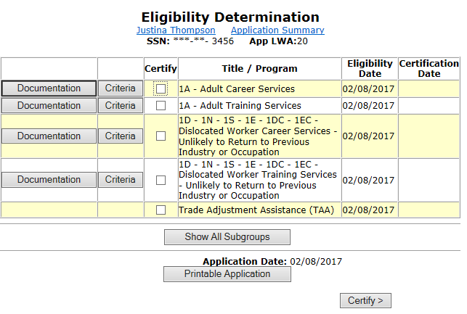
Entering the Client in IWDS
Here is everything the client is eligible to be certified in.

Slide 98
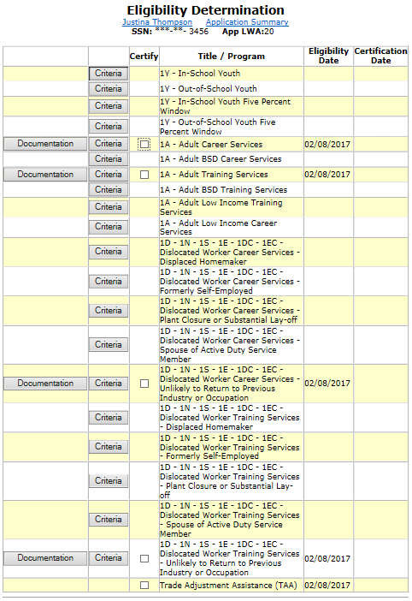
Entering the Client in IWDS
If something you
checked does not show
up, you can click
“Show all Subgroups”.

Slide 99
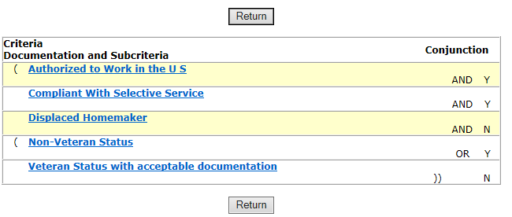
Entering the Client in IWDS
Then select the “Criteria” for the program, and it will show you why it was not included. Yellow is required, white is “one of the following”. In this case Displaced Homemaker = No.

Slide 100
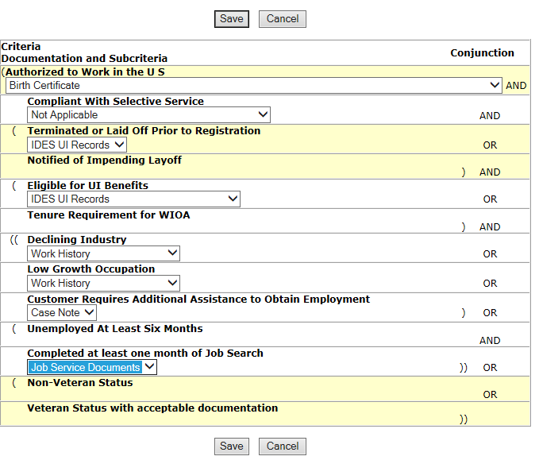
Entering the Client in IWDS
Click “Documentation” on the ones you want to certify and fill in
the drop down
choices.

Slide 101
Entering the Client in IWDS
Once you have completed the documentation for the Titles you want…

Slide 102
Entering the Client in IWDS
…click the “Certify” boxes next to them and then click “Certify” below.

Slide 103
Entering the Client in IWDS
Select “Yes” and enter the Certification Date.

Slide 104
Entering the Client in IWDS
Now your client is certified, but they will not be a Registrant until you enter a service in each application (WIOA and TAA).

Slide 105
WIOA vs. TAA
While active TAA, TAA is for all training related services.
WIOA is 1DC/1EC only while active TAA, and is for case management (or other LWIA approved uses).
If you use the “all TAA services completed” choice, it effectively exits the TAA application and opens up 1D/1E for training and other uses.

Slide 106
Entering a Service in TAA
Select “View” on the TAA Application.

Slide 107
Entering a Service in TAA
This is the TAA application menu screen.
“List Enrolled Services” is on the top right.

Slide 108
Entering a Service in TAA
Select List Enrolled Services, now click “Add Enrolled Service”.

Slide 109
Entering a Service in TAA
Since we are in the TAA Application, the Title choice is “TAA”.

Slide 110
Entering a Service in TAA
You have choices for Service Level. Employment and Case Management will be handled in WIOA. I recommend starting with the IEP.

Slide 111
Entering a Service in TAA
The start date is any valid date after the certification date. For this instance, we will use the exact same date as the certification date.

Slide 112
Entering a Service in TAA
Different Service Levels will have different Activity choices. IEP only has IEP as an Activity choice.

Slide 113
Entering a Service in TAA
Choose your Provider
Pick your O*Net code
(same as Job Screen)
End date (if
Necessary)
Current Status (use
Successful Completion
If Same Day Service)
Add any Comments
Click “Save”

Slide 114
Entering a Service in TAA
IWDS requires a
Status with certain
Services
Add all necessary
Information
Click “Save”

Slide 115
Entering a Service in TAA
Your service is entered.

Slide 116
Entering a Service in TAA
For class purposes, I will have already added a waiver, a training, and other services, so we can see how to add a status.

Slide 117
Entering a Status in TAA
Go back to the Application Menu.
Click “List TAA Status” on the lower left.

Slide 118
Entering a Status in TAA
We already have one status from the IEP service entry. If you have Services connected to Statuses, make sure if you have any changes, that you change both.
To enter a new status, choose “Add TAA Status”.

Slide 119
Entering a Status in TAA
This is the drop down list of Status choices.

Slide 120
Entering a Status in TAA
Let’s choose “Waiver from Training Requirement”.

Slide 121
Entering a Status in TAA
You can close the status by adding an End Date.

Slide 122
Entering a Status in TAA
You can see the status is closed.

Slide 123
Entering a Service in WIOA
Go back to the Application Menu.
Notice that now the TAA shows “Registrant”.
Select the WIOA application.

Slide 124
Entering a Service in WIOA
This is the WIOA Application Menu.
Select “List Enrolled Services” from the upper right.

Slide 125
Entering a Service in WIOA
Select “Add Enrolled Service”

Slide 126
Entering a Service in WIOA
Since this client is co-enrolled, select either 1DC or 1EC.

Slide 127
Entering a Service in WIOA
Since this client is co-enrolled, you will use “Career Services.” You will not use “Training Services” unless you end all TAA Services and click TAA Services Completed (ending their TAA Application).

Slide 128
Entering a Service in WIOA
There may be a lot of choices under 1DC/1EC, but while co-enrolled, stick with Case Management and Career Planning.

Slide 129
Entering a Service in WIOA
Enter all information
See the RED
“Same Day Service”?
Any time you see that, enter the END DATE for the same day as the Start Date and mark “Successful Completion”.

Slide 130
Entering a Service in WIOA
Same Day Services automatically require case notes.
Enter the data and click “Save”.

Slide 131
Entering a Service in WIOA
Next time you have another service event, click on the existing service.

Slide 132
Entering a Service in WIOA
Click “Add Additional Episode”. It will add another Service with TODAY’S DATE .

Slide 133
Entering a Service in WIOA
Add your new case note.

Slide 134
Entering a Service in WIOA
Now the service has a new end date.

Slide 135
Entering a Case Note
You can enter a case note from the Customer Menu or from the Application Menu (WIOA or TAA). Click “Add Case Notes” on the left side in the blue box.

Slide 136
Entering a Case Note
Enter the date for the note, pick which Program (i.e. - WIOA or TAA), choose the Note Category, Confidential (yes/no), then type a subject and the case note.

Slide 137
Entering a Case Note
You can click “Save, Add Another” if you have more to enter or “Save and Return” to finish.

Slide 138
Entering a Case Note
List Case Notes shows all case notes for the client.

Slide 139
Document Upload
First, scan your document and save it to your computer.
I recommend scanning all the documents associated with the client at one time, I suggest making a check list on a note pad as your are entering the client.
Anything you upload stays with the IWDS record.

Slide 140
Document Upload
TAA Document uploading is voluntary, unless it is for Data Validation purposes. WIOA has documents that are mandatory for eligibility purposes.
If you have a veteran, I recommend always scanning the DD-214.

Slide 141
Document Upload
From the Application Menu for both WIOA and TAA, Select “List All Documents” from the middle column (near the bottom).

Slide 142
Document Upload
Click “Add Document”

Slide 143
Document Upload
On the “Path”, click the “Browse” button to the right to navigate to the folder on your computer where you saved the TAA documents to upload.

Slide 144
Document Upload
Find the folder, and select the document

Slide 145
Document Upload
Select the Document Type

Slide 146
Document Upload
Click “Upload”

Slide 147
Document Upload
Congratulations! You successfully uploaded your document!

Slide 148
Document Upload
Repeat as many times as necessary.

