Slide 1
Illinois Youth Career Pathway Grant Opportunity Technical Assistance Session
Illinois Department of Commerce and Economic Opportunity

Slide 2
Access and Participation Guidelines
Meeting Access
Meeting Participation
Select the “Call Me” option on Zoom to use your phone for audio while using the video option, if you choose.
This webinar will be recorded and posted to IWN.
Everyone will be muted for this webinar.
A FAQs Page has been created to track questions raised during the webinar.
Materials shared during the meeting will be available on workNet.

Slide 3
The Education Systems Center Staff
Meagan Mitchell
Pathways Manager

Slide 4
Agenda
Introduction
Education Systems Center
State Frameworks on College and Career Pathways
Pathway Endorsement: Requirements and Key Features
Implementing CCPE
Resources

Slide 5
Geographic Focus: Where We Work
Our Mission Shape and strengthen education and workforce systems to advance racial equity and prepare more young people for productive careers and lives in a global economy.
Focus Areas: What We Do
Statewide
Bridges to
Postsecondary
College & Career
Pathways
Data Impact
& Leadership
Community Networks
Notes:
JON

Slide 6
Postsecondary and Workforce Readiness Act
Public Act 99-0674 (HB 5729) Signed by Governor July 29, 2016
Four Components:
Postsecondary and Career Expectations (PaCE)
Scaling of 12th Grade Transitional Courses
College & Career Pathway Endorsements on High School Diplomas
Pilot of Competency-based High School Graduation Requirements
pwract.org

Slide 7
State Pathways Model
OUTCOMES:
Credential Attainment
&
Labor Market / Economic
Development
Individualized Planning
Endorsement
Secondary Pathway
Postsecondary Pathway
Career Focused Instruction
Internships /CDE
Low-Skilled Jobs
Semi-
Skilled Jobs
Middle-
Skilled Jobs
Advanced-Skilled Jobs
Work-Based Learning
Stackable
Credentials
Stackable
Credentials
AA/AAS
BA/BS
Core Academics

Slide 8
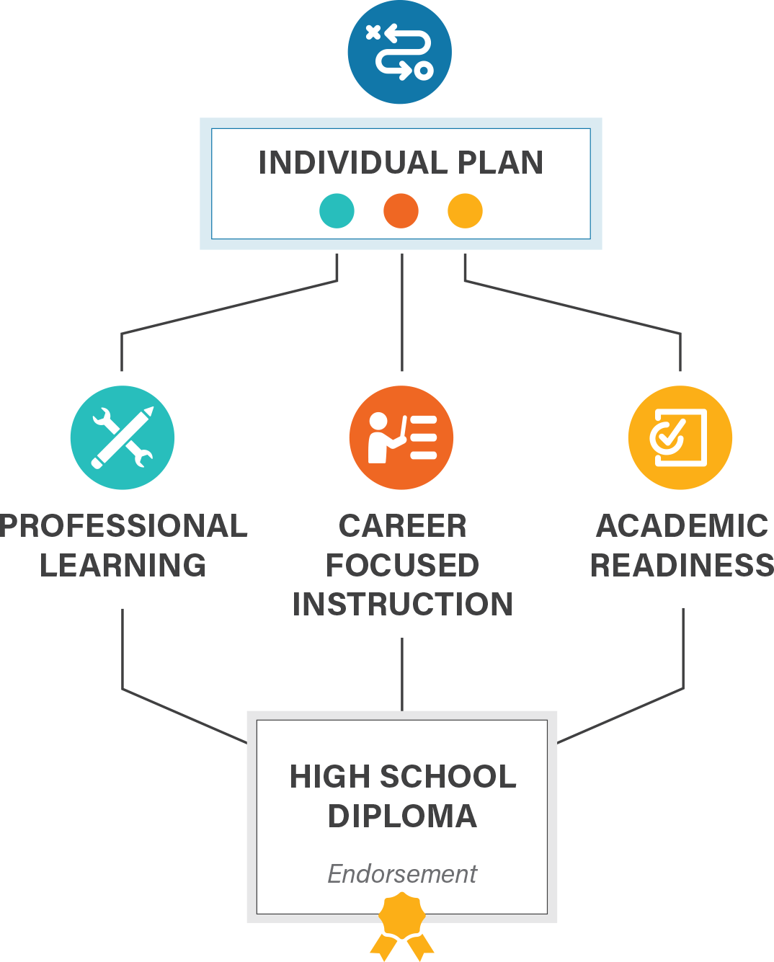
Pathway Endorsement: HS Diploma
WIOA Eligible In-School Youth?

Slide 9
College and Career Pathway Endorsement Framework
INDIVIDUAL PLAN
Each student completing an endorsement must have an individualized plan, which includes college planning linked to early understanding of career goals, financial aid, resume, and personal statement.
PROFESSIONAL LEARNING
Awareness, exploration, and preparation activities that provide opportunities for students to interact with adults in their workplace
9th
10th
11th
12th
At least 2 career exploration activities or 1 intensive experience
60 cumulative hours of paid or credit supervised career development experience with a professional skills assessment
At least 2 team-based challenges with adult mentoring
Through these experiences, a student gains essential employability and technical competencies in their identified sector.
CAREER-FOCUSED INSTRUCTIONAL SEQUENCE
Two years of secondary coursework, or equivalent competencies, that articulate to a postsecondary credential with labor market value. Must include at least 6 hours of early college credit.
9th
10th
11th
12th
Orientation / Introduction
Skill Development
Capstone / Advanced Courses
ACADEMIC READINESS
Ready for non-remedial coursework in reading and math by high school graduation through criteria defined by district and local community college

Slide 10
Endorsement Areas

Slide 11
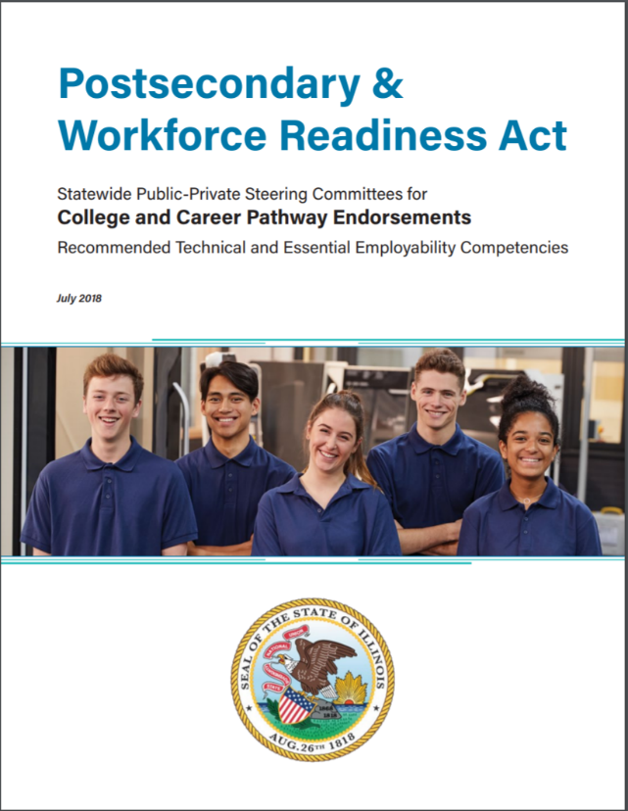
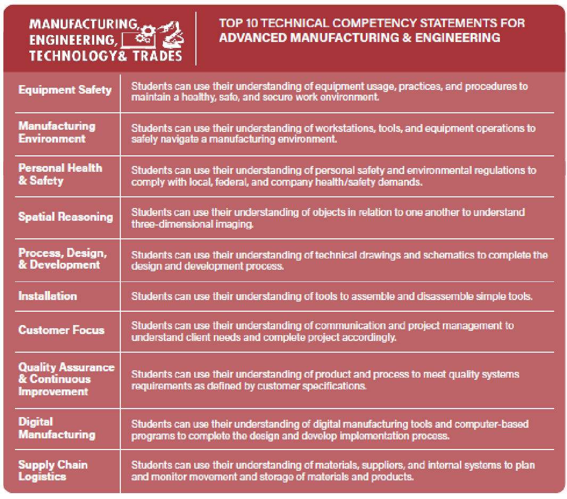
Recommended Technical and Essential Employability Competencies
https://edsystemsniu.org/resources/

Slide 12
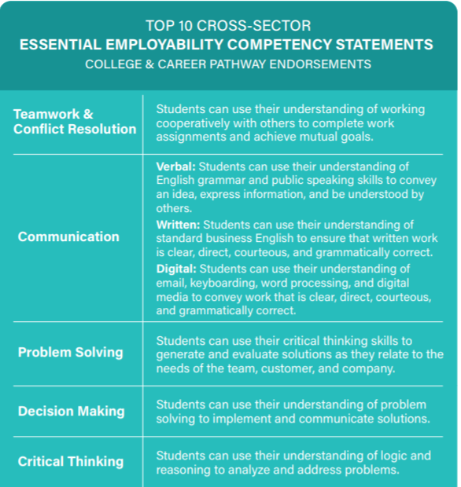
Recommended Technical and Essential Employability Competencies
https://edsystemsniu.org/resources/

Slide 13
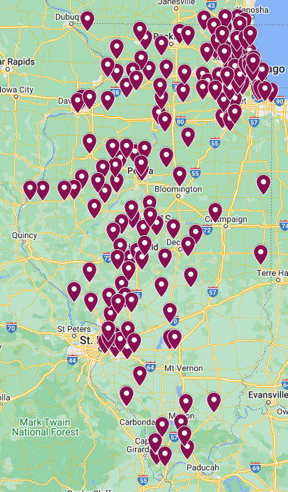
Pathway Endorsements Statewide
Starting in 2017, EdSystems sought out districts willing to commence implementation of the State’s College and Career Pathway Endorsements (mini-grant programs). Edsystems worked with ISBE to create the district pathway approval process and rulemaking processes for pathways compliance.
As a result of our work and requirements of HB3296, there are now 160+ school districts in IL that are seeking to implement endorsement systems aligned to the PWR Act.
Urban, Suburban and Rural
Traditional and CBE and “Pathway” districts

Slide 14
Uniqueness of CCPE Students: College and Career Ready
3
Academically Ready for College
Required success in College-Level, career-focused coursework and electives
Required college-level placement in Math and English (through collaboration with local Community College)
2
Accelerated Towards a Career Area
Understanding and increasing commitment to the industry area
Emphasis on Early college coursework in “career-focused” subjects for a college major or industry credential
Foundational Skills for All Careers
General employability and entrepreneurial skills embedded in HS experience
Student have a familiarity with work-based setting and robust experience in problem-based learning
1
Notes:
https://pwract.org/ccpe/

Slide 15
Benefits of CCPE
Course Sequences
- CTE Course sequence and Programs of Study
- Potential Focus on Industry Credential Attainment
- Not necessarily restricted to CTE Courses,
- Add “Career Focused” Early College Courses
Work-Based Learning
- Job Shadows, Site visits
- Internship Placements / SAE
3 Distinct Work-Based Learning activities with specific numeric goals for each
College Readiness
- Transition to postsecondary institutions an afterthought
- Must create plan for students to enter postsecondary institutions with non-remedial coursework

Slide 16
Field Example: 6 Hours Early College Credit
Resource: Model Programs of Study Guides (https://edsystemsniu.org/model-programs-of-study-guides/)
Target Career-Focused Dual Credit/Enrollment with Easy student eligibility
Common Community College Courses
Intro to Construction (3 credit hours)
Medical Terminology (3 Credits)
Target Industry Credentials through Community College Offerings
Common Community College Courses
Certified Nursing Assistant (6+ Credit Hours)
Manufacturing Processes I/II (3 to 6 Credits)
How to Get Students “Career-Focused” Early College Credit
Integrate Dual Credit Courses Into Existing CTE Structures
Common Community College Courses
Foundations of Production & Manufacturing Processes I/II (3 to 6 Credits)
Intro to Emergency Medical Technician (6+ Credit Hours)
Target Courses w/Applicability to Multiple Industry Areas
Common Community College Courses
Computer Applications for Business (3 Credit Hours)
Blueprint Reading (3 credit Hours)

Slide 17
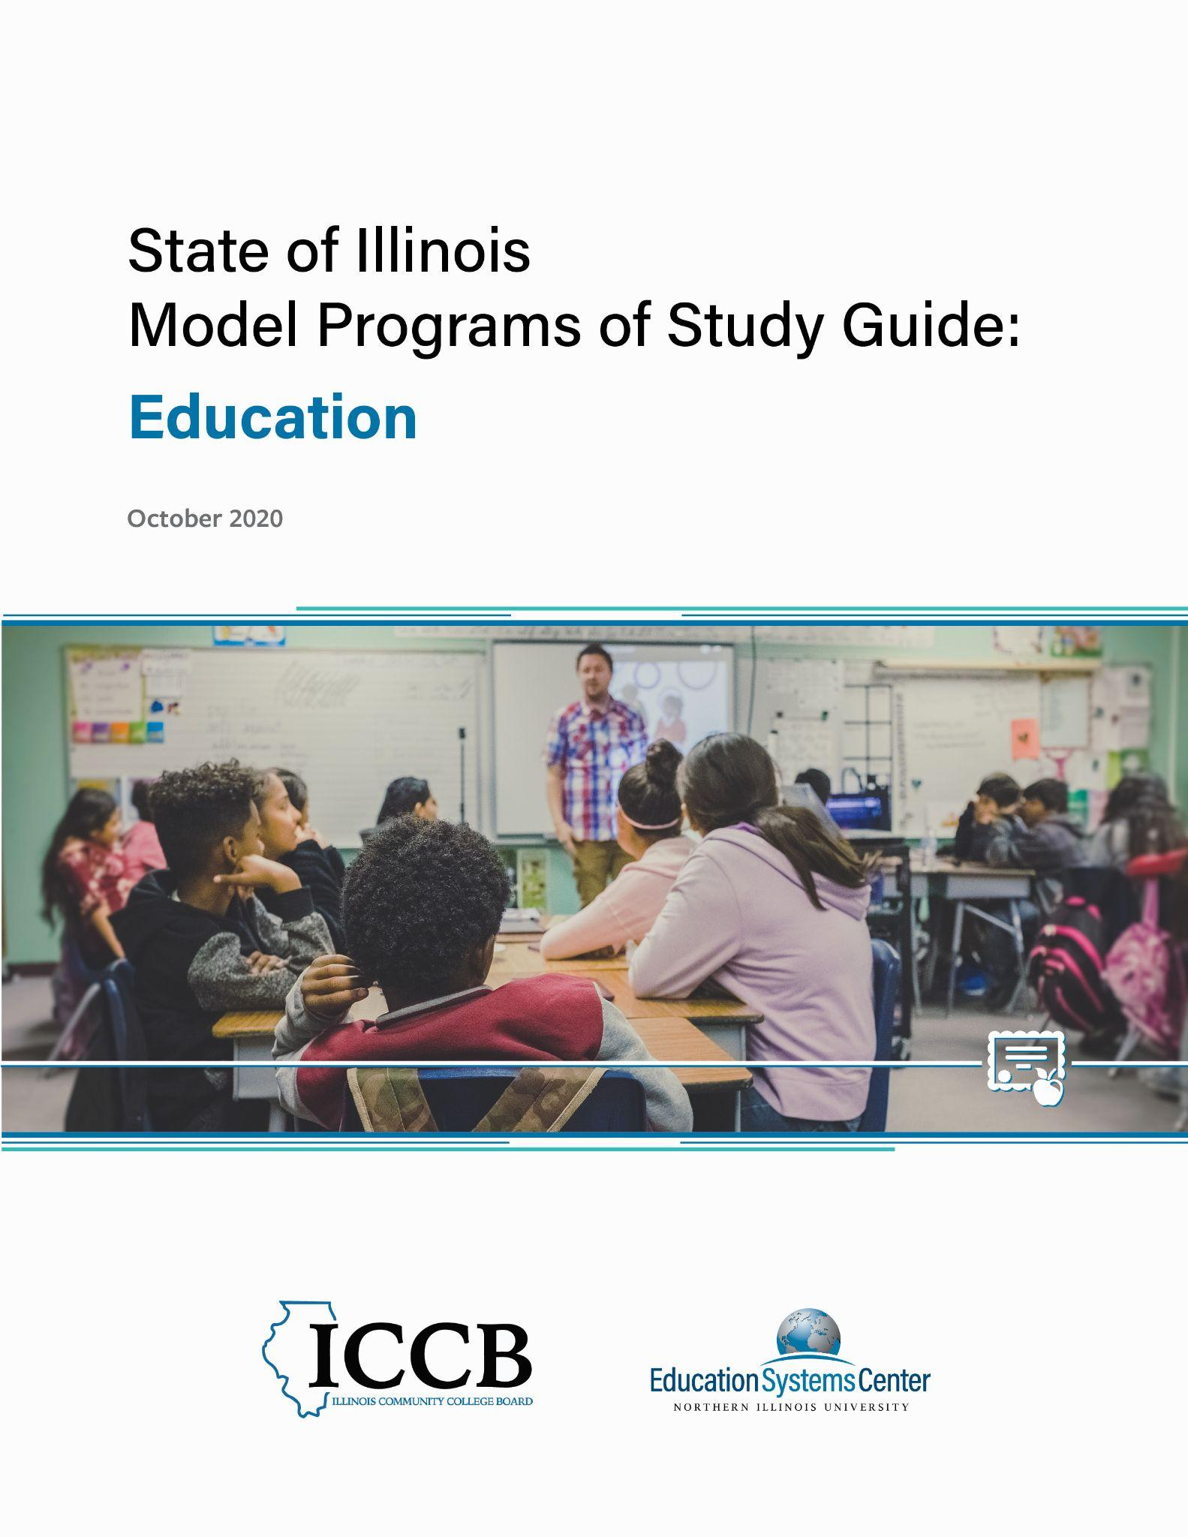
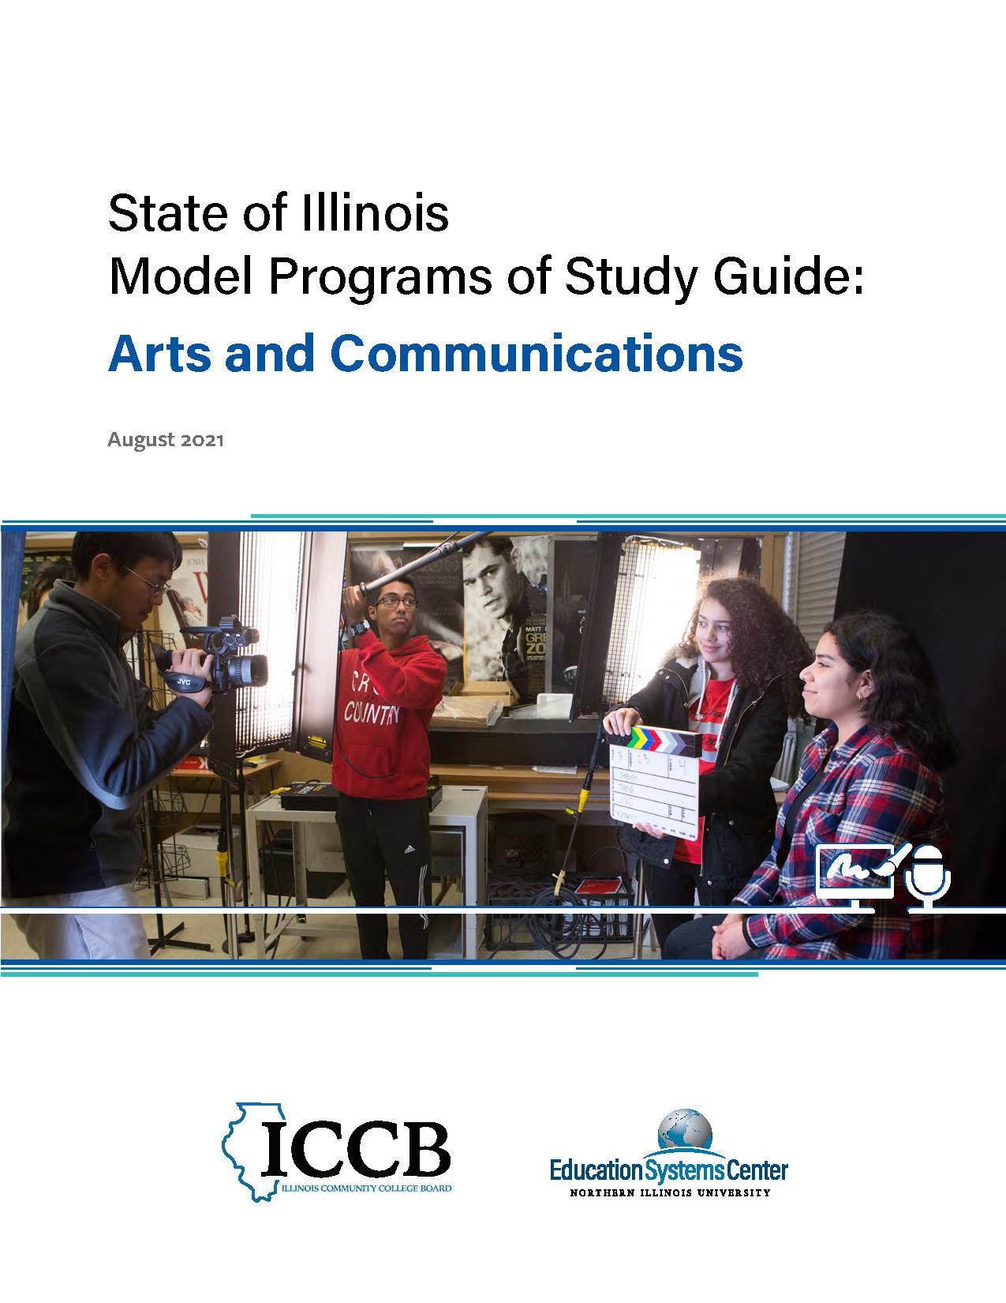
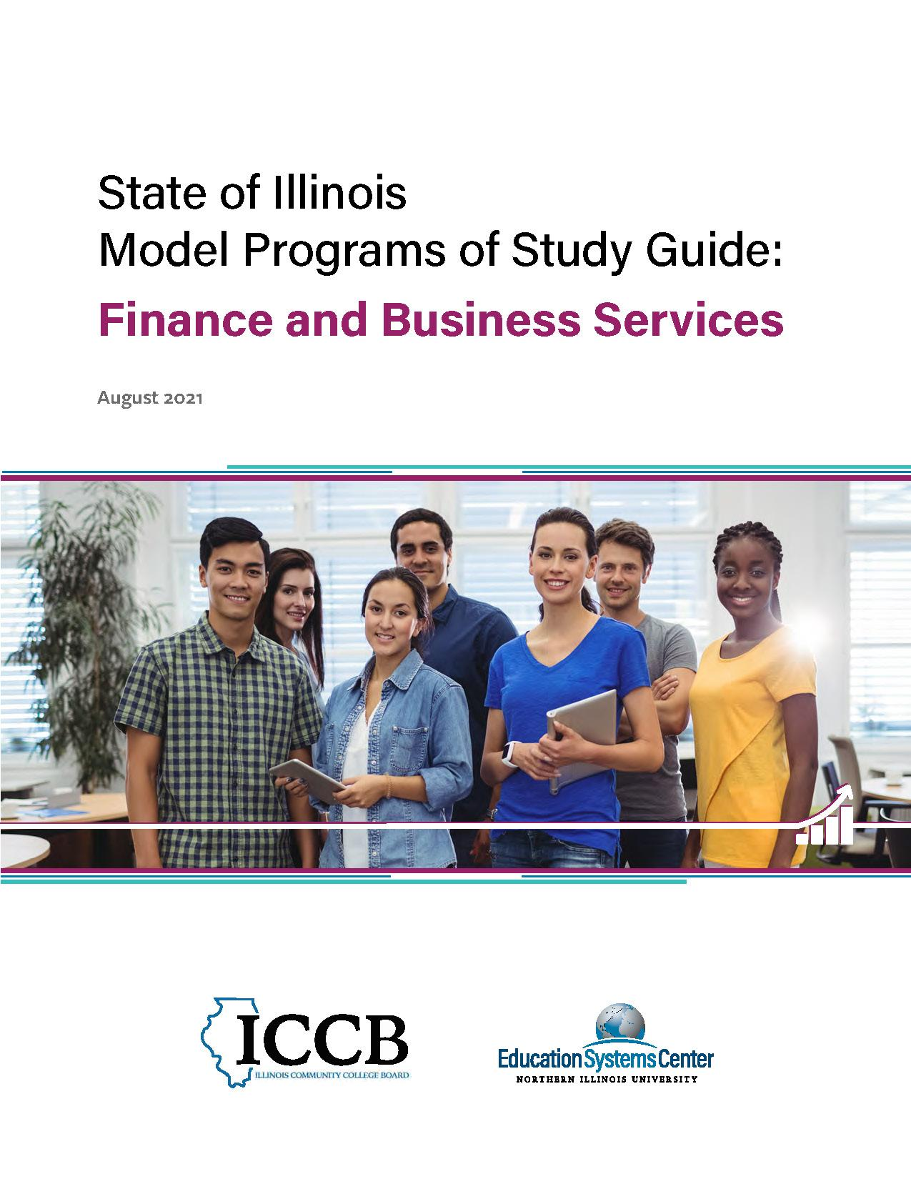
2020 Guides
2021 Guides
2022 Guides
Education
Health Sciences
Information Technology
Manufacturing and Engineering
Agriculture, Food and Natural Resources
Architecture, Construction and Energy
Arts and Communications
Finance and Business Services
Culinary Arts and Hospitality
Human and Public Service
Education (Updated)
edsystemsniu.org/guides
Notes:
Meagan

Slide 18
Work-Based Learning Continuum
Career Awareness
Career Exploration
Team-Based Challenge
Career Development Experience
Pre-apprenticeship / Youth Apprenticeship
Apprenticeship
Increasing Intensity of Employer Engagement
Definitions: Illinois Career Pathways Dictionary

Slide 19
Field Example: Embedded WBL in courses
Orientation Level Courses (9th & 10th Grade)
Skill Development (10th -11th Grade)
Capstone (12th grade)
HS level intro courses (such as CTE) with “Career Exploration
Site visits / Field trips
Job Shadows
HS Level Courses in with Embedded “Team-Based Challenges”
CTSO
Welding Competition,.
Early College Credit Courses start
Early College Courses with Embedded Career Development Experience / Internship
Coop-Courses
CNA Clinical Experiences

Slide 20
Something still circling in my mind is...
Something that squares with my thinking is...
Takeaways I have are...

Slide 21
Thank You
Education Systems Center: https://edsystemsniu.org/
Postsecondary and Workforce Readiness Act: WWW.PWRACT.ORG
Meagan Mitchell: mmitchell9@niu.edu

