Slide 1



Illinois Youth Career Pathway Grant Opportunity
Technical Assistance Session on Work-Based Learning
Illinois Department of Commerce and Economic Opportunity

Slide 2


Moderator & Technology Support
Kiersten Baer
Online Marketing Coordinator Illinois Center for Specialized Professional
Support
ksheary@ilstu.edu
2

Slide 3

Access and Participation Guidelines
Meeting Access
Meeting Participation
Select the “Call Me” option on Zoom to use your phone
for audio while using the video
option, if you choose.
This webinar will be recorded and posted to IWN.
Everyone will be muted for this webinar.
A FAQs Page has been created to track questions raised during the webinar.
Materials shared during the meeting will be available on workNet.
2

Slide 4

Speaker
Jennifer Phillips Strategic Initiatives Coordinator
Illinois Center for Specialized Professional Support https://icsps.illinoisstate.edu jlphil2@ilstu.edu
2

Slide 5


What is work-based learning?
What are the types of work-based learning under WIOA? And how does it relate to Youth Career Pathways NOFO?
Spotlight on apprenticeship as a work-based learning career pathway strategy for young people (16-24)
How to learn more about apprenticeship opportunities in Illinois
What is an Apprenticeship Navigator and how to find them in your Economic Development Region (EDR)
Questions and where to turn for more information
Did you attend Monday’s session on Career Development Experiences (CDE)? Click here for slides.
Work-Based Learning Agenda
6

Slide 6

What is Work-Based Learning?
Benefits to Students
Benefits to Schools
Benefits to Employers
https://www.dol.gov/agencies/odep/program-areas/individuals/youth/career-preparation
6

Slide 7
Career Preparation &
Work-Based Learning Experiences
Career preparation and work-based learning experiences are essential to develop aspirations and to make informed choices about careers. Experiences will require collaborations with other organizations. All youth need information on career options, including:
Understanding role employment plays in economic self- sufficiency and the motivation to build skills, explore careers, and seek employment
Career exploration skills enable youth to identify how various career options match their interests, skills, and work preferences
Self-exploration skills that enable youth to identify interests, skills, and values
Ability to make informed choices about their long-term career interests and the corresponding secondary and postsecondary coursework and industry- recognized credentials necessary to pursue these interests
Career planning and management skills, including academic planning, decision making related to postsecondary pathways, career readiness skills, job search skills, and financial literacy
Career-specific work skills and knowledge as well as employability or "soft" skills such as communication, leadership, decision-making, and conflict management skills
https://www.dol.gov/agencies/odep/program-areas/individuals/youth/career-preparation
7

Slide 8
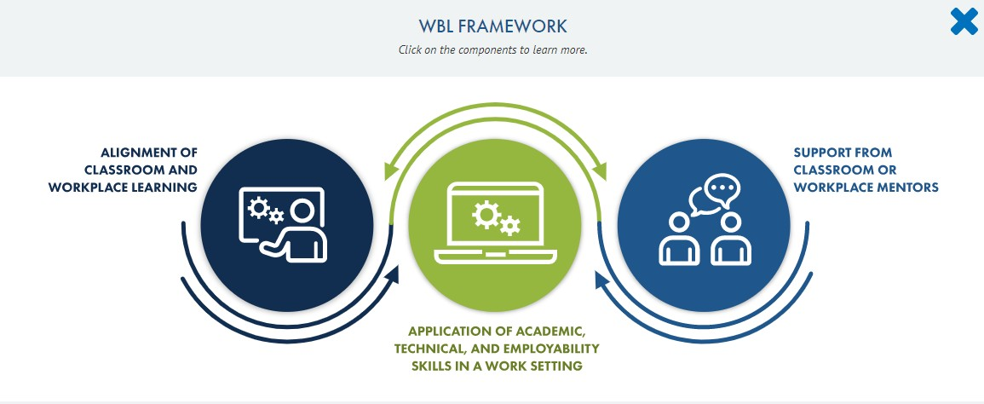
SOURCE: https://cte.ed.gov/wbltoolkit/

Slide 9
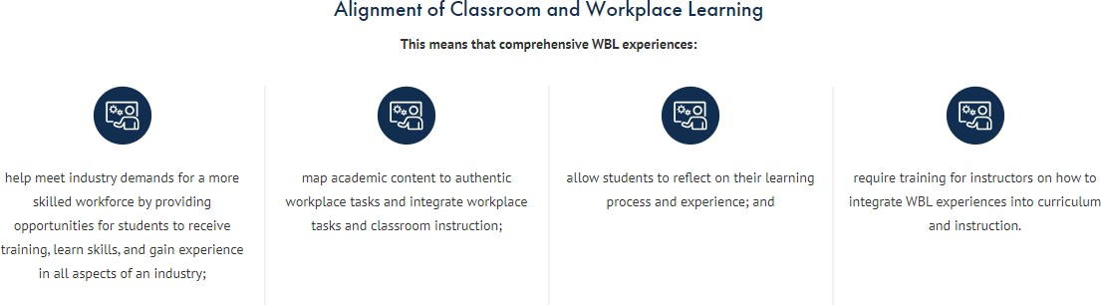
SOURCE: https://cte.ed.gov/wbltoolkit/

Slide 10
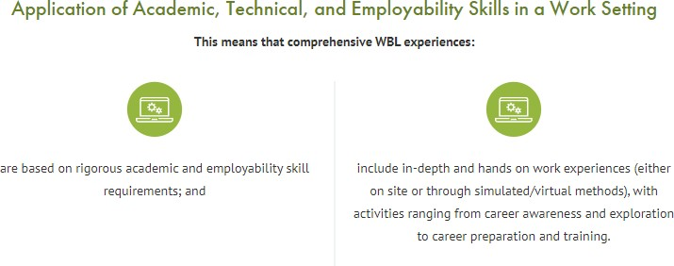
SOURCE: https://cte.ed.gov/wbltoolkit/

Slide 11
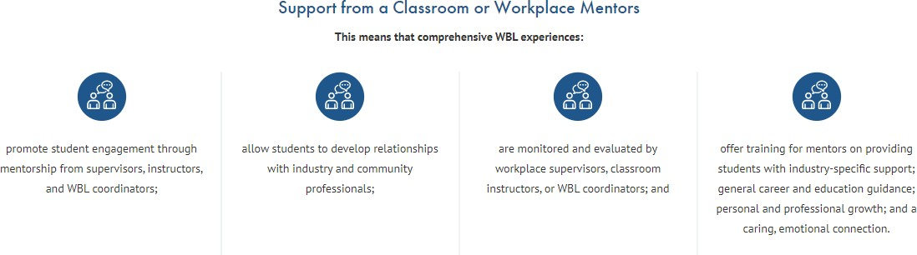
SOURCE: https://cte.ed.gov/wbltoolkit/

Slide 12

Want to Dig Deeper on WBL?
https://www.jff.org/what-we-do/impact-stories/center-for-apprenticeship-and-work-based-
learning/

Slide 13

Want to Dig Deeper on WBL?
https://www.jff.org/what-we-do/impact-stories/center-for-apprenticeship-and-work-based- learning/about-work-based-learning/

Slide 14

Work-Based Learning Glossary
https://www.jff.org/what-we-do/impact-stories/center-for-apprenticeship-and-work-based-
learning/work-based-learning-glossary/

Slide 15

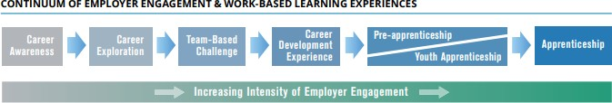
Illinois’ Career Pathways Dictionary
https://icsps.illinoisstate.edu/images/pdfs/CTE/Perkins_V/6Perkins_V_Resource_IL-Career-Pathways-
Dictionary.pdf

Slide 16

Check out EdSystems Career Development Experience Toolkit
https://edsystemsniu.org/resources/career- development-experience-toolkit/
16

Slide 17

Join the WBL Innovation Network
https://edsystemsniu.org/i-win/

Slide 18
WIOA Title I: Youth Vision
Title I of WIOA outlines a broad youth vision that supports an integrated service delivery system and provides a framework through which states and local areas can leverage other Federal, state, local, and philanthropic resources to support in-school youth(ISY) and out- of-school youth (OSY). Title I of WIOA affirms the Department of Labor’s(DOL) commitment to providing high-quality services for youth, beginning with career exploration and guidance, continued support for educational attainment, opportunities for skills training, such as:
pre-apprenticeships or internships, for in-demand industries and occupations, and culminating with employment, enrollment in postsecondary education, or a Registered Apprenticeship.
https://wdr.doleta.gov/directives/attach/TEGL/TEGL_21-16.pdf

Slide 19
WIOA Youth Funds for Work Experience
Title I of WIOA includes a requirement that a minimum of 20 percent of local area Youth funds must be spent on work experience.
Program expenditures on the work experience program element can be more than just wages paid to youth in work experience.
Allowable expenditures include:
Wages/stipends paid for participation in a work experience;
Staff time working to identify and develop a work experience opportunity, including staff time spent working with employers to identify and develop the work experience;
Staff time working with employers to ensure a successful work experience, including staff time spent managing the work experience;
Staff time spent evaluating the work experience;
Participant work experience orientation sessions;
Employer work experience orientation sessions;
Classroom training or the required academic education component directly related to the work experience;
Incentive payments directly tied to the completion of work experience; and
Employability skills/job readiness training to prepare youth for a work experience.
Illinois WIOA e-policy: 18-WIOA 7.2.5 – Work Experience Including Transitional Jobs policy STILL IN DRAFT.

Slide 20
Types of Work-Based Learning
Pre- Apprenticeship Programs
Work Experiences and Internships
Registered Apprenticeship
On-The-Job Training (OJT) (less common for youth)
Customized Training (less common for youth)
Transitional Jobs (less common for youth)
Incumbent Worker Training (less common for youth)
20

Slide 21
Registered Apprenticeship
Registered Apprenticeship is an employer-driven, “learn while you earn” model that combines on-the-job training with job-related instruction in curricula tied to the attainment of industry-recognized skills standards. The OJT is provided by the employer who hires the apprentice, although some employers also provide the job-related instruction. WIOA funds may be used to support placing participants in both the classroom and OJT portions of the program. WIOA funds can also be used to provide supportive services to participants that help an individual succeed in a Registered Apprenticeship program.
Target Populations – Youth, adults and dislocated workers, veterans in receipt of the GI Bill, unemployed workers (including long-term unemployed), underemployed workers, and incumbent workers.
https://ion.workforcegps.org/resources/2017/07/14/09/08/Work-Based-Learning-Desk-Reference

Slide 22
Pre-Apprenticeship
A pre-apprenticeship is a program designed to prepare individuals to enter and succeed in a registered apprenticeship program, which includes:
Training and curriculum that aligns with the skill needs of employers in the economy of the State or region
Access to educational and career counseling, and other supportive services
Hands-on, meaningful learning activities that are connected to education and training activities, such as exploring career options, understanding how skills acquired through coursework can be applied to a future career
Opportunities to attain at least one industry-recognized credential; and
A partnership with one or more registered apprenticeship programs that assists in placing individuals who complete the pre-apprenticeship into a registered apprenticeship program
Target Populations – Youth and adults with barriers to employment who are identified to need certain skills or credentials in order to successfully enter into a registered apprenticeship program, dislocated workers transitioning to new industries or occupations in need of new skills, other eligible individuals identified by case managers as likely to succeed and have an interest in registered apprenticeship programs.
https://ion.workforcegps.org/resources/2017/07/14/09/08/Work-Based-Learning-Desk-Reference

Slide 23
Work Experiences and Internships
A work experience or internship is a planned, structured learning experience that takes place in a workplace for a limited period of time. Work experiences or internships may be paid or unpaid, as appropriate and consistent with other laws, such as the Fair Labor Standards Act. A work experience or internship may be arranged within the private for- profit sector, the non-profit sector, or the public sector.
For youth, work experiences may also include:
  Pre-apprenticeship programs;
  Summer employment and other employment activities available throughout the school year;
  Internships and job shadowing; and
  On-the-job training (OJT)
Target Populations – Youth/adults with barriers to employment who have limited labor market experience, dislocated workers needing exposure to new industries/occupations, unemployed workers, underemployed workers, long-term unemployed workers, and other populations determined appropriate by case manager.
https://ion.workforcegps.org/resources/2017/07/14/09/08/Work-Based-Learning-Desk-Reference

Slide 24
Transitional Jobs
Transitional jobs are a type of work-experience local boards may provide under WIOA, and are considered an individualized career service.
Transitional jobs are time-limited and wage-paid work experiences that can be subsidized up to 100 percent. These jobs are in the public, private, or nonprofit sectors.
Target Populations – Adults and dislocated workers with barriers to employment who are chronically unemployed or have an inconsistent work history.
https://ion.workforcegps.org/resources/2017/07/14/09/08/Work-Based-Learning-Desk-Reference

Slide 25
On-The-Job Training or OJT
OJT provides reimbursements to employers to help compensate for the costs associated with skills upgrade training for newly hired employees and the lost production of current employees providing the training (including management staff). OJT training can assist employers who are looking to expand their businesses and who need additional staff trained with specialized skills. OJT employers may receive up to 50% reimbursement of the wage rate (in certain circumstances up to 75%) of OJT trainees to help defray personnel training costs. Under some programs, such as those funded by H-1B fees, OJT reimbursement may be as high as 90%, depending on employer size.
Target Populations – Adults and dislocated workers in need of new employer- based skills, individuals with barriers to employment including: unemployed workers (including long-term unemployed), underemployed workers, and older/out- school-youth.
https://ion.workforcegps.org/resources/2017/07/14/09/08/Work-Based-Learning-Desk-Reference

Slide 26
Customized Training
Customized training is designed to meet the specific requirements of an employer or group of employers with the commitment that the business or businesses employ an individual(s) upon successful completion of the training. In most instances, the business must pay for a significant portion of the cost of training, as determined by the Local Workforce Development Board (WDB).
Target Populations – Adults and dislocated workers with barriers to employment needing industry or occupational skills, unemployed workers (including long-term unemployed), underemployed workers, and employed workers.
https://ion.workforcegps.org/resources/2017/07/14/09/08/Work-Based-Learning-Desk-Reference

Slide 27
Incumbent Worker Training
Incumbent Worker training is designed to meet the needs of an employer or group of employers to retain a skilled workforce or avert layoffs. Incumbent Worker training can be used to either:
Help avert potential layoffs of employees; or
Obtain the skills necessary to retain employment, such as increasing the skill levels of employees so they can be promoted within the company and create backfill opportunities for new or less-skilled employees.
Unlike other trainings, employers, instead of individuals, must meet the local eligibility criteria to receive funds for training their workforce. In most circumstances, incumbent workers being trained must have been employed with the company for at least six months. Employers who receive these funds are required to meet requirements for providing the non-federal share of the cost of the training.
Target Populations – Businesses and employers who meet local eligibility criteria to receive incumbent worker training funds and who need to provide training to their current workforce to meet new or changing business needs.
https://ion.workforcegps.org/resources/2017/07/14/09/08/Work-Based-Learning-Desk-Reference

Slide 28

Let’s Take a Closer Look at Youth Apprenticeships
https://youtu.be/fgOVXkWyf7s

Slide 29
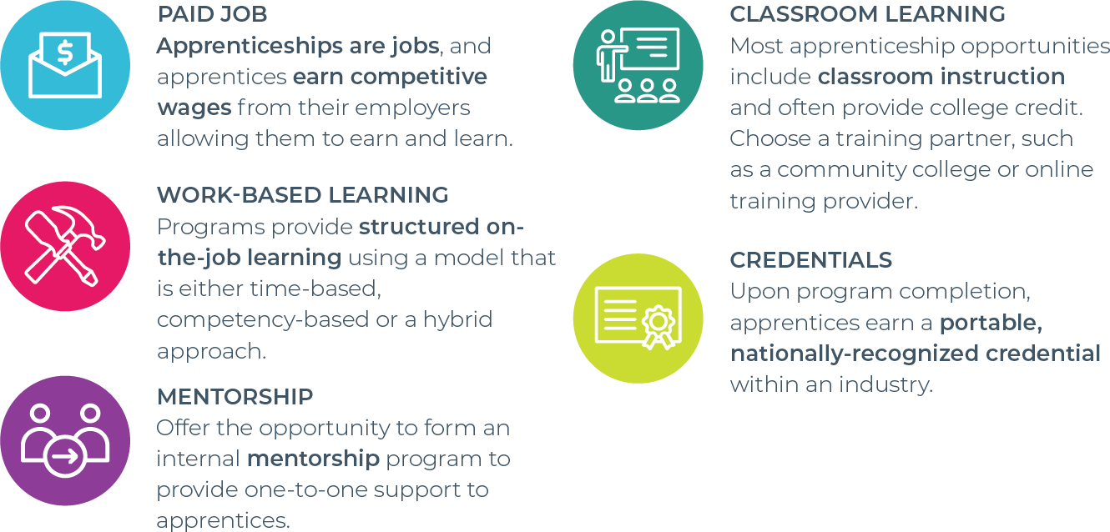
Components of Apprenticeship
https://www.apprenticeship.gov/
29

Slide 30
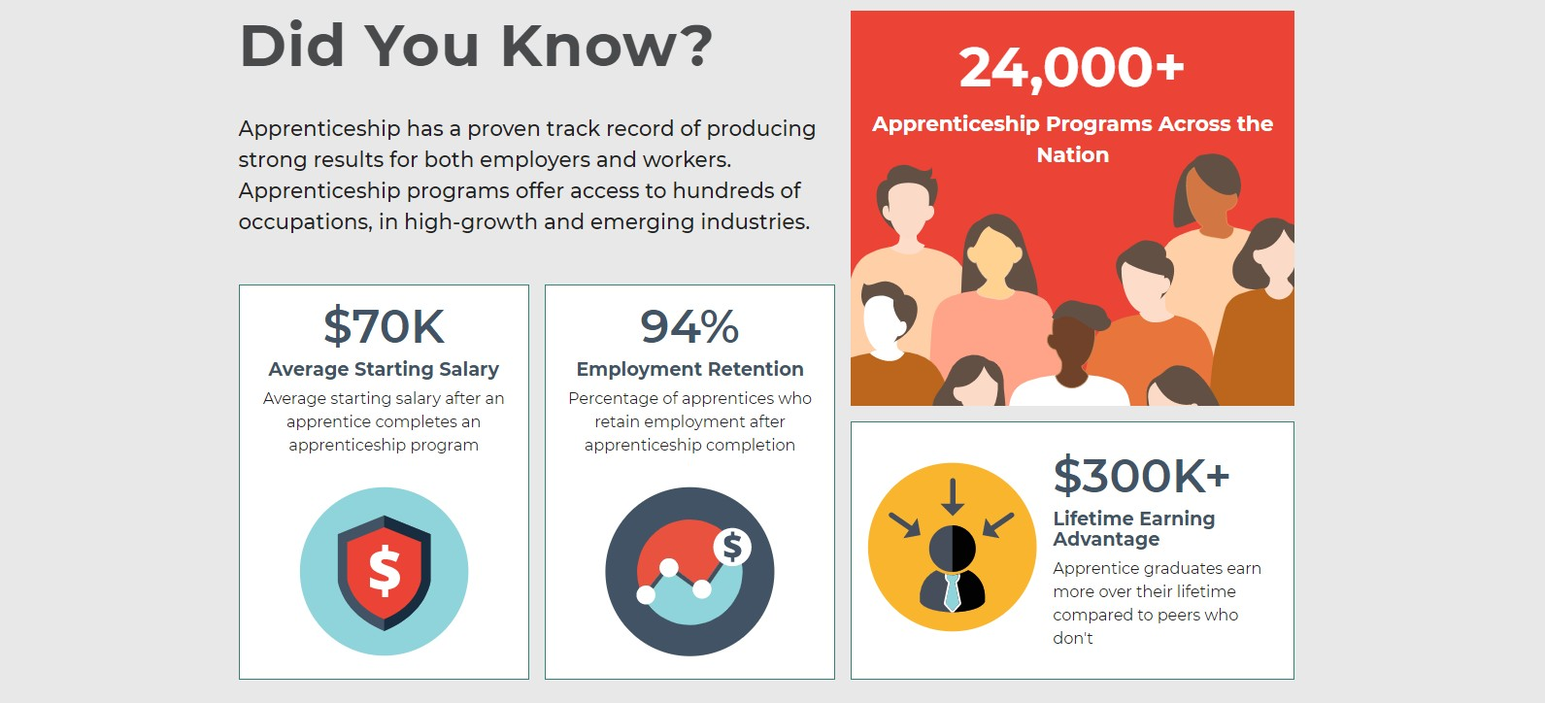
Quick Tour of Apprenticeship.gov
https://www.apprenticeship.gov/

Slide 31
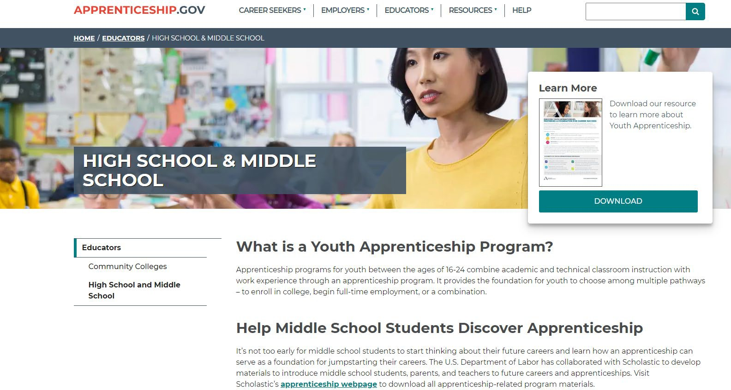
https://www.apprenticeship.gov/resource-hub

Slide 32

Youth Apprenticeship Fact Sheet
https://www.apprenticeship.gov
/sites/default/files/Youth_Appre nticeship_Factsheet.pdf

Slide 33
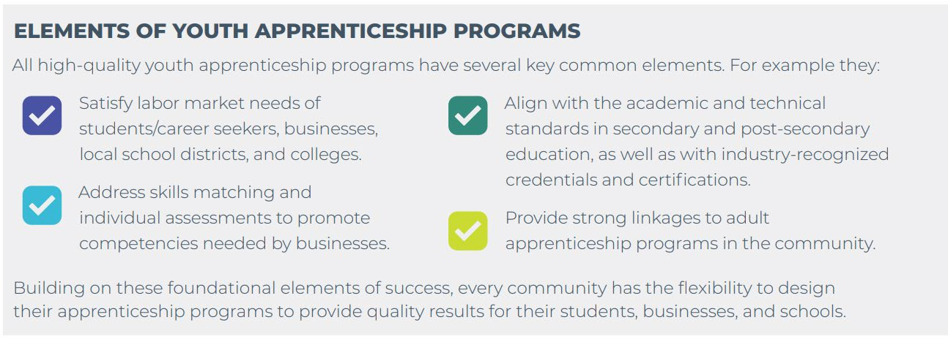
Benefits of Youth Apprenticeship
https://www.apprenticeship.gov/sites/default/files/youth-apprenticeship-fact-sheet.pdf

Slide 34

Youth Apprenticeship Toolkit
https://www.apprenticeship. gov/sites/default/files/aasa- expanded-pathways-youth- apprenticeship-toolkit.pdf

Slide 35

Resources from Scholastic
https://www.apprenticeship.gov/sites/defa ult/files/scholastic-jobs-of-the-future-fall- 2019.pdf

Slide 36
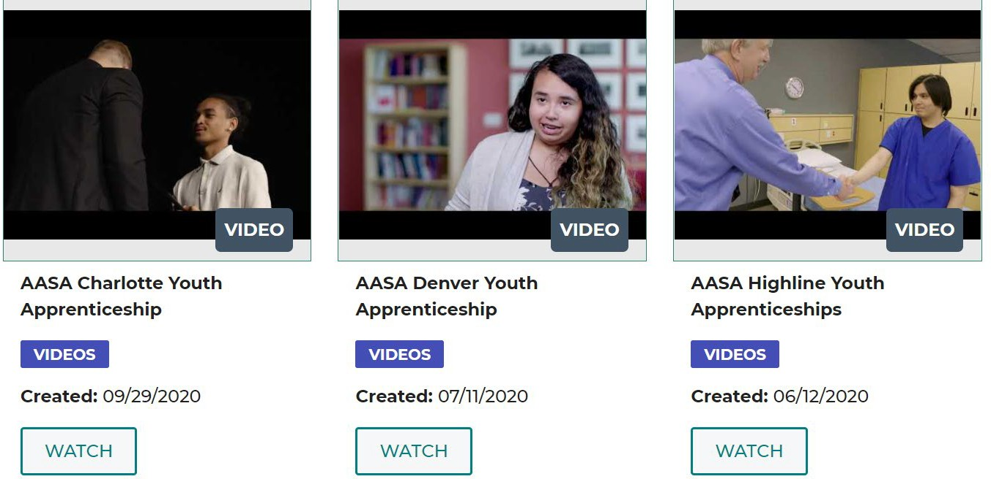
Youth Apprenticeship Videos
https://www.apprenticeship.gov/resource-hub

Slide 37

Quick Tour of Apprenticeship Illinois
www.apprenticeshipil.com

Slide 38
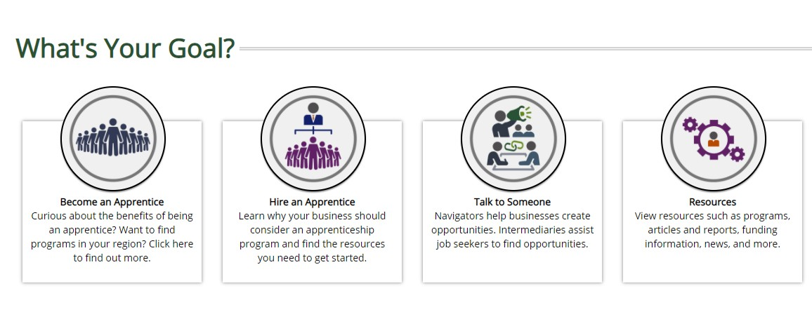

Slide 39

Apprenticeship Illinois Video

Slide 40
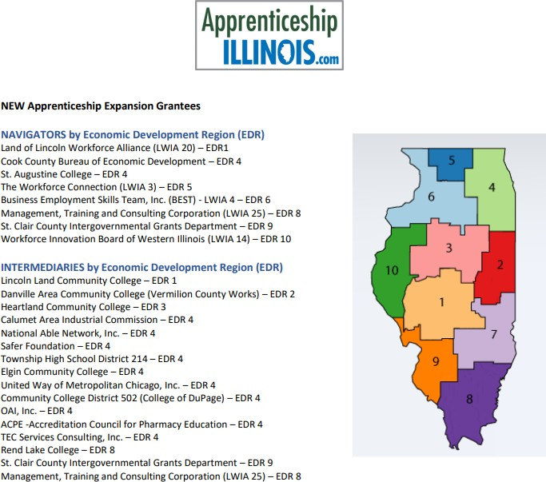
Current USDOL Illinois Apprenticeship Expansion Grantees

Slide 41

Illinois Models for Youth Apprenticeship
https://www.discover214.org/apprenti ceships
41

Slide 42

What’s an Apprenticeship Navigator?

Slide 43
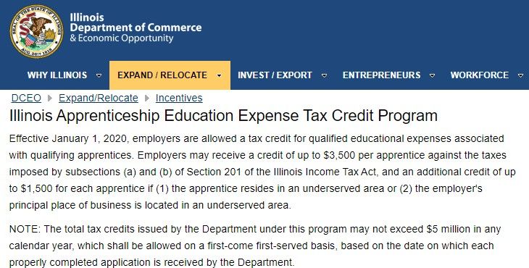
Illinois Apprenticeship Education Expense Tax Credit Program
https://www2.illinois.gov/dceo/ExpandRelocate/Incentives/Pages/ILApprenticeshipTaxCredit.aspx

Slide 44
Illinois Apprenticeship Education Expense Tax Credit Program
Eligibility
A qualifying apprentice must be: (a) an Illinois resident; (b) at least 16 at the close of the
school year for which a credit is sought; (c) a full-time apprentice enrolled in an
apprenticeship program registered with U.S. Department of Labor (USDOL), Office of Apprenticeship during the school year; and (d) employed by the taxpayer in Illinois.
  To register a program with the USDOL, companies should contact the USDOL, Office of Apprenticeship State Director Kim Jones at jones.kimberly@dol.gov.
  U.S. Department of Labor has the following website to support
employers: https://www.apprenticeship.gov/employers; and for additional information specific to Illinois Apprenticeship Programs go to www.ApprenticeshipIllinois.com.
Qualified educational expenses include tuition, book fees, and lab fees.
A qualified school means any Illinois public or nonpublic secondary school that is: (a) an
institution of higher education providing a program that leads to an industry-recognized
postsecondary credential or degree; (b) an entity that carrying out programs registered
under the federal National Apprenticeship Act; or (c) another public or private provider of a program of training services, which may include a joint labor-management organization.

Slide 45
Illinois Apprenticeship Education Expense Tax Credit Program
Certification
Employers must apply to the Department for certification.
Employers must provide certain supporting information, including but not
limited to: (s) the name, age, and taxpayer identification number of each
qualifying apprentice employed by the taxpayer; (b) the amount of qualified
education expenses incurred with respect to each qualifying apprentice,
including supporting documentation; and the name of the school at which
the qualifying apprentice is enrolled and the qualified education expenses are incurred.
Apprenticeship Tax Credit Application
Apprenticeship Educational Expenses Tax Credit Application
Supporting spreadsheet

Slide 46
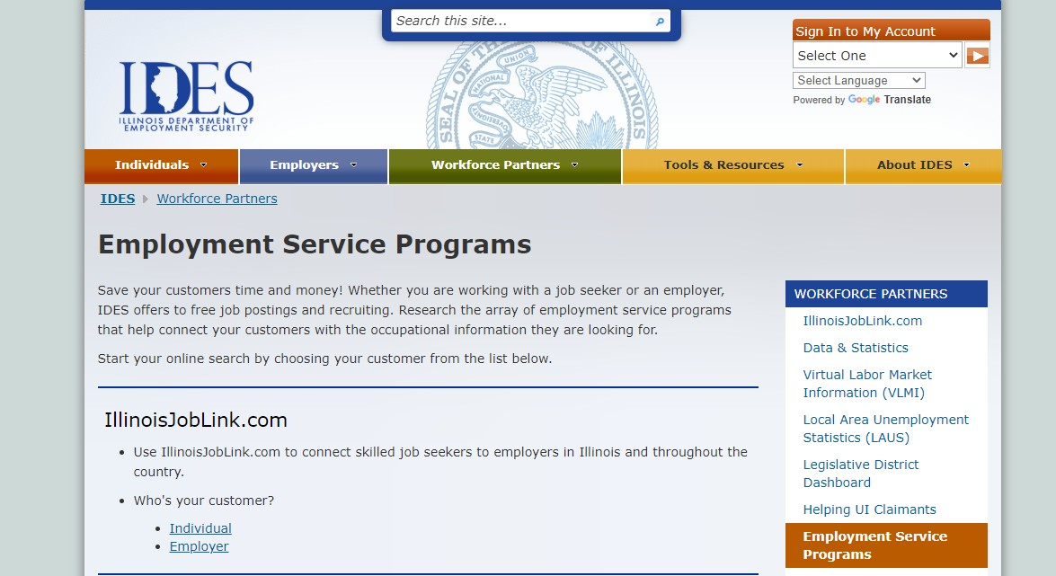

Other Places to Get Information About Apprenticeships - IDES
https://www2.illinois.gov/ides/workforcepartners/Pages/Employment_Service_Programs.aspx

Slide 47
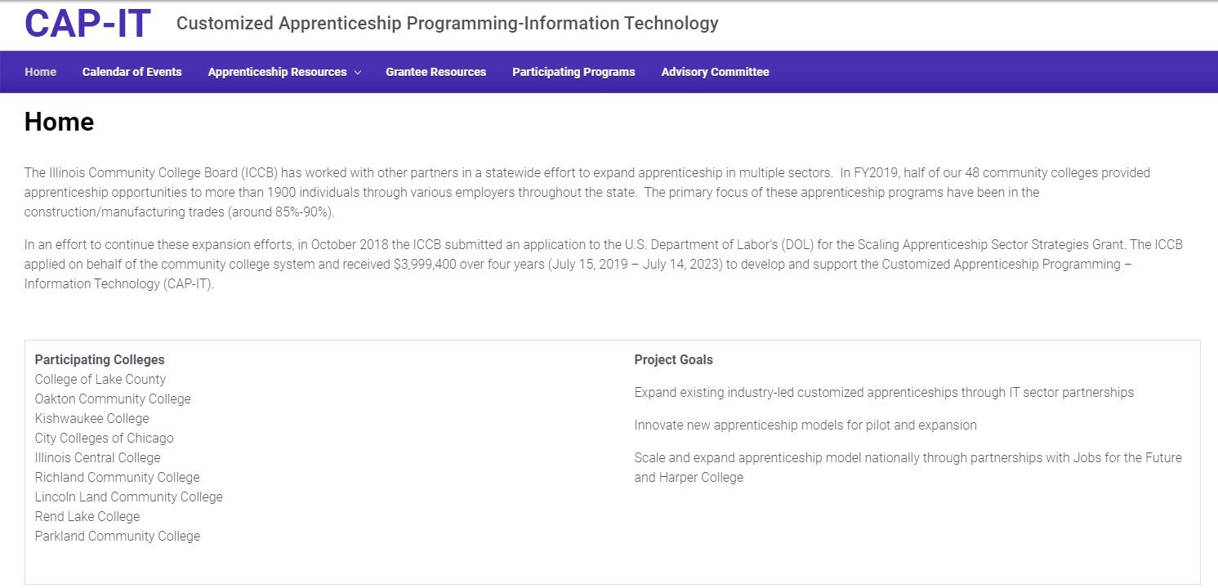
Other Places to Get Information About Apprenticeships - ICCB
https://www.iccb.org/cap-it/

Slide 48
Where to Get More Information
U.S. Dept. of Labor WIOA Youth Formula Program: https://www.dol.gov/agencies/eta/youth/wioa-formula
High School & Middle School Apprenticeship: https://www.apprenticeship.gov/educators/high-school-and-middle-school
TEGL 21-16 (Third Workforce Innovation and Opportunity Act (WIOA) Title I Youth Formula Program Guidance): https://wdr.doleta.gov/directives/attach/TEGL/TEGL_21-16.pdf
Workforce GPS: https://apprenticeship.workforcegps.org/ Apprenticeship Partnership Models in Action:
https://www.illinoisworknet.com/DownloadPrint/RA_Partnership_Models_in_Action.pdf
A Quick-Start Toolkit: Building Registered Apprenticeship Programs: https://www.illinoisworknet.com/DownloadPrint/apprenticeship_toolkit.pdf
Work-Based Learning on Illinois WorkNet: https://www.illinoisworknet.com/wbl#:~:text=Work%2Dbased%20learning%20(WBL),while%20gaining%20critical%20job%20skills.&t ext=To%20prepare%20for%20WIOA%20requirements,and%20tools%20for%20WBL%20programs.

