Slide 1
Office of Employment and Training
Grant Writing Workshop – Program Plan

Slide 2
Welcome and Introductions
Name
Organization
What you want to learn today.
What is your favorite holiday tradition

Slide 3
Today’s Presenters…
Tammy Stone Office of Employment & Training Illinois Department of Commerce & Economic Opportunity
Shannon Hampton Office of Employment & Training Illinois Department of Commerce & Economic Opportunity
Terah Scott Office of Employment & Training Illinois Department of Commerce & Economic Opportunity

Slide 4
Why are We Here?
To learn about the elements of a DCEO OET Grant Application Process
To discuss what a quality work plan should include.
To provide examples of best practices and lessons learned from prior programs.
To engage and ask question on developing a successful work plan.

Slide 5
Illinois Department of Commerce and Economic Opportunity
The mission of the Illinois Department of Commerce and Economic Opportunity (DCEO) is to create equitable economic opportunities across the State of Illinois. By attracting and supporting major job creators, investing in communities, strengthening Illinois’ world-class workforce, fostering innovation, and ushering in the new clean energy economy, DCEO works to fortify Illinois’ reputation as a global economic powerhouse while ensuring Illinois is the best state to live, work and do business.

Slide 6
What we will cover today.
Notice of Funding Opportunity(NOFO), Capacity and Need
Overview of the components of a NOFO
How Capacity and Need influences the program plan/design
Developing a Quality Program Plan/Design
Developing partnerships to serve customers (Holistic approach to services)
Establishing Goals and Objectives
Creating a Program Plan
Services Offered in the Plan
Criteria in NOFO on Grading the Plan

Slide 7
NOFO Review – Key Elements Guide
Program Description
Intent
Program Description
Program History
Performance Goals and Measures
Funding Information
Eligibility Information
Eligible Applicants
Cost Sharing or Matching
Indirect Cost Rate
Application and Submission Information
Address to Request Application Package
Content and Form of Application Submission
Unique Entity Identifier (UEI) and System for Award Management (SAM)
Submission Dates and Times
Intergovernmental Review
Funding Restrictions
Application Review Information
Criteria
Review and Selection Process
Anticipated Announcement
Award Administration Information
State Award Notices
Administrative and National Policy Requirements
Subrecipients and Subcontractors
Grant Uniform Requirements
Procurement
Reporting
Award Range
Start date/End date
Audit

Slide 8
Analysis Before Developing a Program Plan
Before you begin, you need to understand how much capacity your organization has.
BEFORE YOU BEGIN, YOU NEED TO DO AN ANALYSIS OF NEED IN YOUR AREA AND IF YOUR ORGANIZATION CAN MEET THAT NEED.

Slide 9
Organization Capacity
Staffing Capacity
If you want to add a new project/program, does your staff have the capacity?
If you need additional staff, which roles will help with your capacity?
What expertise does your current staff have?
Partnerships
What can your partner organization provide and what can you provide to increase capacity?
Organization Capacity
Is this in your “wheelhouse”?
Is your organization financial sustainable?

Slide 10
Identifying the Need
Identifying a Need:
Does your area have a need or problem?
Does your target population have a need or a problem?
Does your area have workforce needs?
Why is this a need or problem?
What will happen if the need or problem is not addressed?
How do you know this information?
Examine the Data:
Data can come in many forms. For example:
Census or other government data
Community meetings
Stakeholder interviews
Surveys
Original analyses of existing datasets
Reports your organization or others have published
Polling
Case studies
Policy details and analysis
Requests for services your organization receives

Slide 11
Developing a Program Plan
Who what how much
Organizations network
Elements of a quality program

Slide 12
Questions To Consider Before Starting Any Workforce Grant Application
Who?
What?
How Much?
Who will you serve?
How many individuals will you serve?
Who is your training provider?
Who are your business partners?
What is your target industry?
What credentials will be earned?
What type of work-based learning will be used?
What occupations will the training lead to?
How much will training cost?
How much will the program cost per participant?
How much funding will be used for supportive services and/barrier reduction services?
NOTE:
Refer to the NOFO to make sure your population served meets program criteria.

Slide 13
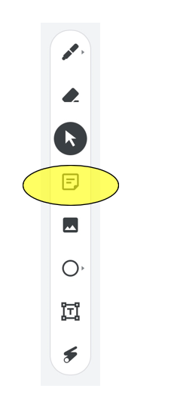
Jamboard #1-3
Who, What, How Much
Use the sticky note icon highlighted below.
Type your response in the text box.
Select the color of the sticky note you desire
Click “Save” to input your sticky note onto the JamBoard.
Use the Arrows at the top of the page to navigate to the next question.

Slide 14
Consider Partnerships
Many organizations cannot do it all on their own. Review your current organizational partnerships, networks, and cohorts.
What programs, roles, or services could be expanded by partnering with another organization?
What programs, roles, or services could your organization provide for another?

Slide 15
Consider Partnerships
Review your current organizational partnerships, networks, and cohorts.
Identify Partnerships that will help with financial sustainability.
Are their services that could be provided by a partnering organization to diversify financial strain to any one organization?

Slide 16
Tell Us About Your Partners

Slide 17
Jamboard #4
Partners
Use the sticky note icon highlighted below.
Type your response in the text box.
Select the color of the sticky note you desire
Click “Save” to input your sticky note onto the JamBoard.
Use the Arrows at the top of the page to navigate to the next question.

Slide 18
Connecting the Need to Each Step of the Process
Need
Need Statement
Goals and Objectives
Workplan Activities

Slide 19
Goals and Objectives
Need
Need Statement
Goals and Objectives
Workplan Activities
IDENTIFY GOALS AND OBJECTIVES
THEN DEVELOP THE PROGRAM PLAN

Slide 20
Goals and Objectives
Once you identified your Needs Statement, it is time to create Goals and Objectives.
Goals are broader statements you wish to accomplish.
Objectives are the individual actions you must take to achieve a goal. They are specific steps to achieving a goal.
Objectives are usually precise and measurable statements that explain how the goal will be accomplished.
When working toward accomplishing a goal, often you'll have objectives you must complete along the way. By completing objectives, you’re making progress towards completing your goal.

Slide 21
Example Goal and Objectives
Personal Goal
Get eight hours of sleep every night.
Objectives
Stop drinking caffeine in the afternoon.
Set alarms for going to bed and for waking up.
Avoid exercising two hours before going to bed.

Slide 22
Understanding Goals and Objectives
Create a Goal for a grant opportunity and then write three corresponding objectives to that goal.
Goal:
_________________________________________________________________________________________________
_________________________________________________________________________________________________
_________________________________________________________________________________________________
Objectives:
_________________________________________________________________________________________________
_________________________________________________________________________________________________
_________________________________________________________________________________________________

Slide 23
Review and Consider
Review your Goals and Objectives:
Are your goal/objectives specific? Do you or your organization have subject matter knowledge on this topic?
Can you measure your goals and objectives?
Are these goal/objectives achievable? Is the goal relevant to your organization or target population?
How will a timeline influence this goal?
Does your organization have the staff capacity to meet the objectives of this goal?

Slide 24
Consider Partnerships
Are there areas of the goal(s) that would be aided if you partnered with another agency?
Could partnering with another organization allow your staff to meet these objectives?

Slide 25
Expand or Regroup
If the goal and objectives are specific, measurable, achievable, relevant, and time-bound, and your organization can achieve them on your own or through partnering, it is time to start your workplan!
If the goal or objectives would put too much strain on your organization and you cannot partner with another agency, you need to revisit your need and/or this funding opportunity.

Slide 26
Creating Your Workplan
Need
Need Statement
Goals and Objectives
Workplan Activities
ELEMENTS OF A PLAN TO Efficiently SERVE
AND MEET GOALS

Slide 27
Workplan
A workplan should answer all the questions a funder may have, including:
What is your solution to the need/problem? How will you approach the solution?
What is your plan of action to address the identified need/problem?
What are the steps you will take? Who will do what? How long will it take?
Explain the project goal and how it would meet the need or solve the problem identified.
List specific, measurable objectives to meet the project’s goal.
State expected project outcomes and how they would benefit the target population.
State the planned activities, methodology, and timetable for accomplishing the planned activities.
Explain how the project will be managed.
Always tie the objectives back to the identified need/problem.

Slide 28
Creating Your Workplan
Once you have reviewed your organization’s capacity, identified a need supported by data, confirmed that you have met the grant’s criteria, drafted a needs statement, created goals and objectives; then it is time to create a workplan.
The workplan typically includes the activities that provide further detail on how the objectives will be achieved by listing specifically what will be completed in a specific timeframe.

Slide 29
Example Workplan
Activity​ | Timeline​ | Responsible Staff and Role​ | Deliverable​ (Outcome)​ | Pivot Person
Expand social media outreach through Facebook and Instagram by geofencing School District 1234​ | January 2024​ | Ms. Teal​, Outreach Coordinator | Increase enrollment by ten students in Program Y​ear 2024 | Mr. Jones, Data Entry
​ | ​ | ​ | ​
​ | ​ | ​ | ​
​ | ​ | ​ | ​
​ | ​ | ​ | ​
​ | ​ | ​ | ​
​ | ​ | ​ | ​
​ | ​ | ​ | ​
​ | ​ | ​ | ​
​ | ​ | ​ | ​
List the major project activities in the first column. In the second column, indicate the timeliness for completion of the activities. Timeliness may be specified by the month of the project (e.g., such as month 1, month 2, etc.) or by specific dates. In the third column, indicate the staff by name and title responsible for performing the activities, and indicate the organizational affiliation of each staff person listed. The fourth column must describe the deliverable associated with the project activity. In the fifth column, enter the back-up person for the primary staff person for this role.

Slide 30
Jamboard #5-8
Workplan
Use the sticky note icon highlighted below.
Type your response in the text box.
Select the color of the sticky note you desire
Click “Save” to input your sticky note onto the JamBoard.
Use the Arrows at the top of the page to navigate to the next question.

Slide 31
Review and Consider
Review your workplan:
Are your activities tied directly to your Need, Goals and Objectives?
Are the timelines realistic?
Have you noted all the activities for each Goal and Objective?
Consider Partnerships
If you are partnering with other organizations, are their activities also noted?
Will partnering with other organizations help your staff capacity and aid in completing these activities?

Slide 32
Review and Consider – Pivot Points
Review your workplan:
Does your staff have the capacity to allow for these pivot points?
Does your staff have time to be sick? Take Vacation?
Is any one staff member responsible for a majority of the knowledge of this grant?
Will your organization have time to hire new staff and train them?
Consider Partnerships
Could partnering with other organizations allow your organization to allow for these pivot points?
Are there partners that already do some of this work?

Slide 33
Expand or Regroup
If you do not have the capacity to sufficiently plan for any pivot points, you need to review your goals and objectives and consider streamlining.
If your organization can plan for these pivot points, allowing for knowledge diversity, and does not overload staff, it is now time to start your budget!

Slide 34
Services Related to the Workplan
Need
Need Statement
Goals and Objectives
Workplan Activities
A successful workplan must
include Activities/services From
Intake to Exit

Slide 35
JTED Program Services
JTED program services address the economic impacts experienced by employers and individuals that are underemployed, unemployed or facing other employment barriers including priority population by providing employment and training services aligned with a career pathway that supports targeted industries
Outreach and Recruitment
Employer Engagement
Career Planning
Training /Sector –Based/Employability Skills
Placement
Follow-Up
Supportive Services / Barrier Reduction Funds
Work-Based Learning /
Work-Based Training
NOFO Page 7-13

Slide 36
Outreach and Recruitment & Employment Engagement
Outreach activities and strategies are focused on a comprehensive culturally relevant communication strategy that raises general program awareness geared to widen participation.
Recruitment activities and strategies are focused on attracting specific participants or groups that grantees are seeking to enroll in their program or to partner with.
Outreach and recruitment should be geared towards established and expanded partners, employer/industry organizations, social service agencies, and others.
Employer Engagement Employers should have a leadership role in developing and supporting the career pathway programs that integrate work-based learning opportunities through experience.
Outreach and Recruitment
Employer Engagement
Career Planning
Training
Work-Based Learning /
Work-Based Training
Supportive Services
Barrier Reduction Funds
Placement
Follow-Up

Slide 37
Career Planning
Successful career planning is a collaborative and ongoing process.
A thorough assessment is the foundation for understanding the participant’s employment goals, existing skills, career readiness and determining all barriers to employment that may exist.
Each participant needs an Individual Employment Plan (IEP) which is living document that identifies employment and education goals as part of a career pathway, objectives, and the appropriate combination of services for the participant to reach the goals.
Outreach and Recruitment
Employer Engagement
Career Planning
Training
Work-Based Learning /
Work-Based Training
Supportive Services
Barrier Reduction Funds
Placement
Follow-Up

Slide 38
Training
Programs lead to a participant increased knowledge on employability skill, job readiness, digital literacy, adult education, ESL and industry-recognized or post-secondary credentials that align with the customer's choice for a career pathway.
Occupational skills training, training for nontraditional employment
Skill upgrading and retraining
Entrepreneurial training
Job readiness training
Adult education and literacy activities
Outreach and Recruitment
Employer Engagement
Career Planning
Training
Work-Based Learning /
Work-Based Training
Supportive Services
Barrier Reduction Funds
Placement
Follow-Up

Slide 39
Work-Based Learning
Work-based learning provides more opportunities for workers to earn income while gaining critical job skills. The following work-based learning services are allowed under this grant:
Apprenticeship (pre-apprenticeship)
On the Job Training (OJT)
Incumbent Worker (IW) Training
Customized Training
Work experiences or internships
Transitional jobs (Category 1 and 3)
Outreach and Recruitment
Employer Engagement
Career Planning
Training
Work-Based Learning /
Work-Based Training
Supportive Services
Barrier Reduction Funds
Placement
Follow-Up

Slide 40
Placement & Follow-Up
The main objective of the JTED program is to place participants in family sustaining unsubsidized employment.
Program follow-up is an essential part of the JTED program. There are many ways to stay in touch with program graduates on a routine basis, including surveys, focus groups or phone, text, social media, and email check-ins.
Outreach and Recruitment
Employer Engagement
Career Planning
Training
Work-Based Learning /
Work-Based Training
Supportive Services
Barrier Reduction Funds
Placement
Follow-Up

Slide 41
Case Notes
Case Notes and file maintenance are vital to quality service and reporting.
They reflect the results of continuous Career Planning in detail so that the participant’s status is easily determined.
The case notes for an open active service must document ongoing two-way communication between the career planner and participant that describes how the service (career, training, supportive) or activity moves the participant toward their goals.
Case notes must be entered into the appropriate case management system within ten (10) calendar days of the service delivery and the regular contact (typically thirty (30) days).
Case notes should also indicate cross-program coordination of services and contacts with staff in other programs.

Slide 42
Reporting Progress
Case Notes and file maintenance are vital to quality service and reporting.
They reflect the results of continuous Career Planning in detail so that the participant’s status is easily determined.
The case notes for an open active service must document ongoing two-way communication between the career planner and participant that describes how the service (career, training, supportive) or activity moves the participant toward their goals.
Case notes must be entered into the appropriate case management system within ten (10) calendar days of the service delivery and the regular contact (typically thirty (30) days).
Case notes should also indicate cross-program coordination of services and contacts with staff in other programs.

Slide 43
Criteria Related to the Workplan
Need
Need Statement
Goals and Objectives
Workplan Activities
CRITERIA THAT WILL GRADE THE QUALITY
AND EFFICIENCE OF YOUR WORK

Slide 44
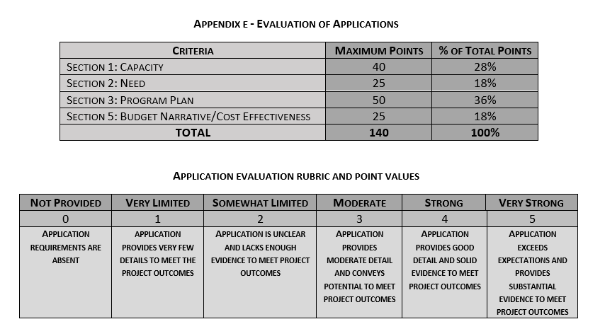
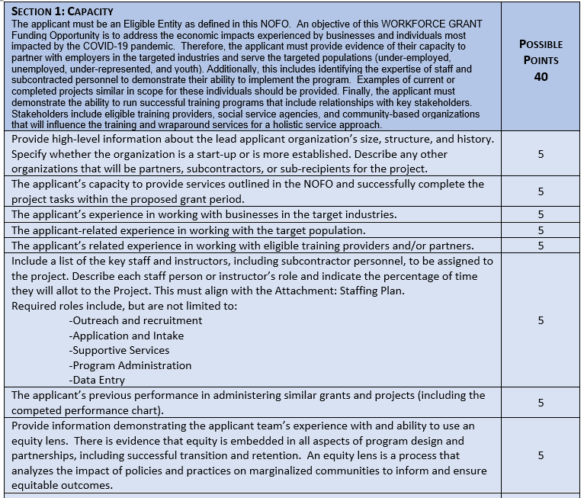
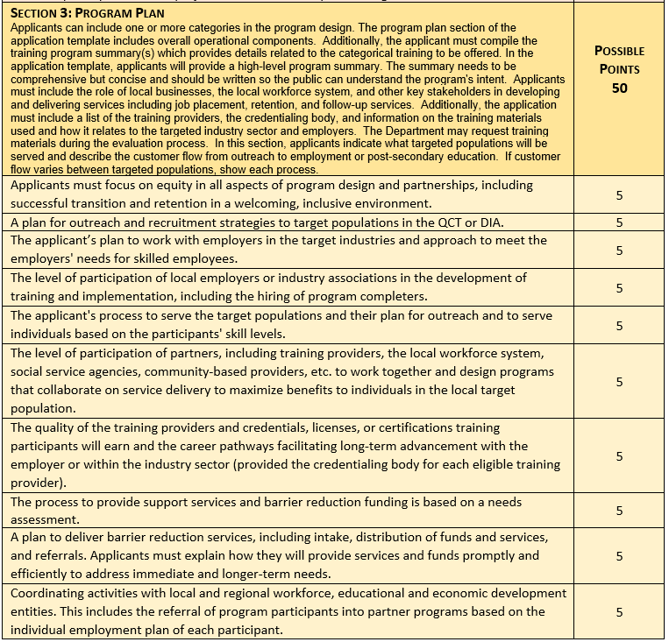
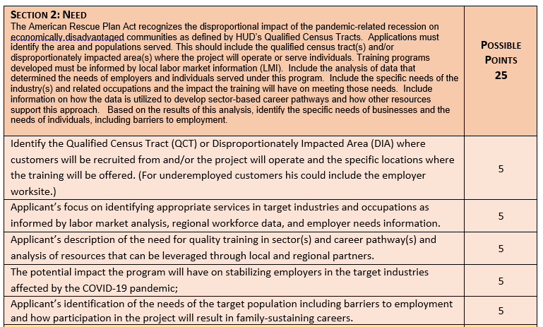
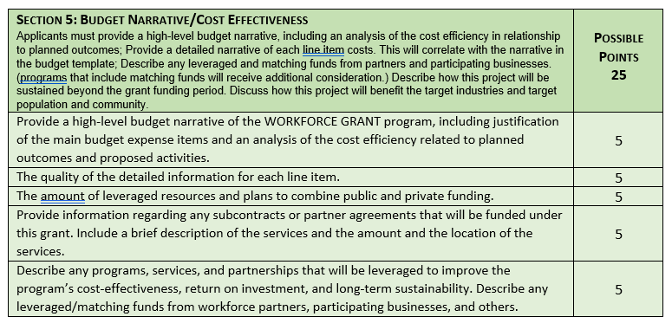
Example Criteria

Slide 45
Tips to Remember Before You Submit
Be concise
Assume the audience is not familiar with your program Explain partnerships and areas of responsibility
Set S.M.A.R.T. goals Specific, Measurable, Attainable, Relevant and Timely
Proofread before final submission – run a spell check and have a colleague read over your final submission.
Don’t be afraid to ask questions.

Slide 46
Additional Tips...
All items need to be “accounted” for; items listed in the budget need to be mentioned in the narrative and vice versa.
Spell out all acronyms at least once (preferably the first time you use them)
Question whether activities are worth repeating, and if there are enhancements, explain them.
Double Check that your program plan matches your budget!
Don’t be afraid to be innovative – look for new solutions to old problems

Slide 47
Best Practices and Lessons Learned...
Partnerships
Communication
Administration
Reporting\Case Notes
Services Offered/Blended
Support and Barrier Reduction Services

Slide 48
Thank you!
Thank you for your time and attention. Additional resources will be shared with attendees later this week.

