Slide 1

Clean Energy Career Pathways NOFO
Application Technical Assistance

Slide 2

AGENDA
Overview of Program
Application Process
Technical Assistance

Slide 3
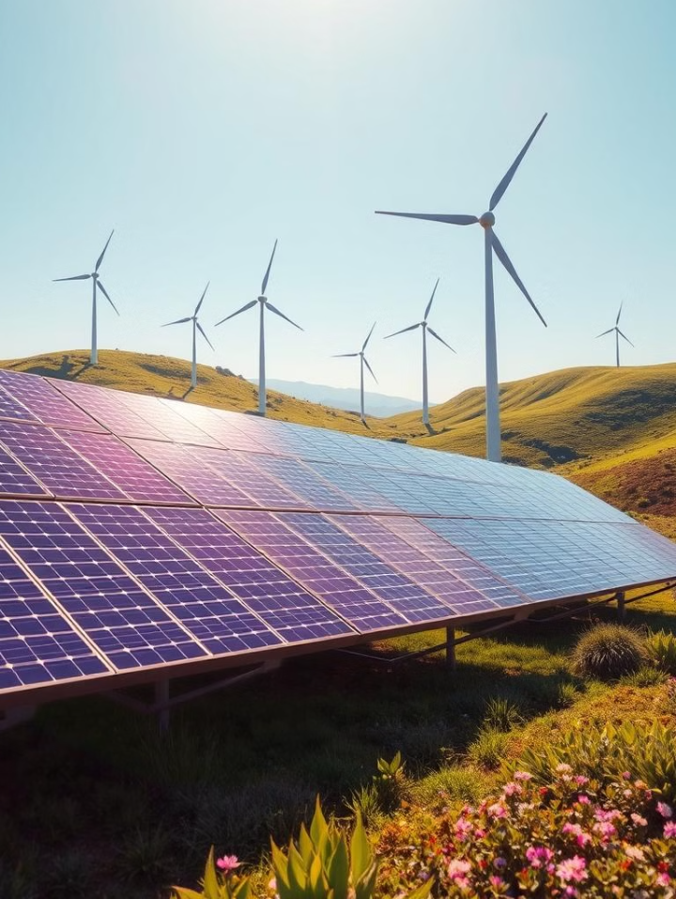
DESCRIPTION
The Clean Energy Career Pathway Program will provide funding directly to eligible recipients to support the planning and implementation of a Clean Energy Career Pathway.
This program will require grantees to create a career pathway that includes aligning curriculum and work-based learning experiences designed to prepare students for entrance into careers focusing on clean energy.
To ensure equitable pathways for students, this funding opportunity seeks qualified eligible entities that will work with the Local Workforce Innovation Areas and employers to recruit students into clean energy fields and create pathways encompassing technical and employability skills with dual credit options.

Slide 4
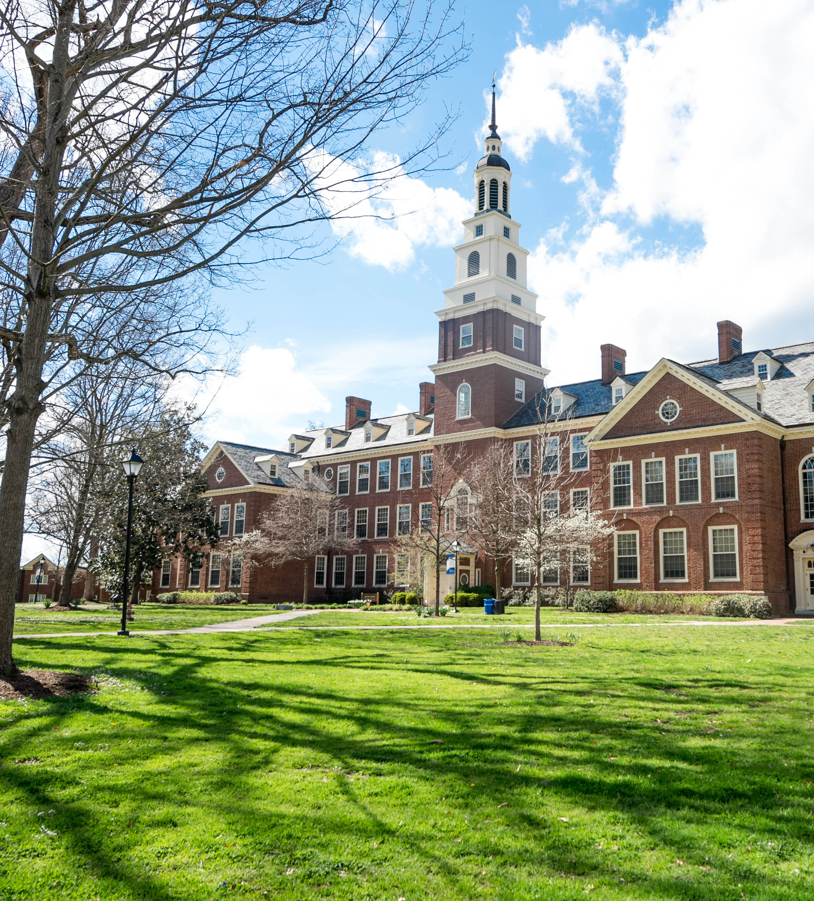
ELIGIBLE ENTITIES
Eligible applicants must partner with a Community College, a Local Workforce Innovation Area, and employers to pilot clean the energy pathway programs
Eligible entities for this NOFO are defined as:
Regional Offices of Education (ROEs)
Intermediate Service Centers (ISCs)
state institutions of higher education
schools designated as laboratory schools
public university laboratory schools approved by the Illinois State Board of Education (ISBE)
area vocational centers
charter schools;
cooperatives and other joint agreements with a governing body or board of control
schools operated by an ROE, ISC, or state agency
school districts
New for this Round Additional Entities:
Entities that are not school districts or Local Education Agencies (LEAs) are eligible to apply
Collaborative applications will be accepted

Slide 5

TARGET POPULATION
In-school youth with one or more barriers to employment.
In-school youth for this funding opportunity is defined as:
  Youth aged 14-21 who is attending secondary school (including alternative school) and has not received a high school diploma or equivalent
Barriers to employment for this funding opportunity is defined as:
  Youth classified as low-income

Slide 6

TIMELINE
Planning periods may be less than a year if the program is ready for implementation.
The grant shall be awarded to selected applicants for a period of two years.
The first year can be a planning period to establish the curriculum, modernize the classroom, or provide professional development to instructors.
In the second year, grantees will pilot a clean energy career pathway program

Slide 7

PROGRAM REQUIREMENTS
Curriculum Alignment, Career Pathway, & Program of Study
The Clean Energy Career Pathways grant requires career pathway alignment. Successful applicants will demonstrate a credible model for career pathway sequencing and explain why this model is appropriate.
The Career Pathways Dictionary - Illinois Career Pathways Dictionary – Defining key terms for career pathways implementation in Illinois
Program of Study - Projects should be aligned to programs of study. According to Perkins V, a program of study allows students to expand opportunities by exploring, choosing, and following career and technical career pathways that lead to valuable credentials.
This Photo by Unknown Author is licensed under CC BY-SA

Slide 8
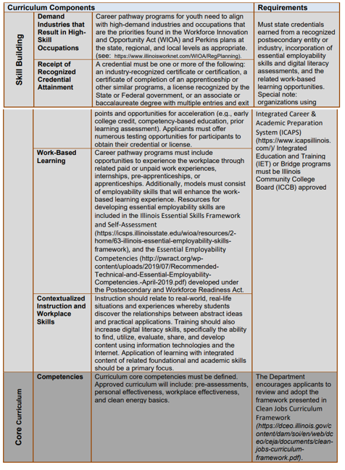
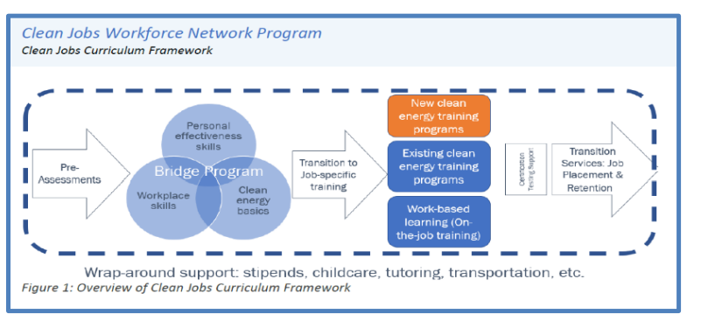
CURRICULUM ALIGNMENT
Framework
Components Needed

Slide 9
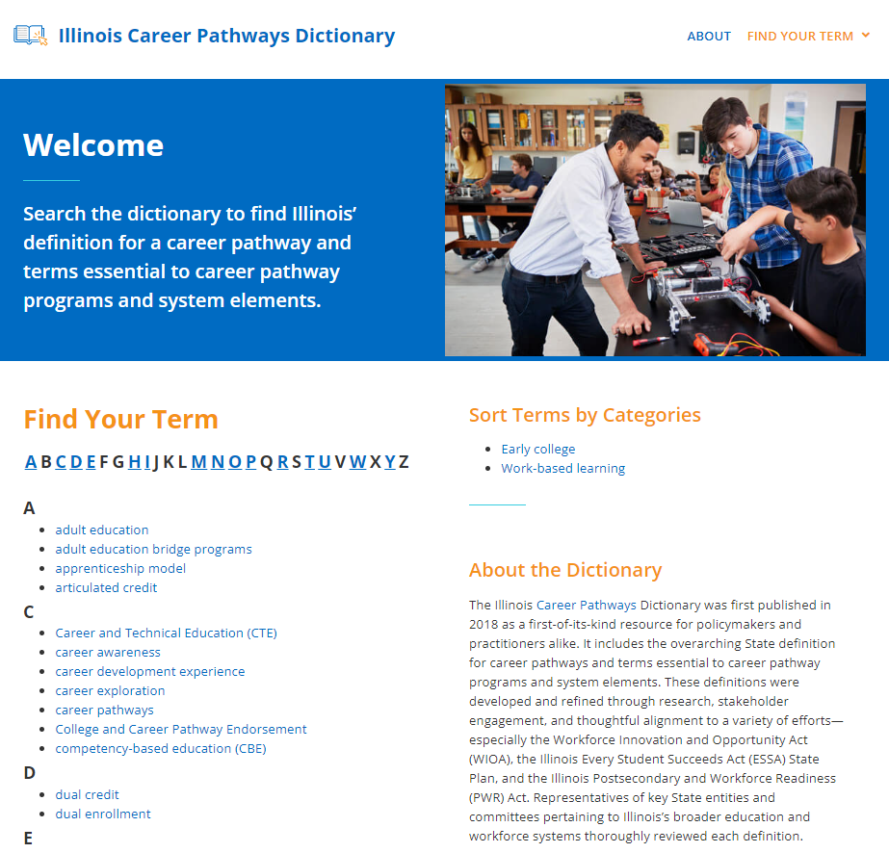
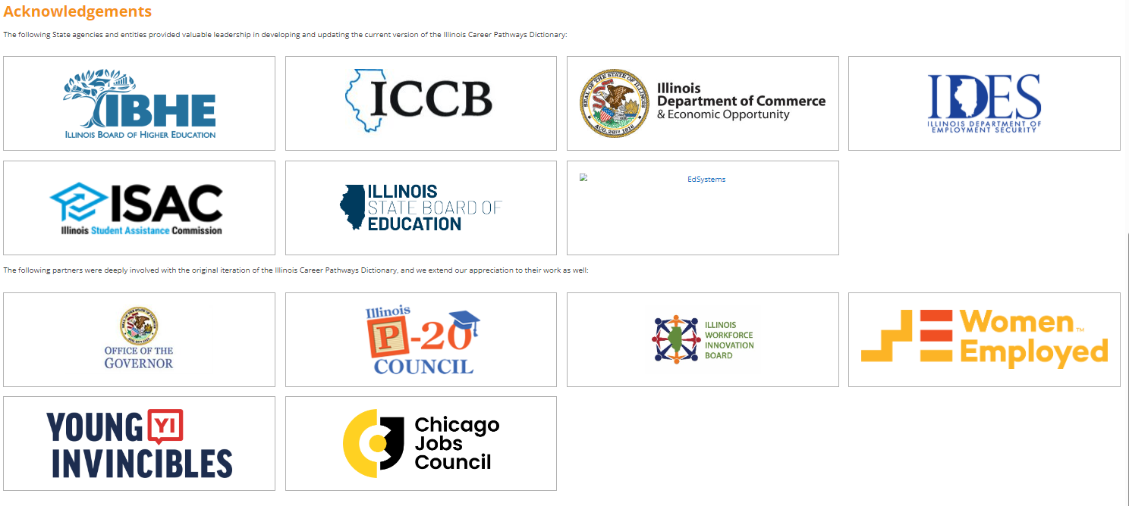
CAREER PATHWAY
Illinois Career Pathways Dictionary – Defining key terms for career pathways implementation in Illinois

Slide 10
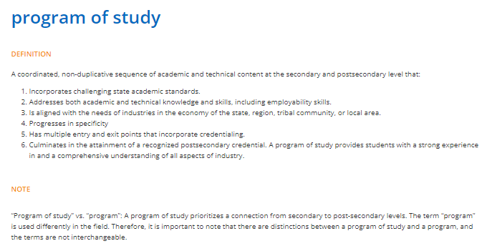

Program Of Study

Slide 11

Program Implementation
Strategies must be flexible enough to allow participating students to accomplish goals.
  Equity-Focused Program - infuse equity into all aspects of program delivery
  Outreach and Recruitment – strategies to recruit youth, specifically low-income youth
  Employer Engagement – business partnerships for career pathway creation
  Career Planning – customer-centered approach to delivery
  Comprehensive Assessment – determining existing skills and creating plans to achieve goals
  Individual Service Strategy – a living document to track goals and achievements
  Supportive Services/Barrier Reduction – key assistance beyond career training
  Placement – where the participant will land after secondary completion
  Follow-Up – services after completion like mentoring, financial literacy, career counseling, etc.
The projects selected for funding through this NOFO will aim to increase career pathway opportunities for in-school youth in the clean energy sector. Strategies must be flexible enough to allow participating students to accomplish goals. Services described in the application must infuse equity into all aspects of program delivery.

Slide 12

Performance Goals and Measures
Grantees will report on the following:
  Number of youth enrolled in the program
  Number of youth completing the program
  Number of youth obtaining credential(s)
  Number of youth that achieve a measurable skill gain
  Number of youth that are placed in post-secondary education
  Number of youth that are placed in unsubsidized employment
Additionally, the Clean Energy Career Pathway program will keep track of grant activities and outcomes for the following:
  Number of businesses engaged
  Number of youth placed in a pre-apprenticeship or registered apprenticeship program
  Number of youth completing a pre-apprenticeship or registered apprenticeship program
  Number of youth placed in a paid work experience or internship
  Number of youth completing a paid work experience or internship

Slide 13
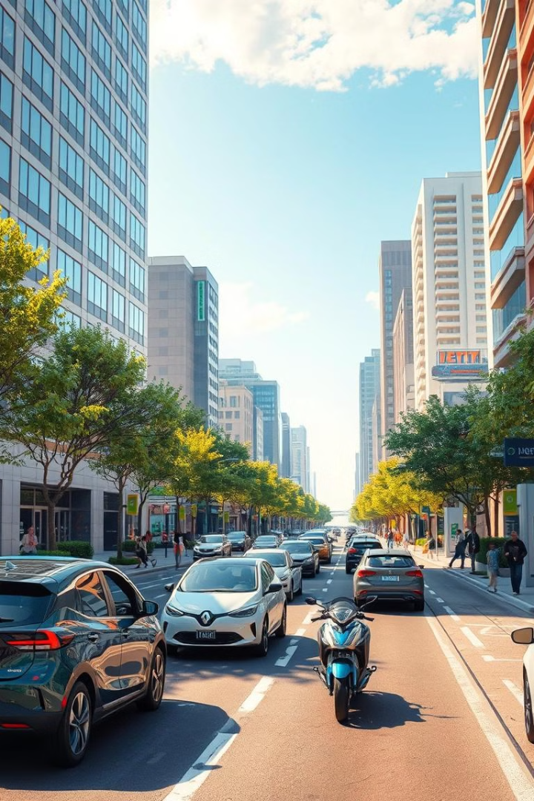
Program Priorities
Priority merit review points will be given to applications that include:
Entities focusing on EV
Entities serving students in rural areas. Priority points will be awarded for applications serving students from the List of Rural Districts https://www.isbe.net/Documents/Rural-Schools-priority-points-list.pdf
Entities partnering with grantees funded by the Illinois Community College Board’s FY2024 Rev Up EV Community College Initiative.
Grant Opportunities and Information – Illinois Community College Board

Slide 14
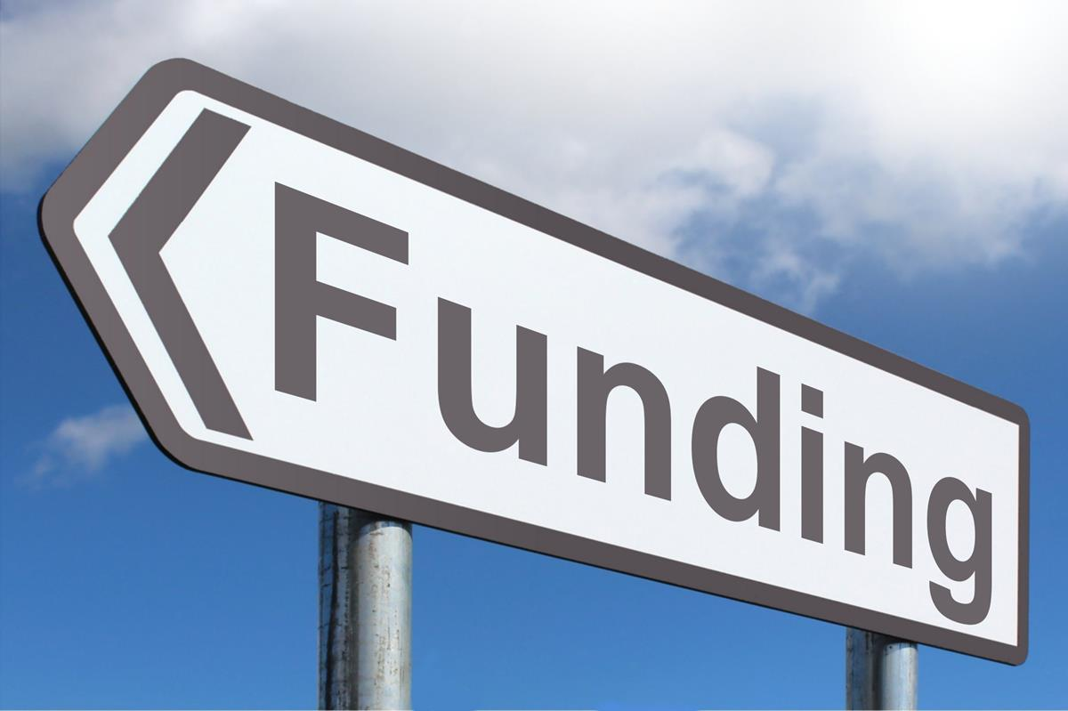

Funding Information
Funding Information
The total amount of funding expected to be awarded through this NOFO is $4,000,000
Awards will range from approximately $250,000 to approximately $750,000
The Department expects to make 8-15 awards through this NOFO. The grant will be awarded to selected applicants for a period of two years. The first year can be a planning period and transition to implementation; the next year will be implementation. Planning periods may be less than a year if the program is ready for implementation.

Slide 15

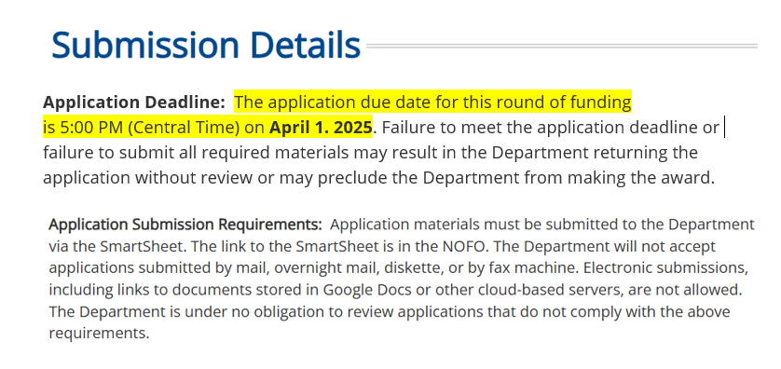
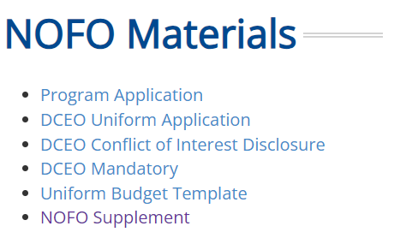
Application and Submission
WIOA (illinoisworknet.com)

Slide 16
Review Information
Capacity
Program Plan
Budget
Need
Not
The
Prog

Slide 17
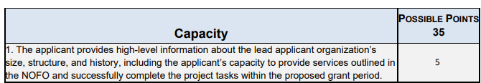
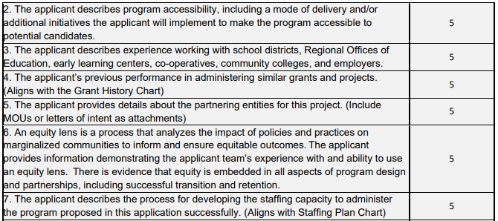
Capacity
Rubric
Capacity
Program Plan
Budget
Need
The applicant must provide evidence of their capacity to partner with employers in the targeted industries and serve the targeted youth populations.
Additionally, this includes identifying the expertise of staff and subcontracted personnel to demonstrate their ability to implement the program.
Finally, the applicant must demonstrate the ability to run successful training programs that include relationships with key stakeholders.

Slide 18
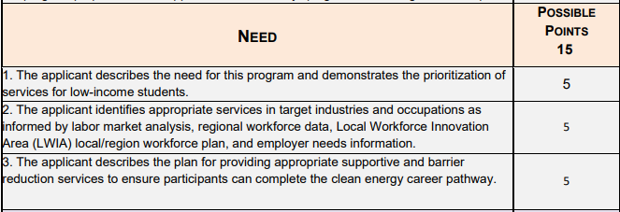
Need
Rubric
Capacity
Program Plan
Budget
Need
Identify the area and populations served.
The need for a clean energy program should be clear.
The expected amount of low-income students to be served should also be stated.
Applicants should include the specific needs of the industry(s) and related occupations and the impact the training will have on meeting those needs.

Slide 19
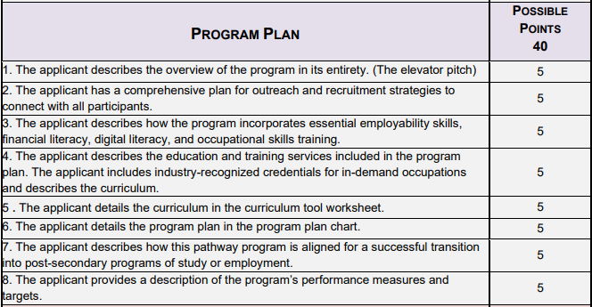
Program Plan
Rubric
Capacity
Program Plan
Budget
Need
Application template includes overall operational components and a high-level program summary.
The summary needs to be comprehensive but concise and should be written so the public can understand the program's intent.
Applicants must include the role of local businesses, the local workforce system, and other key stakeholders in developing and delivering services including job placement, retention, and follow-up services.

Slide 20
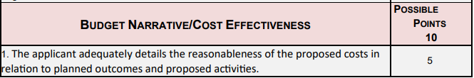

Budget
Rubric
Capacity
Program Plan
Budget
Need
Applicants must provide a high-level budget narrative, include a thorough line-item budget breakdown with reasonable costs, and provide a detailed narrative of each line-item cost. This will correlate with the narrative in the budget template.
Applicants must describe any leveraged and matching funds from partners and participating businesses. Lastly, applicants must explain how this project will be sustained beyond the grant funding period.

Slide 21
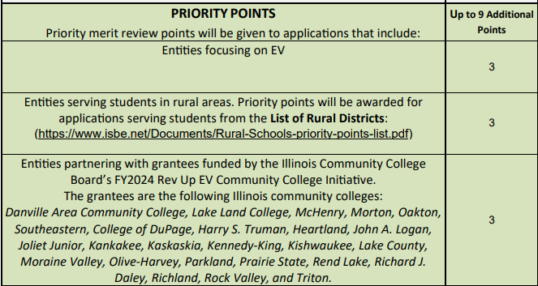

Priority
Points
Capacity
Program Plan
Budget
Need

Slide 22
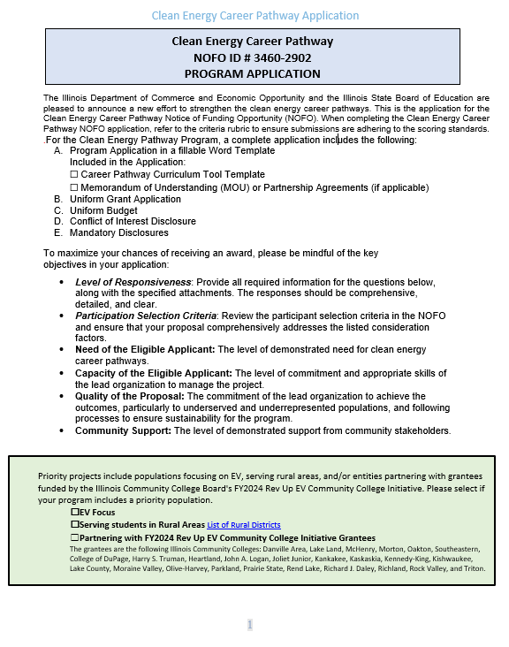
Clean Energy
Career Pathway
Program Application

Slide 23
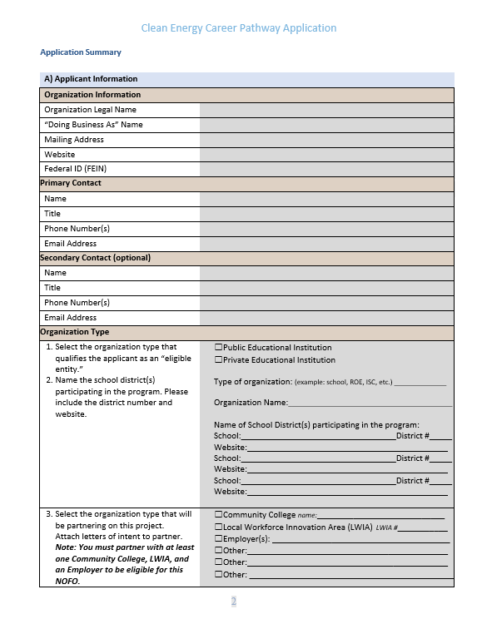
Clean Energy
Career Pathway
Program Application

Slide 24
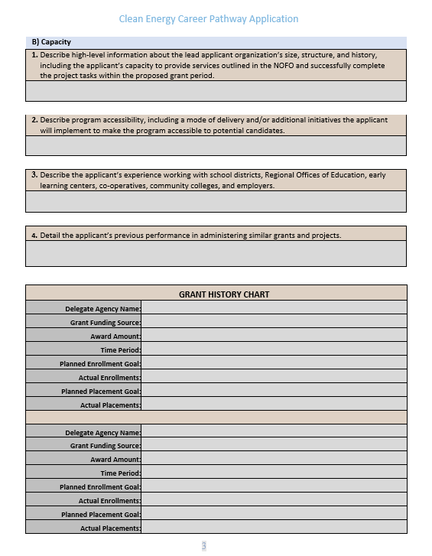
Clean Energy
Career Pathway
Program Application

Slide 25
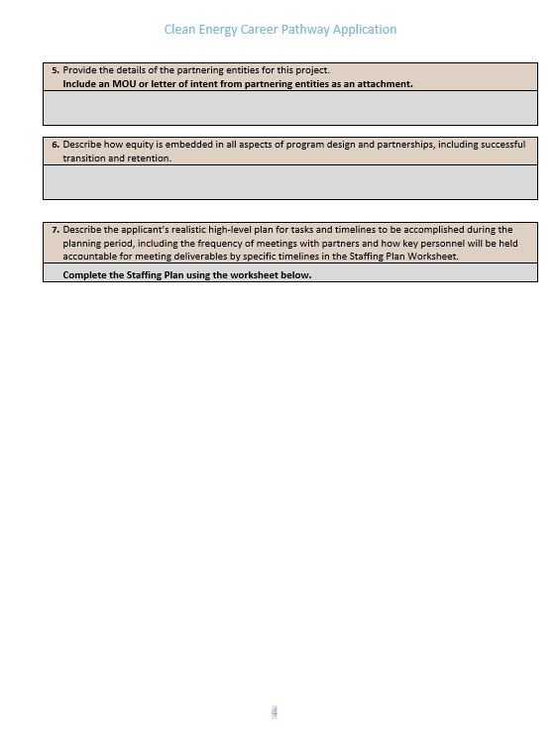
Clean Energy
Career Pathway
Program Application

Slide 26
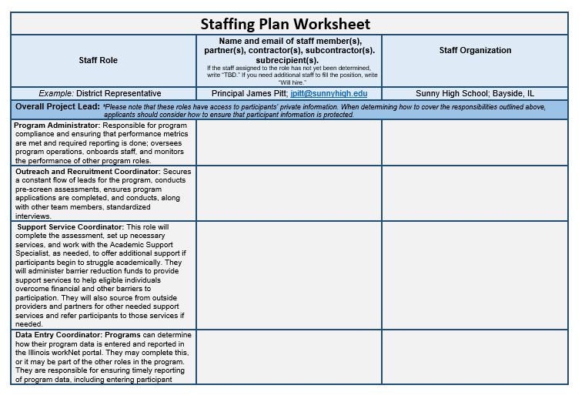
Clean Energy
Career Pathway
Program Application

Slide 27
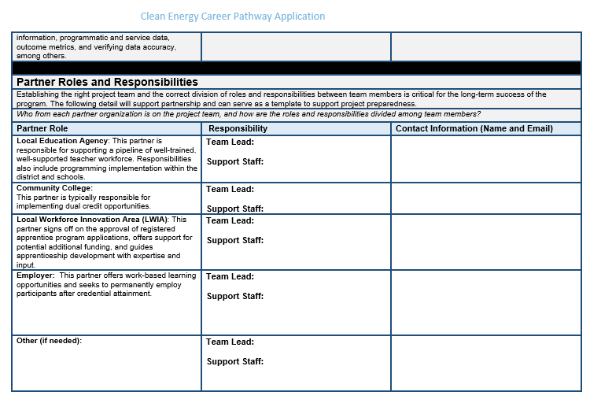
Clean Energy
Career Pathway
Program Application

Slide 28
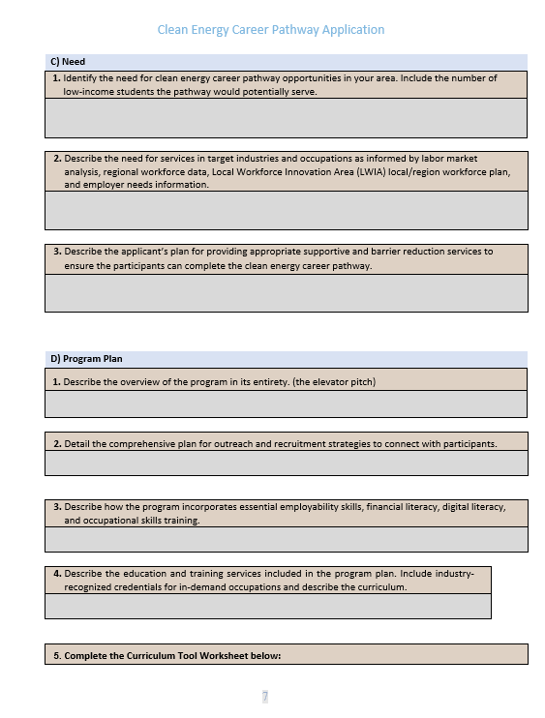
Clean Energy
Career Pathway
Program Application

Slide 29
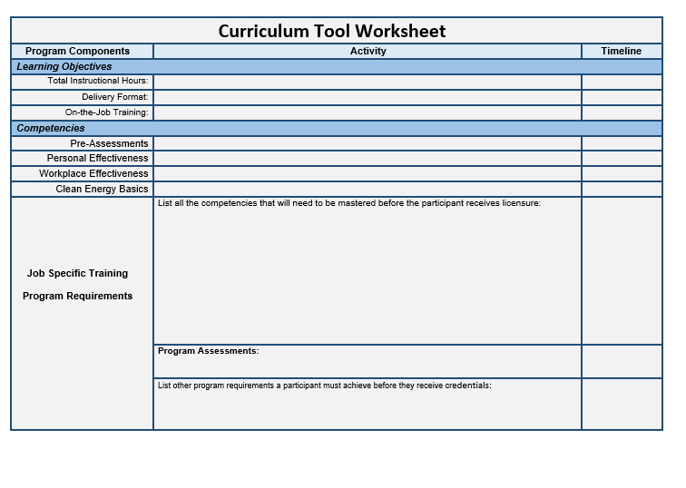
Clean Energy
Career Pathway
Program Application

Slide 30
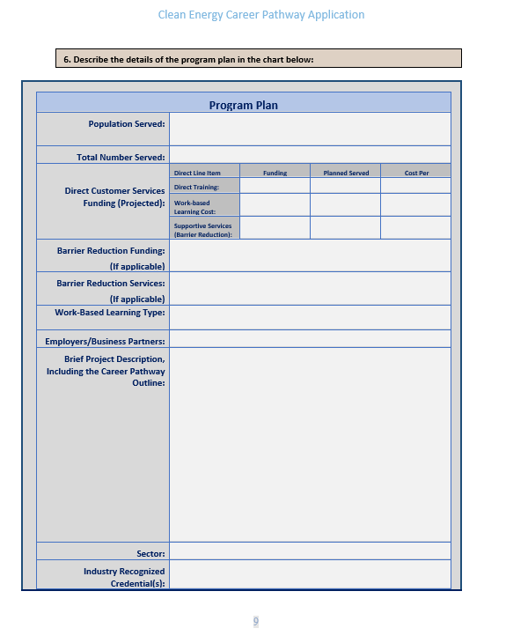
Clean Energy
Career Pathway
Program Application

Slide 31
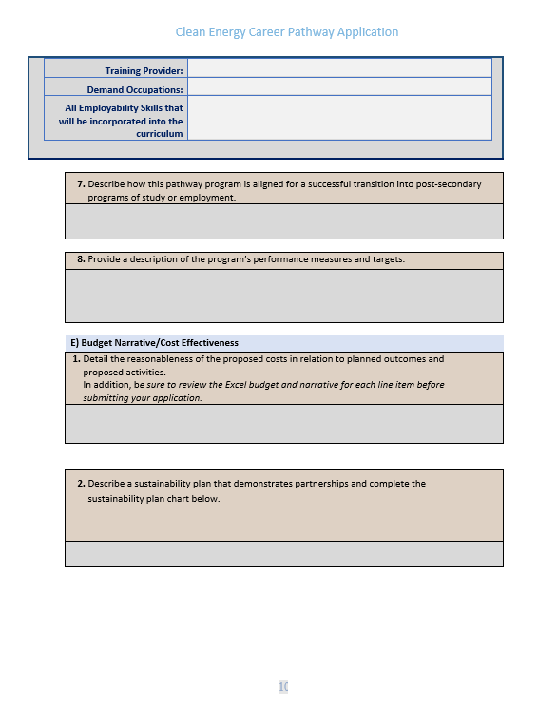
Clean Energy
Career Pathway
Program Application

Slide 32
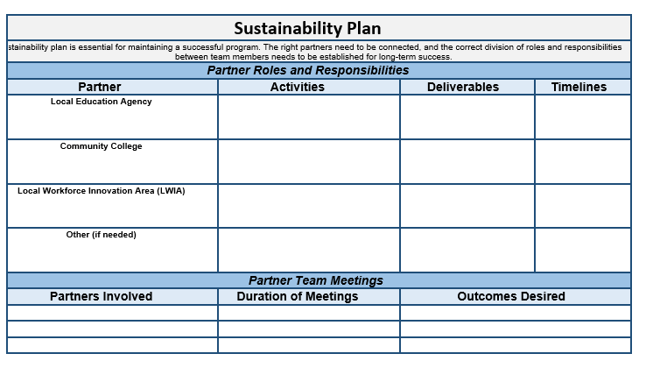
Clean Energy
Career Pathway
Program Application

Slide 33

Reporting
ProPeriodic Performance Report (PPR) and Periodic Financial Report (PFR)
Grantees will be required to submit regular reports to document the progress of the project as part of the grant requirements.
Grantees will be required to document the participant enrollments and the services that are provided to every participant served under this grant within 10 days of providing the service in the IllinoisworkNet.com portal. Grantees are also required to report the program outcomes within 10 days of the outcome.

Slide 34

Office Hours
NOFO Technical Assistance Office Hours
​Applicants are invited to sign up for Technical Assistance Office Hours (via Zoom) to receive one-on-one assistance to prepare their proposals. These Office Hours provide an opportunity to ask questions related to the intent of the NOFO.
Office hours will be held on the following Wednesdays:
March 12
March 19
March 26
All sessions will be held from 2:00 pm to 3:00 pm
This Photo by Unknown Author is licensed under CC BY-NC-ND

