Slide 1


Virtual Job Fairs (VJFs)
Introduction – Job Seekers
January 2021
The Illinois workNet® Center System, an American Job Center, is an equal opportunity employer/program. Auxiliary aids and services are available upon request to individuals with disabilities. All voice telephone numbers may be reached by persons using TTY/TDD equipment by calling TTY (800) 526-0844 or 711. This workforce product was funded by a grant awarded by the U.S. Department of Labor’s Employment and Training Administration. For more information please refer to the footer at the bottom of any webpage at illinoisworknet.com.

Slide 2

Virtual job fairs
Located on homepage of illinoisworknet.com

Slide 3

Job seeker resources

Slide 4
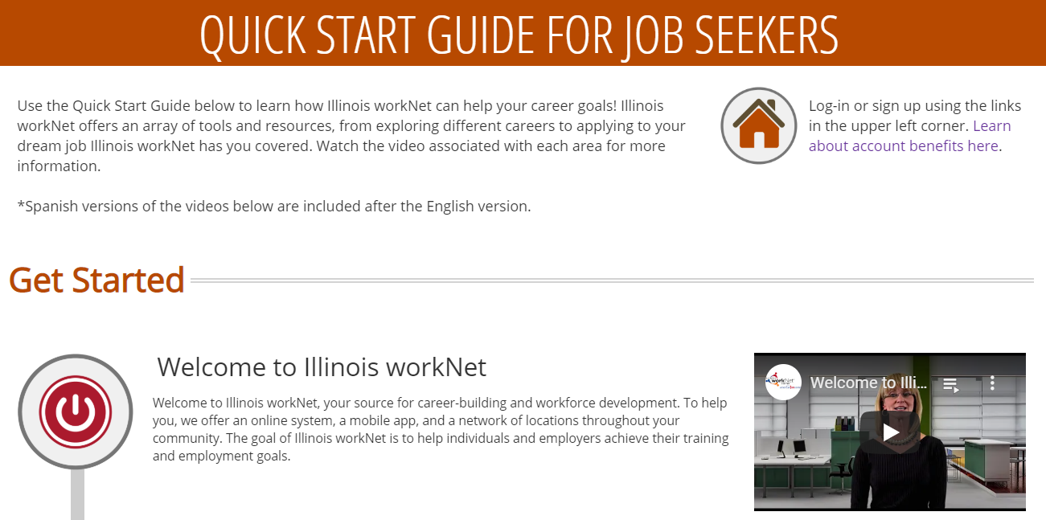
Job seeker – explore resources: quick start guide
Provides an overview of resources on Illinois workNet that are available to job seekers based on their needs.

Slide 5

Job seeker – build your resume: resume writing guide
Job seekers can design, write, and share their resume, practice interviewing and more with the Resume Writing Guide and Builder.

Slide 6

Virtual job fairs (vjf)

Slide 7

Virtual job fairs: search virtual job fairs
Employers may set up VJFs while Job Seekers may search for upcoming VJF Events.

Slide 8
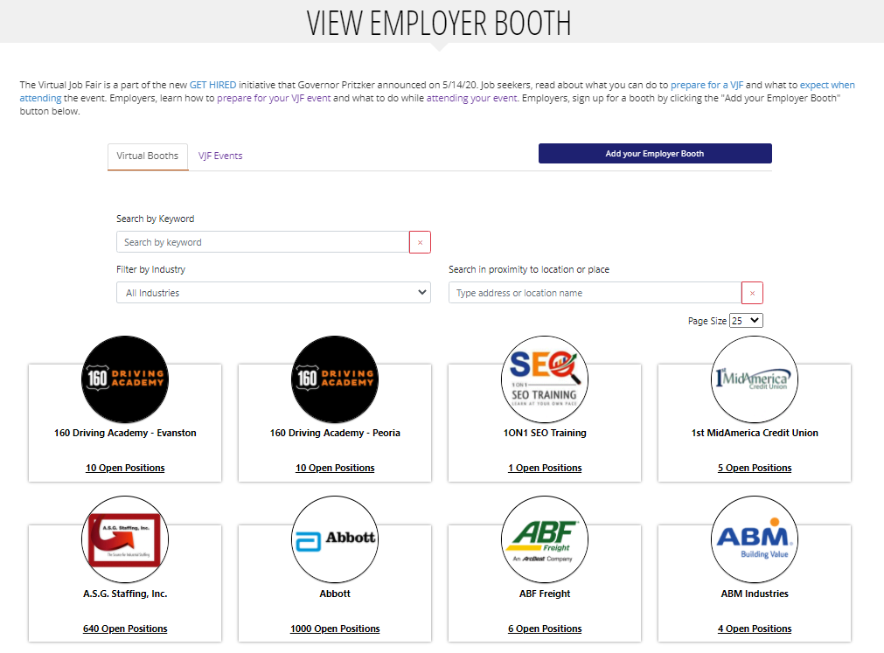
Virtual job fairs: Employer booths
View and search for employer booths by:
Name
Industry
Location
Upcoming VJF Events

Slide 9

Virtual job fairs: Employer booths
Employer Booth Page:
Location and Website
Job Information / Industry
Description
Employer Contact
Upcoming VJF Events
Archived Job Fair Videos
Documents
Links
Social Media

Slide 10
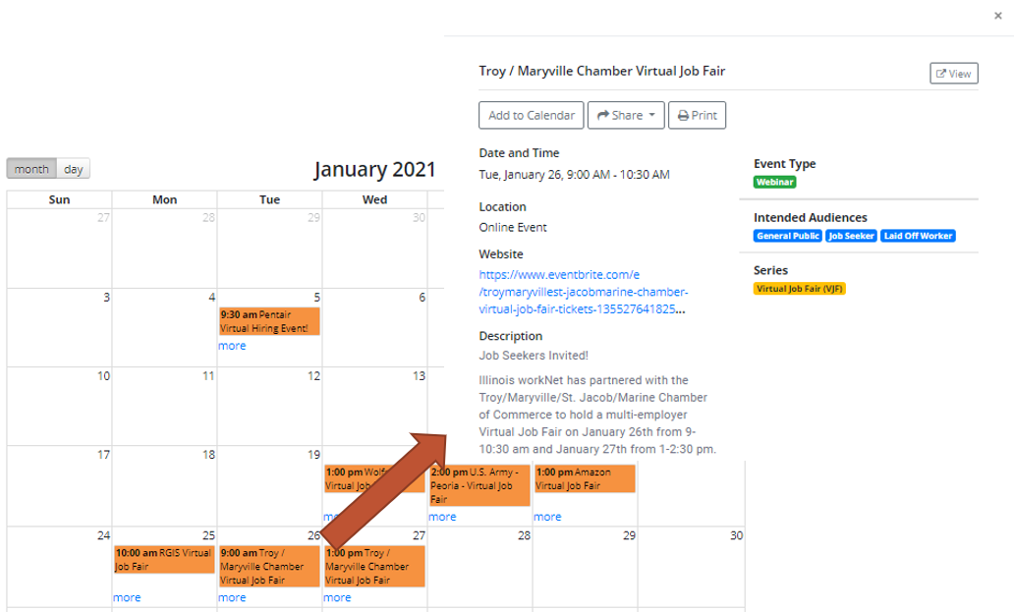
Virtual job fairs: Event calendar
Virtual Job Fair Event Calendar
  Search by City/Zip Code
  Keywords
  LWIA

Slide 11
Virtual job fairs: Events
During these sessions job seekers have the chance to learn about what skills employers are looking for, tips for applying to their jobs, perks, benefits packages, and ask their own questions during the Q&A portion.
Webinars are recorded and added to Illinois workNet’s YouTube channel and to the employer booth pages of the employers who presented.

Slide 12
Virtual job fairs: Additional resources
Additionally, Illinois workNet has a couple articles for job seekers that they may read prior to attending an event:
Prepare for a VJF: Job Seeker Tips for Success covers what individuals can expect and how they can prepare for a VJF event. From researching the company to preparing a resume and testing computer equipment, this is a great introduction to prep job seekers for online meetings and events.
Attending VJFs – Job Seekers includes information for job seekers on how to be professional and what to do during the job fair, i.e. pay attention, take notes, and next steps from following up with employers to keeping a Job Search Record handout to help keep track of employers they are interested in and sending job applications to.

Slide 13
Virtual job fairs
Demonstration

Slide 14

Virtual job fairs
Questions?

Slide 15
Virtual job fairs
Get started at illinoisworknet.com/virtualjobfairs

Slide 16









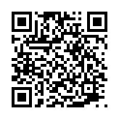
follow us!
Subscribe to our Newsfeed or check us out on Social Media
HOME: https://www.illinoisworknet.com/
EMAIL: info@illinoisworknet.com
MORE INFO: www.illinoisworknet.com/VirtualJobFairs
Facebook
Twitter
Youtube
linkedin
Linkedin group
Pinterest

